Slide 1
网络设备调试
Ping
Tracert
Wireshark
System debugging

Slide 2
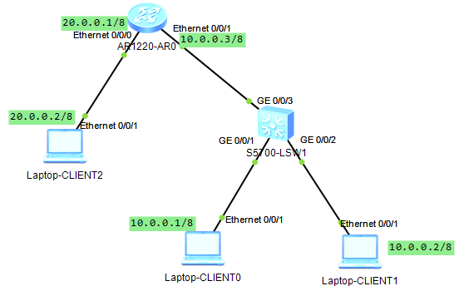
实验拓扑1

Slide 3
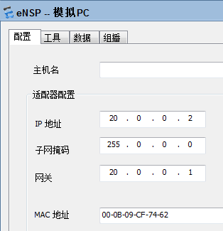
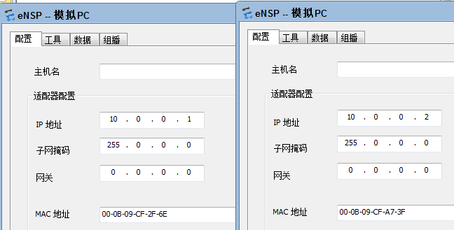
PC配置

Slide 4
路由器配置
<Huawei>sys
Enter system view, return user view with Ctrl+Z.
[Huawei]int e0/0/0
[Huawei-Ethernet0/0/0]ip add 20.0.0.1 8
[Huawei-Ethernet0/0/0]int e0/0/1
[Huawei-Ethernet0/0/1]ip add 10.0.0.3 8

Slide 5
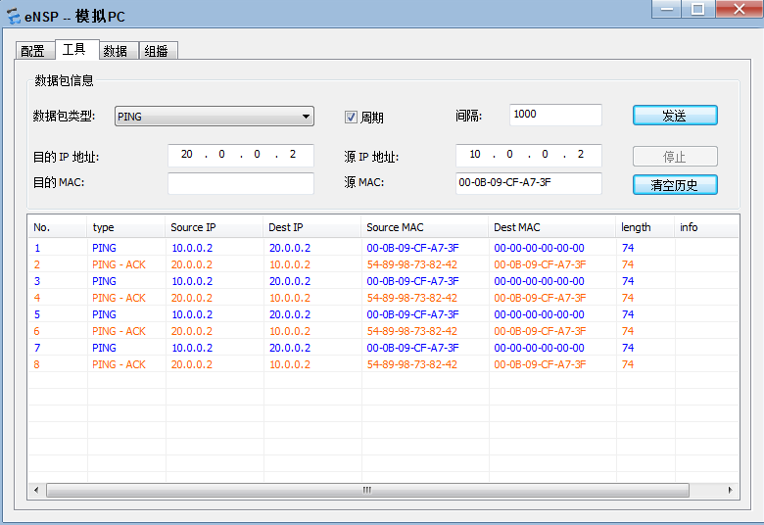
测试
1.Ping 10.0.0.1
2.Tracert 10.0.0.1

Slide 6
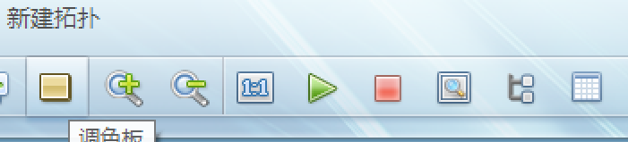
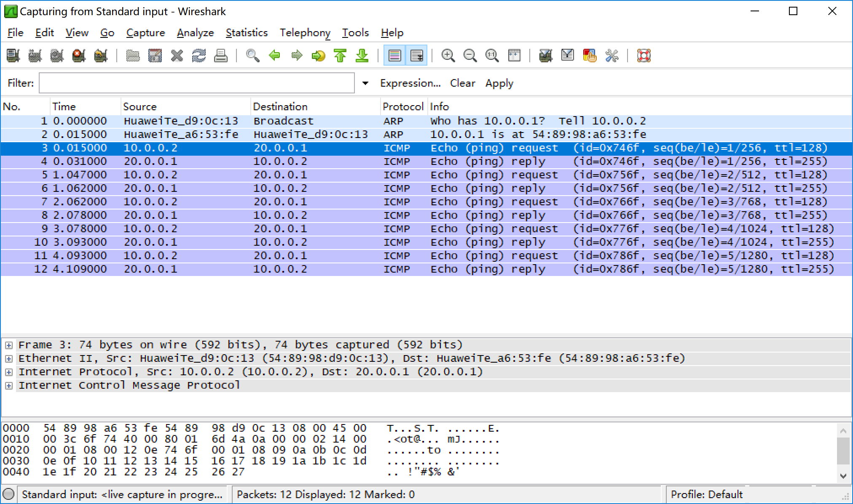
3.抓包

Slide 7
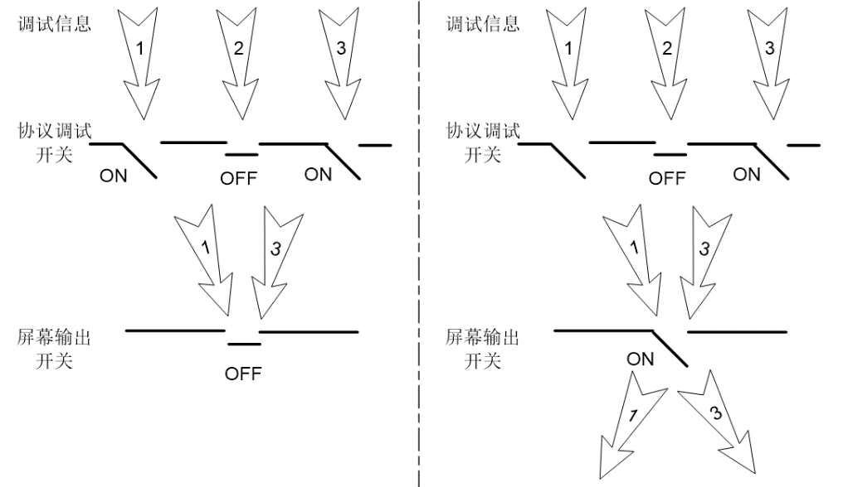
4.系统调试
[Huawei]quit
<Huawei>terminal monitor
Info: Current terminal monitor is on.
<Huawei>terminal debugging
Info: Current terminal debugging is on.
<Huawei>debugging ip pack
Mar 12 2013 21:36:06.0.4-08:00 Huawei IP/7/debug_case:
Sending, interface = Eth0/0/0, version = 4, headlen = 20, tos = 0,
pktlen = 60, pktid = 535, offset = 0, ttl = 127, protocol = 1,
checksum = 7079, s = 10.0.0.2, d = 20.0.0.2
prompt: Sending the packet from Eth0/0/1 at Eth0/0/0
Mar 12 2013 21:36:06.0.5-08:00 Huawei IP/7/debug_case:
Receiving, interface = Eth0/0/0, version = 4, headlen = 20, tos = 0,
pktlen = 60, pktid = 392, offset = 0, ttl = 128, protocol = 1,
checksum = 6966, s = 20.0.0.2, d = 10.0.0.2
prompt: Receiving IP packet from Eth0/0/0

Slide 8
关闭调试
undo terminal debugging
undo terminal monitor

