Slide 1
RIP

Slide 2
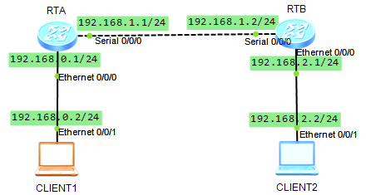
RIP1实验

Slide 3
RTA配置
<Huawei>undo ter moni
Info: Current terminal monitor is off.
<Huawei>sys
[Huawei]sysname RTA
[RTA]int e 0/0/0
[RTA-Ethernet0/0/0]ip add 192.168.0.1 24
[RTA-Ethernet0/0/0]int s 0/0/0
[RTA-Serial0/0/0]ip add 192.168.1.1 24
[RTA-Serial0/0/0]quit
[RTA]rip
[RTA-rip-1]network 192.168.0.0
[RTA-rip-1]network 192.168.1.0
RTB采取类似配置

Slide 4
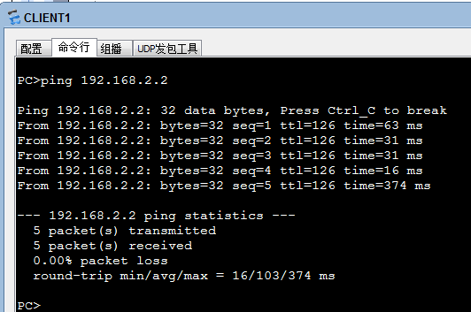

Slide 5
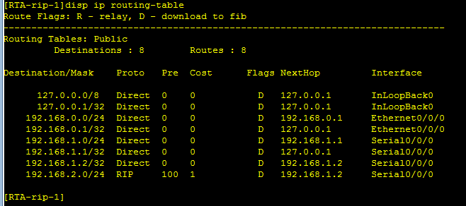
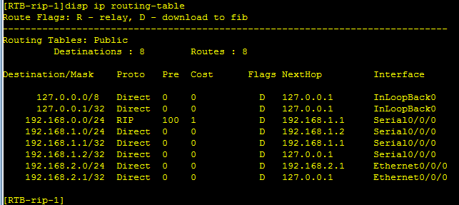

Slide 6
[RTA]disp rip
Public VPN-instance
RIP process : 1
RIP version : 1
Preference : 100
Checkzero : Enabled
Default-cost : 0
Summary : Enabled
Host-route : Enabled
Maximum number of balanced paths : 32
Update time : 30 sec Age time : 180 sec
Garbage-collect time : 120 sec
Graceful restart : Disabled
BFD : Disabled
Silent-interfaces : None
Default-route : Disabled
Verify-source : Enabled
Networks : 192.168.1.0 192.168.0.0
Configured peers : None
Number of routes in database : 3
Number of interfaces enabled : 2
Triggered updates sent : 3
Number of route changes : 1
Number of replies to queries : 1
Number of routes in ADV DB : 3
Total count for 1 process :
Number of routes in database : 3
Number of interfaces enabled : 2
Number of routes sendable in a periodic update : 6
Number of routes sent in last periodic update : 4

Slide 7
<RTA>terminal monitor
Info: Current terminal monitor is on.
<RTA>terminal debugging
Info: Current terminal debugging is on.
<RTA>debugging rip 1 packet
<RTA>
Mar 21 2013 22:42:25.390.1-08:00 RTA RIP/7/DBG: 6: 12227: RIP 1: Sending response on interface Ethernet0/0/0 from 192.168.0.1 to 255.255.255.255(连接计算机的端口发广播)
Mar 21 2013 22:42:25.390.2-08:00 RTA RIP/7/DBG: 6: 12247: Packet: Version 1, Cmd response, Length 64
Mar 21 2013 22:42:25.390.3-08:00 RTA RIP/7/DBG: 6: 12296: Dest 192.168.0.0, Cost 1
Mar 21 2013 22:42:25.390.4-08:00 RTA RIP/7/DBG: 6: 12296: Dest 192.168.1.0, Cost 1
Mar 21 2013 22:42:25.390.5-08:00 RTA RIP/7/DBG: 6: 12296: Dest 192.168.2.0, Cost 2
Mar 21 2013 22:42:52.490.1-08:00 RTA RIP/7/DBG: 6: 12227: RIP 1: Sending response on interface Serial0/0/0 from 192.168.1.1 to 255.255.255.255 (连接RTB的端口发广播)
Mar 21 2013 22:42:52.490.2-08:00 RTA RIP/7/DBG: 6: 12247: Packet: Version 1, Cmd response, Length 24
Mar 21 2013 22:42:52.490.3-08:00 RTA RIP/7/DBG: 6: 12296: Dest 192.168.0.0, Cost 1
Mar 21 2013 22:42:54.450.4-08:00 RTA RIP/7/DBG: 6: 12296: Dest 192.168.1.0, Cost 1
Mar 21 2013 22:42:54.450.5-08:00 RTA RIP/7/DBG: 6: 12296: Dest 192.168.2.0, Cost 2
Mar 21 2013 22:42:45.790.1-08:00 RTA RIP/7/DBG: 6: 12236: RIP 1: Receive response from 192.168.1.2 on Serial0/0/0 (从RTB收到路由更新信息)
Mar 21 2013 22:42:45.790.2-08:00 RTA RIP/7/DBG: 6: 12247: Packet: Version 1, Cmd response, Length 24
Mar 21 2013 22:42:45.790.3-08:00 RTA RIP/7/DBG: 6: 12296: Dest 192.168.2.0, Cost 1
注意：两个口发的目的地址都为255.255.255.255广播地址，且目的地址均无掩码。
Notes:
使用“跳数”(即metric)来衡量到达目标地址的路由距离。这种协议的路由器只关心自己周围的世界，只与自己相邻的路由器交换信息，范围限制在15跳(15度)之内，再远，它就不关心了。

Slide 8
查看水平分割与毒性逆转
[RTA-Serial0/0/0]undo rip split-horizon
[RTA-Serial0/0/0]undo rip poison-reverse
<RTA>deb rip 1 packet
<RTA>
Mar 22 2013 00:09:08.370.1-08:00 RTA RIP/7/DBG: 6: 12227: RIP 1: Sending response on interface Serial0/0/0 from 192.168.1.1 to 255.255.255.255(连接RTB的端口发广播)
Mar 22 2013 00:09:08.370.2-08:00 RTA RIP/7/DBG: 6: 12247: Packet: Version 1, Cmd response, Length 64
Mar 22 2013 00:09:08.370.3-08:00 RTA RIP/7/DBG: 6: 12296: Dest 192.168.0.0, Cost 1
Mar 22 2013 00:09:08.370.4-08:00 RTA RIP/7/DBG: 6: 12296: Dest 192.168.1.0, Cost 1
Mar 22 2013 00:09:08.370.5-08:00 RTA RIP/7/DBG: 6: 12296: Dest 192.168.2.0, Cost 2
Notes:
水平分割水平分割的概念由于路由器可能收到它自己发送的路由信息，而这种信息是无用的。水平分割的原理路由器从某个接口接收到的更新信息不允许再从这个接口发回去。水平分割的优点1，能够阻止路由环路的产生。2，减少路由器更新信息占用的链路带宽资源。水平分割(split horizons)的思想就是在路由信息传送过程中，不再把路由信息发送到接收到此路由信息的接口上。从而在一定程度上避免了环路的产生。毒性逆转（Poisoned Reverse）毒性逆转实际上是一种改进的水平分割。这种方法的运作原理是：路由器从某个接口上接收到某个网段的路由信息之后，并不是不往回发送信息了，而是发送，只不过是将这个网段的跳数设为无限大，再发送出去。收到此种的路由信息后，接收方路由器会立刻抛弃该路由，而不是等待其老化时间到（Age Out）。这样可以加速路由的收敛。

Slide 9
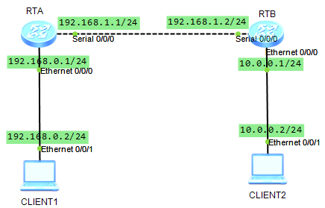
RIP2实验

Slide 10
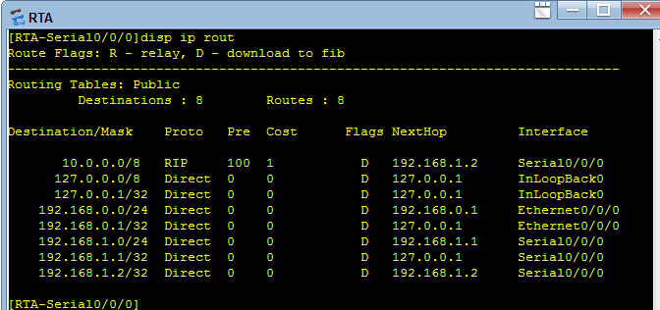
按RIP1 配置好路由器，在RTA上查看路由表
思考为何是10.0.0.0/8?

Slide 11
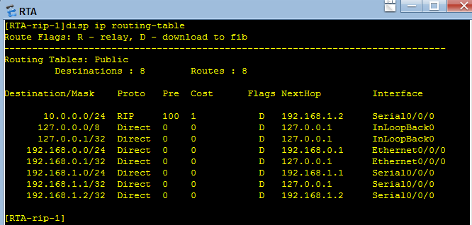
配置RIP2
[RTA]rip
[RTA-rip-1]version 2
RTB同
观察路由表

Slide 12
RIP2 验证
[RTA-Serial0/0/0]rip authentication-mode md5 usual aaaaa
[RTB-Serial0/0/0]rip authentication-mode md5 usual 12345
查看RTA和RTB路由表，观察有无RIP路由？为什么？如何使之正常工作？

Slide 13
查看RIP包
<RTA>deb rip 1 packet
<RTA>
Mar 22 2013 00:48:21.460.1-08:00 RTA RIP/7/DBG: 6: 12227: RIP 1: Sending response on interface Ethernet0/0/0 from 192.168.0.1 to 224.0.0.9
Mar 22 2013 00:48:21.460.2-08:00 RTA RIP/7/DBG: 6: 12247: Packet: Version 2, Cmd response, Length 64
Mar 22 2013 00:48:21.460.3-08:00 RTA RIP/7/DBG: 6: 12315: Dest 10.0.0.0/24, Nexthop 0.0.0.0, Cost 2, Tag 0
Mar 22 2013 00:48:21.460.4-08:00 RTA RIP/7/DBG: 6: 12315: Dest 192.168.0.0/24, Nexthop 0.0.0.0, Cost 1, Tag 0
Mar 22 2013 00:48:21.460.5-08:00 RTA RIP/7/DBG: 6: 12315: Dest 192.168.1.0/24, Nexthop 0.0.0.0, Cost 1, Tag 0deb rip 1 packet
Mar 22 2013 00:48:23.110.1-08:00 RTA RIP/7/DBG: 6: 12236: RIP 1: Receive response from 192.168.1.2 on Serial0/0/0
Mar 22 2013 00:48:23.110.2-08:00 RTA RIP/7/DBG: 6: 12247: Packet: Version 2, Cmd response, Length 68
Mar 22 2013 00:48:23.110.3-08:00 RTA RIP/7/DBG: 6: 12407: Authentication-mode - MD5 Digest: a59324ea.e6ed1efd.aa1add12.1cfe2234

Slide 14
更改验证方式
将双方验证更改为：rip authentication-mode simple abcdef
<RTA>deb rip 1 packet
Mar 22 2013 00:52:16.660.1-08:00 RTA RIP/7/DBG: 6: 12227: RIP 1: Sending response on interface Serial0/0/0 from 192.168.1.1 to 224.0.0.9
Mar 22 2013 00:52:16.660.2-08:00 RTA RIP/7/DBG: 6: 12247: Packet: Version 2, Cmd response, Length 44
Mar 22 2013 00:52:16.660.3-08:00 RTA RIP/7/DBG: 6: 12371: Authentication-mode - Simple: abcdef

Slide 15
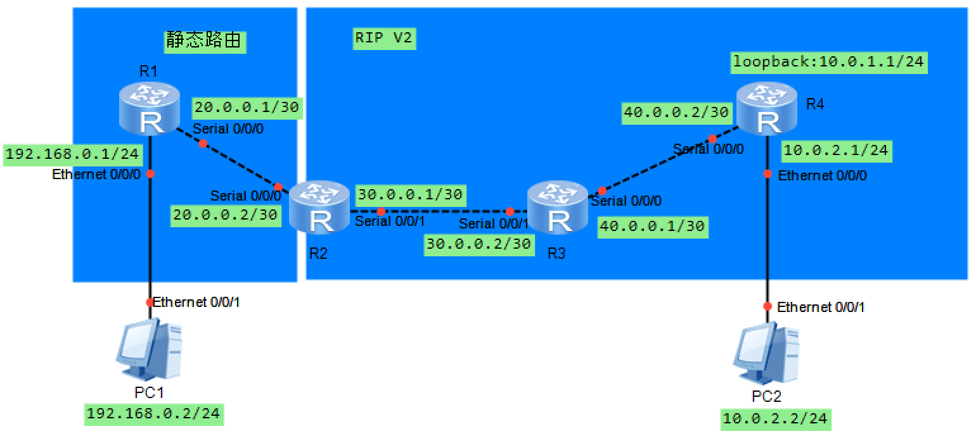
综合练习
完成如下拓扑的构建和连通
[R2-rip-1]import route static 引入静态路由
[R2-rip-1]import route direct 引入直连路由

Slide 16
[R1]int s0/0/0
[R1-Serial0/0/0]ip add 20.0.0.1 30
[R1-Serial0/0/0]int e0/0/0
[R1-Ethernet0/0/0]ip add 192.168.0.1 24
[R1-Ethernet0/0/1]q
[R1]ip route-static 0.0.0.0 0 20.0.0.2
[R3]int s 0/0/0
[R3-Serial0/0/0]ip add 40.0.0.1 30
[R3-Serial0/0/0]int s 0/0/1
[R3-Serial0/0/1]ip add 30.0.0.2 30
[R3-Serial0/0/1]q
[R3]rip
[R3-rip-1]version 2
[R3-rip-1]network 30.0.0.0
[R3-rip-1]network 40.0.0.0
[R4]int s 0/0/0
[R4-Serial0/0/0]ip add 40.0.0.2 30
[R4-Serial0/0/0]int e 0/0/0
[R4-Ethernet0/0/0]ip add 10.0.2.1 24
[R4-Ethernet0/0/0]int LoopBack 0
[R4-LoopBack0]ip add 10.0.1.1 24
[R4-Serial0/0/1]q
[R4]rip
[R4-rip-1]version 2
[R4-rip-1]network 40.0.0.0
[R4-rip-1]network 10.0.0.0
[R2]int s 0/0/0
[R2-Serial0/0/0]ip add 20.0.0.2 30
[R2-Serial0/0/0]int s 0/0/1
[R2-Serial0/0/1]ip add 30.0.0.1 30
[R2-Serial0/0/1]q
[R2]ip route-static 192.168.0.0 24 20.0.0.1
[R2]rip
[R2-rip-1]version 2
[R2-rip-1]network 30.0.0.0

Slide 17
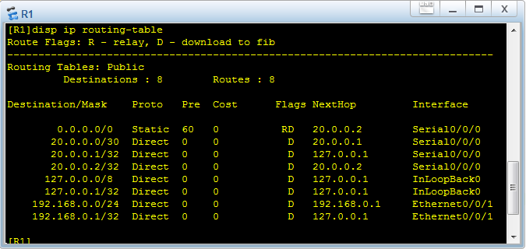
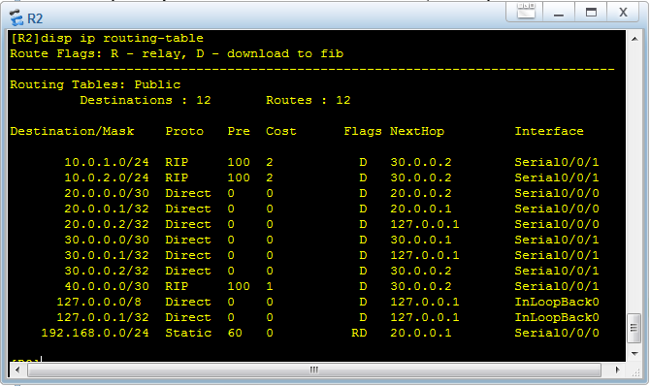
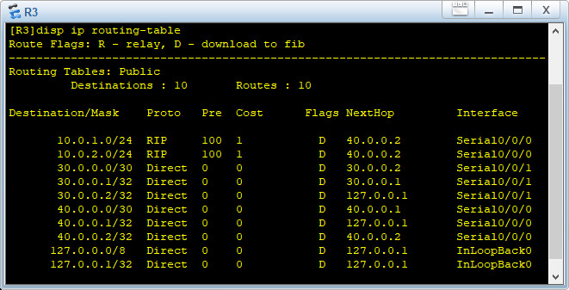

此时PC1能ping通192和20网段以及30.0.0.1，但ping不通30.0.0.2以及40、10网段，因为R3和R4没有到192的路由
PC2能ping通10、40、30网段，但ping不通20和192网段，因为R4没有到20和192的路由

Slide 18
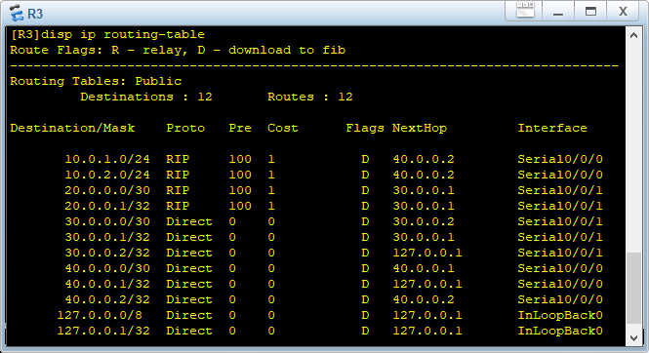
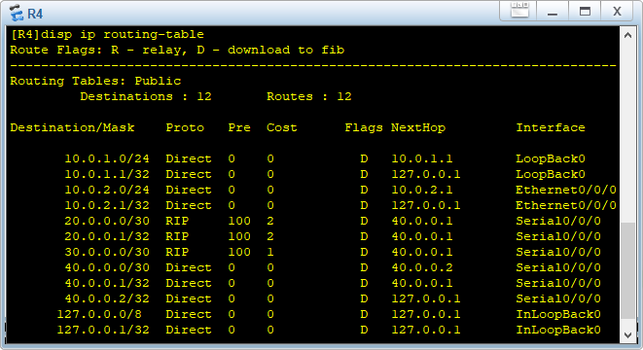
在R2上增加如下配置，然后观察各路由器路由表
[R2-rip-1] import direct ‘在RIP中引用直连路由（原来20网段未被RIP network，现在被引入）
发现R3和R4中均增加了20网段的路由
此时PC2能ping通20网段，但仍ping不通192网段；PC1仍ping不通30.0.0.2和40、10网段
思考为什么？

Slide 19
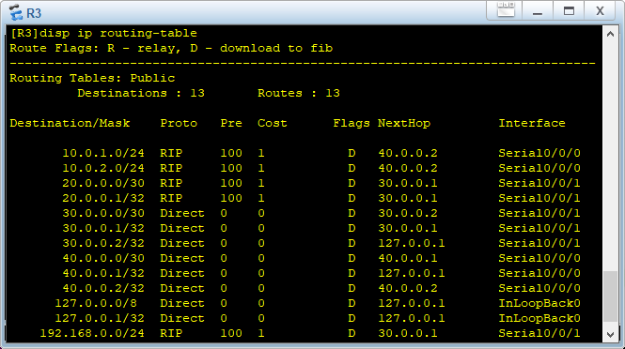
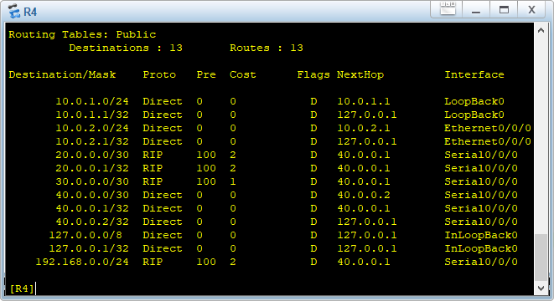
在R2上增加如下配置，然后观察各路由器路由表
[R2-rip-1] import static ‘在RIP中引用静态路由（原来配置的到192网段的静态路由）
发现R3和R4中均增加了192网段的路由
此时PC1和PC2能互通

