Slide 1
OSPF

Slide 2
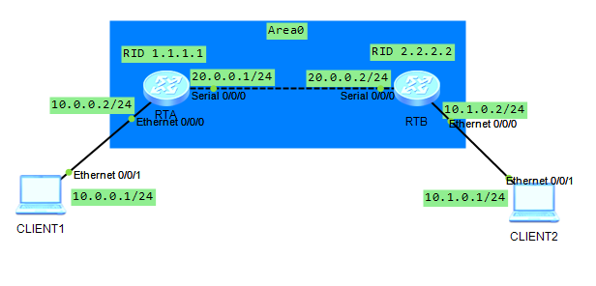
实验拓扑1-单区域OSPF

Slide 3
基本配置
先配置计算机IP及网关
<Huawei>undo ter moni
Info: Current terminal monitor is off.
<Huawei>sys
[Huawei]sysname RTA
[RTA]int e 0/0/0
[RTA-Ethernet0/0/0]ip add 10.0.0.2 24
[RTA-Ethernet0/0/0]int s 0/0/0
[RTA-Serial0/0/0]ip add 20.0.0.1 24
在RTB上做IP配置

Slide 4
检验
PCA>ping 10.0.0.2（通否？）
PCA>ping 20.0.0.1（通否？）
PCA>ping 20.0.0.2（通否？）
PCA>ping 10.1.0.2（通否？）

Slide 5
配置OSPF
[RTA]router id 1.1.1.1
[RTA]ospf
[RTA-ospf-1]area 0
[RTA-ospf-1-area-0.0.0.0]network 1.1.1.1 0.0.0.0
[RTA-ospf-1-area-0.0.0.0]network 10.0.0.0 0.0.0.255 [RTA-ospf-1-area-0.0.0.0]network 20.0.0.0 0.0.0.255 [RTB]router id 2.2.2.2
[RTB]ospf
[RTB-ospf-1]area 0
[RTB-ospf-1-area-0.0.0.0]network 2.2.2.2 0.0.0.0
[RTB-ospf-1-area-0.0.0.0]network 10.1.0.0 0.0.0.255
[RTB-ospf-1-area-0.0.0.0]network 20.0.0.0 0.0.0.255
(实验：将上面掩码改为255.255.255.0，可行否？)
Notes:
反掩码中，“0”表示此位必须严格匹配，“1”表示该地址可以为任意值

Slide 6
检验
PCA>ping 10.0.0.2（通否？）
PCA>ping 20.0.0.1（通否？）
PCA>ping 20.0.0.2（通否？）
PCA>ping 10.1.0.2（通否？）
PCA>ping 10.1.0.1（通否？）

Slide 7
检验
[RTA]disp ospf brief
[RTA]disp ospf peer
[RTA]disp ospf lsdb
[RTA]disp ospf routing
RTA与RID为***的路由器互为邻居？此时邻居状态为***
RTA路由表中有***条OSPF路由，优先级为***，COST值为***

Slide 8
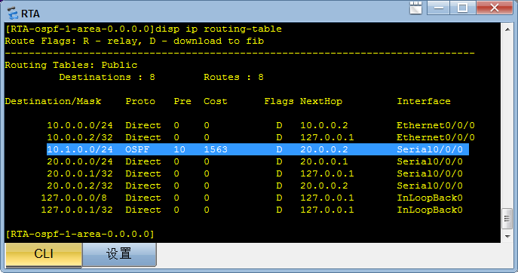
检验
[RTA]disp ip routing-table

Slide 9
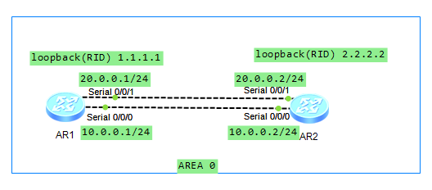
实验拓扑2-路由选择

Slide 10
基本配置
[RTA]int s 0/0/0
[RTA-Serial0/0/0]ip add 10.0.0.1 24
[RTA-Serial0/0/0]int s 0/0/1
[RTA-Serial0/0/1]ip add 20.0.0.1 24
[RTA-Serial0/0/1]int LoopBack 0
[RTA-LoopBack0]ip add 1.1.1.1 32
[RTA-LoopBack0]quit
[RTA]ospf
[RTA-ospf-1]area 0
[RTA-ospf-1-area-0.0.0.0]network 1.1.1.1 0.0.0.0
[RTA-ospf-1-area-0.0.0.0]network 10.0.0.0 0.0.0.255
[RTA-ospf-1-area-0.0.0.0]network 20.0.0.0 0.0.0.255

Slide 11
基本配置
[RTB]int s 0/0/0
[RTB-Serial0/0/0]ip add 10.0.0.2 24
[RTB-Serial0/0/0]int s 0/0/1
[RTB-Serial0/0/1]ip add 20.0.0.2 24
[RTB-Serial0/0/1]int loopback 0
[RTB-LoopBack0]ip add 2.2.2.2 32
[RTB-LoopBack0]quit
[RTB]ospf
[RTB-ospf-1]area 0
[RTB-ospf-1-area-0.0.0.0]network 2.2.2.2 0.0.0.0
[RTB-ospf-1-area-0.0.0.0]network 10.0.0.0 0.0.0.255
[RTB-ospf-1-area-0.0.0.0]network 20.0.0.0 0.0.0.255

Slide 12
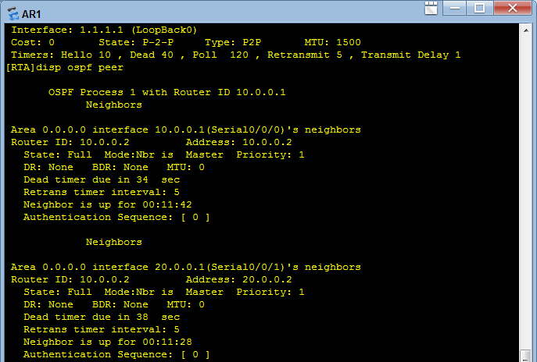
检验
[RTA]ping 2.2.2.2（通否？）
[RTA]disp ospf brief
  问题一：观察 Router ID是多少？为什么是这个值？
[RTA]disp ospf peer

Slide 13
检验
[RTA]disp ospf lsdb
OSPF Process 1 with Router ID 10.0.0.1
Link State Database
Area: 0.0.0.0
Type LinkState ID AdvRouter Age Len Sequence Metric
Router 10.0.0.2 10.0.0.2 928 84 80000005 1562
Router 10.0.0.1 10.0.0.1 927 84 80000005 1562
[RTA]disp ospf routing
OSPF Process 1 with Router ID 10.0.0.1
Routing Tables
Routing for Network
Destination Cost Type NextHop AdvRouter Area
1.1.1.1/32 0 Stub 1.1.1.1 10.0.0.1 0.0.0.0
10.0.0.0/24 1562 Stub 10.0.0.1 10.0.0.1 0.0.0.0
20.0.0.0/24 1562 Stub 20.0.0.1 10.0.0.1 0.0.0.0
2.2.2.2/32 1562 Stub 10.0.0.2 10.0.0.2 0.0.0.0
2.2.2.2/32 1562 Stub 20.0.0.2 10.0.0.2 0.0.0.0
Total Nets: 5
Intra Area: 5 Inter Area: 0 ASE: 0 NSSA: 0
问题二：Ospf路由表和IP路由表有何区别？

Slide 14
检验
[RTA]disp ip routing-table
Route Flags: R - relay, D - download to fib
------------------------------------------------------------------------------
Routing Tables: Public
Destinations : 10 Routes : 11
Destination/Mask Proto Pre Cost Flags NextHop Interface
1.1.1.1/32 Direct 0 0 D 127.0.0.1 LoopBack0
2.2.2.2/32 OSPF 10 1562 D 10.0.0.2 Serial0/0/0
OSPF 10 1562 D 20.0.0.2 Serial0/0/1
10.0.0.0/24 Direct 0 0 D 10.0.0.1 Serial0/0/0
10.0.0.1/32 Direct 0 0 D 127.0.0.1 Serial0/0/0
10.0.0.2/32 Direct 0 0 D 10.0.0.2 Serial0/0/0
20.0.0.0/24 Direct 0 0 D 20.0.0.1 Serial0/0/1
20.0.0.1/32 Direct 0 0 D 127.0.0.1 Serial0/0/1
20.0.0.2/32 Direct 0 0 D 20.0.0.2 Serial0/0/1
127.0.0.0/8 Direct 0 0 D 127.0.0.1 InLoopBack0
127.0.0.1/32 Direct 0 0 D 127.0.0.1 InLoopBack0
问题三：为什么会出现两条路由？代表什么含意？

Slide 15
更改接口COST
[RTA]int s0/0/0
[RTA-Serial0/0/0]ospf cost 150
[RTA-Serial0/0/0]disp ospf routing
OSPF Process 1 with Router ID 10.0.0.1
Routing Tables
Routing for Network
Destination Cost Type NextHop AdvRouter Area
1.1.1.1/32 0 Stub 1.1.1.1 10.0.0.1 0.0.0.0
10.0.0.0/24 150 Stub 10.0.0.1 10.0.0.1 0.0.0.0
20.0.0.0/24 1562 Stub 20.0.0.1 10.0.0.1 0.0.0.0
2.2.2.2/32 150 Stub 10.0.0.2 10.0.0.2 0.0.0.0
Total Nets: 4
Intra Area: 4 Inter Area: 0 ASE: 0 NSSA: 0
问题四：为何比上次少了一条路由？少了哪一条？

Slide 16
更改接口COST
[RTA-Serial0/0/0]disp ip routing-table
Route Flags: R - relay, D - download to fib
------------------------------------------------------------------------------
Routing Tables: Public
Destinations : 10 Routes : 10
Destination/Mask Proto Pre Cost Flags NextHop Interface
1.1.1.1/32 Direct 0 0 D 127.0.0.1 LoopBack0
2.2.2.2/32 OSPF 10 150 D 10.0.0.2 Serial0/0/0
10.0.0.0/24 Direct 0 0 D 10.0.0.1 Serial0/0/0
10.0.0.1/32 Direct 0 0 D 127.0.0.1 Serial0/0/0
10.0.0.2/32 Direct 0 0 D 10.0.0.2 Serial0/0/0
20.0.0.0/24 Direct 0 0 D 20.0.0.1 Serial0/0/1
20.0.0.1/32 Direct 0 0 D 127.0.0.1 Serial0/0/1
20.0.0.2/32 Direct 0 0 D 20.0.0.2 Serial0/0/1
127.0.0.0/8 Direct 0 0 D 127.0.0.1 InLoopBack0
127.0.0.1/32 Direct 0 0 D 127.0.0.1 InLoopBack0
问题五：IP路由表中到2.2.2.2为何只有一条路由了？
问题六：观察RTB的路由表，到RTA有几条路由？为什么？
Notes:
问题六：观察RTB的路由表，到RTA有几条路由？（2条等值路由，RTA接口的COST值不影响RTB的路由计算）

