Slide 1
Lab 8: Binary Search Tree
Jan, 2021

Slide 2
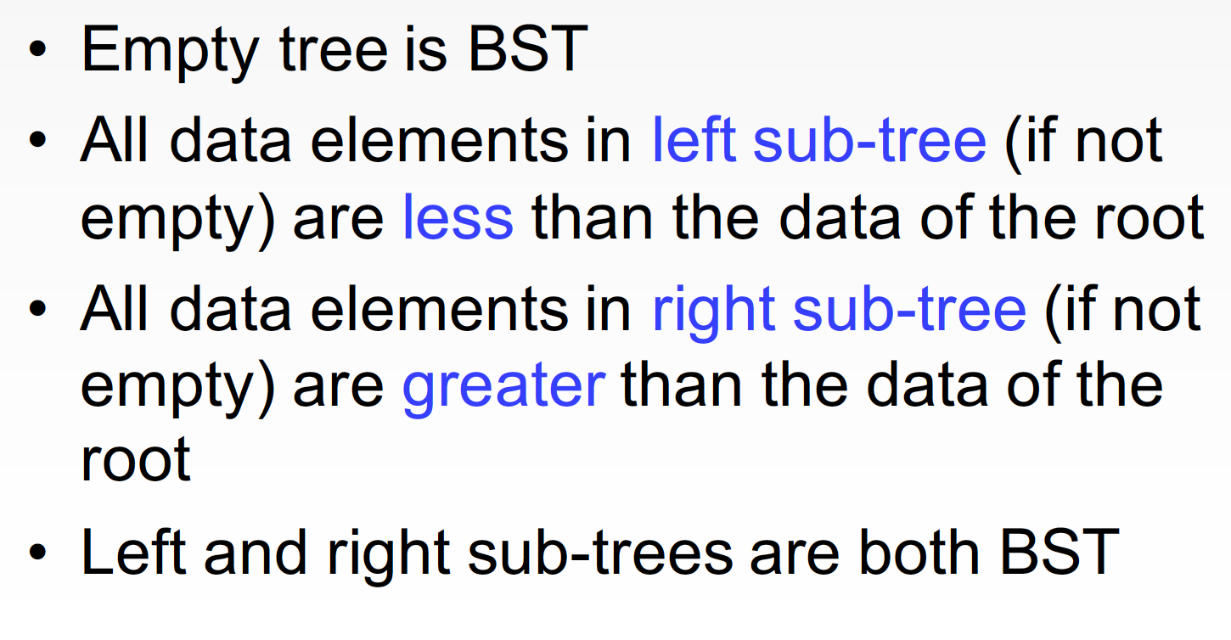
Binary Search Tree (BST)

Slide 3
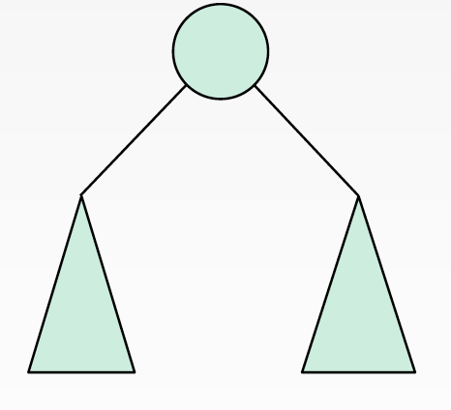
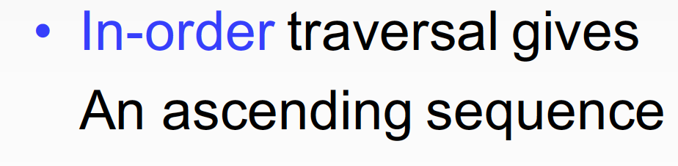
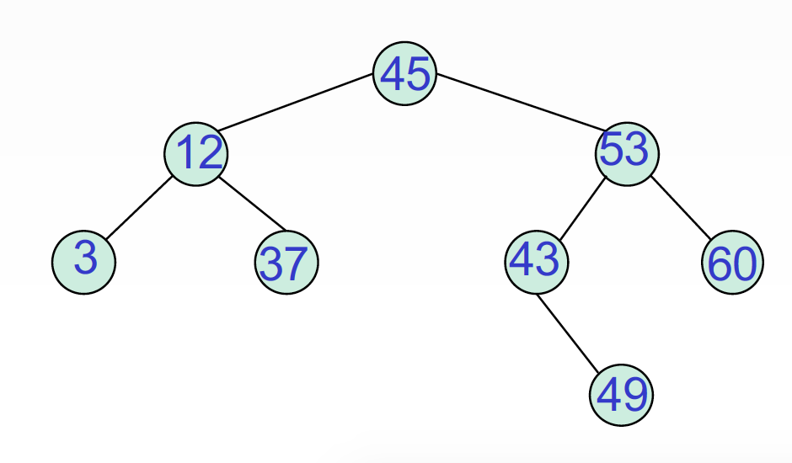
Property

Slide 4
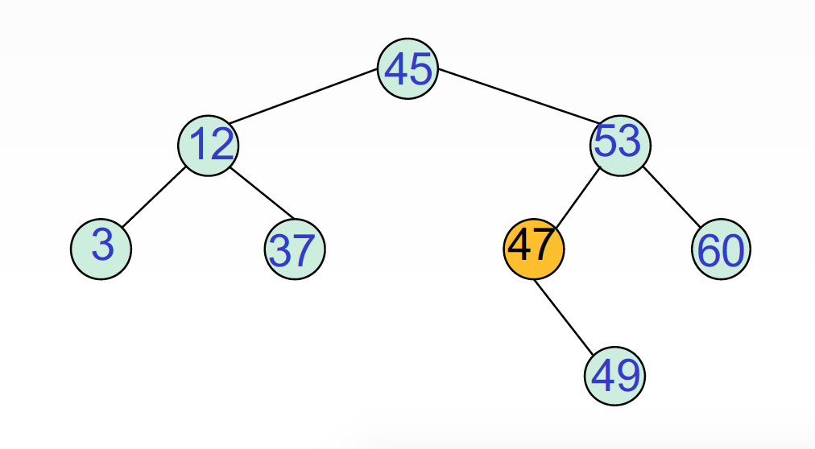
Property

Slide 5
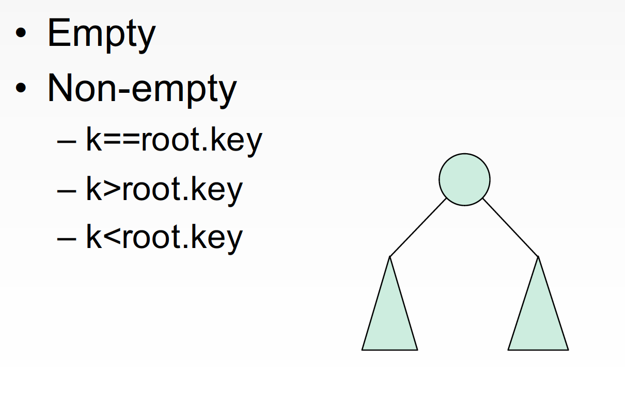
Insertion

Slide 6
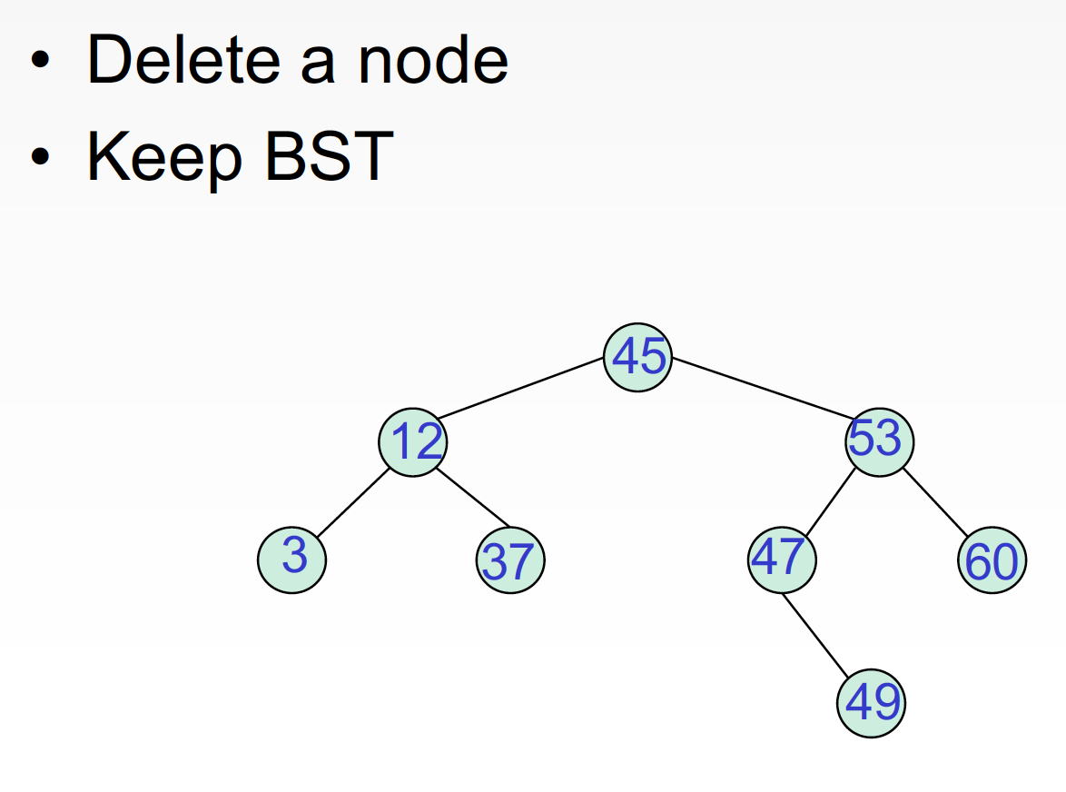
Deletion

Slide 7
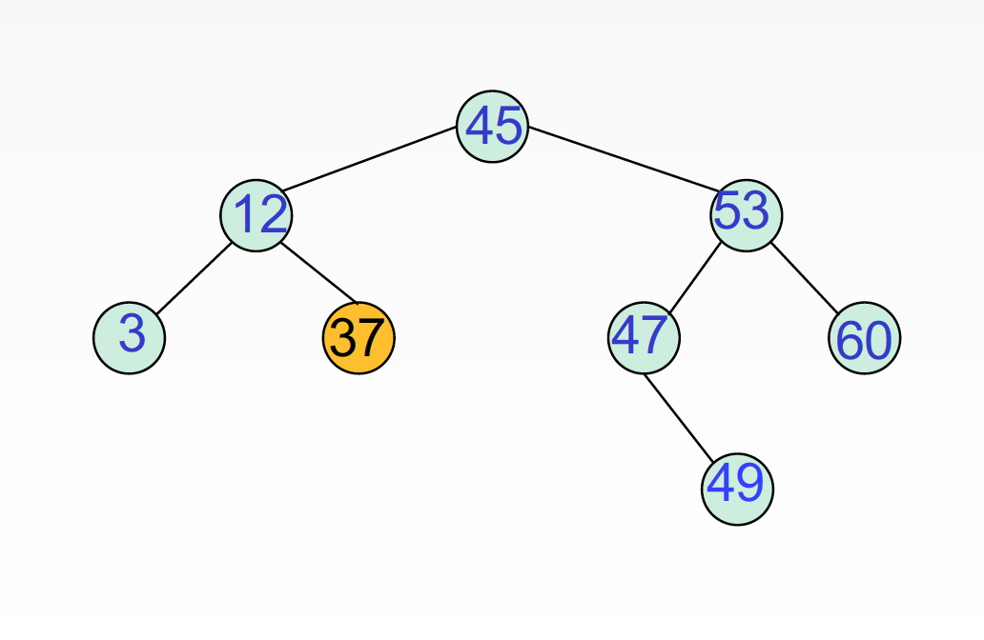
Delete A Leaf

Slide 8
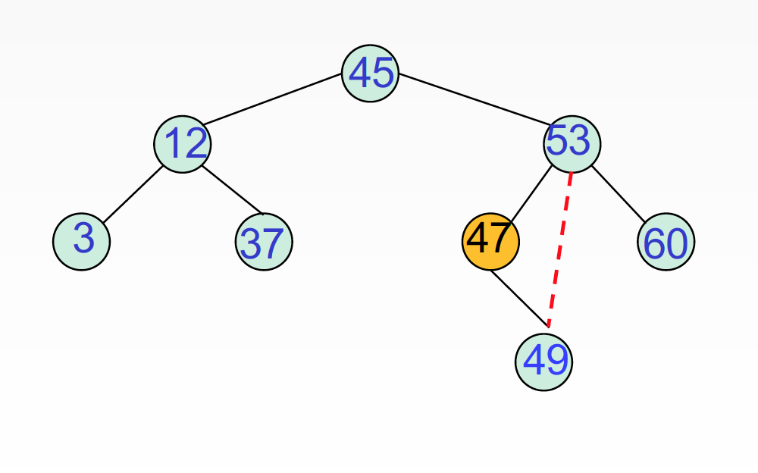
Delete 1-Branch Node

Slide 9
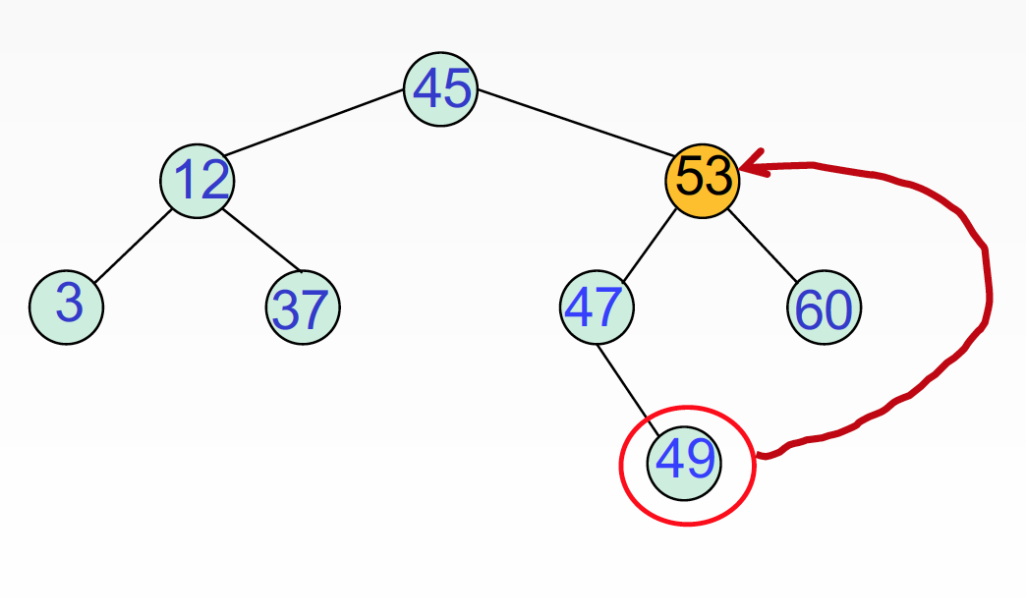
Delete 2-Branch Node

Slide 10
Height of BST
0
1
2
3

Slide 11
Attention!
Deadline: 2021年1月13日晚23:59

Slide 12
Thank you!
Questions?

