Slide 1
Operating System Principle Lab 5
April, 2021

Slide 2
Outline
Processor affinity
Linux process priority
Parameters for kernel modules
Linux completely fair scheduler (CFS)

Slide 3
Processor Affinity
lscpu
taskset
taskset -p -c [coreid] [pid]

Slide 4
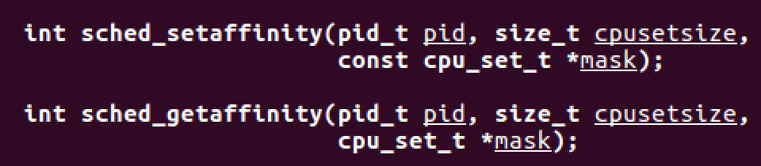
Processor affinity
CPU_ZERO(&cpu_set); //clear
CPU_SET(0, &cpu_set); //set core 0
sched_setaffinity(0, sizeof(cpu_set), &cpu_set); //0 represent current process
sched_gettaffinity(0, sizeof(cpu_set), &cpu_set);
Notes:
ps -elF 查看进程被调度到哪一个核上执行
Process? Or threads?
Fork() or pthread_create()?

Slide 5
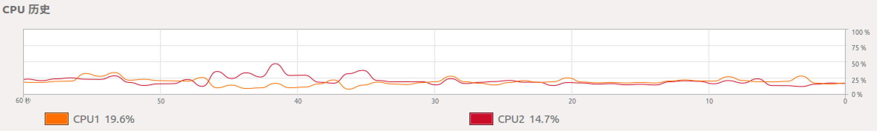
Processor affinity
ps -elF
System monitor
Notes:
kill -9 pid
taskset 命令也可以设定cpu亲和性

Slide 6
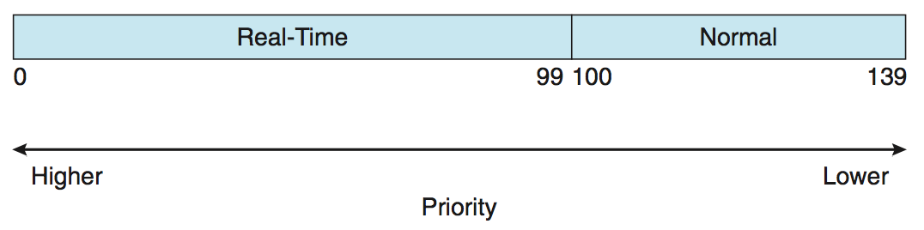
Linux Process Priority
Nice: -20 to 19
Notes:
ps –el
sudo renice [pri] [pid]

Slide 7
Set/get process priority
Get priority
ps -el
getpriority(PRIO_PROCESS, 0) //get priority
0 means current process
Set priority
setpriority(PRIO_PROCESS, 0, -10);
//PRIO_PROCESS means to set the priority of a process, rather than a group of processes
0 means current process
renice [pri] [pid]
sudo to set higher priority
Notes:
How about threads?
Processes or threads?

Slide 8
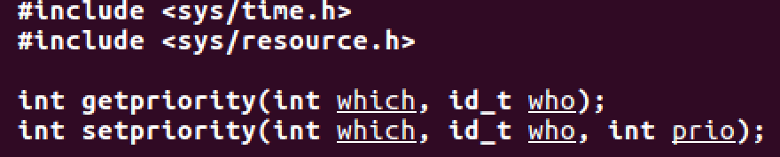
Set/get process priority
Notes:
nice(5); //increment by 5

Slide 9
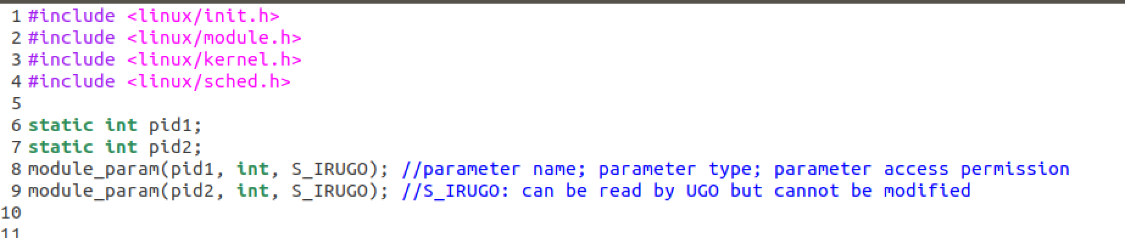
Parameters for Kernel Module
module_param(name, type, perm)
sudo insmod [module-name] pid1= … pid2 = ...
Notes:
dmesg | tail –n 2 //查看最后两行信息

Slide 10
CFS
Completely fair scheduler
Runnable processes: red-black tree

Slide 11
Virtual runtime
Completely fair scheduler
runtime += T * (weight / sum_weight)
vruntime += runtime * (weight₀ / weight)
vruntime += T * (weight / sum_weight) * (weight₀ / weight)
vruntime += T * (weight₀ / sum_weight)
runtime += T * (weight / sum_weight)
vruntime += T * (weight₀ / sum_weight) //constant
//weight₀ = 1024

Slide 12
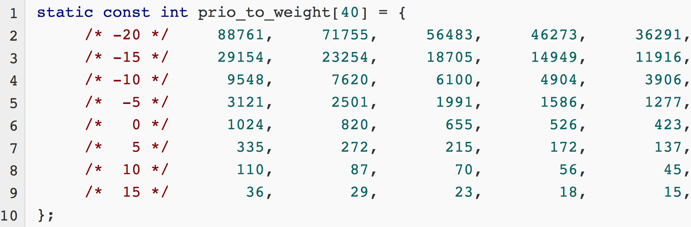
Priority to weight
Completely fair scheduler
Notes:
weight(n)=1024*1.25^(-n)

Slide 13
Process Control Block: sched.h

Slide 14
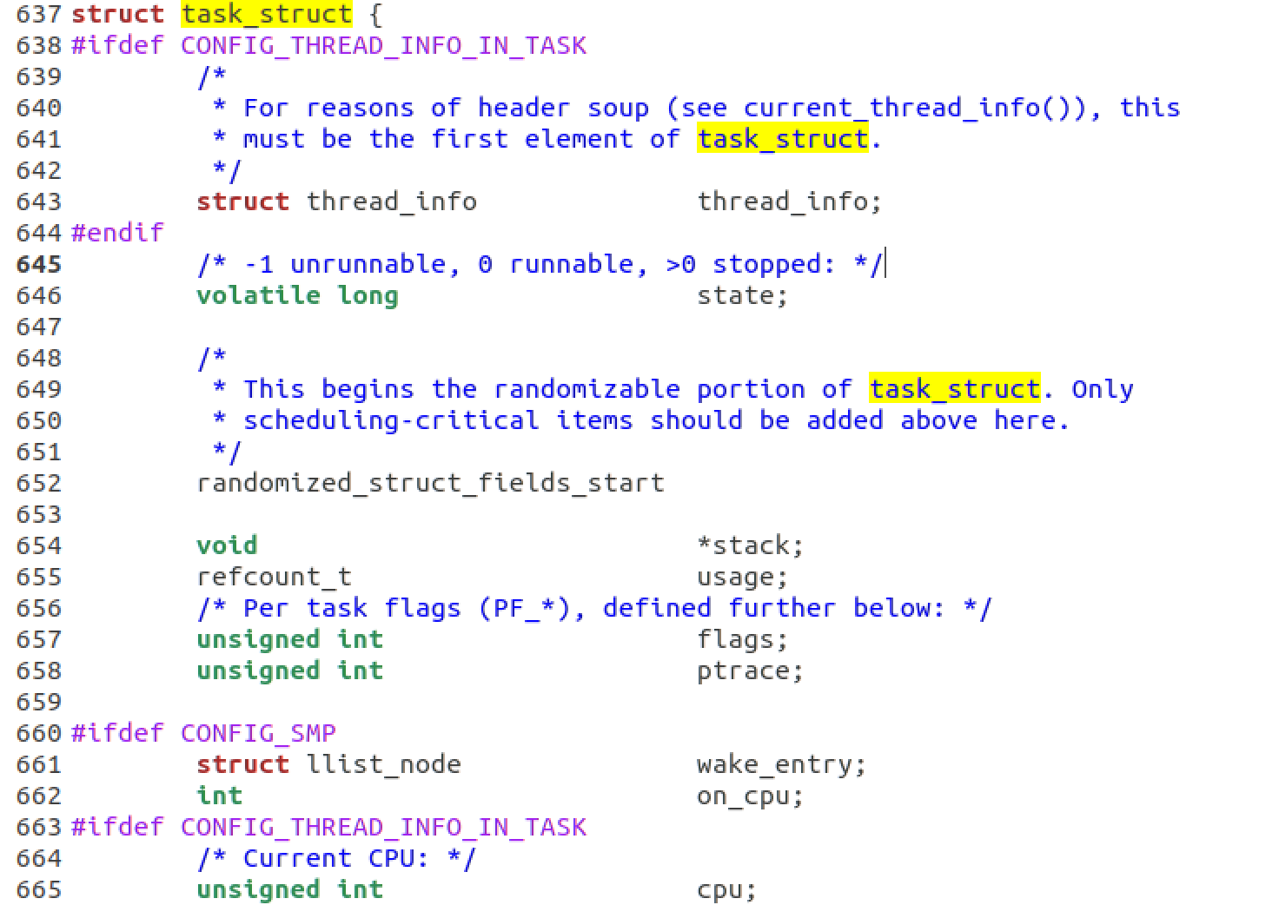
task_struct

Slide 15
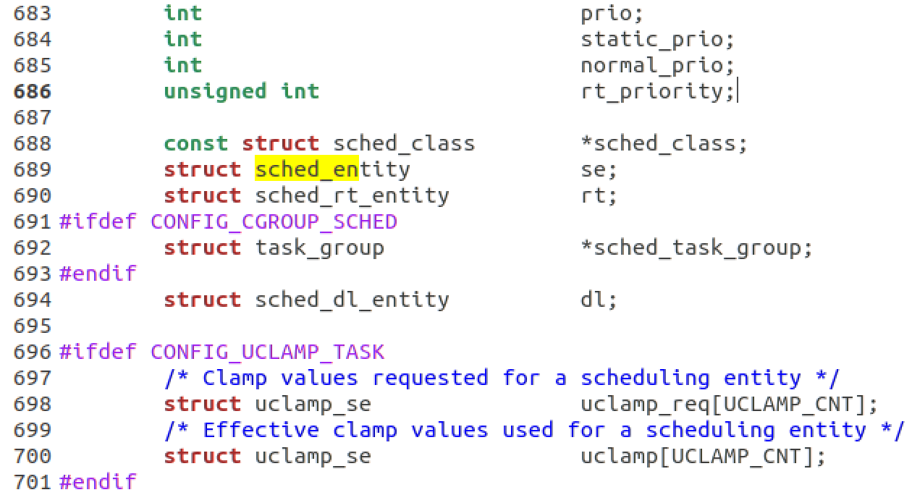
sched_entity

Slide 16
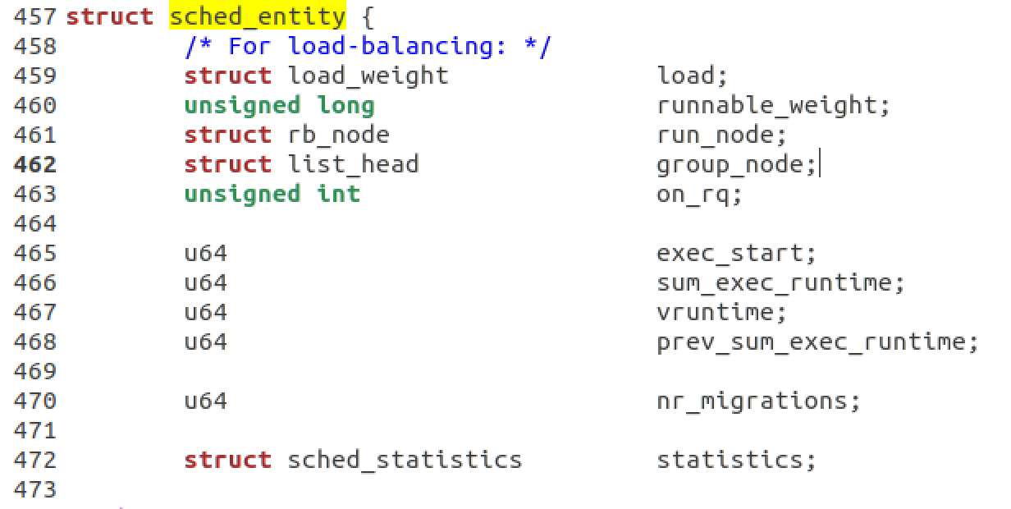
sched_entity
u64: 64-bit unsigned integer
%lld
p->se.vruntime
p->se.sum_exec_runtime
Notes:
The same sched.h
Time precision: nano? Which clock?

Slide 17
Task

Slide 18
Priority to weight
Completely fair scheduler
Notes:
weight(n)=1024*1.25^(-n)

Slide 19
The End

