Slide 1
Chapter 8: Memory Management
Background
Memory Management Tasks
  Virtual memory management
Segmentation and Paging

Slide 2
Objectives
To get an overall idea of virtual memory space
To discuss hardware support for virtual memory: segmentation and paging

Slide 3
Background

Slide 4
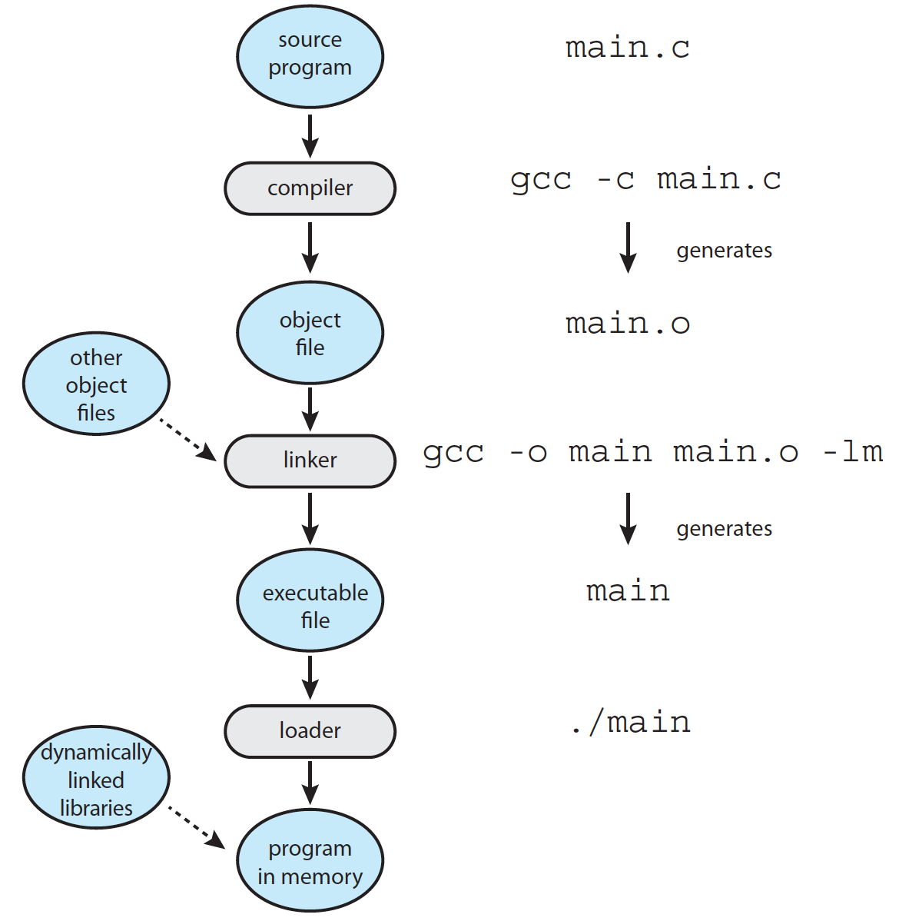
Multistep Processing of a User Program

Slide 5
Program on disk
0
ELF header
Maps contiguous file sections to runtime memory segments
Program header table
.init
Read-only memory segment
(code segment)
.text
.rodata
.data
Read/write memory segment
(data segment)
.bss
.symtab
.debug
Symbol table and debugging info are not
loaded into memory
.line
Describes object file sections
.strtab
Section header table

Slide 6

Process in Memory

Slide 7
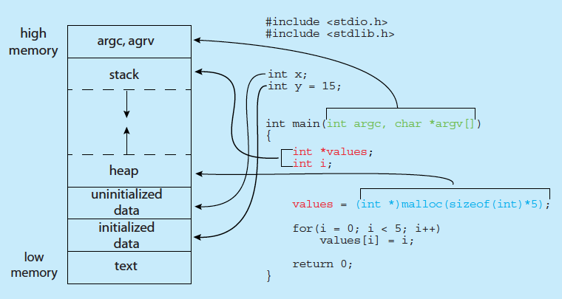
Process in Memory
Notes:
size command
cat /proc/<pid>/maps

Slide 8
Process Resources
Program counter – location of instruction to next execute
CPU registers – contents of all process-centric registers
Memory-management information – memory allocated to the process
I/O status information – I/O devices allocated to process, list of open files

Slide 9
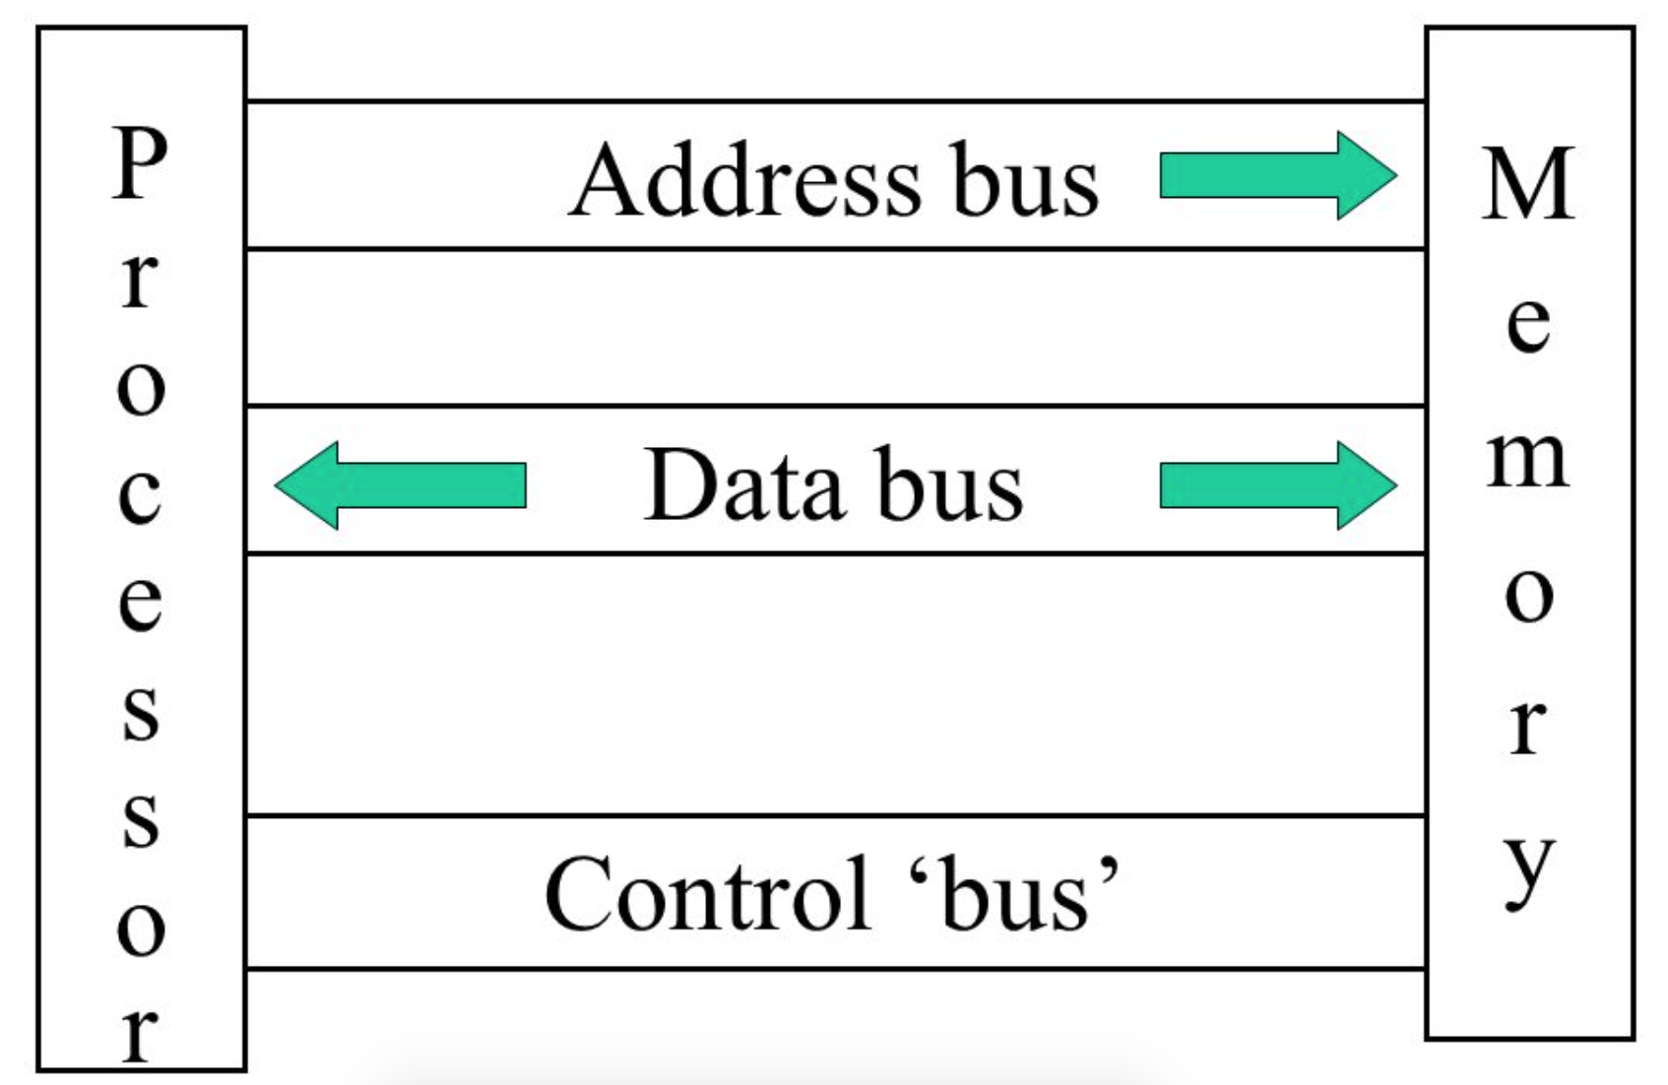
Summary
Main memory and registers are only storage CPU can access directly
Program must be brought (from disk) into memory and placed within a process for it to be run
Memory unit only sees a stream of addresses + read requests, or address + data and write requests

Slide 10
Memory Management

Slide 11
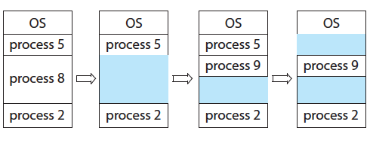
Memory Allocation and Reclaim
Multi-programming

Slide 12

Memory Hierarchy

Slide 13
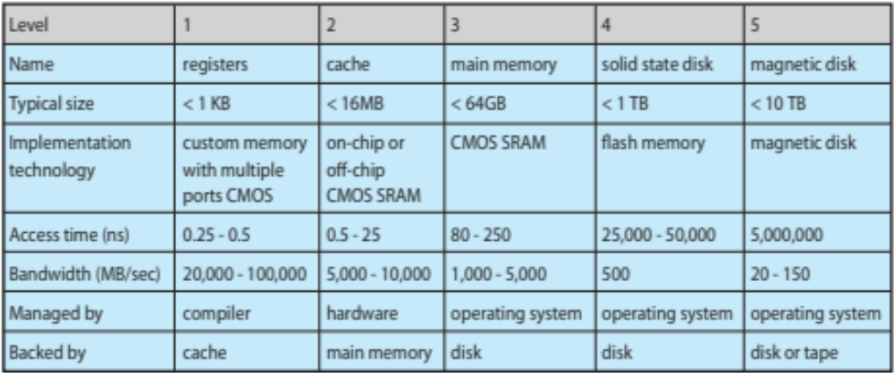
Performance of Various Levels of Storage
ns us ms

Slide 14
Memory Access Speed
Register access in one CPU clock (or less)
Main memory can take many cycles, causing a stall
Cache sits between main memory and CPU registers
How to reduce average memory access time?

Slide 15
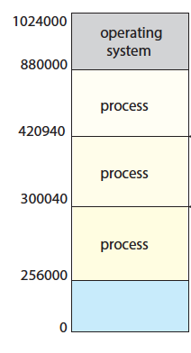
Memory Isolation and Access Control
Read-only memory
demo
Notes:
Demo: segment fault

Slide 16
Summary
Memory Space Usage Efficiency
Memory Access Efficiency
Memory Protection

Slide 17
Thinking About
./a.out
  How much memory to be allocated?
    How much memory at most?
  Which part of free memory space is allocated?
  If a.out is run twice, will the memory space allocated to it be the same? If not, will the execution of a.out be affected?
  How to prevent other processes from accessing the memory space of a.out?

Slide 18
Address Binding
    Demo 1
    Demo 2
Binding: Mapping one address space to another
  Relocatable address
  Absolute address
Notes:
1. Address conflict demo
2. Sum demo: the jump address of sub-function [callq]

Slide 19
Virtual Memory

Slide 20
Logical vs. Physical Address Space
The concept of a logical address space that is bound to a separate physical address space is central to proper memory management
  Logical address – generated by the CPU; also referred to as virtual address
  Physical address – address seen by the memory unit
Logical address space is the set of all logical addresses generated by a program
Physical address space is the set of all physical addresses generated by a program

Slide 21
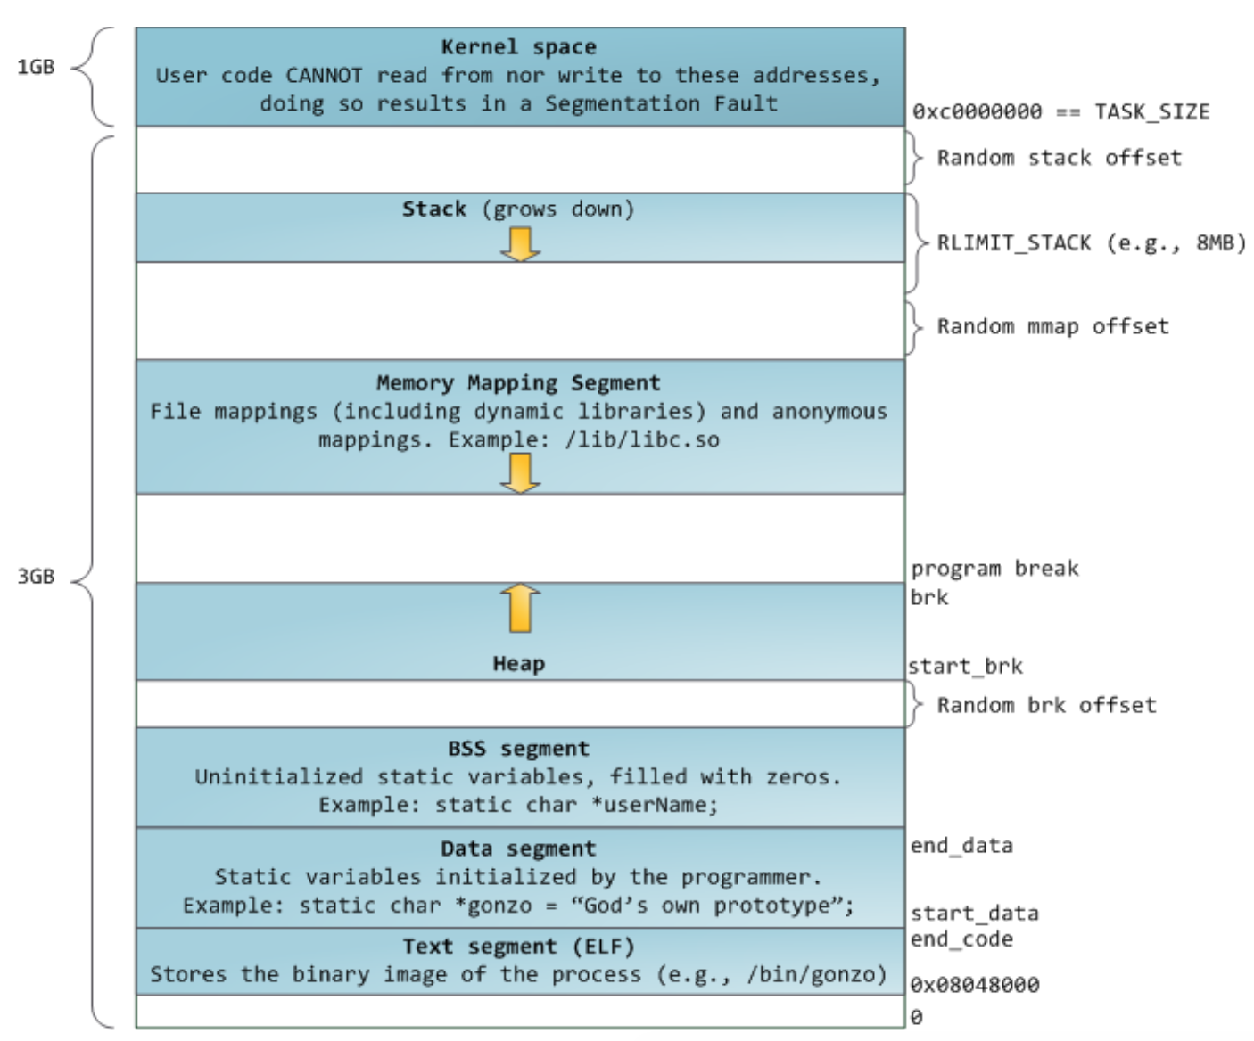
Virtual Address Space (32 bit)

Slide 22
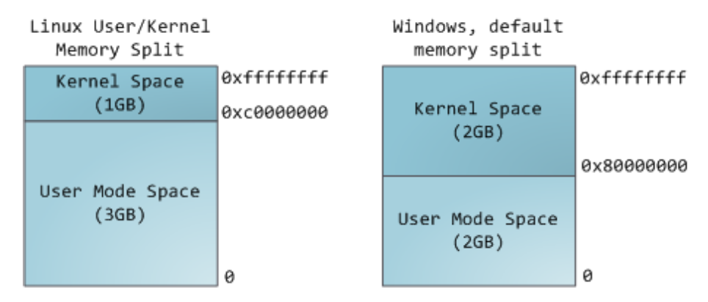
Virtual Address Space (32 bit)

Slide 23
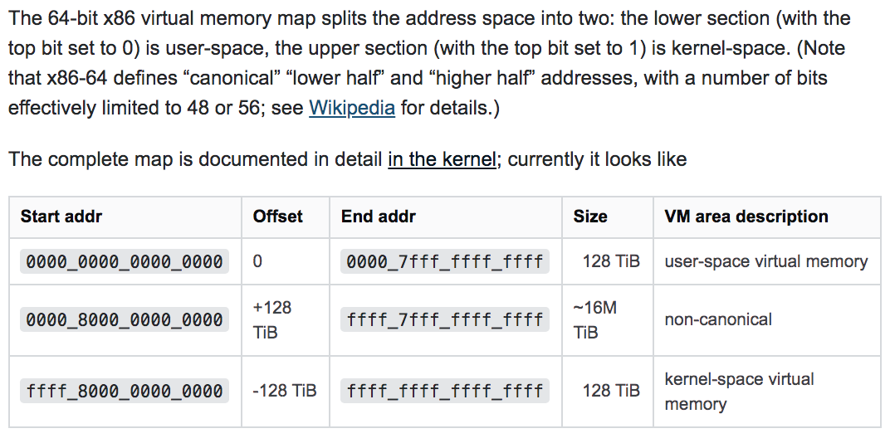
X86-64 Linux
Kernel space 128T
User space 128T
48 bits (not 64) virtual address space
Notes:
https://www.kernel.org/doc/html/latest/x86/x86_64/mm.html
https://unix.stackexchange.com/questions/509607/how-a-64-bit-process-virtual-address-space-is-divided-in-linux
https://stackoverflow.com/questions/6716946/why-do-x86-64-systems-have-only-a-48-bit-virtual-address-space
https://stackoverflow.com/questions/46509152/why-in-x86-64-the-virtual-address-are-4-bits-shorter-than-physical-48-bits-vs
https://stackoverflow.com/questions/63975447/why-virtual-address-are-48-bits-not-64-bits

Slide 24
Pros and Cons of VM
Pros
  Low programming complexity
  Larger memory for programs
  Higher efficiency of physical memory usage
  More protection strategies
  More sharing strategies
Cons
  Complexity in OS design
  V.A. to P.A. translation cost time

Slide 25
Summary
Virtual memory translation
Physical memory space usage
Memory access efficiency
Memory protection

Slide 26
Memory Management: Hardware Support

Slide 27
Memory-Management Unit (MMU)
Hardware device that at run time maps virtual to physical address
VA
PA
CPU
MMU
Memory
DATA
virtual address
space
physical address
space
Notes:
mmu inside cpu
mmu and cache?
Intel: 48 vir vs 52 phy

Slide 28
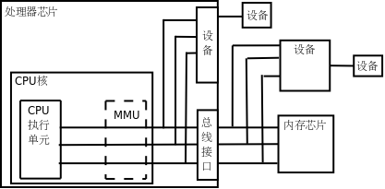
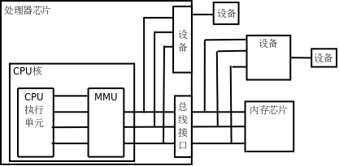
MMU
MMU per CPU core

Slide 29
Memory Management Strategies

Slide 30
Memory Management Strategies
Contiguous memory allocation
Segmentation
Paging

Slide 31
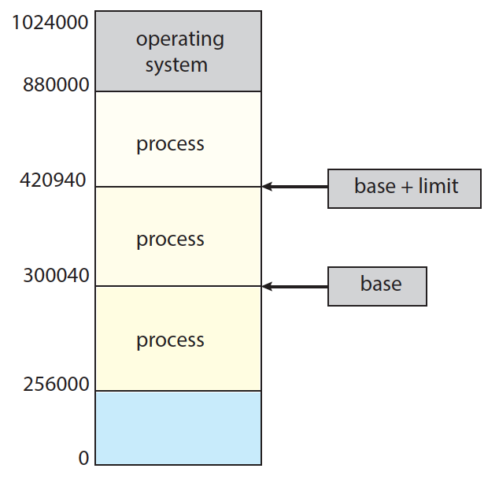
Relocation Registers

Slide 32

Dynamic relocation using a relocation register

Slide 33
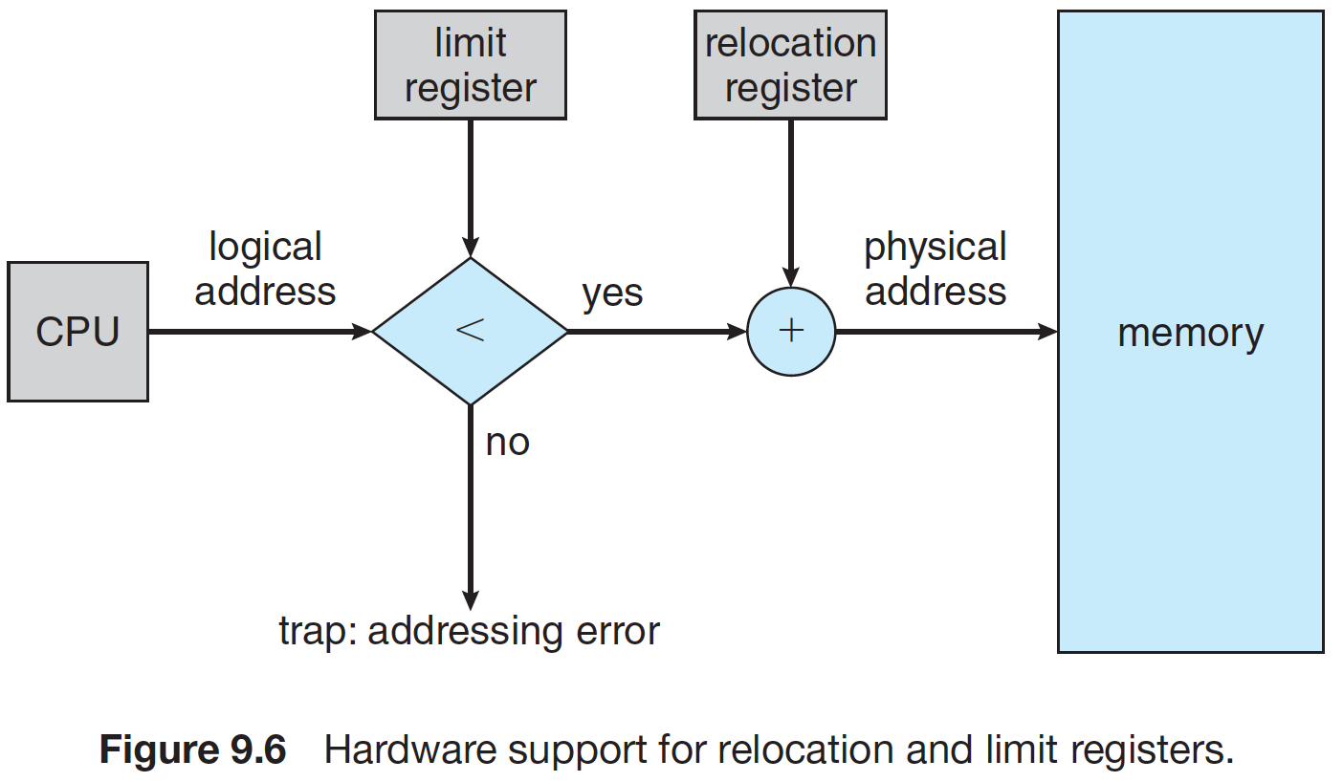
Protection

Slide 34
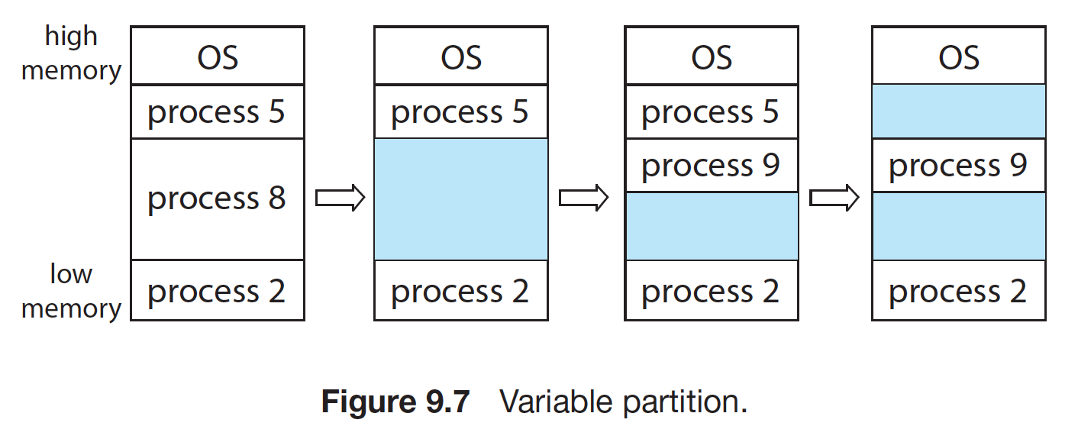
Contiguous Memory Allocation
Hole

Slide 35
Contiguous Memory Allocation
First-fit: Allocate the first hole that is big enough
Best-fit: Allocate the smallest hole that is big enough; must search entire list, unless ordered by size
  Produces the smallest leftover hole
Worst-fit: Allocate the largest hole; must also search entire list
  Produces the largest leftover hole
0 | 4 | 8 | 12 | 16 | 20 | 24 | 28 | 32 | 36
Notes:
Purple：used
Green: free
Now: request 4

Slide 36
Fragmentation
External Fragmentation – total memory space exists to satisfy a request, but it is not contiguous
0 | 4 | 8 | 12 | 16 | 20 | 24 | 28 | 32 | 36
Notes:
Request 12

Slide 37
Fragmentation
Internal Fragmentation – allocated memory may be slightly larger than requested memory; this size difference is memory internal to a partition, but not being used
  request 7 B
  fixed memory block size 8 B

Slide 38
Limitations of Contiguous
External fragmentation
Dynamic memory request
  malloc()
demo

Slide 39
Deal with External Fragmentation
Reduce external fragmentation by compaction
0 | 4 | 8 | 12 | 16 | 20 | 24 | 28 | 32 | 36

Slide 40
Deal with External Fragmentation
Non-contiguous memory allocation
  Segmentation
  Paging

Slide 41
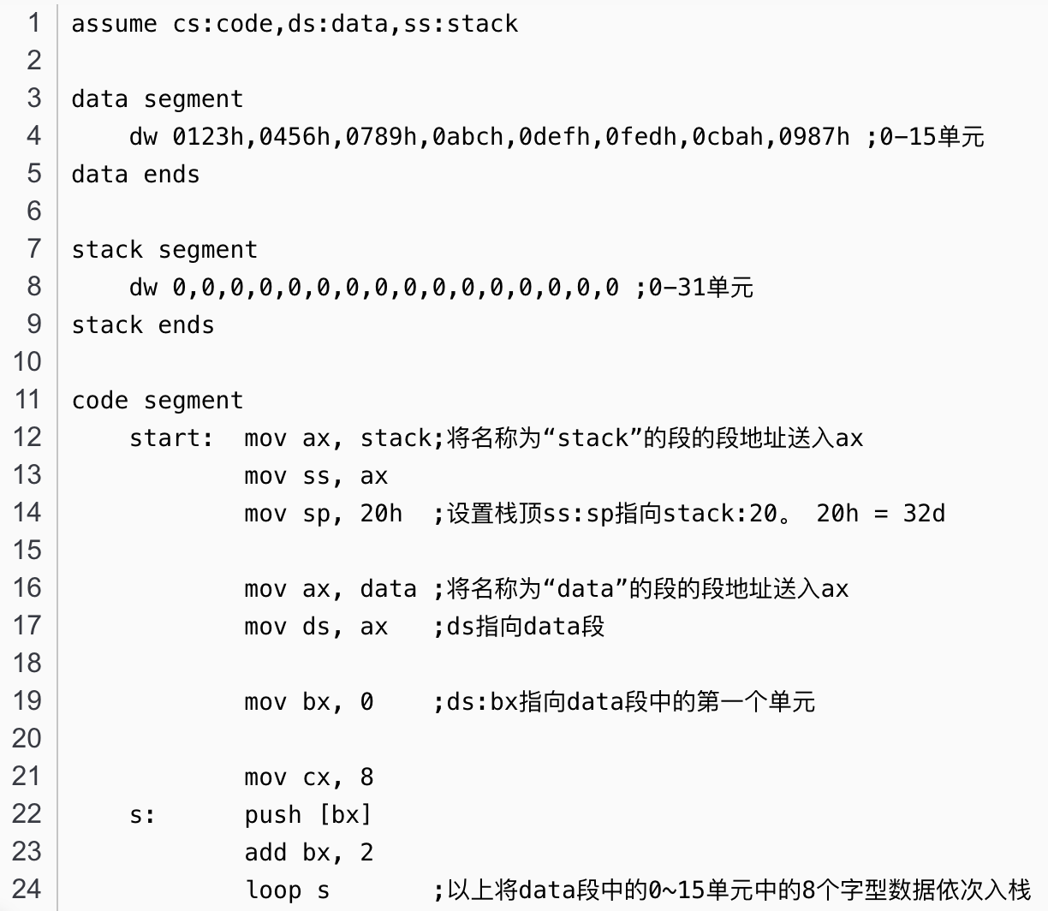
Assembly

Slide 42
Segmentation
A program is a collection of segments
  main program
  procedure
  function
  method
  object
  local variables, global variables
  common block
  stack
  symbol table
  arrays

Slide 43

User’s View of a Program

Slide 44
Logical View of Segmentation
1
1
4
2
3
4
2
3
user space
physical memory space

Slide 45
Segment Table
Segment table – maps two-dimensional physical addresses; each table entry has:
  base – contains the starting physical address where the segments reside in memory
  limit – specifies the length of the segment
Segment-table base register (STBR) points to the segment table’s location in memory
Segment-table length register (STLR) indicates number of segments used by a program

Slide 46
Virtual Address in Segmentation
Logical address consists of a two tuple:
  <segment-number, offset>
  cs:ip
 | base | limit
0 | 0 | 50
1 | 50 | 100
2 | 150 | 200
3 | 350 | 50

Slide 47

Segmentation Hardware
Notes:
Segment fault

Slide 48
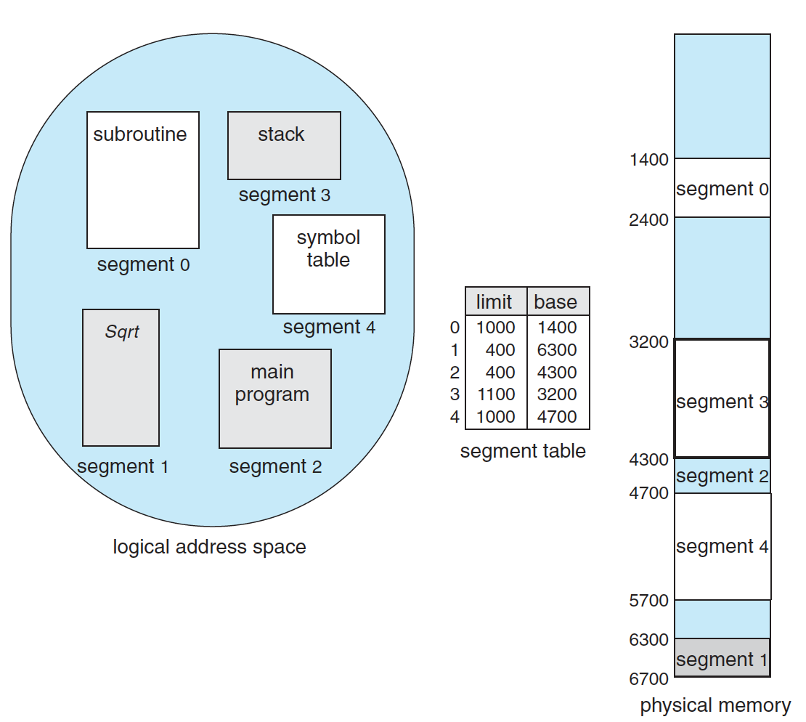
Example
<001, 000000011011>_{b}
<2, 1FF>_{h}
<3, 00F>_{h}
Notes:
Virtual address: 15 bits

Slide 49
The End of Chap 8 (1)

Slide 50
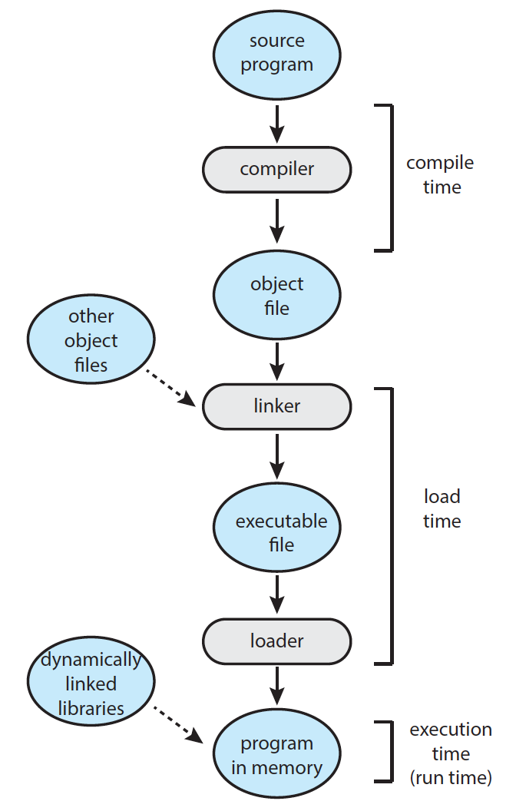
Dynamic Linking and Shared Library
Save space
  Disk
  Memory (shared)
Facilitate update
Notes:
objdump -d main
//dynamic linking
gcc -shared -fpic -o libvector.so addvec.c mulvec.c
gcc main.c ./libvector.so
//static linking
gcc -c addvec.c mulvec.c
ar rcs libvector.a addvec.o mulvec.o
gcc main.c -L. -lvector

