Slide 1
Operating System Principle Lab 7
May, 2021

Slide 2
Outline
Process synchronization
Race condition
Critical section
Mutual exclusion
Process synchronization tools
Mutex lock
Deadlock
The implementation of mutex lock

Slide 3
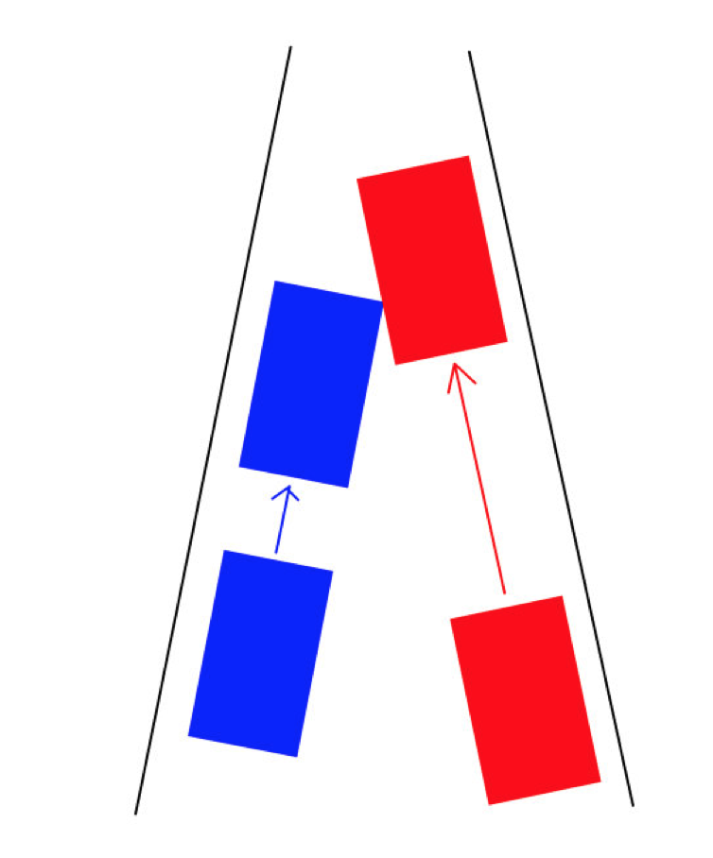
Race condition
Demo
Notes:
Producer-consumer (race.c)

Slide 4
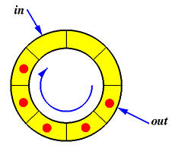
Producer-Consumer

Slide 5
Why? Atomic Instruction
objdum -d [executable-name]

Slide 6
Result Analysis
counter++ could be implemented as register1 = counter register1 = register1 + 1 counter = register1
counter-- could be implemented as register2 = counter register2 = register2 - 1 counter = register2
Consider this execution interleaving with “count = 5” initially:
S0: producer execute register1 = counter {register1 = 5} S1: producer execute register1 = register1 + 1 {register1 = 6} S2: consumer execute register2 = counter {register2 = 5} S3: consumer execute register2 = register2 – 1 {register2 = 4} S4: producer execute counter = register1 {counter = 6 } S5: consumer execute counter = register2 {counter = 4}
Notes:
Given an example: objdump -d [filename]

Slide 7
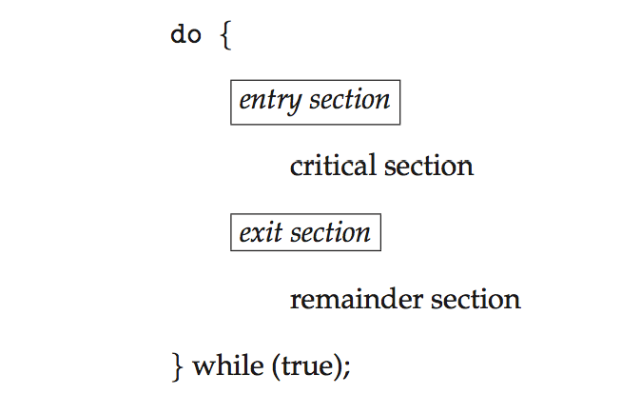
Critical Section
Each process must ask permission to enter critical section in entry section, may follow critical section with exit section, then remainder section

Slide 8
Solution Requirements
Mutual Exclusion - If process P_{i} is executing in its critical section, then no other processes can be executing in their critical section
Progress - If no process is executing in its critical section and there exist some processes that wish to enter their critical section, then only those processes that are not executing in their remainder sections can participate in deciding which will enter its critical section next, and this selection cannot be postponed indefinitely
3. Bounded Waiting - A bound must exist on the number of times that other processes are allowed to enter their critical sections after a process has made a request to enter its critical section and before that request is granted

Slide 9
Possible Solution?
flag = false; //no process in c.s.
//P0
while (flag == true); //do nothing
flag = true;
//critical section;
flag = false;
//remainder section;
//P1
while (flag == true); //do nothing
flag = true;
//critical section;
flag = false;
//remainder section;
What’s the problem?
Notes:
Mutual exclusion violated

Slide 10
Mutex Lock
Mutex lock
pthread_mutex_t mutex;
pthread_mutex_init(&mutex, NULL);
pthread_mutex_lock(&mutex);
pthread_mutex_unlock(&mutex);
#include<pthread.h>
-pthread
Notes:
Mutex.c

Slide 11
Deadlock
Demo
Notes:
Deadlock.c

Slide 12
Implementation of Mutex Lock

Slide 13
Possible Solution?
flag = false; //no process in c.s.
//P0
while (flag == true); //do nothing
flag = true;
//critical section;
flag = false;
//remainder section;
//P1
while (flag == true); //do nothing
flag = true;
//critical section;
flag = false;
//remainder section;
What’s the problem?
Notes:
Mutual exclusion violated

Slide 14
Require Atomic Instruction
test_and_set
boolean lock = false;
boolean test_and_set(boolean *lock)
{
boolean curr_lock = *lock;
*lock = true; //set
return curr_lock; //test
}

Slide 15
Mutex Solution using test_and_set()
Shared Boolean variable lock, initialized to false (unlocked)
Solution:
while(test_and_set(&lock)); /* do nothing */
/* critical section */
lock = false;
/* remainder section */

Slide 16
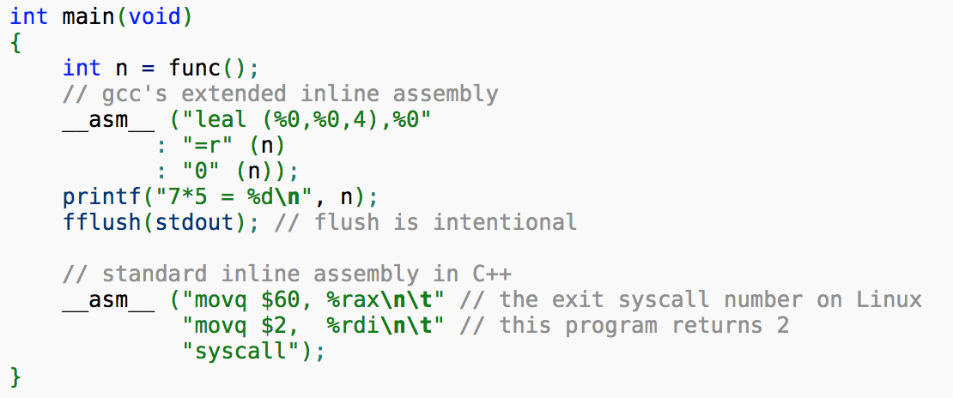
Inline Assembly of C

Slide 17
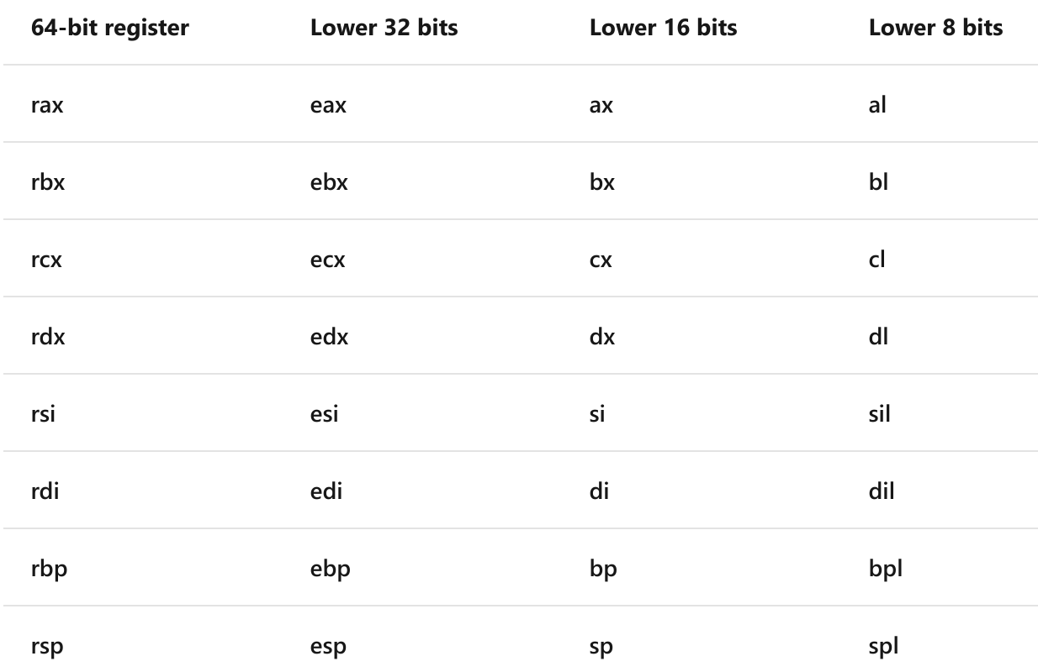
X86-64 Registers

Slide 18
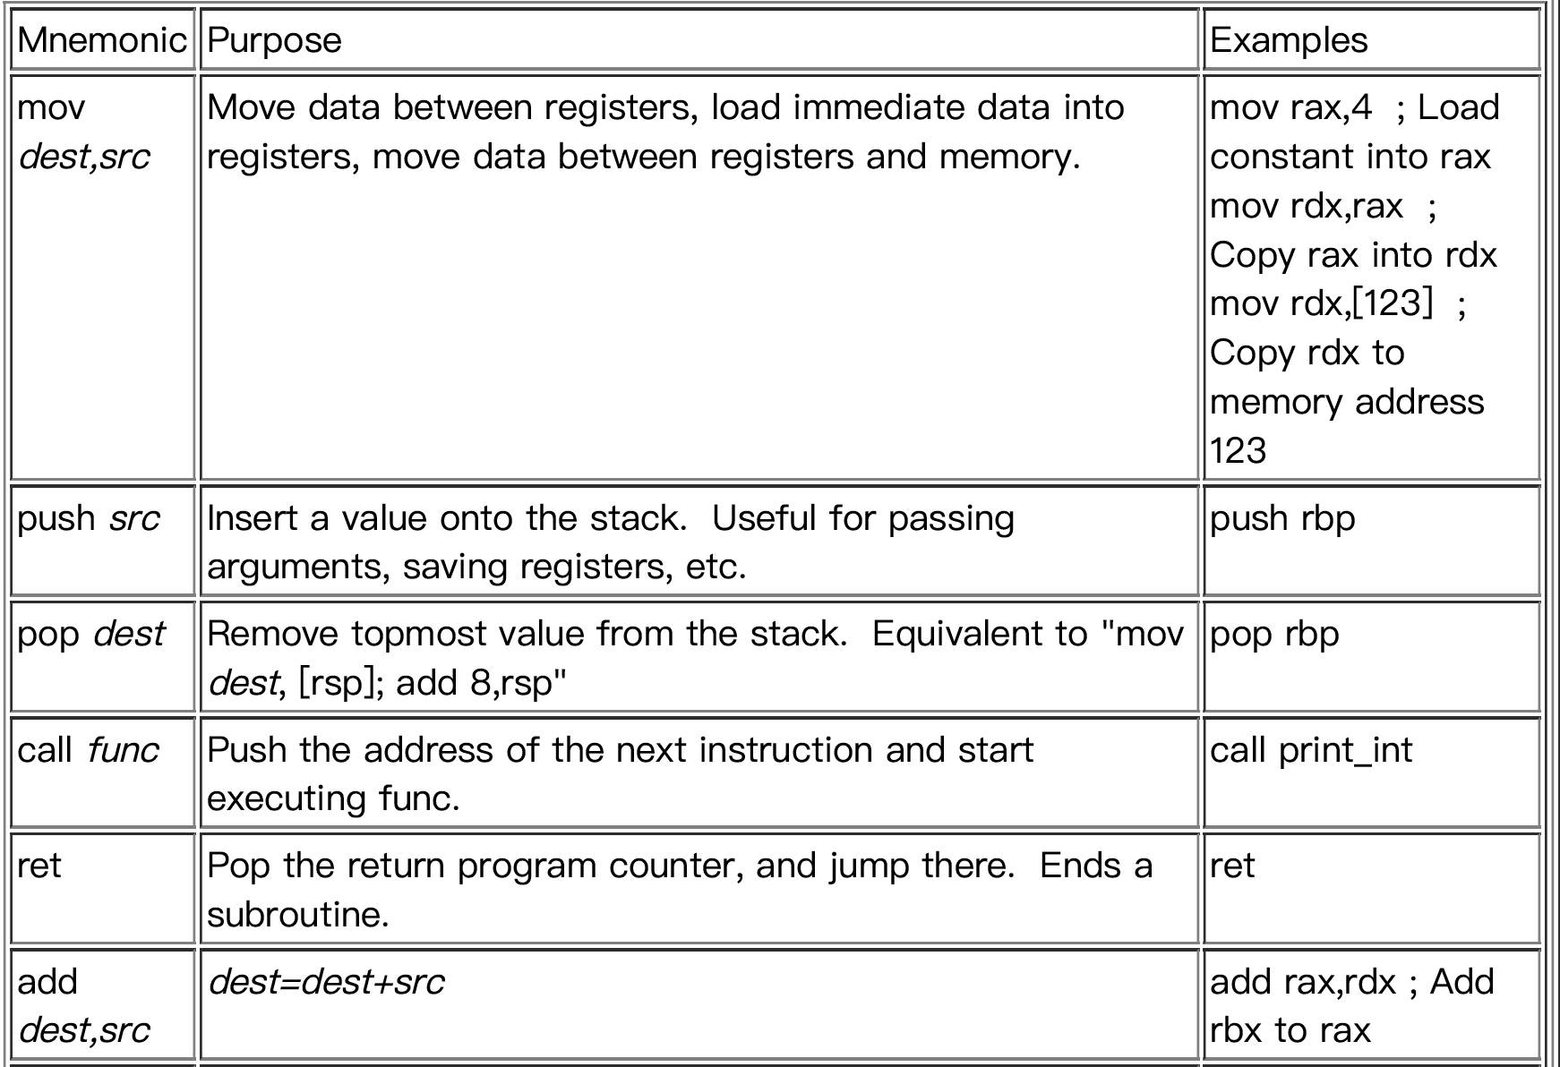
X86-64 Instructions

Slide 19
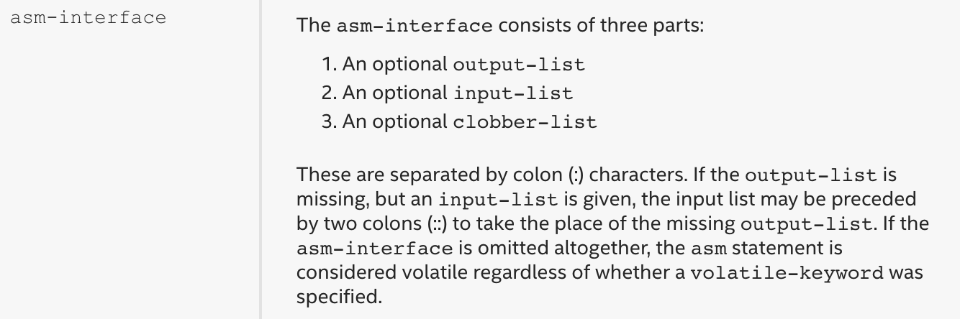
In-line Assembly Syntax
asm-keyword [ volatile-keyword ]
(
asm-template
[ asm-interface ]
) ;

Slide 20
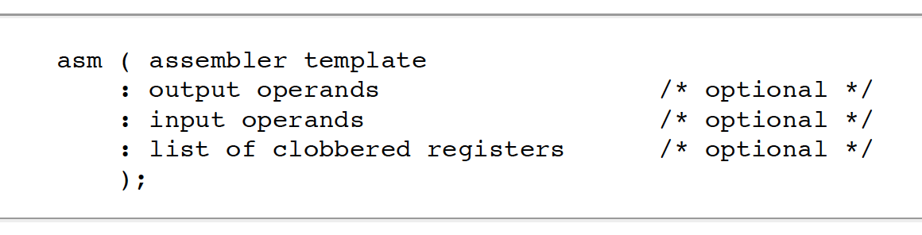
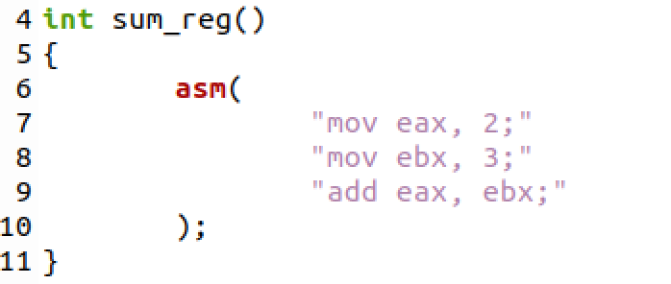
Example: sum
gcc -masm=intel ***.c
Demo
Notes:
gcc -masm=intel test.c

Slide 21
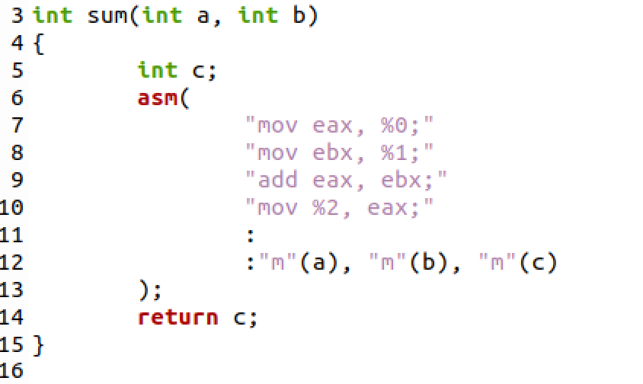
Example: use C variables
gcc -masm=intel ***.c
Demo
Notes:
gcc -masm=intel test.c

Slide 22
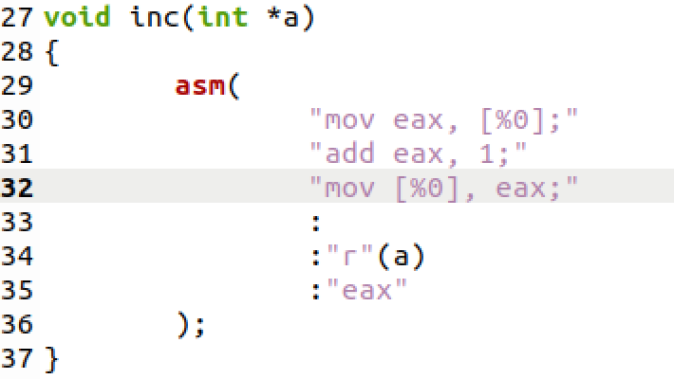
Example: register indirect addressing
gcc -masm=intel ***.c
Demo
mov eax *a
mov *a eax

Slide 23
Recall: Possible Solution?
flag = false; //no process in c.s.
//P0
while (flag == true); //do nothing
flag = true;
//critical section;
flag = false;
//remainder section;
//P1
while (flag == true); //do nothing
flag = true;
//critical section;
flag = false;
//remainder section;
What’s the problem?
Notes:
Mutual exclusion violated

Slide 24
Recall: Require Atomic Instruction
test_and_set
boolean lock = false;
boolean test_and_set(boolean *lock)
{
boolean curr_lock = *lock;
*lock = true; //set
return curr_lock; //test
}

Slide 25
Atomic test_and_set
lock cmpxchg m64, r64
Compare RAX with m64
If equal, r64 is loaded into m64.
Else, load m64 into RAX
Atomic!!!

Slide 26
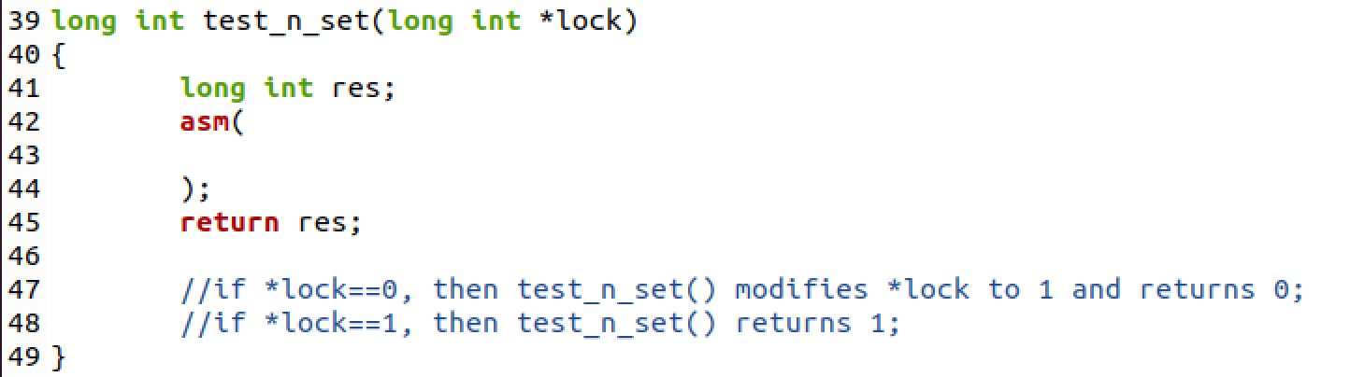
Task 1
Use lock cmpxchg m64, r64
To implement a function
long int test_n_set(long int *lock)
To be implemented!

Slide 27
Task 2
Use the previous test_n_set() to implement your own mutex lock and test it on the producer-consumer example
long int lock = 0; //0 means unlocked
The lock function:
void my_lock(long int *lock);
The unlock function:
void my_unlock(long int* lock);

Slide 28
The End

