Slide 1
Operating System Principle
Lab 1
March 10, 2021

Slide 2
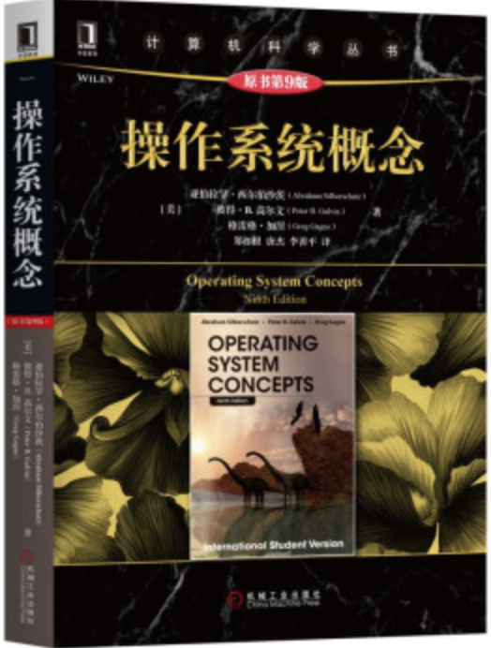

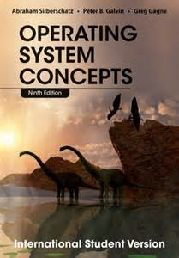
Textbooks
Operating System Concepts, 9th Edition. Abraham Silberschatz, Peter Baer Galvin, Greg Gagne, John Willey & Sons Inc. 2014

Slide 3
Evaluation
Labs: 20%
  Lab reports: 90%
    8 labs
  Class attendance: 5%
  Class performance: 5%

Slide 4

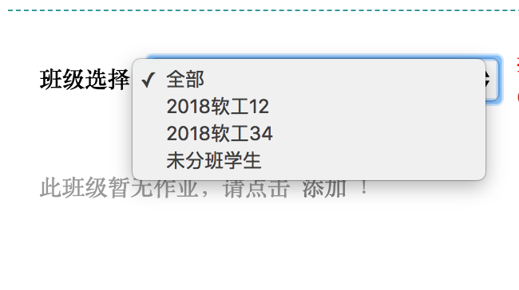
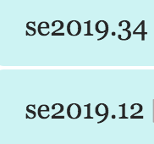
Lab Reports
https://www.scholat.com/course/os2021
班级：
申请加入时请提供完整学号和姓名！

Slide 5
Instruction Book
In progress
  Keep on updating

Slide 6
Outline
Installation of Linux
Basic operations in Linux
C programming in Linux

Slide 7
Installing Linux in Virtual Machine
Virtual machine management: VirtualBox
  https://www.virtualbox.org/wiki/Downloads
Ubuntu image file
  https://www.ubuntu.com/download/desktop
  18.04 vs 20.04? (April 2020)
Demo

Slide 8
Task 1

Slide 9
Basic Operations in Linux

Slide 10
List Files and Directory
List
  ls
  ls -l ls -al
  ls -lh
  ls /usr/bin

Slide 11
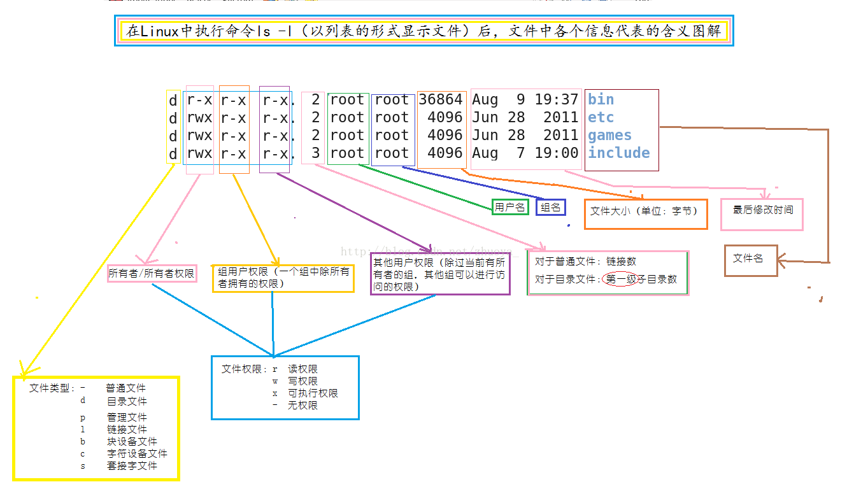
ls -l

Slide 12
File Operation
Concatenate
  cat filename
more
less

Slide 13
File Operation
Copy and move
  cp file1 file2
  mv file1 file2

Slide 14
File Operation
Remove
  rm filename

Slide 15
Directory Operation
Change directory
  cd /usr/bin
  pwd
  cd
  cd .
  cd ..
  echo $HOME

Slide 16
Directory Operation
Create and remove
  mkdir directoryName
  rmdir directoryName
  rm -r direcotryName

Slide 17
Directory Operation
Copy and move
  cp dir1/* dir2
  cp -r dir1/* dir2 (recursively)
  cp -r dir1 dir2 (recursively)
  mv dir1 dir2
  mv dir1/* dir2

Slide 18
User and System Management
Switch user
  su username
  sudo （super user do）

Slide 19
User and System Management
Change password
  passwd

Slide 20
User and System Management
Shutdown and reboot
  shutdown -h now
  shutdown -r now

Slide 21
help
manual
  man ls
  man read

Slide 22
Tips
Clear screen: clear
Termination: ctrl + c
Command history: up and down arrows
Command completion: tab
Notes:
Ctrl+a
Ctrl+e

Slide 23
Task 2

Slide 24
Text Editor
Vi
  vi filename
  i, a： input, append
  x: delete
  o: insert line
  dd: delete line
  Esc: command
  :
    q
    w
    wq
    q!
vi
Command
i, a, o
:
Enter/
return
Esc
Input
Line
q, q! or wq
Three modes of Vi

Slide 25
Text Editor
Gedit
  GUI
  gedit filename

Slide 26
Task 3

Slide 27
C Compiler: GCC
sudo apt-get install gcc
gcc
  -c: output .o （object file）
  -o: name output （executable file）

Slide 28
Multiple Source Files
E.g.
  mysum

Slide 29
Task 4

Slide 30



Requirement for Lab Report
Plagiarism!!!
Just code and screen snapshot!!!
Non-compressed pictures!!!

Slide 31
The End

Slide 32
Other Useful Commands
find

