Slide 1
Chapter 13: I/O Systems
June, 2018

Slide 2
Chapter 13: I/O Systems
Overview
I/O Hardware
Application I/O Interface
Kernel I/O Subsystem
Transforming I/O Requests to Hardware Operations
Performance

Slide 3
Objectives
Explore the structure of an operating system’s I/O subsystem
Discuss the principles of I/O hardware and its complexity
Provide details of the performance aspects of I/O hardware and software

Slide 4
Overview
I/O management is a major component of operating system design and operation
  Important aspect of computer operation
  Various methods to control them
  Performance management
  I/O devices vary greatly
  New types of devices
Device driver

Slide 5
I/O Hardware
Incredible variety of I/O devices
  Storage
  Transmission
  Human-interface
Notes:
Incredible：简直不可思议；daisy chain：菊花链

Slide 6
I/O Hardware
Common concepts – signals from I/O devices interface with computer
  Bus
    PCI bus common in PCs and servers, PCI Express (PCIe)
    expansion bus connects relatively slow devices
  Controller– electronics that operate port, bus, device
    Sometimes integrated
    Contains processor, microcode, private memory, bus controller, etc
  Port – connection point for device

Slide 7
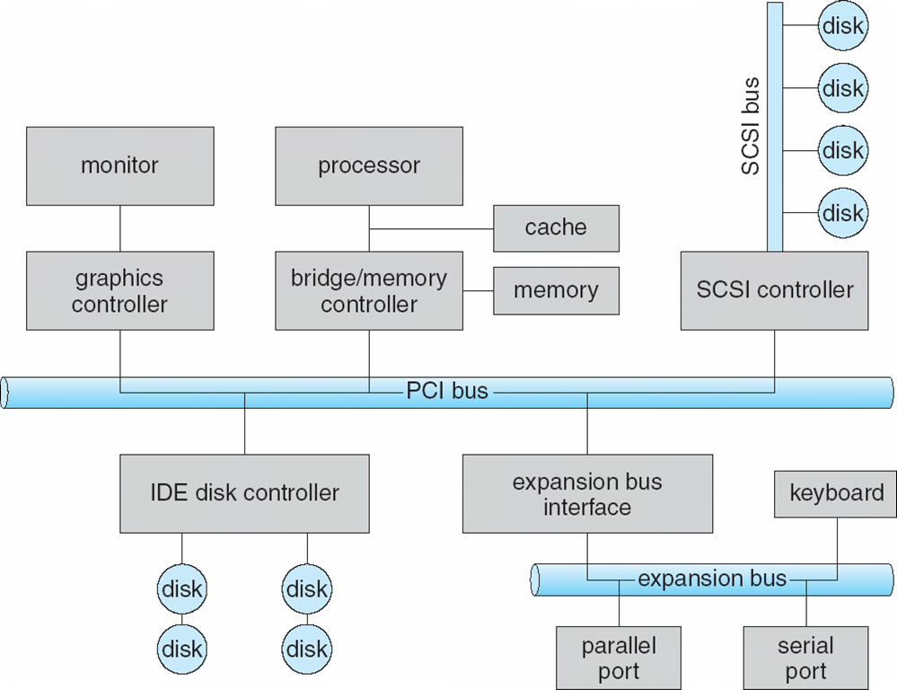
A Typical PC Bus Structure

Slide 8
I/O Hardware (Cont.)
Devices usually have registers where device driver places commands, addresses, and data to write, or read data from registers after command execution
  data-in register
  data-out register
  status register
  control register
  typically 1-4 bytes
Port

Slide 9
I/O Hardware (Cont.)
Devices have addresses, used by
  Direct I/O instructions
  Memory-mapped I/O
    Device memory mapped to processor address space
    Especially for large address spaces (graphics)

Slide 10
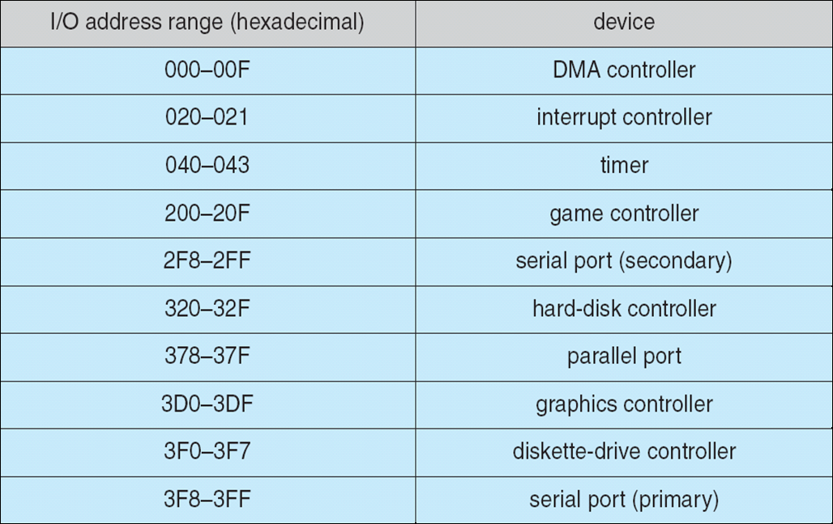
Device I/O Port Locations on PCs (partial)
Notes:
in/out 指令的用法？

Slide 11
Polling
For each byte of I/O
  Read busy bit from status register until 0
  Host sets read or write bit and if write copies data into data-out register
  Host sets command-ready bit
  Controller sets busy bit, executes transfer
  Controller clears busy bit, error bit, command-ready bit when transfer done
Step 1 is busy-wait cycle to wait for I/O from device
  Reasonable if device is fast
  But inefficient if device slow
Notes:
Intricate：错综复杂的；polling：轮询

Slide 12
Interrupts
CPU Interrupt-request line triggered by I/O device
  Checked by processor after each instruction
Interrupt handler receives interrupts
  Maskable to ignore or delay some interrupts
Interrupt vector to dispatch interrupt to correct handler
  Context switch at start and end
  Based on priority
  Some nonmaskable
Notes:
Trigger：触发

Slide 13
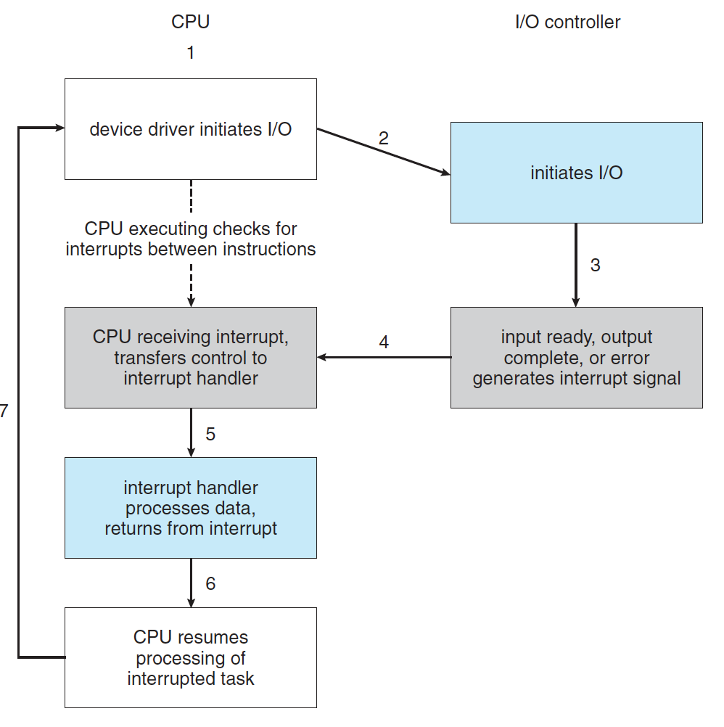
Interrupt-Driven I/O Cycle

Slide 14
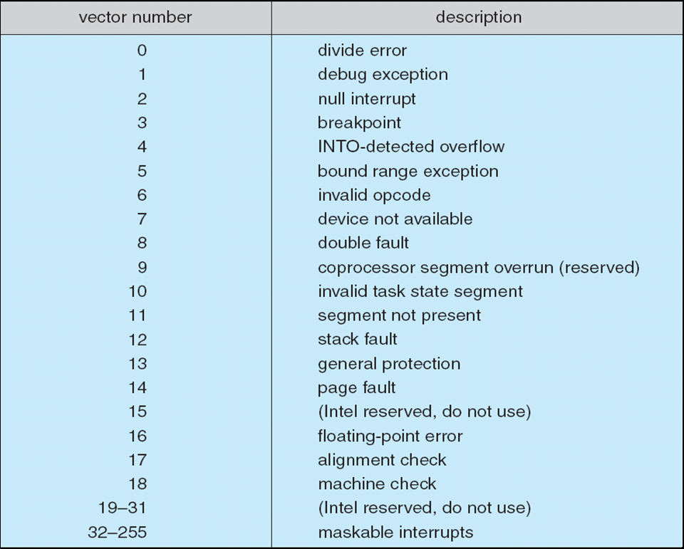
Intel Pentium Processor Event-Vector Table

Slide 15
Interrupts (Cont.)
Interrupt mechanism also used for exceptions
  Terminate process, crash system due to hardware error
Page fault executes when memory access error
System call executes via trap to trigger kernel to execute request
Used for time-sensitive processing, frequent, must be fast

Slide 16
Direct Memory Access
Used to avoid programmed I/O (one byte at a time) for large data movement
Requires DMA controller
Bypasses CPU to transfer data directly between I/O device and memory

Slide 17
Direct Memory Access
OS writes DMA command block into memory
  Source and destination addresses
  Read or write mode
  Count of bytes
  Writes location of command block to DMA controller
  Bus mastering of DMA controller – grabs bus from CPU
    Cycle stealing from CPU but still much more efficient
  When done, interrupts to signal completion
Physical address
Notes:
Grab：抢占

Slide 18
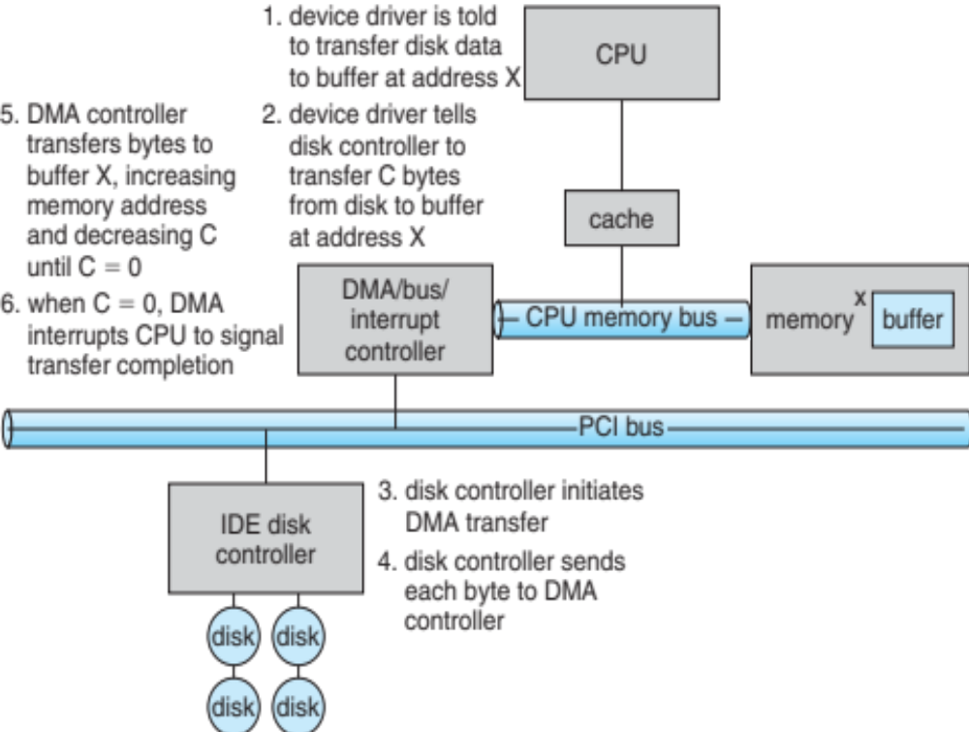
Six Step Process to Perform DMA Transfer

Slide 19
Application I/O Interface
I/O system calls encapsulate device behaviors in generic classes
Device-driver layer hides differences among I/O controllers from kernel
New devices talking already-implemented protocols need no extra work

Slide 20
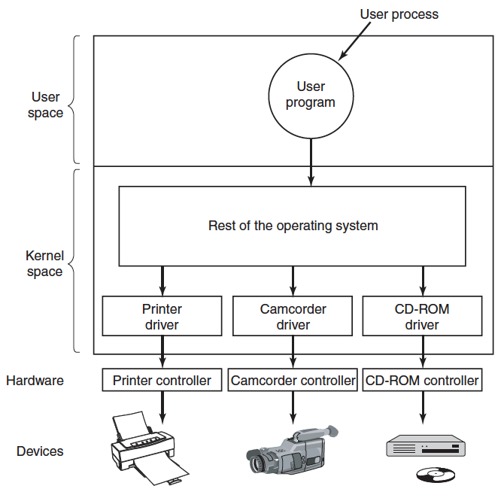
I/O Layers

Slide 21
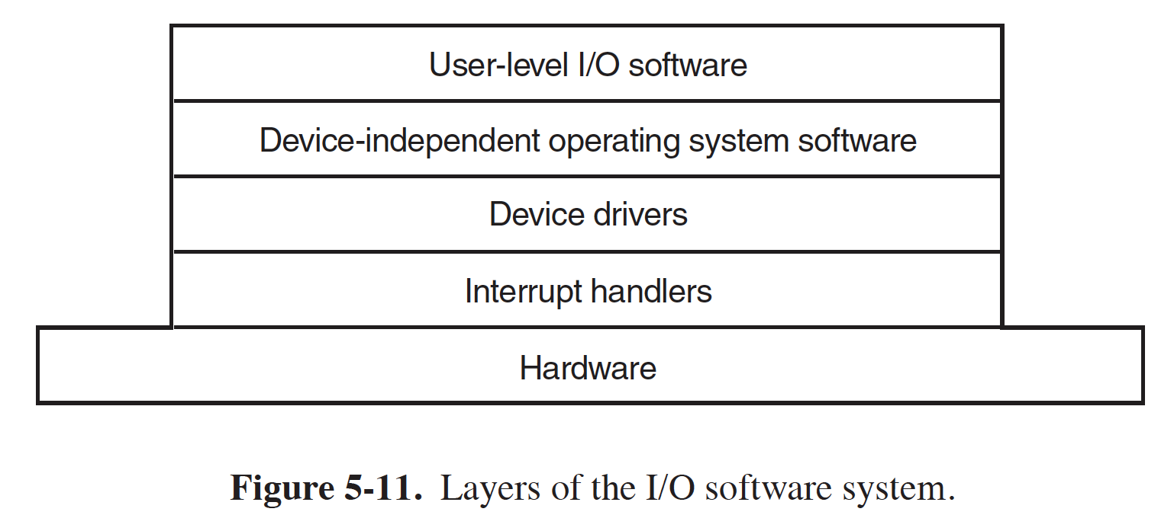
I/O Layers

Slide 22
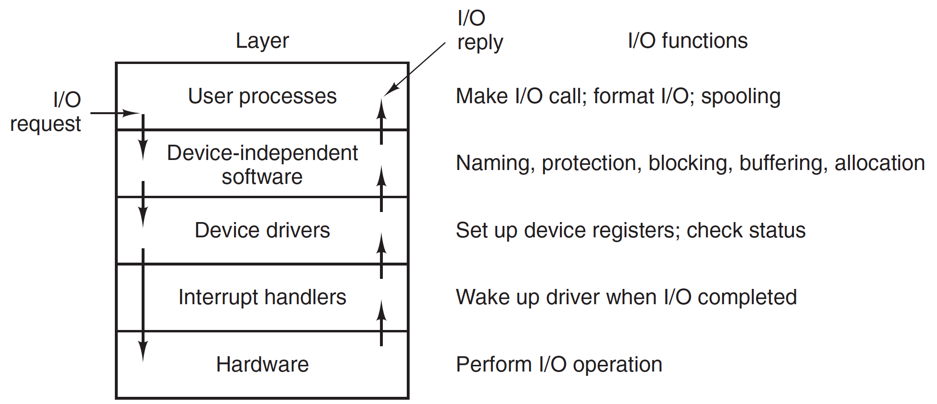
I/O Layers

Slide 23
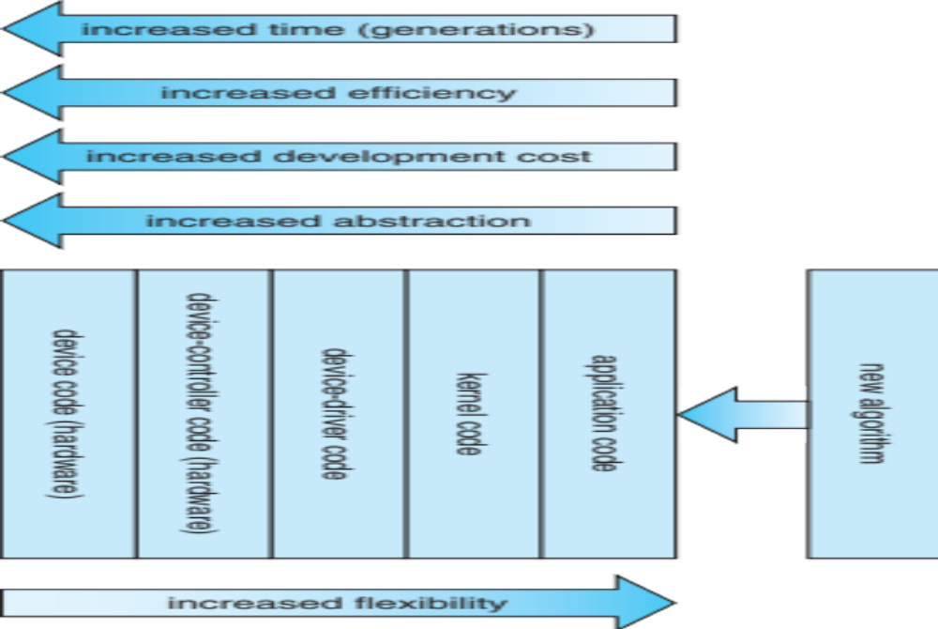
Device-Functionality Progression

Slide 24
Characteristics of I/O Devices
Devices vary in many dimensions
  Character-stream or block
  Sequential or random-access
  Synchronous or asynchronous (or both)
  Sharable or dedicated
  Speed of operation
  read-write, read only, or write only

Slide 25
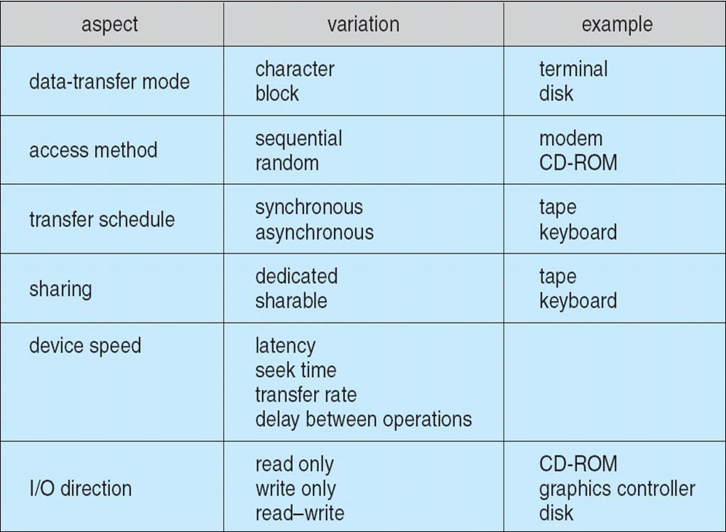
Characteristics of I/O Devices

Slide 26
Characteristics of I/O Devices (Cont.)
Subtleties of devices handled by device drivers
Broadly I/O devices can be grouped by the OS into
  Block I/O
  Character I/O (Stream)
  Network sockets

Slide 27
Block and Character Devices
Block devices include disk drives
  Raw I/O
  file-system access
  Memory-mapped file access possible
    File mapped to virtual memory and clusters brought via demand paging
Character devices include keyboards, mice, serial ports
  Character stream

Slide 28
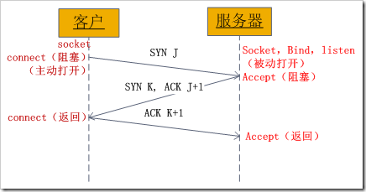
Network Devices
Varying enough from block and character to have own interface
Linux, Unix, Windows and many others include socket interface

Slide 29
Clocks and Timers
Provide current time, elapsed time, timer
Real time clock
Programmable interval timer used for timings, periodic interrupts
Some systems provide higher-resolution timers

Slide 30
Kernel I/O Subsystem
Devices as files
  open()
  release()/close()
  read()
  write()
  /dev

Slide 31
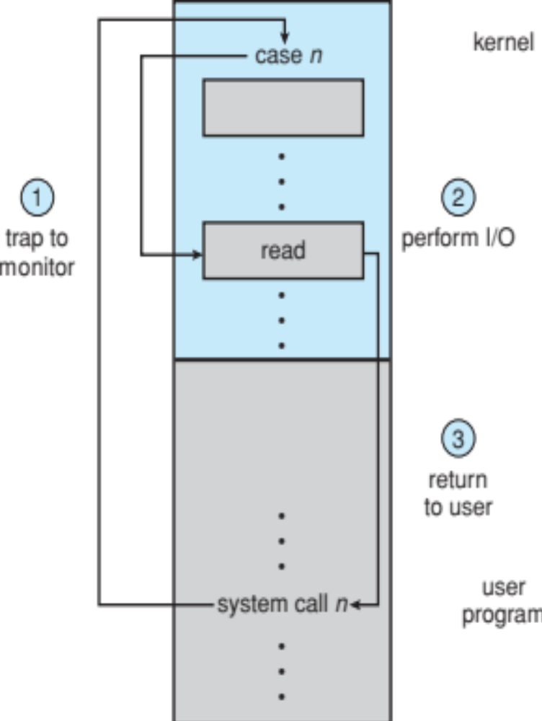
Use of a System Call to Perform I/O

Slide 32
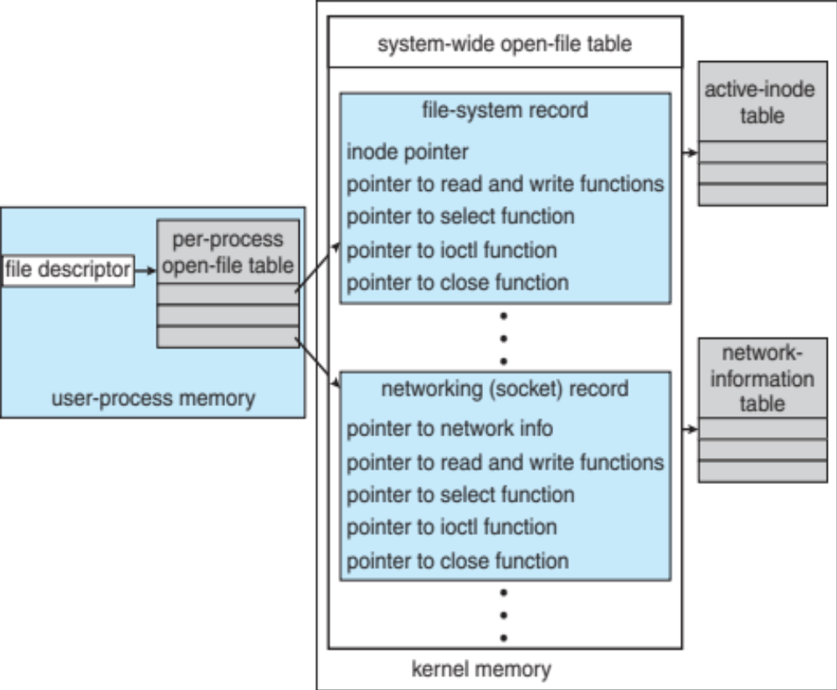
UNIX I/O Kernel Structure

Slide 33
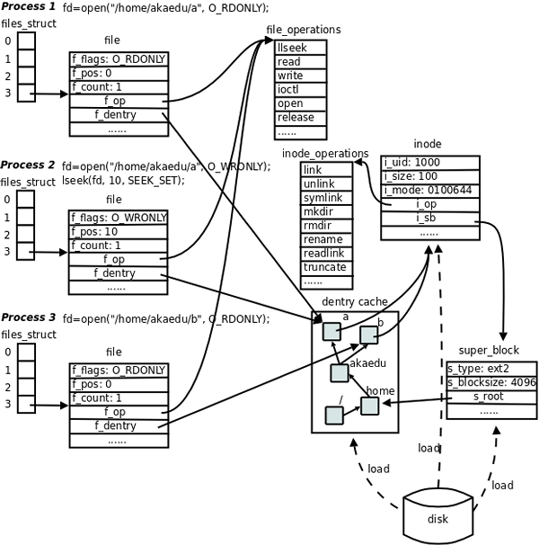

Slide 34
I/O Requests to Hardware Operations
Consider reading a file from disk for a process:
  Determine device holding file
  Translate name to device representation
  Physically read data from disk into buffer
  Make data available to requesting process
  Return control to process

Slide 35
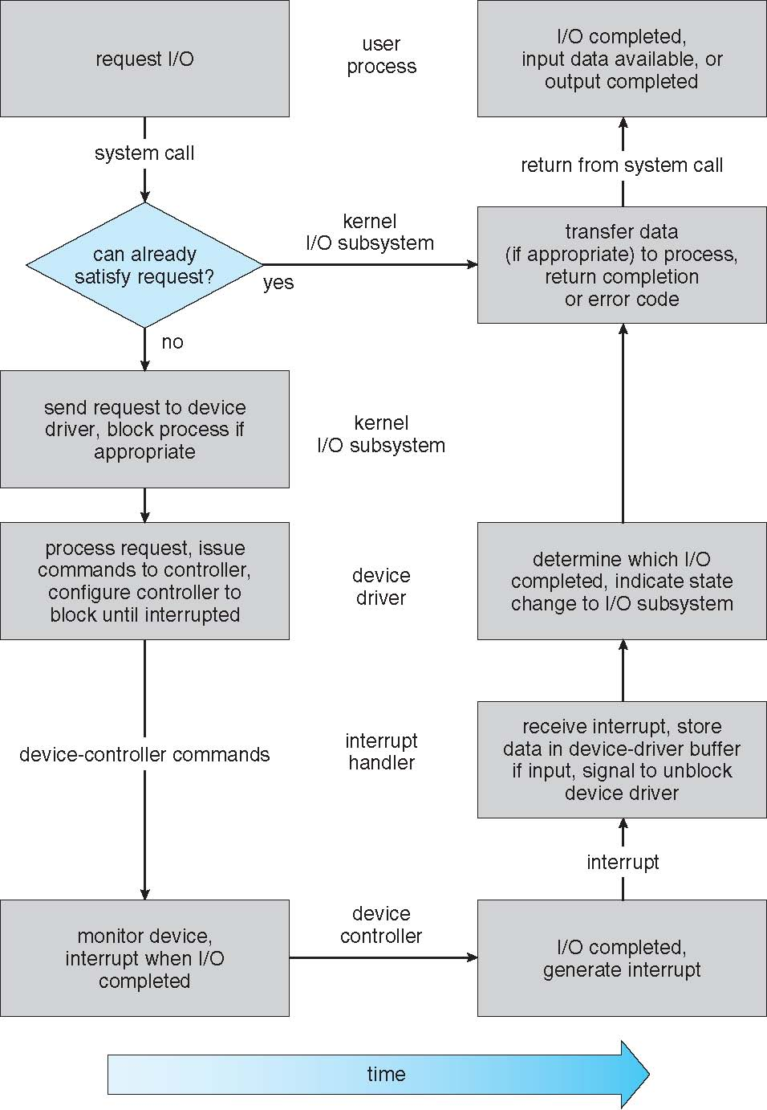
Life Cycle of An I/O Request

Slide 36
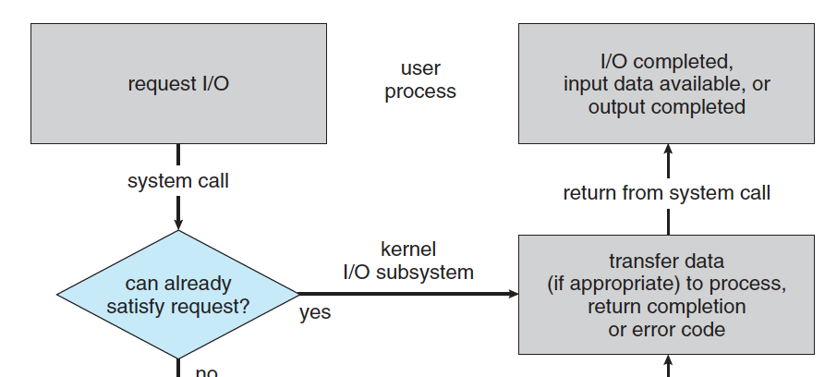

Slide 37
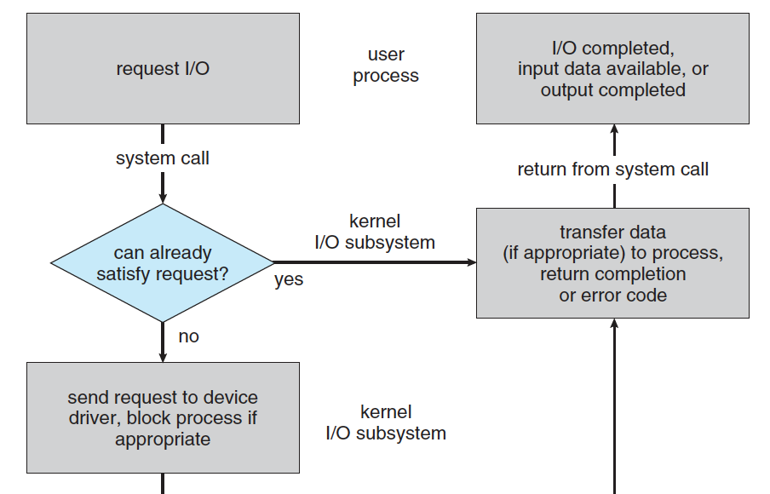

Slide 38
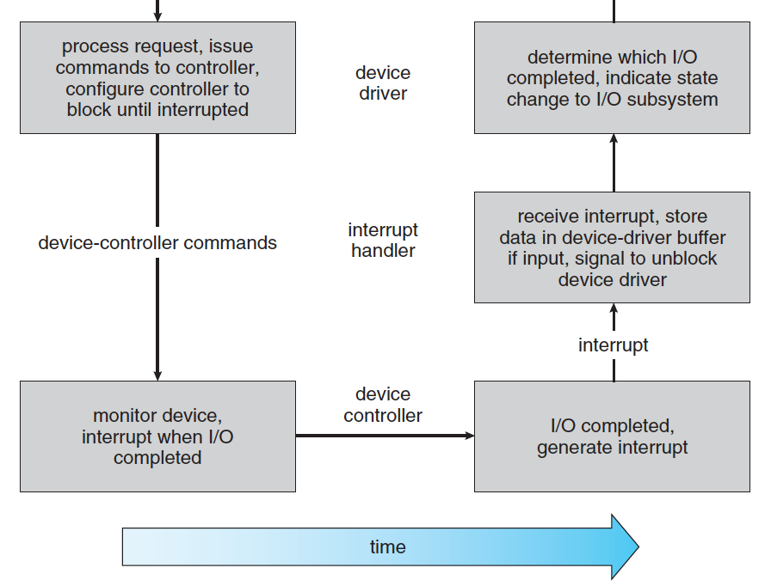

Slide 40
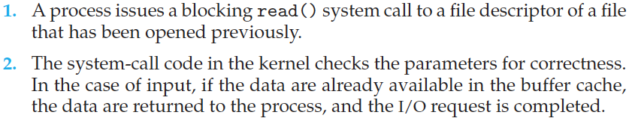
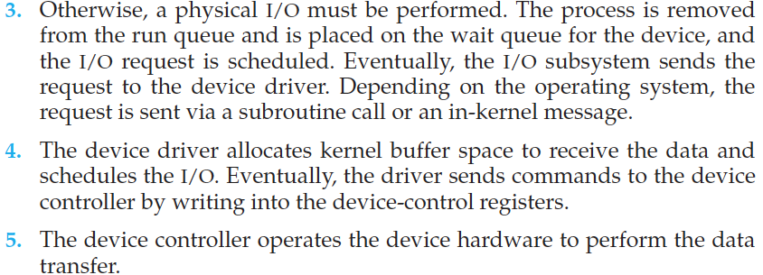

Slide 41
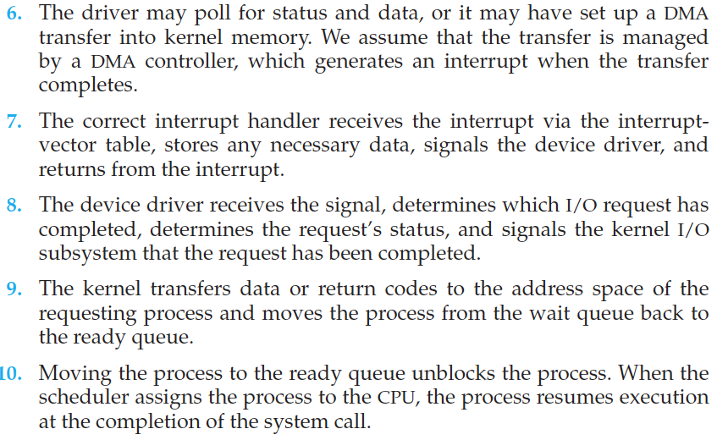

Slide 42
Performance
I/O a major factor in system performance:
  Demands CPU to execute device driver, kernel I/O code
  Context switches due to interrupts
  Data copying
  Network traffic especially stressful

Slide 43
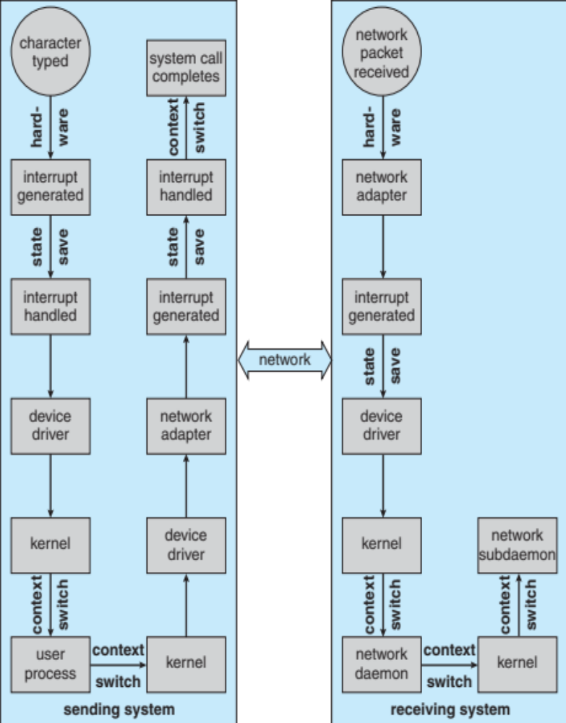
Intercomputer Communications

Slide 44
Improving Performance
Reduce number of context switches
Reduce data copying
Reduce interrupts by using large transfers, smart controllers, polling
Use DMA
Use smarter hardware devices
Balance CPU, memory, bus, and I/O performance for highest throughput
Move user-mode processes / daemons to kernel threads

Slide 45
Kernel I/O Subsystem
Scheduling
  Some I/O request ordering via per-device queue
  Some OSs try fairness
Disk scheduling

Slide 46
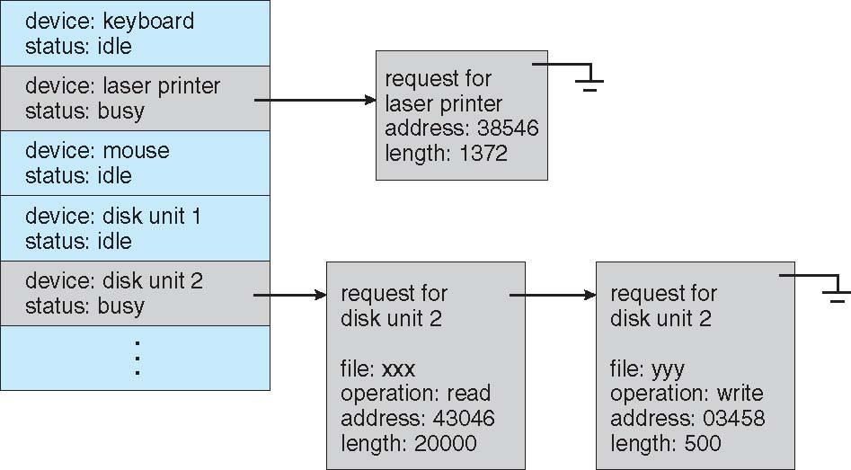
Device-status Table

Slide 47
Kernel I/O Subsystem
Buffering - store data in memory while transferring between devices
  To cope with device speed mismatch
  To cope with device transfer size mismatch

Slide 48
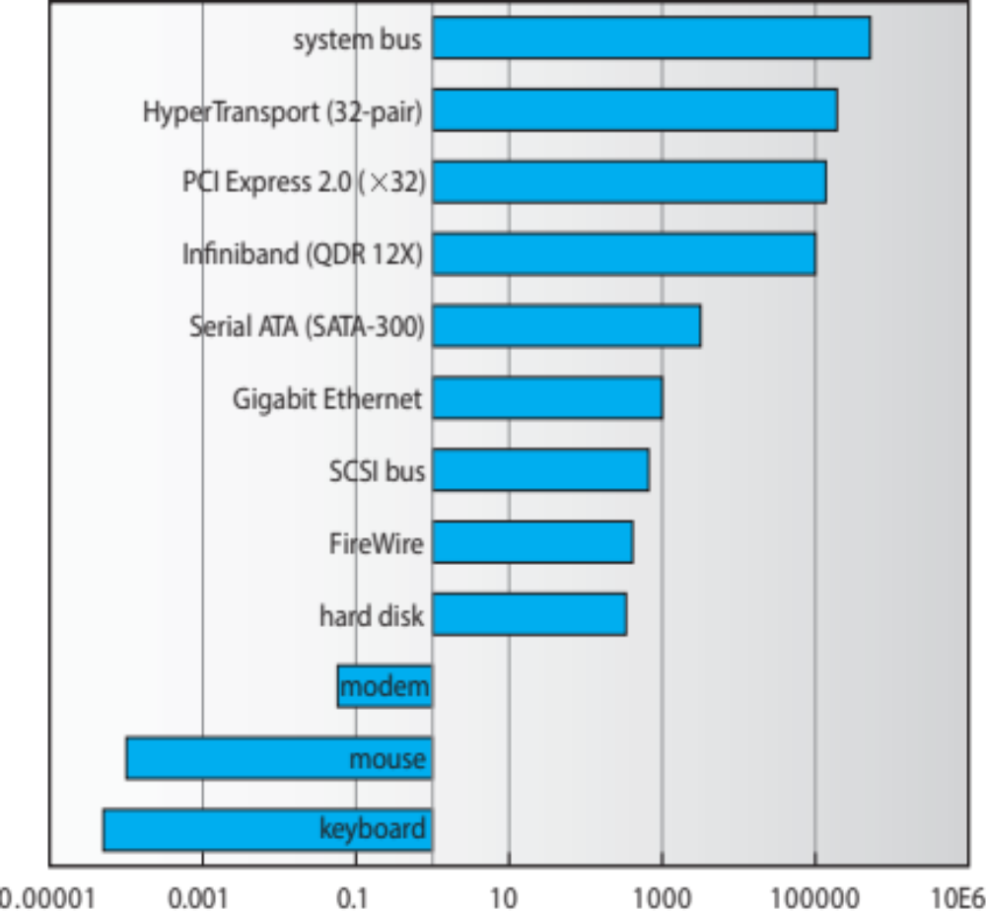
Sun Enterprise 6000 Device-Transfer Rates

Slide 49
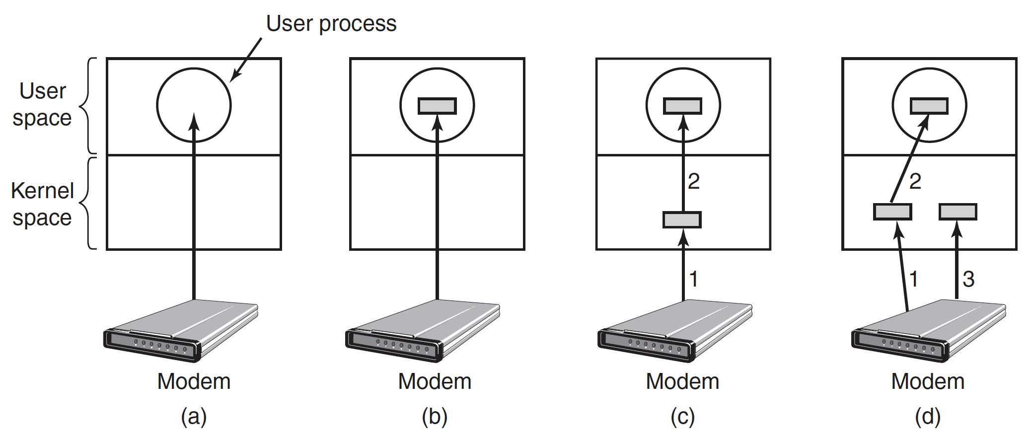
Double Buffering

Slide 50
Kernel I/O Subsystem
Caching - faster device holding copy of data
  Always just a copy
  Key to performance
  Sometimes combined with buffering
  Eg.: win7

Slide 51
Nonblocking and Asynchronous I/O
Blocking - process suspended until I/O completed
Nonblocking - I/O call returns as much as available
Synchronous: process waits
Asynchronous - process runs while I/O executes
read()
write()

Slide 52
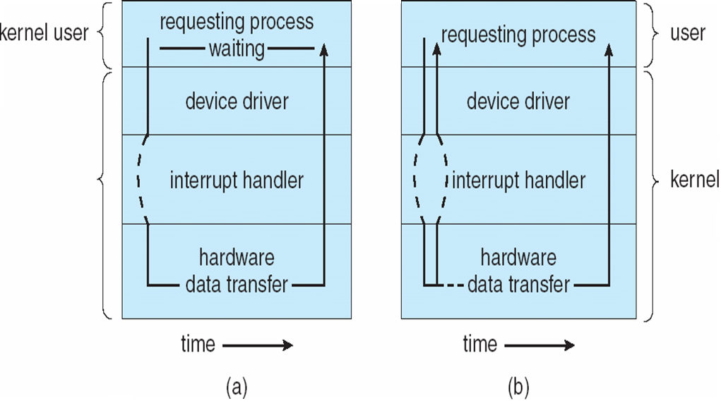
Two I/O Methods
Synchronous
Asynchronous

Slide 53
Kernel I/O Subsystem
Spooling - hold output for a device
  If device can serve only one request at a time
  i.e., Printing (give an example, win7)

Slide 54
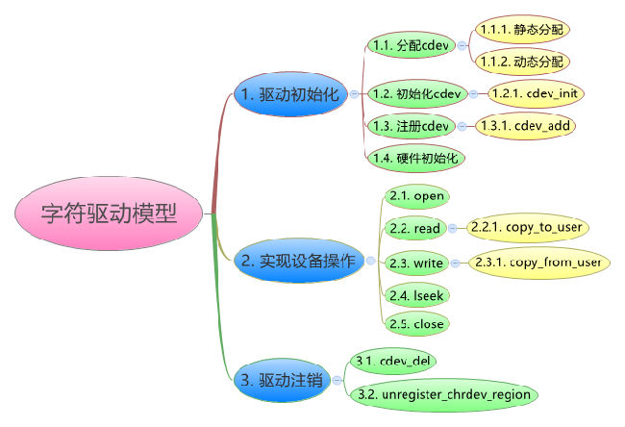
Drivers for linux character devices

Slide 55
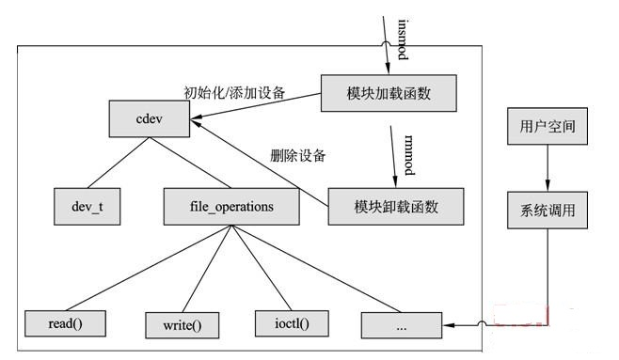
Drivers for linux character devices

Slide 56
End of Chapter 13

