Slide 1
Chapter 3: IPC
April , 2018

Slide 2
Linux Scheduling in Version 2.6.23 +
Scheduling classes
Each has specific priority
Scheduler picks highest priority task in highest scheduling class
Rather than quantum based on fixed time allotments, based on proportion of CPU time
2 scheduling classes included, others can be added
default
real-time

Slide 3
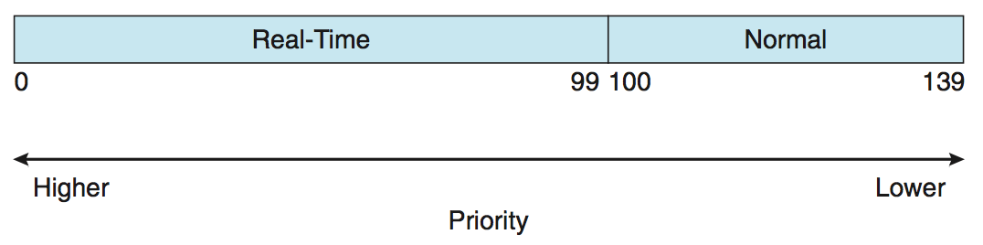
Linux Scheduling (Cont.)
Real-time scheduling according to POSIX.1b
Real-time tasks have static priorities
Real-time plus normal map into global priority scheme
Nice value of -20 maps to global priority 100
Nice value of +19 maps to priority 139

Slide 4
Completely Fair Scheduler (CFS) & Virtual run time
Quantum calculated based on nice value from -20 to +19
Lower value is higher priority
Calculates target latency – interval of time during which task should run at least once
Target latency can increase if say number of active tasks increases
CFS scheduler maintains per task virtual run time in variable vruntime
Associated with decay factor based on priority of task – lower priority is higher decay rate
Normal default priority yields virtual run time = actual run time
To decide next task to run, scheduler picks task with lowest virtual run time
Notes:
分配给进程的运行时间＝调度周期 * 进程权重 / 所有进程权重之和
vruntime = 实际运行时间 * 1024 / 进程权重
vruntime = (调度周期 * 进程权重 / 所有进程总权重) * 1024 / 进程权重=调度周期 * 1024 / 所有进程总权重

Slide 5
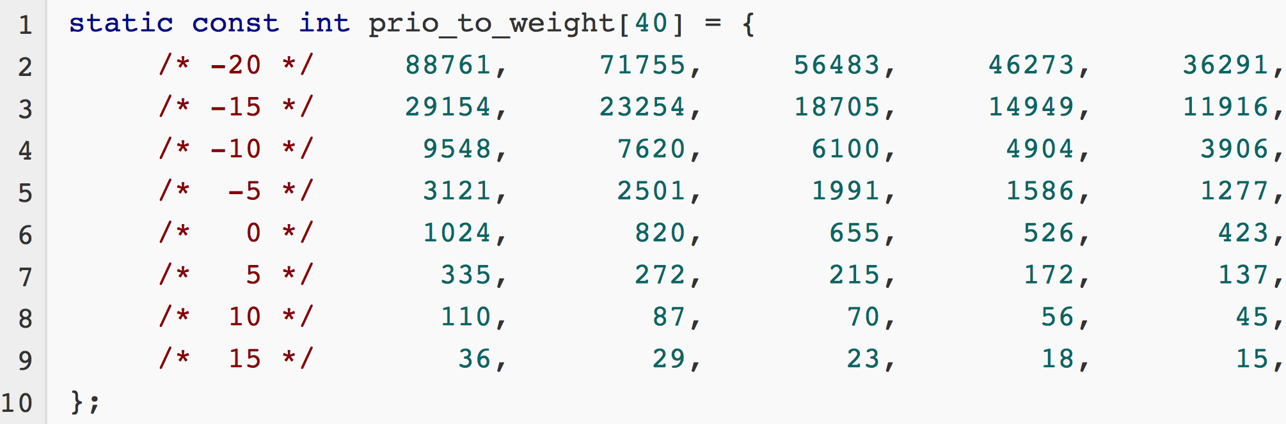
Priority to Weight
Notes:
vruntime = 实际运行时间 * NICE_0_LOAD / 进程权重
= 实际运行时间 * 1024 / 进程权重
NICE_0_LOAD = 1024, 表示nice值为0的进程权重

Slide 6
CFS Performance
Notes:
vruntime = 进程在一个调度周期内的实际运行时间 * 1024 / 进程权重
= (调度周期 * 进程权重 / 所有进程总权重) * 1024 / 进程权重
= 调度周期 * 1024 / 所有进程总权重

Slide 7
POSIX Real-Time Scheduling
The POSIX.1b standard
API provides functions for managing real-time threads
Defines two scheduling classes for real-time threads:
SCHED_FIFO - threads are scheduled using a FCFS strategy with a FIFO queue. There is no time-slicing for threads of equal priority
SCHED_RR - similar to SCHED_FIFO except time-slicing occurs for threads of equal priority
Defines two functions for getting and setting scheduling policy:
pthread_attr_getschedpolicy(pthread attr t *attr, int *policy)
pthread_attr_setschedpolicy(pthread attr t *attr, int policy)

Slide 8
POSIX Real-Time Scheduling API
#include <pthread.h>
#include <stdio.h>
#define NUM THREADS 5
int main(int argc, char *argv[]) give an example
{
int i, policy; pthread t tid[NUM THREADS];
pthread attr t attr;
/* get the default attributes */
pthread attr init(&attr);
/* get the current scheduling policy */ if (pthread attr getschedpolicy(&attr, &policy) != 0)
fprintf(stderr, "Unable to get policy.\n");
else {
if (policy == SCHED OTHER) printf("SCHED OTHER\n");
else if (policy == SCHED RR) printf("SCHED RR\n");
else if (policy == SCHED FIFO) printf("SCHED FIFO\n");
}

Slide 9
SCHED_DEADLINE
SCHED_DEADLINE scheduling class was added to the Linux scheduler in version 3.14 of the Linux kernel mainline, released on 30 March 2014

Slide 10
Commands and call
renice 19 pid
nice( ) 改变一个普通进程的静态优先级
getpriority( ) 获得一组普通进程的最大优先级
setpriority( ) 设置一组普通进程的静态优先级
sched_getscheduler( ) 获得一个进程的调度策略
sched_setscheduler( ) 设置一个进程的调度策略和实时优先级
sched_getparam( ) 获得一个进程的实时优先级
sched_setparam( ) 设置一个进程的实时优先级
sched_yield( ) 自愿放弃处理器而不阻塞
sched_get_ priority_min( ) 获得一种策略的最小实时优先级
sched_get_ priority_max( ) 获得一种策略的最大实时优先级
sched_rr_get_interval( ) 获得时间片轮转策略的时间片值

Slide 11
Interprocess Communication
Pipe
Message queue (passing)
Shared memory
Socket
Remote system call
Semaphore
Monitor

Slide 12
Interprocess Communication
Cooperating processes need interprocess communication (IPC)
Two models of IPC
Shared memory
Message passing

Slide 13
Communications Models
(a) Message passing. (b) shared memory.

Slide 14
Pipes
Acts as a conduit allowing two processes to communicate
Issues:
Is communication unidirectional or bidirectional?
In the case of two-way communication, is it half or full-duplex?
Must there exist a relationship (i.e., parent-child) between the communicating processes?
Ordinary pipes – cannot be accessed from outside the process that created it. Typically, a parent process creates a pipe and uses it to communicate with a child process that it created.
Named pipes – can be accessed without a parent-child relationship.

Slide 15
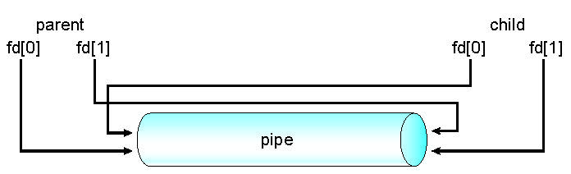
Ordinary Pipes
Ordinary Pipes allow communication in standard producer-consumer style
Producer writes to one end (the write-end of the pipe)
Consumer reads from the other end (the read-end of the pipe)
Ordinary pipes are therefore unidirectional
Require parent-child relationship between communicating processes
Windows calls these anonymous pipes
See Unix and Windows code samples in textbook
Given an example
read
write
Notes:
ulimit –a: 查看buf size

Slide 16
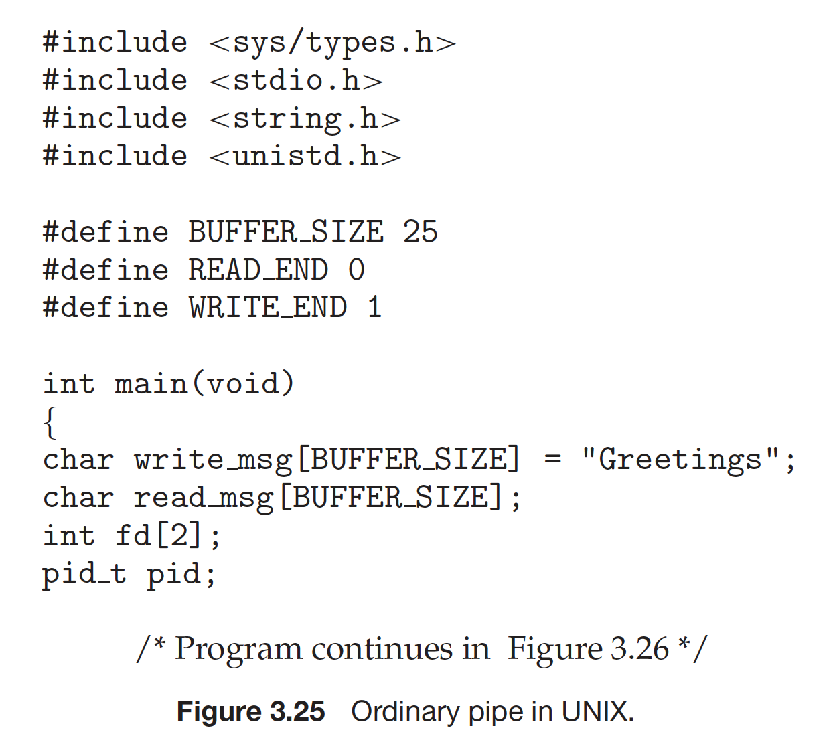
Ordinary pipe in Linux

Slide 17
limit
Half duplex
Limited size
Parent-child
Notes:
ulimit –a (fifo)

Slide 18
Named Pipes
Named Pipes are more powerful than ordinary pipes
No parent-child relationship is necessary between the communicating processes
Several processes can use the named pipe for communication
Provided on both UNIX and Windows systems
Give an example

Slide 19
Application of Pipes
ls ｜ more

Slide 20
Interprocess Communication – Message Passing
Message system – processes communicate with each other without resorting to shared address space
IPC facility provides two operations:
send(message)
receive(message)

Slide 21
Message Passing (Cont.)
If processes P and Q wish to communicate, they need to:
Establish a communication link between them
Exchange messages via send/receive
Implementation issues:
How are links established?
Can a link be associated with more than two processes?
How many links can there be between every pair of communicating processes?
What is the capacity of a link?
Is the size of a message that the link can accommodate fixed or variable?
Is a link unidirectional or bi-directional?

Slide 22
Message Passing (Cont.)
Implementation of communication link
Physical:
Shared memory
Hardware bus
Network
Logical:
Direct or indirect
Synchronous or asynchronous

Slide 23
Direct Communication
Processes must name each other explicitly:
send (P, message) – send a message to process P
receive(Q, message) – receive a message from process Q
Properties of communication link
Links are established automatically
A link is associated with exactly one pair of communicating processes
Between each pair there exists exactly one link
The link may be unidirectional, but is usually bi-directional

Slide 24
Indirect Communication
Messages are directed and received from mailboxes (also referred to as ports)
Each mailbox has a unique id
Processes can communicate only if they share a mailbox
Properties of communication link
Link established only if processes share a common mailbox
A link may be associated with many processes
Each pair of processes may share several communication links
Link may be unidirectional or bi-directional

Slide 25
Indirect Communication
Operations
create a new mailbox
send and receive messages through mailbox
destroy a mailbox
Primitives are defined as:
send(A, message) – send a message to mailbox A
receive(A, message) – receive a message from mailbox A

Slide 26
Indirect Communication
Mailbox sharing
P₁, P₂, and P₃ share mailbox A
P₁, sends; P₂ and P₃ receive
Who gets the message?
Solutions
Allow a link to be associated with at most two processes
Allow only one process at a time to execute a receive operation
Allow the system to select arbitrarily the receiver. Sender is notified who the receiver was.

Slide 27
Synchronization
Message passing may be either blocking or non-blocking
Blocking is considered synchronous
Blocking send -- the sender is blocked until the message is received
Blocking receive -- the receiver is blocked until a message is available
Non-blocking is considered asynchronous
Non-blocking send -- the sender sends the message and continue
Non-blocking receive -- the receiver receives:
A valid message, or
Null message
Different combinations possible
If both send and receive are blocking, we have a rendezvous（交汇点，This is a deadlock.）

Slide 28
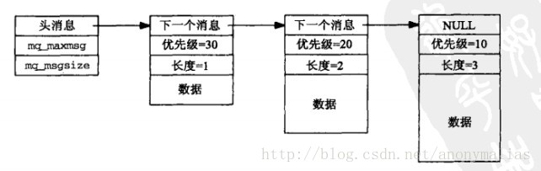
Posix message queue
Given an example

Slide 29
Interprocess Communication – Shared Memory
An area of memory shared among the processes that wish to communicate
The communication is under the control of the users processes not the operating system.
Major issues is to provide mechanism that will allow the user processes to synchronize their actions when they access shared memory.

Slide 30
Shared memory: Producer-Consumer Problem
Paradigm for cooperating processes, producer process produces information that is consumed by a consumer process
unbounded-buffer places no practical limit on the size of the buffer
bounded-buffer assumes that there is a fixed buffer size

Slide 31
Bounded-Buffer – Shared-Memory Solution
Shared data
#define BUFFER_SIZE 10
typedef struct {
. . .
} item;
item buffer[BUFFER_SIZE];
int in = 0;
int out = 0;
Solution is correct, but can only use BUFFER_SIZE-1 elements

Slide 32
Bounded-Buffer – Producer
item next_produced;
while (true) {
/* produce an item in next produced */
while (((in + 1) % BUFFER_SIZE) == out)
; /* do nothing */
buffer[in] = next_produced;
in = (in + 1) % BUFFER_SIZE;
}

Slide 33
Bounded Buffer – Consumer
item next_consumed;
while (true) { while (in == out)
; /* do nothing */ next_consumed = buffer[out];
out = (out + 1) % BUFFER_SIZE;
/* consume the item in next consumed */
}

Slide 34
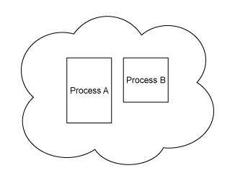
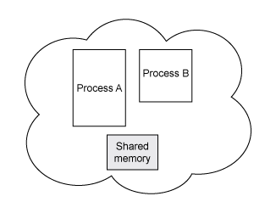
Linux： shared memory

Slide 35
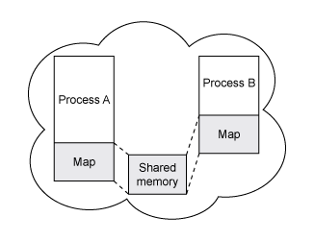
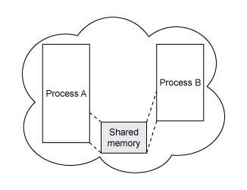
Linux： shared memory

Slide 36
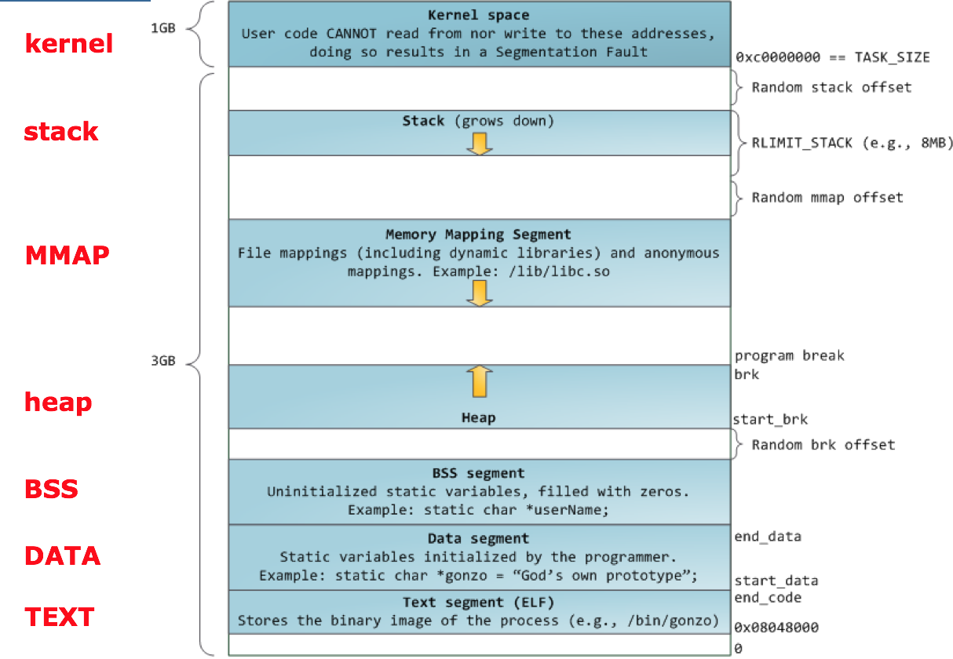
Linux： shared memory
Notes:
pmap pid

Slide 37
shm_open
/dev/shm
file system: tmpfs
cat /proc/pid/maps
Notes:
cat /proc/pid/maps

Slide 38
Examples of IPC Systems - POSIX
POSIX Shared Memory
Process first creates shared memory segment shm_fd = shm_open(name, O CREAT | O RDWR, 0666);
Also used to open an existing segment to share it
Set the size of the object
ftruncate(shm_fd, 4096);
Now the process could write to the shared memory
sprintf(shared memory, "Writing to shared memory");

Slide 39
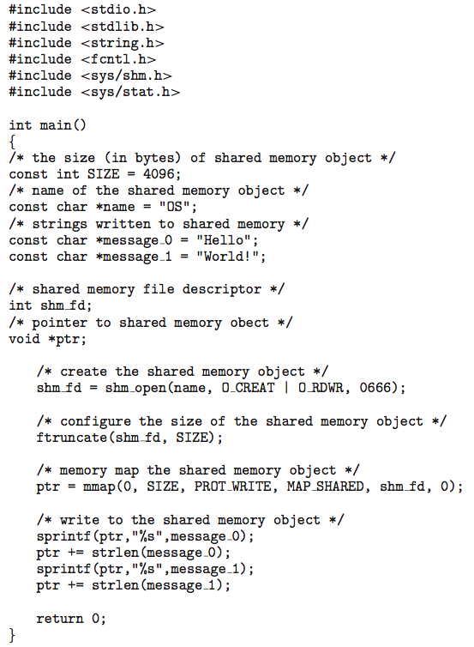
IPC POSIX Producer

Slide 40
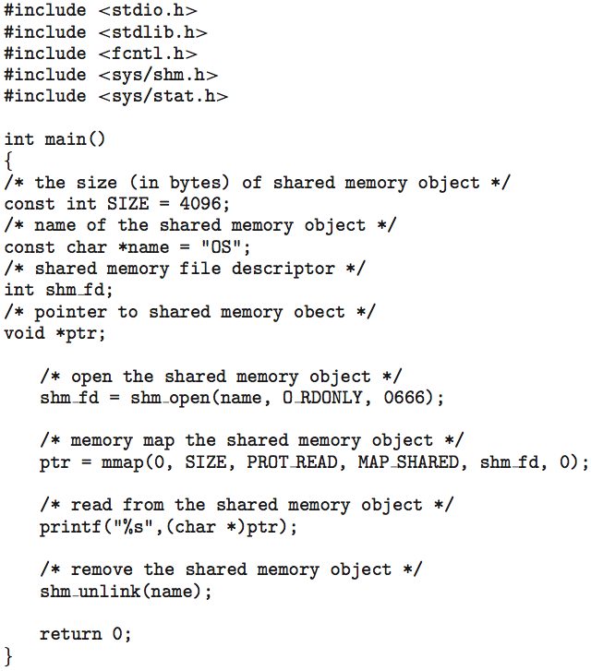
IPC POSIX Consumer

Slide 41
Communications in Client-Server Systems
Sockets
Remote Procedure Calls

Slide 42
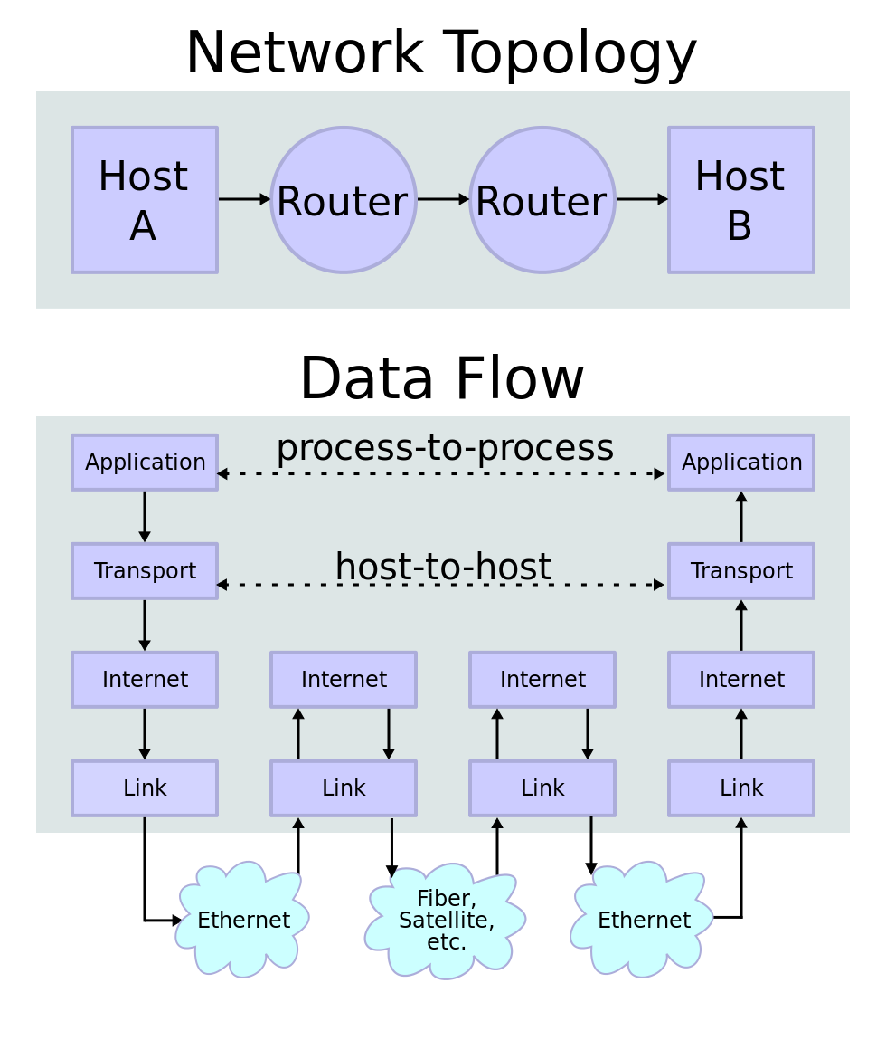
TCP/IP

Slide 43
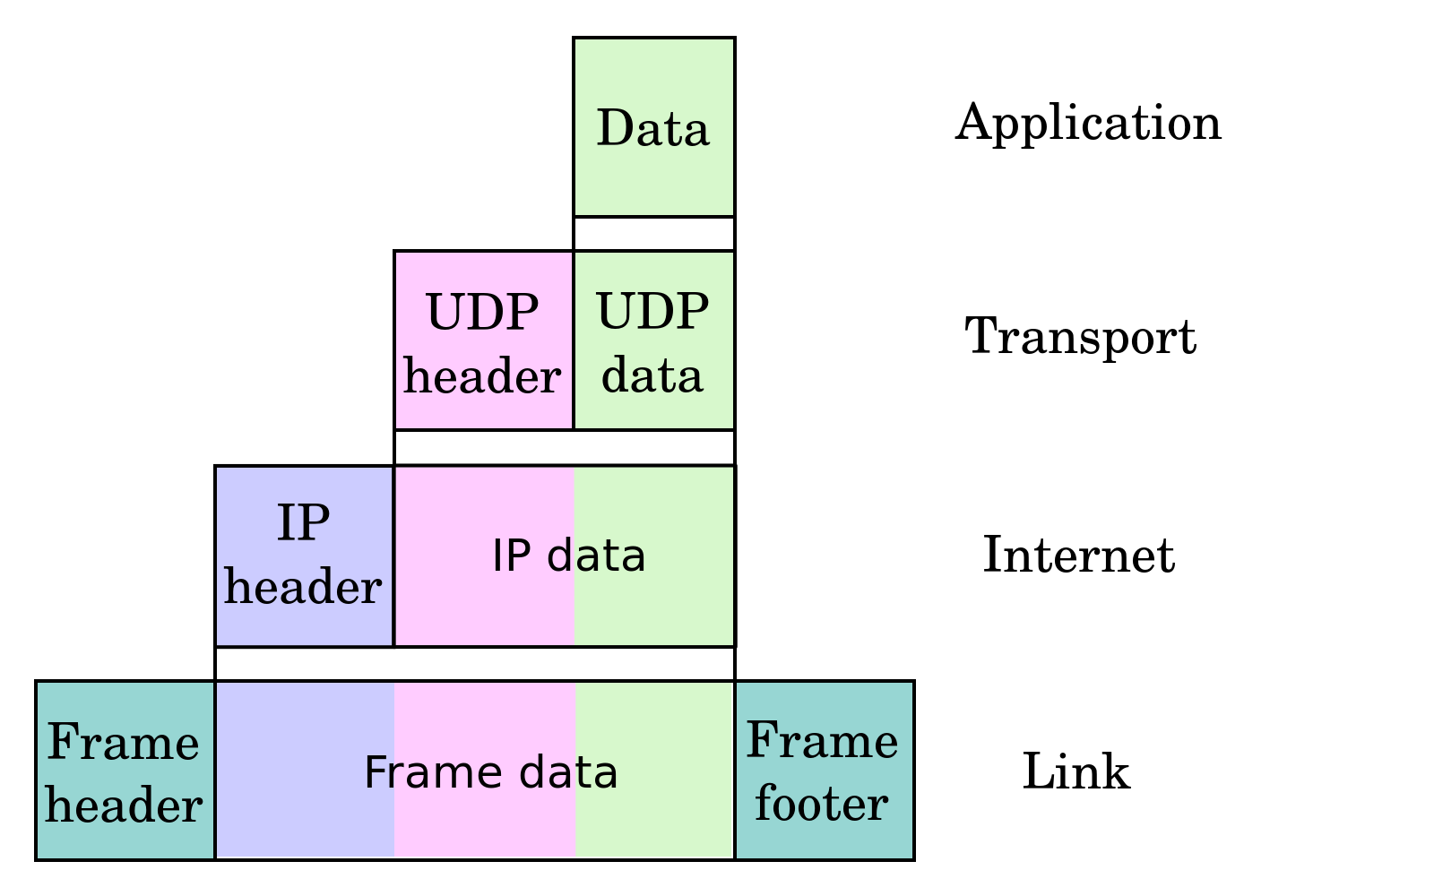
TCP/IP

Slide 44
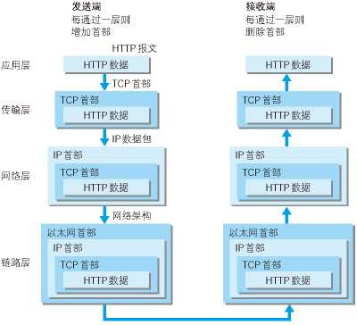
TCP/IP

Slide 45
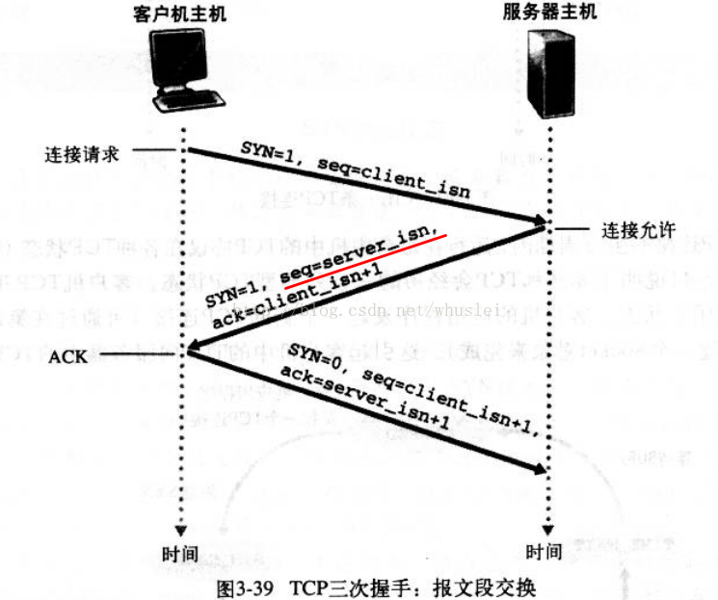
TCP connection

Slide 46
Sockets
A socket is defined as an endpoint for communication
Concatenation（级联） of IP address and port – a number included at start of message packet to differentiate network services on a host
The socket 161.25.19.8:1625 refers to port 1625 on host 161.25.19.8
Communication consists between a pair of sockets
All ports below 1024 are well known, used for standard services
Special IP address 127.0.0.1 (loopback) to refer to system on which process is running

Slide 47
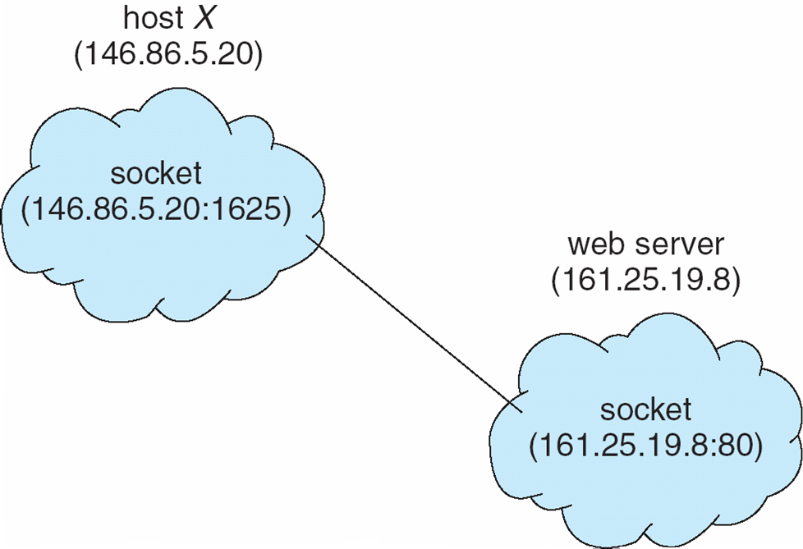
Socket Communication

Slide 48
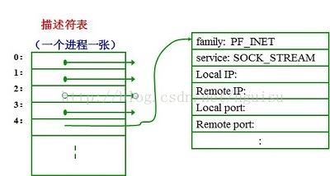
Socket API
socket()
bind()
listen()
connect()
accept()
read()
write()

Slide 49
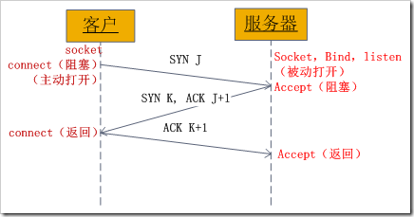
TCP connection
Notes:
hostname -i

Slide 50
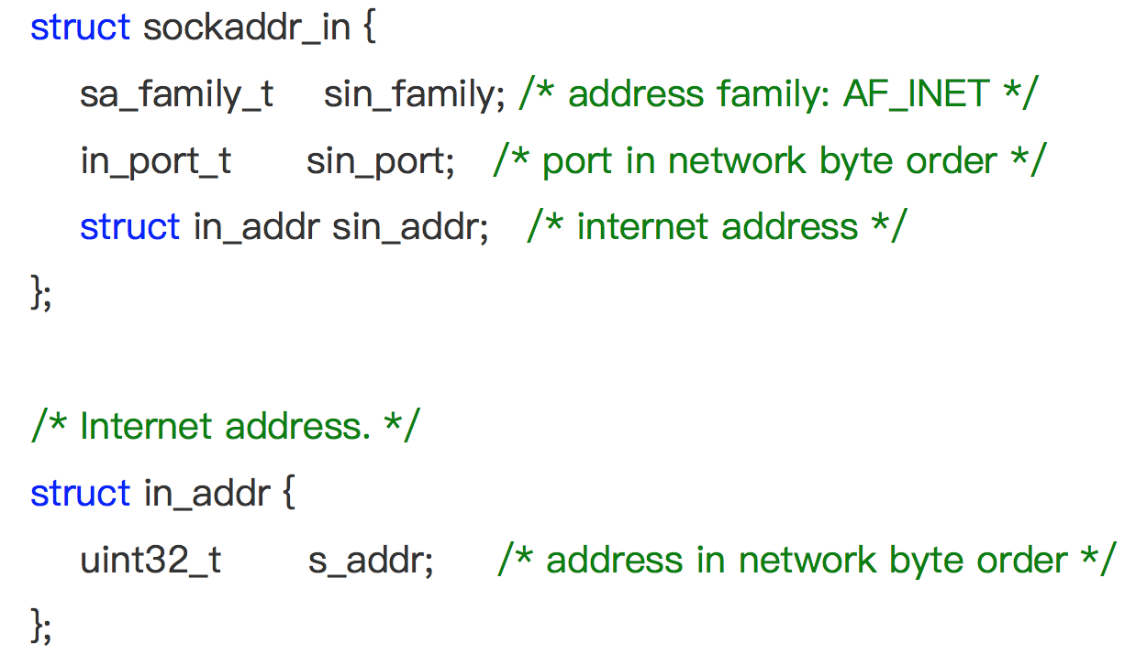
Ipv4 address
Notes:
lscpu

Slide 51
Host/network byte order
0x01234567 give an example
big-endian | 0x100 | 0x101 | 0x102 | 0x103
 | 01 | 23 | 45 | 67
little-endian | 0x100 | 0x101 | 0x102 | 0x103
 | 67 | 45 | 23 | 01
Notes:
lscpu

Slide 52
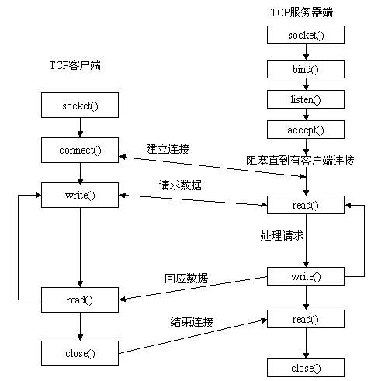
Summary of Socket Programming

Slide 53
Remote Procedure Calls
Remote procedure call (RPC) abstracts procedure calls between processes on networked systems
Again uses ports for service differentiation
Stubs – client-side proxy for the actual procedure on the server
The client-side stub locates the server and marshals the parameters
The server-side stub receives this message, unpacks the marshalled parameters, and performs the procedure on the server

Slide 54
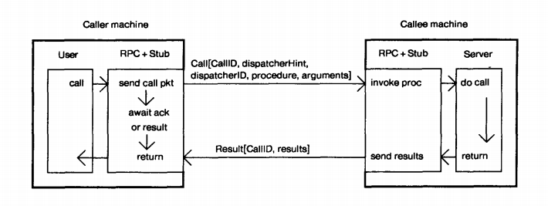
Remote Procedure Calls

Slide 55
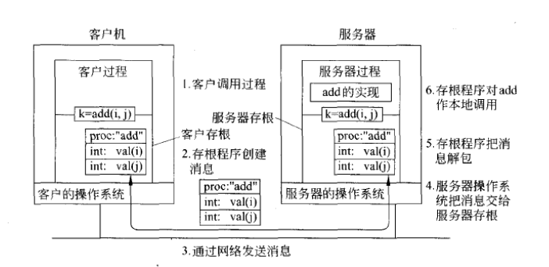
Remote Procedure Calls

Slide 56
Remote Procedure Calls (Cont.)
Data representation for different architectures
Big-endian and little-endian
Remote communication has more failure scenarios than local
Messages can be delivered exactly once rather than at most once
Timestamp
Ack, resend
OS typically provides a rendezvous (or matchmaker) service to connect client and server
Fixed port
Dynamic port

Slide 57
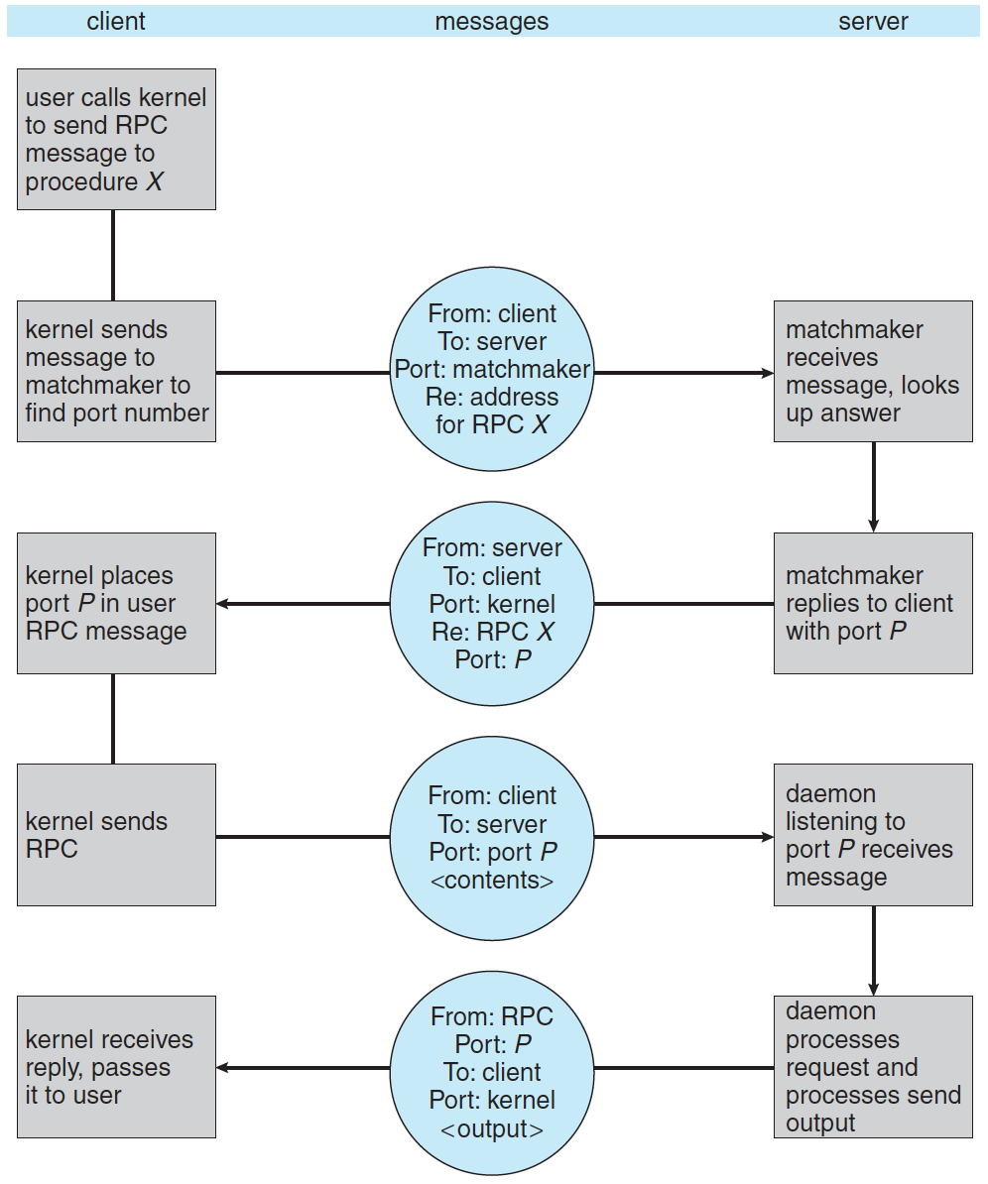
Execution of RPC

Slide 58
The End

