Slide 1
Chapter 3: Processes
March ， 2018

Slide 2
Chapter 3: Processes
Process Concept
Operations on Processes
Process Scheduling

Slide 3
Objectives
To introduce the notion of a process -- a program in execution, which forms the basis of all computation
To describe the various features of processes, including scheduling, creation and termination, and communication

Slide 4
Process Concept
An operating system executes a variety of programs:
  Batch system – jobs
  Time-shared systems – user programs or tasks
Textbook uses the terms job and process almost interchangeably
Process – a program in execution; process execution must progress in sequential fashion

Slide 5
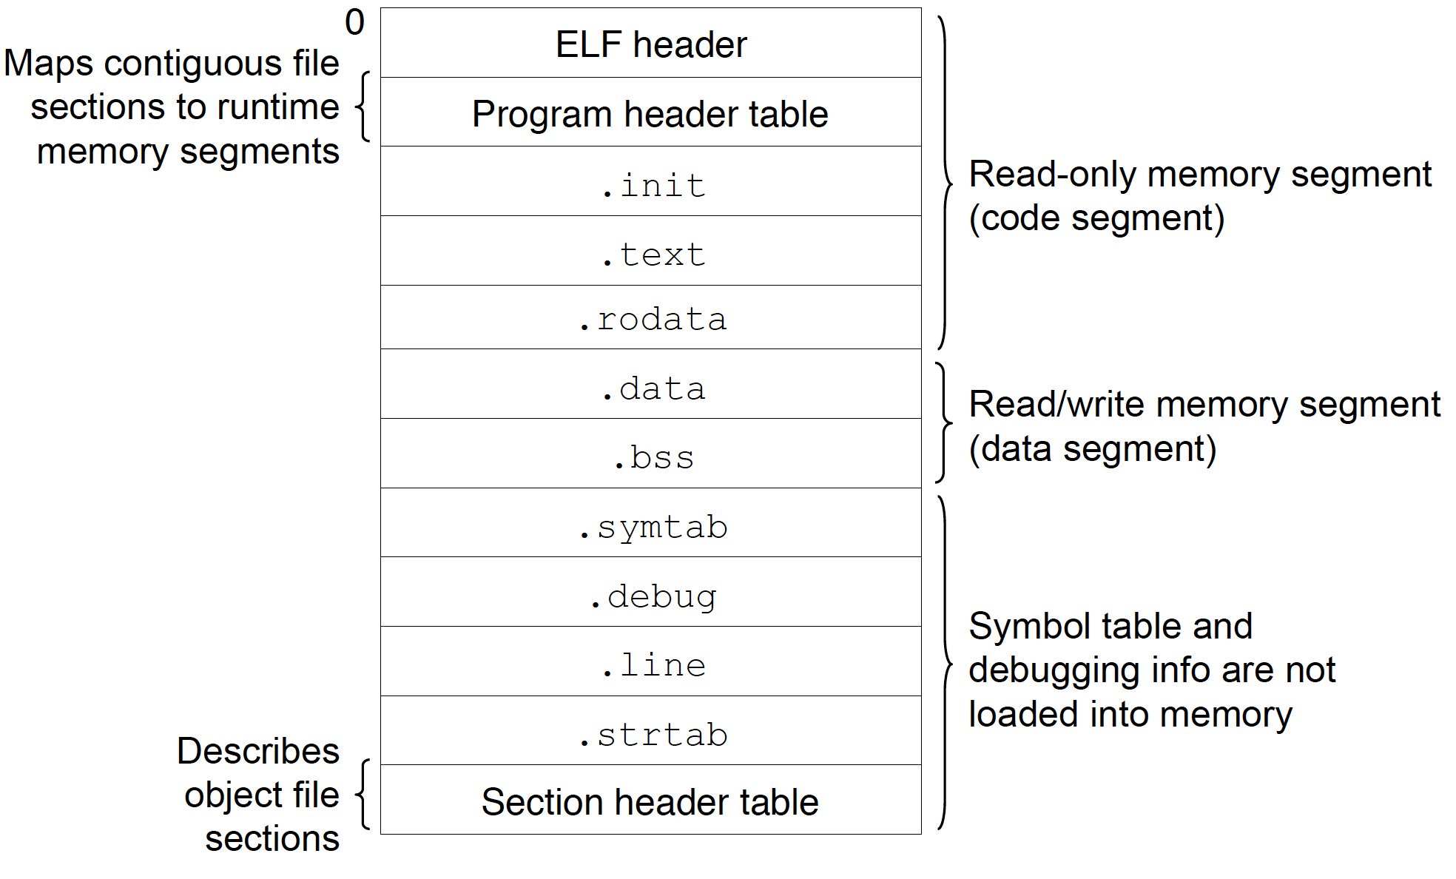
Program on disk

Slide 6
Process Concept (Cont.)
Program is passive entity stored on disk (executable file), process is active entity
  Program becomes process when executable file loaded into memory
Execution of program started via GUI mouse clicks, command line entry of its name, etc
One program can be several processes
  Consider multiple users executing the same program
We emphasize that a program and a process is different concept.

Slide 7
Program in memory
Multiple parts
  The program code, also called text section
  Data section containing global variables
  Stack containing temporary data
    Function parameters, return addresses, local variables
  Heap containing memory dynamically allocated during run time
  Current activity including program counter, processor registers

Slide 8

Process in Memory
Given an example

Slide 9
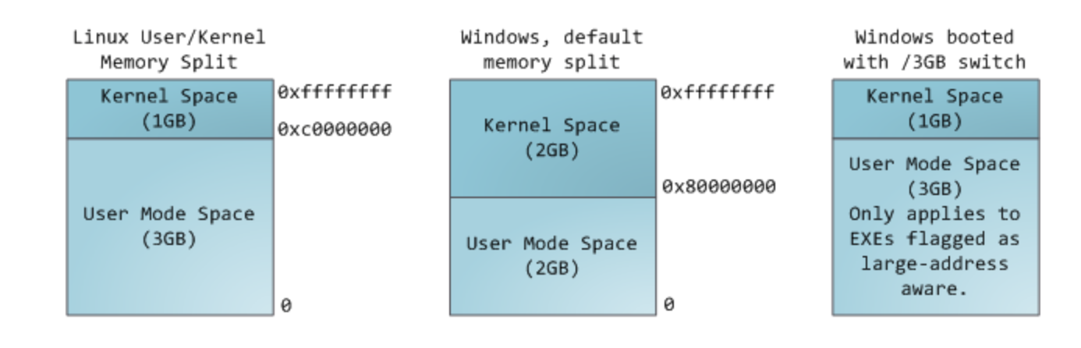
Virtual address

Slide 10
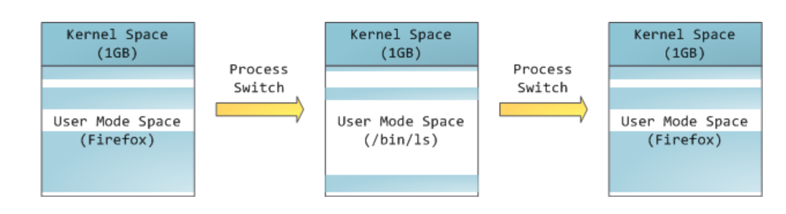
Process in VM

Slide 11
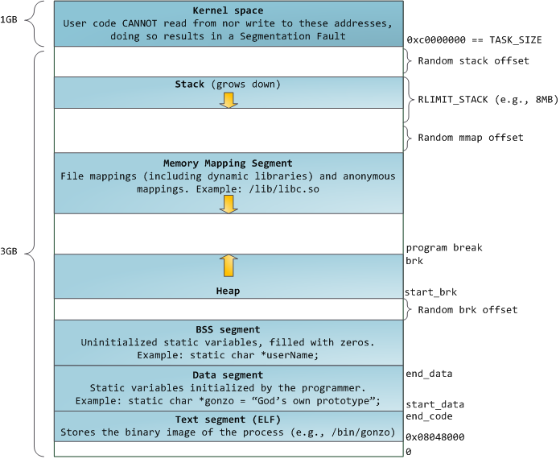
VM layout
kernel
stack
MMP
heap
BSS
DATA
TEXT

Slide 12
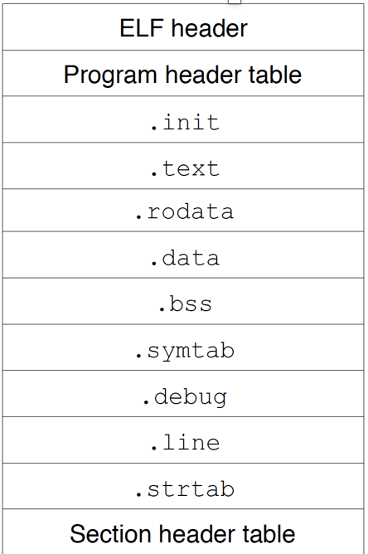
VM layout
kernel
stack
MMP
heap
BSS
DATA
TEXT

Slide 13
Example cont.
Random stack offset
/proc/pid/maps

Slide 14
Process State
As a process executes, it changes state
  new: The process is being created
  running: Instructions are being executed
  waiting: The process is waiting for some event to occur
  ready: The process is waiting to be assigned to a processor
  terminated: The process has finished execution

Slide 15

Diagram of Process State
Attention： It is important to realize that only one process can be running on any processor at any instant. Many processes may be ready and waiting, however.

Slide 16
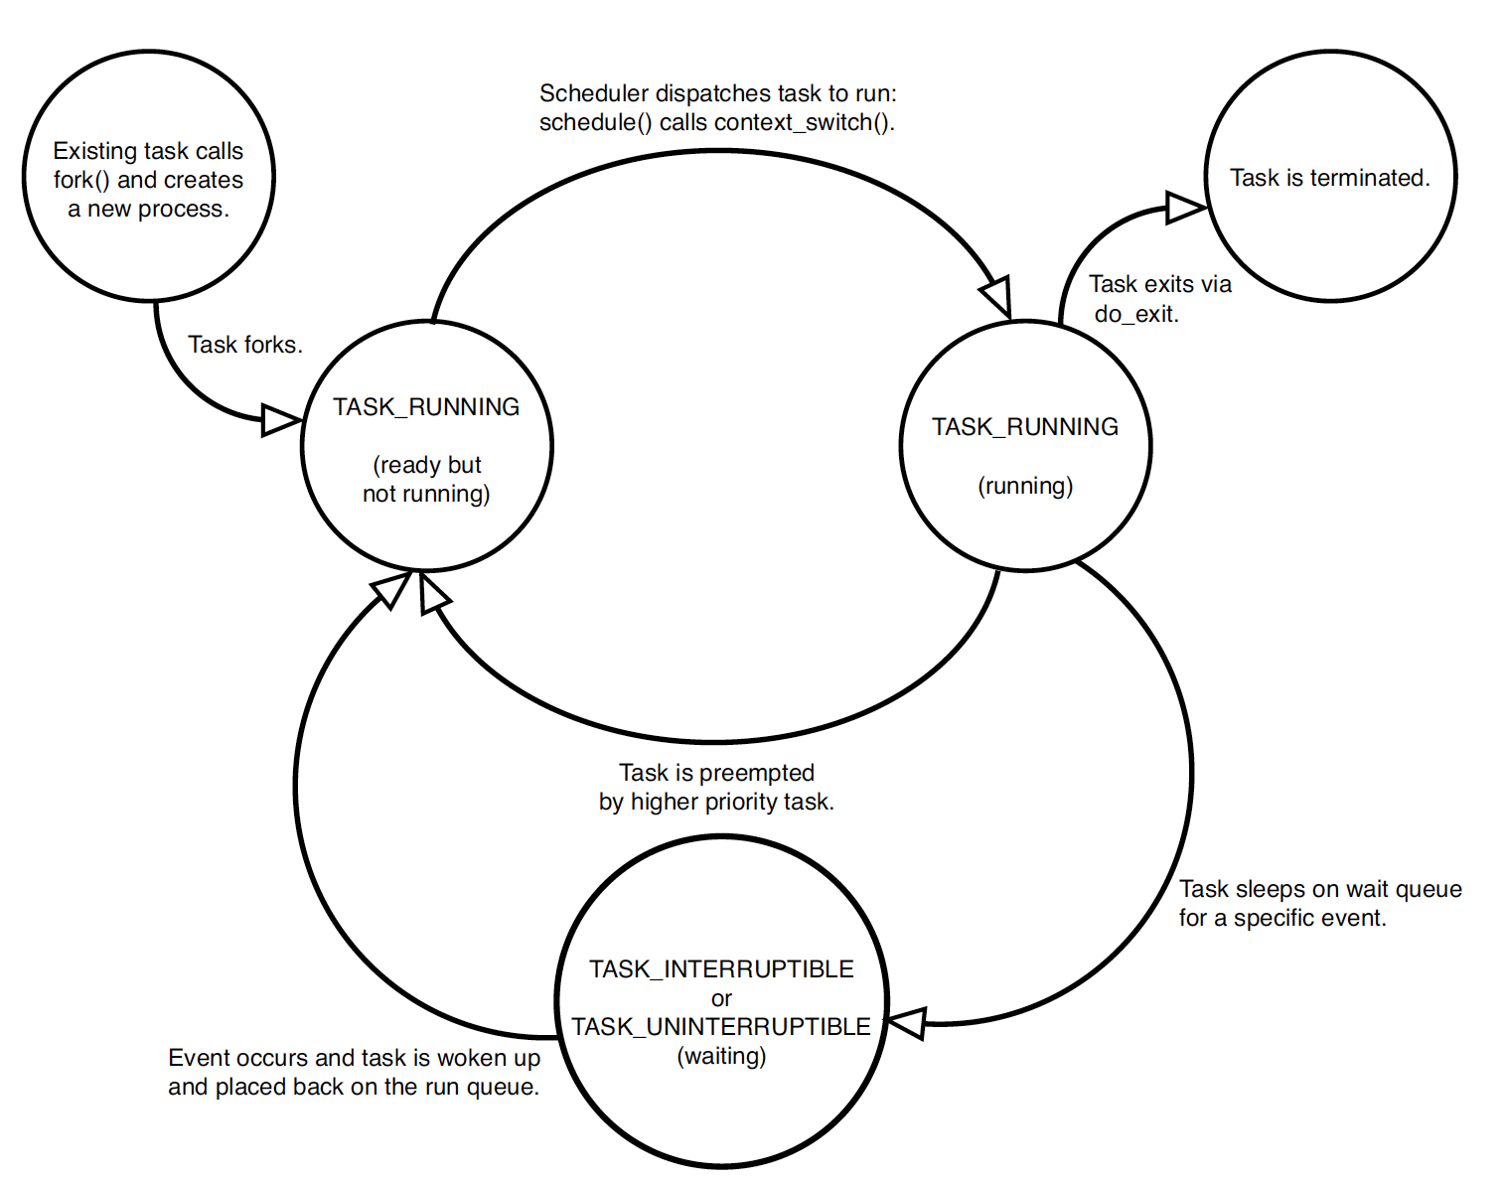
Linux process state

Slide 17

Process Control Block (PCB)
Each process is represented in the operating system by a process control block (PCB)--also called task control block. It contains many pieces of Information associated with each process.
Process state – running, waiting, etc
Program counter – location of instruction to next execute
CPU registers – contents of all process-centric registers
CPU scheduling information- priorities, scheduling queue pointers
Memory-management information – memory allocated to the process
Accounting information – CPU used, clock time elapsed since start, time limits
I/O status information – I/O devices allocated to process, list of open files

Slide 18
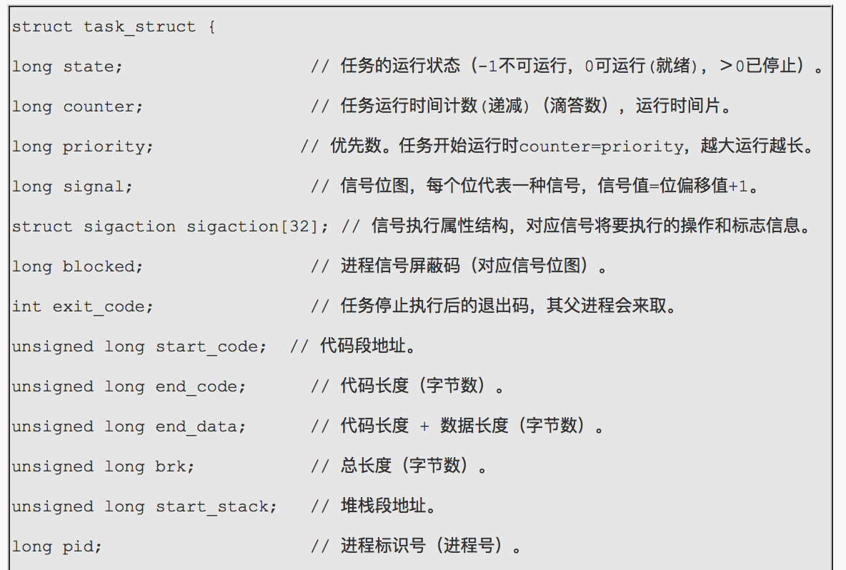
The linux pcb structure

Slide 19
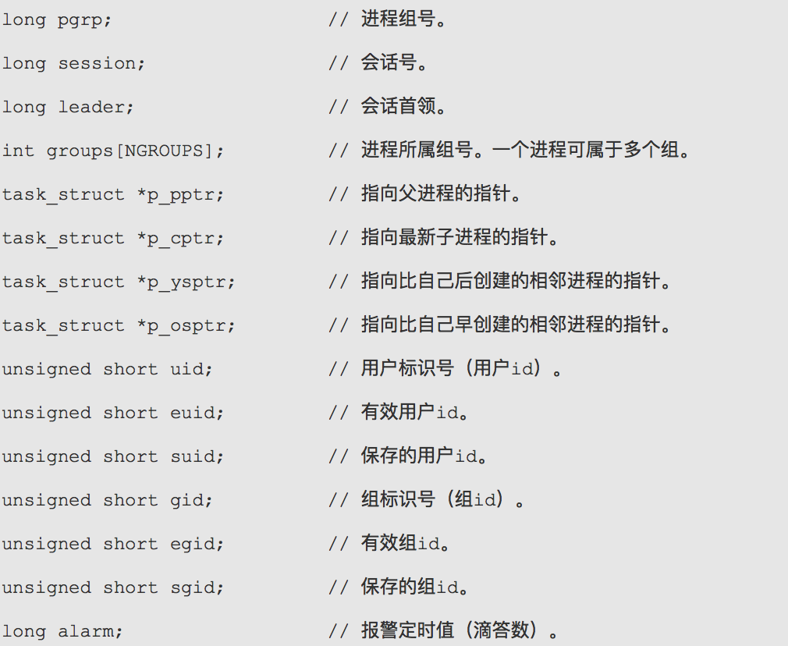
The linux pcb structure

Slide 20
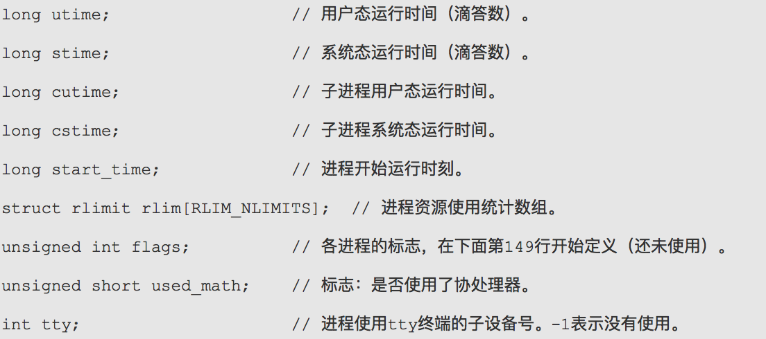
The linux pcb structure

Slide 21
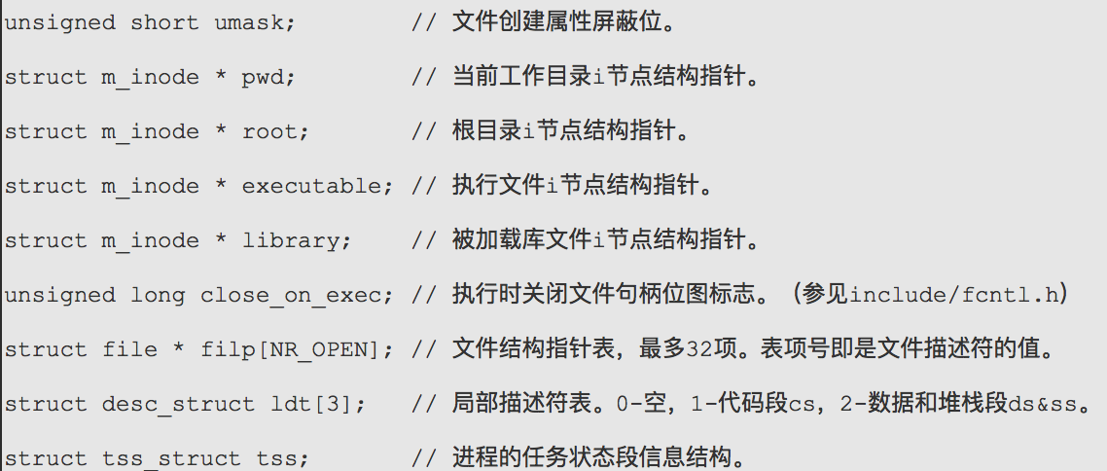
The linux pcb structure

Slide 22

Process Representation in Linux
Represented by the C structure task_struct
pid t_pid; /* process identifier */
long state; /* state of the process */
unsigned int time_slice /* scheduling information */
struct task_struct *parent; /* this process’s parent */
struct list_head children; /* this process’s children */
struct files_struct *files; /* list of open files */
struct mm_struct *mm; /* address space of this process */
Give an example:
Kernel module

Slide 23
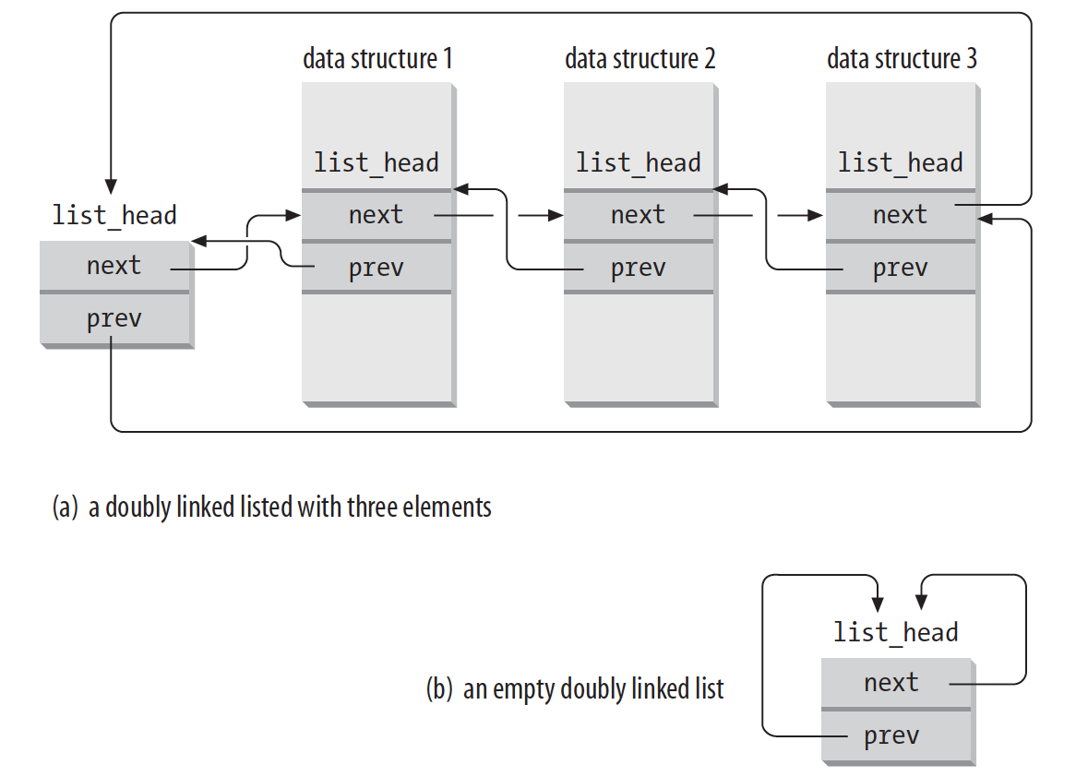
Circular doubly linked list
Give an example:
Kernel module

Slide 24

CPU Switch From Process to Process

Slide 25
Context Switch
When CPU switches to another process, the system must save the state of the old process and load the saved state for the new process via a context switch
Context of a process represented in the PCB
Context-switch time is overhead; the system does no useful work while switching
  The more complex the OS and the PCB ➔ the longer the context switch
Time dependent on hardware support
  Some hardware provides multiple sets of registers per CPU ➔ multiple contexts loaded at once

Slide 26
Process Scheduling
Maximize CPU use, quickly switch processes onto CPU for time sharing
Process scheduler selects among available processes for next execution on CPU
Maintains scheduling queues of processes
  Job queue – set of all processes in the system
  Ready queue – set of all processes residing in main memory, ready and waiting to execute
  Device queues – set of processes waiting for an I/O device
  Processes migrate among the various queues

Slide 27

Representation of Process Scheduling
Queueing diagram represents queues, resources, flows

Slide 28

Ready Queue And Various I/O Device Queues

Slide 29
Schedulers
Short-term scheduler (or CPU scheduler) – selects which process should be executed next and allocates CPU
  Sometimes the only scheduler in a system
  Short-term scheduler is invoked frequently (milliseconds) ⇒ (must be fast)
Long-term scheduler (or job scheduler) – selects which processes should be brought into the ready queue
  Long-term scheduler is invoked infrequently (seconds, minutes) ⇒ (may be slow)
  The long-term scheduler controls the degree of multiprogramming
Processes can be described as either:
  I/O-bound process – spends more time doing I/O than computations, many short CPU bursts
  CPU-bound process – spends more time doing computations; few very long CPU bursts
Long-term scheduler strives for good process mix of I/O-bound and CPU-bound processes.

Slide 30

Addition of Medium Term Scheduling
Medium-term scheduler can be added if degree of multiple programming needs to decrease
  Remove process from memory, store on disk, bring back in from disk to continue execution: swapping

Slide 31
Multitasking in Mobile Systems
Some mobile systems (e.g., early version of iOS) allow only one process to run, others suspended
Due to screen real estate, user interface limits iOS provides for a
  Single foreground process- controlled via user interface
  Multiple background processes– in memory, running, but not on the display, and with limits
  Limits include single, short task, receiving notification of events, specific long-running tasks like audio playback
Android runs foreground and background, with fewer limits
  Background process uses a service to perform tasks
  Service can keep running even if background process is suspended
  Service has no user interface, small memory use

Slide 32
Threads
So far, process has a single thread of execution
Consider having multiple program counters per process
  Multiple locations can execute at once
    Multiple threads of control -> threads
Must then have storage for thread details, multiple program counters in PCB
See next chapter

Slide 33
Operations on Processes
System must provide mechanisms for:
  process creation,
  process termination,
  and so on as detailed next

Slide 34
Process Creation
Parent process create children processes, which, in turn create other processes, forming a tree of processes
Generally, process identified and managed via a process identifier (pid)
Resource sharing options
  Parent and children share all resources
  Children share subset of parent’s resources
  Parent and child share no resources
Execution options
  Parent and children execute concurrently
  Parent waits until children terminate

Slide 35

A Tree of Processes in Linux

Slide 36
Process Creation (Cont.)
Address space
  Child duplicate of parent
  Linux example： fork（）

Slide 37
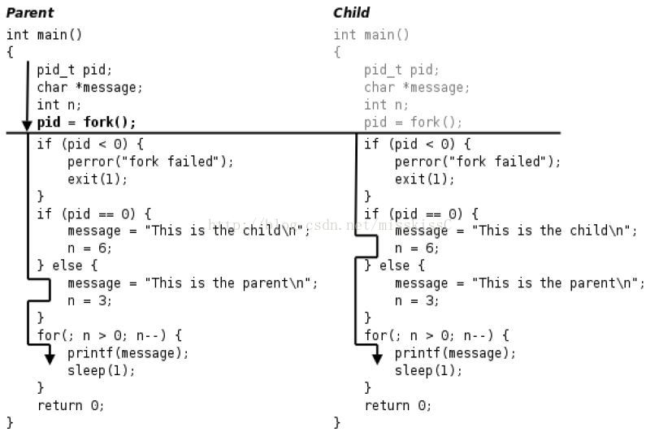
Fork example

Slide 38

Process Creation (Cont.)
UNIX examples
  fork() system call creates new process
  exec() system call used after a fork() to replace the process’ memory space with a new program
Give an example:
Kernel module

Slide 39
Process Termination
Process executes last statement and then asks the operating system to delete it using the exit() system call.
  Returns status data from child to parent (via wait())
  Process’ resources are deallocated by operating system
The parent process may wait for termination of a child process by using the wait()system call. The call returns status information and the pid of the terminated process
pid = wait(&status);
Give an example:
Kernel module

Slide 40
Process Termination
If no parent waiting (did not invoke wait()) process is a zombie
If parent terminated without invoking wait , process is an orphan
Some operating systems do not allow child to exists if its parent has terminated. If a process terminates, then all its children must also be terminated.
  cascading termination. All children, grandchildren, etc. are terminated.
  The termination is initiated by the operating system.
Give an example:
Kernel module

Slide 41
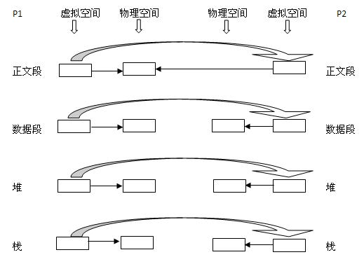
More about fork（）

Slide 42
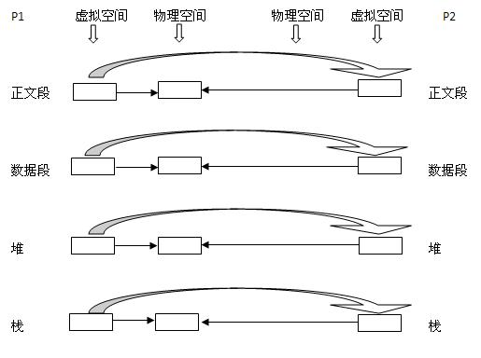
More about fork（）

Slide 43
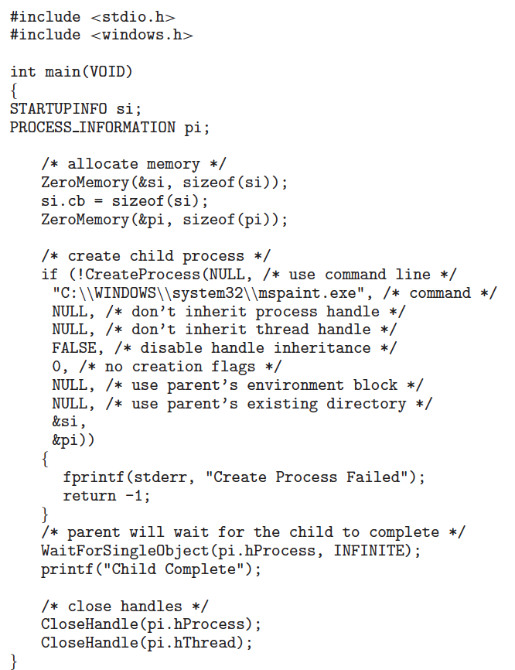
Windows example
Give an example:
Kernel module

