Slide 1
Chapter 4: Threads
April, 2018

Slide 2
Chapter 4: Threads
Multicore Programming & Multithreading
Multithreading Models
Thread Libraries
  Create, terminate, wait, cancel
  Linux, Windows, Java
Implicit Threading
  Pool
  Openmp
Threading Issues
  TLS
  upcall

Slide 3
Objectives
To introduce the notion of a thread—a fundamental unit of CPU utilization that forms the basis of multithreaded computer systems
To discuss the APIs for the Pthreads, Windows, and Java thread libraries
To cover operating system support for threads in Windows and Linux
To explore several strategies that provide implicit threading
To examine issues related to multithreaded programming

Slide 4
Motivation
Most modern applications are multithreaded
Threads run within application
Multiple tasks with the application can be implemented by separate threads: word processor
  Response to keystroke
  Update display
  Spell checking
Process creation is heavy-weight while thread creation is light-weight
Can simplify code, increase efficiency

Slide 5

Multithreaded Server Architecture

Slide 6
Benefits
Responsiveness – may allow continued execution if part of process is blocked, especially important for user interfaces
Resource Sharing – threads share resources of process, easier than shared memory or message passing
Economy – cheaper than process creation, thread switching lower overhead than context switching
Scalability（可扩展性） – process can take advantage of multiprocessor architectures

Slide 7
Multicore Programming
Parallelism implies a system can perform more than one task simultaneously
Concurrency supports more than one task making progress
  Single processor / core, scheduler providing concurrency

Slide 8


Concurrency vs. Parallelism
Concurrent execution on single-core system:
Parallelism on a multi-core system:

Slide 9

Speedup & Amdahl’s Law
Identifies performance gains from adding additional cores to an application that has both serial and parallel components
S is serial portion
N processing cores
That is, if application is 75% parallel / 25% serial, moving from 1 to 2 cores results in speedup of 1.6 times
As N approaches infinity, speedup approaches 1 / S
Serial portion of an application has disproportionate effect on performance gained by adding additional cores

Slide 10
Type of parallelism
Types of parallelism
  Data parallelism – distributes subsets of the same data across multiple cores, same operation on each
  Task parallelism – distributing tasks across cores, each thread performing unique operation
  Hybrid

Slide 11
Challenges
Multicore or multiprocessor systems putting pressure on programmers, challenges include:
  Dividing activities
  Data splitting
  Data dependency
  Balance
  Testing and debugging

Slide 12
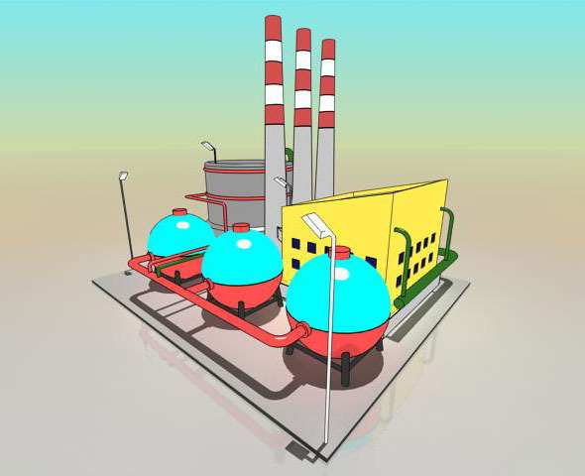
Process vs. Thread
http://www.ruanyifeng.com/blog/2013/04/processes_and_threads.html

Slide 13

Process vs. Thread

Slide 14

Process vs. Thread

Slide 15

Process vs. Thread

Slide 16

Process vs. Thread

Slide 17
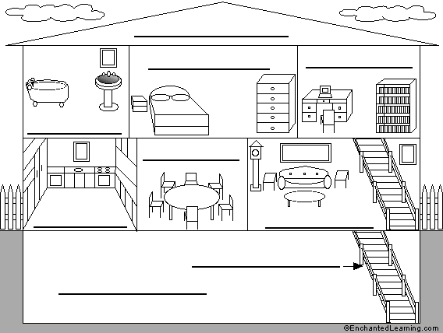
Process vs. Thread

Slide 18

Multithreaded Processes
pc
pc
pc

Slide 19
User Threads and Kernel Threads
User threads - management done by user-level threads library
  POSIX Pthreads
  Windows threads
  Java threads
Kernel threads - Supported by the Kernel
  Linux
  Windows

Slide 20
Multithreading Models
Many-to-One
One-to-One
Many-to-Many

Slide 21

Many-to-One
Many user-level threads mapped to single kernel thread
One thread blocking causes all to block
Multiple threads may not run in parallel on muticore system because only one may be in kernel at a time
Few systems currently use this model

Slide 22
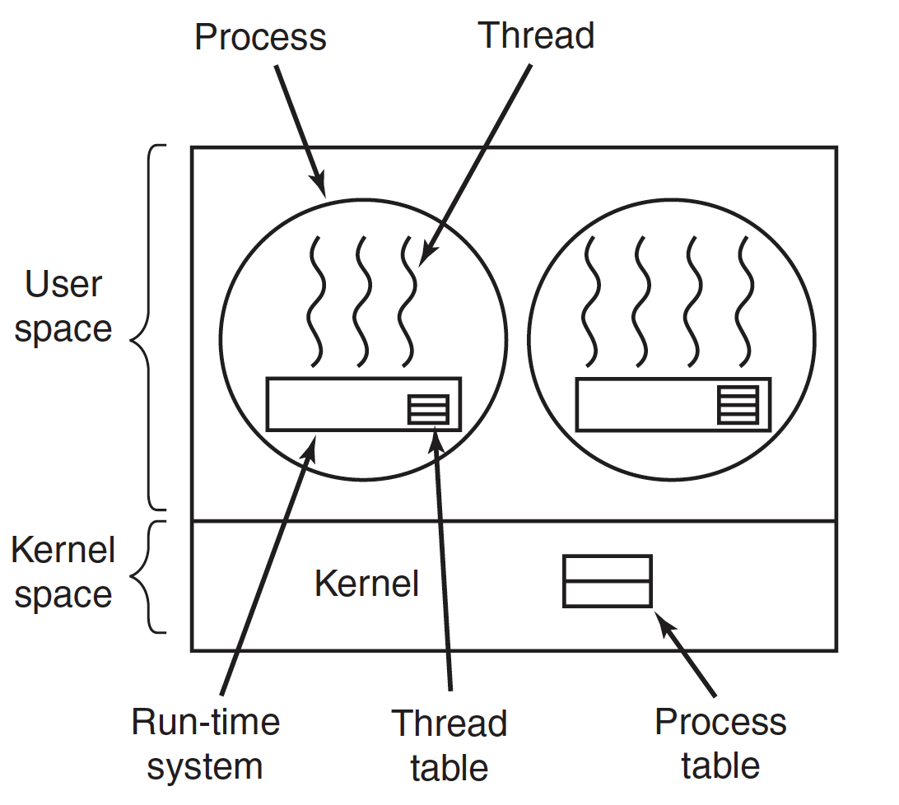
Many-to-One

Slide 23

One-to-One
Each user-level thread maps to kernel thread
Creating a user-level thread creates a kernel thread
More concurrency than many-to-one
Number of threads per process sometimes restricted due to overhead
Examples
  Windows
  Linux
  Solaris 9 and later

Slide 24
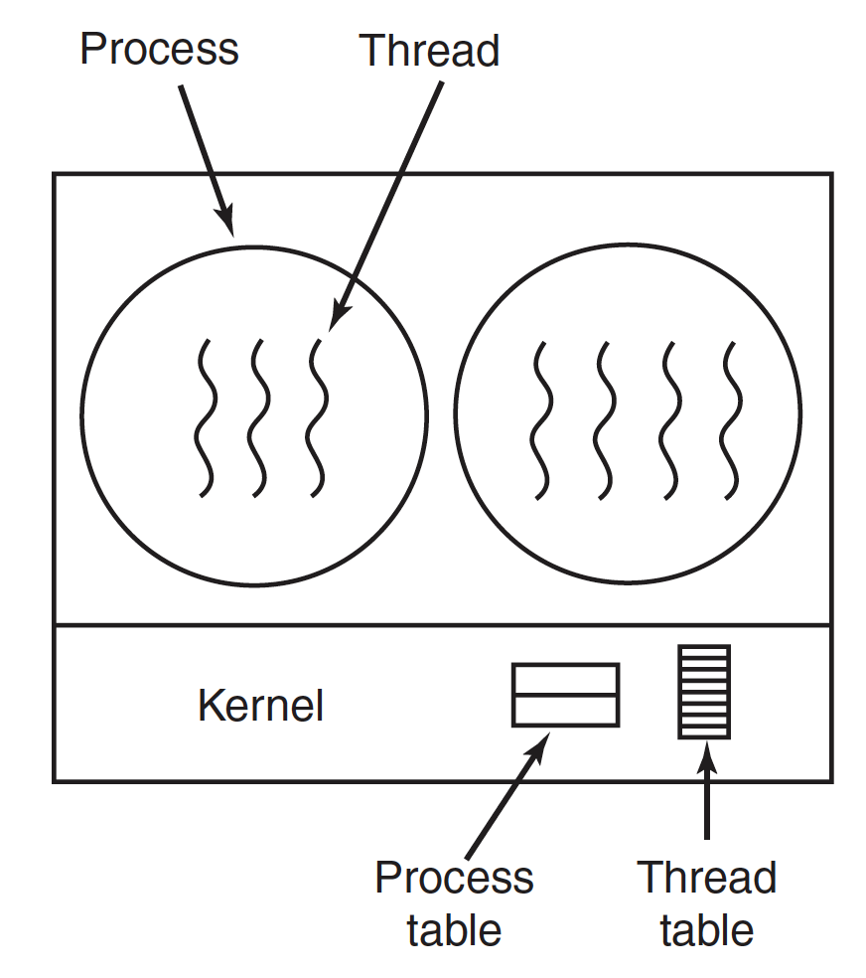
One-to-One

Slide 25

Many-to-Many Model
Allows many user level threads to be mapped to many kernel threads
Allows the operating system to create a sufficient number of kernel threads
Solaris prior to version 9

Slide 26
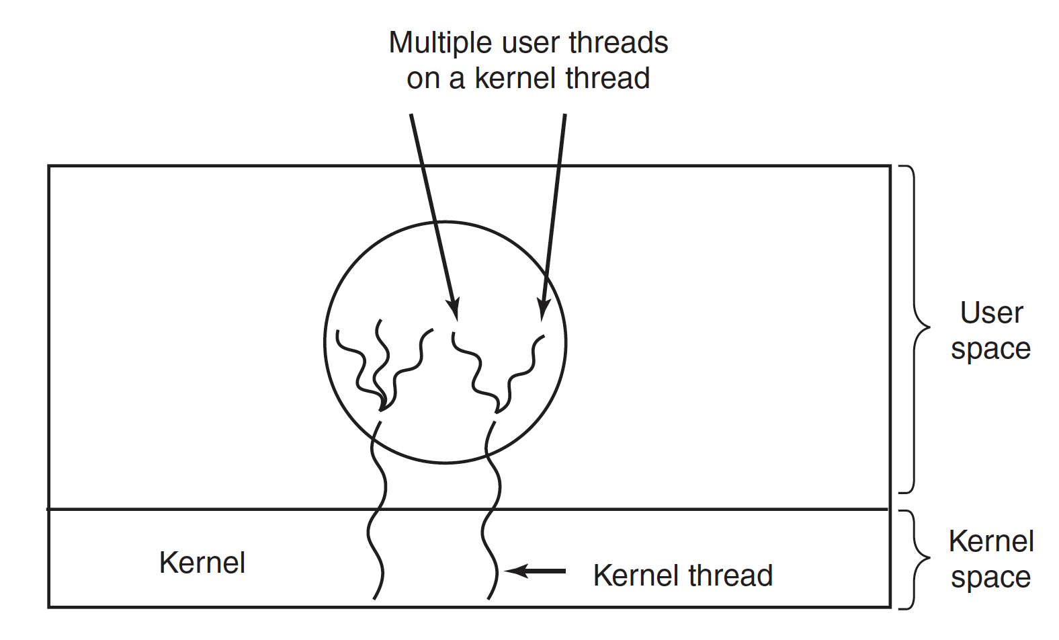
Many-to-Many Model

Slide 27
Thread Libraries
Thread library provides programmer with API for creating and managing threads
  Pthread
  Windows
  Java

Slide 28
Pthreads
A POSIX standard (IEEE 1003.1c) API for thread creation and synchronization
Specification, not implementation
API specifies behavior of the thread library, implementation is up to development of the library
Common in UNIX operating systems (Solaris, Linux, Mac OS X)

Slide 29
API
fork pthread_create
exit pthread_exit
waitpid pthread_join
getpid pthread_self
abort pthread_cancel

Slide 30
pthread example
Give an example

Slide 31
pthread_create
fork() vs. clone()
fork
clone
do_fork

Slide 32
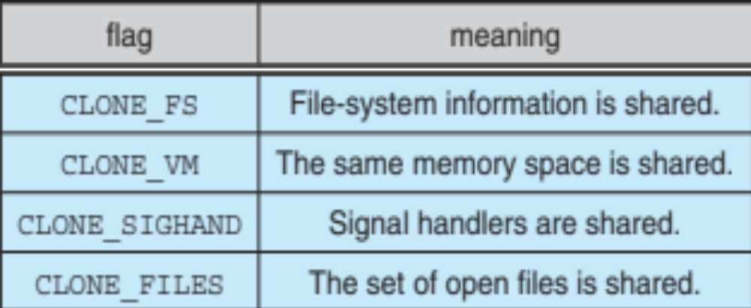
Linux Threads
Linux refers to them as tasks rather than threads
Thread creation is done through clone() system call
clone() allows a child task to share the address space of the parent task (process)
  Flags control behavior

Slide 33
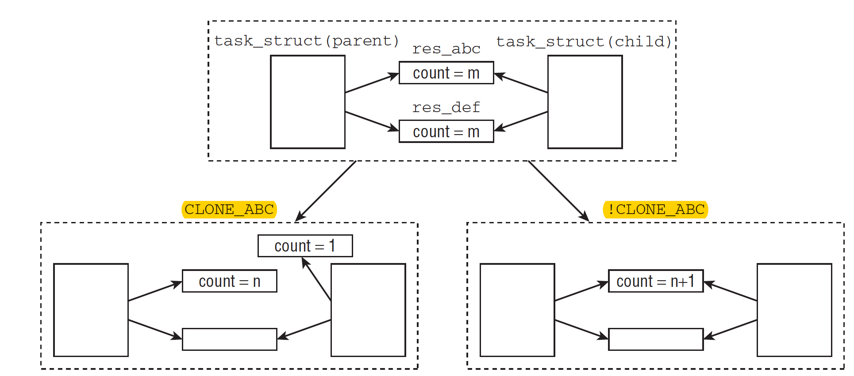
Share resources

Slide 34
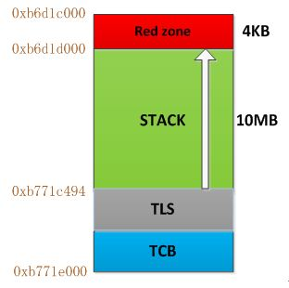
pthread_create
mmap
stack
tls
low
high

Slide 35

Thread Cancellation
Terminating a thread before it has finished
Thread to be canceled is target thread
Two general approaches:
  Asynchronous cancellation terminates the target thread immediately
  Deferred cancellation allows the target thread to periodically check if it should be cancelled
Pthread code to create and cancel a thread:

Slide 36

Thread Cancellation (Cont.)
Invoking thread cancellation requests cancellation, but actual cancellation depends on thread state
If thread has cancellation disabled, cancellation remains pending until thread enables it
Default type is deferred
  Cancellation only occurs when thread reaches cancellation point
    i.e. pthread_testcancel()
Give an example

Slide 37
Windows Threads
Windows implements the Windows API – primary API for Win 98, Win NT, Win 2000, Win XP, and Win 7
Implements the one-to-one mapping, kernel-level
Each thread contains
  A thread id
  Register set representing state of processor
  Separate user and kernel stacks for when thread runs in user mode or kernel mode
  Private data storage area
The register set, stacks, and private storage area are known as the context of the thread

Slide 38
Windows Threads (Cont.)
The primary data structures of a thread include:
  ETHREAD (executive thread block) – includes pointer to process to which thread belongs and to KTHREAD, in kernel space
  KTHREAD (kernel thread block) – scheduling and synchronization info, kernel-mode stack, pointer to TEB, in kernel space
  TEB (thread environment block) – thread id, user-mode stack, thread-local storage, in user space

Slide 39

Windows Threads Data Structures

Slide 40
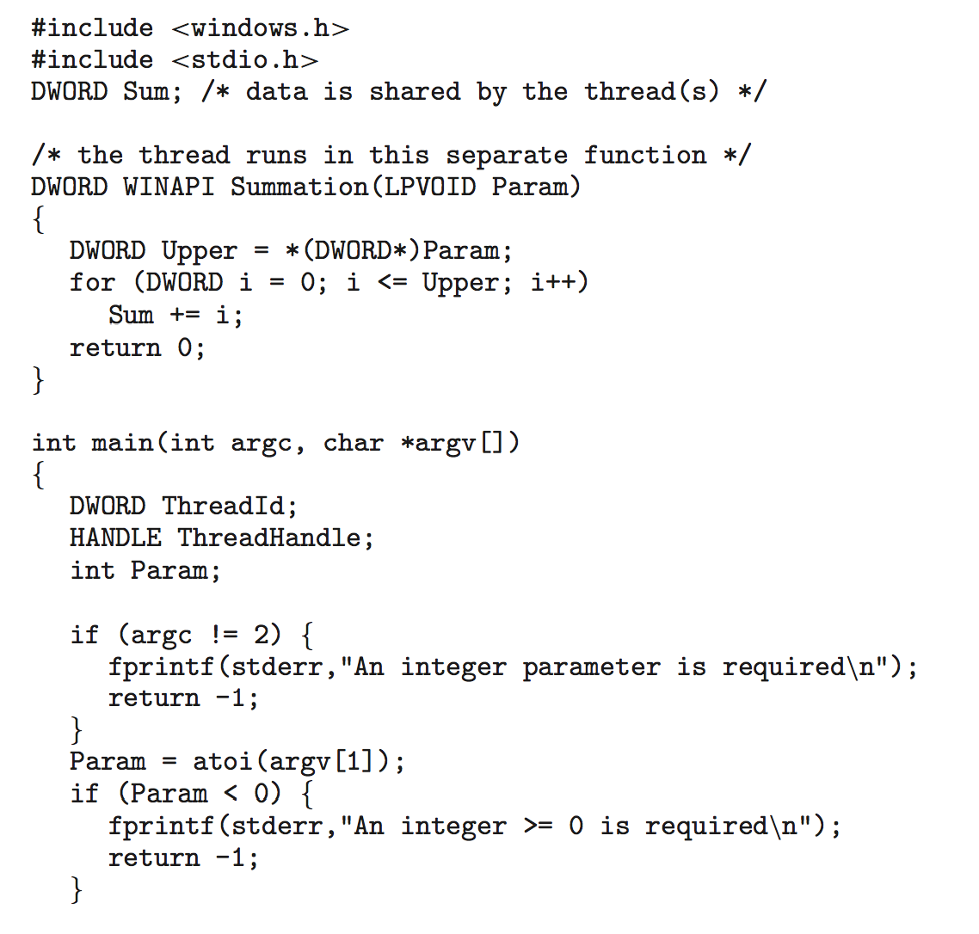
Windows Multithreaded C Program

Slide 41

Java Threads
Java threads are managed by the JVM
Typically implemented using the threads model provided by underlying OS
Java threads may be created by:
  Implementing the Runnable interface

Slide 42

Java Multithreaded Program

Slide 43
Implicit Threading
Growing in popularity as numbers of threads increase, program correctness more difficult with explicit threads
Creation and management of threads done by compilers and run-time libraries rather than programmers
Three methods explored
  Thread Pools
  OpenMP
Other methods include Microsoft Threading Building Blocks (TBB), java.util.concurrent package

Slide 44

Thread Pools
Create a number of threads in a pool where they await work
Advantages:
  Usually slightly faster to service a request with an existing thread than create a new thread
  Allows the number of threads in the application(s) to be bound to the size of the pool
  Separating task to be performed from mechanics of creating task allows different strategies for running task
    i.e.Tasks could be scheduled to run periodically
Windows API supports thread pools:

Slide 45

OpenMP
Set of compiler directives and an API for C, C++, FORTRAN
Provides support for parallel programming in shared-memory environments
Identifies parallel regions – blocks of code that can run in parallel
#pragma omp parallel
Create as many threads as there are cores
#pragma omp parallel for for(i=0;i<N;i++) {
c[i] = a[i] + b[i];
}
Run for loop in parallel

Slide 46
Threading Issues
Semantics of fork() and exec() system calls
Thread cancellation of target thread
  Asynchronous or deferred
Thread-local storage

Slide 47
Semantics of fork() and exec()
Does fork()duplicate only the calling thread or all threads?
  Some UNIXes have two versions of fork
exec() usually works as normal – replace the running process including all threads

Slide 48
Thread-Local Storage
Thread-local storage (TLS) allows each thread to have its own copy of data
Different from local variables
  Local variables visible only during single function invocation
  TLS visible across function invocations

Slide 49
End of Chapter 4

