Slide 1
Chapter 6: Synchronization
Arp. 2017

Slide 2
Chapter 6: Process Scheduling
Background
The Critical-Section（临界区） Problem
Peterson’s Solution
Synchronization Hardware
Mutex Locks
Semaphores
Classic Problems of Synchronization
Monitors
Synchronization Examples

Slide 3
Objectives
To introduce the critical-section problem, whose solutions can be used to ensure the consistency of shared data
To present both software and hardware solutions of the critical-section problem
To examine several classical process-synchronization problems
To explore several tools that are used to solve process synchronization problems

Slide 4
Background
Processes can execute concurrently
  May be interrupted at any time, partially completing execution
Concurrent access to shared data may result in data inconsistency
Maintaining data consistency requires mechanisms to ensure the orderly execution of cooperating processes

Slide 5
Producer
while (true) {
/* produce an item in next produced */
while (counter == BUFFER_SIZE) ;
/* do nothing */
buffer[in] = next produced;
in = (in + 1) % BUFFER SIZE;
counter++;
}

Slide 6
Consumer
while (true) {
while (counter == 0)
; /* do nothing */
next consumed = buffer[out];
out = (out + 1) % BUFFER_SIZE;
counter--;
/* consume the item in next consumed */
}

Slide 7
Result
counter++ could be implemented as
register1 = counter
register1 = register1 + 1
counter = register1
counter-- could be implemented as
register2 = counter
register2 = register2 - 1
counter = register2
Consider this execution interleaving with “count = 5” initially:
  S0: producer execute register1 = counter {register1 = 5}
  S1: producer execute register1 = register1 + 1 {register1 = 6}
  S2: consumer execute register2 = counter {register2 = 5}
  S3: consumer execute register2 = register2 – 1 {register2 = 4}
  S4: producer execute counter = register1 {counter = 6 }
  S5: consumer execute counter = register2 {counter = 4}
Notes:
Given an example

Slide 8
Race condition
several processes access and manipulate the same data concurrently and the
outcome of the execution depends on the particular order in which the access takes place

Slide 9
Critical Section Problem
Consider system of n processes {p₀, p₁, … p_{n-1}}
Each process has critical section segment of code
  Process may be changing common variables, updating table, writing file, etc
  When one process in critical section, no other may be in its critical section
  That is, no two processes are executing in their critical sections at the same time
Critical section problem is to design protocol to solve this

Slide 10
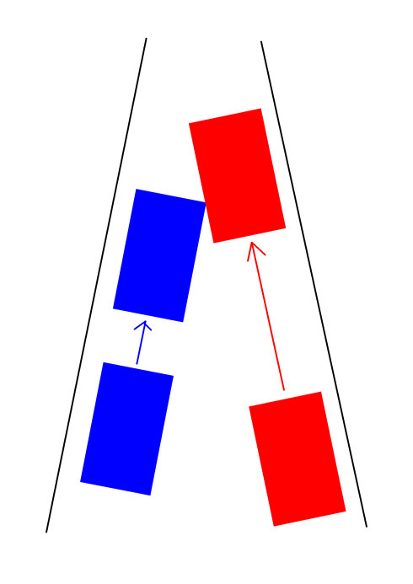
Critical Section Problem

Slide 11

Critical Section
Each process must ask permission to enter critical section in entry section, may follow critical section with exit section, then remainder section

Slide 12
Solution Requirements for Critical-Section Problem
Mutual Exclusion - If process P_{i} is executing in its critical section, then no other processes can be executing in their critical section
Progress - If no process is executing in its critical section and there exist some processes that wish to enter their critical section, then only those processes that are not executing in their remainder sections can participate in deciding which will enter its critical section next, and this selection cannot be postponed indefinitely
3. Bounded Waiting - A bound must exist on the number of times that other processes are allowed to enter their critical sections after a process has made a request to enter its critical section and before that request is granted
Notes:
Indefinitely：无限期地

Slide 13
Peterson’s Solution
Good algorithmic description of solving the problem
Two process solution
The two processes share two variables:
  int turn;
  Boolean flag[2]
The variable turn indicates whose turn it is to enter the critical section
The flag array is used to indicate if a process is ready to enter the critical section. flag[i] = true implies that process P_{i} is ready!

Slide 14
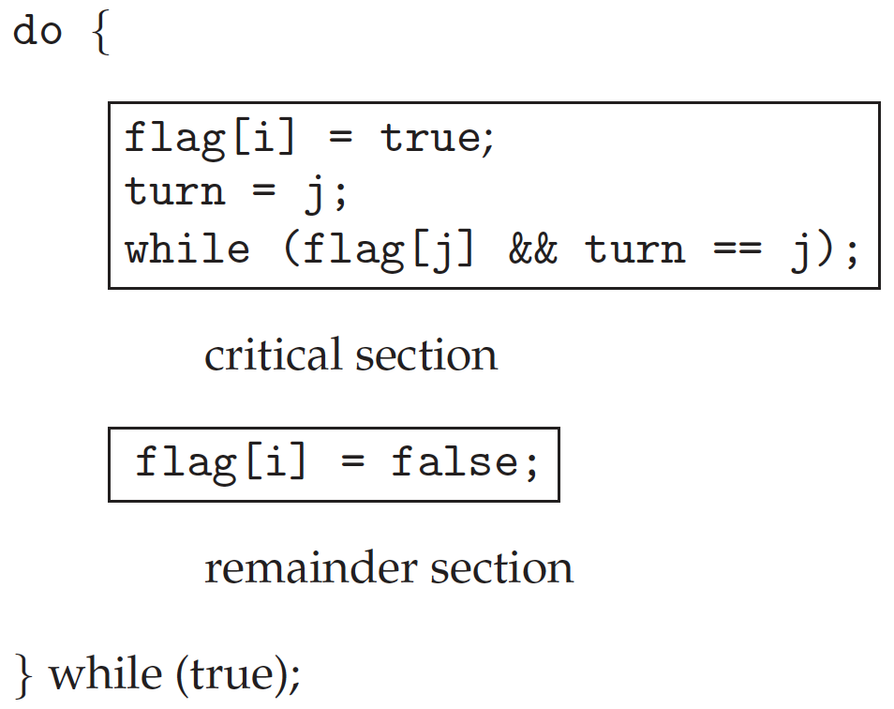
Algorithm for Process P_{i}

Slide 15
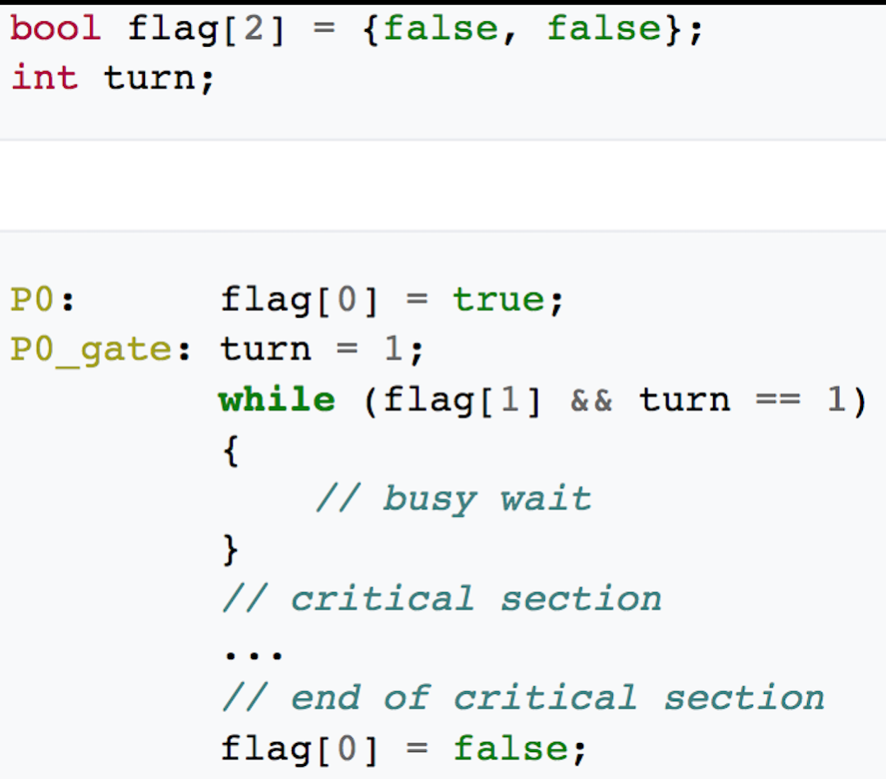
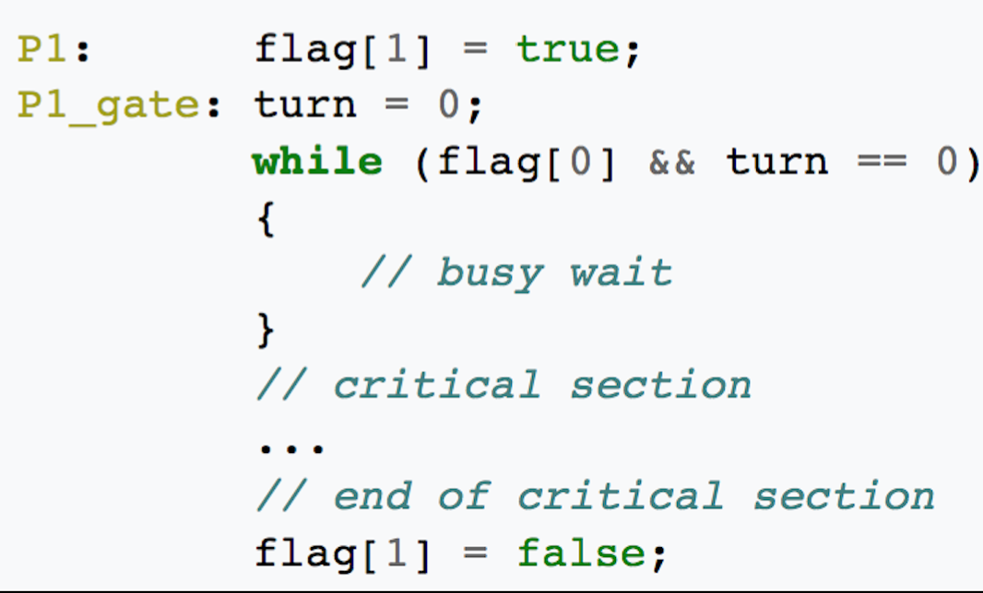
Correctness
Provable that
Mutual exclusion is preserved
Progress requirement is satisfied
Bounded-waiting requirement is met

Slide 16
Some more analysis

Slide 17
Restrictions of Peterson’s
Two process
Software solution

Slide 18
Flaw of Peterson’s solution
This algorithm works some of the time when it is assumed that the multiprocessor has strongly ordered memory.
Some multiprocessors, including some SPARC-based multiprocessors, have store buffers. When a thread issues a store instruction, the data is put into a store buffer. The buffer contents are eventually sent to the cache, but not necessarily right away. (Note that the caches on each of the processors maintain a consistent view of memory, but modified data does not reach the cache right away.)
When multiple memory locations are stored into, the changes reach the cache (and memory) in the correct order, but possibly after a delay. SPARC-based multiprocessors with this property are said to have total store order (TSO).
When one processor stores into location A and then loads from location B, and another processor stores into location B and loads from location A, the expectation is that either the first processor fetches the newly modified value in location B or the second processor fetches the newly modified value in location A, or both. However, the case in which both processors load the old values simply cannot happen.
Moreover, with the delays caused by load and store buffers, the "impossible case" can happen.
What could happen with Peterson's algorithm is that two threads running on separate processors each stores into its own slot of the particular array and then loads from the other slot. They both read the old values (0), assume that the other party is not present, and both enter the critical section. (Note that this is the sort of problem that might not occur when you test a program, but only much later.)
This problem is avoided when you use the threads synchronization primitives, whose implementations issue special instructions to force the writing of the store buffers to the cache.

Slide 19
Synchronization Hardware
Many systems provide hardware support for critical section code
All solutions below based on idea of locking
  Protecting critical regions via locks
Uniprocessors – could disable interrupts
  Currently running code would execute without preemption
  Generally too inefficient on multiprocessor systems
    Operating systems using this not broadly scalable
Modern machines provide special atomic hardware instructions
    Atomic = non-interruptible
  Either test memory word and set value
  Or swap contents of two memory words
Notes:
Premise：前提；inefficient：效率低下的；feasible：可行的

Slide 20
test_and_set Instruction
Definition:
boolean test_and_set (boolean *target)
{
boolean rv = *target;
*target = TRUE;
return rv:
}

Slide 21
Mutex Solution using test_and_set()
Shared boolean variable lock, initialized to FALSE
Solution:
do {
while (test_and_set(&lock))
; /* do nothing */
/* critical section */
lock = false;
/* remainder section */
} while (true);

Slide 22
compare_and_swap Instruction
Definition:
int compare_and_swap(int *value, int expected, int new value) {
int temp = *value;
if (*value == expected)
*value = new value;
return temp;
}

Slide 23
Mutex Solution using compare_and_swap
Shared Boolean variable lock initialized to FALSE; Each process has a local Boolean variable key
Solution:
do {
while (compare_and_swap(&lock, 0, 1) != 0)
; /* do nothing */
/* critical section */
lock = 0;
/* remainder section */
} while (true);

Slide 24
Mutex Solution using test_and_set()
Shared boolean variable lock, initialized to FALSE
Solution:
do {
while (test_and_set(&lock))
; /* do nothing */
/* critical section */
lock = false;
/* remainder section */
} while (true);
Correctness

Slide 25
Bounded-waiting Mutual Exclusion with test_and_set
do {
waiting[i] = true;
key = true;
while (waiting[i] && key)
key = test_and_set(&lock);
waiting[i] = false;
/* critical section */
j = (i + 1) % n;
while ((j != i) && !waiting[j]) //the first waiting==true
j = (j + 1) % n;
if (j == i)
lock = false;
else
waiting[j] = false;
/* remainder section */
} while (true);

Slide 26
Mutex Locks
Previous solutions are complicated and generally inaccessible to application programmers
OS designers build software tools to solve critical section problem
Simplest is mutex lock
Product critical regions with it by first acquire() a lock then release() it
  Boolean variable indicating if lock is available or not

Slide 27
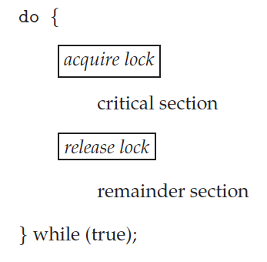
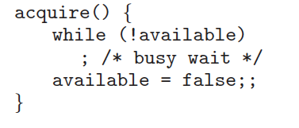
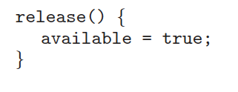
Solution to Critical-section Problem Using Locks

Slide 28
Mutex Locks
Calls to acquire() and release() must be atomic
  Usually implemented via hardware atomic instructions
But this solution requires busy waiting
    This lock therefore called a spinlock
Notes:
Spinlock：自旋锁

Slide 29
Limitations of Mutex
Count Number
Busy waiting

Slide 30
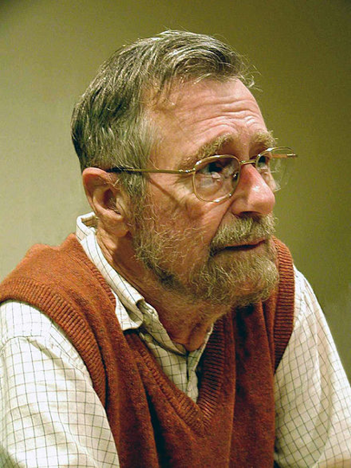
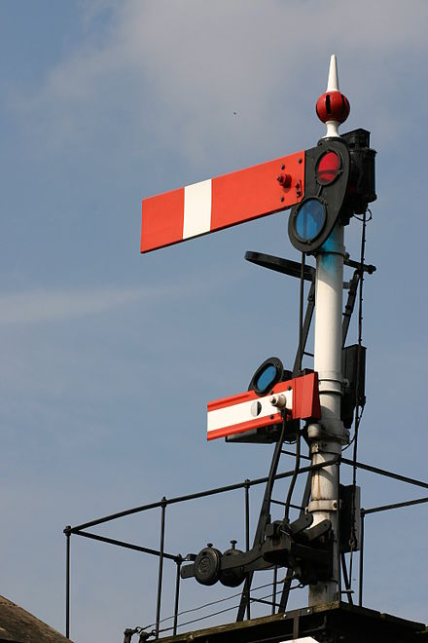
Semaphore

Slide 31
Semaphore
Synchronization tool that does not require busy waiting
Semaphore S – integer variable
Two standard operations modify S: wait() and signal()
  Originally called P() and V() (proberen, verhogen)
Less complicated
Can only be accessed via two indivisible (atomic) operations
  wait (S) {
  while (S <= 0)
  ; // busy wait
  S--;
  }
  signal (S) {
  S++;
  }

Slide 32

Semaphore

Slide 33

Semaphore

Slide 34
Semaphore Type
Counting semaphore – integer value can range over an unrestricted domain
Binary semaphore – integer value can range only between 0 and 1
  Then a mutex lock

Slide 35
Semaphore Usage: synchronization
Can solve various synchronization problems
Consider P₁ and P₂ that require S₁ to happen before S₂
  P1:
  S₁;
  signal(synch); //initialized to 0
  P2:
  wait(synch); //initialized to 0
  S₂;

Slide 36
Semaphore with busy waiting
  wait (S) {
  while (S <= 0)
  ; // busy wait
  S--;
  }
  signal (S) {
  S++;
  }

Slide 37
Semaphore Implementation
Must guarantee that no two processes can execute wait () and signal () on the same semaphore at the same time
Thus, implementation becomes the critical section problem where the wait and signal code are placed in the critical section
  Could now have busy waiting in critical section implementation
    But implementation code is short
    Little busy waiting if critical section rarely occupied
Note that applications may spend lots of time in critical sections and therefore this is not a good solution

Slide 38
Semaphore Implementation with no Busy waiting (Cont.)
typedef struct{
int value;
struct process *list;
} semaphore;
wait(semaphore *S) {
S->value--;
if (S->value < 0) {
add this process to S->list;
block();
}
}
signal(semaphore *S) {
S->value++;
if (S->value <= 0) {
remove a process P from S->list;
wakeup(P);
}
}

Slide 39
Semaphore Implementation with no Busy waiting
With each semaphore there is an associated waiting queue
Each entry in a waiting queue has two data items:
  value (of type integer)
  pointer to next record in the list
  If negative:
Two operations:
  block – place the process invoking the operation on the appropriate waiting queue
  wakeup – remove one of processes in the waiting queue and place it in the ready queue

Slide 40
Deadlock and Starvation
Deadlock – two or more processes are waiting indefinitely for an event that can be caused by only one of the waiting processes
Let S and Q be two semaphores initialized to 1
P₀ P₁
wait(S); wait(Q);
wait(Q); wait(S);
. .
signal(S); signal(Q);
signal(Q); signal(S);
Starvation – indefinite blocking
  A process may never be removed from the semaphore queue in which it is suspended

Slide 41
Peterson’s solution
P1
P2
... ...
turn=1;
while(turn==1);
critical section
turn=1;
... ...
... ...
turn=0;
while(turn==0);
critical section
turn=0;
... ...

Slide 42
Ex6.9
Use atomic instruction to implement mutex lock/spinlock
void acquire(lock *mutex)
{
while(compare_and_swap(&mutex->available, 0, 1)); //busy waiting
return;
}
void release(lock *mutex)
{
mutex->available=0;
return;
}
void initialize(lock *mutex)
{
mutex->available=0;
return;
}

Slide 43
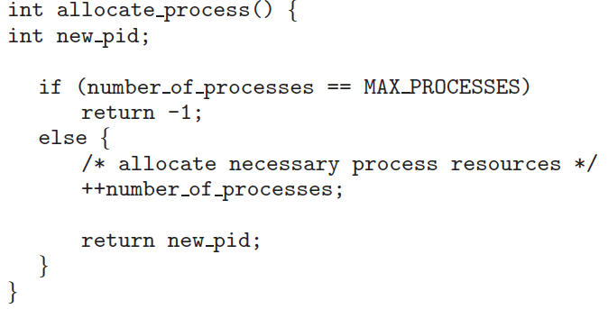
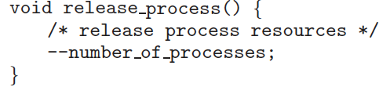
Ex6.14
acquire(&mutex)
release(&mutex)
acquire(&mutex)
release(&mutex)

Slide 44
Ex6.15
semaphore s = N;

Slide 45
Ex6.17
Use spinlock (in Ex6.9) to implement semaphore
typedef struct
{
int value;
struct process *list;
lock mutex;
}semaphore;
wait(semaphore *S)
{
acquire(&mutex);
S->value--;
if(S->value<0){
add this process to S->list;
release(&mutex);
block();
}
else
release(&mutex);
}
signal(semaphore *S)
{
acquire(&mutex);
S->value++;
if(S->value<=0){
remove a process P from S->list;
release(&mutex);
wakeup(P);
}
else
release(&mutex);
}

Slide 46
Ex6.6
Spinlock, semaphore

Slide 47
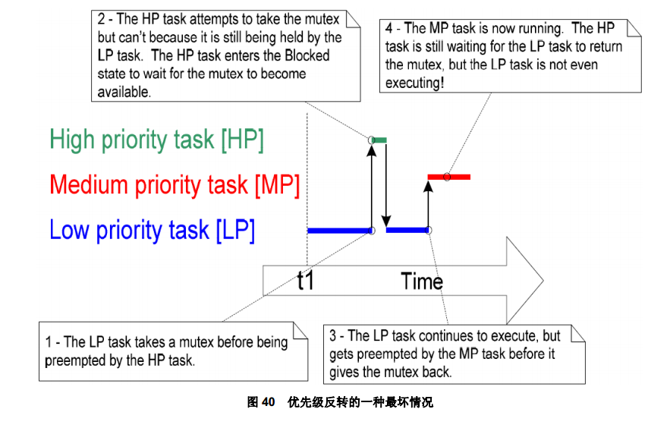
Priority Inversion

Slide 48


Example
Priority inheritance

Slide 49
Summary of mutex&semaphore
Operation pair
  Acquire/release
  Wait/signal, P / V
Hardware instruction -> mutex lock/spinlock -> semaphore
Binary semaphore
  mutex lock (with waiting queue), initialized to 1 (not as efficient as spinlock)
  Mutual exclusion
Counting semaphore
  Resource allocation: e.g. initialized to N
  Synchronization: e.g. initialized to 0

Slide 50
Classical Problems of Synchronization
Classical problems used to test newly-proposed synchronization schemes
  Bounded-Buffer Problem
  Readers and Writers Problem
  Dining-Philosophers Problem

Slide 51
Bounded-Buffer Problem
while (true) {
/* produce an item in next produced */
while (counter == BUFFER_SIZE) ;
/* do nothing */
buffer[in] = next produced;
in = (in + 1) % BUFFER SIZE;
counter++;
}
while (true) {
while (counter == 0) ;
/* do nothing */
next consumed = buffer[out];
out = (out + 1) % BUFFER_SIZE;
counter--;
/* consume the item in next consumed */
}

Slide 52
Bounded-Buffer Problem
item next_produced;
while (true) {
/* produce an item in next produced */
while (((in + 1) % BUFFER_SIZE) == out)
; /* do nothing */
buffer[in] = next_produced;
in = (in + 1) % BUFFER_SIZE;
}
item next_consumed;
while (true) {
while (in == out) ;
/* do nothing */
next_consumed = buffer[out];
out = (out + 1) % BUFFER_SIZE;
/* consume the item in next consumed */
}

Slide 53
Bounded-Buffer Problem
n buffers, each can hold one item
Semaphore mutex initialized to the value 1
Semaphore full initialized to the value 0
Semaphore empty initialized to the value n

Slide 54
Bounded Buffer Problem (Cont.)
The structure of the producer process
do {
...
/* produce an item in next_produced */
...
wait(empty);
wait(mutex);
...
/* add next produced to the buffer */
...
signal(mutex);
signal(full);
} while (true);

Slide 55
Bounded Buffer Problem (Cont.)
The structure of the consumer process
do {
wait(full);
wait(mutex);
...
/* remove an item from buffer to next_consumed */
...
signal(mutex);
signal(empty);
...
/* consume the item in next consumed */
...
} while (true);

Slide 56
Readers-Writers Problem
A data set is shared among a number of concurrent processes
  Readers – only read the data set; they do not perform any updates
  Writers – can both read and write
Problem – allow multiple readers to read at the same time
  Only one single writer can access the shared data at the same time
Several variations of how readers and writers are treated – all involve priorities
Shared Data
  Data set
  Semaphore rw_mutex initialized to 1
  Semaphore mutex initialized to 1
  Integer read_count initialized to 0

Slide 57
Readers-Writers Problem Variations
First variation – no reader kept waiting unless writer has permission to use shared object
Second variation – once writer is ready, it performs write asap
Both may have starvation leading to even more variations

Slide 58
First Readers-Writers Problem
Shared Data
  Data set
  Semaphore rw_mutex initialized to 1
  Integer read_count initialized to 0
  Semaphore mutex initialized to 1

Slide 59
Readers-Writers Problem (Cont.)
The structure of a writer process
do {
wait(rw_mutex);
...
/* writing is performed */
...
signal(rw_mutex);
} while (true);

Slide 60
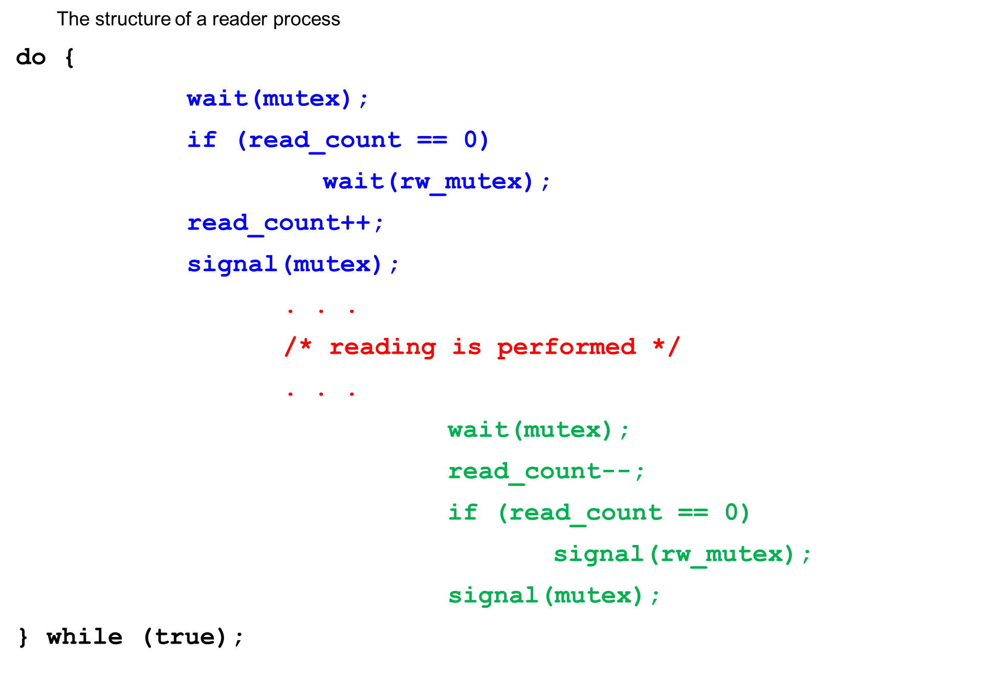
Readers-Writers Problem (Cont.)

Slide 61

Dining-Philosophers Problem
Philosophers spend their lives thinking and eating
Don’t interact with their neighbors, occasionally try to pick up 2 chopsticks (one at a time) to eat from bowl
  Need both to eat, then release both when done
In the case of 5 philosophers
  Shared data
    Bowl of rice (data set)
    Semaphore chopstick [5] initialized to 1

Slide 62
Dining-Philosophers Problem Algorithm
The structure of Philosopher i:
    do {
    wait ( chopstick[i] );
    wait ( chopstick[ (i + 1) % 5] );
    // eat
    signal ( chopstick[i] );
    signal ( chopstick[ (i + 1) % 5] );
    // think
    } while (TRUE);
What is the problem with this algorithm?

Slide 63
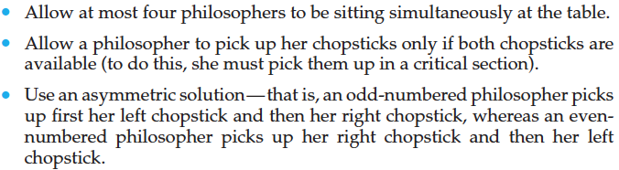
Possible remedies

Slide 64
Problems with Semaphores
Incorrect use of semaphore operations:
  signal (mutex) …. wait (mutex)
  wait (mutex) … wait (mutex)
  Omitting of wait (mutex) or signal (mutex) (or both)
Deadlock or violation of mutual exclusion
Notes:
Violation：违反

Slide 65

Monitors
[Brinch-Hansen (1973)]
[Hoare (1974)]

Slide 66
Monitors
A high-level abstraction that provides a convenient and effective mechanism for process synchronization
Abstract data type, internal variables only accessible by code within the procedure
Only one process may be active within the monitor at a time
        monitor monitor-name
        {
        // shared variable declarations
        procedure P1 (…) { …. }
        procedure Pn (…) {……}
        Initialization code (…) { … }
        }
        }

Slide 67

Schematic view of a Monitor

Slide 68
Condition Variables
condition x, y;
Two operations on a condition variable:
  x.wait () – a process that invokes the operation is suspended until x.signal ()
  x.signal () – resumes one of processes (if any) that invoked x.wait ()
    If no x.wait () on the variable, then it has no effect on the variable

Slide 69

Monitor with Condition Variables

Slide 70
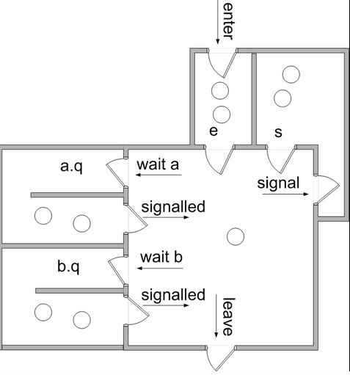
Signal and wait

Slide 71
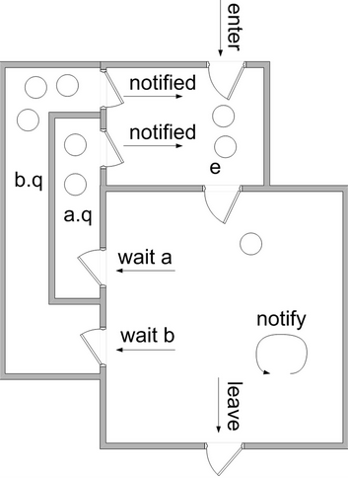
Signal and continue

Slide 72
Monitor Implementation Using Semaphores
Variables
semaphore e_mutex; // (initially = 1)
semaphore s_sem; // (initially = 0)
int s_count = 0;
Each procedure F will be replaced by
wait(e_mutex);
…
body of F;
…
if (s_count > 0)
signal(s_sem)
else
signal(e_mutex);
Mutual exclusion within a monitor is ensured

Slide 73
Monitor Implementation – Condition Variables
For each condition variable b, we have:
semaphore b_sem; // (initially = 0)
int b_count = 0;
The operation b.wait can be implemented as:
b_count++;
if (s_count > 0)
signal(s_sem);
else
signal(e_mutex);
wait(b_sem);
b_count--;

Slide 74
Monitor Implementation (Cont.)
The operation b.signal can be implemented as:
if (b_count > 0) {
s_count++;
signal(b_sem);
wait(s_sem);
s_count--;
}

Slide 75
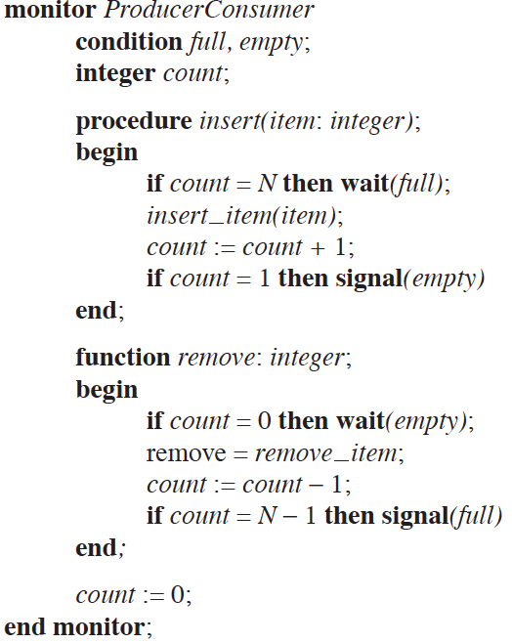
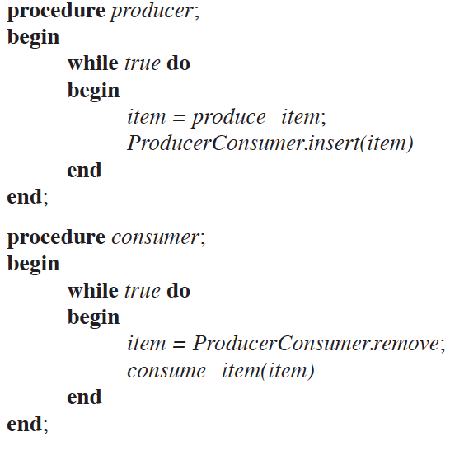
Monitor: producer-consumer

Slide 76
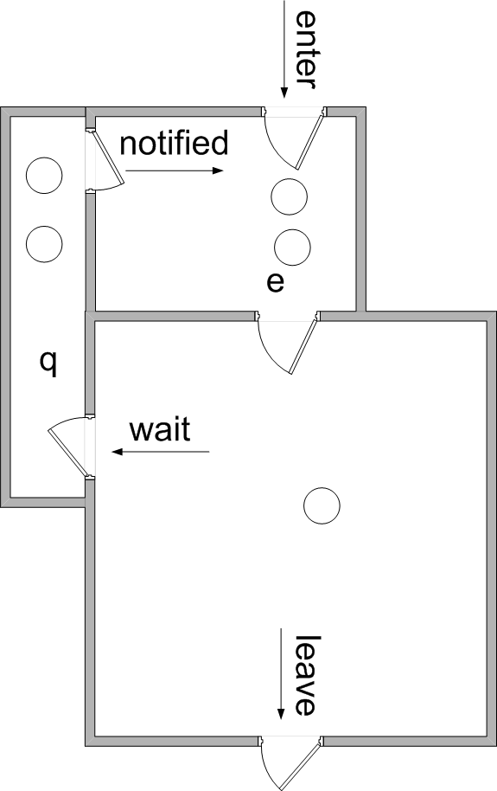
Java monitor
Give an example

Slide 77
Linux atomic integers
typedef struct {
int counter;
} atomic_t;
static inline void atomic_add(int i, atomic_t *v);
static inline int atomic_add_return(int i, atomic_t *v);
static inline void atomic_sub(int i, atomic_t *v);
static inline int atomic_sub_return(int i, atomic_t *v);
atomic_read;
atomic_set;
atomic_inc;
atomic_dec;

Slide 78
Linux spinlock
typedef struct spinlock {
struct raw_spinlock rlock;
} spinlock_t;
typedef struct raw_spinlock {
arch_spinlock_t raw_lock;
} raw_spinlock_t;
typedef struct { } arch_spinlock_t;
在单cpu，不可抢占内核中，自旋锁为空操作
在单cpu，可抢占内核中，自旋锁实现为“禁止内核抢占”，并不实现“自旋”
在多cpu，可抢占内核中，自旋锁实现为“禁止内核抢占” + “自旋”

Slide 79
Linux mutex lock
struct mutex
{
... ...
spinlock_t wait_lock;
struct list_head wait_list;
… ...
};
struct mutex mtx;
mutex_init(&mtx); /*定义*/
mutex_lock(&mtx); /*获取互斥锁*/
mutex_unlock(&mtx); /*释放互斥锁*/

Slide 80
Linux semaphore
struct semaphore {
raw_spinlock_t lock;
unsigned int count;
struct list_head wait_list;
};
void down(struct semaphore * sem); //wait, P
void up(struct semaphore * sem); //signal, V

Slide 81
Pthread synchronization
Mutex lock
  pthread_mutex_t mutex;
  pthread_mutex_init(&mutex, NULL);
  pthread_mutex_lock(&mutex);
  pthread_mutex_destroy(&mutex);
  pthread_mutex_unlock(&mutex);
Semaphore
  sem_t sem;
  sem_init(&sem, 0, 1);
  sem_wait(&sem);
  sem_post(&sem);
  sem_getvalue(&sem, &val);
  sem_destroy(&sem);
Give an example
Give an example

Slide 82
The End

Slide 83
Solution to Dining Philosophers
monitor DiningPhilosophers
{
enum {THINKING; HUNGRY, EATING} state [5] ;
condition self[5];
void pickup (int i) {
state[i] = HUNGRY;
test(i);
if (state[i] != EATING)
self[i].wait( );
}
void putdown (int i) {
state[i] = THINKING;
test((i + 4) % 5); // test left and right neighbors
test((i + 1) % 5);
}

Slide 84
Solution to Dining Philosophers (Cont.)
void test (int i)
{
if ( (state[(i + 4) % 5] != EATING) && (state[i] == HUNGRY) && (state[(i + 1) % 5] != EATING) )
{
state[i] = EATING ;
self[i].signal( ) ;
}
}
initialization_code()
{
for (int i = 0; i < 5; i++)
state[i] = THINKING;
}
}

Slide 85
Solution to Dining Philosophers (Cont.)
Each philosopher i invokes the operations pickup() and putdown() in the following sequence:
DiningPhilosophers.pickup (i);
//EAT
DiningPhilosophers.putdown (i);
No deadlock, but starvation is possible

Slide 86
Resuming Processes within a Monitor
If several processes queued on condition x, and x.signal() executed, which should be resumed?
FCFS frequently not adequate
conditional-wait construct of the form x.wait(c)
  Where c is priority number
  Process with lowest number (highest priority) is scheduled next

Slide 87
A Monitor to Allocate Single Resource
monitor ResourceAllocator
{
boolean busy;
condition x;
void acquire(int time) {
if (busy)
x.wait(time);
busy = TRUE;
}
void release() {
busy = FALSE;
x.signal();
}
initialization code() {
busy = FALSE;
}
}

