Slide 1
Chapter 8: Main Memory
May, 2018

Slide 2
Chapter 8: Memory Management
Background
Linking
Shared library and memory mapped files
Memory Allocation
Segmentation
Paging
Structure of the Page Table
Example: The Intel 32 and 64-bit Architectures, ARM Architecture

Slide 3
Objectives
To get an overall idea of virtual memory space
To discuss hardware support for virtual memory: paging and segmentation
To provide a detailed description of the Intel Pentium, which supports both pure segmentation and segmentation with paging

Slide 4
Background
Main memory and registers are only storage CPU can access directly
Program must be brought (from disk) into memory and placed within a process for it to be run
Memory unit only sees a stream of addresses + read requests, or address + data and write requests
Logical and physical address
Instruction counter， indexing， indirection， literal address， and so on
Dynamic linking and shared libraries
Notes:
literal address：直接地址

Slide 5
Background
Register access in one CPU clock (or less)
Main memory can take many cycles, causing a stall
Cache sits between main memory and CPU registers
Notes:
Stall：失速，延迟

Slide 6

Storage-Device Hierarchy

Slide 7

Performance of Various Levels of Storage

Slide 8
Program on disk
0
ELF header
Maps contiguous file sections to runtime memory segments
Program header table
.init
Read-only memory segment
(code segment)
.text
.rodata
.data
Read/write memory segment
(data segment)
.bss
.symtab
.debug
Symbol table and debugging info are not
loaded into memory
.line
Describes object file sections
.strtab
Section header table

Slide 9
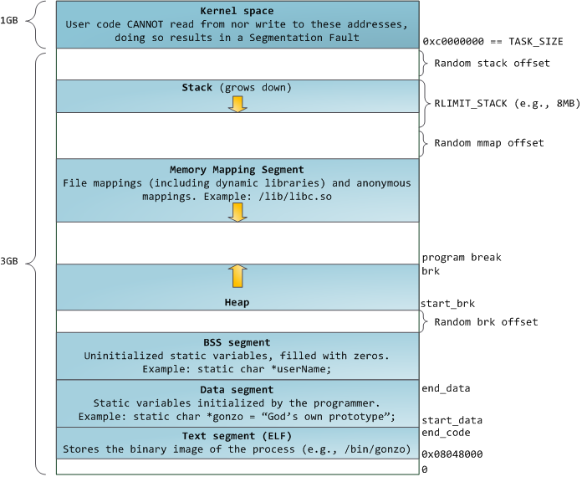
Virtual address space
kernel
stack
MMAP
heap
BSS
DATA
TEXT

Slide 10
Logical vs. Physical Address Space
The concept of a logical address space that is bound to a separate physical address space is central to proper memory management
  Logical address – generated by the CPU; also referred to as virtual address
  Physical address – address seen by the memory unit
Logical address space is the set of all logical addresses generated by a program
Physical address space is the set of all physical addresses generated by a program

Slide 11
Memory-Management Unit (MMU)
Hardware device that at run time maps virtual to physical address
To start, consider simple scheme where the value in the relocation register is added to every address generated by a user process at the time it is sent to memory
  Base register： relocation register

Slide 12

Base and Limit Registers
A pair of base and limit registers define the logical address space
CPU must check every memory access generated in user mode to be sure it is between base and limit for that user
Notes:
Remedy：补救方法
Privileged：有特权的

Slide 13
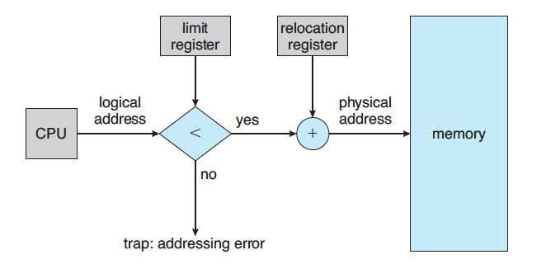
Hardware Address Protection

Slide 14

Dynamic relocation using a relocation register

Slide 15

Multistep Processing of a User Program

Slide 16
Binding of Instructions and Data to Memory
Address binding of instructions and data to memory addresses can happen at three different stages
  Compile time: If memory location known a priori, absolute code can be generated; must recompile code if starting location changes
  Load time: Must generate relocatable code if memory location is not known at compile time
  Execution time: Binding delayed until run time if the process can be moved during its execution from one memory segment to another

Slide 17
Static linking
0
ELF header
Maps contiguous file sections to runtime memory segments
Program header table
.init
Read-only memory segment
(code segment)
.text
.rodata
.data
Read/write memory segment
(data segment)
.bss
.symtab
.debug
Symbol table and debugging info are not
loaded into memory
.line
Describes object file sections
.strtab
Section header table
Give an example
Notes:
gcc –c addvec.c mulvec.c
ar rcs libvector.a addvec.o mulvec.o
gcc -static main.c -L. -lvector

Slide 18
Dynamic Linking
Dynamic linking is particularly useful for libraries
System also known as shared libraries
Consider applicability to patching system libraries
  Versioning may be needed
MMAP
Give an example
Notes:
gcc –shared –fpic –o libvector.so addvec.c mulvec.c
gcc main.c ./libvector.so

Slide 19
Dynamic loading and shared library
MMAP
Give an example
Notes:
gcc –rdynamic dll.c -ldl

Slide 20
Dynamic Memory Allocation
heap

Slide 21
Dynamic memory allocation
brk
0 | 4 | 8 | 12 | 16 | 20 | 24 | 28 | 32 | 36

Slide 22
Fragmentation
External Fragmentation – total memory space exists to satisfy a request, but it is not contiguous
Internal Fragmentation – allocated memory may be slightly larger than requested memory; this size difference is memory internal to a partition, but not being used
0 | 4 | 8 | 12 | 16 | 20 | 24 | 28 | 32 | 36

Slide 23
Fragmentation (Cont.)
Reduce external fragmentation by compaction
0 | 4 | 8 | 12 | 16 | 20 | 24 | 28 | 32 | 36

Slide 24
Dynamic Storage-Allocation Problem
First-fit: Allocate the first hole that is big enough
Best-fit: Allocate the smallest hole that is big enough; must search entire list, unless ordered by size
  Produces the smallest leftover hole
Worst-fit: Allocate the largest hole; must also search entire list
  Produces the largest leftover hole
0 | 4 | 8 | 12 | 16 | 20 | 24 | 28 | 32 | 36

Slide 25
Virtual address space
kernel
stack
MMAP
heap
BSS
DATA
TEXT

Slide 26
Segmentation
Memory-management scheme that supports user view of memory
A program is a collection of segments
  main program
  procedure
  function
  method
  object
  local variables, global variables
  common block
  stack
  symbol table
  arrays

Slide 27

User’s View of a Program

Slide 28
Logical View of Segmentation
1
1
4
2
3
4
2
3
user space
physical memory space

Slide 29
Segmentation Architecture
Logical address consists of a two tuple:
<segment-number, offset>,
Segment table – maps two-dimensional physical addresses; each table entry has:
  base – contains the starting physical address where the segments reside in memory
  limit – specifies the length of the segment
Segment-table base register (STBR) points to the segment table’s location in memory
Segment-table length register (STLR) indicates number of segments used by a program;
segment number s is legal if s < STLR

Slide 30

Segmentation Hardware

Slide 31
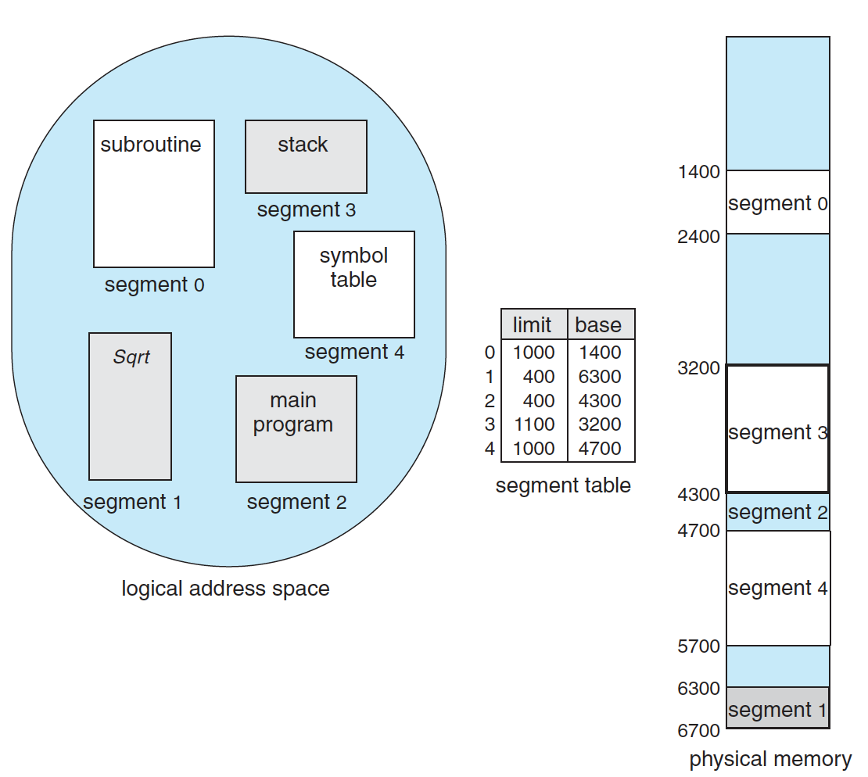
Example

Slide 32
Paging
Physical address space of a process can be noncontiguous; process is allocated physical memory whenever the latter is available
  Avoids external fragmentation
  Avoids problem of varying sized memory chunks

Slide 33
Paging
Divide physical memory into fixed-sized blocks called frames
  Size is power of 2, between 512 bytes and 16 Mbytes
Divide logical memory into blocks of same size called pages

Slide 34
Paging
Keep track of all free frames
To run a program of size N pages, need to find N free frames and load program
Set up a page table to translate logical to physical addresses
Still have Internal fragmentation

Slide 35

Paging Model of Logical and Physical Memory

Slide 36
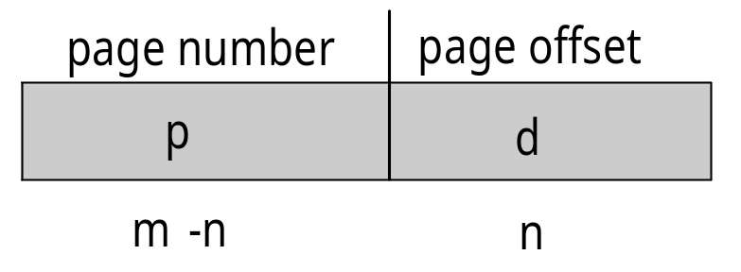
Address Translation Scheme
Address generated by CPU is divided into:
  Page number (p) – used as an index into a page table which contains base address of each page in physical memory
  Page offset (d) – combined with base address to define the physical memory address that is sent to the memory unit
  For given logical address space 2^{m} and page size 2^{n}

Slide 37
Implementation of Page Table
Page table is kept in main memory
Page-table base register (PTBR) points to the page table
Page-table length register (PTLR) indicates size of the page table

Slide 38

Paging Hardware

Slide 39

Paging Example
n=2 and m=4 32-byte memory and 4-byte pages

Slide 40

Free Frames
Before allocation
After allocation

Slide 41
Paging (Cont.)
Calculating internal fragmentation
  Page size = 2,048 bytes
  Process size = 72,766 bytes
  35 pages + 1,086 bytes
  Internal fragmentation of 2,048 - 1,086 = 962 bytes
  Worst case fragmentation = 1 frame – 1 byte
  On average fragmentation = 1 / 2 frame size
  So small frame sizes desirable?
  But each page table entry takes memory to track

Slide 42
Memory Protection
Memory protection implemented by associating protection bit with each frame to indicate if read-only or read-write access is allowed
  Can also add more bits to indicate page execute-only, and so on
Valid-invalid bit attached to each entry in the page table:
Any violations result in a trap to the kernel

Slide 43

Valid (v) or Invalid (i) Bit In A Page Table

Slide 44
Shared Pages
Shared code
  One copy of read-only (reentrant) code shared among processes (i.e., text editors, compilers, window systems)
  Similar to multiple threads sharing the same process space
  Also useful for interprocess communication if sharing of read-write pages is allowed
Private code and data
  Each process keeps a separate copy of the code and data
  The pages for the private code and data can appear anywhere in the logical address space

Slide 45

Shared Pages Example

Slide 46
Structure of the Page Table
Memory structures for paging can get huge using straight-forward methods
  Consider a 32-bit logical address space as on modern computers
  Page size of 4 KB (2¹²)
  Page table would have 1 million entries (2³² / 2¹²)
  If each entry is 4 bytes -> 4 MB of physical address space / memory for page table alone
    That amount of memory used to cost a lot

Slide 47
Structure of the Page Table
Hierarchical Paging
Hashed Page Tables
Inverted Page Tables

Slide 48
Hierarchical Page Tables
Break up the logical address space into multiple page tables
A simple technique is a two-level page table
We then page the page table

Slide 49

Two-Level Page-Table Scheme

Slide 50
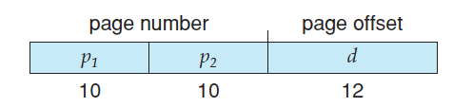
Two-Level Paging Example
A logical address (on 32-bit machine with 1K page size) is divided into:
  a page number consisting of 20 bits
  a page offset consisting of 12 bits
Since the page table is paged, the page number is further divided into:
  a 10-bit page number
  a 10-bit page offset
Thus, a logical address is as follows:

Slide 51

Address-Translation Scheme

Slide 52
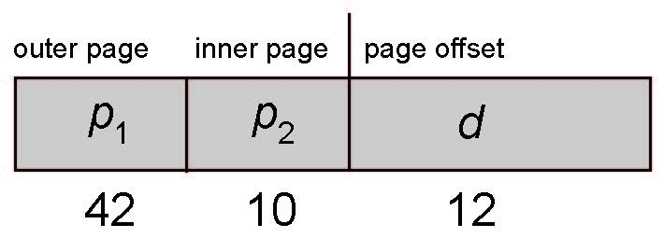
64-bit Logical Address Space
Even two-level paging scheme not sufficient
If page size is 4 KB (2¹²)
  Then page table has 2⁵² entries
  If two level scheme, inner page tables could be 2¹⁰
  4-byte entries
  Address would look like

Slide 53
64-bit Logical Address Space
  Outer page table has 2⁴² entries or 2⁴⁴ bytes
  One solution is to add a 2nd outer page table
  But in the following example the 2nd outer page table is still 2³⁴ bytes in size
    And possibly 4 memory access to get to one physical memory location

Slide 54


Three-level Paging Scheme

Slide 55
Implementation of Page Table
In this scheme every data/instruction access requires two memory accesses
  One for the page table and one for the data / instruction
The two memory access problem can be solved by the use of a special fast-lookup hardware cache called associative memory or translation look-aside buffers (TLBs)

Slide 56
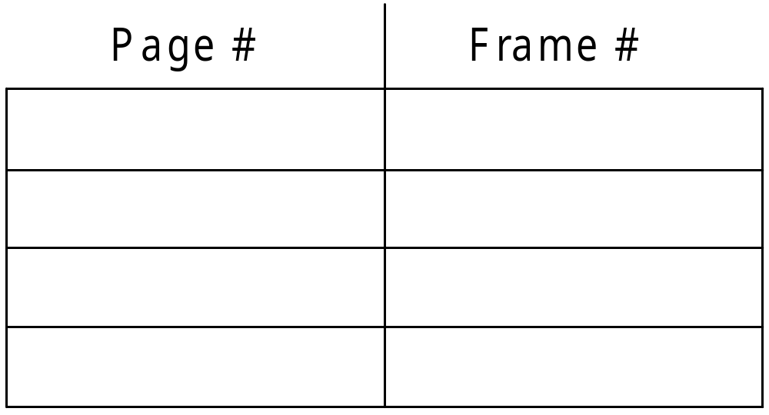
TLB

Slide 57

Paging Hardware With TLB

Slide 58
Effective Access Time
Associative Lookup = ε time unit
  Can be < 10% of memory access time
Hit ratio = α
  Hit ratio – percentage of times that a page number is found in the associative registers; ratio related to number of associative registers

Slide 59
Effective Access Time
Effective Access Time (EAT)
EAT = (t + ε) α + (2t + ε)(1 – α)
Consider α = 80%, 100ns for memory access
  EAT = 0.80 x 100 + 0.20 x 200 = 120ns
Consider more realistic hit ratio -> α = 99%, 100ns for memory access
  EAT = 0.99 x 100 + 0.01 x 200 = 101ns

Slide 60
Hashed Page Tables
Common in address spaces > 32 bits
The virtual page number is hashed into a page table
  This page table contains a chain of elements hashing to the same location
Each element contains (1) the virtual page number (2) the value of the mapped page frame (3) a pointer to the next element
Virtual page numbers are compared in this chain searching for a match
  If a match is found, the corresponding physical frame is extracted

Slide 61

Hashed Page Table

Slide 62
Hashed Page Tables
Variation for 64-bit addresses is clustered page tables
Similar to hashed but each entry refers to several pages (such as 16) rather than 1

Slide 63
Inverted Page Table
Rather than each process having a page table and keeping track of all possible logical pages, track all physical pages
One entry for each real page of memory
Entry consists of the virtual address of the page stored in that real memory location, with information about the process that owns that page
<process-id, page-number, offset>

Slide 64

Inverted Page Table Architecture

Slide 65
Inverted Page Table
Decreases memory needed to store each page table, but increases time needed to search the table when a page reference occurs
  Use hash table to limit the search to one — or at most a few — page-table entries
  TLB can accelerate access
But shared memory?

Slide 66
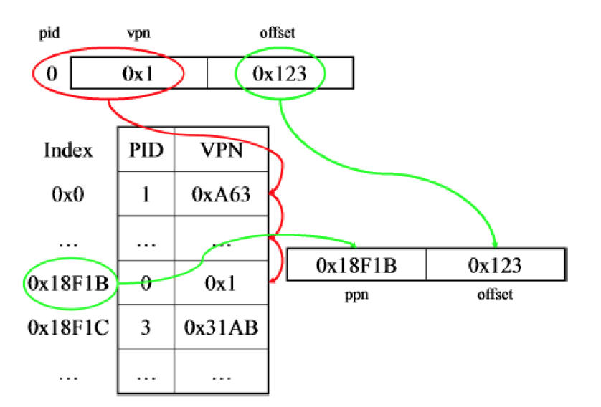
Hashed inverted table

Slide 67
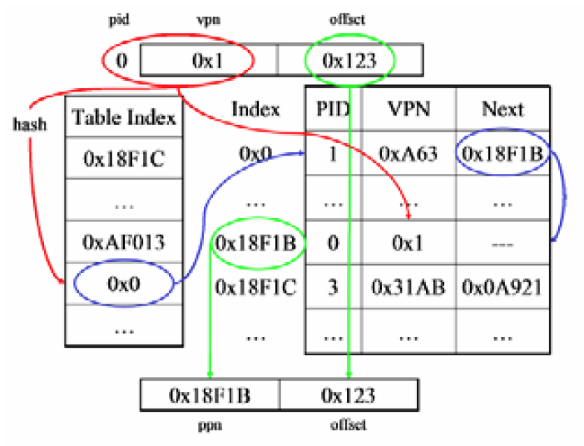
Hashed inverted table

Slide 68
Example: The Intel 32 and 64-bit Architectures
Dominant industry chips
Pentium CPUs are 32-bit and called IA-32 architecture
Current Intel CPUs are 64-bit and called IA-64 architecture
Many variations in the chips, cover the main ideas here

Slide 69
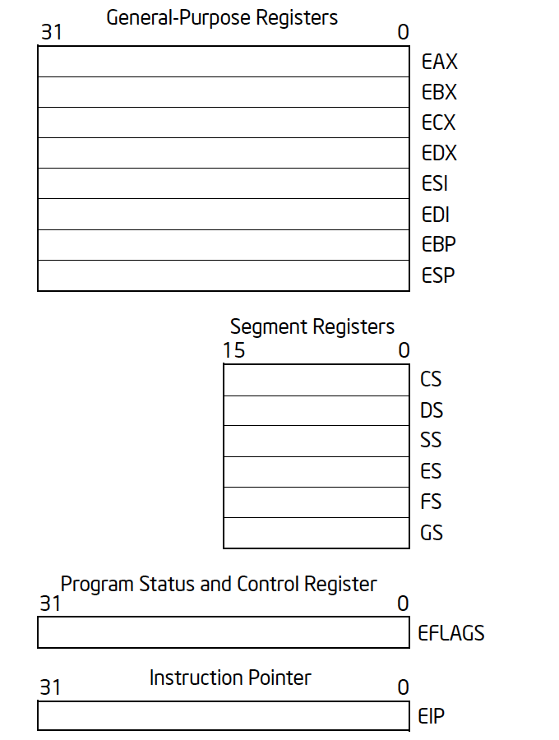
IA32 registers

Slide 70
IA32 registers
GDTR
LDTR
CR3

Slide 71

The IA-32 Address Translation

Slide 72
Example: The Intel IA-32 Architecture
Supports both segmentation and segmentation with paging
  Each segment can be 4 GB
  Up to 16 K segments per process
  Divided into two partitions
    First partition of up to 8 K segments are private to process (kept in local descriptor table (LDT))
    Second partition of up to 8K segments shared among all processes (kept in global descriptor table (GDT))

Slide 73

Example: The Intel IA-32 Architecture (Cont.)
CPU generates logical address
  Selector given to segmentation unit
    Which produces linear addresses

Slide 74
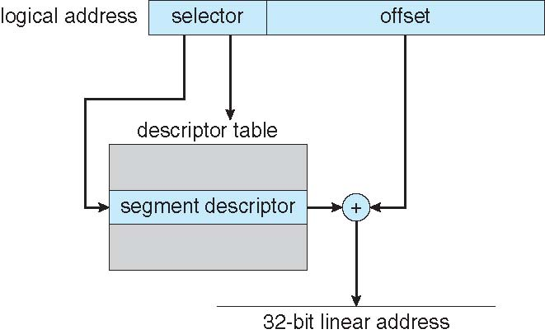
Intel IA-32 Segmentation

Slide 75

Example: The Intel IA-32 Architecture (Cont.)
Linear address given to paging unit
    Which generates physical address in main memory
    Pages sizes can be 4 KB or 4 MB

Slide 76

Intel IA-32 Paging Architecture

Slide 77
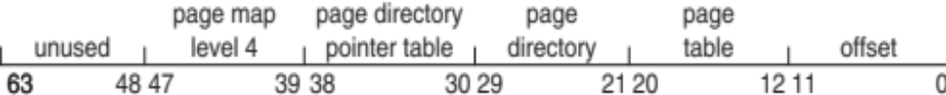
Intel x86-64
Current generation Intel x86 architecture
64 bits is ginormous (> 16 exabytes)
In practice only implement 48 bit addressing
  Page sizes of 4 KB, 2 MB, 1 GB
  Four levels of paging hierarchy

Slide 78
Example: ARM Architecture
Dominant mobile platform chip (Apple iOS and Google Android devices for example)
Modern, energy efficient, 32-bit CPU
  4 KB and 16 KB pages
  1 MB and 16 MB pages (termed sections)
One-level paging for sections, two-level for smaller pages
Two levels of TLBs
  Outer level has two micro TLBs (one data, one instruction)
  Inner is single main TLB
  First inner is checked, on miss outers are checked, and on miss page table walk performed by CPU

Slide 79
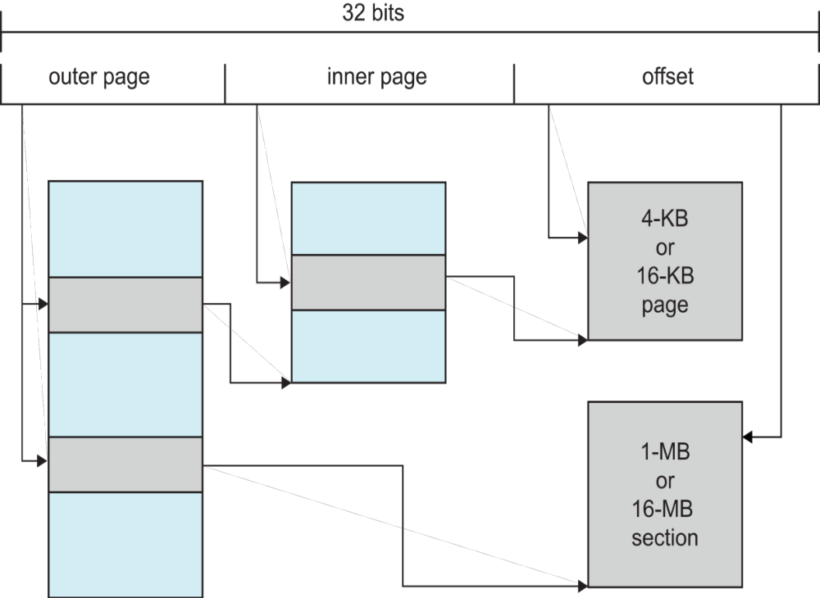
Example: ARM Architecture

Slide 80
End of Chapter 8

Slide 81
Swapping
A process can be swapped temporarily out of memory to a backing store, and then brought back into memory for continued execution
  Total physical memory space of processes can exceed physical memory
Backing store – fast disk large enough to accommodate copies of all memory images for all users; must provide direct access to these memory images
Roll out, roll in – swapping variant used for priority-based scheduling algorithms; lower-priority process is swapped out so higher-priority process can be loaded and executed
Major part of swap time is transfer time; total transfer time is directly proportional to the amount of memory swapped
System maintains a ready queue of ready-to-run processes which have memory images on disk

Slide 82
Swapping (Cont.)
Does the swapped out process need to swap back in to same physical addresses?
Depends on address binding method
  Plus consider pending I/O to / from process memory space
Modified versions of swapping are found on many systems (i.e., UNIX, Linux, and Windows)
  Swapping normally disabled
  Started if more than threshold amount of memory allocated
  Disabled again once memory demand reduced below threshold

Slide 83

Schematic View of Swapping

Slide 84
Context Switch Time including Swapping
If next processes to be put on CPU is not in memory, need to swap out a process and swap in target process
Context switch time can then be very high
100MB process swapping to hard disk with transfer rate of 50MB/sec
  Swap out time of 2000 ms
  Plus swap in of same sized process
  Total context switch swapping component time of 4000ms (4 seconds)
Can reduce if reduce size of memory swapped – by knowing how much memory really being used
  System calls to inform OS of memory use via request_memory() and release_memory()

Slide 85
Context Switch Time and Swapping (Cont.)
Other constraints as well on swapping
  Pending I/O – can’t swap out as I/O would occur to wrong process
  Or always transfer I/O to kernel space, then to I/O device
    Known as double buffering, adds overhead
Standard swapping not used in modern operating systems
  But modified version common
    Swap only when free memory extremely low

Slide 86
Swapping on Mobile Systems
Not typically supported
  Flash memory based
    Small amount of space
    Limited number of write cycles
    Poor throughput between flash memory and CPU on mobile platform
Instead use other methods to free memory if low
  iOS asks apps to voluntarily relinquish allocated memory
    Read-only data thrown out and reloaded from flash if needed
    Failure to free can result in termination
  Android terminates apps if low free memory, but first writes application state to flash for fast restart
  Both OSes support paging as discussed below

