Slide 1
Chapter 9: Virtual Memory
May， 2018

Slide 2
Chapter 9: Virtual Memory
Background
Swapping
Demand Paging
Copy-on-Write
Page Replacement
Allocation of Frames
Thrashing
Other Considerations

Slide 3
Objectives
To explain the concepts of swapping, demand paging, page-replacement algorithms, and allocation of page frames
To discuss the principle of the working-set model
To explore how physical memory is allocated in the kernel

Slide 4
Swapping
A process can be swapped temporarily out of memory to a backing store, and then brought back into memory for continued execution
Backing store – fast disk large enough to accommodate copies of all memory images for all users; must provide direct access to these memory images

Slide 5

Schematic View of Swapping

Slide 6
Context Switch Time including Swapping
Context switch time can then be very high
100MB process swapping to hard disk with transfer rate of 50MB/sec
  Swap out time of 2000 ms
  Plus swap in of same sized process
  Total context switch swapping component time of 4000ms (4 seconds)

Slide 7
Context Switch Time and Swapping (Cont.)
Other constraints as well on swapping
  Pending I/O – can’t swap out as I/O would occur to wrong process
  Or always transfer I/O to kernel space, then to I/O device
    Known as double buffering, adds overhead

Slide 8

Swapping with paging

Slide 9

Virtual Memory That is Larger Than Physical Memory
  Total physical memory space of processes can exceed physical memory

Slide 10
Demand Paging
Could bring entire process into memory at load time
Or bring a page into memory only when it is needed
  Less I/O needed, no unnecessary I/O
  Less memory needed
  More users
Page is needed ⇒ reference to it
  invalid reference ⇒ abort
  not-in-memory ⇒ bring to memory
Lazy swapper – never swaps a page into memory unless page will be needed
  Swapper that deals with pages is a pager

Slide 11
Basic Concepts
If pages needed are already memory resident
  No difference from non demand-paging
If page needed and not memory resident
  Need to detect and load the page into memory from storage
    Without changing program behavior
    Without programmer needing to change code

Slide 12

Valid-Invalid Bit
With each page table entry a valid–invalid bit is associated
(v ⇒ in-memory – memory resident, i ⇒ not-in-memory)
Initially valid–invalid bit is set to i on all entries
Example of a page table snapshot:
During MMU address translation, if valid–invalid bit in page table entry is i ⇒ page fault

Slide 13

Page Table When Some Pages Are Not in Main Memory

Slide 14
Page Fault
If there is a reference to a page, first reference to that page will trap to operating system: page fault
Operating system decides:
  Invalid reference ⇒ abort
  Just not in memory
Find free frame
Swap page into frame via scheduled disk operation
Reset tables to indicate page now in memory
Set validation bit = v
Restart the instruction that caused the page fault

Slide 15

Steps in Handling a Page Fault
Swap

Slide 16
Aspects of Demand Paging
Extreme case – start process with no pages in memory
  OS sets instruction pointer to first instruction of process, non-memory-resident -> page fault
  And for every other process pages on first access
  Pure demand paging
Actually, a given instruction could access multiple pages -> multiple page faults
  Consider fetch and decode of instruction which adds 2 numbers from memory and stores result back to memory
  Pain decreased because of locality of reference
Hardware support needed for demand paging
  Page table with valid / invalid bit
  Secondary memory (swap device with swap space)
  Instruction restart (interrupt handling)

Slide 17

Instruction Restart
Consider an instruction that could access several different locations
  block move
  auto increment/decrement location
  Restart the whole operation?
    What if source and destination overlap? (source modified)

Slide 18
Steps in Handling a Page Fault

Slide 19
Steps of Demand Paging
Trap to the operating system
Save the user registers and process state
Determine that the interrupt was a page fault
Check that the page reference was legal and determine the location of the page on the disk
Issue a read from the disk to a free frame:
  Wait in a queue for this device until the read request is serviced
  Wait for the device seek and/or latency time
  Begin the transfer of the page to a free frame

Slide 20
Steps of Demand Paging
While waiting, allocate the CPU to some other user
Receive an interrupt from the disk I/O subsystem (I/O completed)
Save the registers and process state for the other user
Determine that the interrupt was from the disk
Correct the page table and other tables to show page is now in memory
Wait for the CPU to be allocated to this process again
Restore the user registers, process state, and new page table, and then resume the interrupted instruction

Slide 21
Performance of Demand Paging (Cont.)
Three major activities
  Service the interrupt – careful coding means just several hundred instructions needed
  Read the page – lots of time
  Restart the process – again just a small amount of time
Page Fault Rate 0 ≤ p ≤ 1
  if p = 0 no page faults
  if p = 1, every reference is a fault
Effective Access Time (EAT)
EAT = (1 – p) x memory access
+ p (page fault overhead
+ swap page out
+ swap page in )

Slide 22
Demand Paging Example
Memory access time = 200 nanoseconds
Average page-fault service time = 8 milliseconds
EAT = (1 – p) x 200 + p (8 milliseconds)
= (1 – p) x 200 + p x 8,000,000
= 200 + p x 7,999,800
If one access out of 1,000 causes a page fault, then
EAT = 8.2 microseconds.
41*200ns
If want performance degradation < 10 percent
  220 > 200 + 7,999,800 x p
  20 > 7,999,800 x p
  p < .0000025
  < one page fault in every 400,000 memory accesses

Slide 23
Demand Paging Optimizations
Swap space I/O faster than file system I/O even if on the same device
  Swap allocated in larger chunks, less management needed than file system
Copy entire process image to swap space at process load time
  Then page in and out of swap space
Demand page in from program binary on disk, but discard rather than paging out when freeing frame
  Read-only
  Not modified (dirty)

Slide 24
Copy-on-Write
vfork() variation on fork()system call has parent suspend and child using copy-on-write address space of parent
  Designed to have child call exec()
  Very efficient

Slide 25
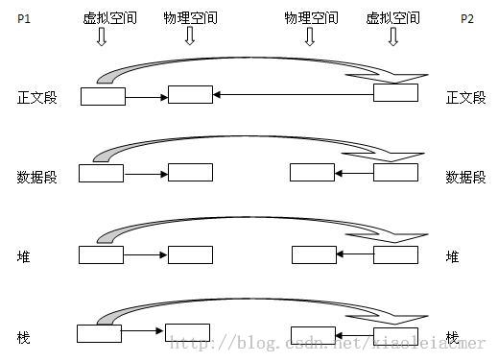
fork

Slide 26
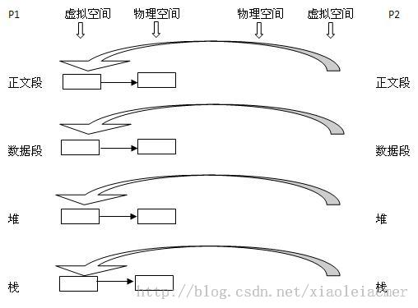
vfork / thread_create

Slide 27
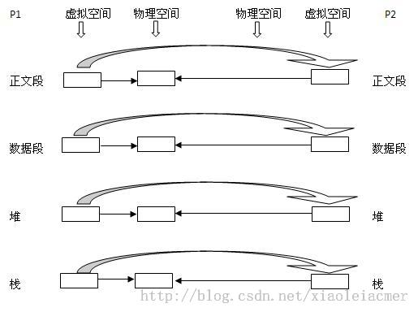
fork: copy-on-write (cow)

Slide 28
Copy-on-Write
Copy-on-Write (COW) allows both parent and child processes to initially share the same pages in memory
  If either process modifies a shared page, only then is the page copied
COW allows more efficient process creation as only modified pages are copied

Slide 29

Before Process 1 Modifies Page C

Slide 30

After Process 1 Modifies Page C
Minor page fault

Slide 31
What Happens if There is no Free Frame?
Page replacement – find some page in memory, but not really in use, page it out
Page buffering
  A free frame pool
  keep list of modified pages, when backing store otherwise idle, write pages there
  If referenced again before reused, no need to load contents again from disk
  Minor page fault

Slide 32
Summary
Major page fault (from disk)
  Swap area
  Disk file system
Minor page fault (from memory)
  COW
  Page buffering
Give an example
Notes:
ps -eo min_flt,maj_flt,cmd
/usr/bin/time -v firefox
top
vmstat -1

Slide 33
Basic Page Replacement
Find the location of the desired page on disk
Find a free frame:
  If there is a free frame, use it
  If there is no free frame, use a page replacement algorithm to select a victim frame
  Write victim frame to disk if dirty
Bring the desired page into the (newly) free frame; update the page and frame tables
Continue the process by restarting the instruction that caused the trap

Slide 34

Page Replacement
f | v
xxx | i

Slide 35
Replacement algorithm
Page-replacement algorithm
  Want lowest page-fault rate
Time for replacement
Scope of replacement

Slide 36


Fixed/Dynamic Allocation
Equal allocation – For example, if there are 100 frames (after allocating frames for the OS) and 5 processes, give each process 20 frames
Proportional allocation – Allocate according to the size of process
Dynamic allocation

Slide 37
Global vs. Local Allocation
Local replacement – each process selects from only its own set of allocated frames
  More consistent per-process performance
  But possibly underutilized memory
Global replacement – process selects a replacement frame from the set of all frames; one process can take a frame from another
  Then process execution time can vary greatly
  But greater throughput so more common

Slide 38
Non-Uniform Memory Access
So far all memory accessed equally
Many systems are NUMA – speed of access to memory varies
  Consider system boards containing CPUs and memory, interconnected over a system bus
Optimal performance comes from allocating memory “close to” the CPU on which the thread is scheduled
  And modifying the scheduler to schedule the thread on the same system board when possible
  Solved by Solaris by creating lgroups
    Structure to track CPU / Memory low latency groups
    Used my schedule and pager
    When possible schedule all threads of a process and allocate all memory for that process within the lgroup

Slide 39
Replacement Algorithms
Evaluate algorithm by running it on a particular string of memory references (reference string) and computing the number of page faults on that string
  String is just page numbers, not full addresses
  Results depend on number of frames available
In all our examples, the reference string of referenced page numbers is
  7,0,1,2,0, 3,0,4,2,3, 0,3,0,3,2, 1,2,0,1,7, 0,1
  3 physical frames
  Local or global does not matter

Slide 40

Graph of Page Faults Versus The Number of Frames

Slide 41
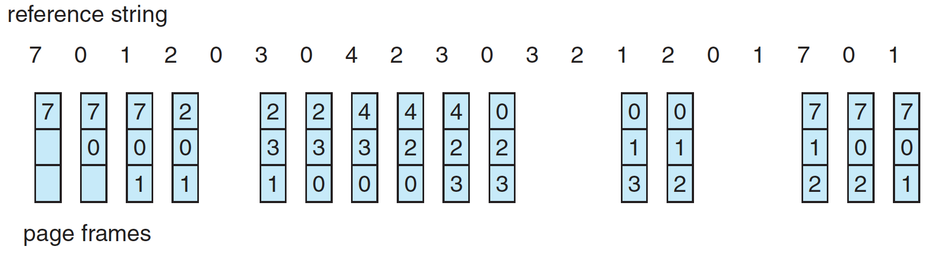
First-In-First-Out (FIFO) Algorithm
Reference string:
7,0,1,2,0,3,0,4,2,3,0,3,0,3,2,1,2,0,1,7,0,1
3 frames (3 pages can be in memory at a time per process)

Slide 42
First-In-First-Out (FIFO) Algorithm
Can vary by reference string: consider 1,2,3,4,1,2,5,1,2,3,4,5
  Adding more frames can cause more page faults!
  4 vs 3 frames
    Belady’s Anomaly

Slide 43

FIFO Illustrating Belady’s Anomaly

Slide 44
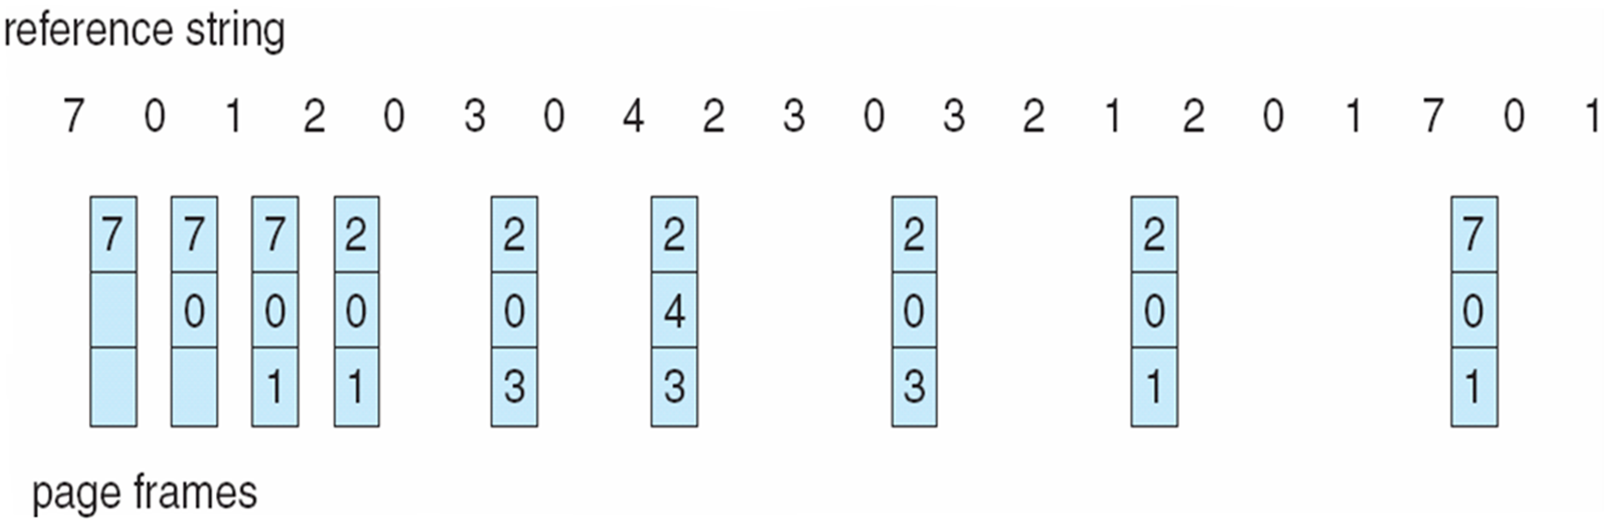
Optimal Page Replacement
Replace page that will not be used for longest period of time
  7,0,1,2,0,3,0,4,2,3,0,3,0,3,2,1,2,0,1,7,0,1

Slide 45
Optimal Algorithm
Replace page that will not be used for longest period of time
How do you know this?
  Can’t read the future
Used for measuring how well your algorithm performs

Slide 46
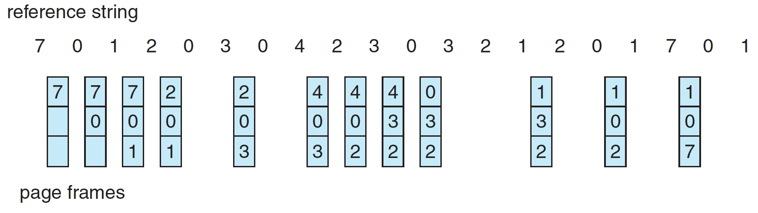
Least Recently Used (LRU) Algorithm
Use past knowledge rather than future
Replace page that has not been used in the most amount of time
Associate time of last use with each page
    7,0,1,2,0,3,0,4,2,3,0,3,0,3,2,1,2,0,1,7,0,1

Slide 47
Least Recently Used (LRU) Algorithm
Use past knowledge rather than future
Replace page that has not been used in the most amount of time
Associate time of last use with each page
Generally good algorithm and frequently used
But how to implement?

Slide 48
LRU Algorithm (Cont.)
Counter implementation
  Every page entry has a counter; every time page is referenced through this entry, copy the clock into the counter
  When a page needs to be changed, look at the counters to find smallest value
    Search through table needed

Slide 49
LRU Algorithm (Cont.)
Stack implementation
  Keep a stack of page numbers in a double link form:
  Page referenced:
    move it to the top
  No search for replacement, but each update more expensive
LRU and OPT are cases of stack algorithms that don’t have Belady’s Anomaly

Slide 50
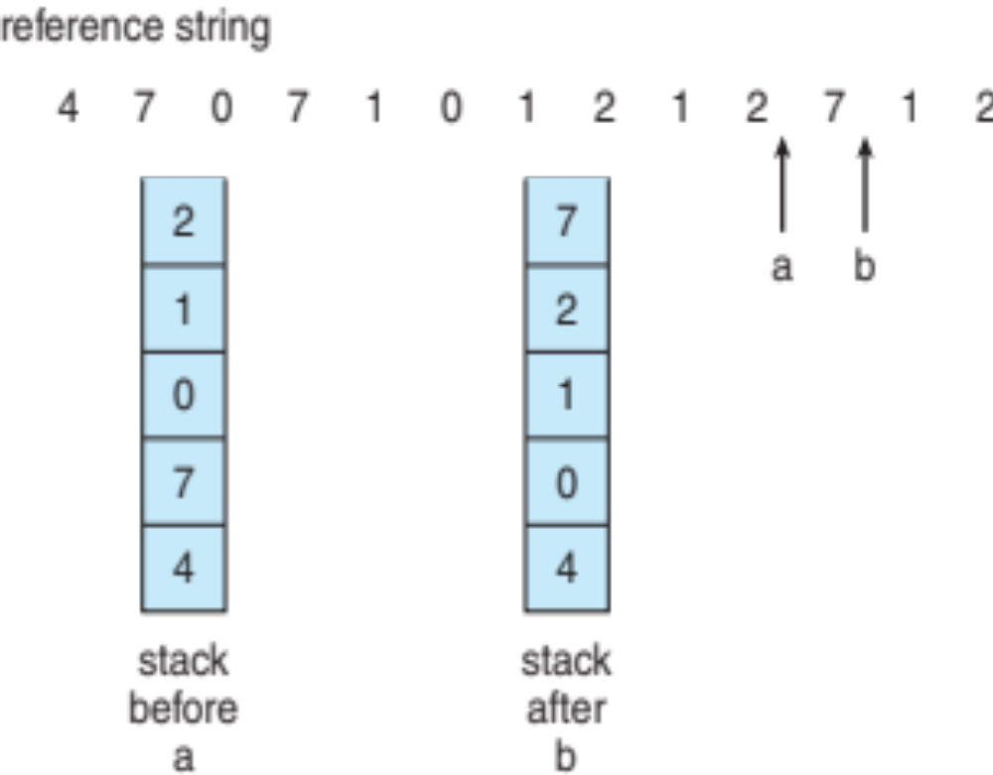
Use Of A Stack to Record Most Recent Page References

Slide 51
LRU Approximation Algorithms
LRU still slow
Reference bit
  With each page associate a bit, initially = 0
  When page is referenced bit set to 1
  Replace any with reference bit = 0 (if one exists)
Page frame NO. |  |  |  | M | R | V
modify
valid
Or block NO. on disk
reference

Slide 52
Second chance Algorithms
Second-chance algorithm
Clock algorithm
  Reference bit = 0 -> replace it
  reference bit = 1 then:
    set reference bit 0, leave page in memory
    Go to next page, subject to same rules

Slide 53
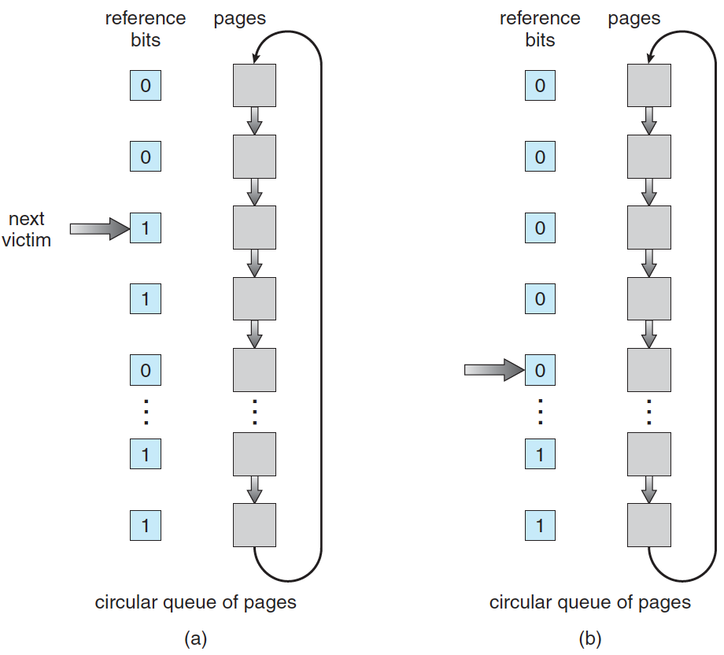
Second-Chance (clock) Page-Replacement Algorithm

Slide 54
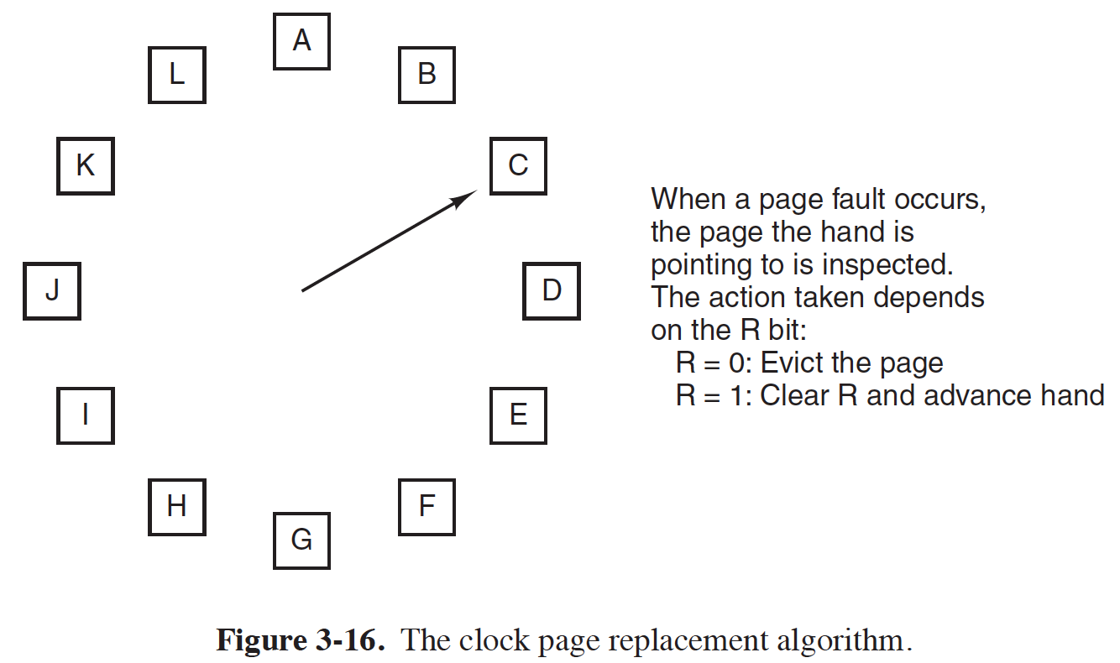
Clock algorithm

Slide 55
Enhanced Second-Chance Algorithm
Improve algorithm by using reference bit and modify bit (if available) in concert
Page frame NO. |  |  |  | M | R | V
modify
valid
Or block NO. on disk
reference

Slide 56
Enhanced Second-Chance Algorithm
Take ordered pair (reference, modify)
  (0, 0) neither recently used not modified
  (0, 1) not recently used but modified
  (1, 0) recently used but clean
  (1, 1) recently used and modified
When page replacement called for, use the clock scheme but use the four classes replace page in lowest non-empty class
  Might need to search circular queue several times

Slide 57
Additional reference-bits algorithm
Reference byte
1000000
Time interrupt, shift right
  01000000
  11000000
LRU: smallest

Slide 58
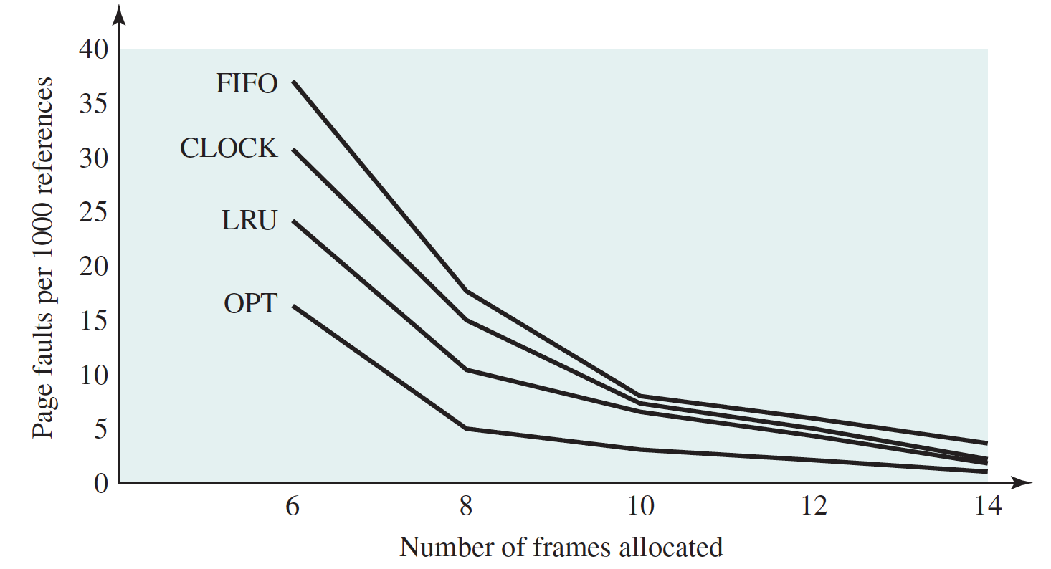
Comparison

Slide 60
Thrashing
If a process does not have “enough” pages, the page-fault rate is very high
  Page fault to get page
  Replace existing frame
  But quickly need replaced frame back
Thrashing ≡ a process is busy swapping pages in and out

Slide 61
Thrashing
This leads to:
    Low CPU utilization
    Operating system thinking that it needs to increase the degree of multiprogramming
    Another process added to the system
Thrashing ≡ a process is busy swapping pages in and out

Slide 62

Thrashing (Cont.)

Slide 63
Prevent Thrashing
Why does demand paging work?
Locality model
  Process migrates from one locality to another
Why does thrashing occur?
Σ size of locality > total memory size

Slide 64

Locality In A Memory-Reference Pattern

Slide 65
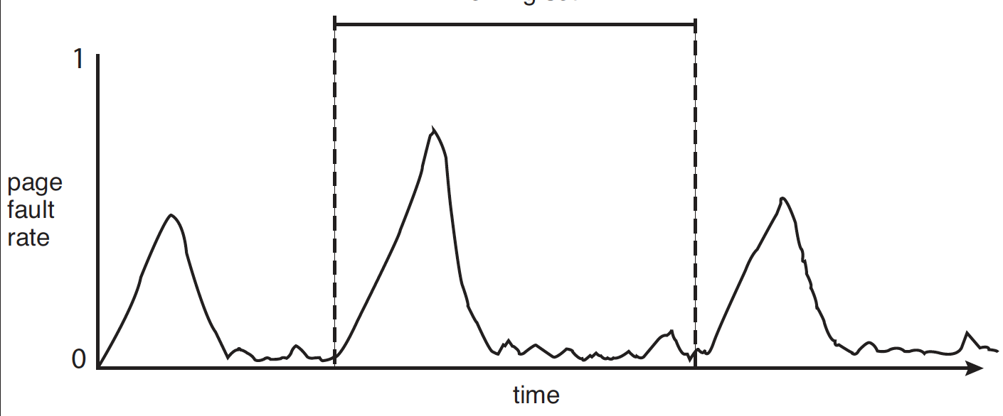
Locality and Page Fault Rates

Slide 66

Working-Set Model
Working set: w(Δ,t)
  Δ ≡ working-set window ≡ a fixed number of page references. Example: 10,000 instructions
  t
WSS_{i} (working set size of Process P_{i}) =
total number of pages referenced in the most recent Δ page references

Slide 67
Working-Set Model
WSS_{i} =
total number of pages referenced in the most recent Δ page references
  if Δ too small will not encompass entire locality
  if Δ too large will encompass several localities
  if Δ = ∞ ⇒ will encompass entire program

Slide 68
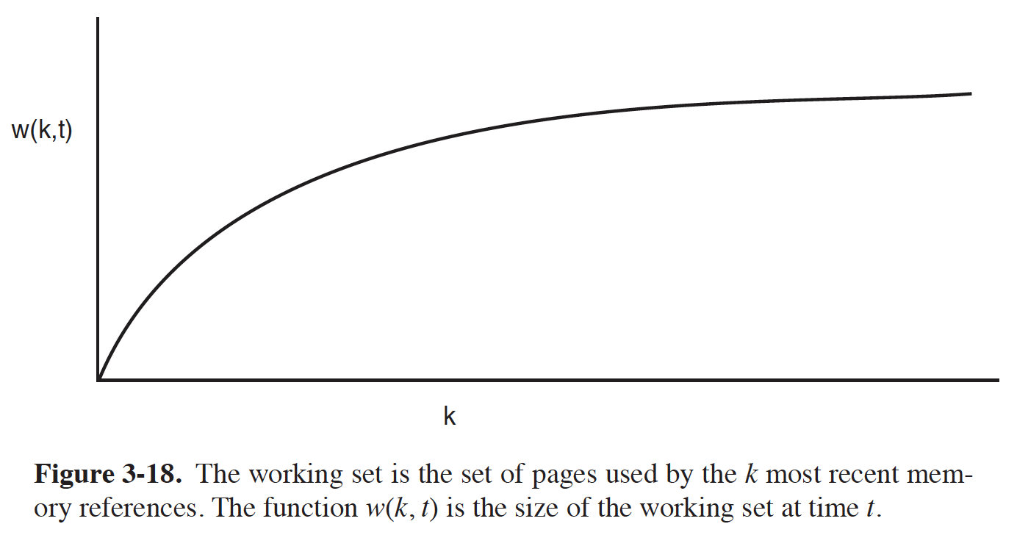
Working set

Slide 69
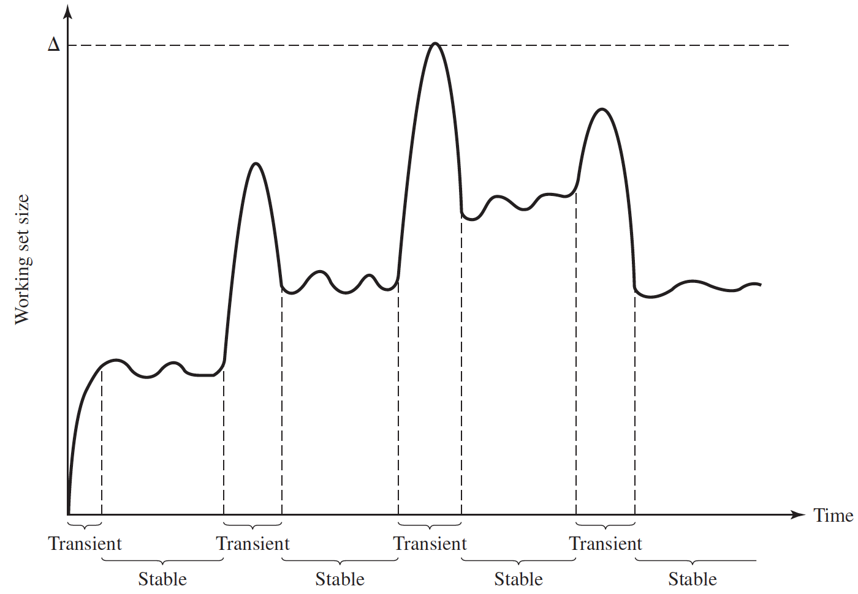
Working set size

Slide 70
Working-Set Model
WSS_{i} =
total number of pages referenced in the most recent Δ page references
D = Σ WSS_{i} ≡ total demand frames
  Approximation of locality
if D > m ⇒ Thrashing (m: the number of frames)
Policy if D > m, then suspend or swap out one of the processes

Slide 71

Page-Fault Frequency
More direct approach than WSS
Establish “acceptable” page-fault frequency (PFF) rate and use local replacement policy
  If actual rate too low, process loses frame
  If actual rate too high, process gains frame

Slide 72
Other Considerations -- Prepaging
Prepaging
  To reduce the large number of page faults that occurs at process startup
  Prepage all or some of the pages from the working set, before they are referenced

Slide 73
Other issues:
Allocating Physical Memory
Various size
Contiguous
Buddy and slab

Slide 74
Buddy System
Allocates memory from fixed-size segment consisting of physically-contiguous pages
Memory allocated using power-of-2 allocator
  Satisfies requests in units sized as power of 2
  Request rounded up to next highest power of 2
  When smaller allocation needed than is available, current chunk split into two buddies of next-lower power of 2
    Continue until appropriate sized chunk available

Slide 75
Buddy System
For example, assume 256KB chunk available, kernel requests 21KB
  Split into A_{L} _{and} A_{R} of 128KB each
    One further divided into B_{L} and B_{R} of 64KB
      One further into C_{L} and C_{R} of 32KB each – one used to satisfy request

Slide 76

Buddy System Allocator

Slide 77
Buddy System
Advantage – quickly coalesce unused chunks into larger chunk
Disadvantage – (internal) fragmentation

Slide 78
Slab Allocator
Alternate strategy
Slab is one or more physically contiguous pages
Cache consists of one or more slabs
Single cache for each unique kernel data structure
  Each cache filled with objects – instantiations of the data structure
Notes:
cat /proc/meminfo

Slide 79
Slab Allocator
When cache created, filled with objects marked as free
When structures stored, objects marked as used
If slab is full of used objects, next object allocated from empty slab
  If no empty slabs, new slab allocated
Benefits include no (internal) fragmentation, fast memory request satisfaction

Slide 80

Slab Allocation

Slide 81
Slab Allocator in Linux
For example process descriptor is of type struct task_struct
Approx 1.7KB of memory
New task -> allocate new struct from cache
  Will use existing free struct task_struct
Slab can be in three possible states
  Full – all used
  Empty – all free
  Partial – mix of free and used
Upon request, slab allocator
  Uses free struct in partial slab
  If none, takes one from empty slab
  If no empty slab, create new empty

Slide 82
Other Issues – Page Size
Page size selection must take into consideration:
  Fragmentation (small)
  Resolution and locality (small)
  I/O time (big)
  Page table size (big)
  TLB size and effectiveness (big)
  Page fault rate??
On average, growing over time

Slide 83
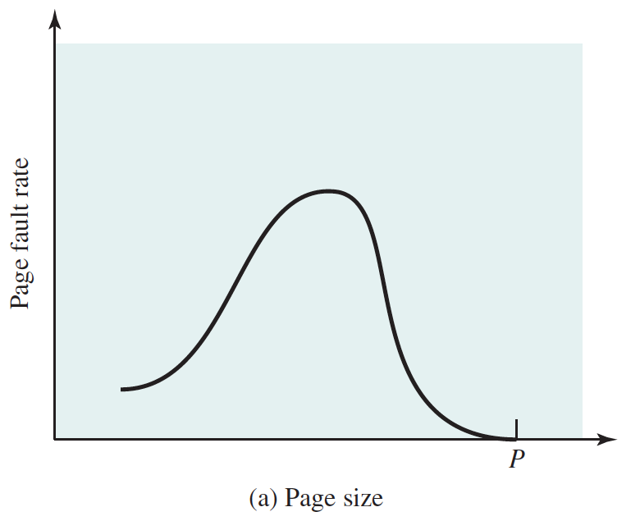

Slide 84

Other Issues – I/O interlock
I/O Interlock – Pages must sometimes be locked into memory
Consider I/O - Pages that are used for copying a file from a device must be locked from being selected for eviction by a page replacement algorithm
Pinning of pages to lock into memory

Slide 85
Other Issues – Program Structure
Program structure
  int[128,128] data;
  Each row is stored in one page
  Program 1
for (j = 0; j <128; j++)
for (i = 0; i < 128; i++)
data[i,j] = 0;
  128 x 128 = 16,384 page faults
  Program 2
  for (i = 0; i < 128; i++)
  for (j = 0; j < 128; j++)
  data[i,j] = 0;
  128 page faults
Give an example

Slide 86
End of Chapter 9

