Slide 1
Operating System Principle
Lab 4
April 2021

Slide 2
Outline
Threads
Pthread Library APIs
Concurrent Programming

Slide 3
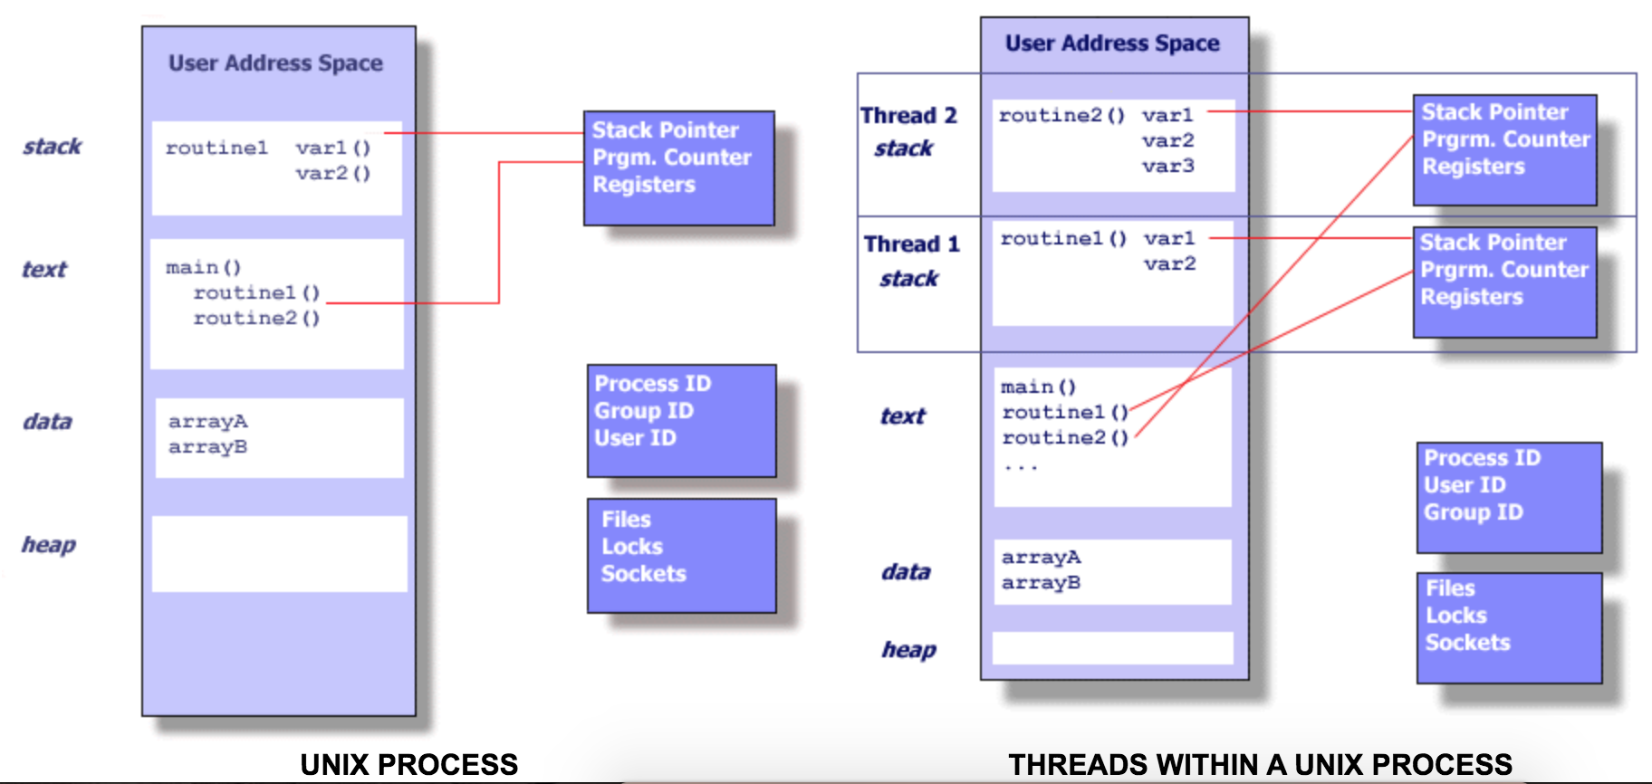
Thread
Light weight process （LWP）
Resource sharing
Notes:
https://computing.llnl.gov/tutorials/pthreads/

Slide 4
Pthread Library
  POSIX Threads API
    C language threads programming interface
    specified by the IEEE POSIX 1003.1c standard （1995）
  #include <pthread.h>
Create
    pthread_create()
Terminate
    pthread_join()
    pthread_exit()
Compile: dynamically linked library
    -pthread

Slide 5
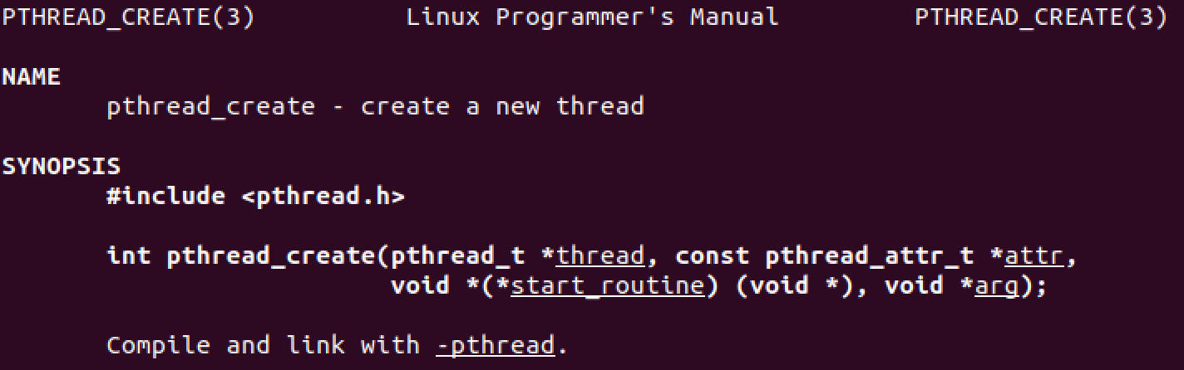
pthread_create()
fork
man pthread_create
demo
ps -eLf

Slide 6
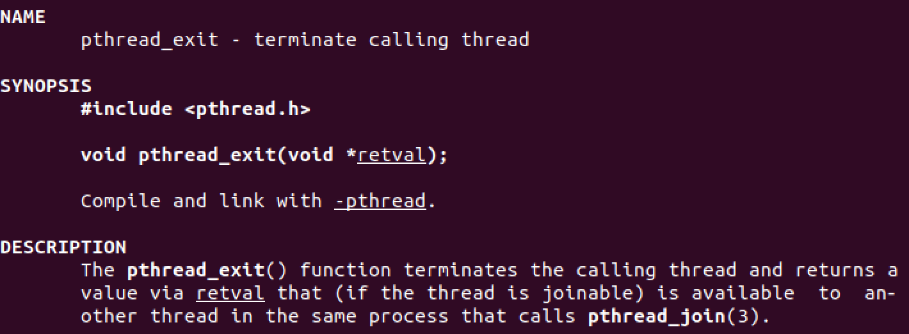
pthread_exit()
wait

Slide 7
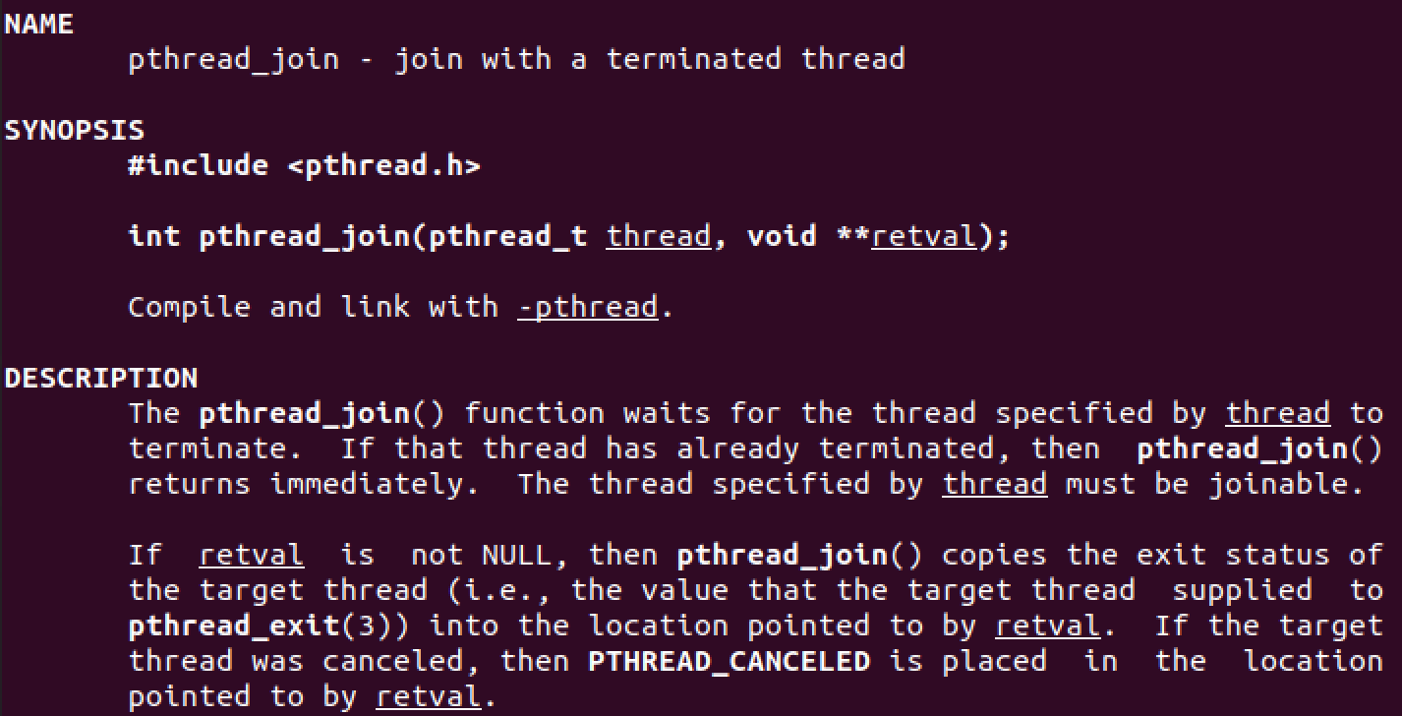
pthread_join()
exit

Slide 8
Global Variables
Global variables are shared

Slide 9
Pass Parameters
Pass parameters to thread runner
Multiple parameters?
  structure

Slide 10
Task1

Slide 11
Sorting
Single threaded sorting
  Bubble
  Selection
  Insertion
  Quicksort

Slide 12
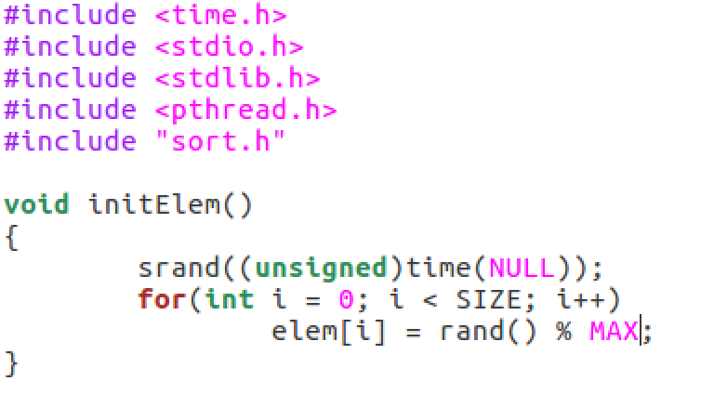
Random Number
2147483647
[0, MAX)

Slide 13
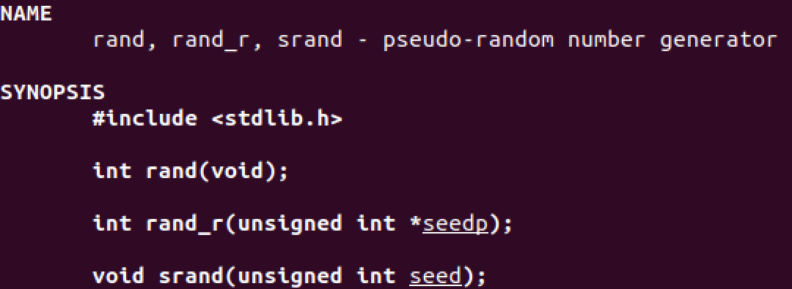
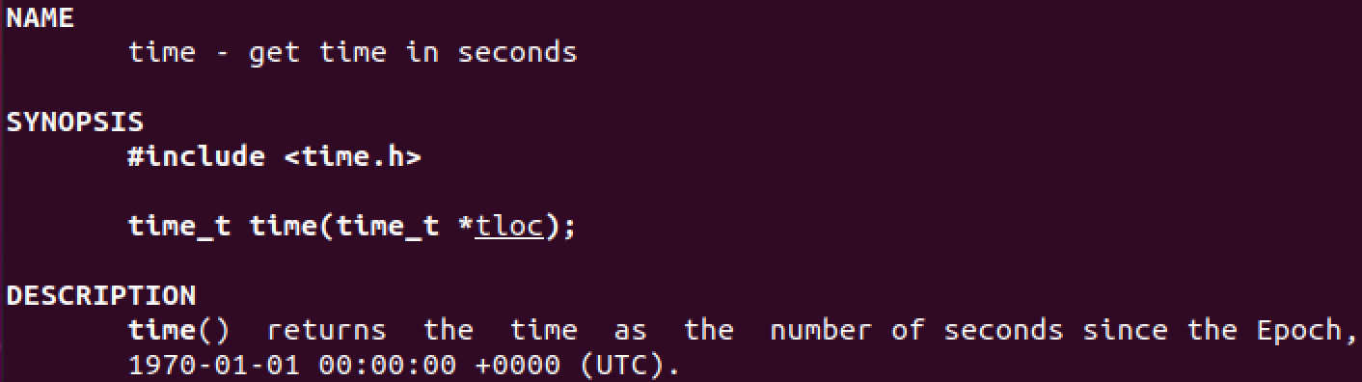
Manual
2147483647
Notes:
man 2 time
man 3 rand

Slide 14
Task2
Sort a random array

Slide 15
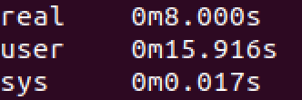
time command

Slide 16
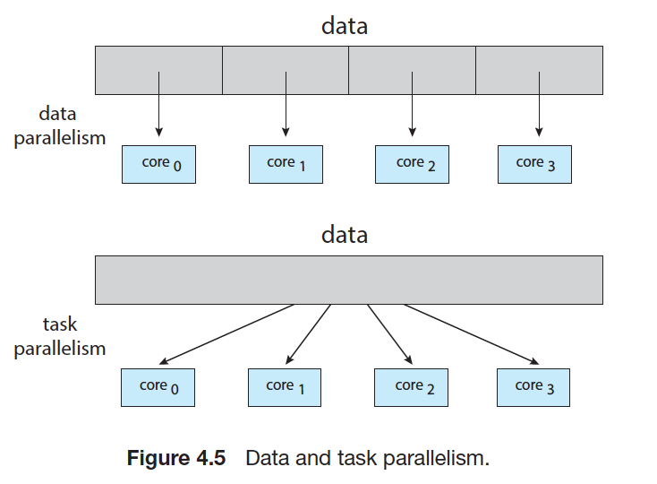
Concurrent Programming

Slide 17
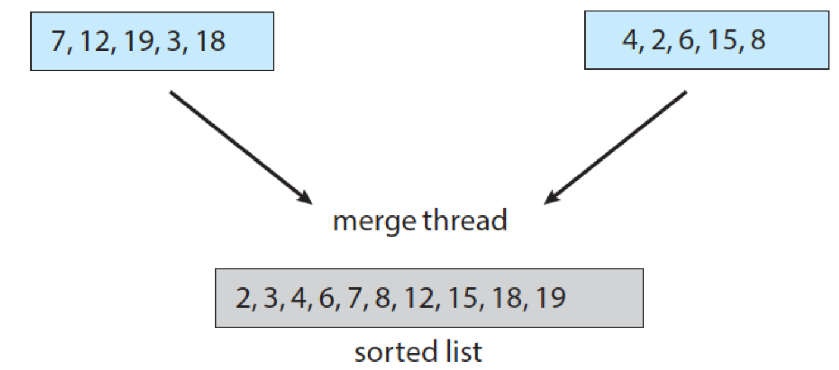
Exercise 2
Merge two ordered arrays
merge

Slide 18
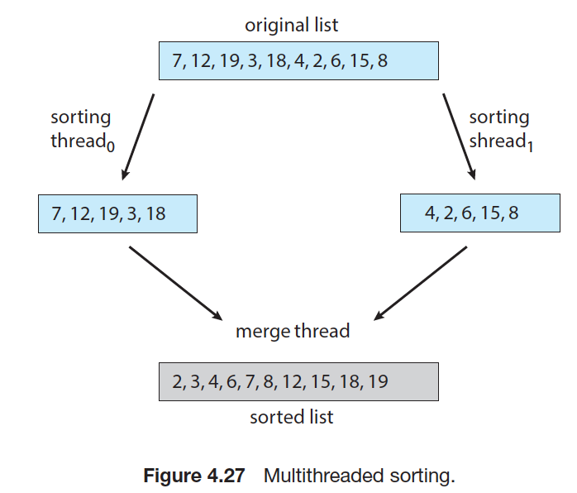
Parallel sorting

Slide 19
Task3
Merge

Slide 20
Compute speedup
#CPU >= 2

Slide 21
Task4

Slide 22
The End

