Slide 1
Chapter 9(2): Virtual Memory
May, 2021

Slide 2
Chapter 9: Virtual Memory
Page Replacement
Thrashing
Other Considerations

Slide 3
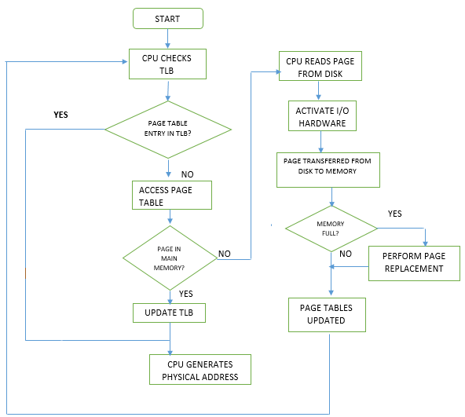
Memory Access Flowchart:
Demand Paging and Swapping

Slide 4

Page Replacement
f | v
b₁ | i
b₁

Slide 5
Page Replacement
b₂
b₂ | i
b₁ | i
b₁

Slide 6
Page Replacement
b₂
b₂ | i
f | v
b₁

Slide 7
Replacement algorithm
Objective
  Want lowest page-fault rate
Scope of replacement

Slide 8
Global vs. Local Replacement
Local replacement – each process selects from only its own set of allocated frames
  More consistent per-process performance
  But possibly underutilized memory
Global replacement – process selects a replacement frame from the set of all frames; one process can take a frame from another
  Then process execution time can vary greatly
  But greater throughput so more common

Slide 9
Replacement Algorithms
Evaluate algorithm by running it on a particular string of memory references (reference string) and computing the number of page faults on that string
  String is just page numbers, not full addresses
  Results depend on number of frames available
In all our examples, the reference string of referenced page numbers is
  7,0,1,2,0, 3,0,4,2,3, 0,3,2,1,2, 0,1,7,0,1
  3 physical frames

Slide 10

Graph of Page Faults Versus The Number of Frames

Slide 11
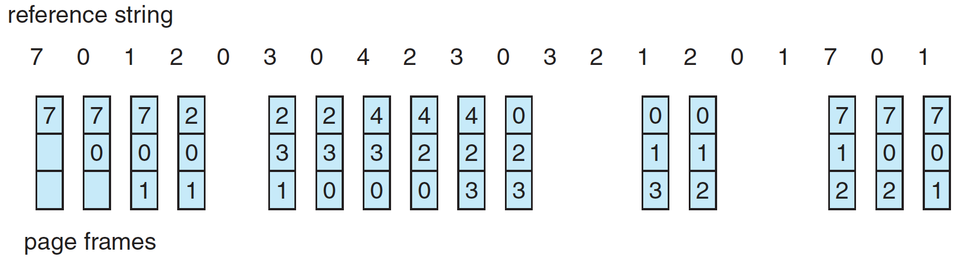
First-In-First-Out (FIFO) Algorithm
Reference string:
  7,0,1,2,0, 3,0,4,2,3, 0,3,2,1,2, 0,1,7,0,1
3 frames (3 pages can be in memory at a time per process)
Notes:
15 page faults

Slide 12
First-In-First-Out (FIFO) Algorithm
Adding more frames can cause more page faults!
Consider 1,2,3,4,1,2,5,1,2,3,4,5
  4 vs 3 frames
    Belady’s Anomaly
Notes:
9 vs 10 page faults
Reason: 5,1,2,3,4

Slide 13

FIFO Illustrating Belady’s Anomaly

Slide 14
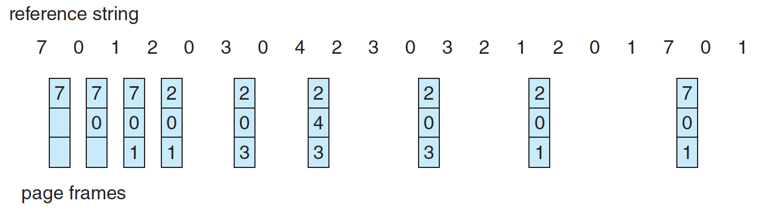
Optimal Algorithm
Replace page that will not be used for longest period of time
  7,0,1,2,0, 3,0,4,2,3, 0,3,2,1,2, 0,1,7,0,1
Notes:
9 page faults

Slide 15
Optimal Algorithm
Replace page that will not be used for longest period of time
How do you know this?
  Can’t read the future
Used for measuring how well your algorithm performs

Slide 16
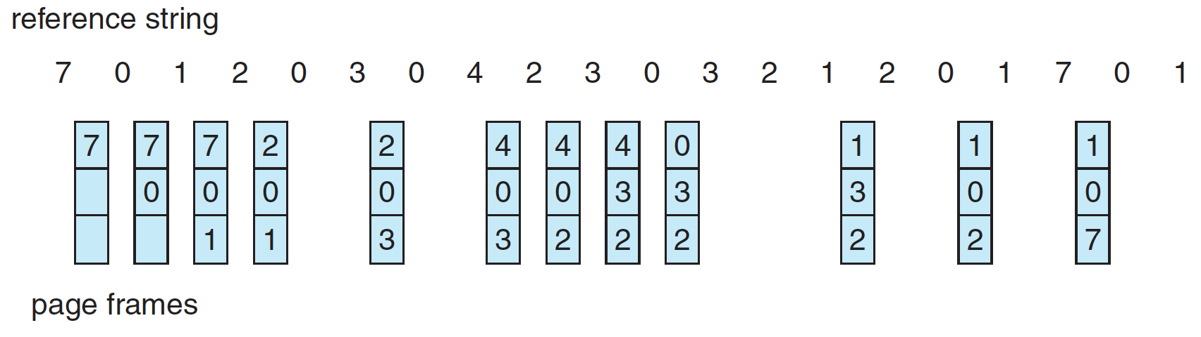
Least Recently Used (LRU) Algorithm
Use past knowledge rather than future
Replace page that has not been used in the most amount of time
Associate time of last use with each page
  7,0,1,2,0, 3,0,4,2,3, 0,3,2,1,2, 0,1,7,0,1
Notes:
12 page faults

Slide 17
Least Recently Used (LRU) Algorithm
Use past knowledge rather than future
Replace page that has not been used in the most amount of time
Associate time of last use with each page
Generally good algorithm and frequently used
But how to implement?

Slide 18
LRU Algorithm (Cont.)
Counter implementation
  Every page entry has a counter; every time page is referenced through this entry, copy the clock into the counter
  When a page needs to be changed, look at the counters to find smallest value
    Search through table needed

Slide 19
LRU Algorithm (Cont.)
Stack implementation
  Keep a stack of page numbers in a double link form:
  Page referenced:
    move it to the top
  No search for replacement, but each update more expensive
LRU and OPT are cases of stack algorithms that don’t have Belady’s Anomaly

Slide 20
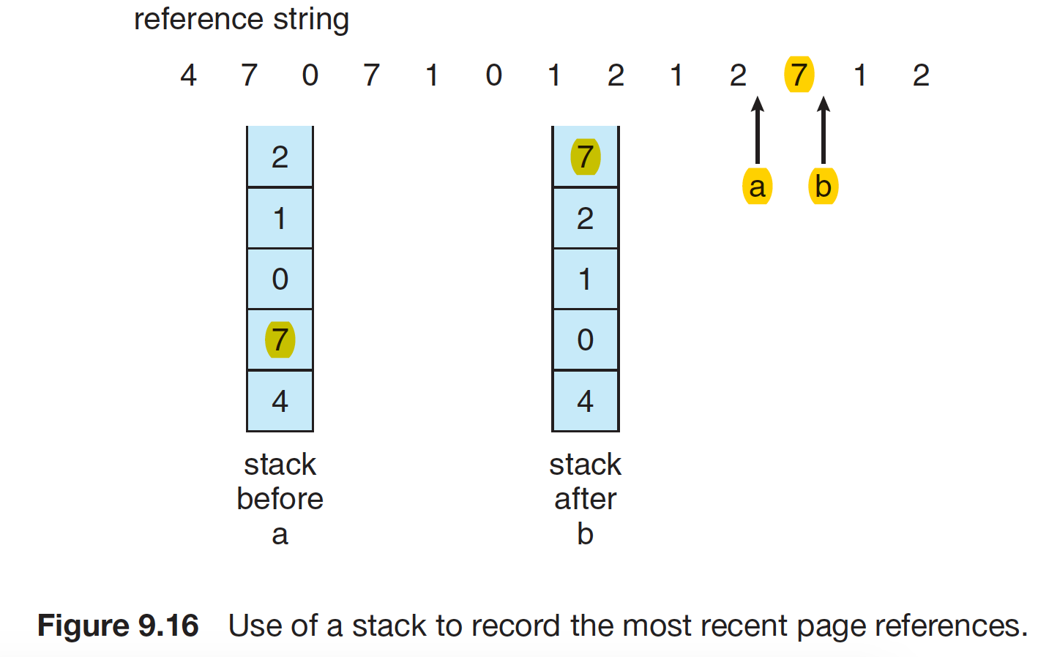
Use of A Stack to Record Most Recent Page References

Slide 21
LRU Approximation Algorithms
LRU still slow
Reference bit
  With each page associate a bit, initially = 0
  When page is referenced bit set to 1
  Replace any with reference bit = 0 (if one exists)
Page frame NO. |  |  |  | M | R | V
modify
valid
reference

Slide 22
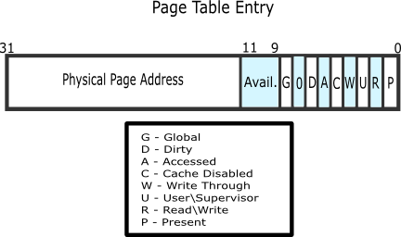
example
Notes:
https://wiki.osdev.org/Paging

Slide 23
Second chance Algorithms
Second-chance algorithm (Clock algorithm)
  Reference bit = 0 -> replace it
  reference bit = 1 then:
    set reference bit 0, leave page in memory
    Go to next page, subject to same rules

Slide 24
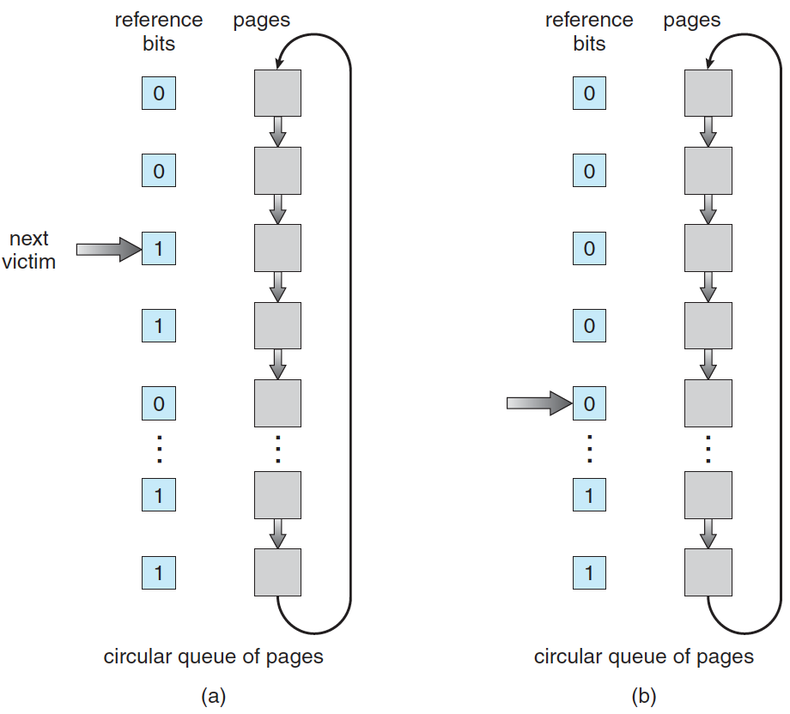
Second-Chance (clock) Page-Replacement Algorithm

Slide 25
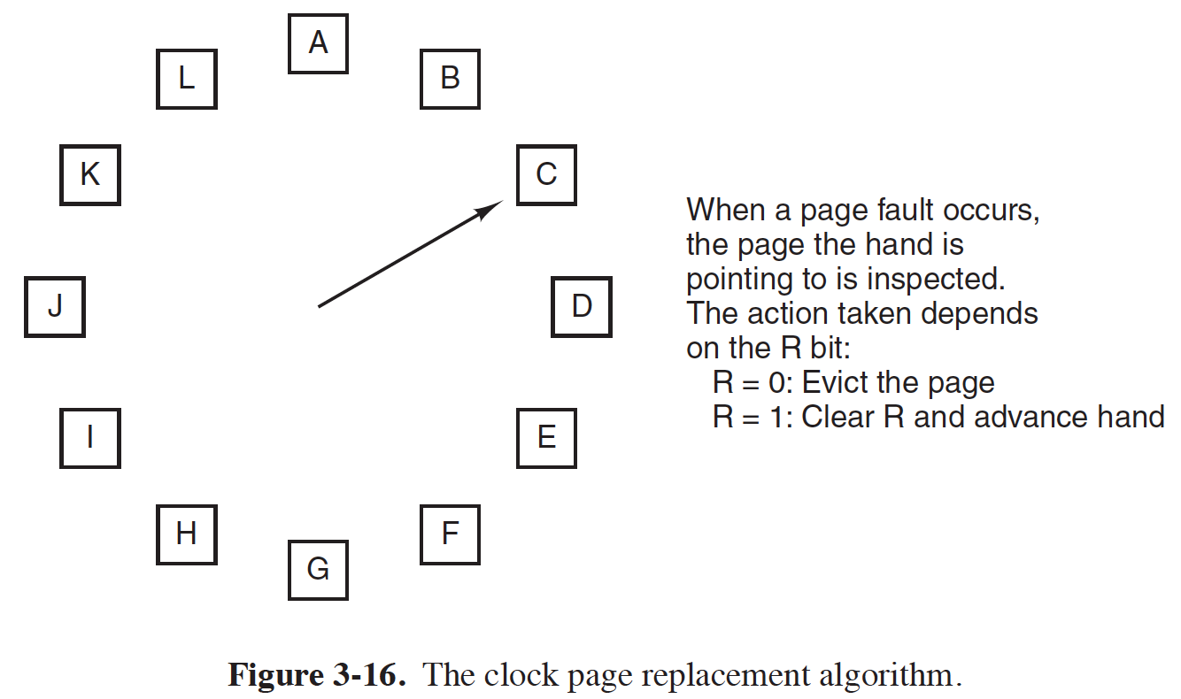
Clock algorithm
Notes:
Give an example?

Slide 26
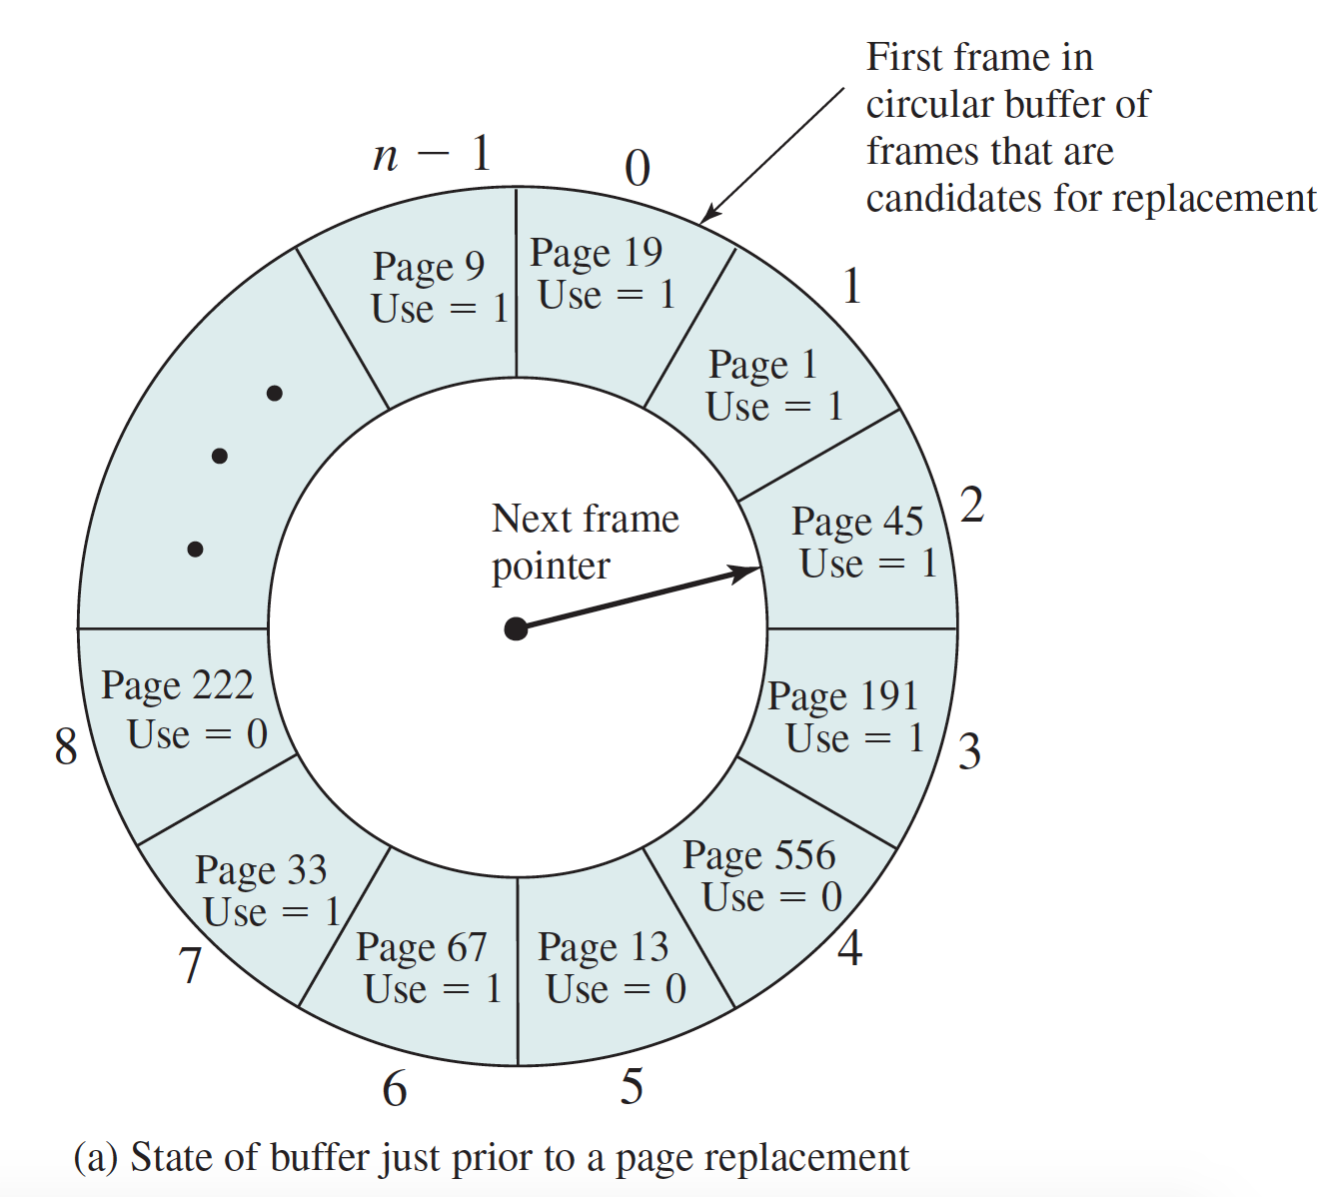
Clock Algorithm

Slide 27
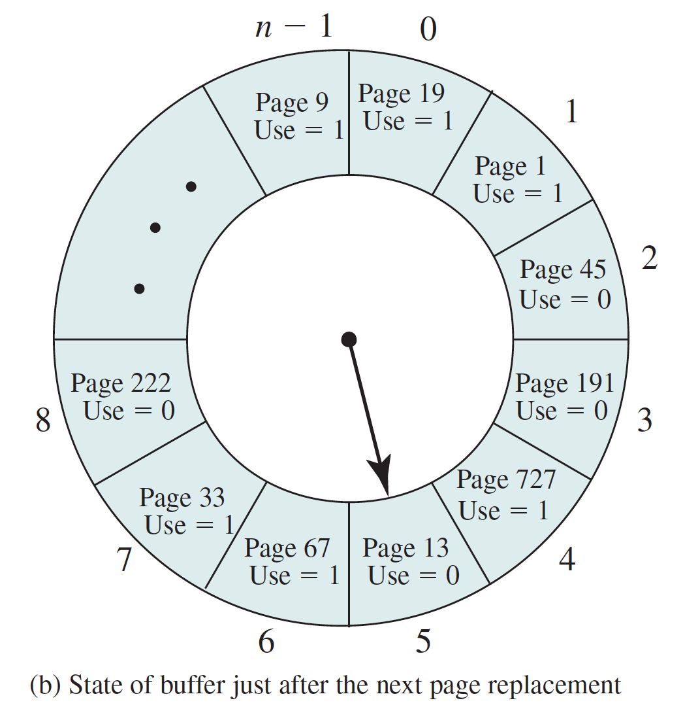
Clock Algorithm

Slide 28
Enhanced Second-Chance Algorithm
Improve algorithm by using reference bit and modify bit (if available) in concert
Page frame NO. |  |  |  | M | R | V
modify
valid
reference

Slide 29
Enhanced Second-Chance Algorithm
Take ordered pair (reference, modify)
  (0, 0) neither recently used not modified
  (0, 1) not recently used but modified
  (1, 0) recently used but clean
  (1, 1) recently used and modified
When page replacement called for, use the clock scheme but use the four classes replace page in lowest non-empty class
  Might need to search circular queue several times

Slide 30
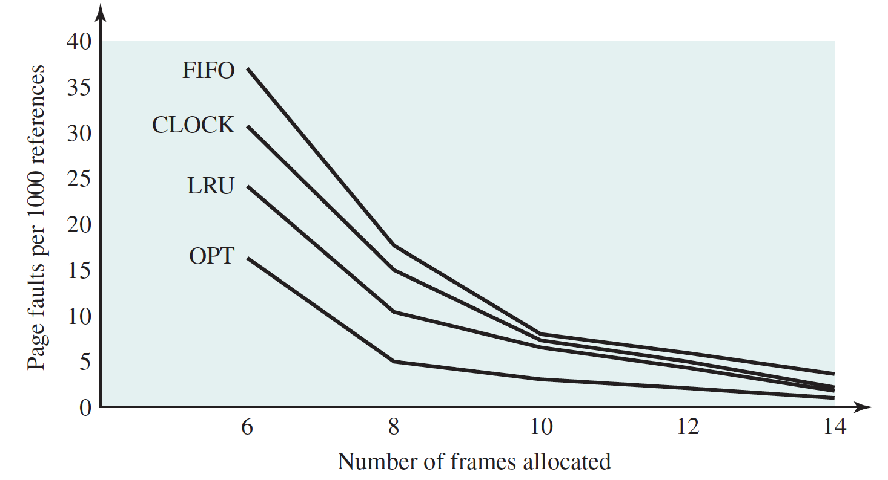
Comparison

Slide 31
Thrashing
If a process does not have “enough” pages, the page-fault rate is very high
  Page fault to get page
  Replace existing frame
  But quickly need replaced frame back
This leads to:
    Low CPU utilization
Thrashing ≡ a process is busy swapping pages in and out
Notes:
Give an example?

Slide 32

Thrashing (Cont.)

Slide 33
Prevent Thrashing
Why does demand paging work? Locality model
  Process migrates from one locality to another
Why does thrashing occur?
  Σ size of locality > total memory size

Slide 34
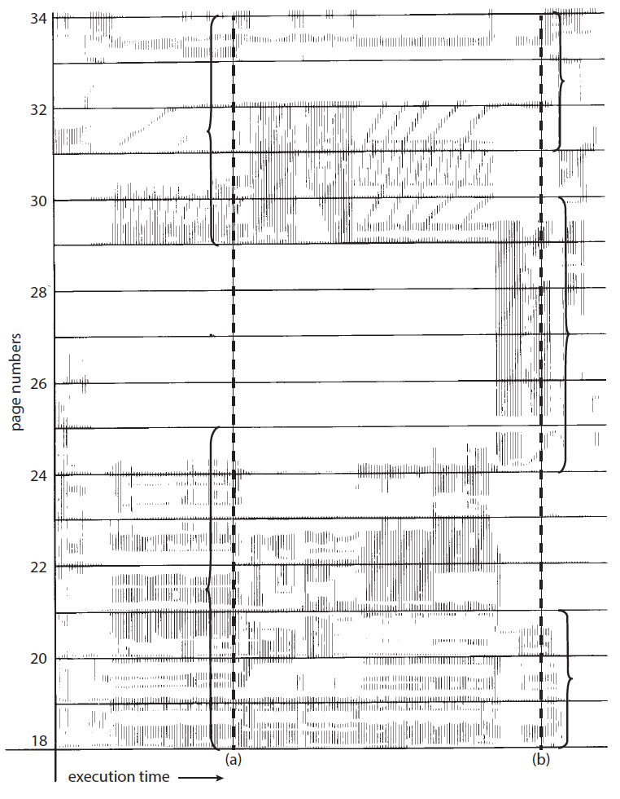
Locality In A Memory-Reference Pattern

Slide 35
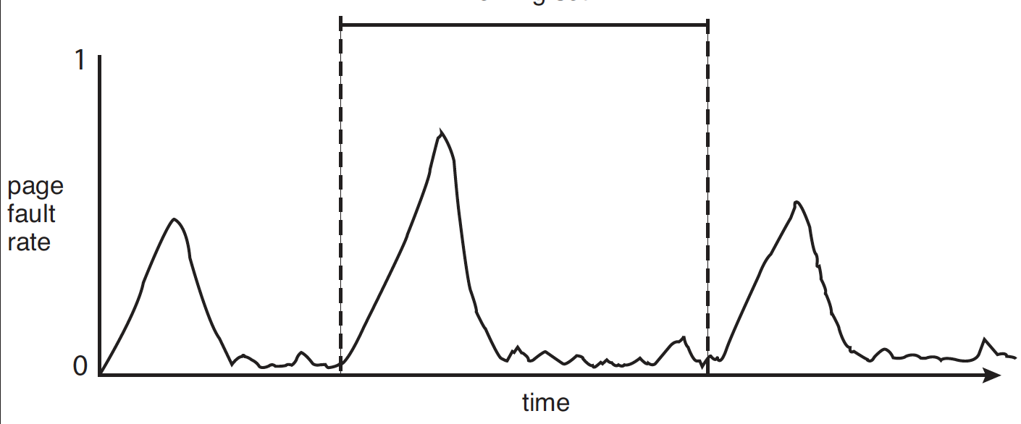
Locality and Page Fault Rates
locality

Slide 36

Working-Set Model
Working set: w(Δ,t)
  Δ ≡ working-set window ≡ a fixed number of page references. Example: 10,000 instructions
  t
WSS_{i} (working set size of Process P_{i}) =
total number of pages referenced in the most recent Δ page references

Slide 37
Working-Set Model
WSS_{i} =
total number of pages referenced in the most recent Δ page references
  if Δ too small will not encompass entire locality
  if Δ too large will encompass several localities
  if Δ = ∞ ⇒ will encompass entire program

Slide 38
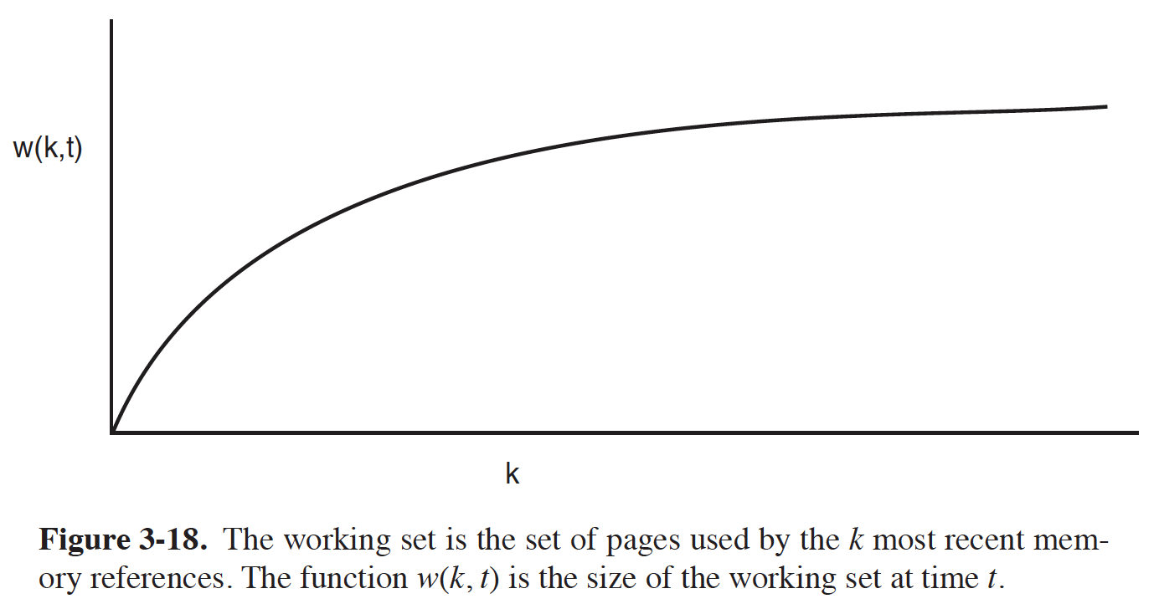
Working set

Slide 39
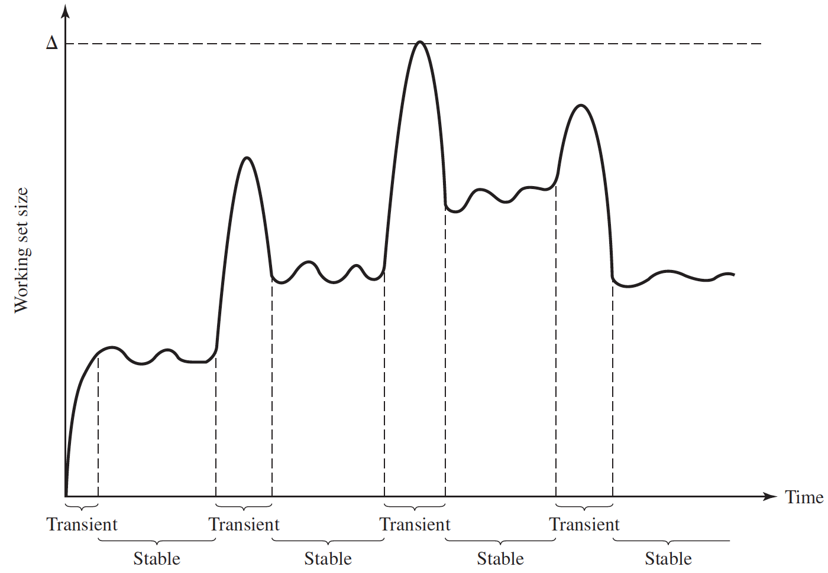
Working set size

Slide 40
Working-Set Model
WSS_{i} =
total number of pages referenced in the most recent Δ page references
D = Σ WSS_{i} ≡ total demand frames
  Approximation of locality
if D > m ⇒ Thrashing (m: the number of frames)
Policy if D > m, then suspend or swap out one of the processes

Slide 41
Other Considerations – Prepaging
Prepaging
  To reduce the large number of page faults that occurs at process startup
  Prepage all or some of the pages from the working set, before they are referenced

Slide 42
Other Issues – Page Size
Page size selection must take into consideration:
  Fragmentation (small)
  Resolution and locality (small)
  Page table size (big)
  TLB size and effectiveness (big)
On average, growing over time
Notes:
Resolution: For example, consider a process 200 KB in size, of
which only half (100 KB) is actually used in an execution.
Number of page faults (big) ？？？？

Slide 43

Other Issues – I/O interlock
I/O Interlock – Pages must sometimes be locked into memory
Consider I/O - Pages that are used for copying a file from a device must be locked from being selected for eviction by a page replacement algorithm
Pinning of pages to lock into memory
Notes:
Illustrate the background: double buffering/interlock

Slide 44
Other Issues – Program Structure
Program structure
  int[128,128] data;
  Each row is stored in one page
  Program 1
for (j = 0; j < 128; j++)
for (i = 0; i < 128; i++)
data[i,j] = 0;
  128 x 128 = 16,384 page faults
  Program 2
  for (i = 0; i < 128; i++)
  for (j = 0; j < 128; j++)
  data[i,j] = 0;
  128 page faults
1 physical frame allocated
Notes:
1 frames allocated to the program
Also related to cache

Slide 45
End of Chapter 9(2)

Slide 46
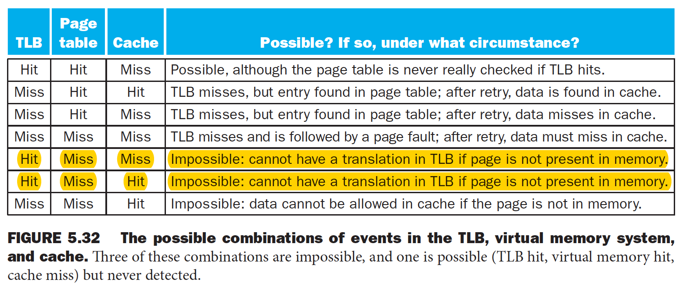
TLB, Page Table, Main Memory, Cache
Notes:
cat /proc/[pid]/oom_score

