Slide 1
Security in Computing, Fifth Edition
Chapter 13: Emerging Topics

Slide 2
Chapter 13 Objectives
Define the Internet of Things and discuss associated emerging security issues
Discuss nascent efforts to financially measure cybersecurity to make sound investment decisions
Explore the evolving field of electronic voting, which has been an important and open security research problem for over a decade
Study potential examples of cyber warfare and their policy implications

Slide 3
The Internet of Things (IoT)
IoT refers to the connection of everyday devices to the Internet, making a world of so-called smart devices
Examples:
Smart appliances, such as refrigerators and dishwashers
Smart home, such as thermostats and alarm systems
Smart health, such as fitness monitors and insulin pumps
Smart transportation, such as driverless cars
Smart entertainment, such as video recorders
Potential downsides:
Loss of privacy
Loss of control of data
Potential for subversion
Mistaken identification
Uncontrolled access
Notes:
The goals of this slide are for students to understand what IoT refers to and to consider the security and privacy implications of this class of devices.
Mistaken identification—e.g., a thermostat mistaking a houseguest for its owner

Slide 4
Smartphones
Smartphones are the control hub of the IoT
In 2013, Kaspersky Labs identified 143,211 distinct new forms of malware against mobile devices
98% targeted Android devices, far in excess of its market share
Android, unlike its competitors, does not limit the software users are allowed to install and is thus an easier target
Apple, in contrast, only allows apps from its app store to be installed on its smartphones
All apps go through an approval process, which includes some security review
Once approved, apps are signed, using a certificate approach similar to that described in Chapter 2
Notes:
The lessons of this slide are that
Mobile phones have become an important target for malware.
Apple’s locked-down approach to software installation acts as a deterrent against malware authors as compared to Android’s approach.

Slide 5
Economics
Cybersecurity planning includes deciding how to allocate scarce resources for investing in security controls
Making a business case:
A description of the problem or need to be addressed
A list of possible solutions
A list of constraints on solving the problem
A list of underlying assumptions
An analysis of the risks, costs, and benefits of each alternative
A summary of why the proposed investment is a good idea

Slide 6
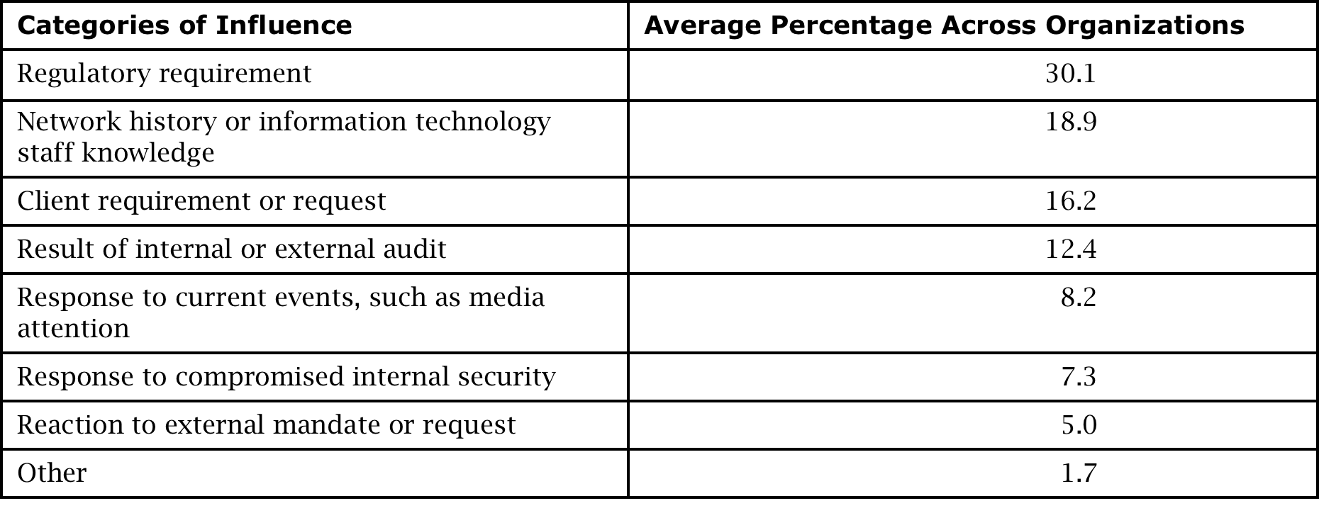
Influences on Cybersecurity Investment
Notes:
This table is adapted from [ROW06]. The key takeaway here is that a business case is never about good security for its own sake. Violating regulatory requirements can result in fines, lawsuits, or loss of customers, so it drives investment. All of the other reasons listed, with the exception of “Network history or information technology staff knowledge,” are also ones in which a direct business impact is visible, and the value of the investment can be quantified.

Slide 7
Quantifying Security
Cybersecurity threats are impossible to accurately quantify and estimate
How do you predict the likelihood that a hacker will attack a network, and how do you know the precise value of the assets the hacker will compromise?
While many industrial surveys collect cybersecurity incident data, they are inconsistent on key issues:
No standards for defining or categorizing security incidents
Disagreements about sources of attack
Selection bias among respondents
Useful data for decision making, such as rates and severity of attacks, cost of damage and recovery, and cost of security measures, are not yet known with any accuracy

Slide 8
Electronic Voting
Confidentiality
We want to be able to cast a ballot without revealing our votes to others.
Integrity
We want votes to represent our actual choices and not be changed between the time we mark the ballot and the time our vote is counted. We also want every counted ballot to reflect one single vote of an authorized person. That is, we want to be able to ensure that our votes are authentic and that the reported totals accurately reflect the votes cast.
Availability
Usually, votes are cast during an approved pre-election period or on a designated election day, so we must be able to vote when voting is allowed. If we miss the chance to vote or if voting is suspended during the designated period, we lose the opportunity to cast a vote in the given election.

Slide 9
What Is a Fair Election?
Each voter’s choices must be kept secret.
Each voter may vote only once and only for allowed offices.
The voting system must be tamperproof, and the election officials must be prevented from allowing it to be tampered with.
All votes must be reported accurately.
The voting system must be available for use throughout the election period.
An audit trail must be kept to detect irregularities in voting but without disclosing how any individual voted.
Notes:
Many of the attacks described throughout this book have strong potential to violate these principles in an electronic voting system:
Program flaws, incorrect use of encryption, and man-in-the-middle attacks could violate secrecy and allow tampering. Consider having students brainstorm specific attack examples.

Slide 10
Cyber Warfare
Open questions:
When is an attack on cyber infrastructure considered an act of warfare?
Is cyberspace different enough to be considered a separate domain for war, or is it much like any other domain (e.g., land, sea, or air)?
What are the different ways of thinking about cyber war offense and defense?
What are the benefits and risks of strategic cyber warfare and tactical cyber warfare?
Notes:
Cyber warfare is a poorly defined term—and an inherently political one—so it brings up far more questions than answers.

Slide 11
Possible Examples of Cyber Warfare
Estonia
Beginning in April 2007, the websites of a variety of Estonian government departments were shut down by multiple DDoS attacks immediately after a political altercation with Russia.
Iran
The Stuxnet worm attacked a particular model of computer used for many production control systems, and all the infections could be traced back to domains within Iran linked to industrial processing.
Israel and Syria
Missiles fired in 2007 by Israeli planes did not show up on Syrian radar screens because software had replaced live images with fake, benign ones.
Canada
In January 2011, the Canadian government revealed that several of its national departments had been the victims of a cyber attack traced back to servers in China.
Russia
According to the New York Times, Russian hackers infiltrated the computers of various national governments, NATO, and the Ukraine.
Notes:
These examples illustrate three lessons:
The line between cyber warfare and cyber espionage is not yet defined and may always be fuzzy.
Attack attribution is a major impediment to addressing cyber warfare as an issue.
Known cyber warfare incidents have thus far been small in scope, but that will not always be the case.

Slide 12
Summary
The IoT has resulted in a flood of new devices connecting our private and personal lives to the Internet but is far from mature from a security and privacy perspective
Cybersecurity investment decision making remains challenged by our inability to accurately measure risk and vulnerability
After over a decade of research and practice, electronic voting remains an unsolved research problem
Cyber warfare continues to lack clear definition and presents critical challenges, including attribution

