Slide 1
Lab2: Container & Iterator
September 27, 2021

Slide 2
Outline
Operator overloading
Containers
Template Containers
Iterators

Slide 3
Review of Best Paid Employee
Try to improve the implementation
  Overloading operators
    compare()
    copy()
<return type> operator<op> (parameter list);
demo

Slide 4
Review of Best Paid Employee
Try to improve the implementation
  Store all the entered employee in an array
Problem
  Fixed capacity
  Implementation details of the storage

Slide 5

Use a container
A container is a variable that consists of a collection of items
  Hold items (of a certain type)
  Construct
  Destruct
  Add an item
  Remove an item
  Get size
  Check empty
  Access/traverse

Slide 6
Container class
A container class is a class whose objects are containers
  Encapsulate an array (or other storage structures, e.g. linked)
  Provide a list of method interfaces

Slide 7

Class Template
A container is a variable that consists of a collection of items
  Hold items (of any type)

Slide 8
Demo

Slide 9
Attention!
For template classes, keep the interface definition and its implementation in a single .h file!
Notes:
Why? Cannot compile the .cpp with parametric class if seperated from the .h file

Slide 10
Traverse A Container
Define a class
  Encapsulate the position of a container
  Provide public method for manipulating the position
    Retrieve the value stored at the position
    Move to the next position
    Test whether two positions are the same
  The head position and the tail position

Slide 11
For the Linked List Template
class Position
{
private:
Node *curr;
public:
operator*; //retrieve value
operator++; //the next
operator==; //equivalence
}

Slide 12
For the Linked List Template
Two special positions
  Position(head)
  Position(NULL)

Slide 13
Nested Class
Container Class A --- Position Class PA
The class PA is not used anywhere else except for in the class A
Define class PA inside class A so that it is only visible within class A
Notes:
虽然内部类在外部类内部定义，但它是一个独立的类，基本上与外部类不相关。它的成员不属于外部类，同样，外部类的成员也不属于该内部类。内部类的出现只是告诉外部类有一个这样的类型成员供外部类使用。并且，外部类对内部类成员的访问没有任何特权，内部类对外部类成员的访问也同样如此，它们都遵循普通类所具有的标号访问控制。

Slide 14
The Iterator Inner Class
Demo

Slide 15
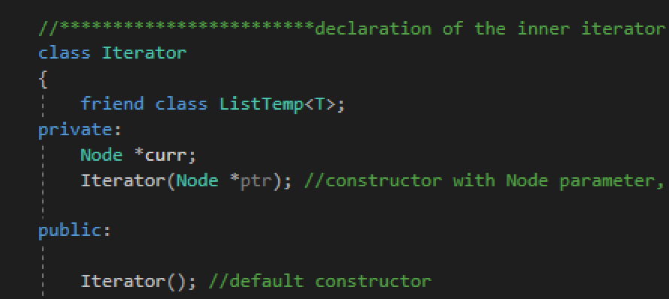
Friend Class

Slide 16
Thank you!
Questions?

Slide 17
Appendix
copy constructor vs. assignment operator???
void operator= (const Employee& otherEmployee)
  return type???
typename
  nested dependent name is not a type
Notes:
调用的是拷贝构造函数还是赋值运算符，主要是看是否有新的对象实例产生。如果产生了新的对象实例，那调用的就是拷贝构造函数；如果没有，那就是对已有的对象赋值，调用的是赋值运算符
声明template参数时，前缀关键字class与typename可以互换
请使用关键字typename标识嵌套从属类型名称；但不得在base class lists或者member initialization list内使用typename

