Slide 1
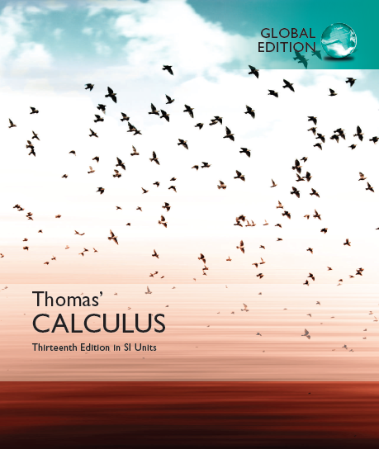

© 2010 Pearson Education, Inc. All rights reserved

Slide 2
Chapter 5
Integrals
Copyright © 2010 Pearson Education, Inc. Publishing as Pearson Addison-Wesley

Slide 3
5.1
Area and Estimating with Finite Sums
Copyright © 2010 Pearson Education, Inc. Publishing as Pearson Addison-Wesley

Slide 4
Find the area?

Slide 5
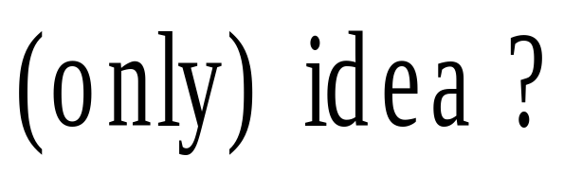
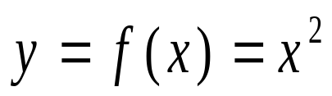



Slide 6
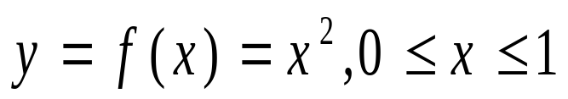
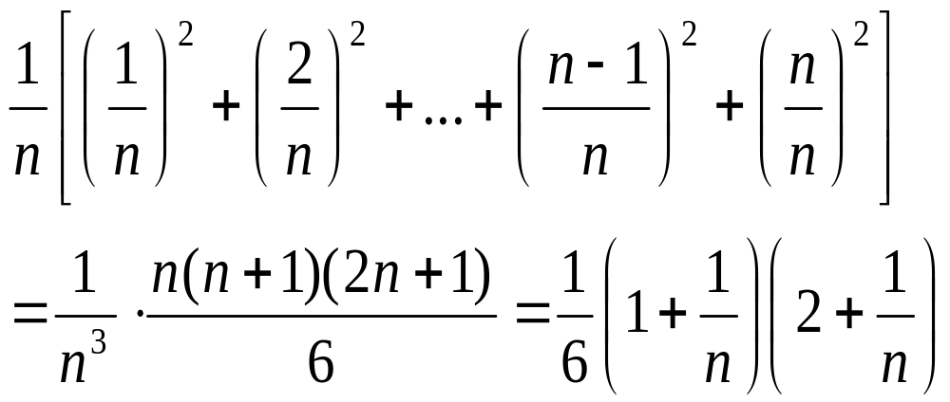
(Two Examples)Nonnegative function: y = f(x) ≥ 0
(I)

Slide 7
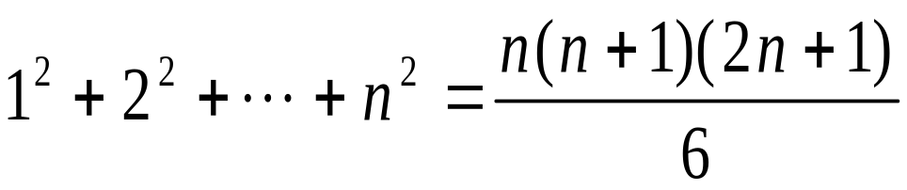

Slide 8
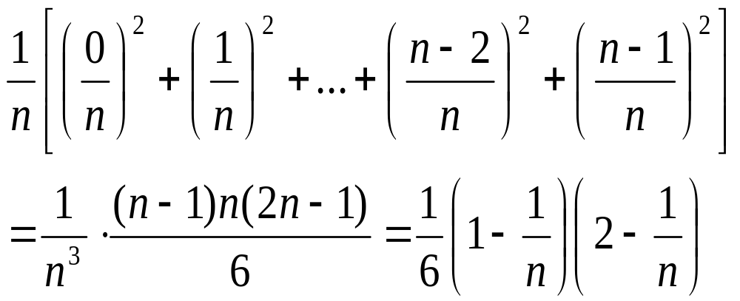

Slide 9
(II)

Slide 10
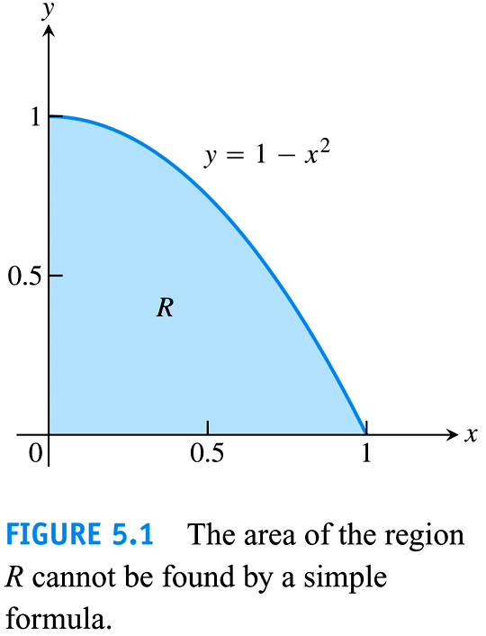

Slide 11
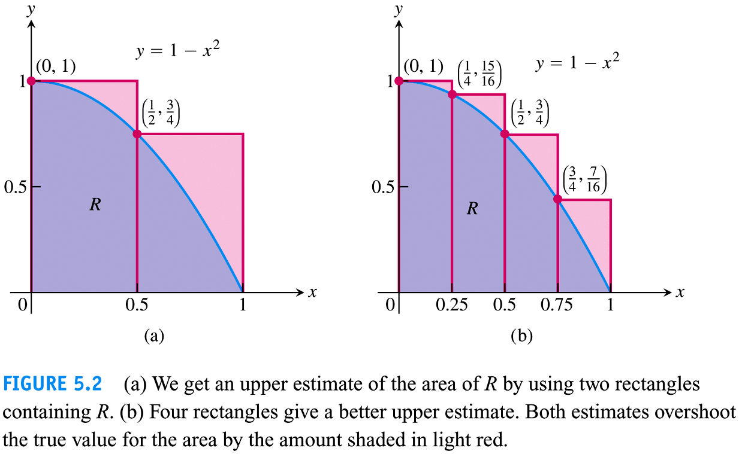

Slide 12
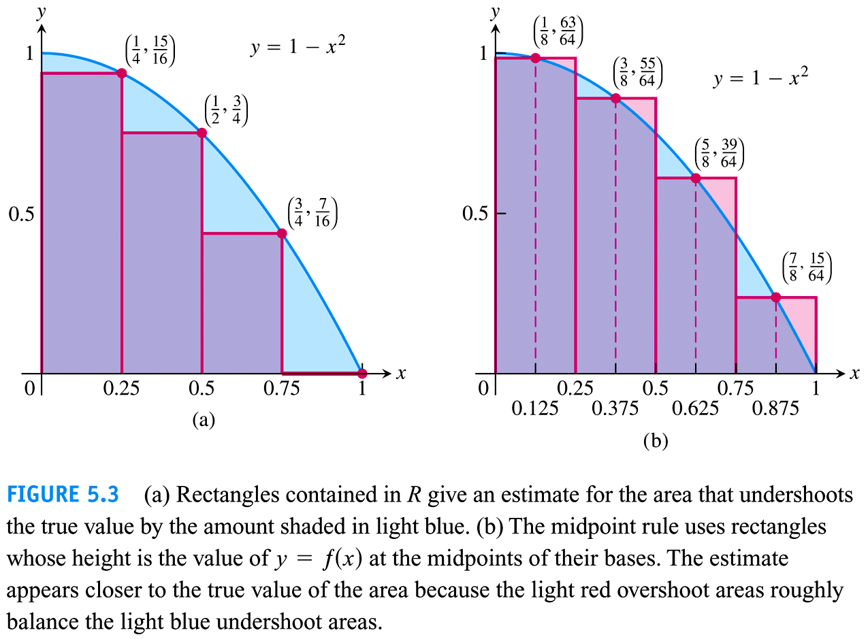

Slide 13
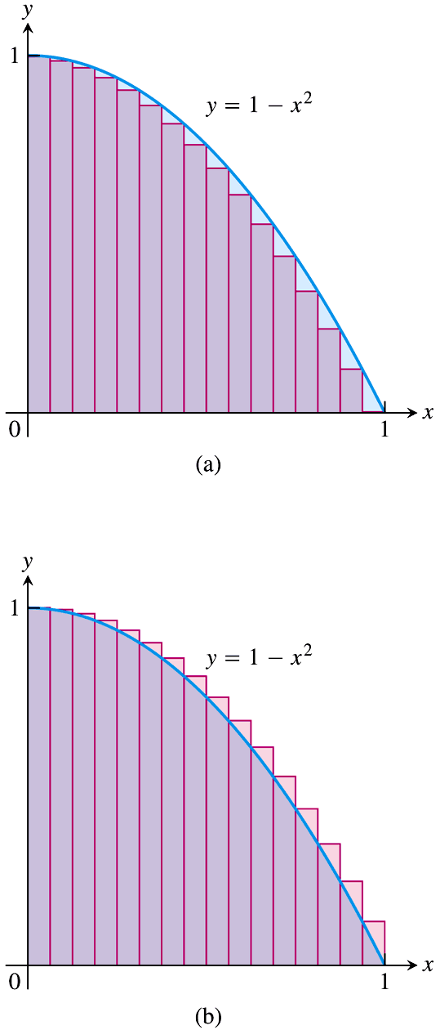
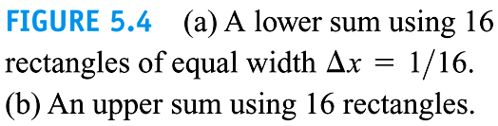

Slide 14
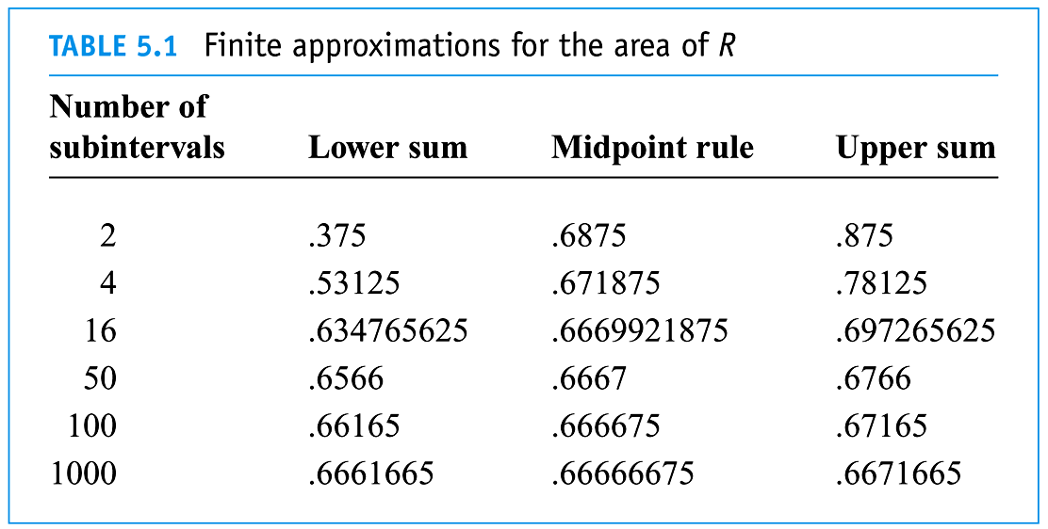

Slide 15
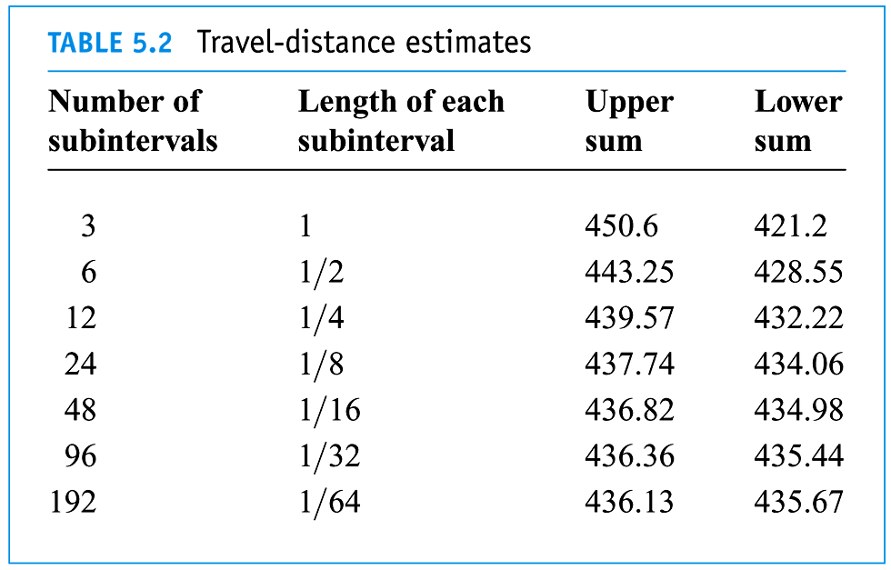

Slide 16
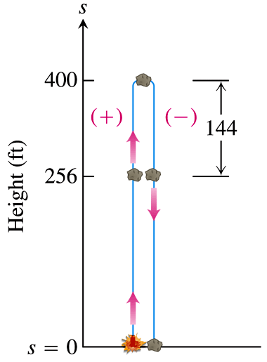
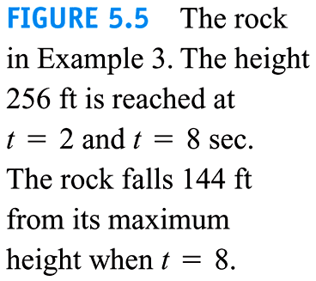

Slide 17
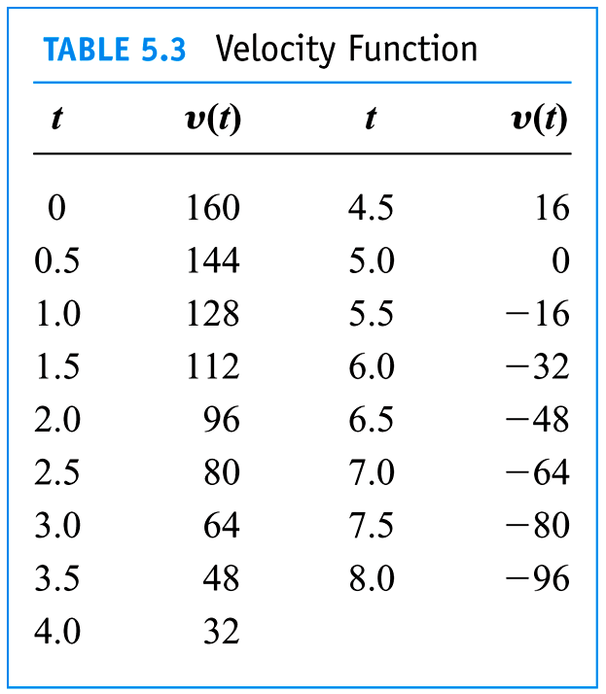

Slide 18
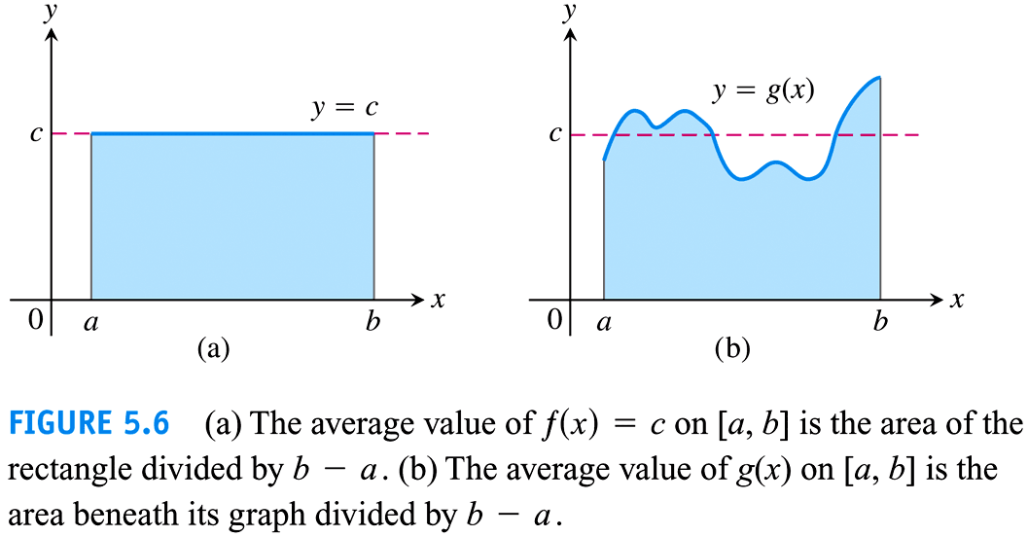

Slide 19
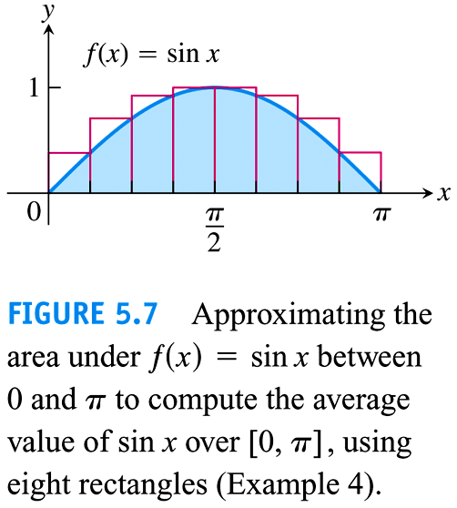

Slide 20
5.2
Sigma Notation and Limits of Finite Sums
(Riemann Sums)
Copyright © 2010 Pearson Education, Inc. Publishing as Pearson Addison-Wesley

Slide 21





Area of trapezoid region with curved edge?

Slide 22
Step 1 Partition (arbitrary P)
Step 2 Approximation (arbitrary c_{k})

Slide 23

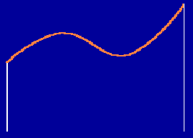






Slide 24
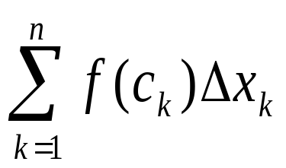
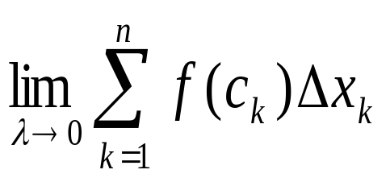
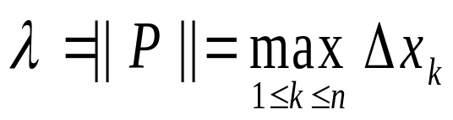
Step 3 Summation
Step 4 Taking the Limit

Slide 26
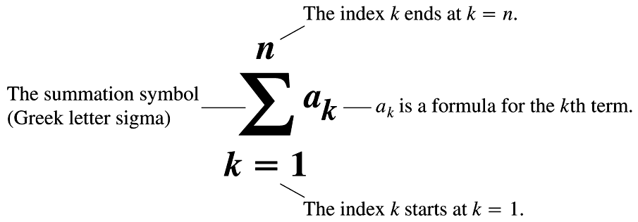
Finite Sums

Slide 27
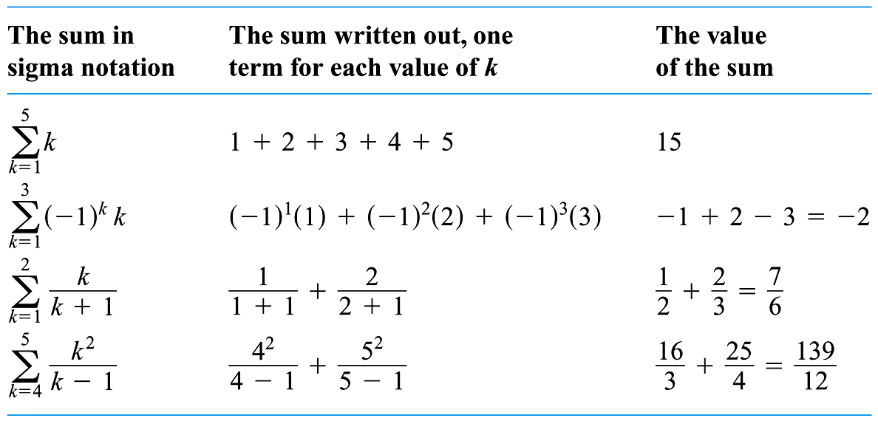

Slide 28
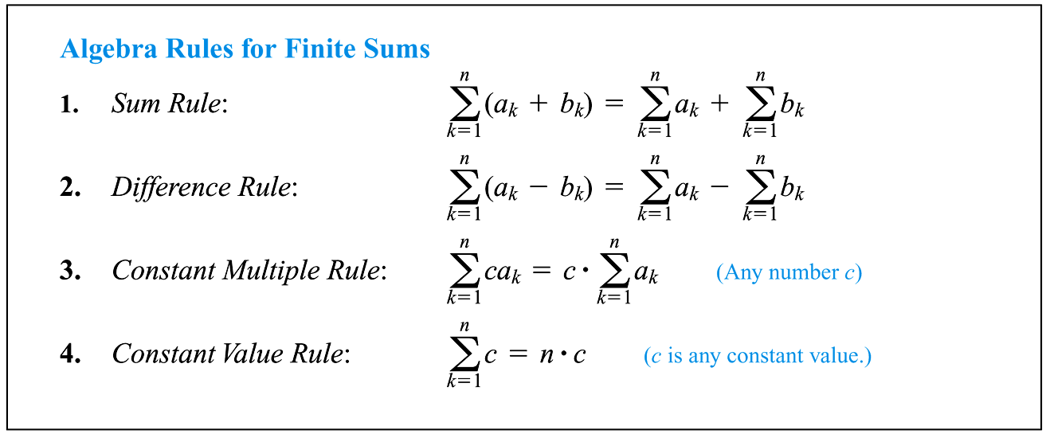

Slide 29
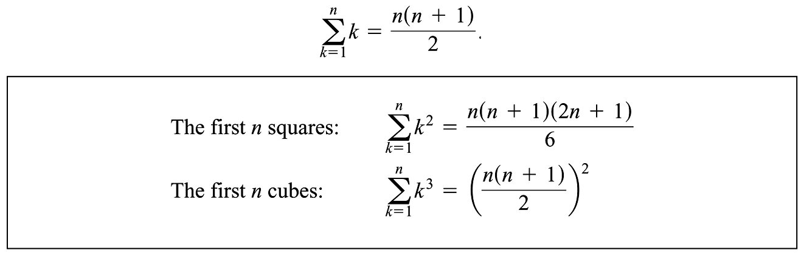

Slide 30
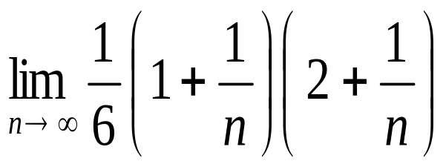
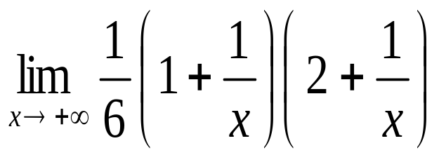

Slide 31
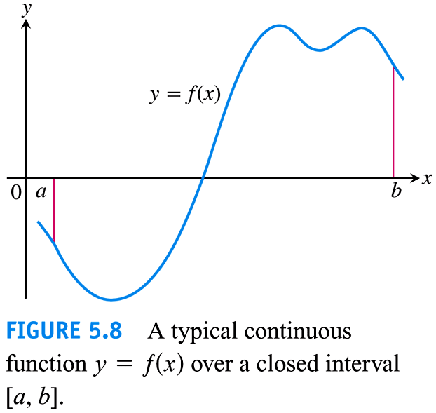
Riemann Sums

Slide 32
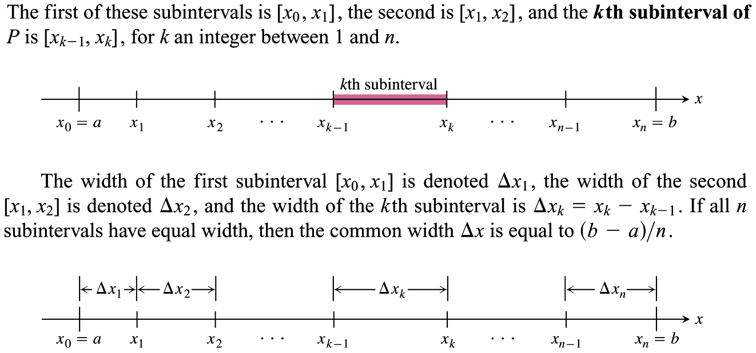

Slide 33
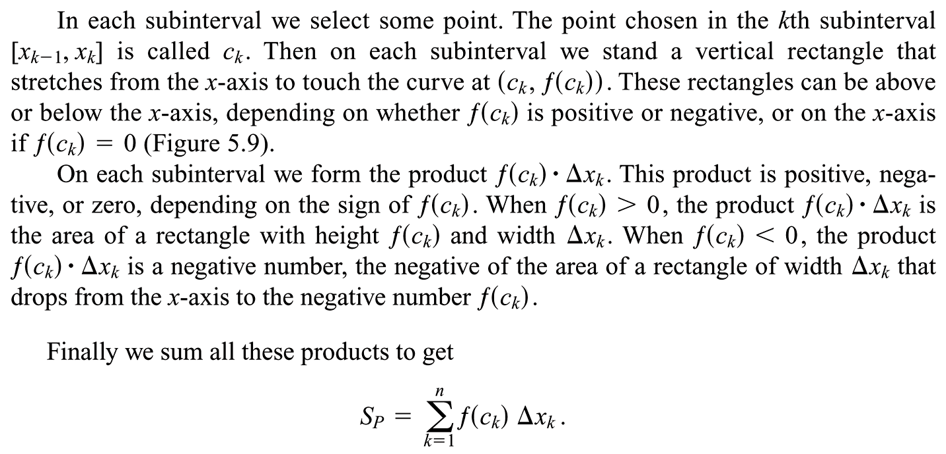

Slide 34
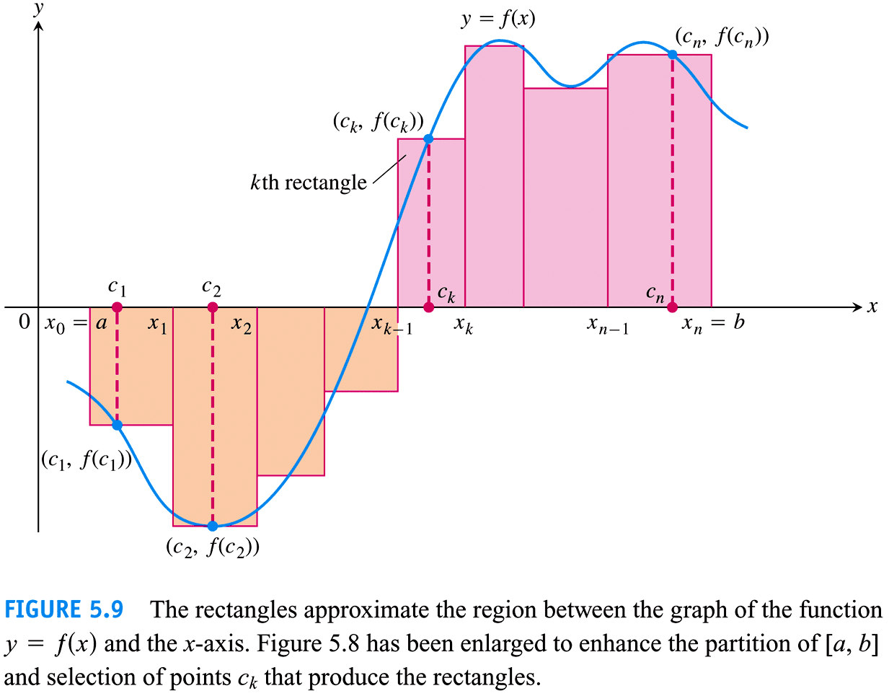

Slide 35
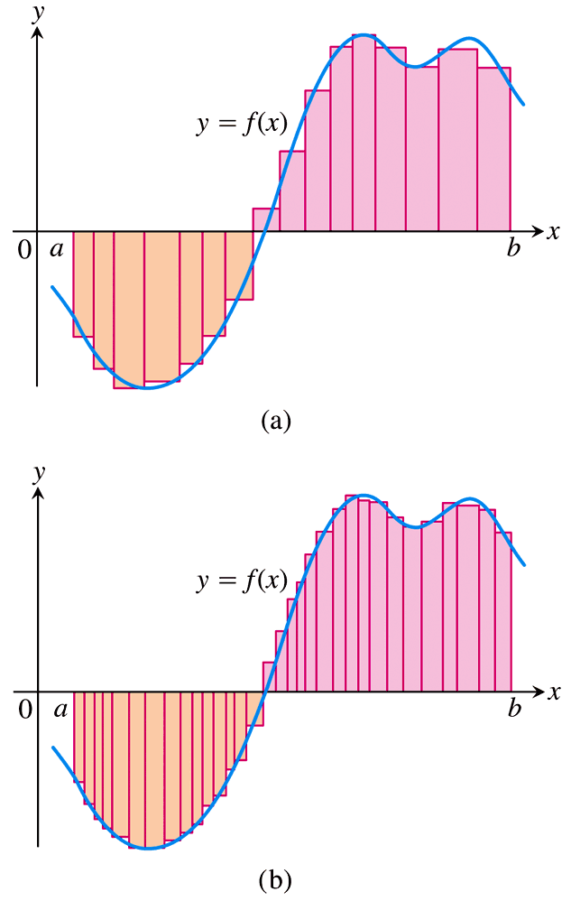
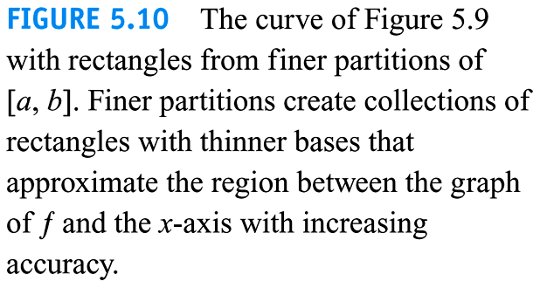

Slide 36
5.3
The Definite Integral
Copyright © 2010 Pearson Education, Inc. Publishing as Pearson Addison-Wesley

Slide 37
Given a function y = f(x), a ≤ x ≤ b.

Slide 38
1. Definition of the Definite Integral
Step 1 Partition (arbitrary P)
Step 2 Approximation (arbitrary c_{k})

Slide 39












Slide 40
Step 3 Summation
Step 4 Taking the Limit

Slide 41
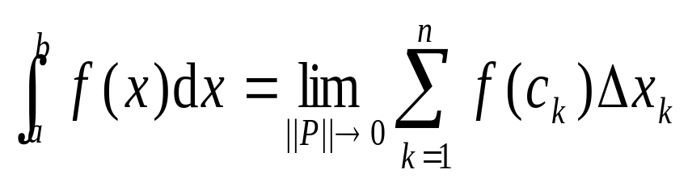

Slide 43
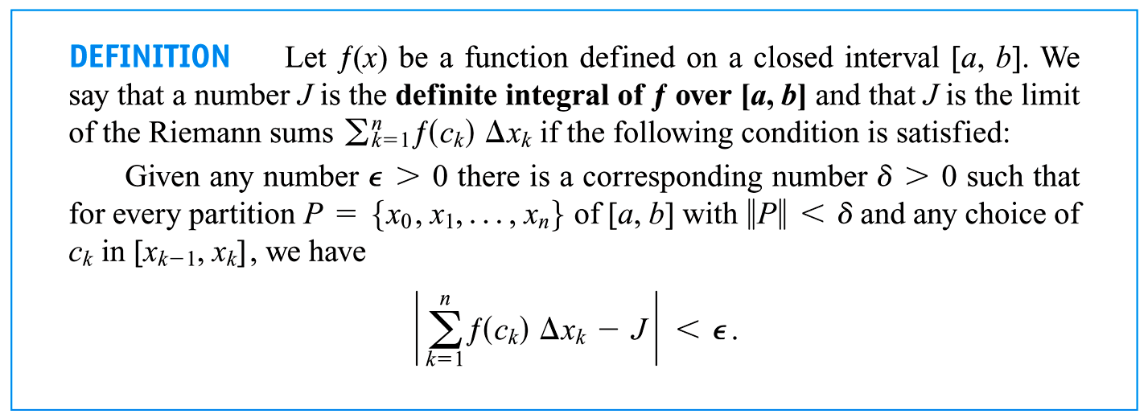

Slide 44
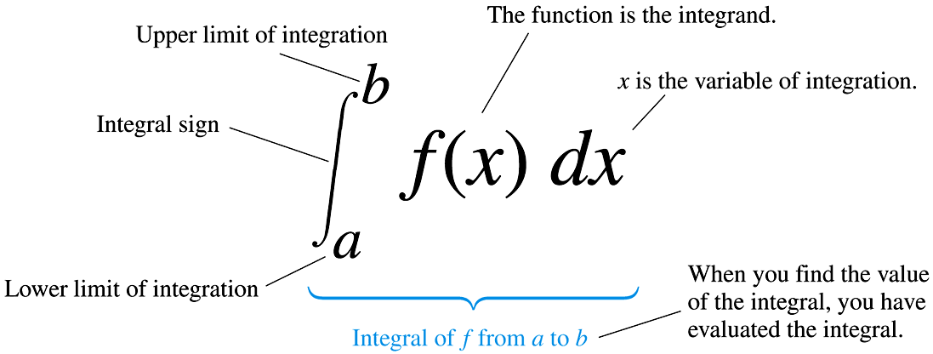

Slide 45
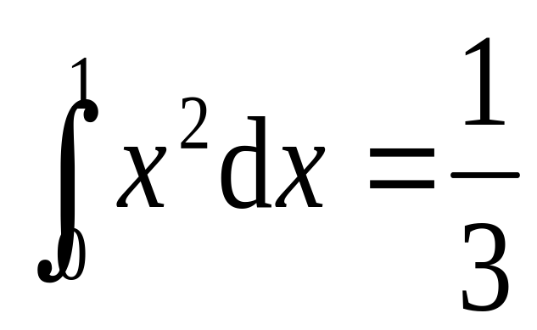
Find the area by definition of definite integral?

Slide 46
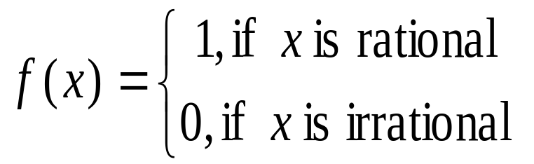
(i) Existence of Definite Integrals?
Example 4

Slide 47
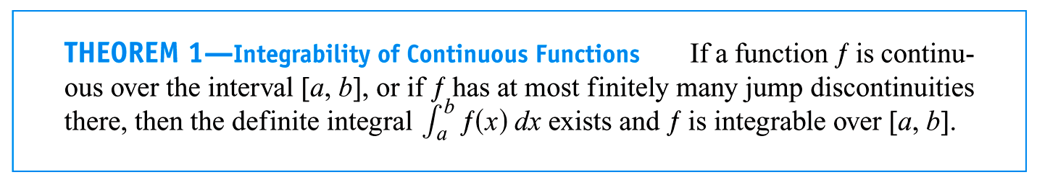
(2)

Slide 48
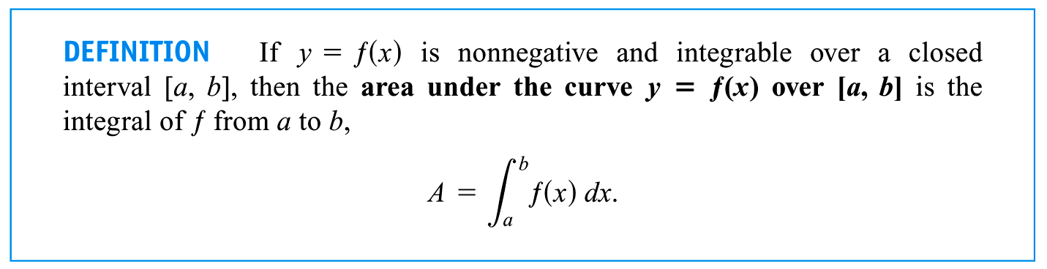
2. Geometric Interpretation
(1) f(x) ≥0:

Slide 49
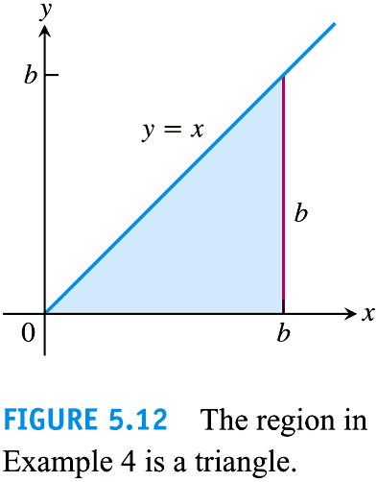

Slide 50
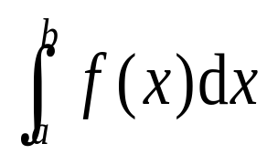
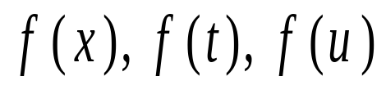
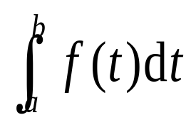



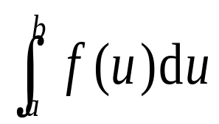
Dummy variable

Slide 51
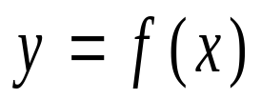
(2) f(x) ≤0?
(3) General function?

Slide 52
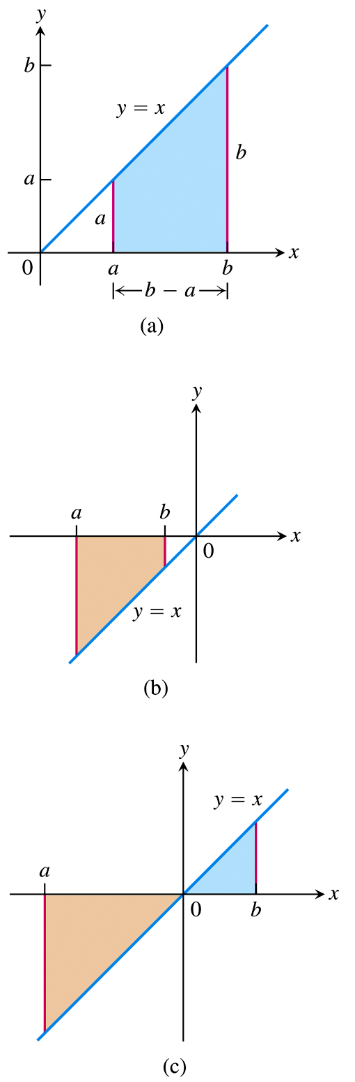
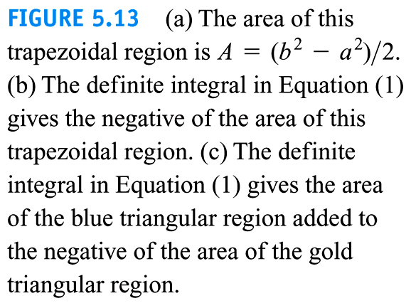

Slide 53
3. Properties of Definite Integrals
See P284

Slide 54


Slide 55


Slide 56



Slide 57


Slide 58


Slide 59


Slide 60
5.4
The Fundamental Theorem of Calculus
(Newton-Leibniz Theorem)
Copyright © 2010 Pearson Education, Inc. Publishing as Pearson Addison-Wesley

Slide 61
1. Mean Value Theorem for Definite Integrals
It is used to prove the Fundamental Theorem of Calculus.

Slide 62


Slide 63


Slide 64


Proof Since f is continuous on the closed interval [a, b], f obtains both the global maximum M and the global minimum m over [a, b].

Slide 65



Slide 66


Slide 67

2. The Function of Upper Limit of Integral
Assume that f is an integrable function on interval I = [a, b]. Define

Slide 68


Slide 69


Slide 70

[a, b]

Slide 71





Proof

Slide 72
Corollary The continuous function have antiderivatives on the interval I .

Slide 73



Example 1
(a)
(b)
(c )

Slide 74

3. Newton-Leibniz Theorem

Slide 75


Proof

Slide 76


For convenience, we write
Key: Find an antiderivative of the continuous function f on [a, b].

Slide 77


Example 3
(a)
(c)

Slide 78


Slide 79

4. Total Area
Example 6

Slide 80


Slide 81


Slide 82


Slide 83
5.6
Indefinite Integrals and the Substitution Method
(Substitution Method for
Indefinite Integrals)
Copyright © 2010 Pearson Education, Inc. Publishing as Pearson Addison-Wesley

Slide 84










Indefinite Integral Formulas(Sec. 8.1):

Slide 85


1. Method of Assembling the differential of a function (The First Substitution Method)
The Constructing a Differential Method

Slide 86

u = g(x) ← du = dg(x)

Slide 87


Slide 88




Example 1

Slide 89


Example 2

Slide 90

Example 4

Slide 91

Example 5

Slide 92





The Integrals of sin²x and cos²x:
(a)
(b)

Slide 93
2. Method of Substituting integral variable directly (The Second Substitution Method)
The Direct Substitution Method
Take directly x = φ(t) ⇔ t = φ⁻¹(x) (See also Section 8.3)

Slide 94



Step 1
Step 2
Step 3
Step 4

Slide 95


Example 6

Slide 96




Supple. Example Evaluate
Method 1
Method 2?

Slide 97


Slide 98




Integrand involving (Section 8.4)

Slide 99



Slide 100







Slide 101






Section 5.5(P307):

Slide 102





Slide 103


Slide 104
5.6
Definite Integral Substitution and the Area Between Curves
(1.Substitution for Definite Integrals; 2. The Area of a Plane Region)
Copyright © 2010 Pearson Education, Inc. Publishing as Pearson Addison-Wesley

Slide 105

1. Substitution Formula
(1) u = g(x)?

Slide 106




Slide 107



Example 1

Slide 108

(2) x = φ(t) ⇔ t = φ⁻¹(x)

Slide 109




Slide 110

Supplementary Example
Solution 1

Slide 111



Slide 112

Theorem

Slide 113


Solution 2

Slide 114

Compute the area of a circle with radius r.

Slide 115





Slide 116

Role of Substitution for Definite Integrals?

Slide 117


Slide 118






Proof

Slide 119


2. The Area of a Plane Region
(1)Review: Definition of definite integral?
4 steps?

Slide 120













Geometric interpretation:

Slide 121


f(x) ≤ 0

Slide 122


General case

Slide 123

(2)[important] Idea of Definite Integrals
(Differential) Element method

Slide 124




Take f(x) ≥ 0 for example

Slide 125










(3) Area of a Plane Region
1) Integration with respect to x
A simple example

Slide 126


Slide 127


P313:

Slide 128
Example 4(P313) Find the area of the region enclosed by the parabola y = 2 – x² and the line y = -x.
Sketch the graph?

Slide 129


Slide 130



Slide 131




2) Integration with respect to y

Slide 132




Slide 133


Slide 134


Example 5 Find the area of the region in the first quadrant that is bounded above
By and below by the x-axis and the line y = x – 2.
Sketch the graph
Methods we had?

Slide 135

Solution 1

Slide 136
Solution 2(P314) Divide the region at x = 2 into two subregions A and B.

Slide 137


Area of the region A:
Area of the region B:

Slide 138


A New Method Find the area of the region by integrating with respect to y.

Slide 139


Slide 140

Summary
Idea of differential element method (Applied also in the next chapter)
f(x) ≥ 0:

Slide 141
Class Work
Example 7 (P316)
Assignment in teaching schedule
P317 7, 46

