Slide 1
Lab4: Iterator
November 6, 2020

Slide 2
Comments on Lab3
size
AddTail()
  Empty list

Slide 3
Outline
Iterator
Nested class
Friend class

Slide 4
How to find best paid?
Access(i)
  Access(1), Access(2), …,
findBestPaid() ???
Use the head pointer

Slide 5
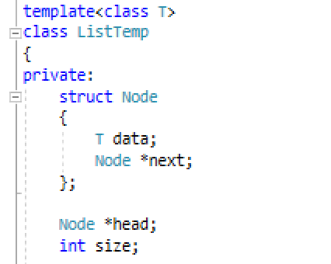
Solution?
Node *getHeadPointer()
{ return head; }
Difficulty?

Slide 6
Ideas of Solution
Define a class
  Encapsulate the position of a container
  Provide public method for manipulating the position
    Retrieve the value stored at the position
    Move to the next position
    Test whether two positions are the same
  The head position and the tail position

Slide 7
For the Linked List Template
class Position
{
private:
Node *curr;
public:
operator*; //retrieve value
operator++; //the next
operator==; //equivalence
}

Slide 8
For the Linked List Template
Two special positions
  Position(head)
  Position(NULL)

Slide 9
Nested Class
Container Class A --- Position Class PA
The class PA is not used anywhere else except for in the class A
Define class PA inside class A so that it is only visible within class A
Notes:
虽然内部类在外部类内部定义，但它是一个独立的类，基本上与外部类不相关。它的成员不属于外部类，同样，外部类的成员也不属于该内部类。内部类的出现只是告诉外部类有一个这样的类型成员供外部类使用。并且，外部类对内部类成员的访问没有任何特权，内部类对外部类成员的访问也同样如此，它们都遵循普通类所具有的标号访问控制。

Slide 10
The Iterator Inner Class
Demo

Slide 11
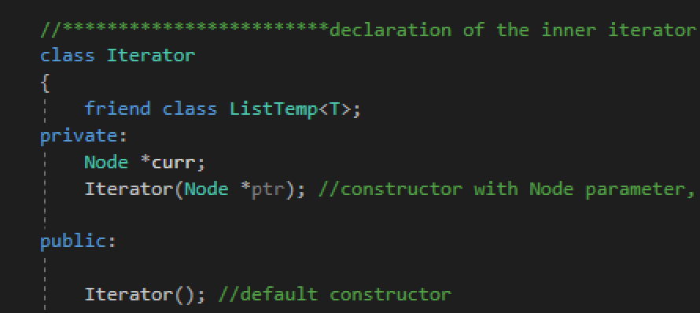
Friend Class

Slide 12
Task 1
Implement findBestPaid()

Slide 13
Task2: For the Array Template
Position Class
  Private: ?
  Methods
    *
    ++
    ==
Two special positions?
  Position(0)
  Position(length-1)

Slide 14
Summary
Data structure
  Containers (the course)
Template
Iterator

Slide 15
Thank you!
Questions?

Slide 16
Appendix
copy constructor vs. assignment operator???
void operator= (const Employee& otherEmployee)
  return type???
typename
  nested dependent name is not a type
Notes:
调用的是拷贝构造函数还是赋值运算符，主要是看是否有新的对象实例产生。如果产生了新的对象实例，那调用的就是拷贝构造函数；如果没有，那就是对已有的对象赋值，调用的是赋值运算符
声明template参数时，前缀关键字class与typename可以互换
请使用关键字typename标识嵌套从属类型名称；但不得在base class lists或者member initialization list内使用typename

