Slide 1
Lab 7: Queue & Simulation
December, 2020

Slide 2
Outline
Container Adaptor
  queue
Simulation
  Exponential distribution
  Sampling
  Queueing theory

Slide 3
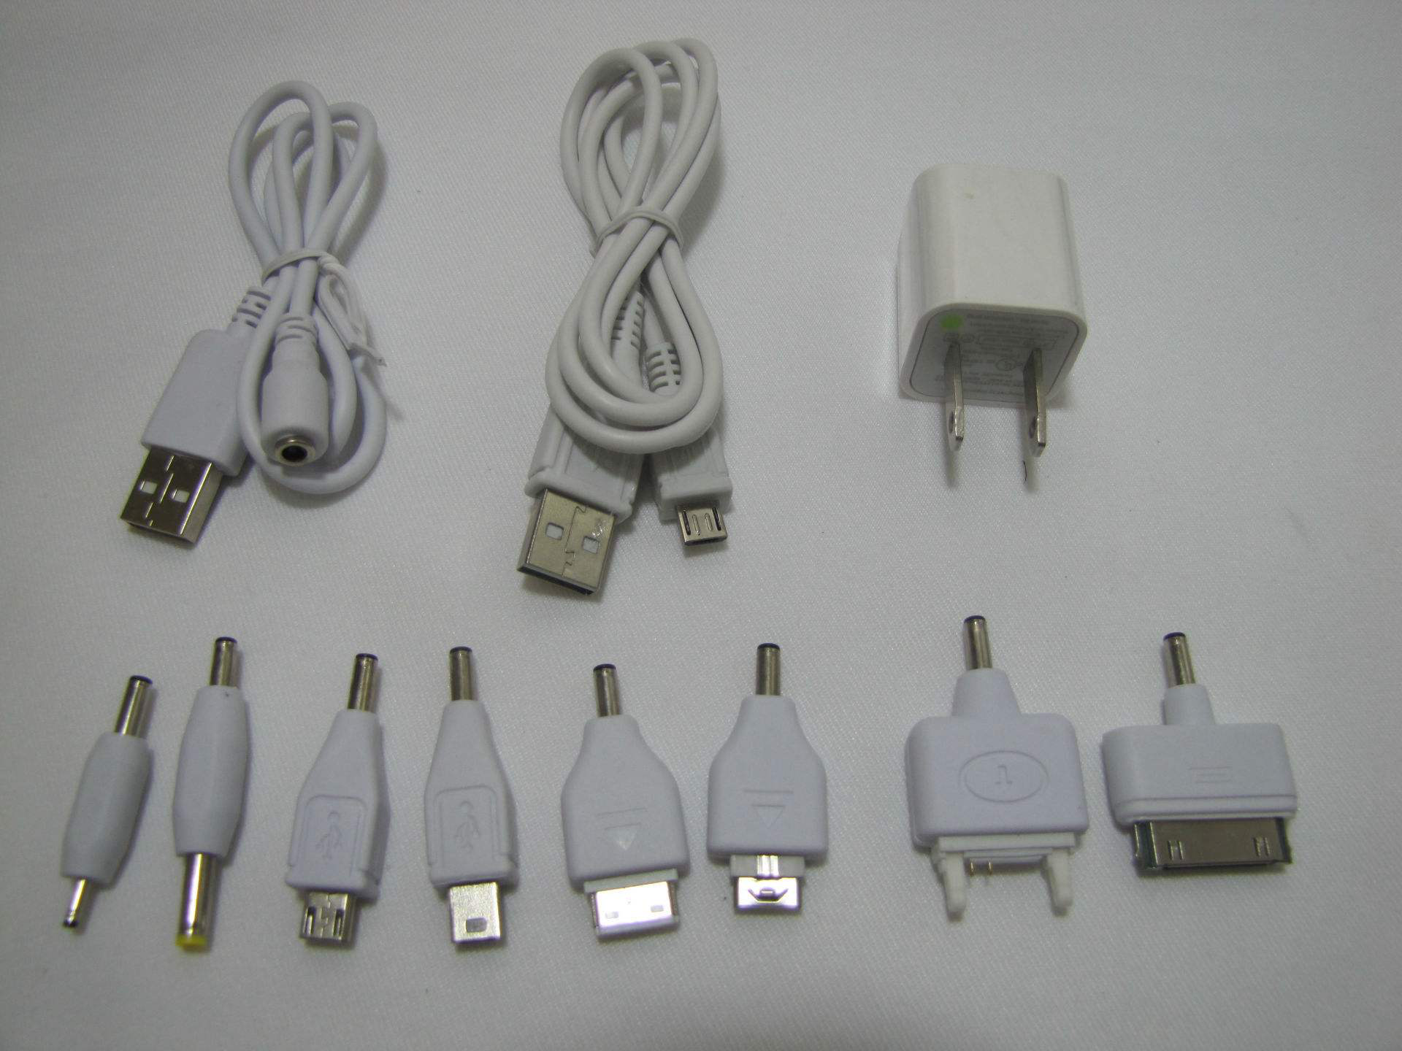
Adaptor

Slide 4
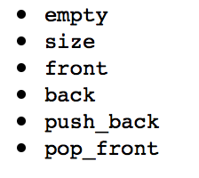
Deque and Lists

Slide 5
Container Adaptor
A container adaptor C uses some underlying container object to define C’s methods

Slide 6
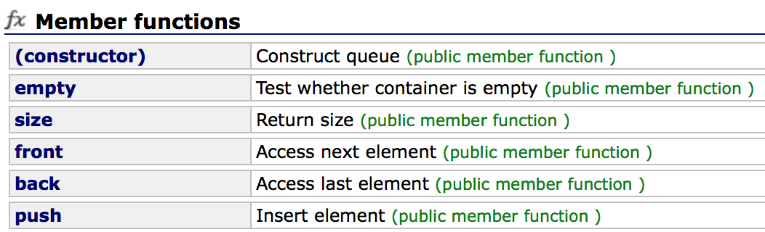
Queue
First-in-first-out (FIFO)
#include<queue>
queue<T> queueName

Slide 7
Queuing Theory
Arrival time
Departure time
Service time
Waiting time
Sojourn time
t
A
S
D

Slide 8
Queuing Theory
Inter-arrival time: 到达时间间隔
Arrival rate
  1 / mean inter-arrival time
  （单位时间平均到达的顾客数）
Service rate
  1 / mean service time
  （单位时间平均服务的顾客数）
Service intensity
  arrival rate / service rate （要求 < 1）
Queue length

Slide 9
Car Wash
One server
10 minutes service time
At most five car waiting (overflow)
Arrival time input from command line
  999 is the sentinel
Simulate and calculate the average waiting time

Slide 10
Analysis: Event Driven
arrival
departure

Slide 11
Demo
Car-washing simulation

Slide 12
Task
Extended car-washing simulation

Slide 13
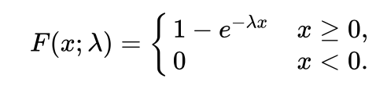
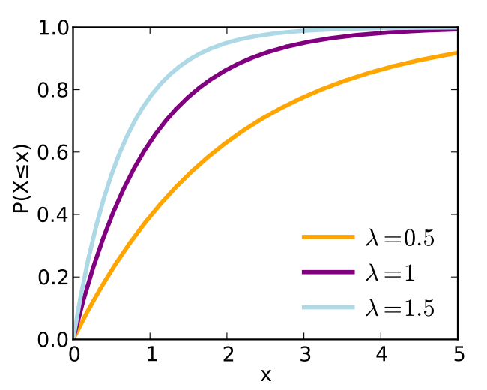
Cumulative Distribution Function
Exponential distribution
Rate parameter

Slide 14
Sampling of Exponential Distribution
Exponential distribution
Rate parameter

Slide 15

Sampling of Exponential Distribution
Exponential distribution
Rate parameter
= p in [0, 1)

Slide 16
Task: Improved Car Washing
No restriction on CAPACITY
The inter-arrival time and service time of each car follow exponential distributions
Output: the average waiting time and the maximal queue length
t
c1
c2
c3
t
A
S
D

Slide 17
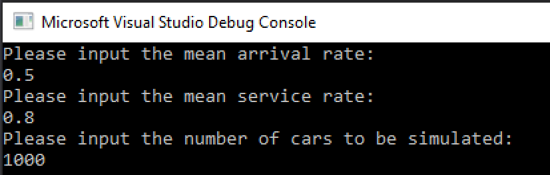
User’s input

Slide 18
Thank you!
Questions?

