Slide 1
Lab4: Iterator
October 31, 2019

Slide 2
Outline
Iterator
Time complexity

Slide 3
How to find best paid?
1. Access(i)
  Access(1), Access(2), …,
2. Iterator

Slide 4
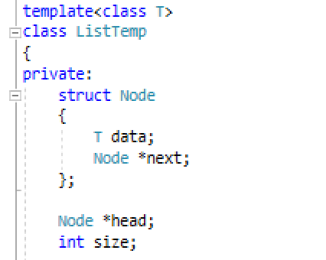
What’s the difficulty?

Slide 5
Solution?
Node *getHeadPointer()
{ return head; }

Slide 6
Ideas of Solution
Define a class
  Encapsulate the position of a container
  Provide public method for manipulating the position
    Retrieve the value stored at the position
    Move to the next position
    Test whether two positions are the same
  The head position and the tail position

Slide 7
For the Linked List Template
class Position
{
private:
Node *curr;
public:
operator*; //retrieve value
operator++; //the next
operator==; //equivalence
}

Slide 8
For the Linked List Template
Two special positions
  Position(head)
  Position(NULL)

Slide 9
Inner Class
Container Class A --- Position Class PA
The class PA is not used anywhere else except for in the class A
Define class PA inside class A so that it is only visible within class A

Slide 10
The Iterator Inner Class
Demo

Slide 11
Task 1
Implement findBestPaid()

Slide 12
Task2: For the Array Template
Position Class
  Private: ?
  Methods
    *
    ++
    ==
Two special positions
  Position(0)
  Position(length-1)

Slide 13
Summary
Data structure
  Containers (the course)
Template:
Iterator:

Slide 14
Thank you!
Questions?

