Slide 1
Lab 6: Backtrack
November 28, 2019

Slide 2
Outline
Recursion
Backtrack
  Maze
  8-Queen

Slide 3
Recursion
Base case
Induction
Factorial

Slide 4
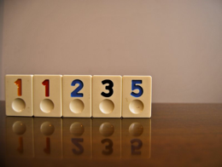
Task1: Recursion
Fibonacci numbers

Slide 5
Backtrack

Slide 6
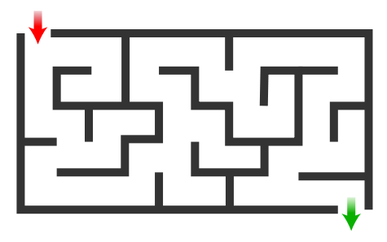
Maze

Slide 7
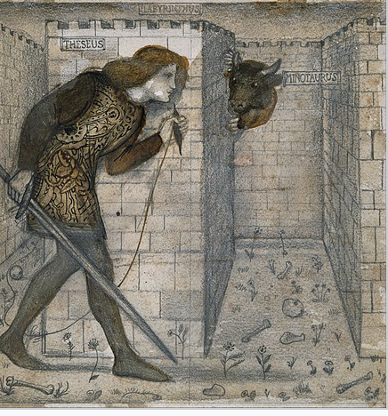
Maze

Slide 8
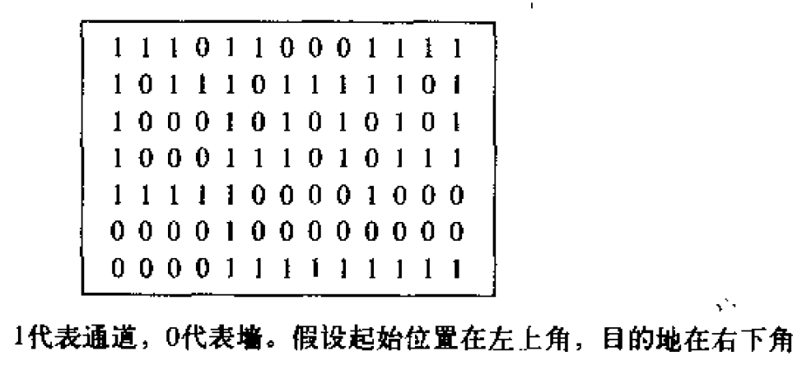
Maze （8*13）

Slide 9
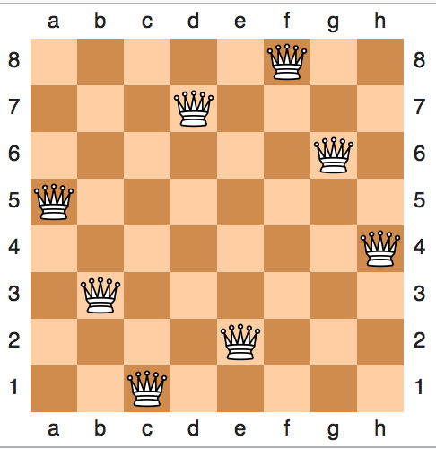
Task2: 8-Queen Puzzle

Slide 10
Thank you!
Questions?

