Slide 1
Lab 7: Queue & Simulation
December 19, 2019

Slide 2
Outline
Container Adaptor
  queue
Simulation
  Exponential distribution
  Sampling
  Queueing theory

Slide 3
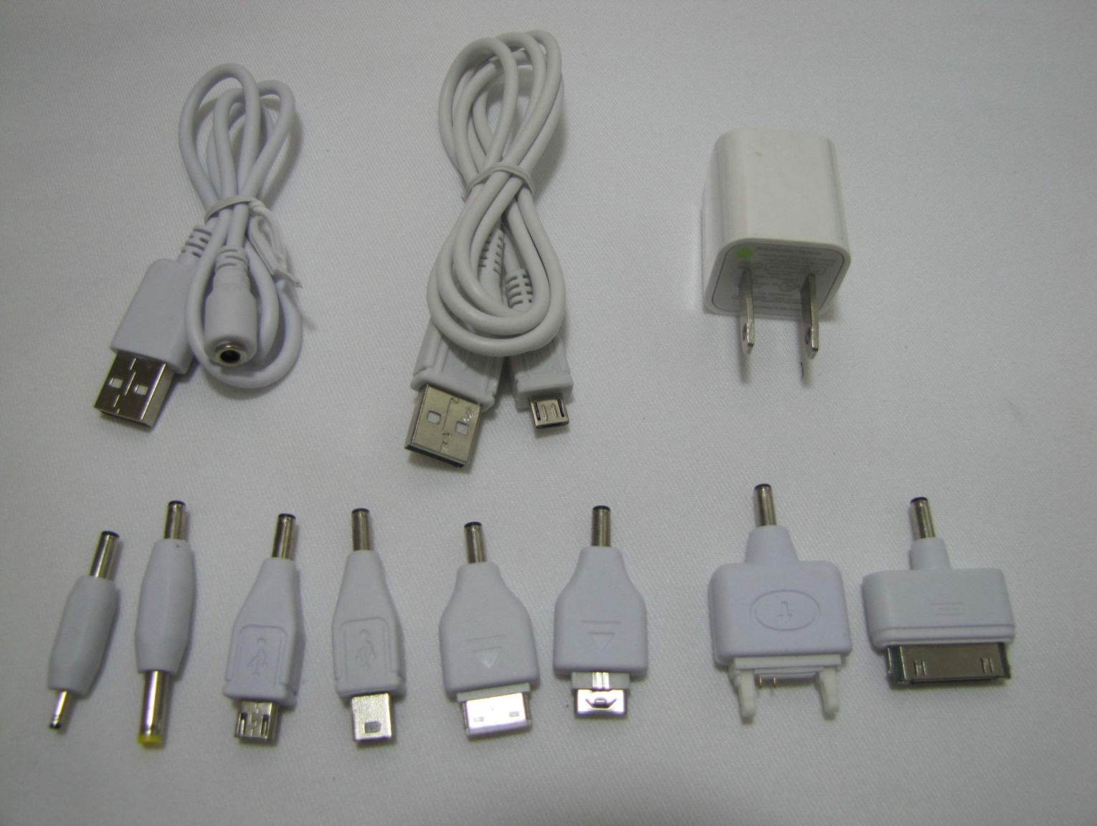
Container Adapter

Slide 4
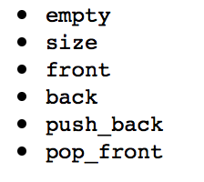
Deque and Lists

Slide 5
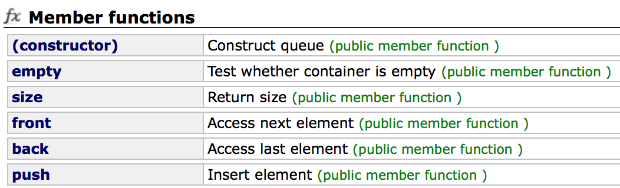
Queue
#include<queue>
queue<T> queueName
Complexity ?

Slide 6
Queuing Theory （排队论）
Arrival time
Service time
Departure time
Waiting time
Sojourn time
Queue length

Slide 7
Queuing Theory
Inter-arrival time: 到达时间间隔
Arrival rate(到达率）
  1 / mean inter-arrival time
  （单位时间平均到达的顾客数）
Service rate（服务率）
  1 / mean service time
  （单位时间平均服务的顾客数）
Service intensity
  arrival rate / service rate （要求 < 1）

Slide 8
Car Wash
One server
10 minutes service time
At most five car waiting (overflow)
Arrival time input from command line
  999 is the sentinel
Simulate and calculate the average waiting time

Slide 9
Analysis: Event Driven
arrival
departure

Slide 10
Demo
Car-washing simulation

Slide 11
Task
Extended car-washing simulation

Slide 12
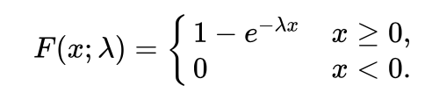
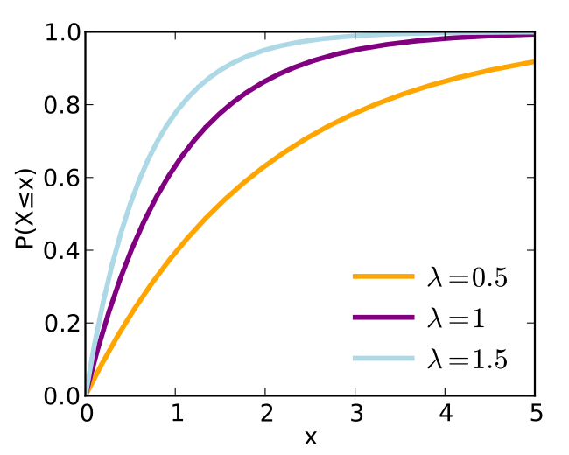
Cumulative Distribution Function累积分布函数
Exponential distribution
Rate parameter

Slide 13
Sampling of Exponential Distribution
Exponential distribution
Rate parameter

Slide 14

Sampling of Exponential Distribution
Exponential distribution
Rate parameter
= p in [0, 1]
P由random生成，反解x即为等待时长

Slide 15
Task: Improved Car Washing
No restriction on CAPACITY
The arrival time interval and service time of each car follow exponential distributions
Output: the average waiting time and the maximal queue length

Slide 16
Thank you!
Questions?

