Slide 1
Lab 8: Binary Search Tree
December 26, 2019

Slide 2
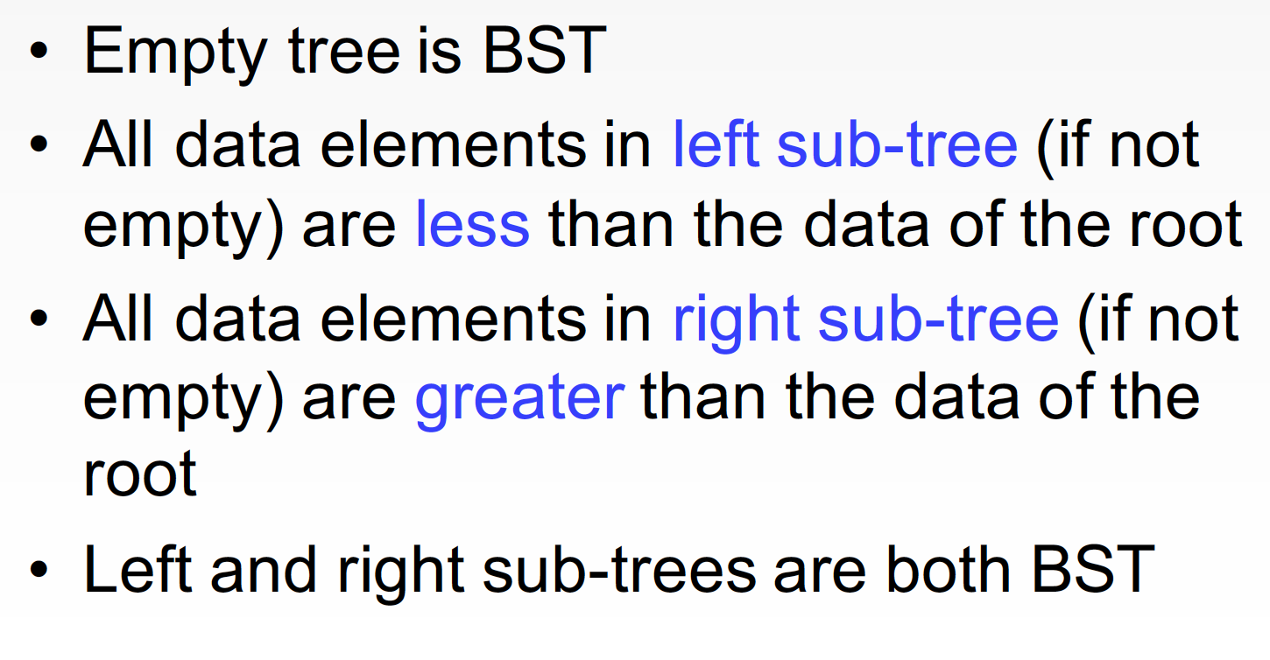
Binary Search Tree (BST)

Slide 3
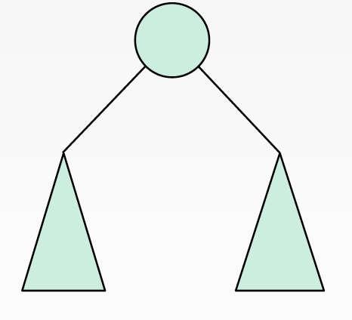
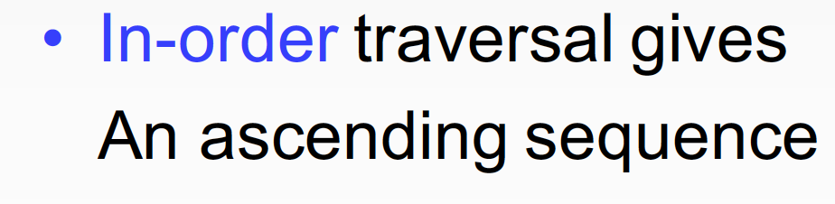
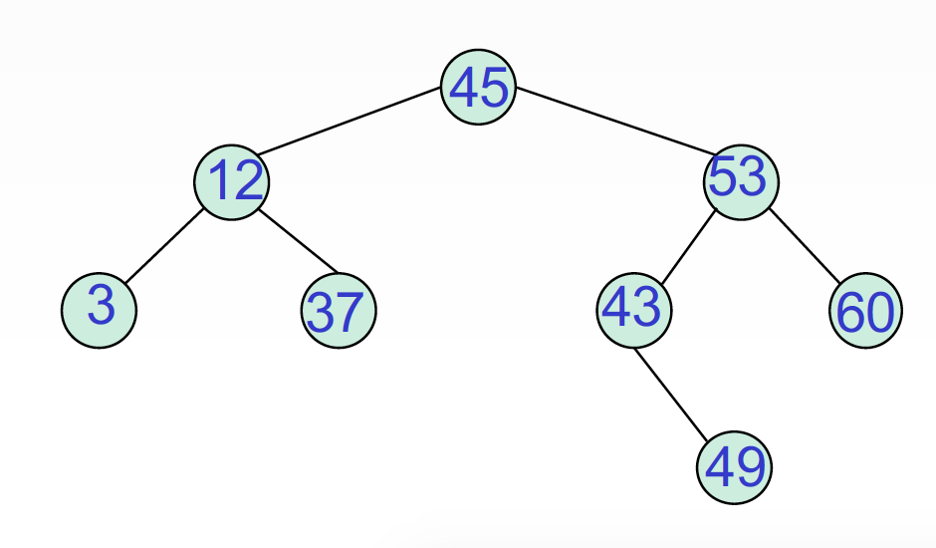
Property

Slide 4
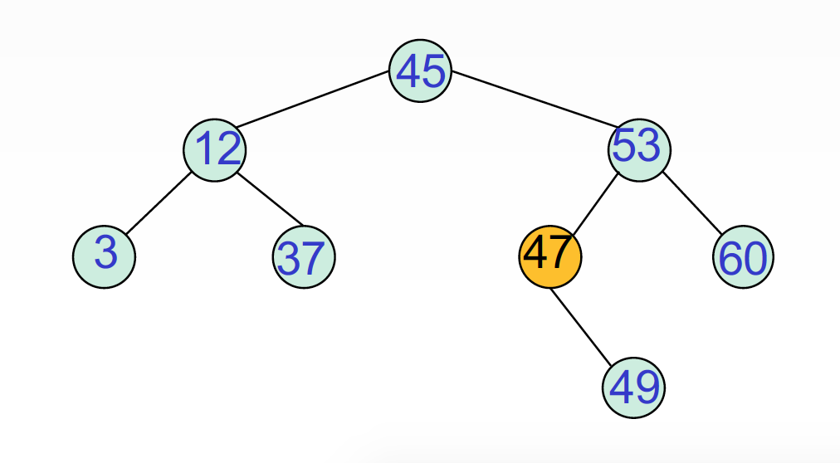
Property

Slide 5
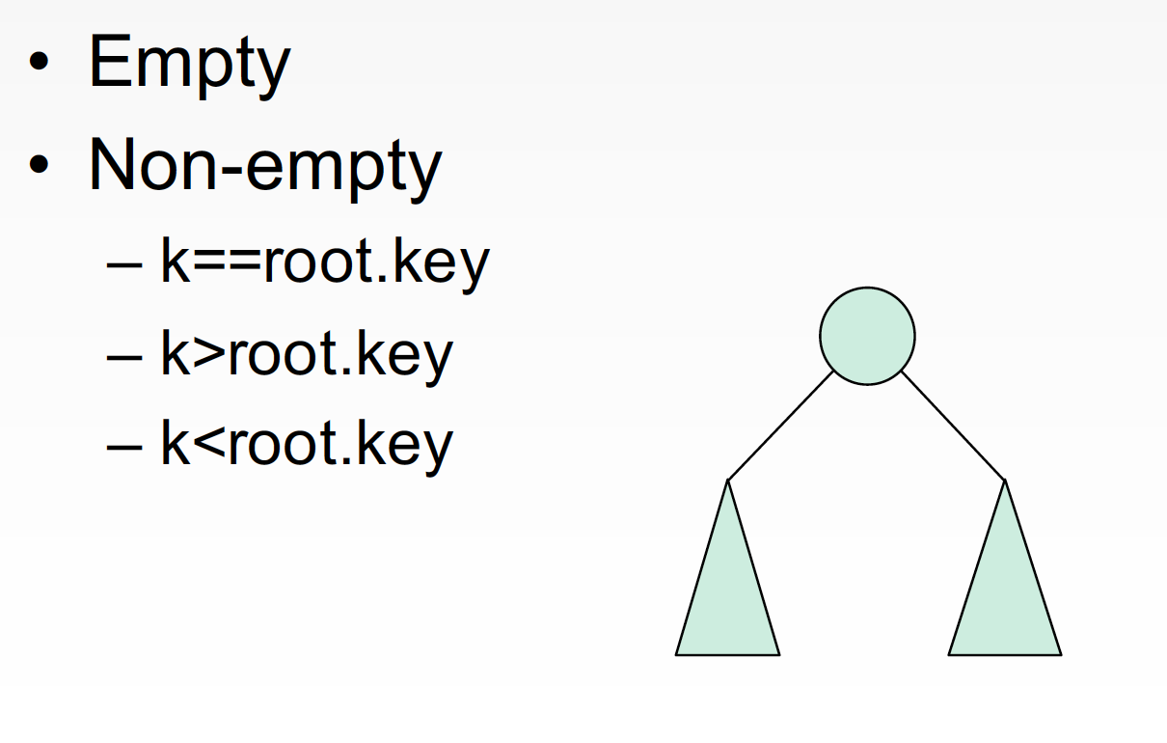
Insertion

Slide 6
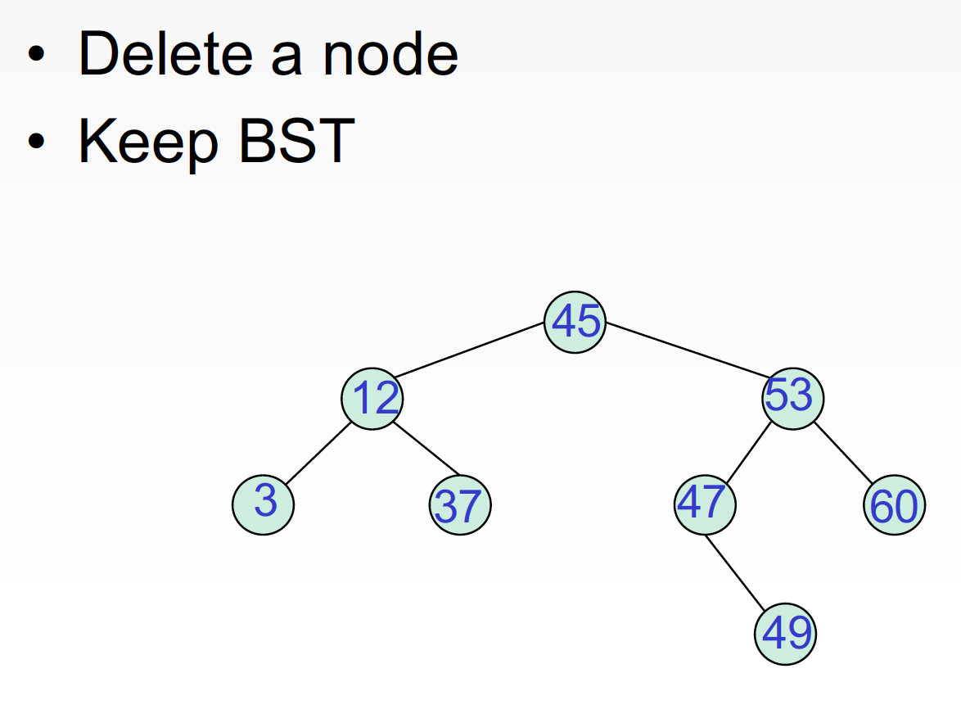
Deletion

Slide 7
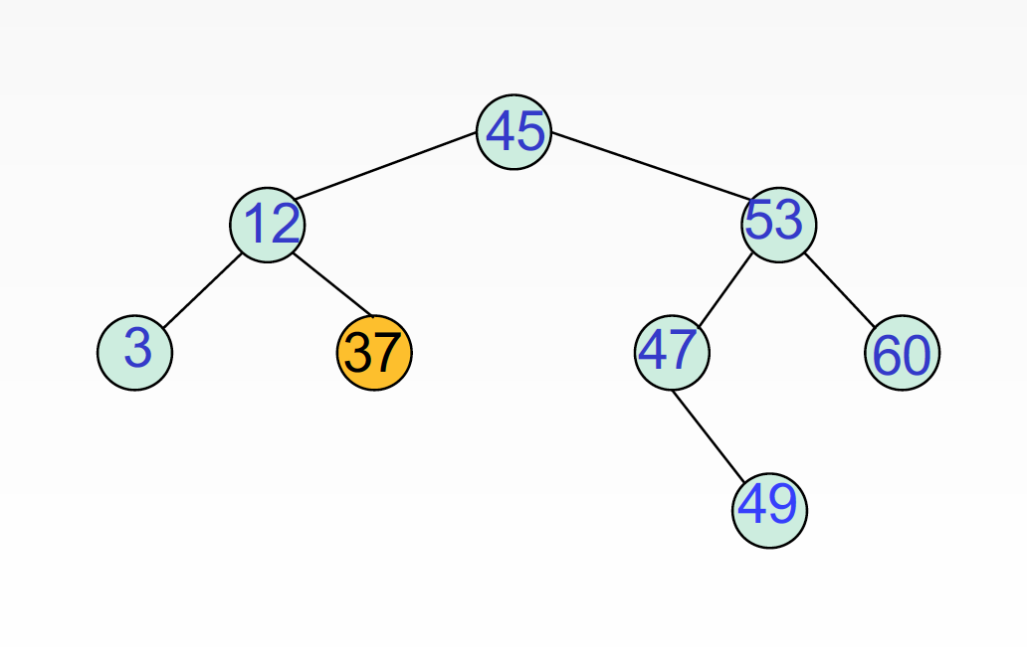
Delete A Leaf

Slide 8
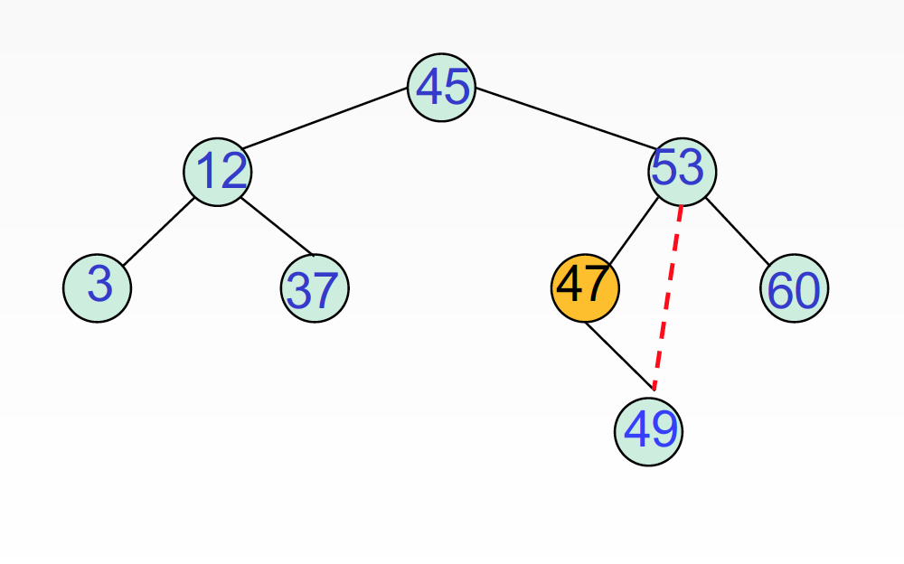
Delete 1-Branch Node

Slide 9
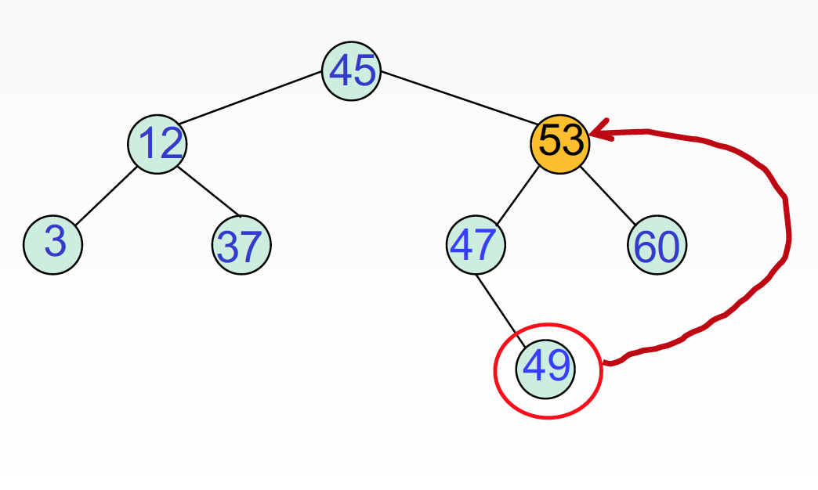
Delete 2-Branch Node

Slide 10
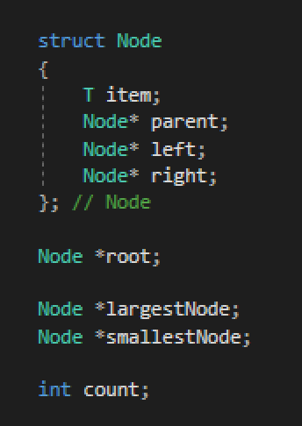
BinSearchTree Class: private

Slide 11
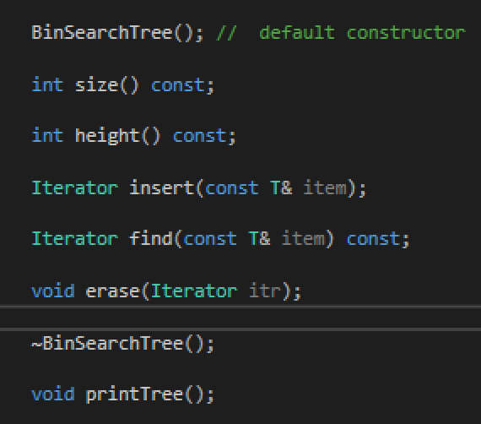
BinSearchTree Class: public

Slide 12
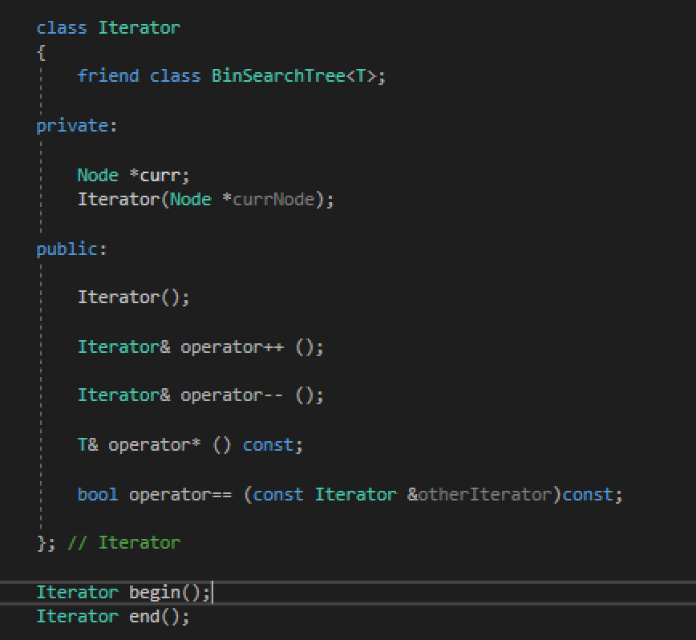
BinSearchTree Class: iterator

Slide 13
Task

Slide 14
Task 1: Implement

Slide 15
Task 2: Average Height

Slide 16
Thank you!
Questions?

