Slide 1
Review
June 14&15, 2017

Slide 2
Evaluation
Final exam: 60%
Lab reports: 20%
Assignments: 10%
Attendance: 5%
Class performance: 5%

Slide 3
About the final exam
Time: Jun 24, 19:00-21:00
Place: 26-202
Scope: ch1-ch13
8 pages, 5 questions, 22 sub-questions
  Multiple choice: 2points*5
  True/false: 2points*5
  Fill-in-blanks: 2points*5
  Short-answer: 5points*1+10points*4+15points*1
  Programming: 10points*1
In English
Use answer card for multiple-choice & true/false

Slide 4
About lab reports & weekly assignments
Registration：
Deadline: Jun 25th, 2017

Slide 5
About attendance and performance
纪委: excel sent to lyuanj@swu.edu.cn
Deadline: Jun 25th, 2019

Slide 6
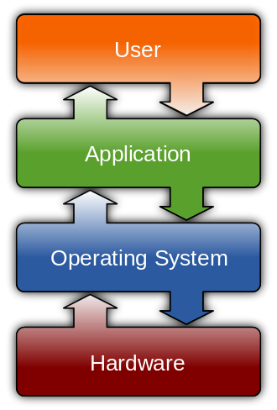
Operating System

Slide 7
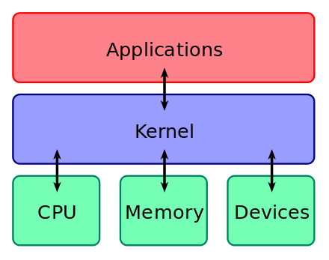
Operating System

Slide 8
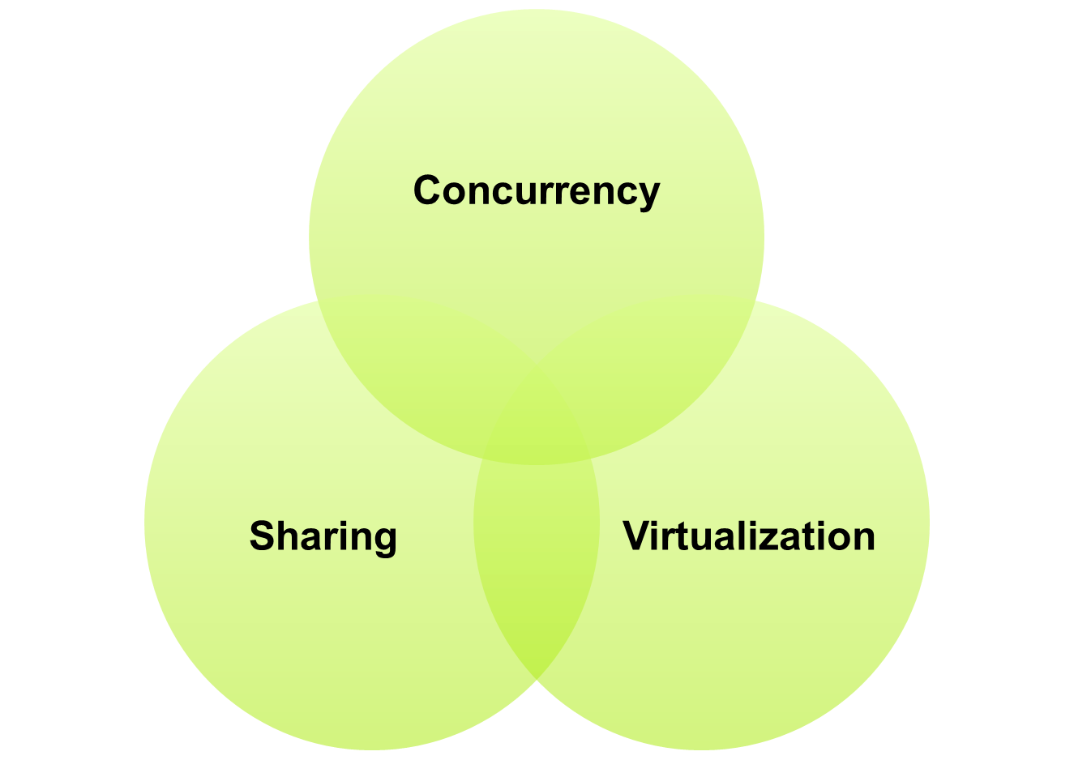
Operating System

Slide 9
Ch1
Hardware (★)
  Architecture
  CPU
  Disk
  Memory
  IO
Interrupt-driven (★★)
  (1.2.1)
Multi-programming & time-sharing (★★★)
  (1.4)

Slide 10
Ch2
Dual mode (★★★) 1.5
    User mode
    Kernel mode
OS’s Services (★)2.1
User and OS interface (★★)2.2
  Command
  GUI
  System call (★★) 2.3
    Types of System calls 2.4 (★★★)
    System programs 2.5 (★)

Slide 11
Ch3
Process concept
  Process vs program (★★) (3.1.1)
  Process in memory (★) (3.1.1)
  Process states (★★★) (3.1.2) e.g.
  PCB (★★★) (3.1.3) e.g.
Scheduling
  Queues (★) (3.2.1)
  Scheduler (★) (3.2.2)
  Context switch (★★★) (3.2.3) e.g.
Process creation & termination
  fork (★★)
  exec (★)
  wait (★)
  exit (★)

Slide 12
Ch3-ipc
Shared memory (★)
  3.4.1
Message passing (★)
  3.4.2
Socket (★★)
  3.6.1
Pipe (★★)
  3.6.3

Slide 13
Ch4
Thread vs process (★★★)
  (4.1)
Multi-core programming
  Parallel vs concurrency (★★)
  Amdahl’s Law & speedup (★★)
Multithreading models
  1-1 (★★)
  m-1 (★★)
  m-m (★)
Pthread & Java thread (★)
Thread pool (★) (4.5.1)

Slide 14
Ch5
CPU/IO burst, CPU/IO bound (★) (5.1.1)
Time for scheduling (★★) (5.1.3)
Preemptive/non-preemptive scheduling (★★) (5.1.3)
Scheduling criteria (★★★) (5.2)
Scheduling algorithm
  FCFS (★★★)
  SJF (★★★)
  Round-robin (★★★)
  Priority (★★★)
  Shortest remaining time first (★)
  Multilevel Queue Scheduling (★)
e.g. average wait time, average turnaround time, Gantt chart

Slide 15
Ch5
Thread scheduling (★) (5.4.1)
  Contention scope
Multi-processor scheduling
  Processor affinity (★★) (5.5.2)
  NUMA (★) (5.5.2)
  Load balancing (★★) (5.5.3)
Real time scheduling
  Hard/soft real time (★)
  Deadline, period, rate (★)
  RM scheduling algorithm (★★)
  EDF scheduling algorithm (★★)

Slide 16
Ch6
Race condition (★★) (6.1)
Critical section problems (★★) (6.2)
  Three requirements for the solution
Peterson’s solution (★)
Atomic instruction (★★)
  test_and_set
  compare_and_swap
Mutex lock (★★★)
  spinlock
e.g. 互斥问题

Slide 17
Ch6
Semaphore (★★★)
  Counting
  Binary
  wait
  signal
  Atomic
  Waiting list
  Initialization of mutex lock and semaphores
  E.g. 同步、互斥问题
Deadlock & starvation (★) (6.6.3)
Priority inversion (★) (6.6.4)

Slide 18
Ch6
Classic synchronization problems (★★★)
  Producer-consumer
  Reader-writer
  Dining philosopher
  E.g. 能灵活运用这几个经典问题
Monitor
  Structure and properties of monitor (★★) (6.8.1)
  Use of monitor (★) (6.8.2)

Slide 19
Ch7
Necessary conditions for deadlock (★★)
Resource allocation graph (★★)
  Cycle and deadlock
Deadlock prevention (★★)
  Break four conditions
Deadlock avoidance (★)
  Safe/unsafe/deadlock
  Banker’s algorithm
    Safety algorithm
    Resource request algorithm
Deadlock detection (★)
E.g. 死锁的四个必要条件

Slide 20
Ch8
Virtual address space (★★) (9.1)
Virtual address vs physical address (★) (8.1.3)
Memory management hardware (★)
  MMU (8.1.3)
  Base/limit register (8.1.1)
Static/dynamic linking (★) (8.1.2, 8.1.4, 8.1.5)
Memory mapped files & shared memory & memory mapped I/O (★★) (9.7)
Dynamic memory allocation (★★)
  Best/worst/first fit (8.3.2)
  Internal/external fragmentation (8.3.3)
E.g. 各种适应算法中空闲块的排列方式

Slide 21
Ch8
Segmentation (★★) (8.4)
  Segmentation table, base, limit
Paging (★★★)
  Frame, page, page no., frame no., page offset, page size
  Page table, frame table
  translation look-aside buffer or associate memory (TLB)
  TLB miss, TLB hit, hit ratio
  Effective memory-access time
  Valid bit, r/w bit
  E.g. page offset, page size, TLB hit, hit ratio, Effective memory-access time的计算等
Hierarchical page table (★★)
Inverted page table (★★)

Slide 22
Ch9
Swapping (★★) (8.2)
Demand paging (★★★) (9.2)
  Resident memory
  Swap space
  Pure demand paging
  Page fault
  Page fault rate
  Effect access time
  E.g. Page fault, Page fault rate, Effect access time等的计算； 另外，给出逻辑地址，计算页号，将逻辑地址转换为物理地址等。
Copy-on-write (★) (9.3)

Slide 23
Ch9
Page replacement
  Victim page, dirty/modify bit (★) (9.4.1)
  Replacement scope (★) (9.5)
  Reference string (★★) (9.4.1)
  FIFO (★★★) (9.4.2)
  OPT (★★★) (9.4.3)
  LRU (★★★) (9.4.4)
  Reference bit, clock algorithm (★★) (9.4.5.2)
  Page buffering (★) (9.4.7)
E.g. 给出页面号调用顺序串，按照不同的页面置换算法，计算缺页中断次数和缺页率。注意Valid bit的影响。

Slide 24
Ch9
Thrashing (★★) (9.6.1 & 9.6.2)
  Locality
  Working set window
  Working set
  Working set size
Buddy system (★★) (9.8.1)
Slab allocator (★) (9.8.2)
Pre-paging (★) (9.9.1)
Page size choice (★) (9.9.2)

Slide 25
Ch 10
File concept (★★)
Access methods (★★)
Directory and Disk structure (★★★)
File-system mounting (★)
File sharing (★)
Protection (★★)
这一章重点在基本概念，比如File concept ，Access methods， Access control bits等。

Slide 26
Ch 11
File-system structure (★★★)
File-system implementation (★★★)
Directory implementation (★★)
Allocation methods (★★)
Free-Space management (★★★)
E.g. 计算磁盘的空间大小、空闲空间管理中各种方法所占空间的计算等。
E.g. Textbook Fig.11.9 UNIX inode，计算这种文件最多能存储多少字节的内容、存储多少副图像等问题。

Slide 27
Ch 12
Disk structure (★★★)
Disk Attachment(★★)
Disk scheduling(★★★)
Disk management (★★★)
RAID structure (★)
E.g. seek time计算, 各种disk scheduling algorithm中调度顺序与总调度时间计算等。

Slide 28
Ch 13
I/O Hardware
Application I/O interface
Kernel I/O subsystem
Transforming I/O requests to hardware system
E.g. DMA、SPOOLing、Buffering的概念及工作原理等。

Slide 29
Thank you & good luck!

