Slide 1
Chapter 3: Processes
March 15， 2021

Slide 2
Chapter 3: Processes
Process Concept
  Process vs Program
  Resources
  Process State
  Process Control Block
  Process Scheduling
Operations on Processes
  fork()

Slide 3
Objectives
To introduce the notion of a process -- a program in execution, which forms the basis of all computation
To describe the various features of processes, including scheduling, creation and termination, etc.

Slide 4
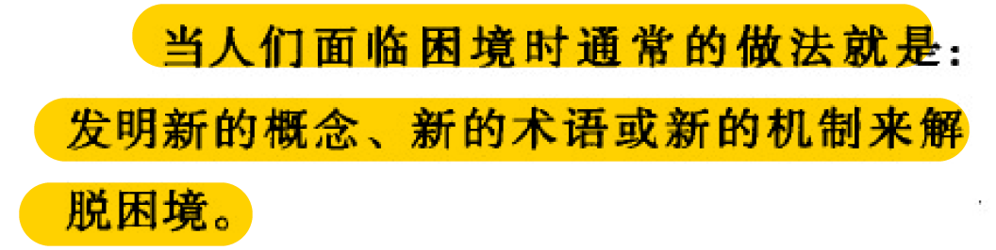
Process Concept
An operating system executes a variety of programs:
  Batch system – jobs
Multi-programming
－－《操作系统之哲学原理》
Process
Notes:
从单道程序，讲到多道程序，讲到切换、上下文，引入管理需求，引出进程的概念

Slide 5
Program vs Process

Slide 6
An Empty Program
int main()
demo
Notes:
size a.out
text data bss dec hex filename
1418 544 8 1970 7b2 a.out
objdump -S a.out

Slide 7
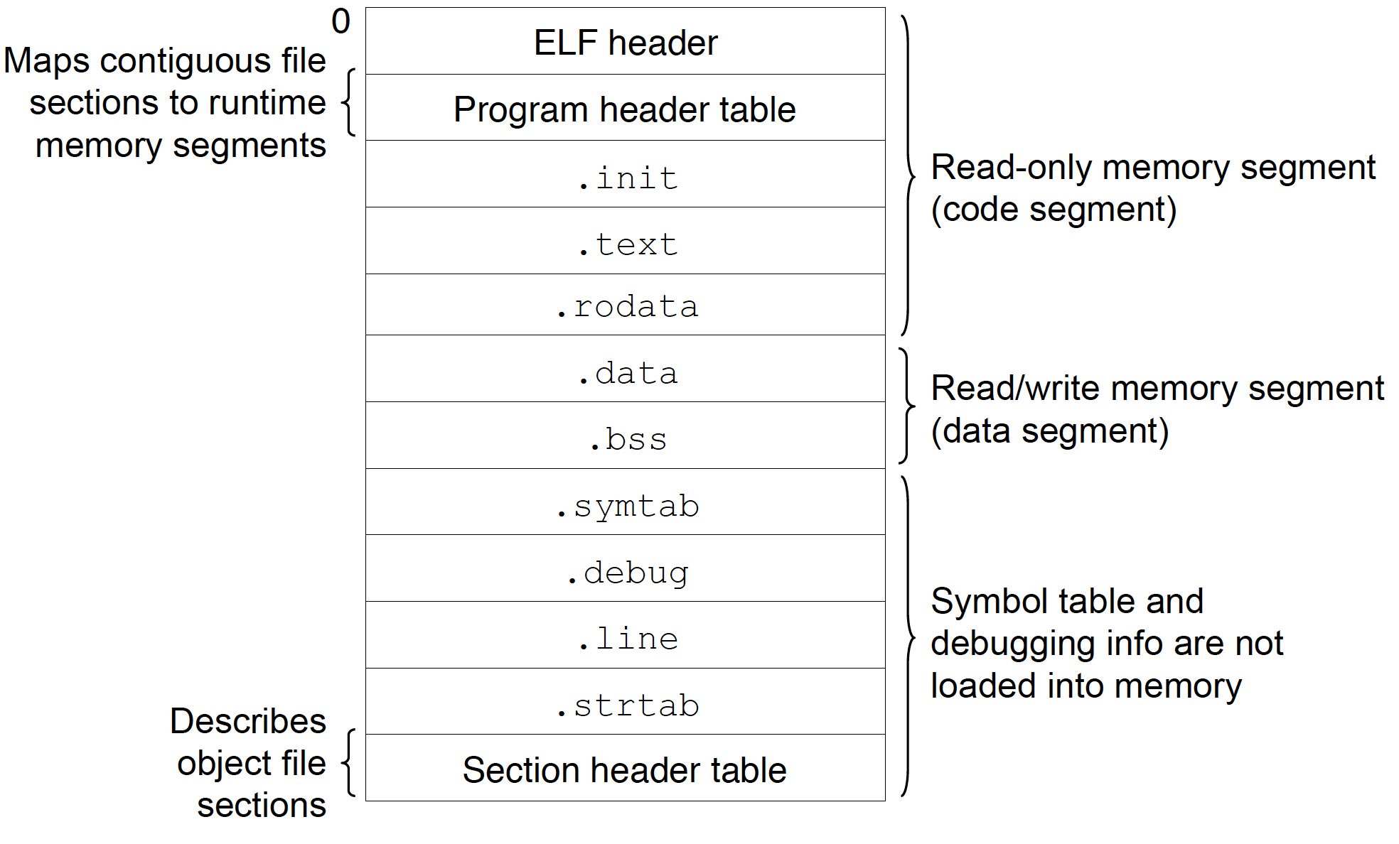
Program on disk
Notes:
file a.out
size a.out

Slide 8
Program in Memory
demo
Notes:
Demo: The global array （如果初始化时指定的的元素个数比数组大小少，剩下的元素都回被初始化为 0）
Size命令的输出不包括stack和heap的部分。只包括文本段(text), 代码段(data),未初始化数据段(bss)三部分。
1、文本段：包含程序的指令，它在程序的执行过程中一般不会改变。
2、数据段：包含了经过初始化的全局变量和静态变量，以及他们的值。
3、BSS段：包含未经初始化的全局变量和静态变量。
4、堆栈段：包含了函数内部声明的局部变量。当然，上面段的作用不仅于此，具体的作用
1、经过初始化的全局变量和静态变量保存在数据段中。
2、未经初始化的全局变量和静态变量保存在BSS段。
3、函数内部声明的局部变量保存在堆栈段中。
4、const修饰的全局变量保存在文本段中，const修饰的局部变量保存在堆栈段中。
5、字符串常量保存在文本段中。

Slide 9
Program in Memory
Local variables
demo
Notes:
Local array demonstration

Slide 10
Program in memory
Multiple parts
  The program code, also called text section
  Data section containing global variables
  Stack containing temporary data
    Function parameters, return addresses, local variables
  Heap containing memory dynamically allocated during run time

Slide 11

Process in Memory

Slide 12
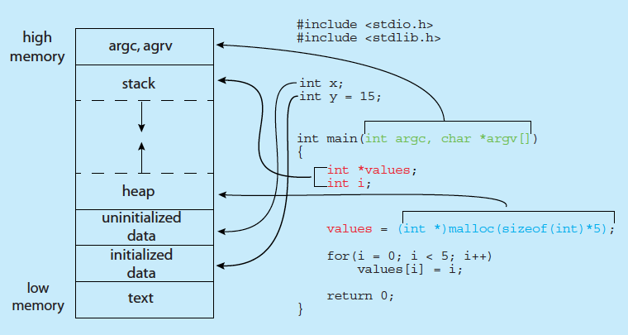
Process in Memory
demo
Notes:
size a.out
cat /proc/<pid>/maps

Slide 13
Registers
Program Counter
Arithmetic
Notes:
Arithmetic？？？？

Slide 14
Scheduling
memory
Program Counter

Slide 15
Life Cycle
time
Program Counter
memory

Slide 16
Summary
To run a program

Slide 17
Process Concept (Cont.)
Program is a passive entity stored on disk (executable file), process is active
  Program becomes process when executable file loaded into memory
  Execution of program started via GUI mouse clicks, command line entry of its name, etc
  Life cycle
  Resources
  One program can be several processes (Demo: iexplorer)
Process = program + execution

Slide 18
Management of Process in OS

Slide 19
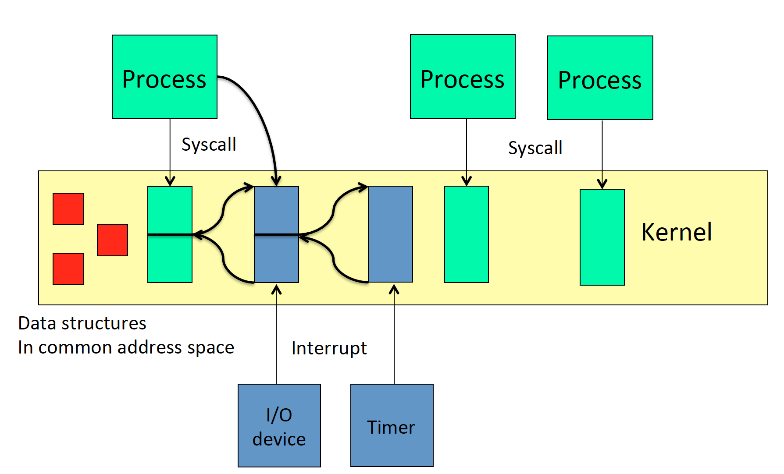
Lecture 2
Notes:
data structures: PCB etc.

Slide 20

Process Control Block -- PCB
Information associated with each process
Program counter – location of instruction to next execute
CPU registers – contents of all process-centric registers
Memory-management information – memory allocated to the process
I/O status information – I/O devices allocated to process, list of open files
Process identifier – number
Process state – running, waiting, etc
CPU scheduling information – priorities, scheduling queue pointers
Accounting information – CPU used, clock time elapsed since start, time limits

Slide 21
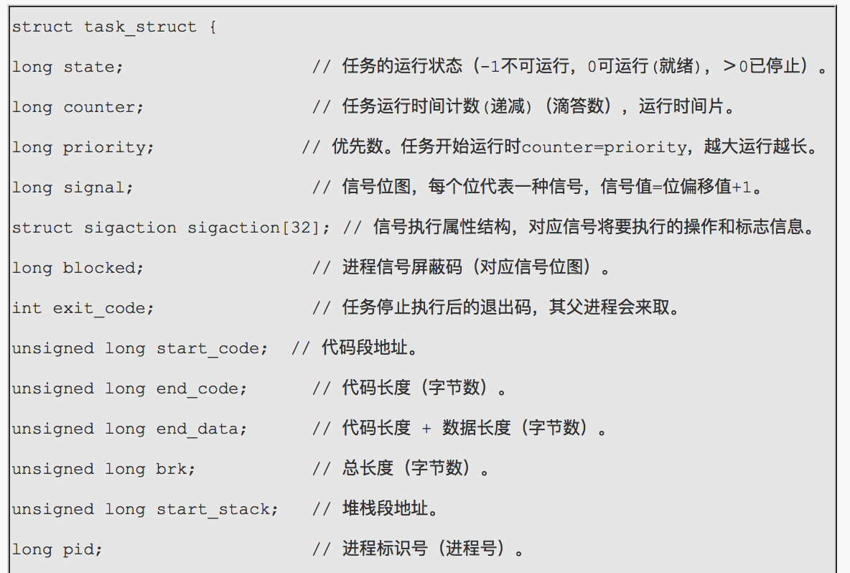
The Linux PCB Structure （V0.11）
Notes:
//最新版本linux的进程进程控制块？

Slide 22
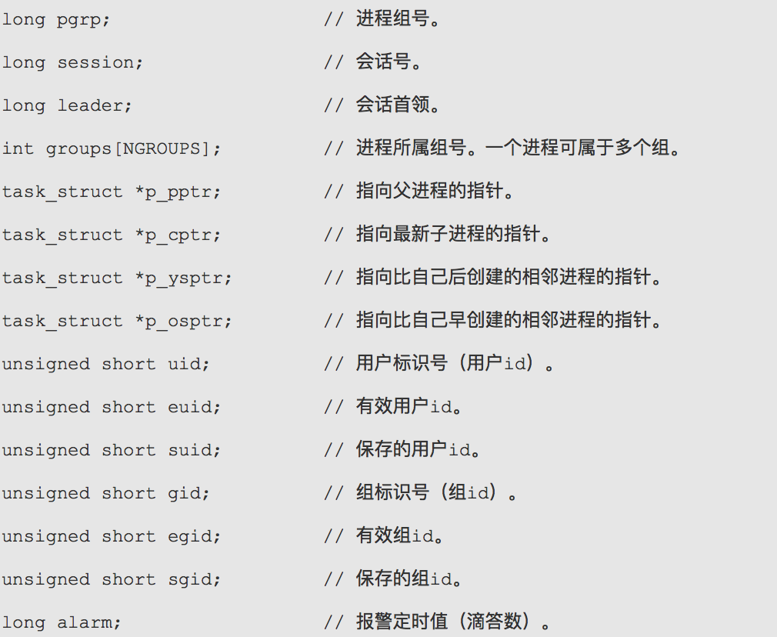
The Linux PCB Structure （V0.11）

Slide 23
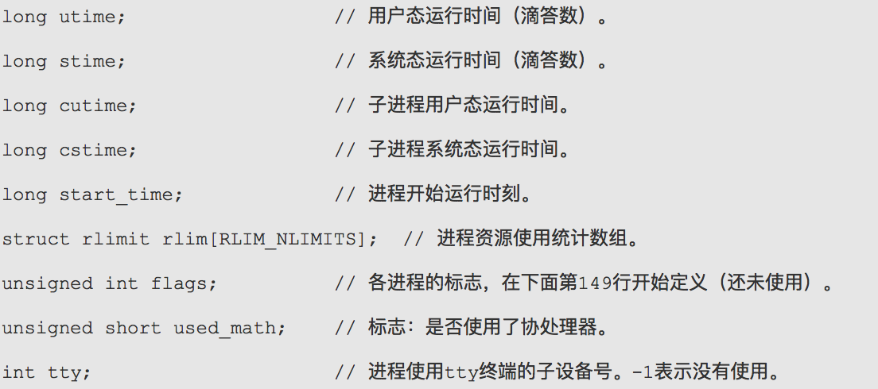
The Linux PCB Structure （V0.11）

Slide 24
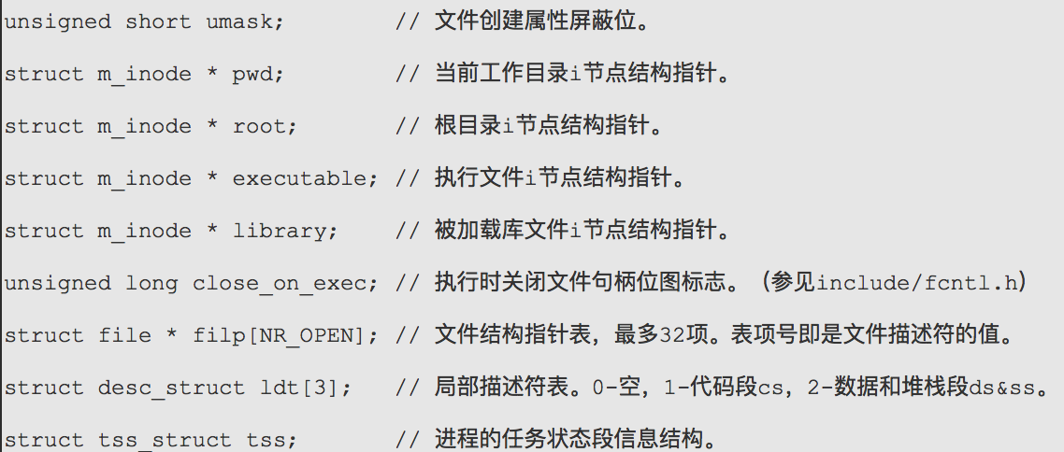
The Linux PCB Structure （V0.11）
registers

Slide 25
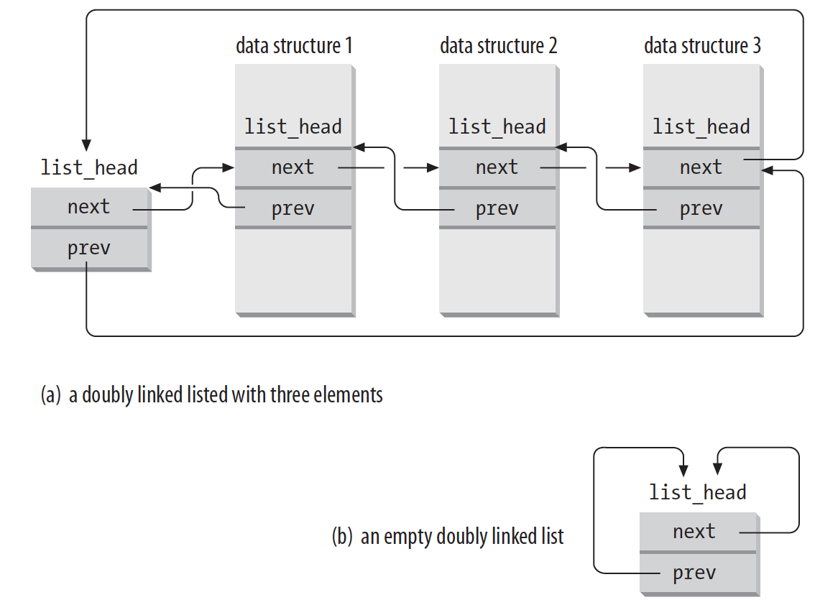
Circular doubly linked list

Slide 26
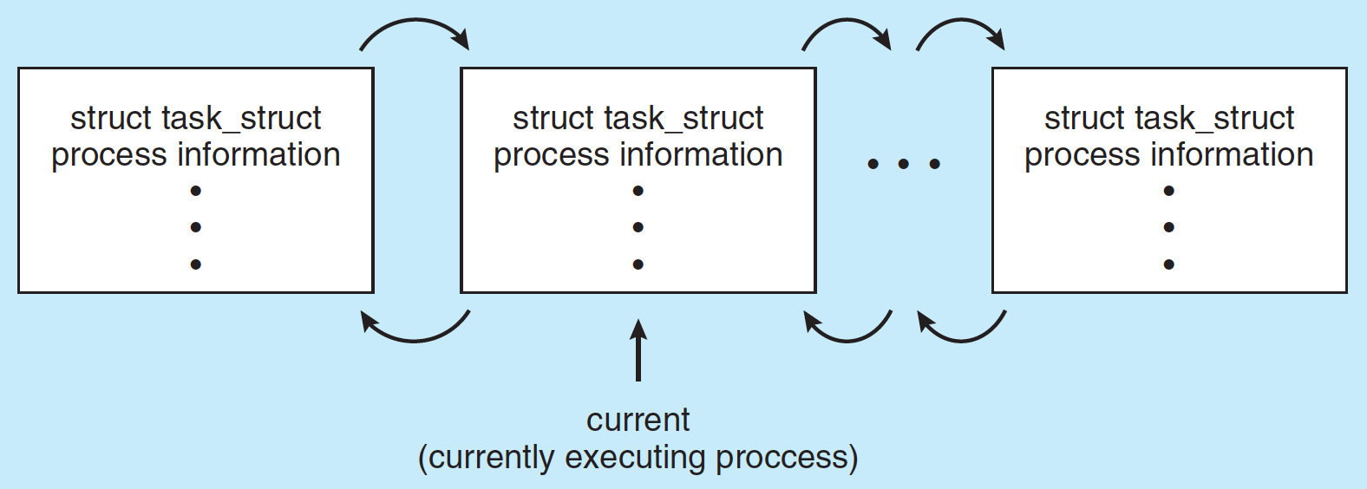
Process Representation in Linux
Represented by the C structure task_struct

Slide 27
Process Control Block -- PCB
Information associated with each process
Process identifier – number
Program counter – location of instruction to next execute
CPU registers – contents of all process-centric registers
Memory-management information – memory allocated to the process
I/O status information – I/O devices allocated to process, list of open files
Process state – running, waiting, etc
CPU scheduling information – priorities, scheduling queue pointers
Accounting information – CPU used, clock time elapsed since start, time limits

Slide 28
Process Control Block -- PCB
Information associated with each process
Process identifier – number
Program counter – location of instruction to next execute
CPU registers – contents of all process-centric registers
Memory-management information – memory allocated to the process
I/O status information – I/O devices allocated to process, list of open files
Process state – running, waiting, etc
CPU scheduling information – priorities, scheduling queue pointers
Accounting information – CPU used, clock time elapsed since start, time limits

Slide 29
Process Resources
Program counter – location of instruction to next execute
CPU registers – contents of all process-centric registers
Memory-management information – memory allocated to the process
I/O status information – I/O devices allocated to process, list of open files

Slide 30
Process Control Block -- PCB
Information associated with each process
Process identifier – number
Program counter – location of instruction to next execute
CPU registers – contents of all process-centric registers
Memory-management information – memory allocated to the process
I/O status information – I/O devices allocated to process, list of open files
Process state – running, waiting, etc
CPU scheduling information – priorities, scheduling queue pointers
Accounting information – CPU used, clock time elapsed since start, time limits

Slide 31
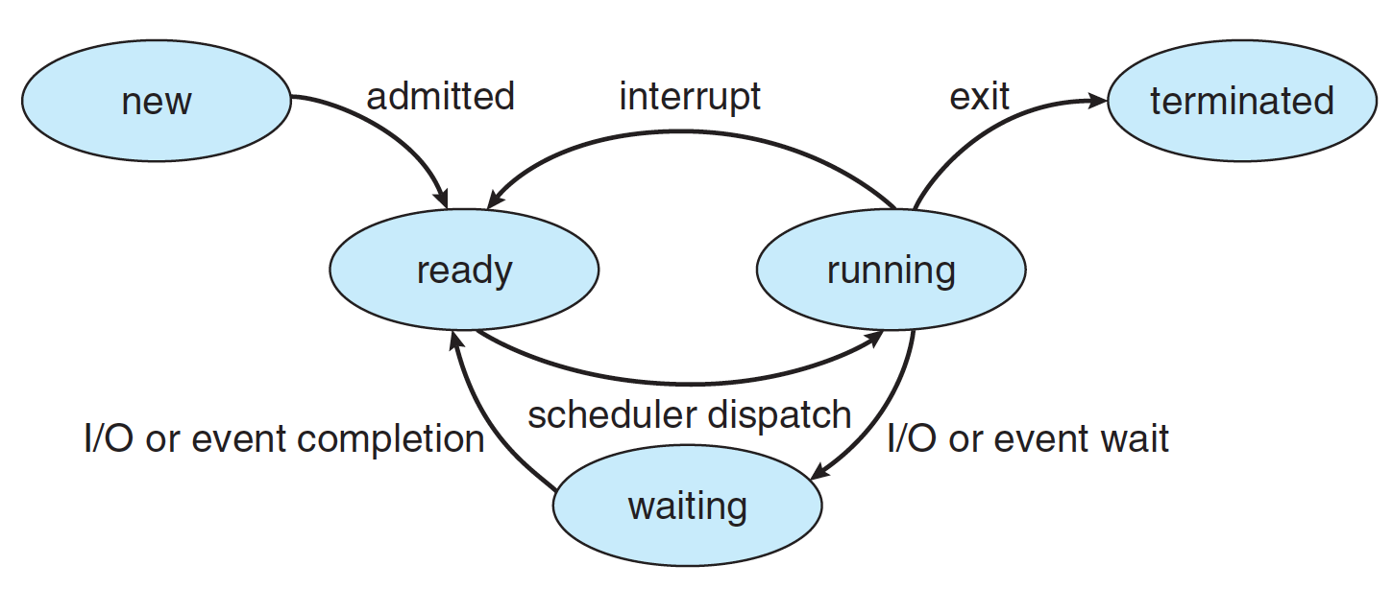
Diagram of Process State

Slide 32
Process State
As a process executes, it changes state
  new: The process is being created
  running: Instructions are being executed
  waiting: The process is waiting for some event to occur
  ready: The process is waiting to be assigned to a processor
  terminated: The process has finished execution

Slide 33
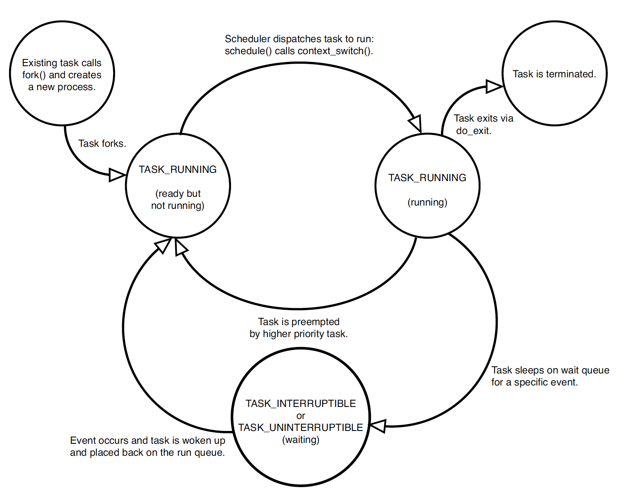
Linux process state

Slide 34
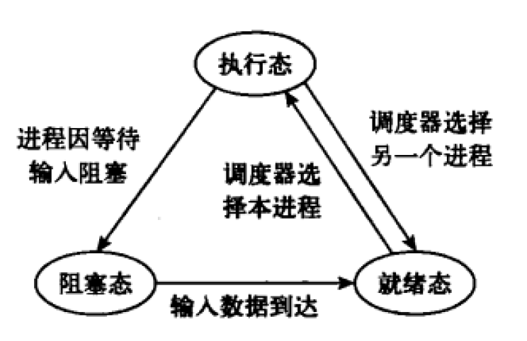
Three States

Slide 35
Process Control Block -- PCB
Information associated with each process
Process identifier – number
Program counter – location of instruction to next execute
CPU registers – contents of all process-centric registers
Memory-management information – memory allocated to the process
I/O status information – I/O devices allocated to process, list of open files
Process state – running, waiting, etc
CPU scheduling information – priorities, scheduling queue pointers
Accounting information – CPU used, clock time elapsed since start, time limits

Slide 36
Process Scheduling
Maximize CPU use, quickly switch processes onto CPU for time sharing
Process scheduler selects among available processes for next execution on CPU
Maintains scheduling queues of processes
  Ready queue – set of all processes residing in main memory, ready and waiting to execute
  Device queues – set of processes waiting for an I/O device
  Processes migrate among the various queues

Slide 37
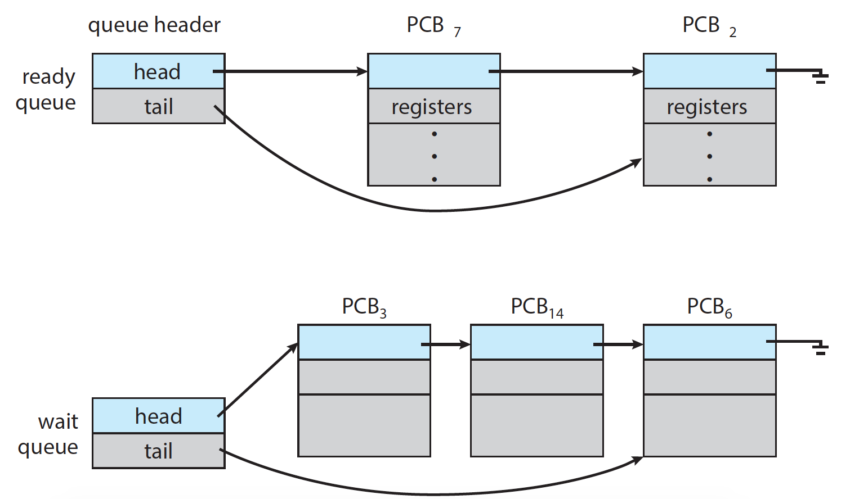
Ready Queue and Wait Queue

Slide 38

Ready Queue And Various I/O Device Queues

Slide 39
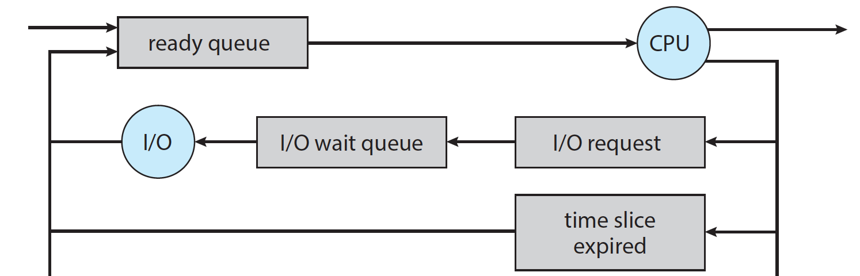
Representation of Process Scheduling
Queueing diagram represents queues, resources, flows
Notes:
Wait for interrupt to complete
Wait for child to exit

Slide 40
Schedulers
CPU scheduler – selects which process should be executed next and allocates CPU
  Sometimes the only scheduler in a system
  Short-term scheduler is invoked frequently (milliseconds) ⇒ (must be fast)
Processes can be described as either:
  I/O-bound process – spends more time doing I/O than computations, many short CPU bursts
  CPU-bound process – spends more time doing computations; few very long CPU bursts

Slide 41
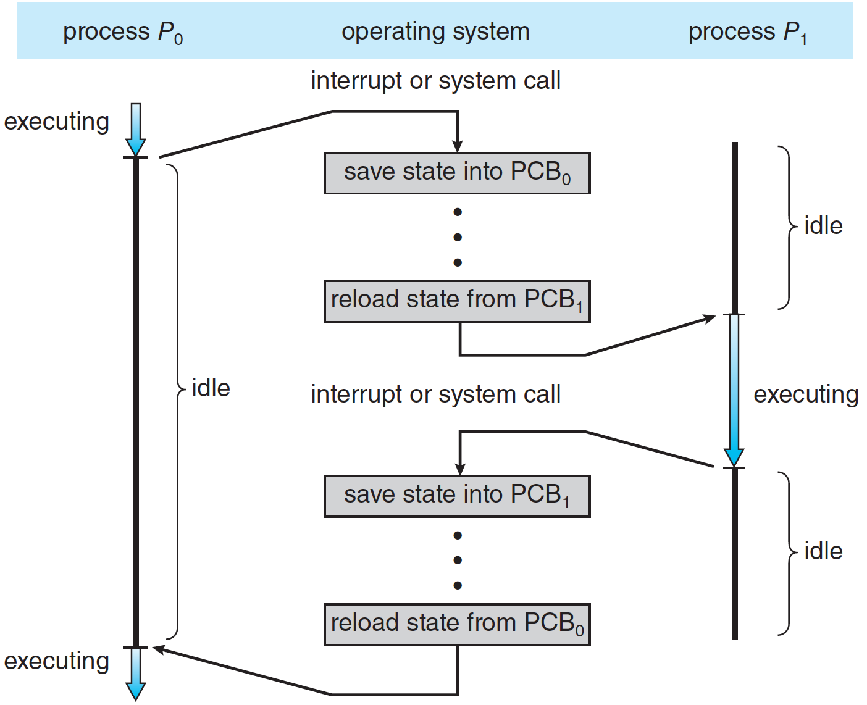
CPU Switch From Process to Process
Notes:
寄存器保存：内核栈 or TSS ？？？？

Slide 42
Context Switch
When CPU switches to another process, the system must save the context of the old process and load the saved context for the new process via a context switch
Context of a process represented in the PCB
It includes the value of the CPU registers, the process state, and memory-management information.
Context-switch time is overhead; the system does no useful work while switching
  The more complex the OS and the PCB ➔ the longer the context switch

Slide 43
Summary of Process
During the lift cycle of a process
  State changes
  Migrate among queues

Slide 44
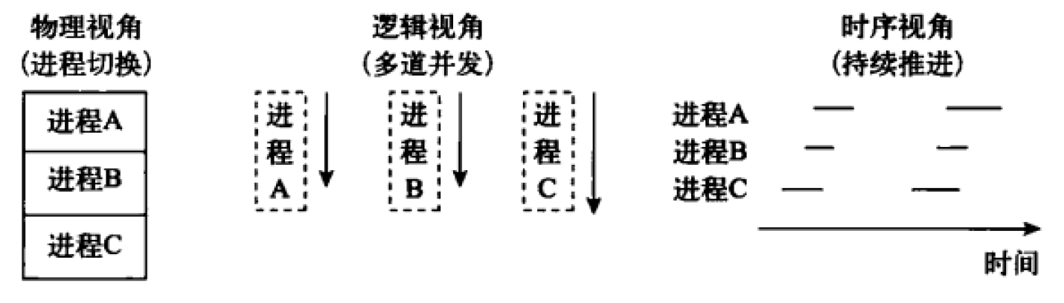
Summary of Process

Slide 45
Operations on Process

Slide 46
Operations on Processes
System must provide mechanisms for:
  process creation,
  process termination,
  and so on as detailed next

Slide 47
Process Creation
Parent process create children processes, which, in turn create other processes, forming a tree of processes
Generally, process identified and managed via a process identifier (pid)

Slide 48
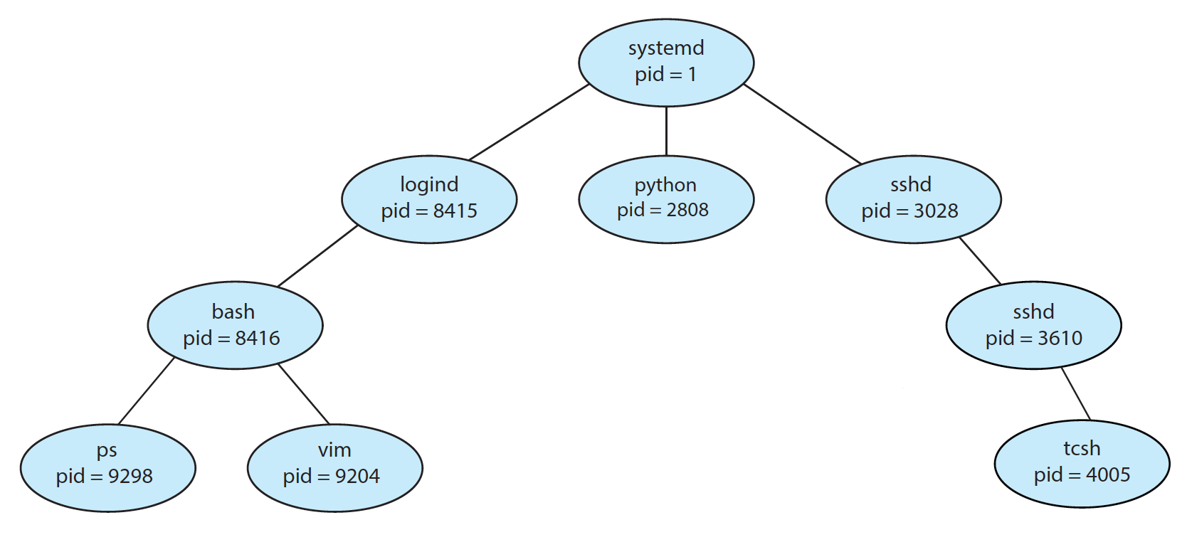
A Tree of Processes in Linux
demo
Notes:
ps -el
pstree -p <pid>

Slide 49
Process Creation
Resource sharing options
  Parent and children share all resources
  Children share subset of parent’s resources
  Parent and child share no resources
Execution options
  Parent and children execute concurrently
  Parent waits until children terminate

Slide 50
Process Creation (Cont.)
Linux example： fork（）
  Child duplicate of parent
  demo

Slide 51
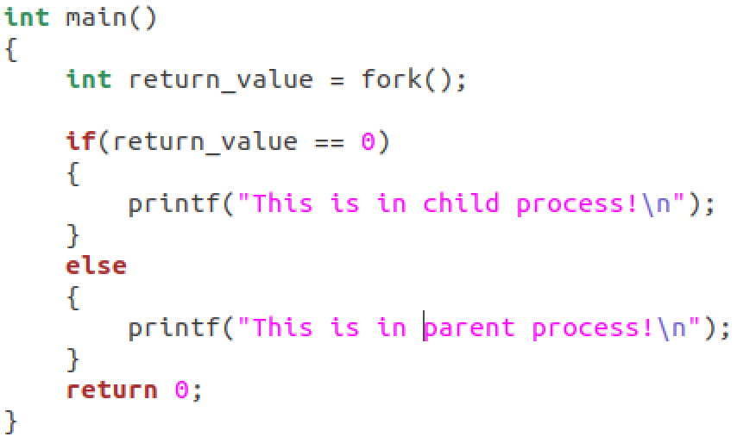
fork() example
parent
child

Slide 52
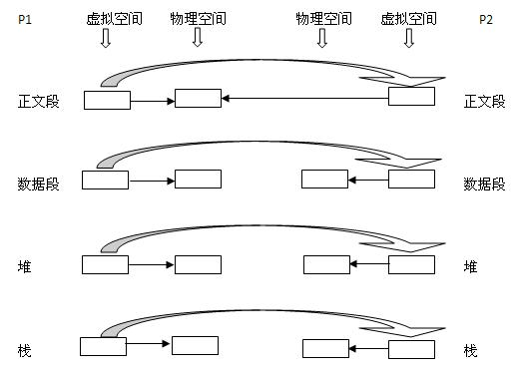
More about fork（）

Slide 53
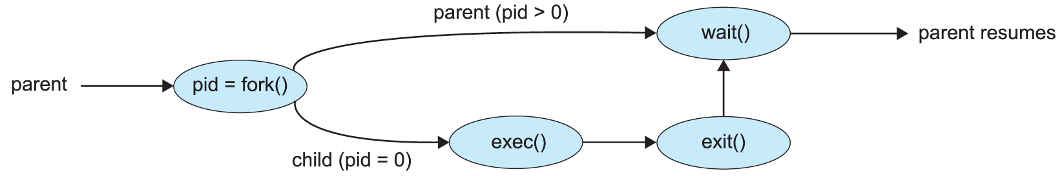
Process Creation (Cont.)
Linux examples
  fork() system call creates new process
  exec() system call used after a fork() to replace the process’ memory space with a new program

Slide 54
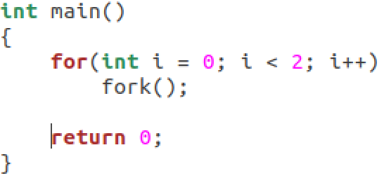
Exercise 1

Slide 55
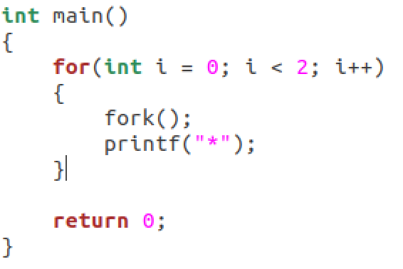
Exercise 2

Slide 56
End of Chapter 3

