Slide 1
Chapter 8: Main Memory (2)
May, 2021

Slide 2
Review
Virtual memory translation
Physical memory space usage
Memory access efficiency
Memory protection

Slide 3
Memory-Management Unit (MMU)
Hardware device that at run time maps virtual to physical address
VA
PA
CPU
MMU
Memory
DATA
virtual address
space
physical address
space
Notes:
mmu inside cpu
mmu and cache?

Slide 4
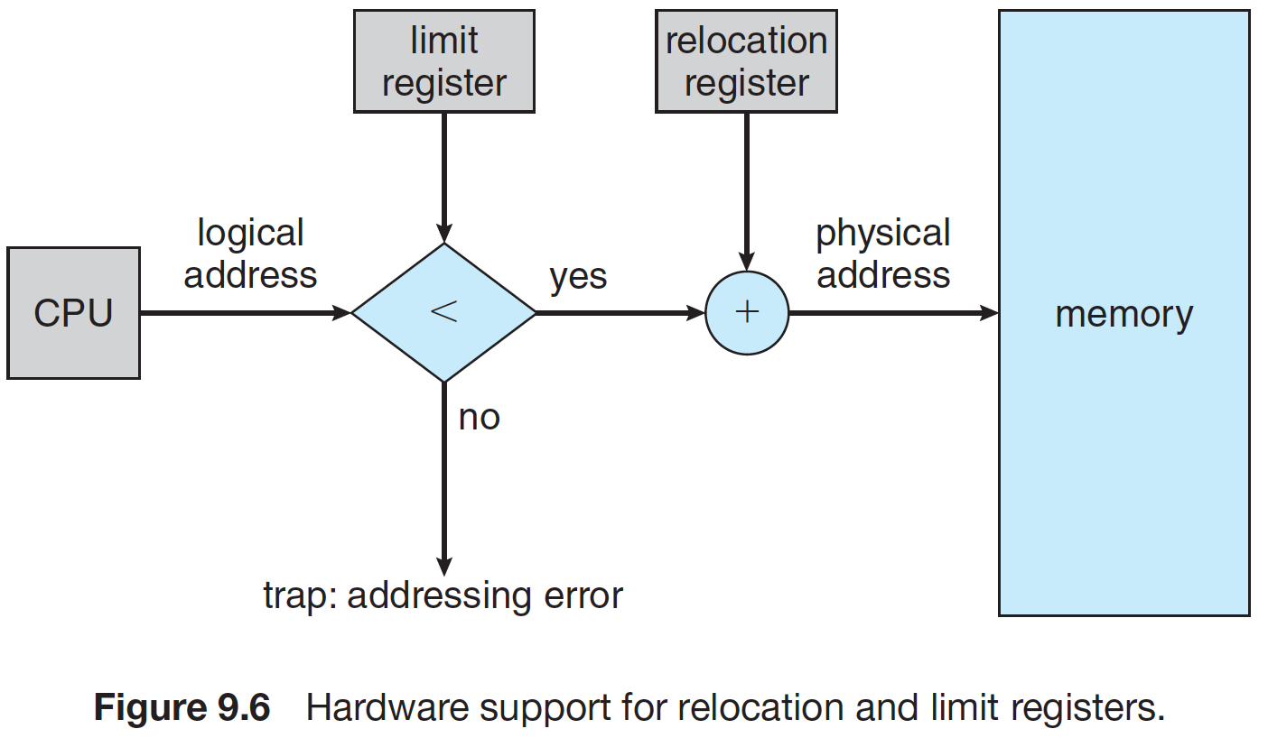
Contiguous
Limit
Base

Slide 5

Segmentation
<segment-number, offset>

Slide 6
Chapter 8: Memory Management
Paging
  Basics
  Implementation
  Virtual address translation
  Improvement of paging
    TLB
    two-level paging

Slide 7
Deal with External Fragmentation
Reduce external fragmentation by compaction
0 | 4 | 8 | 12 | 16 | 20 | 24 | 28 | 32 | 36
0 | 4 | 8 | 12 | 16 | 20 | 24 | 28 | 32 | 36

Slide 8
Segmentation
PA
VA
Notes:
Blue: used
Grey: free

Slide 9
Segmentation
PA
VA
Notes:
Blue: used
Grey: free

Slide 10
Segmentation?
PA
VA
demo
Notes:
getconf PAGESIZE

Slide 11
Paging: Basics

Slide 12
Paging
Divide physical memory into fixed-sized blocks called frames
  Size is power of 2
Divide logical memory into blocks of same size called pages
Notes:
getconf PAGESIZE

Slide 13
Pages and Frames
VA
PA
page
frame

Slide 14
VA-PA mapping
Physical memory layout

Slide 15
Implementation of Paging

Slide 16
How to do paging
Keep track of all free frames
To run a program of size N pages, need to find N free frames and load program
Set up a page table to translate logical to physical addresses

Slide 17

Page Table
page number
frame number

Slide 18

A Paging Example
Before allocation
After allocation
Notes:
Blue: used
Grey: free

Slide 19
Page table is per process!!!

Slide 20
How to do translation

Slide 21
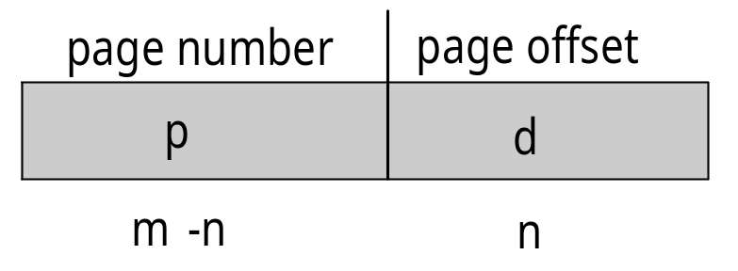
Virtual Address
Address generated by CPU is divided into:
  Page number (p) – used as an index into a page table which contains base address of each page in physical memory
  Page offset (d) – combined with base address to define the physical memory address that is sent to the memory unit
  For given logical address space 2^{m} and page size 2^{n}

Slide 22
Physical Address
Physical address is divided into:
  frame number (f)
  frame offset (d)
Frame number | Frame offset

Slide 23
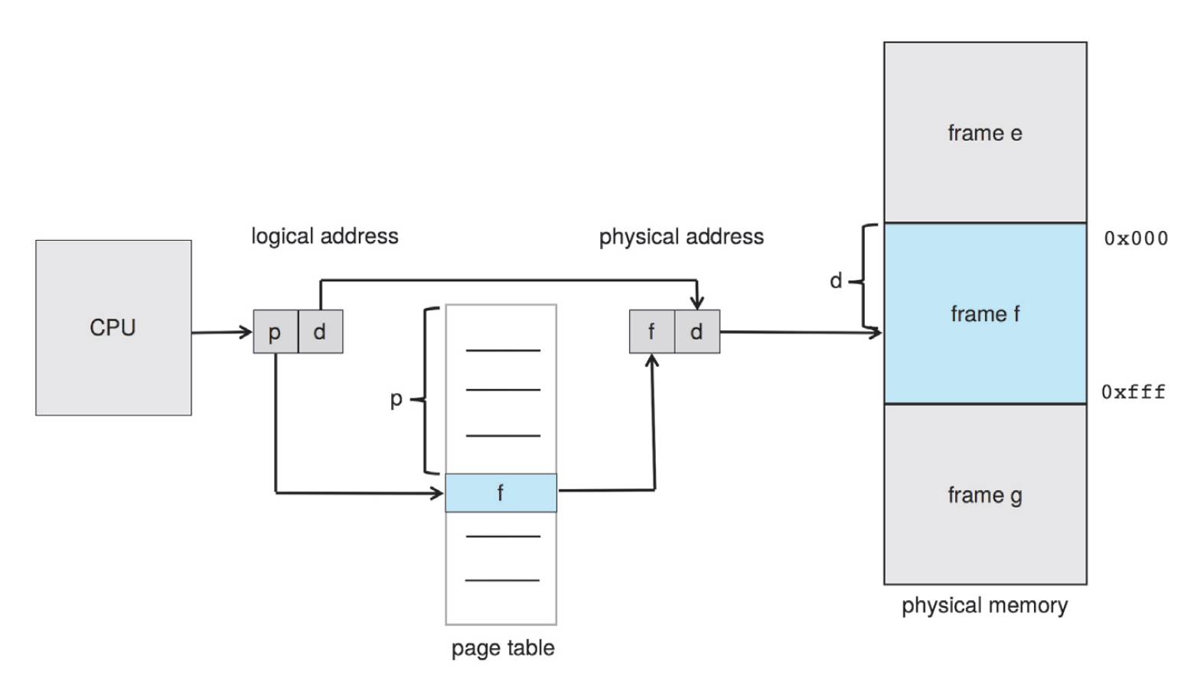
Translation in Paging

Slide 24

Paging Example
0
1
2
3
16-byte virtual memory and 4-byte pages: 4 pages
0
1
2
3
4
5
6
7
Example:
32-byte physical memory and 4-byte pages: 8 frames
Read the data stored
at V.A. 13: 1101_{b}
Read the data stored
at V.A. 6: 0110_{b}
Notes:
页表扩大寻址能力

Slide 25
Summary: Virtual address
Contiguous
  Logical address
Segmentation
  <segment number, segment offset>
Paging
  <page number, page offset>

Slide 26
Summary: VA to PA
Contiguous
  base + limit
Segmentation
  Segment table
  Va: <#seg, offset>
Paging
  Page table
  Va: <#page, offset>
seg# | base | limit
In memory
Per process
page# | frame#

Slide 27
Improvement of Paging

Slide 28
Paging: Pros and Cons
Advantage
  Avoids external fragmentation
Problems
  Internal fragmentation
  Double memory access
  Page table size

Slide 29
Internal fragmentation
Internal Fragmentation – allocated memory may be slightly larger than requested memory; this size difference is memory internal to a partition, but not being used
VA
Small page size?

Slide 30
Internal fragmentation
Calculating internal fragmentation
  Page size = 2,048 bytes
  Process size = 72,766 bytes
  35 pages + 1,086 bytes
  Internal fragmentation of 2,048 - 1,086 = 962 bytes
  Worst case fragmentation = 1 frame – 1 byte
  On average fragmentation = 1 / 2 frame size
  So small frame sizes desirable?
Notes:
Larger page size:
Smaller table
Tlb hit ratio high
Read disk less frequently

Slide 31
Double Memory Access
Page table is kept in memory!!!
page-table base register (PTBR)

Slide 32
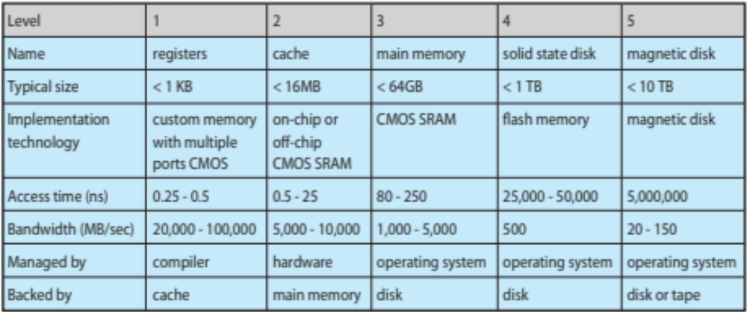
Performance of Various Levels of Storage

Slide 33
Hardware Solution
The two memory access problem can be solved by the use of a special fast-lookup hardware cache called associative memory or translation look-aside buffers (TLBs)
TLB is a cache in MMU
of page table in memory!!!

Slide 34
Memory-Management Unit (MMU)
Hardware device that at run time maps virtual to physical address
VA
PA
CPU
MMU
Memory
DATA

Slide 35
MMU & Paging
Hardware device that at run time maps virtual to physical address
VPN
VA
PFN
CPU
MMU
Memory
PA
DATA

Slide 36
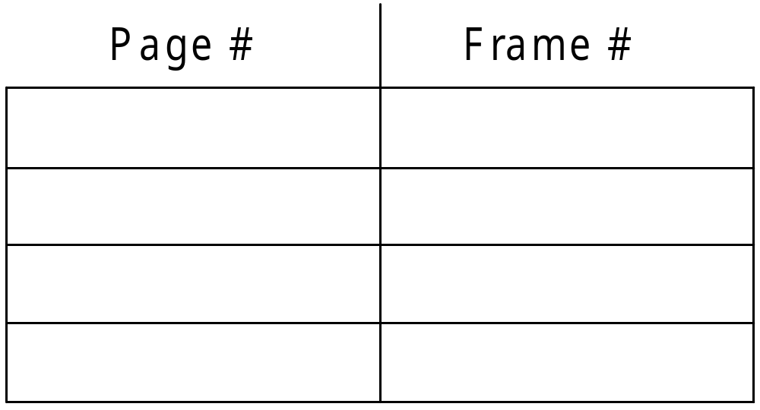
TLB
VPN
PPN (PFN)

Slide 37
MMU & Paging & TLB
Hardware device that at run time maps virtual to physical address
TLB
VPN
PFN
VA
PA
Memory
CPU
MMU
DATA

Slide 38

Paging Hardware With TLB

Slide 39
TLB Miss
Hardware device that at run time maps virtual to physical address
TLB
VPN
PFN
Memory
VA
VPN
CPU
MMU
PA
DATA

Slide 40
TLB hit or miss: hardware support!!!

Slide 41
Effective Access Time
TLB lookup = ε time unit
  Can be < 10% of memory access time
Hit ratio = α
  Hit ratio – percentage of times that a page number is found in TLB

Slide 42
Effective Access Time
Effective Access Time (EAT)
  ε: TLB access time
  t: memory access time
  α: hit ratio
  EAT = tα + 2t(1 – α)
Consider α = 80%, 100ns for memory access
  EAT = 0.80 x 100 + 0.20 x 200 = 120ns
Consider more realistic hit ratio: α = 99%, 100ns for memory access
  EAT = 0.99 x 100 + 0.01 x 200 = 101ns
Notes:
EAT = (t + ε) α + (2t + ε)(1 – α)
EMAT = h*(c+m) + (1-h)*(c+2m)
where, h = hit ratio of TLB
m = Memory access time
c = TLB access time

Slide 43
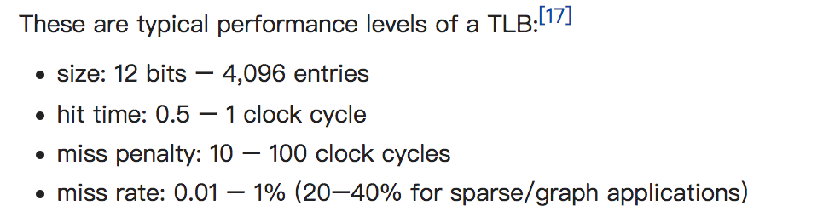
Typical TLB
Notes:
sudo sh -c ‘echo -1 > /proc/sys/kernel/perf_event_paranoid’
sudo perf stat -e dTLB-loads,dTLB-load-misses,iTLB-loads,iTLB-load-misses -p pid

Slide 44
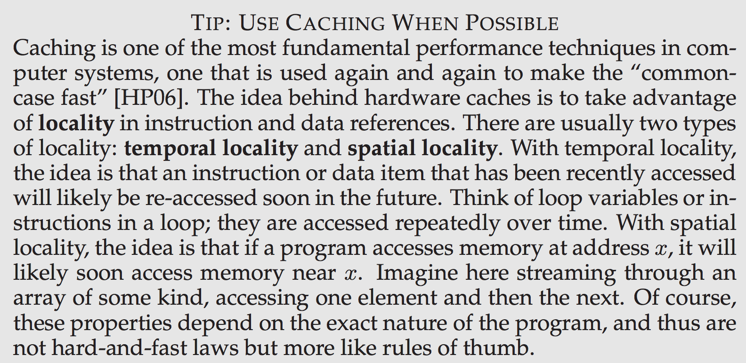
Locality

Slide 45
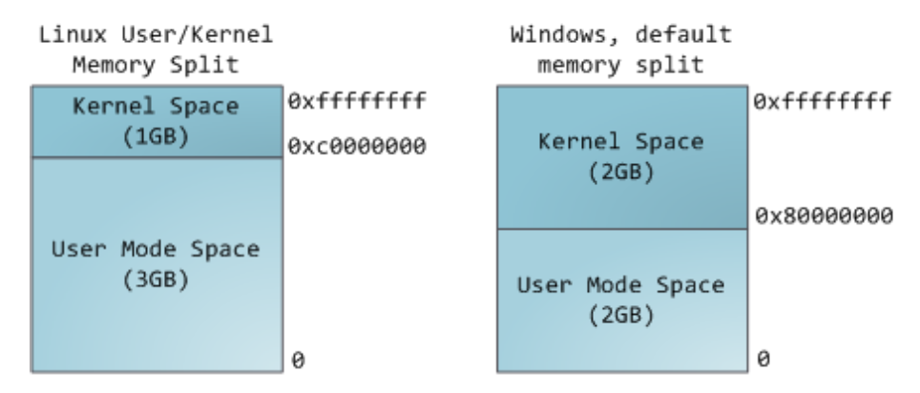
Paging Problem: huge table

Slide 46
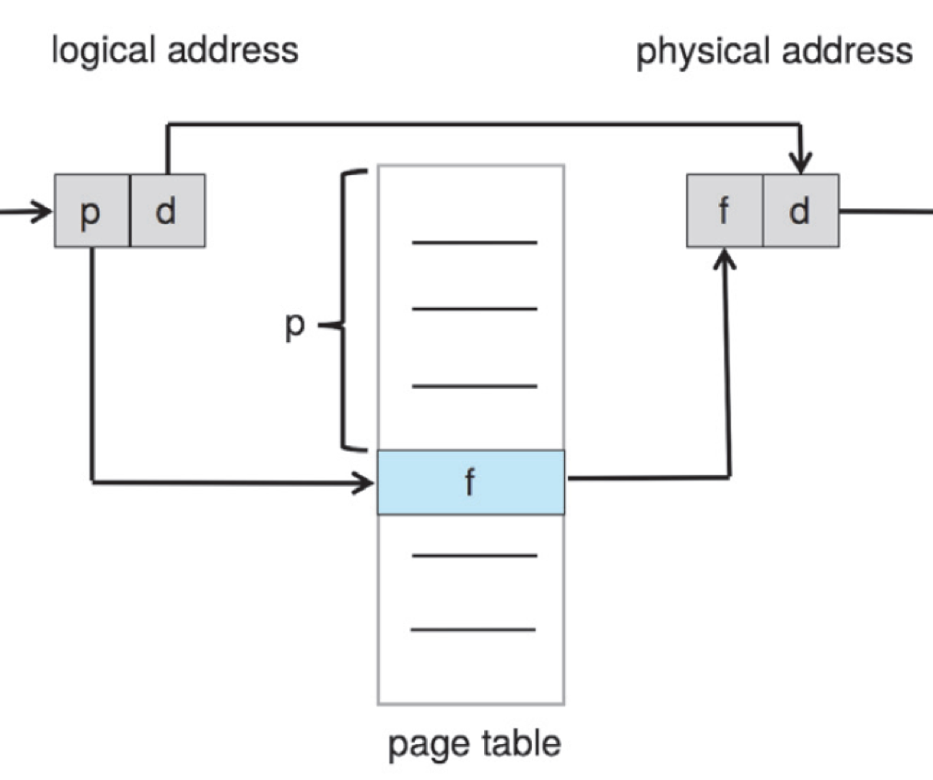
Paging Problem: huge table
Consider a 32-bit logical address space as on modern computers
Page size of 4 KB (2¹²)
Page table would have 1 million entries (2³² / 2¹²)
If each entry is 4 bytes -> 4 MB of physical address space memory for page table alone
Page tables must be
contiguous for efficient indexing

Slide 47
Paging Problem: huge table
Consider a 32-bit logical address space as on modern computers
Page size of 4 KB (2¹²)
Page table would have 1 million entries (2³² / 2¹²)
If each entry is 4 bytes: 4 MB of physical address space memory for page table alone
  That amount of memory used to cost a lot
  Page tables are per process
  64-bit even worse

Slide 48
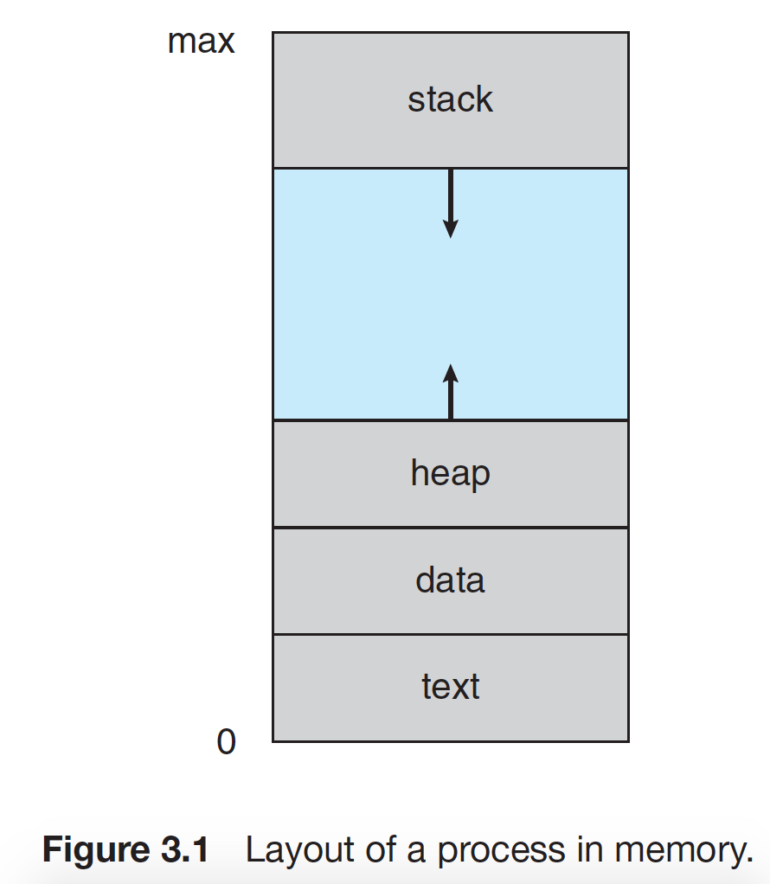
Solution
Hierarchical
paging

Slide 49
Hierarchical Page Tables
Break up the logical address space into multiple page tables
A simple technique is a two-level page table
We then page the page table

Slide 50
Two-Level Paging Example
A logical address (on 32-bit machine with 4K page size) is divided into:
  a page number consisting of 20 bits
  a page offset consisting of 12 bits
PTE
2²⁰

Slide 51
Two-Level Paging Example
A logical address (on 32-bit machine with 4K page size) is divided into:
  a page number consisting of 20 bits
  a page offset consisting of 12 bits
PTE (4B)
…
PTE (4B)
A page
1K*4B = 4KB
2²⁰
^{= 1K * 1K}

Slide 52
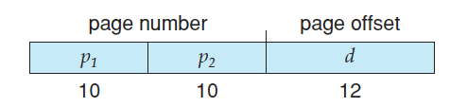
Two-Level Paging Example
A logical address (on 32-bit machine with 4K page size) is divided into:
  a page number consisting of 20 bits
  a page offset consisting of 12 bits
Since the page table is paged, the page number is further divided into:
  a 10-bit page number
  a 10-bit page offset
Thus, a logical address is as follows:

Slide 53
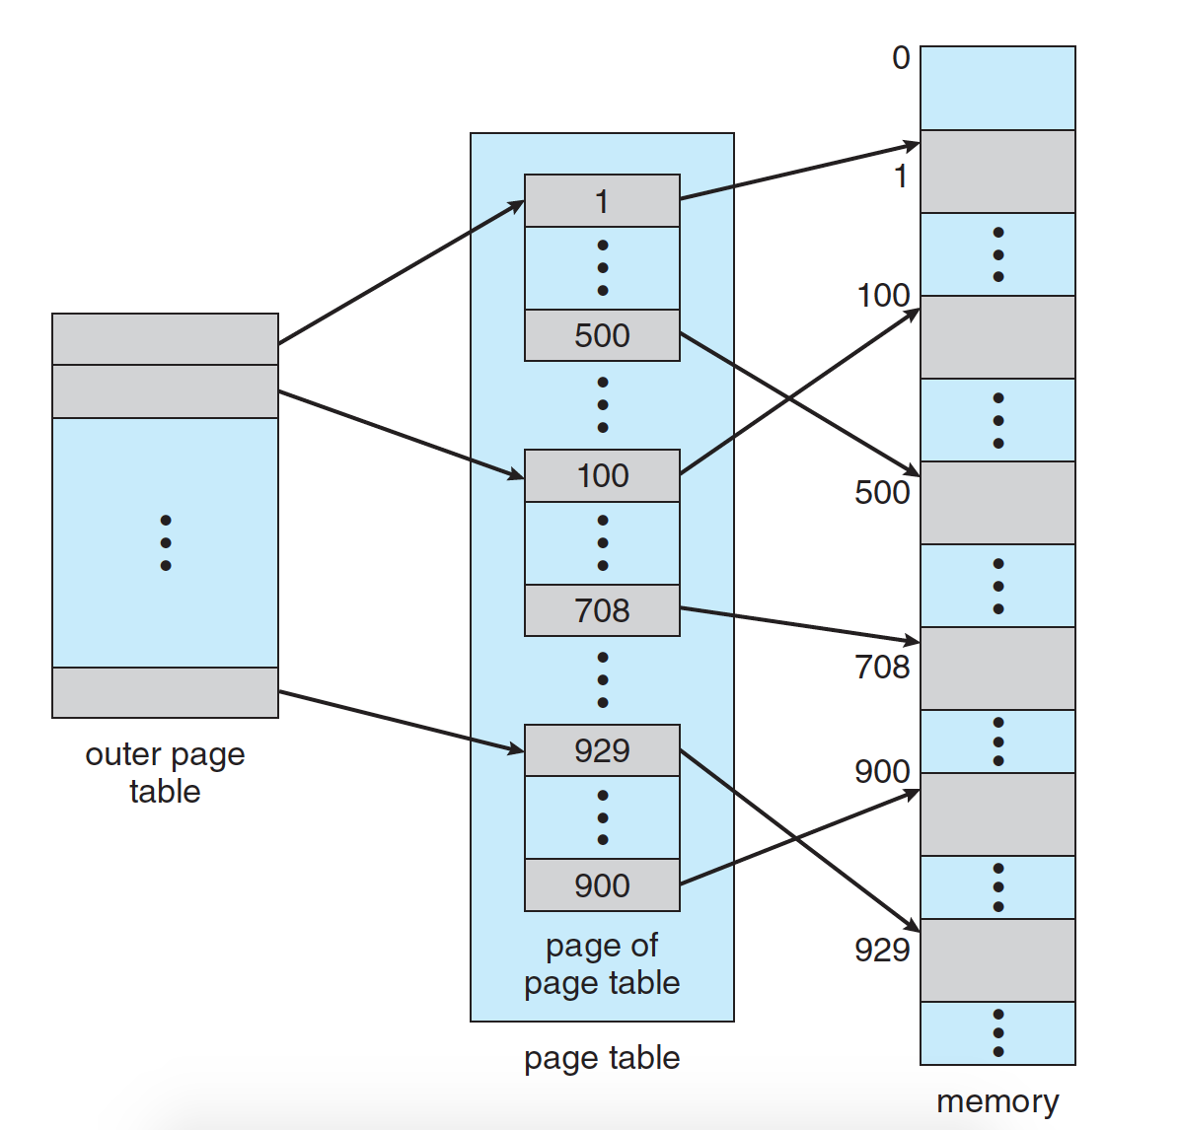
Two-Level Page-Table Scheme
Page table
Physical memory:
Frame #

Slide 54
Two-Level Page-Table Scheme
Page of page table
Physical memory:
Frame #

Slide 55

Address-Translation Scheme

Slide 56
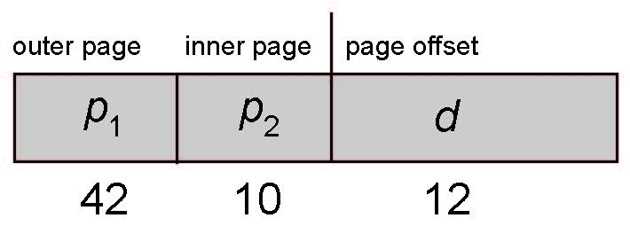
64-bit Logical Address Space
Even two-level paging scheme not sufficient
If page size is 4 KB (2¹²)
  Then page table has 2⁵² entries
  If two level scheme, inner page tables could be 2¹⁰
  4-byte entries
  Address would look like

Slide 57
64-bit Logical Address Space
  Outer page table has 2⁴² entries or 2⁴⁴ bytes
  One solution is to add a 2nd outer page table
  But in the following example the 2nd outer page table is still 2³⁴ bytes in size
    And possibly 4 memory access to get to one physical memory location

Slide 58


Three-level Paging Scheme

Slide 59
Summary
Paging is the most popular memory management mechanism in modern operating systems
  Pages, frames, page table
  No external fragmentation, but internal
  TLB for reduce effective memory access time
  Hierarchical paging for reduce memory cost

Slide 60
Other Issues

Slide 61
Memory Protection
Memory protection implemented by associating protection bit with each frame to indicate if read-only or read-write access is allowed
  Can also add more bits to indicate page execute-only, and so on
Any violations result in a trap to the kernel

Slide 62

Protection Bit In A Page Table
read only?

Slide 63
Shared Pages
Shared code
  One copy of read-only (reentrant) code shared among processes (i.e., text editors, compilers, window systems)
  Similar to multiple threads sharing the same process space
  Also useful for inter-process communication if sharing of read-write pages is allowed

Slide 64

Shared Pages Example

Slide 65
The End of Chap 8

