Slide 1
Chapter 9: Virtual Memory
May, 2021

Slide 2
Chapter 9: Virtual Memory
Background
Demand Paging
Swapping

Slide 3
Objectives
To explain the concepts of demand paging
To explain the concepts of swapping

Slide 4
Review
Physical memory layout

Slide 5
Three Issues
Space
Time
Protection
Address Translation

Slide 6
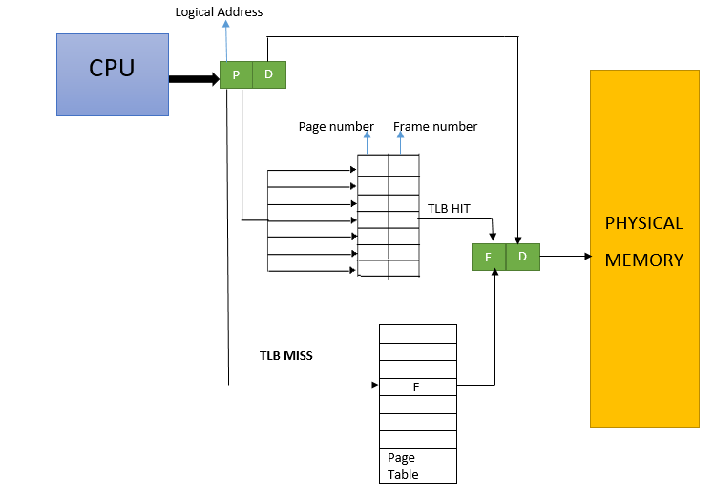
Address Translation with Paging

Slide 7
Other Issues

Slide 8
Memory Protection
Memory protection implemented by associating protection bit with each frame to indicate if read-only or read-write access is allowed
  Can also add more bits to indicate page execute-only, and so on
Any violations result in a trap to the kernel

Slide 9

Protection Bit In a Page Table
read only?

Slide 10
Shared Pages
Shared code
  One copy of read-only (reentrant) code shared among processes (i.e., text editors, compilers, window systems)
  Similar to multiple threads sharing the same process space
  Also useful for inter-process communication if sharing of read-write pages is allowed

Slide 11

Shared Pages Example

Slide 12
Chapter 9

Slide 13
Not enough frames?
Physical memory layout

Slide 14
Not enough frames?
Physical memory layout

Slide 15
Background
In many cases, the entire program is not needed
  Programs often have code to handle unusual error conditions. Since these errors seldom, if ever, occur in practice, this code is almost never executed.
  Arrays, lists, and tables are often allocated more memory than they actually need.
  Certain options and features of a program may be used rarely.

Slide 16
Programs could be partially in memory!
demo
Notes:
Give an example: int data[1024][1024]
top -p pid
d: 0.1s
res: 物理内存(KiB)

Slide 17
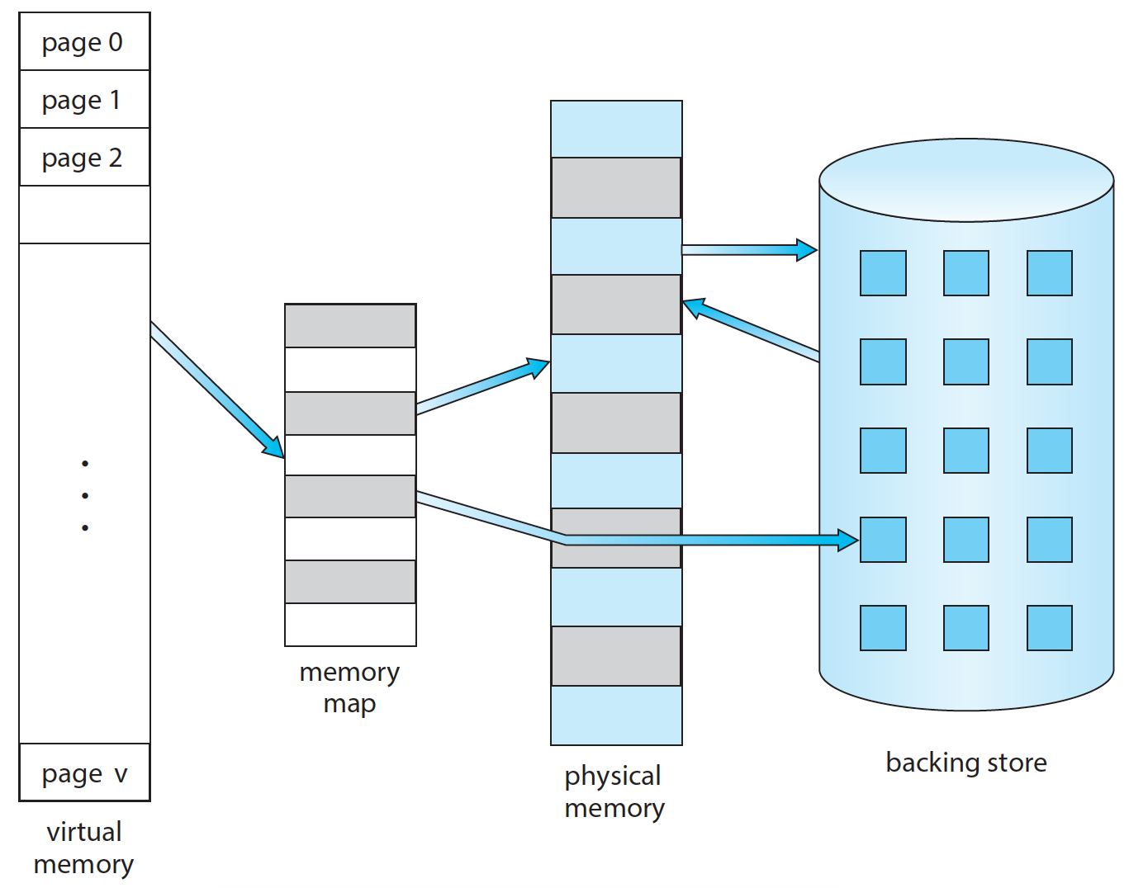
Backing Store
page
table

Slide 18
Page demanding
Programs could be partially in memory!
Only the pages needed are loaded into memory (on demand)!

Slide 19
Demand Paging
Or bring a page into memory only when it is needed
Page is needed ⇒ reference to it
  not-in-memory ⇒ bring to memory
Advantages
  Less I/O needed, no unnecessary I/O
  Less memory needed
  More users

Slide 20
Extreme Case: Pure demand paging
Start process with no pages in memory
OS sets instruction pointer to first instruction of process
  non-memory-resident -> bring into memory
And for every other process pages on first access

Slide 21
How to implement
If pages needed are already memory resident
  No difference from non demand-paging
If page needed and not memory resident
  Need to detect and load the page into memory from storage
    Without changing program behavior
    Without programmer needing to change code

Slide 22

Page table support
With each page table entry a valid–invalid bit is associated
(v ⇒ in-memory – memory resident, i ⇒ not-in-memory)
Initially valid-invalid bit is set to i on all entries
Example of a page table snapshot:

Slide 23

Valid-invalid Bit

Slide 24
Page Fault
During MMU address translation, if valid–invalid bit in page table entry is i ⇒ page fault
  Hardware support
    demo
  OS support
Notes:
Divided by zero fault

Slide 25
Interrupt and Exceptions
fetch | decode | execute
fetch | decode | execute
fetch | decode | execute

Slide 26
OS support: handling page fault
page fault
  Trap into OS kernel
  Handling of page fault
Operating system decides:
  Invalid reference ⇒ abort
  Just not in memory
Find free frame
Read page into frame via scheduled disk operation
Reset page table to indicate page now in memory
Set validation bit = v
Restart the instruction that caused the page fault

Slide 27

Steps in Handling a Page Fault
V

Slide 28
Performance of Demand Paging
Trap to the operating system
Save the user registers and process state
Determine that the interrupt was a page fault
Check that the page reference was legal and determine the location of the page on the disk
Issue a read from the disk to a free frame:
  Wait in a queue for this device until the read request is serviced
  Wait for the device seek and/or latency time
  Begin the transfer of the page to a free frame

Slide 29
Performance of Demand Paging
While waiting, allocate the CPU to some other user
Receive an interrupt from the disk I/O subsystem (I/O completed)
Save the registers and process state for the other user
Determine that the interrupt was from the disk
Correct the page table and other tables to show page is now in memory
Wait for the CPU to be allocated to this process again
Restore the user registers, process state, and new page table, and then resume the interrupted instruction
Notes:
10. Correct TLB?
结合板书

Slide 30
Performance of Demand Paging
Three major activities
  Service the interrupt – careful coding means just several hundred instructions needed
  Read the page – lots of time
  Restart the process – again just a small amount of time

Slide 31
Performance of Demand Paging (Cont.)
Page Fault Rate 0 ≤ p ≤ 1
  if p = 0 no page faults
  if p = 1, every reference is a fault
Effective Access Time (EAT)
EAT = (1 – p) x memory access
+ p x page fault time

Slide 32
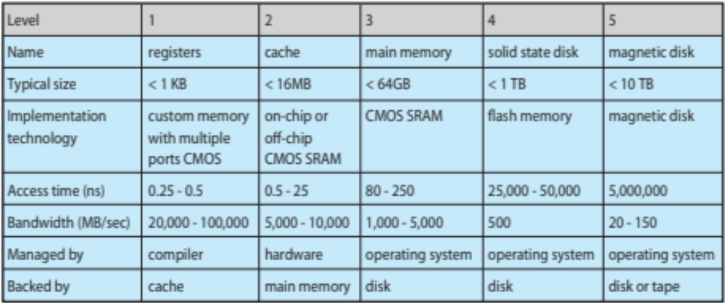
Performance of Various Levels of Storage

Slide 33
EAT Computation Example
Memory access time = 200 nanoseconds (ns)
Average page-fault service time = 8 milliseconds (ms)
EAT = (1 – p) x 200 + p x (8 milliseconds)
= (1 – p) x 200 + p x 8,000,000 (ns)
= 200 + p x 7,999,800 (ns)
If one access out of 1,000 causes a page fault, then
EAT = 8.2 microseconds (us)
41*200ns
If want performance degradation < 10 percent
  220 > 200 + 7,999,800 x p
  20 > 7,999,800 x p
  p < 0.0000025
  < one page fault in every 400,000 memory accesses

Slide 34
Swapping

Slide 35
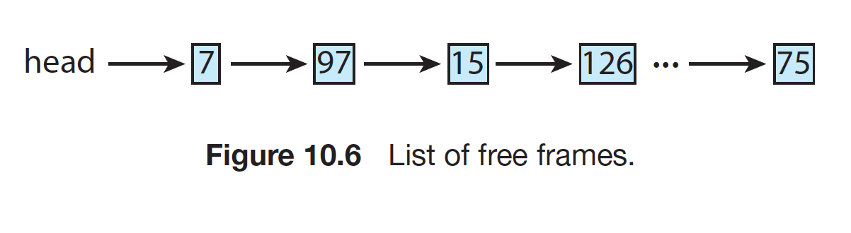
Free Frame List
OS maintain a free-frame list: a pool of free frames
When a system starts up, all available memory is placed on the free-frame list
As free frames are requested, the size of the free-frame list shrinks

Slide 36
Steps in Handling a Page Fault
No free
Swap

Slide 37
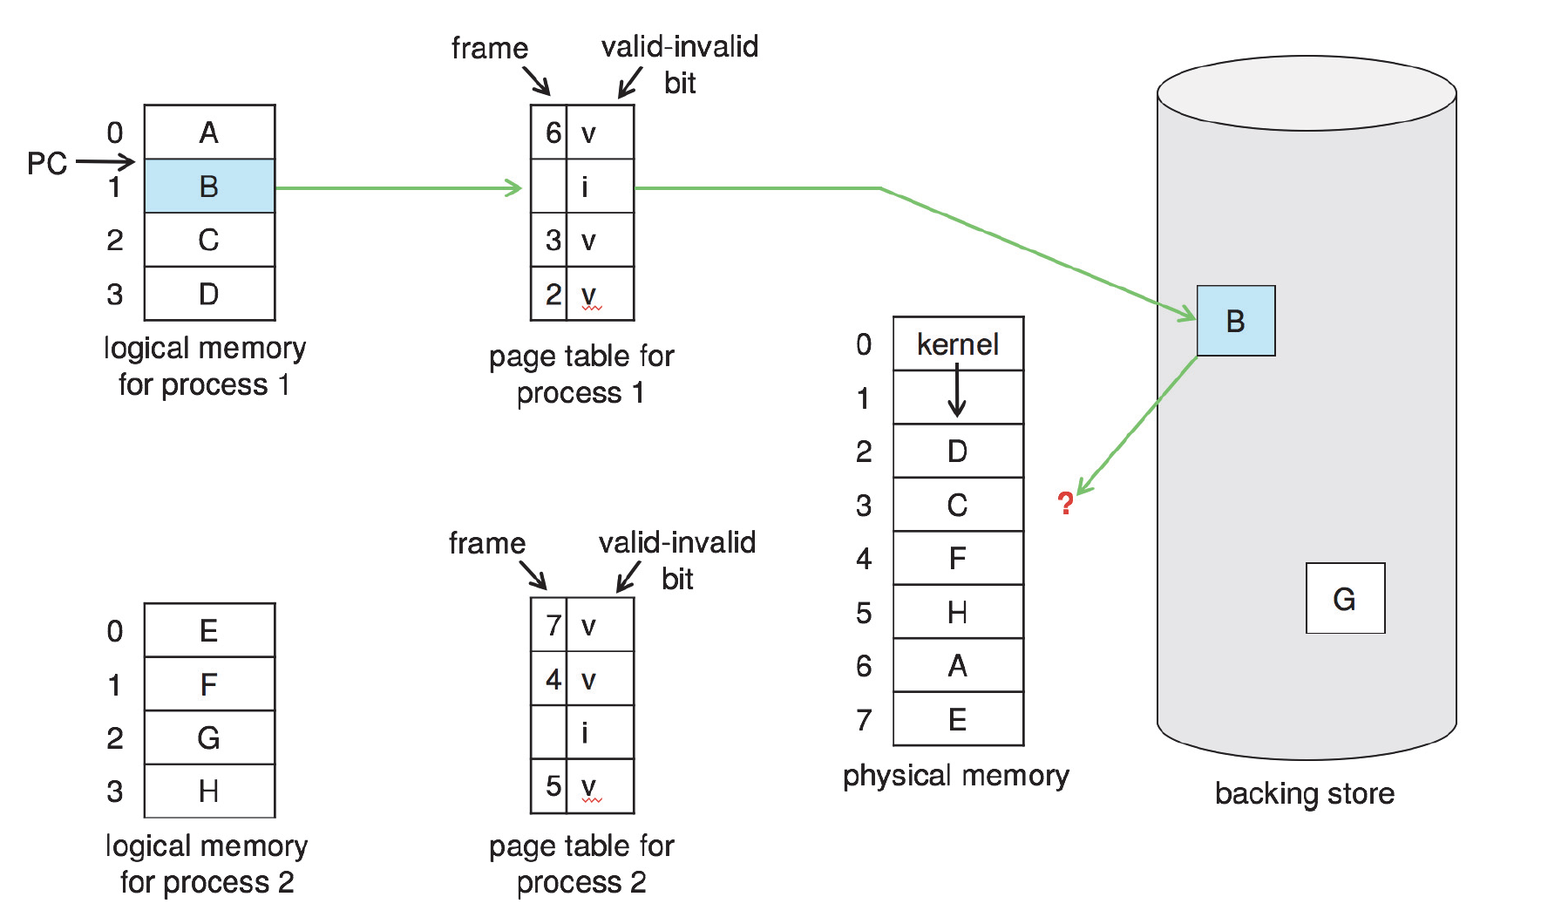
No free frame

Slide 38
Swapping
A process can be swapped temporarily out of memory to a backing store, and then brought back into memory for continued execution
Backing store – fast disk large enough to accommodate copies of all memory images for all users; must provide direct access to these memory images

Slide 39

Schematic View of Swapping

Slide 40

Swapping with paging

Slide 41
Basic Page Replacement
Find the location of the desired page on disk
Find a free frame:
  If there is a free frame, use it
  If there is no free frame, use a page replacement algorithm to select a victim frame
  Write victim frame to disk if dirty
  Change page table accordingly
Bring the desired page into the (newly) free frame; update the page and frame tables
Continue the process by restarting the instruction that caused the trap

Slide 42

Page Table Update in Page Replacement
f | v
b₁ | i
b₁

Slide 43
Page Table Update in Page Replacement
b₂
b₂ | i
b₁ | i
b₁

Slide 44
Page Table Update in Page Replacement
b₂
b₂ | i
f | v
b₁

Slide 45
Performance of Demand Paging (Cont.)
Page Fault Rate 0 ≤ p ≤ 1
  if p = 0 no page faults
  if p = 1, every reference is a fault
Effective Access Time (EAT)
EAT = (1 – p) x memory access
+ p x page fault time
Swapping： disk IO

Slide 46
Demand Paging Optimizations (1)
Swap space I/O faster than file system I/O even if on the same device
  Swap allocated in larger chunks, less management needed than file system
  Demo
Demand page in from program binary on disk, but discard rather than paging out when freeing frame
  Read-only，not modified (not dirty); otherwise, dirty
Notes:
Linux swap space

Slide 47
Demand Paging Optimizations (2)
Page buffering
  A free frame pool
  keep list of modified pages, when backing store otherwise idle, write pages there
  If referenced again before reused, no need to load contents again from disk

Slide 48
Minor vs Major Page Fault
Major page fault (from disk)
  Swap area
  Disk file system
Minor page fault (from memory)
  Page buffering
Give an example: firefox
Notes:
/usr/bin/time -v firefox
ps -eo min_flt,maj_flt,cmd
ps -o min_flt,maj_flt [pid]
top
vmstat 2 1

Slide 49
Demand Paging Optimizations (3)
How to choose a victim page to gain a low page fault rate?

Slide 50
Summary
contiguous
segmentation
paging
demand paging
swapping

Slide 51
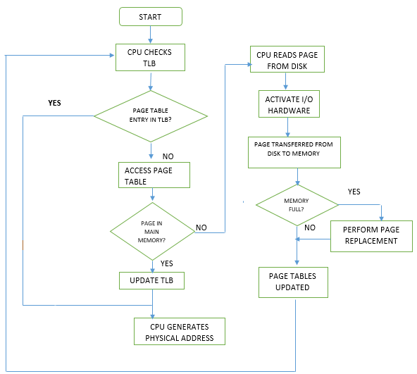
Memory Access Flowchart
Restart instruction

Slide 52
End of Chapter 9(1)

