Slide 1
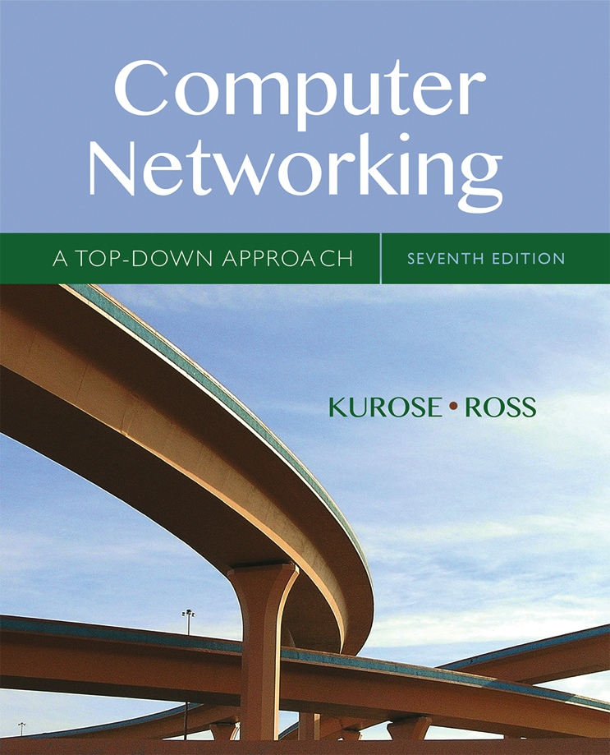

Chapter 2
Application Layer
A note on the use of these Powerpoint slides:
We’re making these slides freely available to all (faculty, students, readers). They’re in PowerPoint form so you see the animations; and can add, modify, and delete slides (including this one) and slide content to suit your needs. They obviously represent a lot of work on our part. In return for use, we only ask the following:
Computer Networking: A Top Down Approach
If you use these slides (e.g., in a class) that you mention their source (after all, we’d like people to use our book!)
If you post any slides on a www site, that you note that they are adapted from (or perhaps identical to) our slides, and note our copyright of this material.
Thanks and enjoy! JFK/KWR
All material copyright 1996-2016
J.F Kurose and K.W. Ross, All Rights Reserved
7th edition
Jim Kurose, Keith Ross
Pearson/Addison Wesley
April 2016
Application Layer
2-<number>

Slide 2
Chapter 2: outline
2.1 principles of network applications
2.2 Web and HTTP
2.3 electronic mail
  SMTP, POP3, IMAP
2.4 DNS
2.5 P2P applications
2.6 video streaming and content distribution networks
2.7 socket programming with UDP and TCP
Application Layer
2-<number>

Slide 3


HTTP overview
HTTP: hypertext transfer protocol
Web’s application layer protocol
client/server model
  client: browser that requests, receives, (using HTTP protocol) and “displays” Web objects
  server: Web server sends (using HTTP protocol) objects in response to requests
HTTP request
PC running
Firefox browser
HTTP response
HTTP request
server
running
Apache Web
server
HTTP response
iPhone running
Safari browser
Application Layer
2-<number>

Slide 4
HTTP overview (continued)
uses TCP:
client initiates TCP connection (creates socket) to server, port 80
server accepts TCP connection from client
HTTP messages (application-layer protocol messages) exchanged between browser (HTTP client) and Web server (HTTP server)
TCP connection closed
HTTP is “stateless”
server maintains no information about past client requests
aside
protocols that maintain “state” are complex!
past history (state) must be maintained
if server/client crashes, their views of “state” may be inconsistent, must be reconciled
Application Layer
2-<number>

Slide 5
DNS: domain name system
people: many identifiers:
  SSN, name, passport #
Internet hosts, routers:
  IP address (32 bit) - used for addressing datagrams
  “name”, e.g., www.yahoo.com - used by humans
Q: how to map between IP address and name, and vice versa ?
Domain Name System:
distributed database implemented in hierarchy of many name servers
application-layer protocol: hosts, name servers communicate to resolve names (address/name translation)
  note: core Internet function, implemented as application-layer protocol
  complexity at network’s “edge”
Application Layer
2-<number>

Slide 6
DNS: services, structure
DNS services
hostname to IP address translation
Run over UDP and Default port 53
host aliasing
  canonical, alias names
mail server aliasing
load distribution
  replicated Web servers: many IP addresses correspond to one name
why not centralize DNS?
single point of failure
traffic volume
distant centralized database
maintenance
A: doesn‘t scale!
Application Layer
2-<number>

Slide 7
DNS: a distributed, hierarchical database
Root DNS Servers
…
…
com DNS servers
org DNS servers
edu DNS servers
yahoo.com
DNS servers
pbs.org
DNS servers
poly.edu
DNS servers
umass.edu
DNS servers
amazon.com
DNS servers
client wants IP for www.amazon.com; 1st approximation:
client queries root server to find com DNS server
client queries .com DNS server to get amazon.com DNS server
client queries amazon.com DNS server to get IP address for www.amazon.com
Application Layer
2-<number>

Slide 8
SDN
SDN is software-based
SDN is more flexible, allowing users greater control and ease for managing resources virtually throughout the control plane.
Traditional networking is usually hardware-based. i.e., use switches, routers and other physical infrastructure to create connections and run the network.
SDN controllers feature a northbound interface that communicates with APIs. Application developers can directly program the network,
The protocols required by traditional networking.
Application Layer
2-<number>

Slide 9
When SDN virtualizes your entire network, it generates an abstract copy of your physical network, and lets you provision resources from a centralized location (remotely).
Traditional network the physical location of the control plane hinders an IT administrator’s ability to control the traffic flow.
Application Layer
2-<number>

Slide 10
NAT: network address translation
rest of
Internet
local network
(e.g., home network)
10.0.0/24
10.0.0.1
10.0.0.4
10.0.0.2
138.76.29.7
10.0.0.3
all datagrams leaving local
network have same single source NAT IP address: 138.76.29.7,different source port numbers
datagrams with source or
destination in this network
have 10.0.0/24 address for
source, destination (as usual)
Network Layer: Data Plane
4-<number>

Slide 11
NAT: network address translation
motivation: local network uses just one IP address as far as outside world is concerned:
  range of addresses not needed from ISP: just one IP address for all devices
  can change addresses of devices in local network without notifying outside world
  can change ISP without changing addresses of devices in local network
  devices inside local net not explicitly addressable, visible by outside world (a security plus)
Network Layer: Data Plane
4-<number>

Slide 12
NAT: network address translation
implementation: NAT router must:
  outgoing datagrams: replace (source IP address, port #) of every outgoing datagram to (NAT IP address, new port #)
    . . . remote clients/servers will respond using (NAT IP address, new port #) as destination addr
  remember (in NAT translation table) every (source IP address, port #) to (NAT IP address, new port #) translation pair
  incoming datagrams: replace (NAT IP address, new port #) in dest fields of every incoming datagram with corresponding (source IP address, port #) stored in NAT table
Network Layer: Data Plane
4-<number>

Slide 13
NAT: network address translation
NAT translation table
WAN side addr LAN side addr
2: NAT router
changes datagram
source addr from
10.0.0.1, 3345 to
138.76.29.7, 5001,
updates table
1: host 10.0.0.1
sends datagram to
128.119.40.186, 80
138.76.29.7, 5001 10.0.0.1, 3345
…… ……
S: 10.0.0.1, 3345
D: 128.119.40.186, 80
10.0.0.1
1
2
S: 138.76.29.7, 5001
D: 128.119.40.186, 80
10.0.0.4
10.0.0.2
138.76.29.7
S: 128.119.40.186, 80
D: 10.0.0.1, 3345
4
S: 128.119.40.186, 80
D: 138.76.29.7, 5001
3
10.0.0.3
4: NAT router
changes datagram
dest addr from
138.76.29.7, 5001 to 10.0.0.1, 3345
3: reply arrives
dest. address:
138.76.29.7, 5001
* Check out the online interactive exercises for more examples: http://gaia.cs.umass.edu/kurose_ross/interactive/
Network Layer: Data Plane
4-<number>

Slide 14
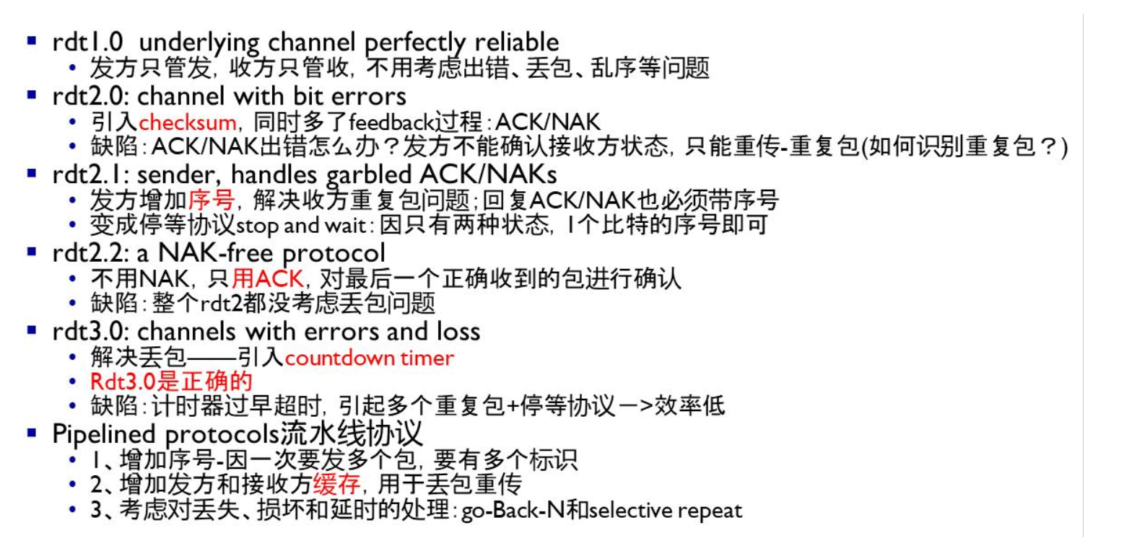
RDT
Application Layer
2-<number>

Slide 15
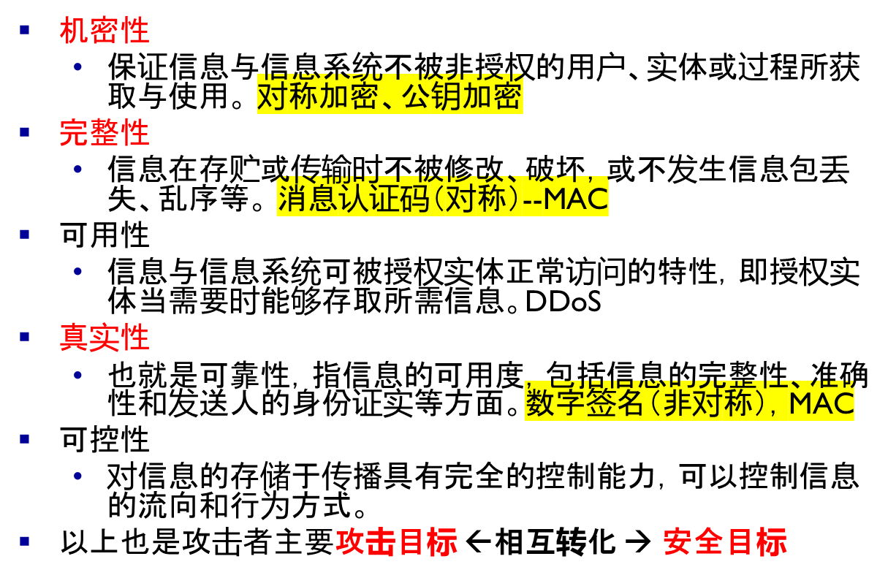
常见网络安全的目标

Slide 16
公开密钥系统
-- RSA
Rivest、Shamir、Adleman联合提出的简称为RSA公钥密码系统。
RSA的基础是数论的欧拉定理，它的安全性依赖于大对数的因数分解的困难性。

Slide 17
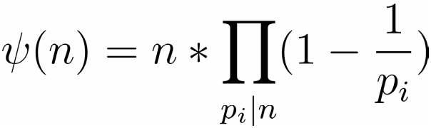
公开密钥系统
-- 欧拉函数
给定一个正整数 n ，用ψ(n) 表示比 n 小且与 n 互为素数的正整数的个数，称ψ(n) 为欧拉函数
例如：ψ（10）=10*（1－1/2）*（1－1/5）=4
欧拉函数是积性函数
  若m,n互素，i.e. gcd(m,n) =1
则：ψ(mn)= ψ(m)*ψ(n）
若m为素数，则ψ(m) = m-1

Slide 18
公开密钥系统
-- 欧拉定理
若整数 a 和 n 互素，则a^{ψ(n)} = 1(mod n)
  Ord_{n}(a) = |Z*_{n}| = ψ(n)
举例说明：
ψ(24)=8
{1,5,7,11,13,17,19,23}是小于24并与24互素的数
1⁸=1 mod 24 即：1^{ψ(24)} =1 mod 24
5⁸=1 mod 24 即：5^{ψ(24)} =1 mod 24
7⁸=1 mod 24 即：7^{ψ(24)} =1 mod 24
……

Slide 19
公开密钥系统
-- Extended Euclid Algorithm
选取两个大素数p和q，两个数长度接近:
计算n=p*q, ψ(n) =(p-1)(q-1)
随机选取整数e,满足gcd(e, ψ(n) )=1 （互质）
计算d=e⁻¹,满足d*e = 1 mod ψ(n)
公开密钥：（e,N）
私有密钥：d

Slide 20
公开密钥系统
-- Extended Euclid Algorithm
已知整数u和a,EEA算法用来计算整数s,t满足u*s + a*t = gcd(a,u)
已知ψ(n)，求e的逆元素d:
  ψ(n) *s +e*d = 1 →
e*d = 1 mod ψ(n)

Slide 21
公开密钥系统
-- RSA的加解密过程
消息0< m < n 并且 gcd(m, n) = 1
  PKCS#1 v1.5, padding
  m’= 00|02|random padding|00|m
  s.t. gcd(m’,n)=1 (不带padding称为教科书版本）
加密算法：c=m^{e}(mod n)
解密算法：m=c^{d}(mod n)
  e*d = 1 + s* ψ(n) (for some integer s)
  c^{d} = m^{e*d} = m*m^{s* ψ(n)} = m*(m ^{ψ(n)})^{s} （mod n)
  = m (mod n)
其它密码功能
  数字签名

Slide 22
Dijkstra’s algorithm: another example
Step
0
1
2
3
4
5
N'
u
ux
uxy
uxyv
uxyvw
uxyvwz
D(v),p(v)
2,u
2,u
2,u
D(w),p(w)
5,u
4,x
3,y
3,y
D(x),p(x)
1,u
D(y),p(y)
∞
2,x
D(z),p(z)
∞
∞
4,y
4,y
4,y
5
v
3
w
2
5
u
2
1
z
3
1
2
x
y
1
* Check out the online interactive exercises for more examples: http://gaia.cs.umass.edu/kurose_ross/interactive/
Network Layer: Control Plane
5-<number>

Slide 23
Dijkstra’s algorithm: example (2)
resulting shortest-path tree from u:
v
w
u
z
x
y
resulting forwarding table in u:
destination
link
v
(u,v)
x
(u,x)
y
(u,x)
w
(u,x)
z
(u,x)
Network Layer: Control Plane
5-<number>

Slide 24
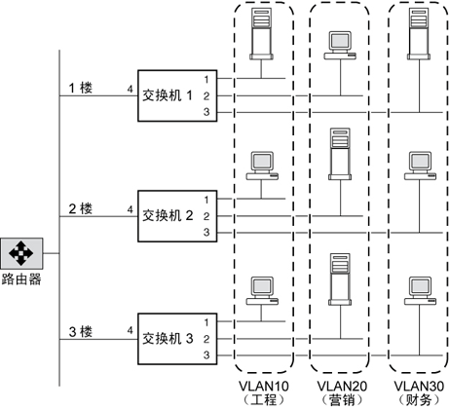

Notes:
1 楼 VLAN 10 的某个成员向 2 楼 VLAN 10 的某个成员发送一个帧，则交换机 1 会检查帧报头中的 VLAN 标记（以确定 VLAN）以及目标 MAC 地址。交换机 1 不知道目标 MAC 地址。因此，交换机将帧转发到属于 VLAN 10 的所有其他端口，即交换机 2 和交换机 3 的端口 1。同样，交换机 2 和交换机 3 也将检查帧报头。如果 VLAN 10 上的目标 MAC 地址对于任一交换机是已知的，则该交换机将帧转发到目标位置。然后，2 楼上的终端工作站将接收到帧。

Slide 25
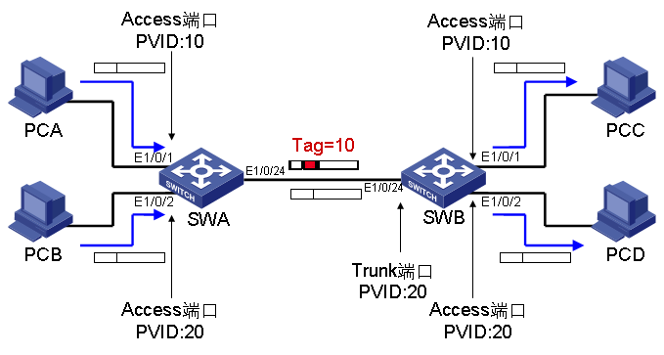
Access口：
  入：带标记的，与接口PVID相同的就接收，不相同的不接收；不带标记的直接接收，并打上接口PVID标记
  出：TAG标记与PVID相同的，去TAG后发送，不相同的不允许通过；
Trunk口：
  出： TAG标记与PVID相同的，去标记后发送（和Access口相同）；不相同的根据配置也可以通过，但不改TAG。
  入：带标记的，与PVID相同的接收，不相同的根据配置也可接收，且不改TAG；不带TAG的直接接收，并打上PVID标记
Notes:
The PVID of a port is the VLAN id that will be assigned to any untagged frames entering the switch on that port (assuming the switch is using port-based VLAN classification). This is a concept that is defined in IEEE 802.1Q.

