Slide 1
Operating System Principle
Lab 3
March, 2021

Slide 2
Outline
Process Operations
Review of Kernel Module
Process Control Block (PCB)

Slide 3
Process Operations
ps command
system call
  fork()
  exec()
  wait()
  exit()

Slide 4
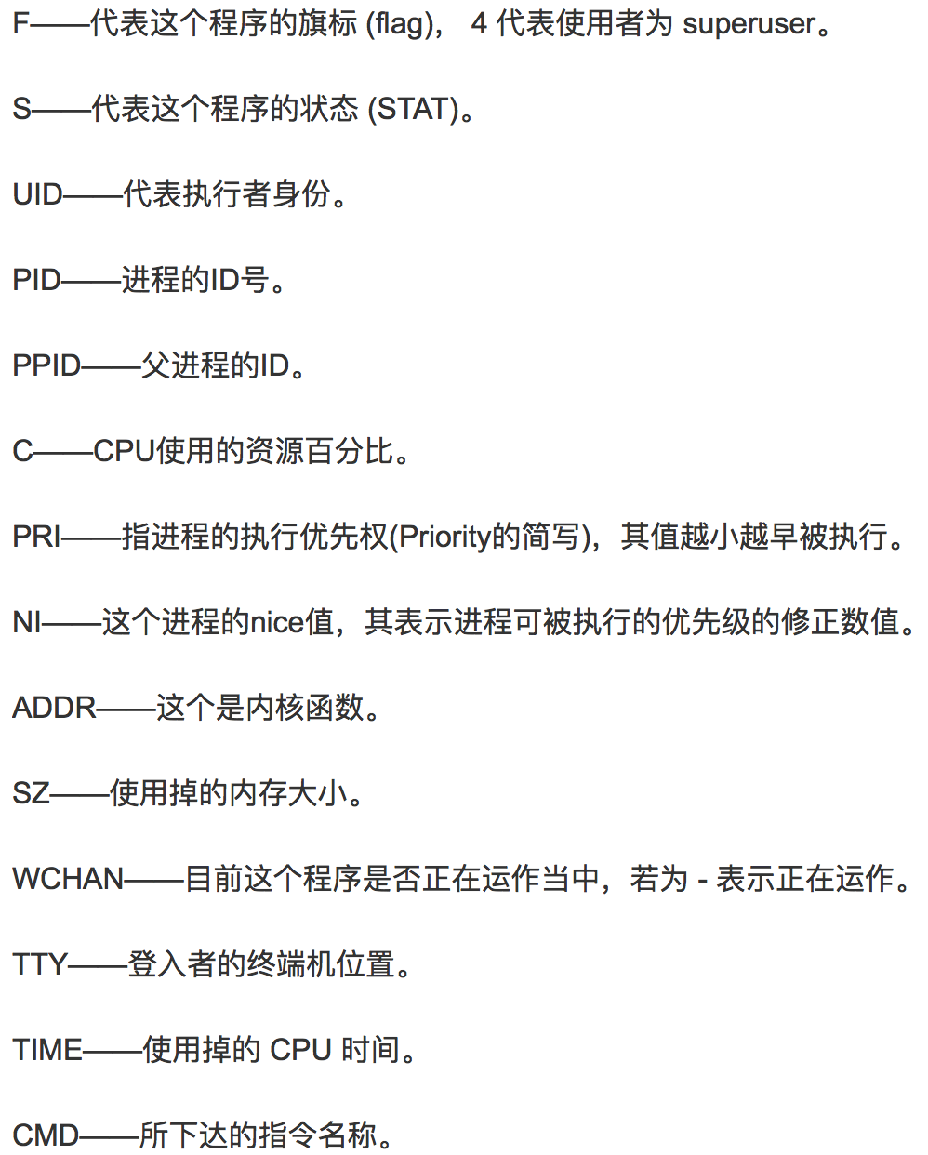
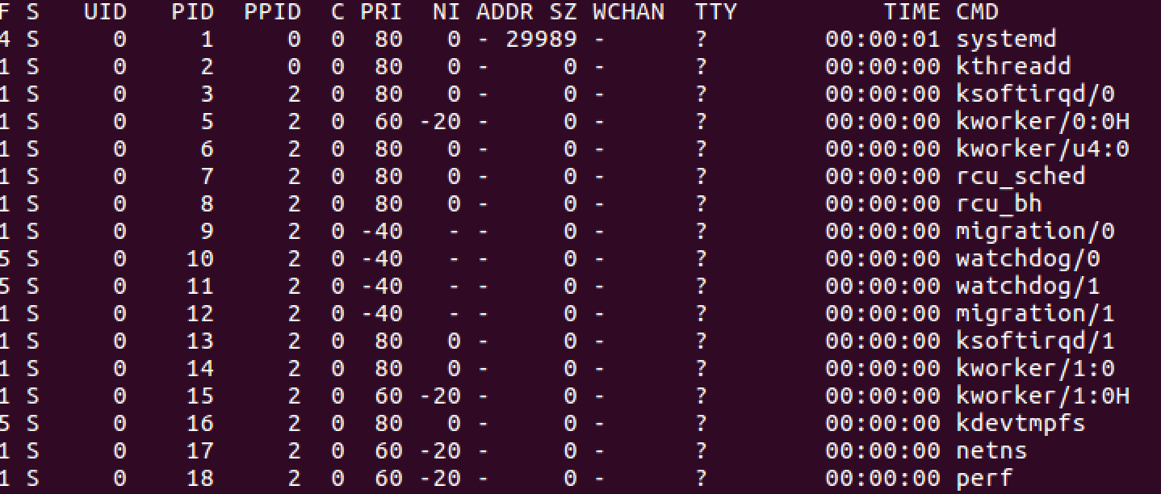
ps
ps -el

Slide 5
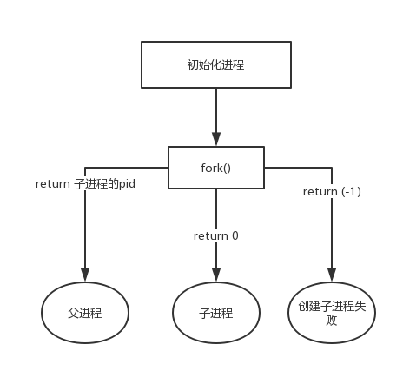
Process Creation
fork()
pid_t fork(void);
#include <unistd.h>

Slide 6
Process Termination
exit()
  void exit(int status)﻿;
  #include <stdlib.h>
  exit()
  exit(*)
wait()
  pid_t wait(int *status);
  ﻿#include <sys/wait.h>
  ﻿WEXITSTATUS(*) //8-bit
Notes:
exit(0) and return 0:
main作为程序入口那次的返回值，会传送给exit系统调用，最终会送达需要这个返回值的地方去（也就是题中的shell）。
而shell取得这个返回值后，会将其低8位取出来作为程序退出状态码(exit status)，即使用echo $?命令看到的那个数字。
至于为什么要取出低8位，这是前人定下的一个约定。即大家约定好，这个返回值的哪些部分分别干什么用，大家在用的时候，也按照这个约定来用。其中，低8为就是exit status。
详情可参见wait(2) - Linux manual page，在页面中搜索“WEXITSTATUS”。

Slide 7
Load A New Task
main() with arguments
  ﻿int argc
  char *argv[]
  ./a.out arg1 arg2 (./a.out is arg0)
  https://docs.microsoft.com/en-us/cpp/cpp/main-function-command-line-args?view=msvc-160
Notes:
Standard command-line arguments
The arguments for main allow convenient command-line parsing of arguments. The types for argc and argv are defined by the language. The names argc and argv are traditional, but you can name them whatever you like.
The argument definitions are as follows:
argc
An integer that contains the count of arguments that follow in argv. The argc parameter is always greater than or equal to 1.
argv
An array of null-terminated strings representing command-line arguments entered by the user of the program. By convention, argv[0] is the command with which the program is invoked. argv[1] is the first command-line argument. The last argument from the command line is argv[argc - 1], and argv[argc] is always NULL.

Slide 8
Load A New Task
execl()
  ﻿#include <unistd.h>
  ﻿int execl(const char *path, const char *arg, ... , NULL);
  execl(path, arg0, arg1, arg2, …, NULL)
Notes:
execl()用来执行参数path 字符串所代表的文件路径, 接下来的参数代表执行该文件时传递过去的argv(0),argv[1], ..., 最后一个参数必须用空指针(NULL)作结束.

Slide 9
Task 1

Slide 10
Linux Kernel Module
Loadable Kernel Module (LKM) is an object file that contains code to extend the running kernel, or so-called base kernel, of an operating system. LKMs are typically used to add support for new hardware (as device drivers) and/or file systems, or for adding system calls. When the functionality provided by a LKM is no longer required, it can be unloaded in order to free memory and other resources. (https://en.wikipedia.org/wiki/Loadable_kernel_module)
It is important for you to keep in mind that you are indeed writing kernel code that directly interacts with the kernel. That normally means that any errors in the code could crash the system!

Slide 11
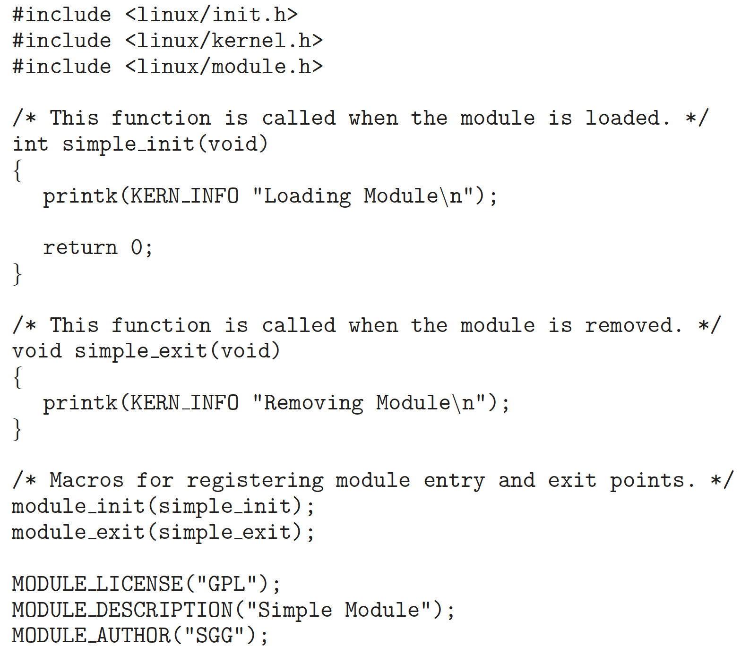
Kernel Module Structure
Head files
Function called when module is loaded
Function called when module is removed
Module registration
License, description, author
Notes:
https://tldp.org/LDP/lkmpg/2.6/html/
https://linux-kernel-labs.github.io/refs/heads/master/labs/kernel_modules.html

Slide 12
Compile Kernel Module
obj-m += <filename>.o
  Output <filename>.ko （the same name as the <filename>.c source file）
all:
  make -C /lib/modules/$(shell uname -r)/build M=$(shell pwd) modules
clean:
  make -C /lib/modules/$(shell uname -r)/build M=$(shell pwd) clean
Notes:
-C 进入到内核的目录执行Makefile ，M=$(PWD)表示返回当前目录，再次执行Makefile，modules 编译成模块的意思

Slide 13
List, Show,Load & Remove Modules
file *.ko
modinfo *.ko
lsmod
sudo insmod *.ko
sudo rmmod *
head -n
tail -n
pipe: |

Slide 14
Kernel Message
printk(KERN INFO "*******");
  KERN INFO: priority of this message
dmesg: display
sudo dmesg -c: clean

Slide 15
Useful Commands
head
  head -n
tail
  tail -n
Linux pipe
  |
Notes:
grep “***”

Slide 16
Task 2
Values and functions available only in the kernel
  jiffies: number of timer interrupts since the system boot
  HZ: the timer interrupt frequency
jiffies and HZ are two variables defined in the kernel
  jiffies: unsigned long int
  HZ: int

Slide 17
Process Control Block

Slide 18
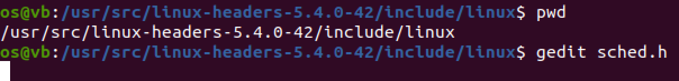
Process Control Block: sched.h

Slide 19
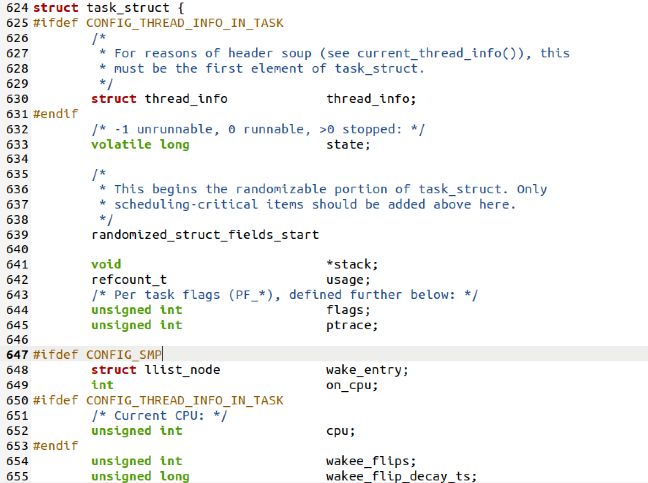
Ubuntu 20.04
Notes:
/usr/src/linux-headers-5.4.0-42/include/linux

Slide 20
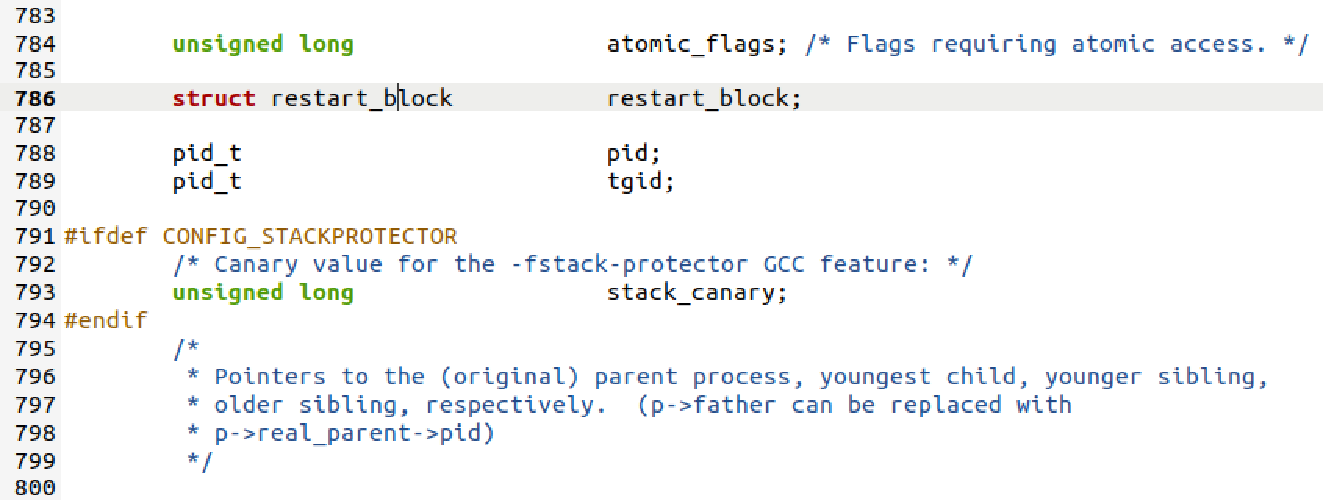
PID

Slide 21
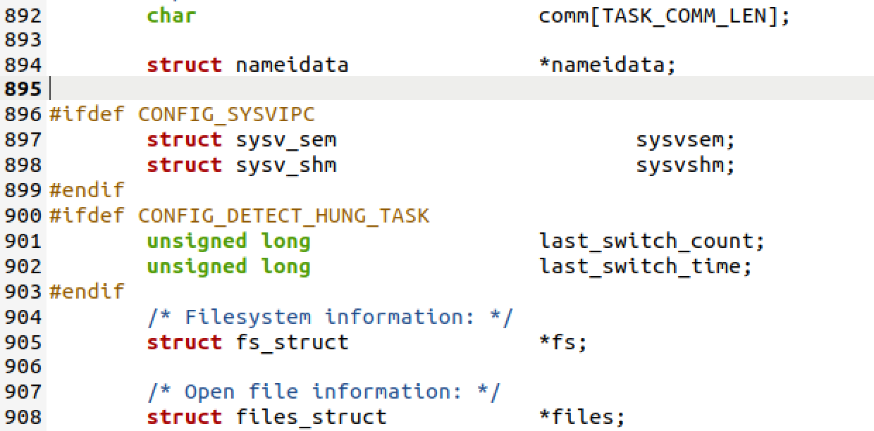
command
16

Slide 22
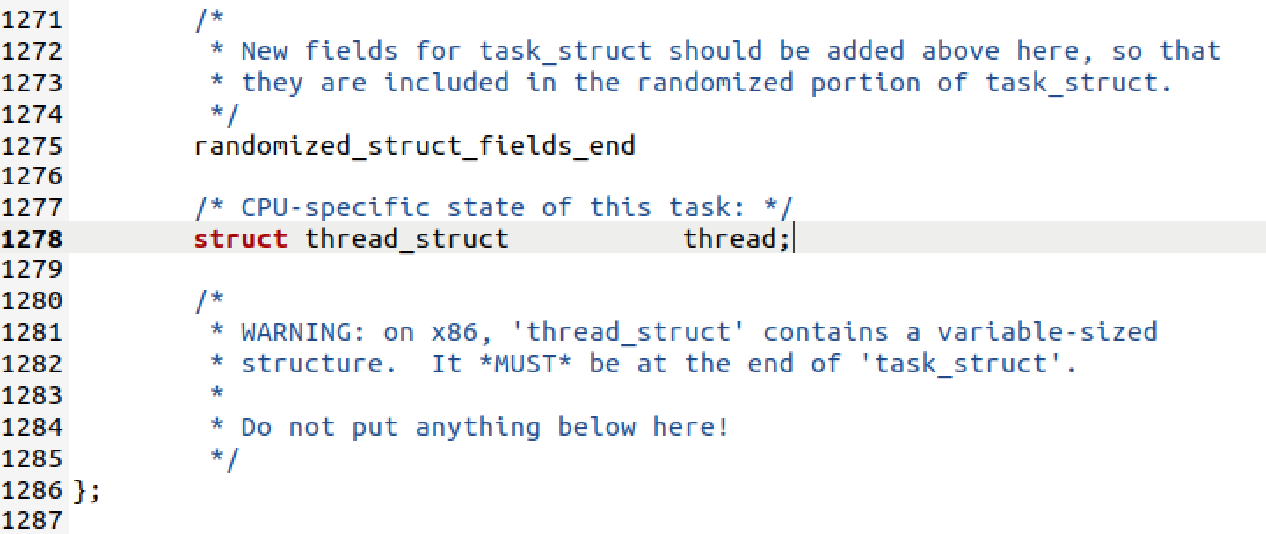
The End

Slide 23
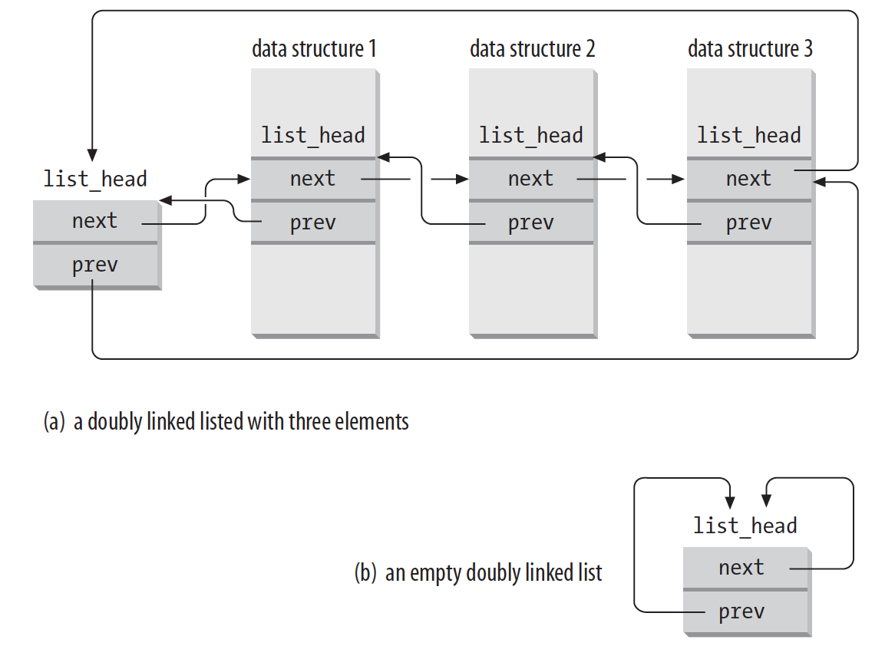
List All Processes
Doubly linked list

Slide 24
List All Processes
for_each_process
demo

Slide 25
Task 3
wc
  wc -l

Slide 26
The End

Slide 27
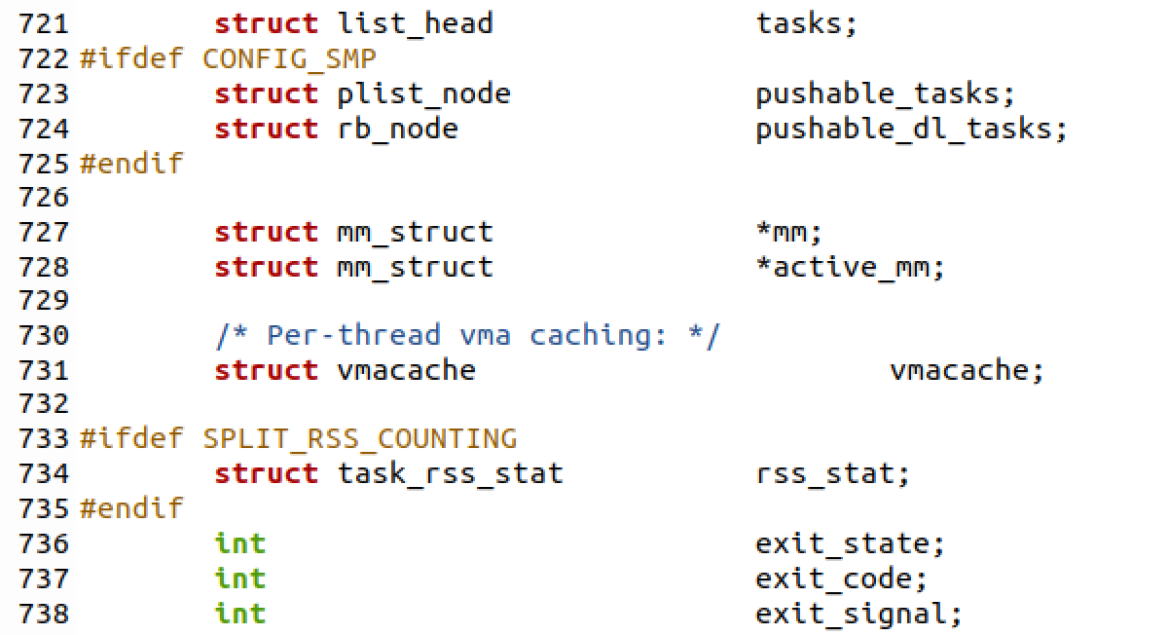
list_head tasks

