Slide 1
Operating System Principle
Lab 3-2
March, 2021

Slide 2
Outline
Process Control Block (PCB)
Review of Kernel Module
Traverse doubly linked list of PCBs

Slide 3
Process Control Block

Slide 4
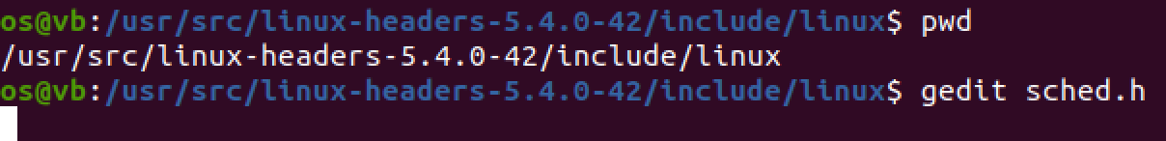
Process Control Block: sched.h

Slide 5
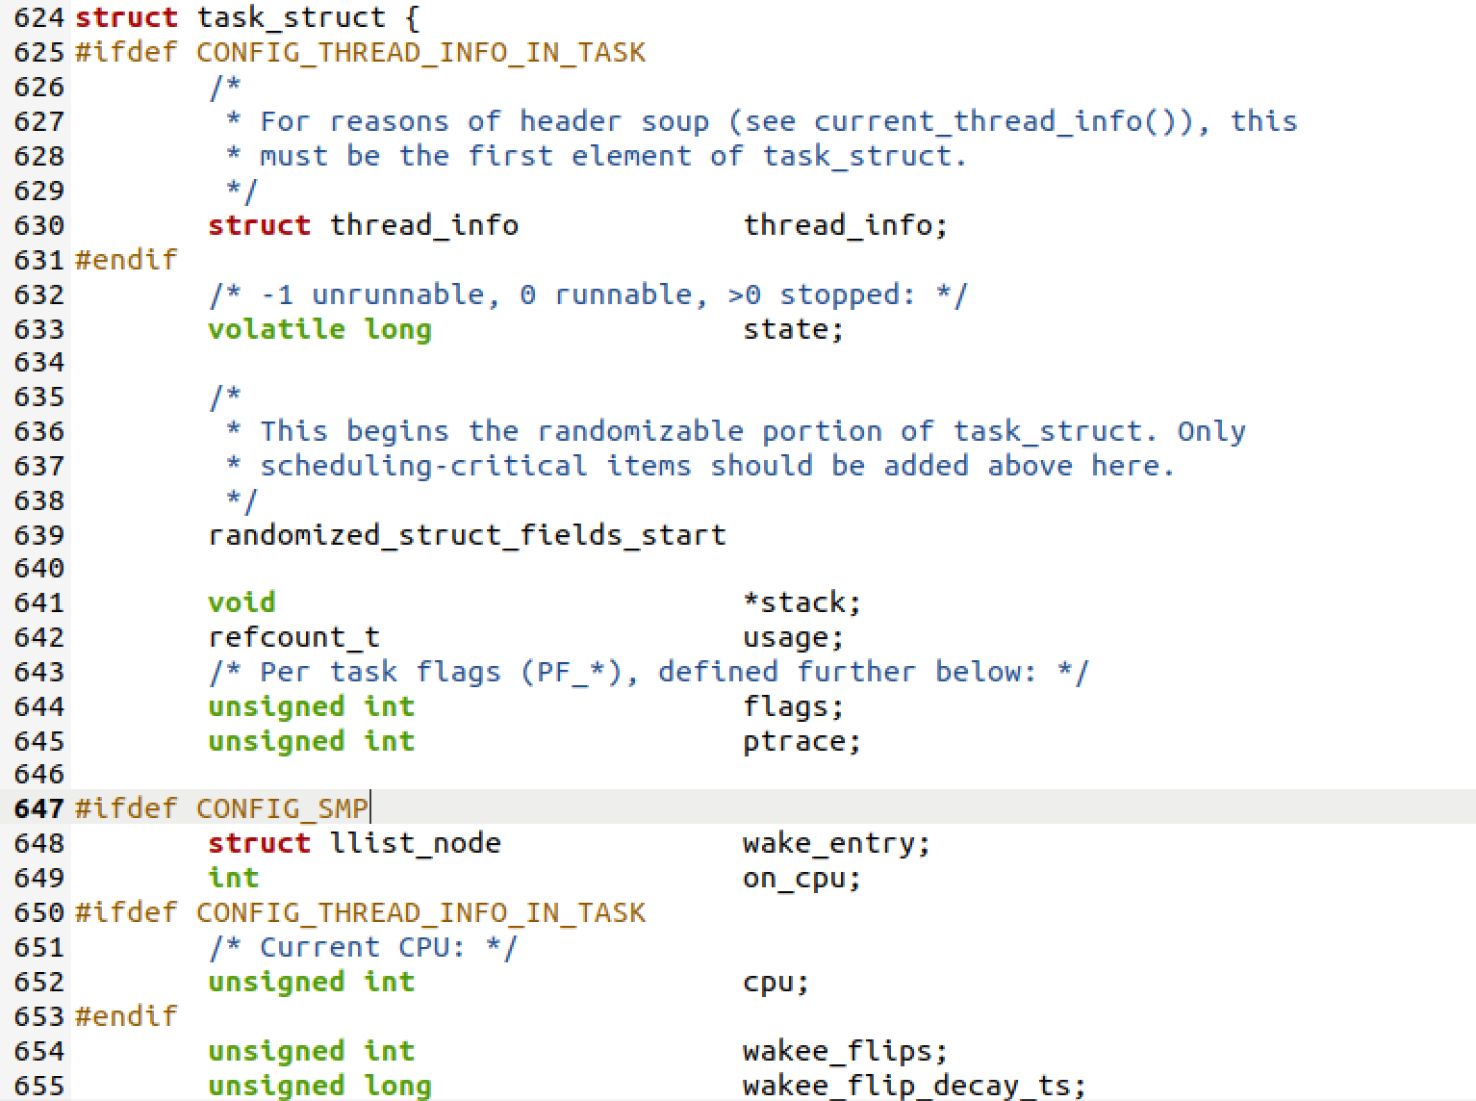
Ubuntu 20.04
Notes:
/usr/src/linux-headers-5.4.0-42/include/linux

Slide 6
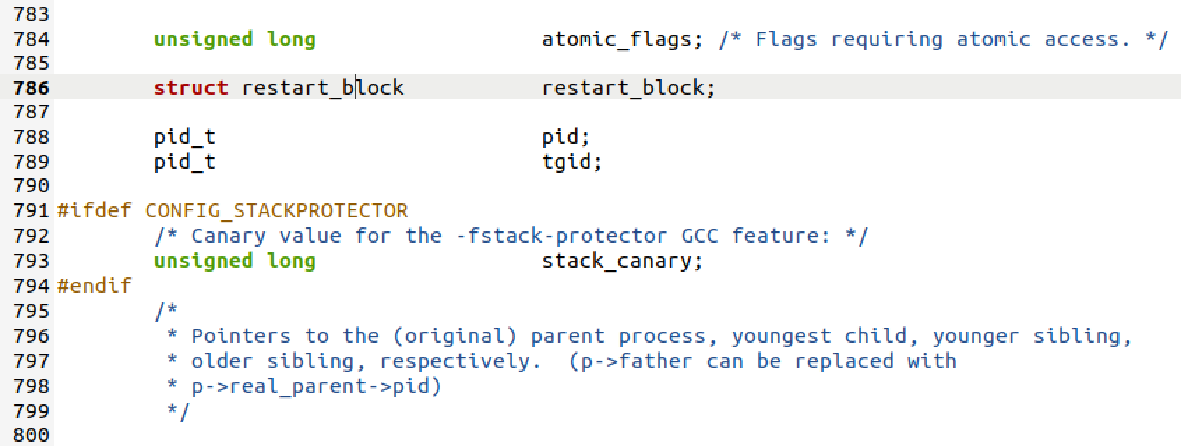
PID

Slide 7
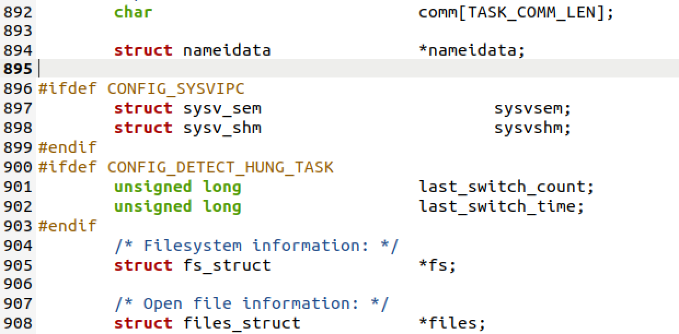
command
16

Slide 8
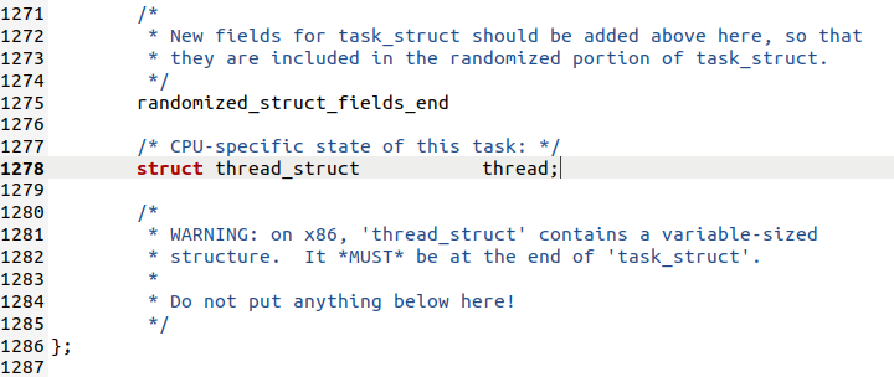
The End

Slide 9
Task 1

Slide 10
Linux Kernel Module
Loadable Kernel Module (LKM) is an object file that contains code to extend the running kernel, or so-called base kernel, of an operating system. LKMs are typically used to add support for new hardware (as device drivers) and/or file systems, or for adding system calls. When the functionality provided by a LKM is no longer required, it can be unloaded in order to free memory and other resources. (https://en.wikipedia.org/wiki/Loadable_kernel_module)
It is important for you to keep in mind that you are indeed writing kernel code that directly interacts with the kernel. That normally means that any errors in the code could crash the system!

Slide 11
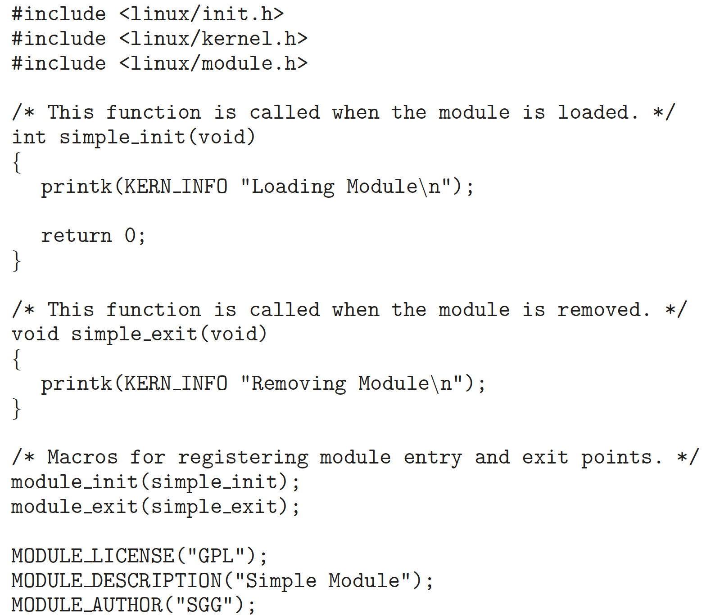
Kernel Module Structure
Head files
Function called when module is loaded
Function called when module is removed
Module registration
License, description, author
Notes:
https://tldp.org/LDP/lkmpg/2.6/html/
https://linux-kernel-labs.github.io/refs/heads/master/labs/kernel_modules.html

Slide 12
Compile Kernel Module
obj-m += <filename>.o
  Output <filename>.ko （the same name as the <filename>.c source file）
all:
  make -C /lib/modules/$(shell uname -r)/build M=$(shell pwd) modules
clean:
  make -C /lib/modules/$(shell uname -r)/build M=$(shell pwd) clean
Notes:
-C 进入到内核的目录执行Makefile ，M=$(PWD)表示返回当前目录，再次执行Makefile，modules 编译成模块的意思

Slide 13
List, Load & Remove Modules
file *.ko
modinfo *.ko
lsmod: list kernel modules
sudo insmod *.ko: insert a kernel module into kernel
sudo rmmod *: remove a kernel module

Slide 14
Kernel Message
printk(KERN INFO "*******");
  KERN INFO: priority of this message
dmesg: display kernel message
sudo dmesg -c: clear kernel messages

Slide 15
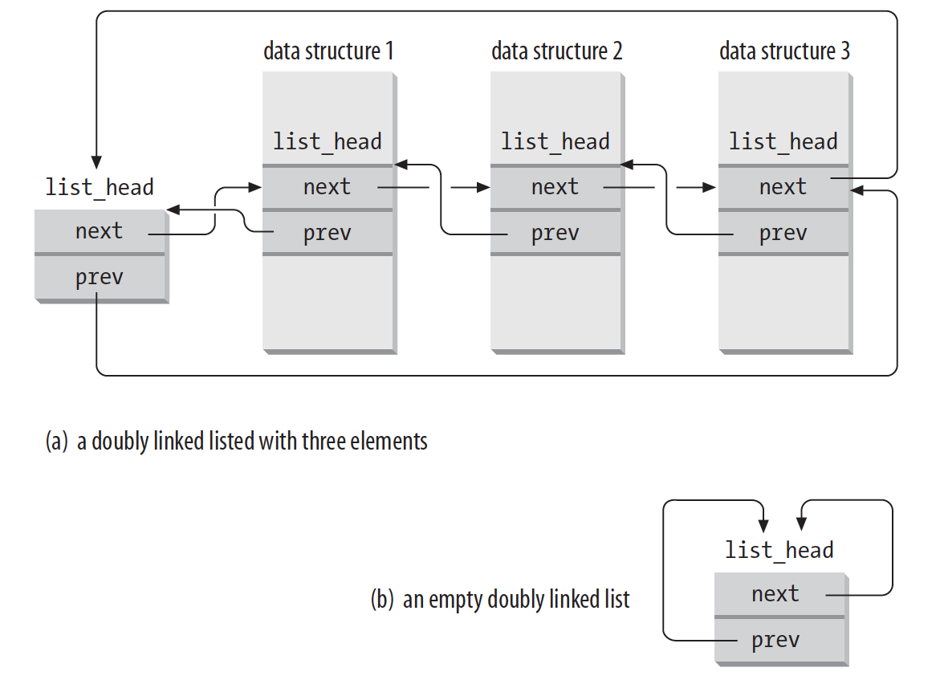
List All Processes
Doubly linked list

Slide 16
List All Processes
for_each_process
  #include <linux/sched/signal.h>
demo
Notes:
For old kernels: #include <linux/sched.h>

Slide 17
Task 2
ps -el

Slide 18
Useful Commands
head
  head -n
tail
  tail -n
Linux pipe
  |
String search (regular expression)
  grep “***”
Word count (line)
  wc -l
Notes:
grep “***”

Slide 19
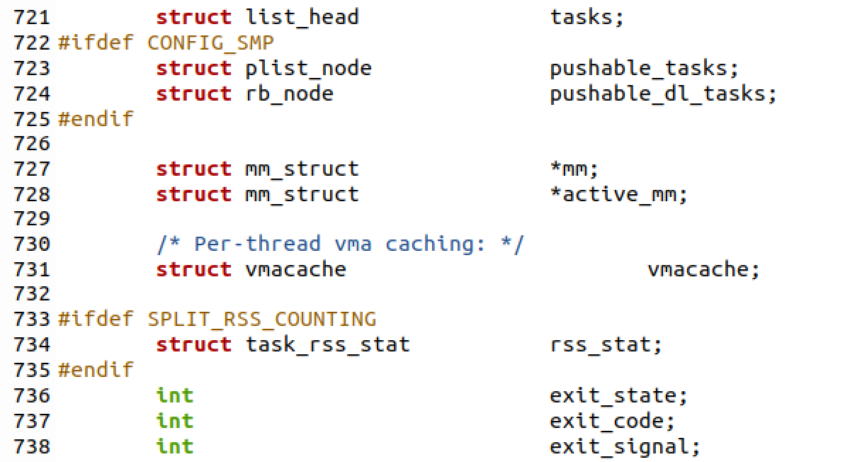
list_head tasks

Slide 20
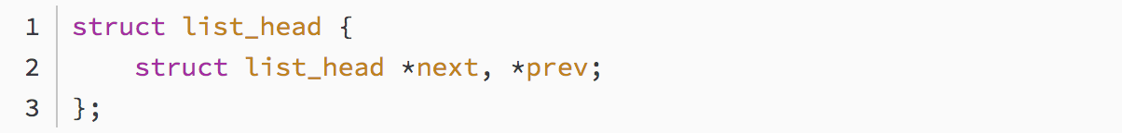
List All Processes
Doubly linked list
Notes:
kernel/inclue/linux/types.h

Slide 21
Task 3

Slide 22
The End

