Slide 1
Operating System Principle
Lab 6
April 2021

Slide 2

QQ

Slide 3
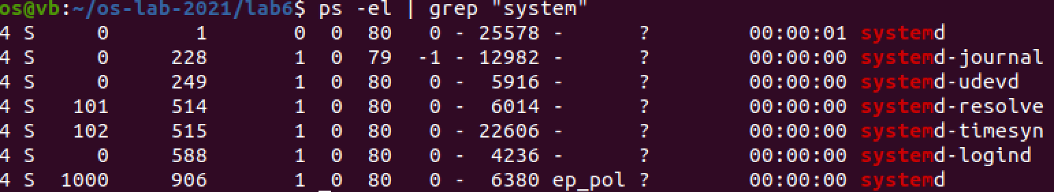
Linux Pipe
|

Slide 4
Outline
Inter-process Communication
  Named Pipe: FIFO
Basic operations on FIFO
Duplex communication by FIFO and multithreaded programming

Slide 5

Pipe
FIFO: first in, first out
Notes:
https://linux.cn/article-9314-1.html?pr

Slide 6
Create Named Pipe
FIFO
  #include <sys/types.h>
  #include <sys/stat.h>
  int mkfifo(const char *pathname, mode_t mode);
    pathname：
    mode_t mode: access permissions
    success: 0
    fail: -1

Slide 7
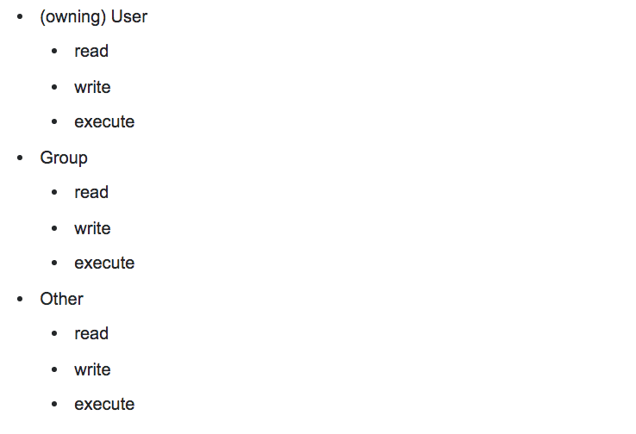
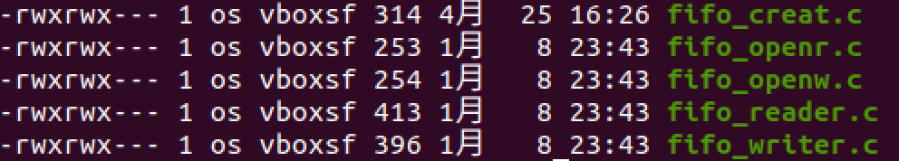
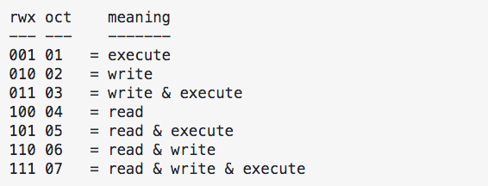

Access Permissions
0
644
Octal number

Slide 8
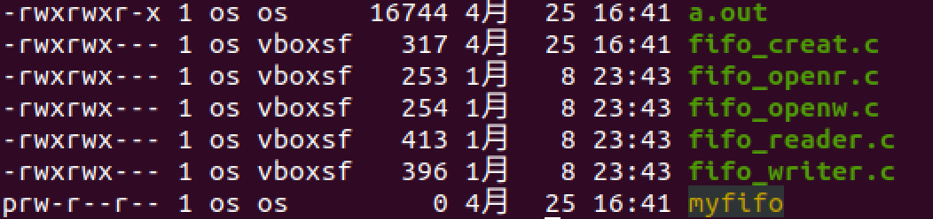
Exercise: create
Demo

Slide 9
Operations
open
close
read
write

Slide 10
Open
#include <sys/types.h>
#include <sys/stat.h>
#include <fcntl.h>
int open(const char *pathname, int flags);
Notes:
open(const char *filename,O_RDONLY);
open(const char *filename,O_RDONLY|O_NONBLOCK);
open(const char *filename,O_WRONLY);
open(const char *filename,O_WRONLY|O_NONBLOCK);

Slide 11
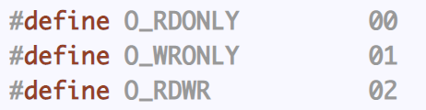
File Access Mode
int open(const char *pathname, int flags);
  open(const char *filename, O_RDONLY);
  open(const char *filename, O_WRONLY);
    Cannot open in O_RDWR flag﻿
Notes:
open(const char *filename,O_RDONLY);
open(const char *filename,O_RDONLY|O_NONBLOCK);
open(const char *filename,O_WRONLY);
open(const char *filename,O_WRONLY|O_NONBLOCK);

Slide 12
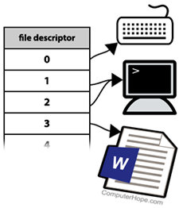
File Descriptor
  int open(const char *pathname, int flags);
  success: file descriptor
  fail: -1
A file descriptor is a number that uniquely identifies an open file in a computer's operating system.

Slide 13
close
﻿#include <unistd.h>
int close(int fd);
  fd: file descriptor
  ﻿success: return 0
  On error: -1 is returned

Slide 14
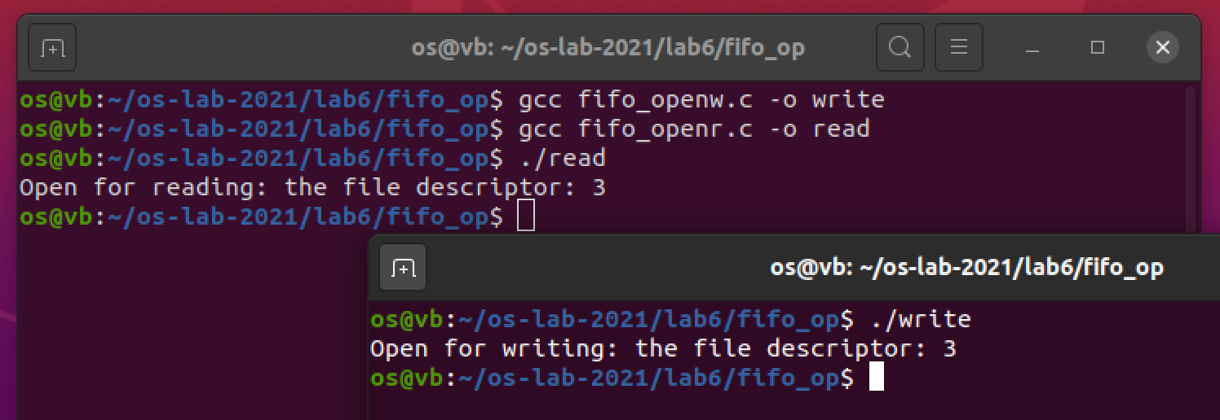
Exercise: open and fifo
open
Blocking Open!

Slide 15
read
﻿#include <unistd.h>
ssize_t read(int fd, void *buf, size_t count);
  ﻿read() attempts to read up to
  count bytes
  from file descriptor fd
  into the buffer starting at buf
  ﻿On success, the number of bytes read is returned
  ﻿On error, -1 is returned
Notes:
ssize_t: int or long int
size_t: unsigned int or long int

Slide 16
Exercise: read
﻿#include <unistd.h>
ssize_t read(int fd, void *buf, size_t count);
blocking read
  Blocked if pipe is empty
Blocking read!

Slide 17
write
﻿#include <unistd.h>
ssize_t write(int fd, const void *buf, size_t count);
  ﻿﻿write() writes
  up to count bytes
  from the buffer starting at buf
  to the file referred to by the file descriptor fd
  ﻿On success, ﻿the number of bytes written is returned
  ﻿On error, -1 is returned
Notes:
ssize_t: int or long int
size_t: unsigned int or long int

Slide 18
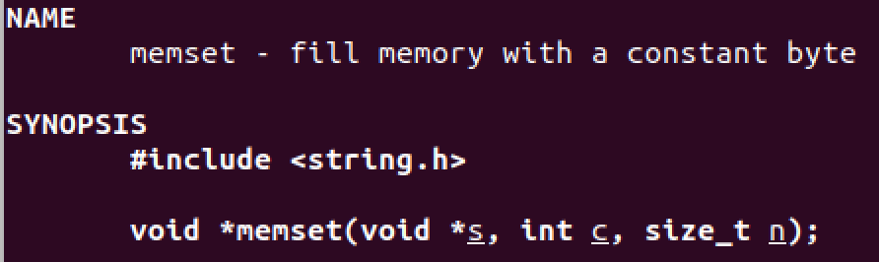
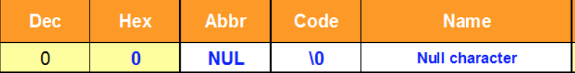
Set Buffer
﻿﻿The memset() function fills the first n bytes of the memory area pointed to by s with the constant byte c.
  memset(buf, ‘\0’, size);
  fill memory with ‘\0 of length size (terminator of string)

Slide 19
Exercise: write
Demo

Slide 20
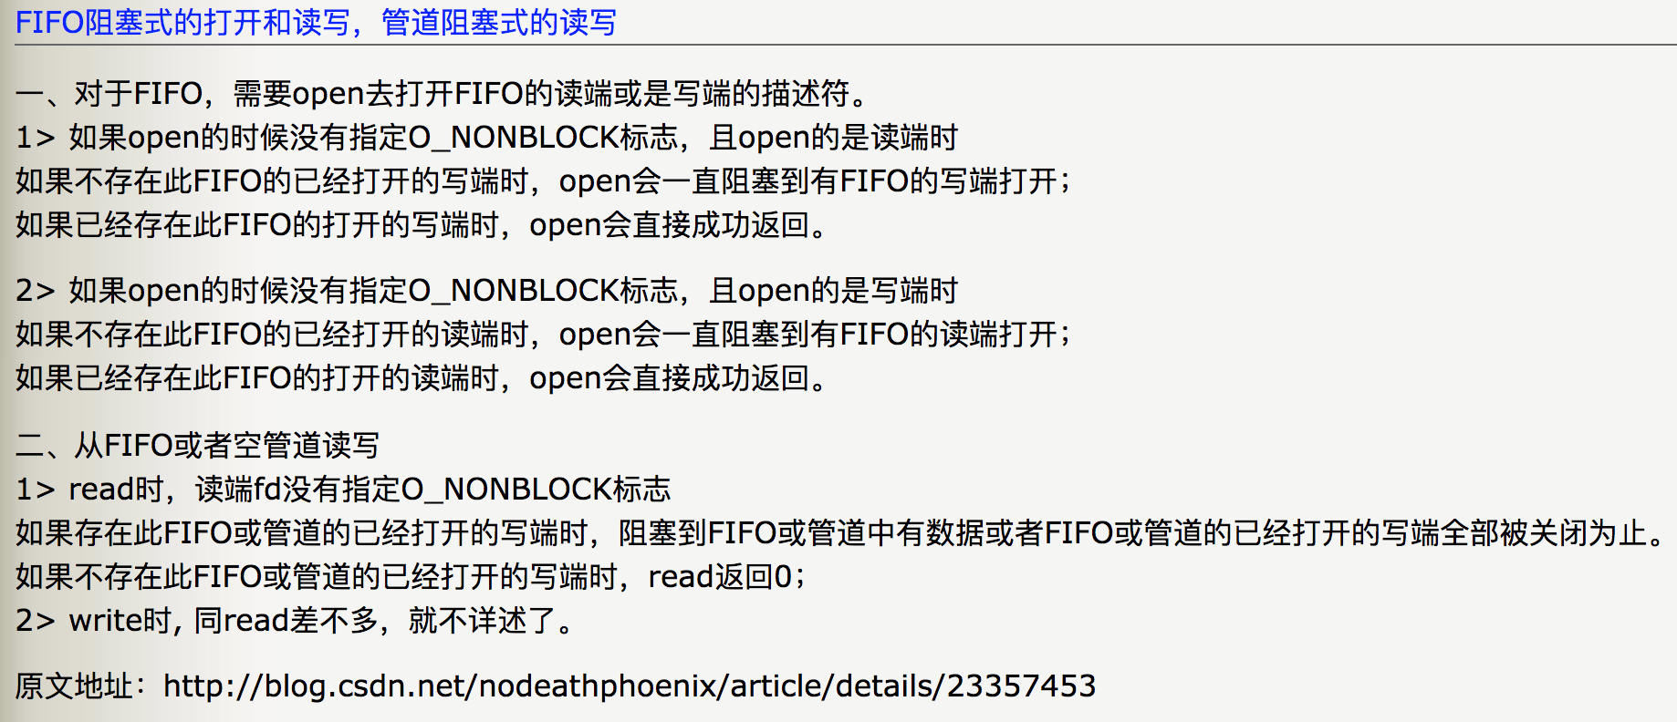
Summary
Notes:
https://blog.csdn.net/nodeathphoenix/article/details/23357453

Slide 21
Task 1
See report

Slide 22
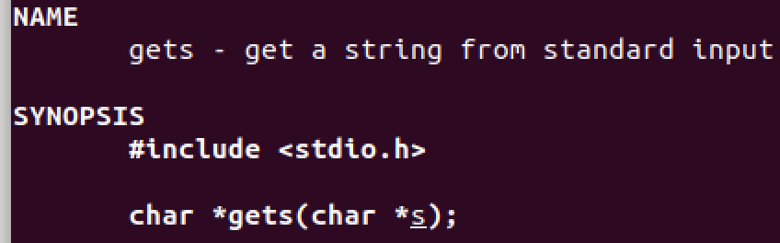
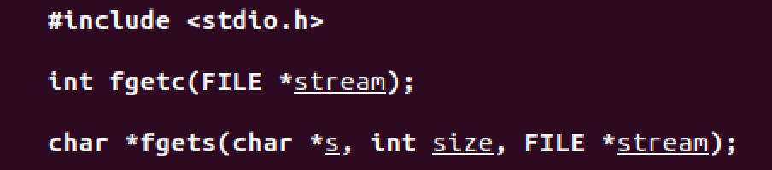
Get inputs from keyboard
scanf: no space, no newline
gets: space, no newline
fgets: space, newline

Slide 23
fgets
﻿fgets() reads in at most one less than size characters from stream
and stores them into the buffer pointed to by s
Reading stops after an EOF or a newline
﻿A terminating null byte ('\0') is stored after the last character in the buffer

Slide 24
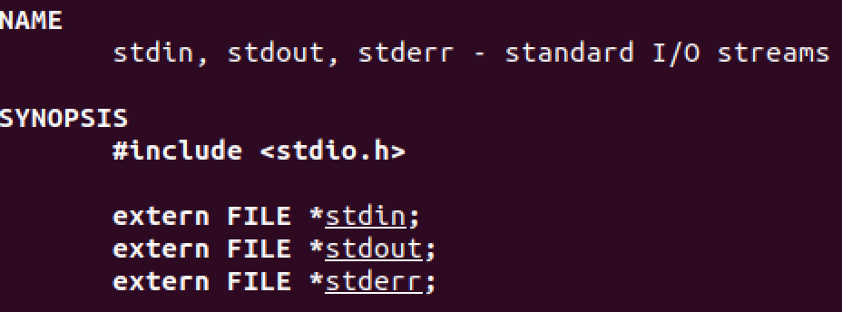
File Stream
stdin: 0 (get inputs from keyboard)
stdout: 1 (output to terminal)

Slide 25
Simplex, Half-Duplex, Full-Duplex

Slide 26

Simplex, Half-Duplex, Full-Duplex

Slide 27
Simplex, Half-Duplex, Full-Duplex

Slide 28
Task
A
B
send
receive
receive
send
demo

Slide 29
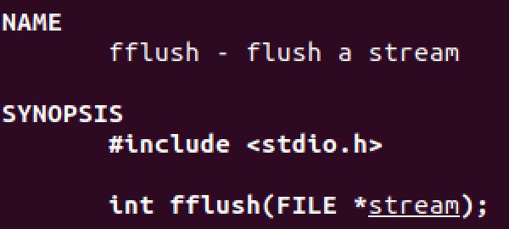
Flush buffer
﻿fflush(stdout);

Slide 30
Backspace
printf(“\b“);

Slide 31
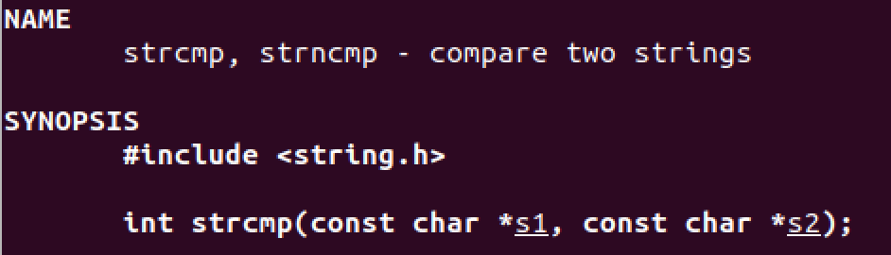
String compare
s1 == s2

Slide 32
The End

