Slide 1
Lab1: Review of C++
September 18, 2020

Slide 2
Self-introduction
Name: 赵恒军
Position: Lecturer, Software Engineering
Mail: zhaohj2016@swu.edu.cn

Slide 3
Outline
Classes
Objects
Inheritance
Lab Assessment

Slide 4
Hello World!
Visual Studio
Project

Slide 5
Classes
Fields
  data member
Methods
  member function
  constructor
  destructor

Slide 6
Objects
An object is an instance of a given class

Slide 7
Data Abstraction
Data abstraction is about the separation of what a class provides to users from how the class is defined
A user’s code should not access the implementation details of the class used
User’s view vs. developer’s view

Slide 8
User’s view
What information is needed by a user from the class? How is the class used by the user?
Method interface
  Precondition (true)
  Postcondition
  Method heading

Slide 9
Method Interface
// precondition
<return type> <method name> (<parameter list…>);
// postcondition

Slide 10
Developer’s View
How to satisfy the user’s need?
What information?
  Fields
How to provide the information?
  Method body

Slide 11
Contract
User ensures that the precondition is true before invoking a method
Developer guarantees that the post condition will be true after execution of the method

Slide 12
Class Declaration
header file *.h
class <class name>
{
private:
(fields)
public:
(method interfaces)
}
Developer’s view
User’s view

Slide 13
Class Definition
source file *.cpp
<return type> <class name>::<method name> (<list …>)
{
...
}
Body
Developer’s view

Slide 14
Company
A company
The leader wants to know who earns most
  How to find?

Slide 15
Find the Best-Paid Employee
Store all the employee
Input one by one
  The best-paid employee
  How to output?
Employee bestPaidEmployee
findBestPaid()
printBestPaid()

Slide 16
The Best-Paid Employee
Employee
  Name
  Salary
  Input
  Compare
  Output
  Copy
name
salary
input()
output()
compare()
copy()
Constructor!!!

Slide 17
Demonstration

Slide 18
Inheritance
class <derived class> : public <base class>
{
  …
}

Slide 19
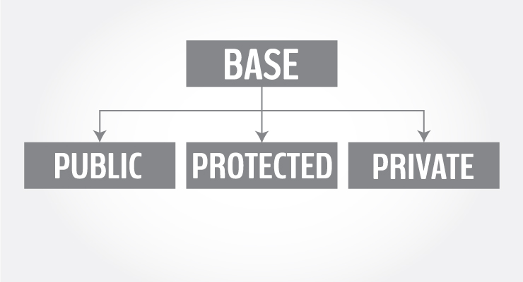
Inheritance

Slide 20
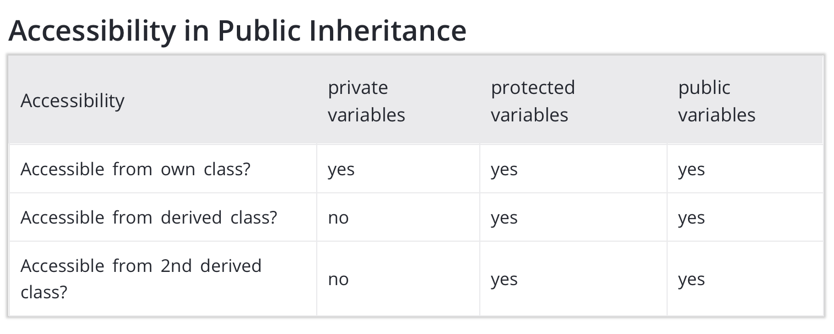
Inheritance

Slide 21
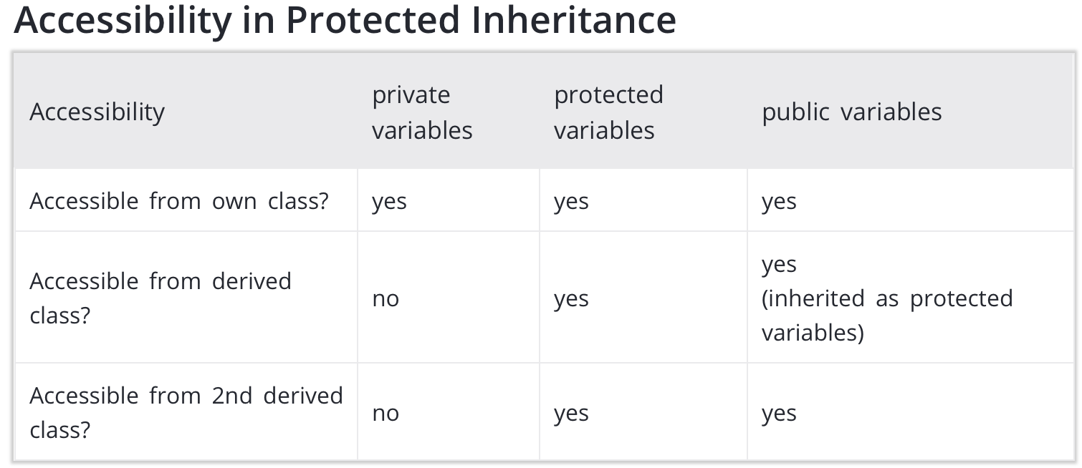
Inheritance

Slide 22
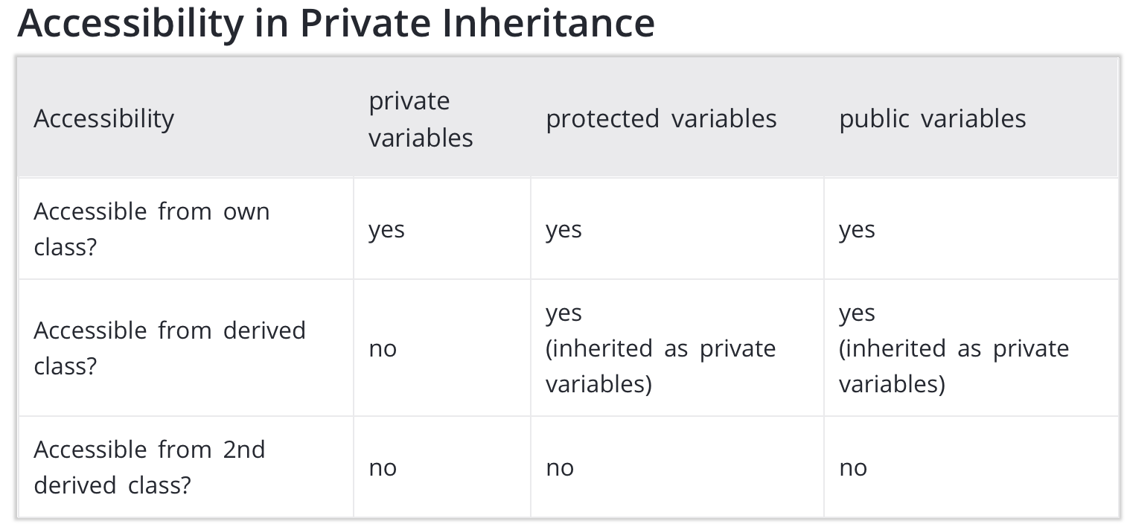
Inheritance

Slide 23
Hourly Paid Employee
A new class?
  Name
  Gross Salary
  Hours
  Salary per hour
  Input
  Compare
  Output
  Copy

Slide 24
Hourly Paid Employee
A new class?
  Name
  Gross Salary
  Hours
  Salary per hour
  Input
  Compare
  Output
  Copy

Slide 25
Hourly Paid Employee
A new class?
  Name
  Gross Salary
  Hours
  Salary per hour
  Input
  Compare
  Output
  Copy
Code reuse!
Open-Closed Principle
extension
modification

Slide 26
New Company
Employee bestPaidEmployee
findBestPaid()
printBestPaid()
  Name
  Gross Salary
  Hours
  Salary per hour
  Input
  Compare
  Output
  Copy

Slide 27
New Company
Employee bestPaidEmployee
findBestPaid()
printBestPaid()
  Name
  Gross Salary
  Hours
  Salary per hour
  Input
  Compare
  Output
  Copy

Slide 28
New Company
Employee bestPaidEmployee
findBestPaid()
printBestPaid()
  Name
  Gross Salary
  Hours
  Salary per hour
  Input
  Compare
  Output
  Copy

Slide 29
New Classes
Employee
  hours
  salary per hour
  input()
Company
  findBestPaid()

Slide 30
Lab Assessment

Slide 31
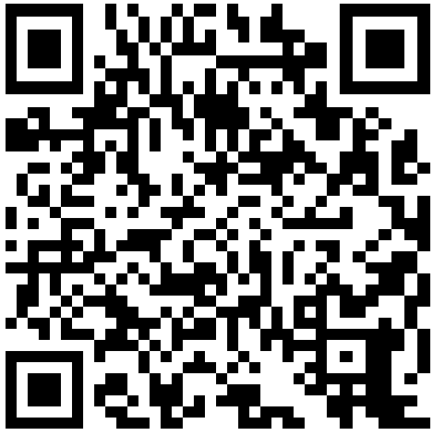
Course Website
http://www.scholat.com/course/ds2020autumn

Slide 32
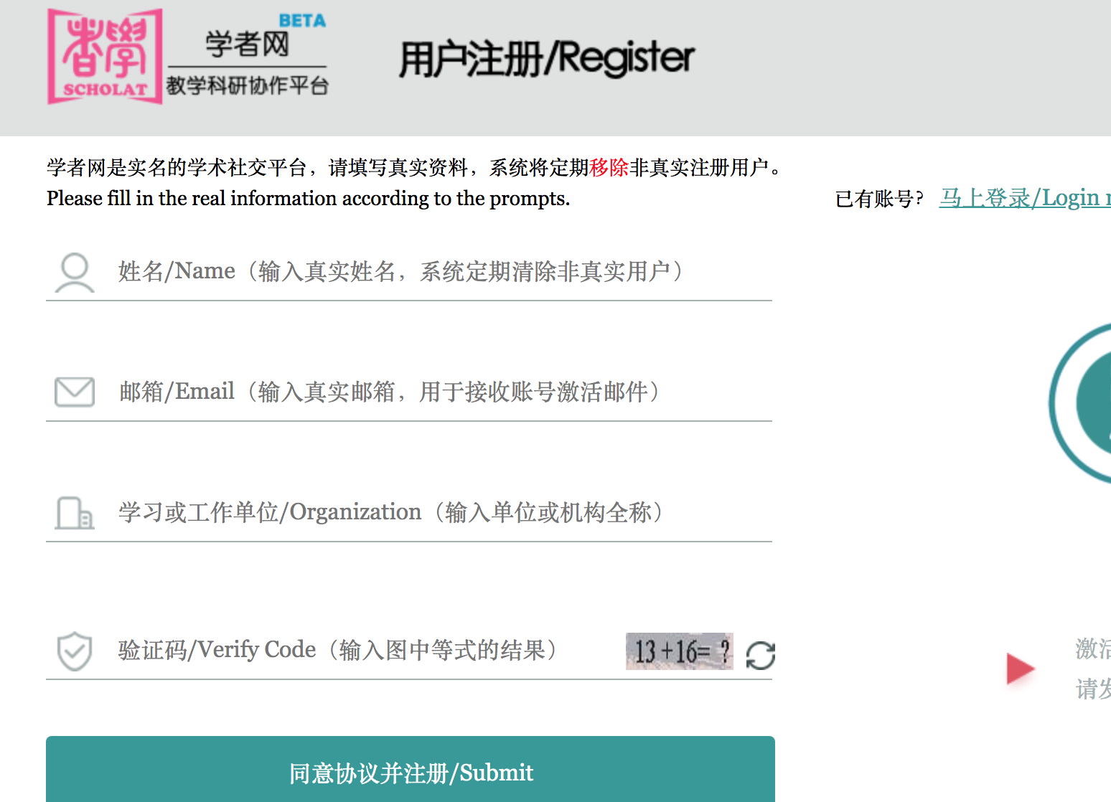
Registration
Real name

Slide 33
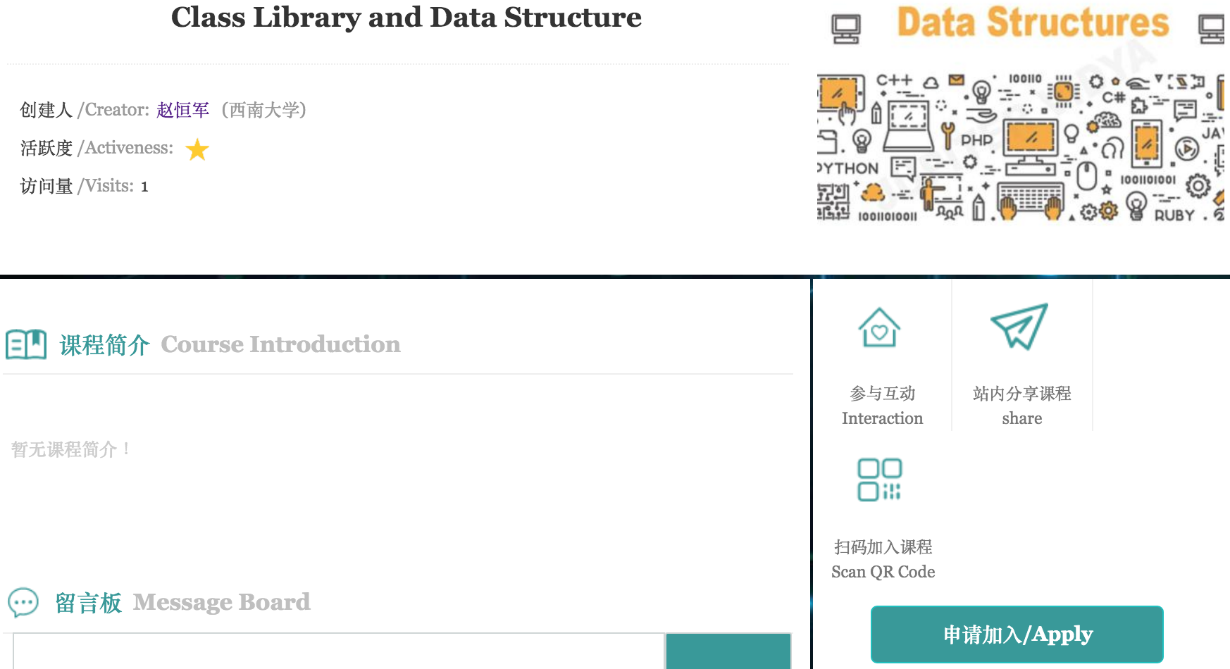
Apply

Slide 34
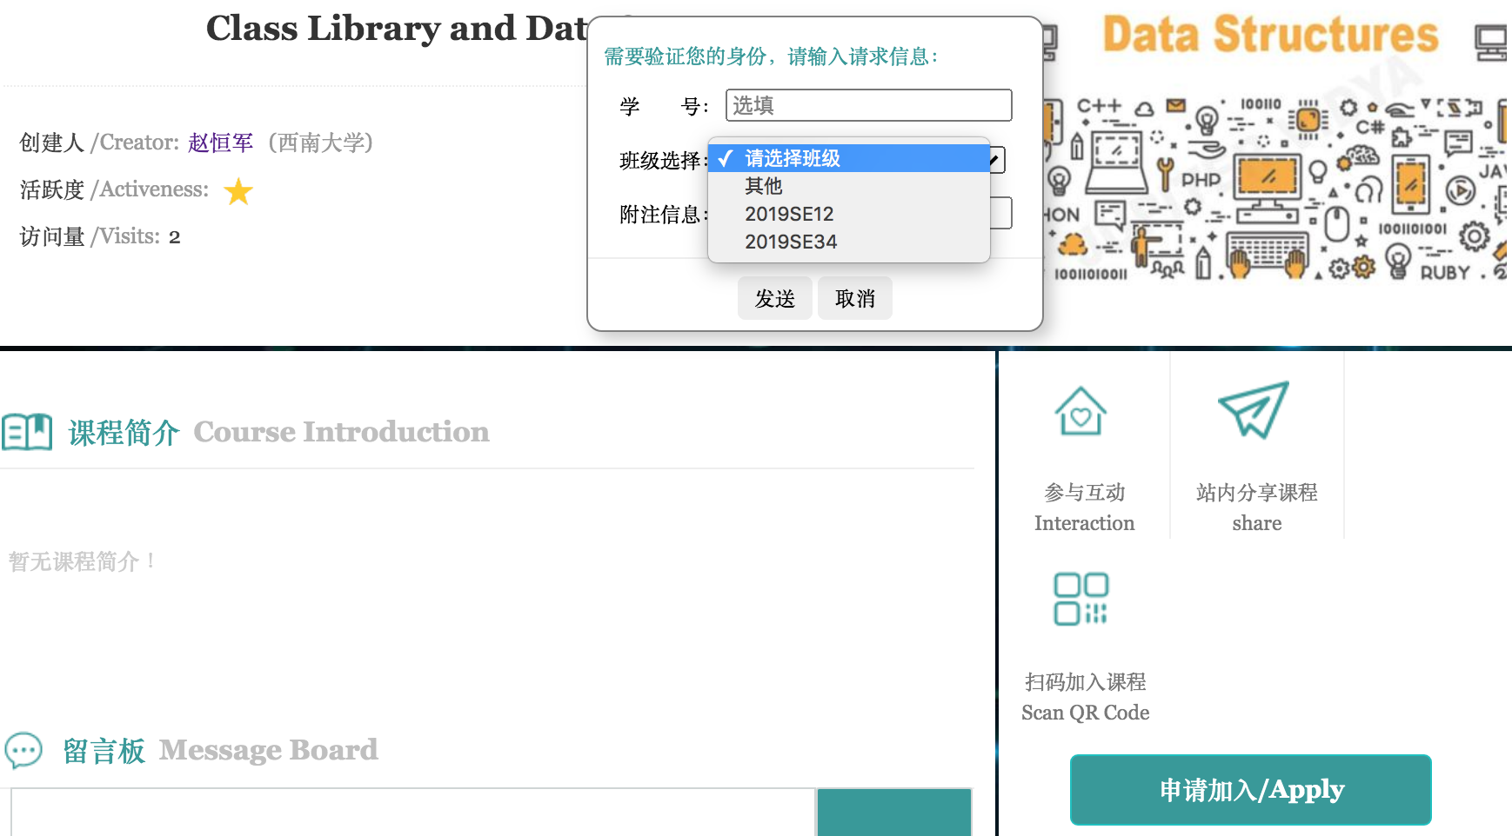
Apply
ID number

Slide 35
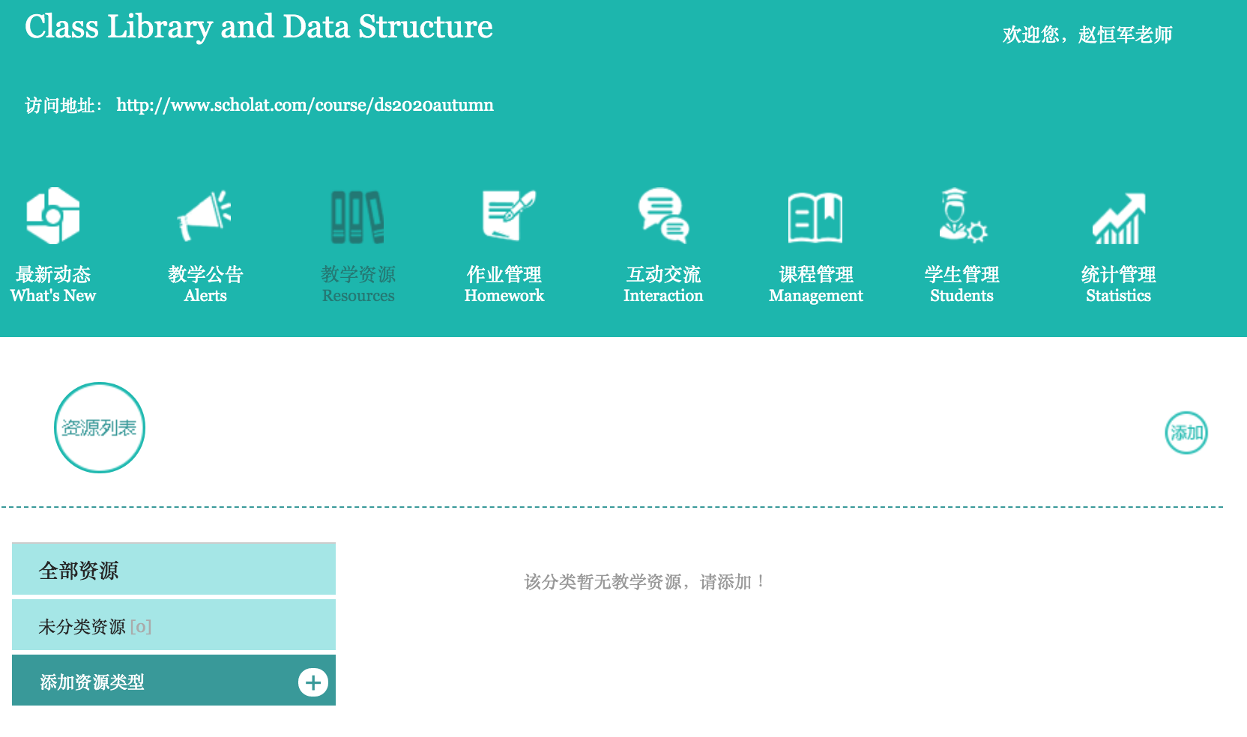
Resources & Assignments

Slide 36
Evaluation
Labs (20%)
  8 labs
  Class attendance + class performance

Slide 37




Requirements for Lab Reports
Plagiarism!!!
Just code and screen snapshot!!!
Non-compressed pictures!!!
Upload the complete project!!!

Slide 38
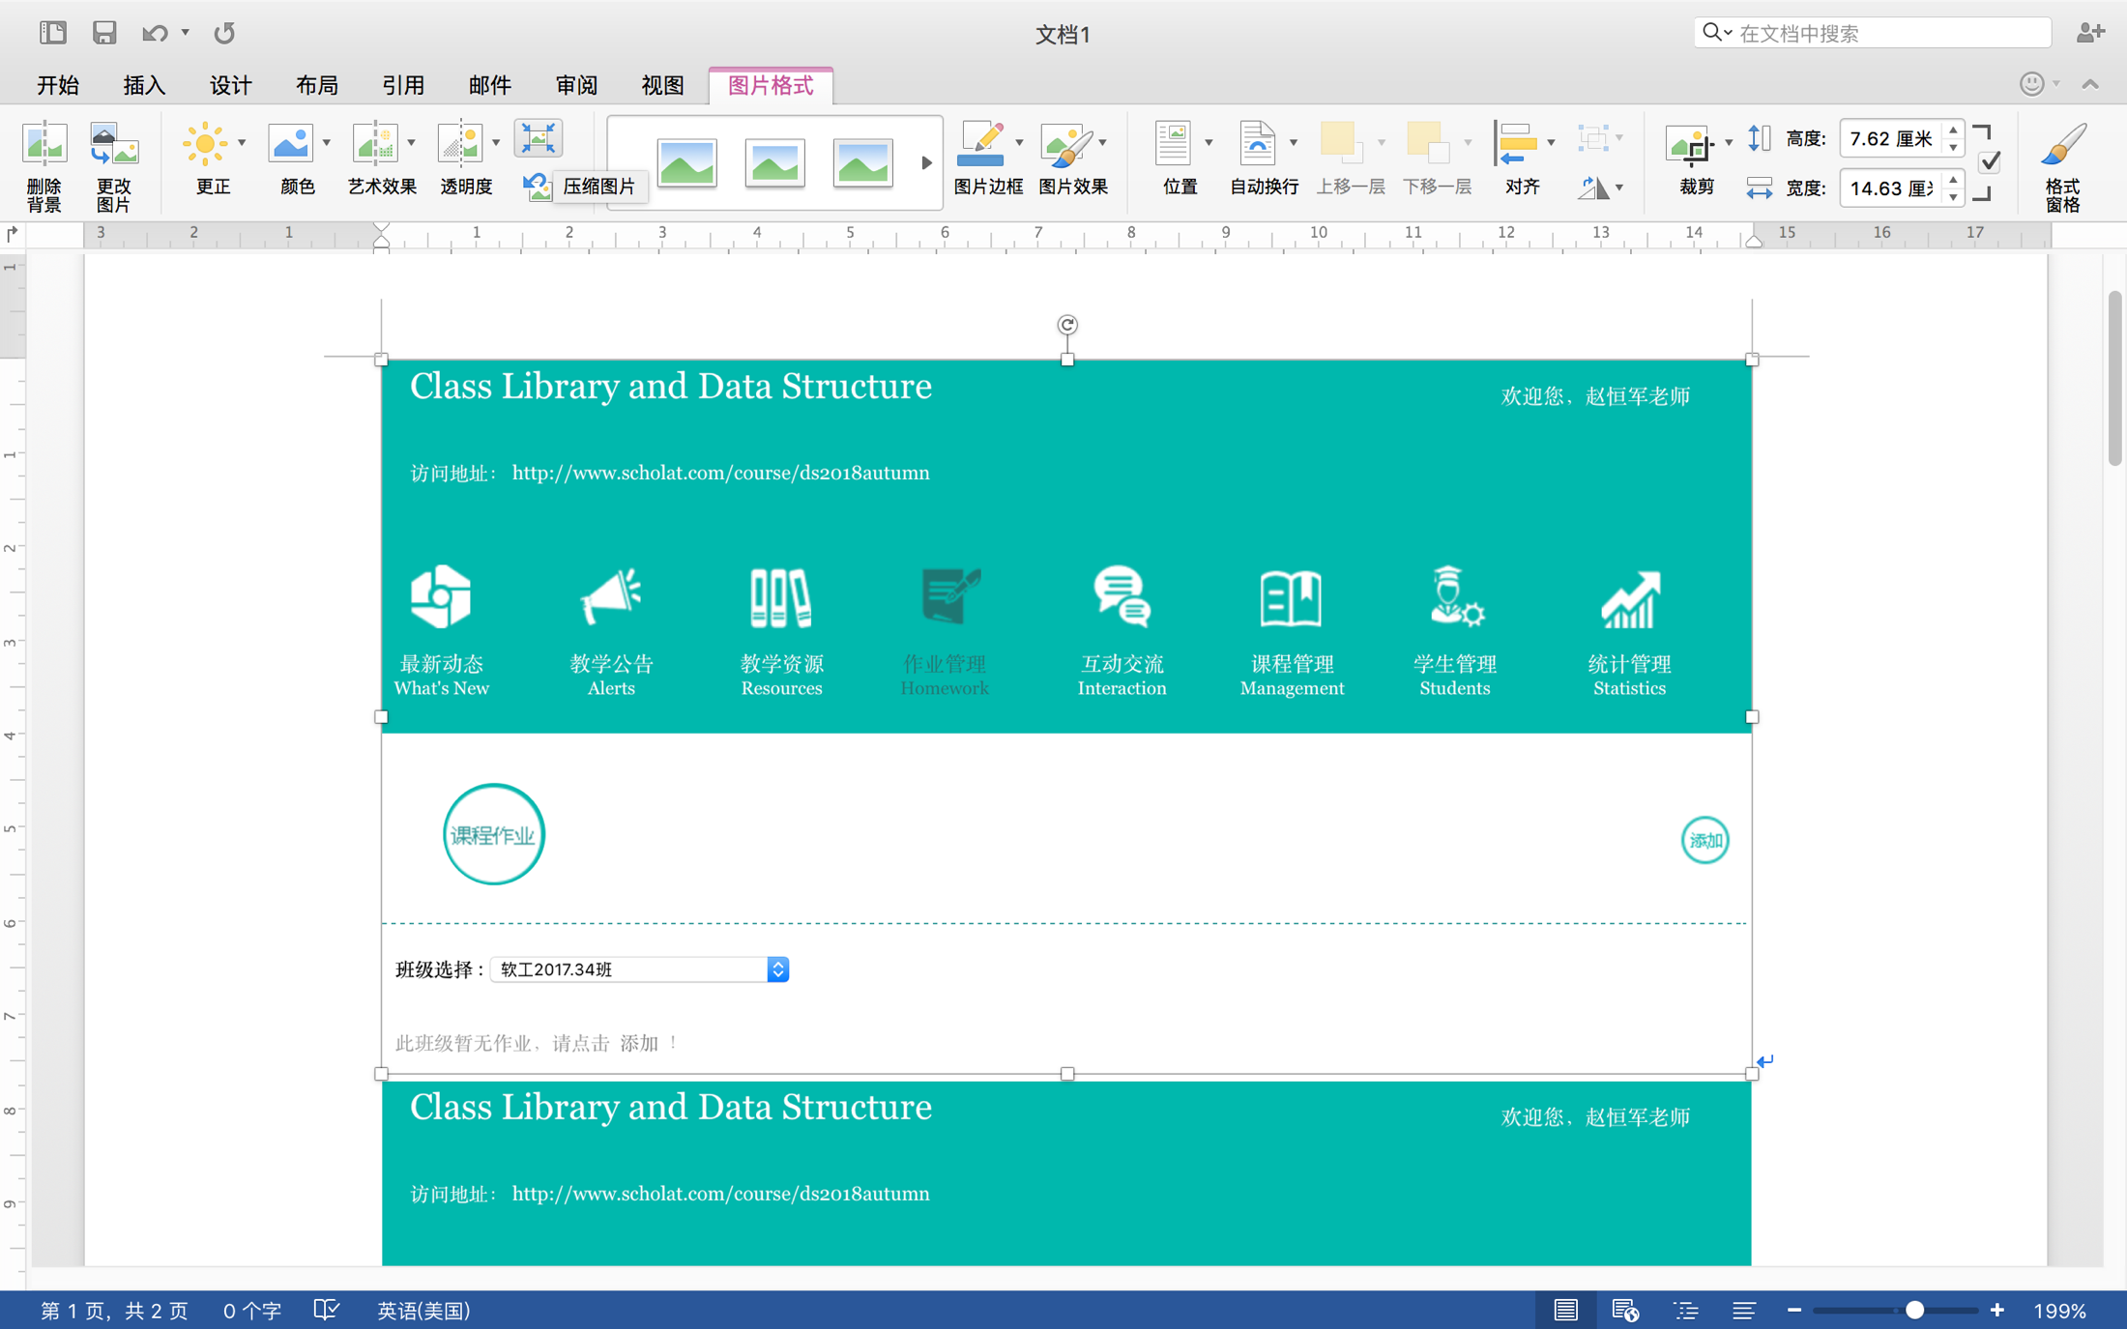
Attention Please!
Compress
pictures

Slide 39
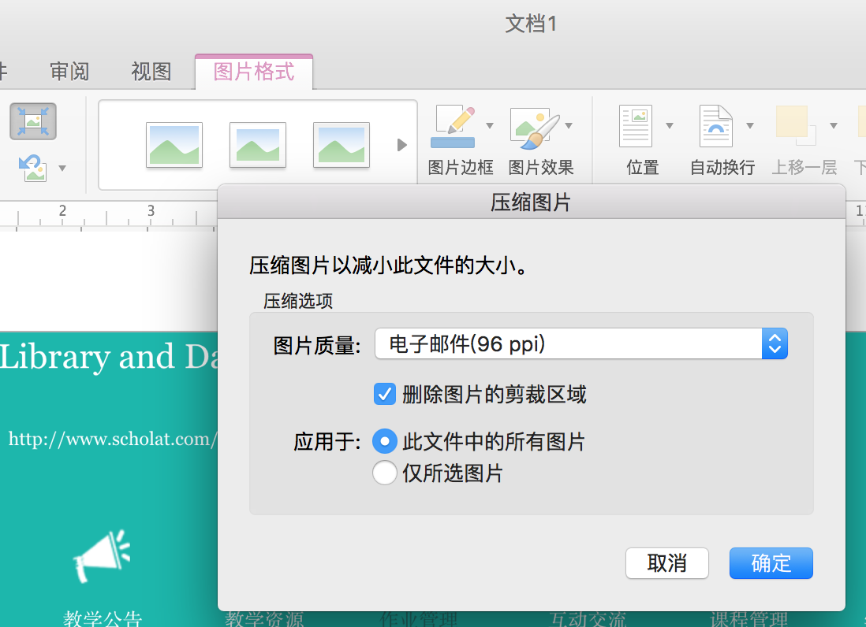
Attention Please!

Slide 40
No plagiarism!

Slide 41
Thank you!
Questions?

Slide 42
Substitution rule

