Slide 1
Lab3: Template
Oct 29, 2020

Slide 2
Reports of lab2
Comments

Slide 3
Outline
Containers
Templates
Generic algorithms
Linked storage

Slide 4

Use a container
A container is a variable that consists of a collection of items
  Hold items (of any type)

Slide 5
A Company
Employee
Devices
Products
…

Slide 6
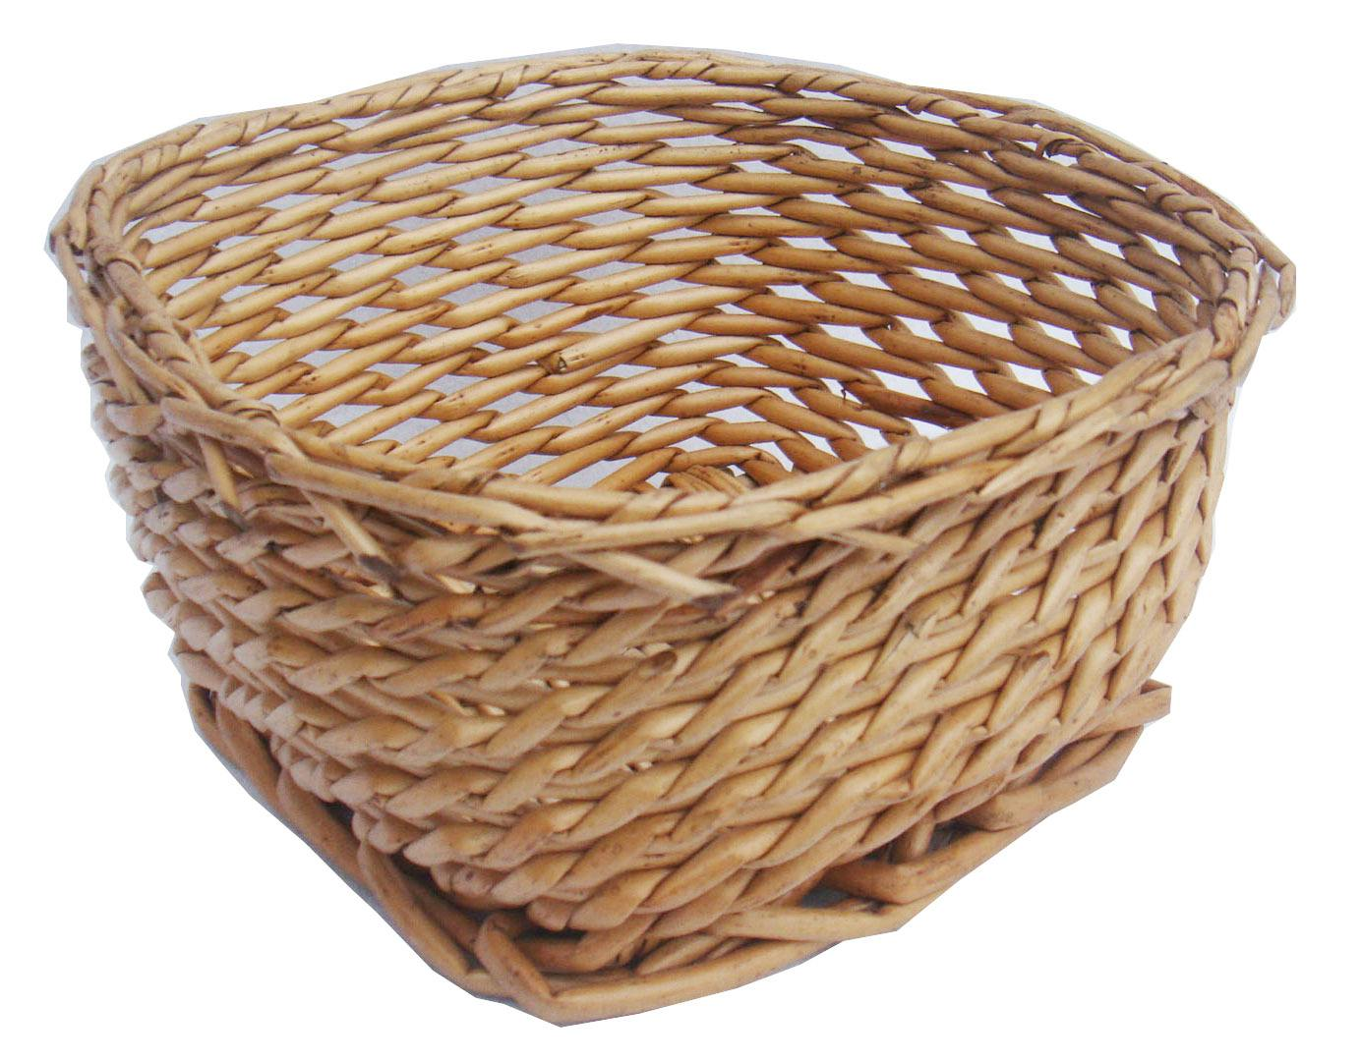
Use a container
A container is a variable that consists of a collection of items
  Hold items (of a certain type)
  Construct
  Destruct
  Add an item
  Remove an item
  Get size
  Check empty
  Access/traverse

Slide 7
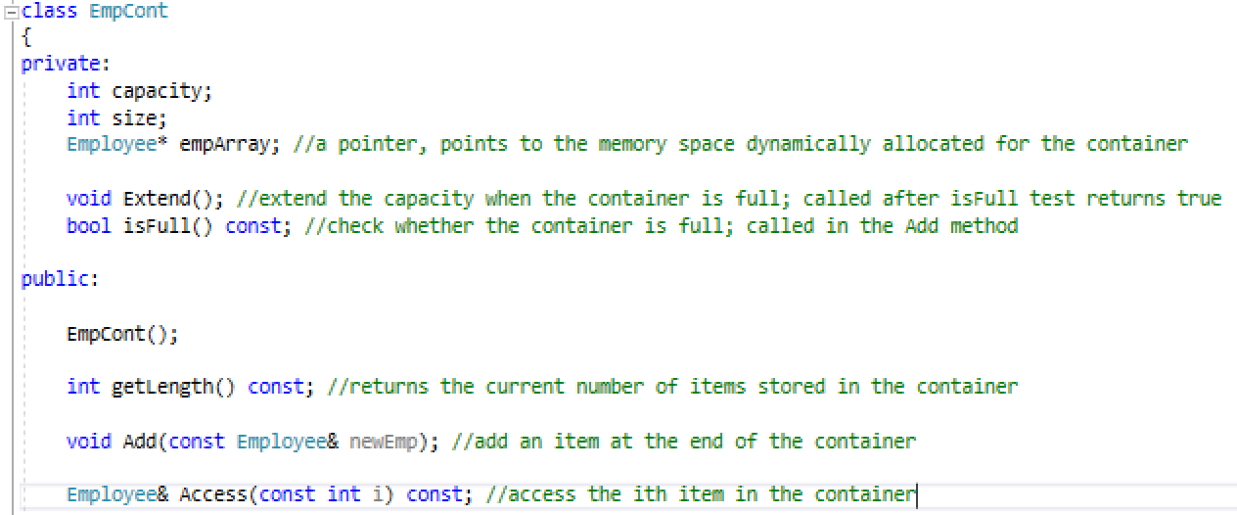
Template

Slide 8
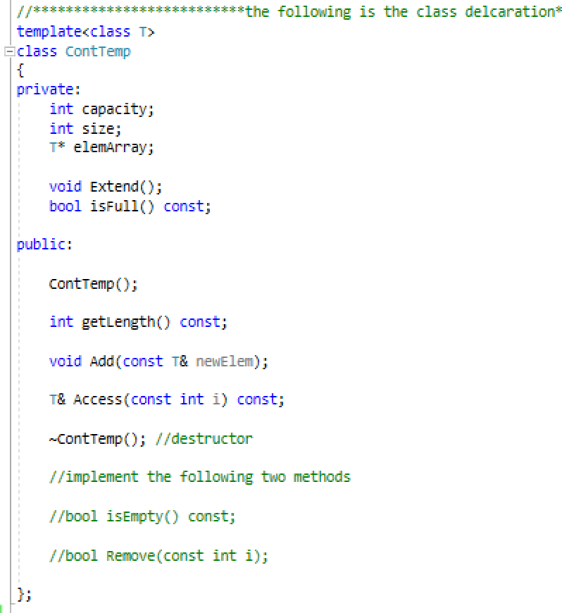
Template

Slide 9
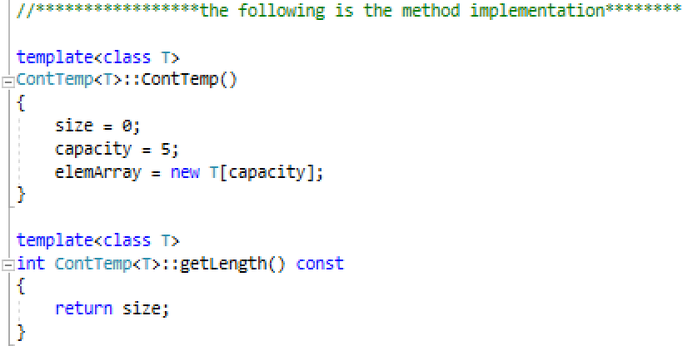
Generic method using template

Slide 10
Attention!
For template classes, keep the interface definition and its implementation in a single .h file!
Notes:
Why? Cannot compile the .cpp with parametric class if seperated from the .h file

Slide 11
Task 1

Slide 12
Contiguous vs. Linked
Storage
  Contiguous
    Consider the capacity of the array-based container
    A waste of memory space
  Linked

Slide 13
struct in C++
Similar to classes
Can have methods (default: public)

Slide 14
Company with Linked Storage
size
head: pointer

Slide 15
Company with Linked Storage
Avoid memory leak:
  destructor
curr=head
temp

Slide 16
Task 2&3
In the container class using linked storage, implement the method for adding a new element at the head of the linked list
  void AddHead()
  Void AddTail()
Test your implementation in main()

Slide 17
Question
How to implement findBestPaid() in Company class?
What kind of functions should the Linked Template Container provide to implement findBestPaid()?
Notes:
How?

Slide 18
Summary
Data structure
  Containers (this course)
Template:

Slide 19
Thank you!
Questions?

