Slide 1

This Course is intended for studying Data Structures and algorithms using C++ and STL.
Textbook: William J. Collins. Data Structure and the Standard Template Library（中文版）. 北京:机械工业出版社. 2003年3月.
References:
[1] Mark Allen Weiss. 数据结构与算法分析:Java语言描述, 机械工业出版社, 2016年3月.
[2] Nicolai M. Josuttis. The C++ Standard Library: A Tutorial and Reference, Addison Wesley Longman, Jul. 1999.
[3]William Ford, William Topp. Data Structures in C++: Using the Standard Template Library (STL)(数据结构C++语言描述——应用标准模板库（STL））第2版. 北京：清华大学出版社. 2003年5月.
[4] Matthew H.Austern. 泛型编程与STL（影印版）,中国电力出版社, 2003年11月。

Slide 2
Labs: 20%
Assignments: 10%
Final Test: 70%
IMPORTANT: IF YOU FAIL THE LABS, YOU FAIL THE COURSE.

Slide 3
How to learn this course well?
Read the text book carefully and be able to read other English technical materials.
Try to verify the code in the textbook.
Try to complete the lab on your own.
Love the programming and get used to think in programming logic.
Books for extended reading:
[1] Bruce Eckel, Chuck Allison, Think in C++(C++编程思想), 机械工业出版社，2011 (Think in Java/C#....)
[2] Scott Meyers, Effective C++:改善程序与设计的55个具体做法(第3版), 电子工业出版社, 2011 (Effective Java....)

Slide 4
Some important issues in learning C++:
Execute Sequence for whole program, constructor, destructor etc.
What happens in initializing the class?
The above issues are more complicated if we consider the inheritance case.
Using operators and expressions in C++.
Using pointer to implement dynamic memory allocation in C++.

Slide 5
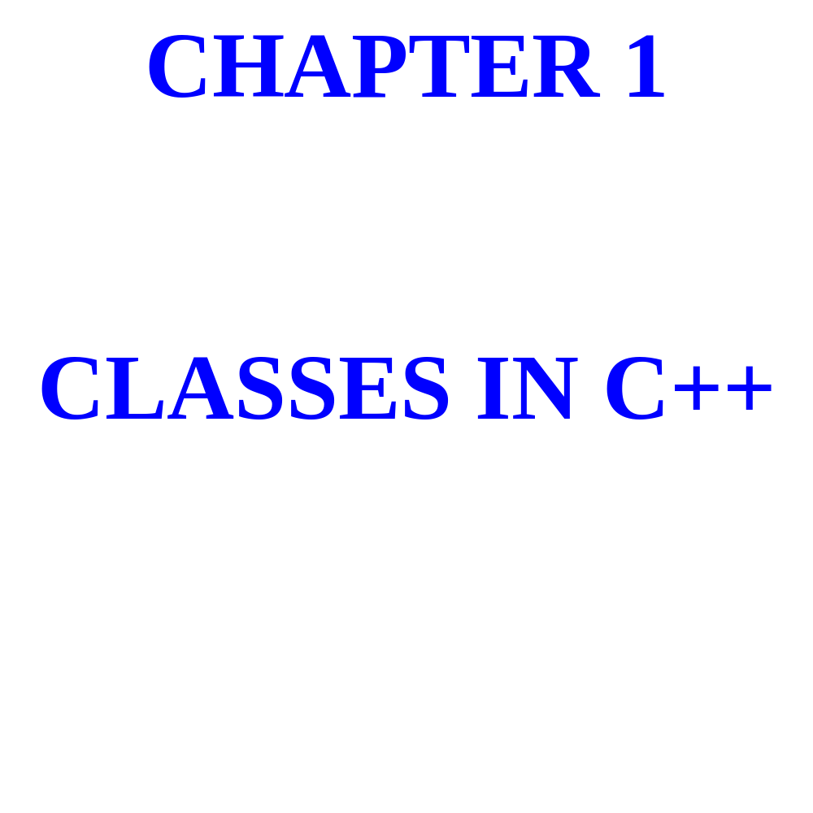

Slide 6
A class consists of variables,
Called fields, together with
Functions, called methods,
That act on those fields.

Slide 7
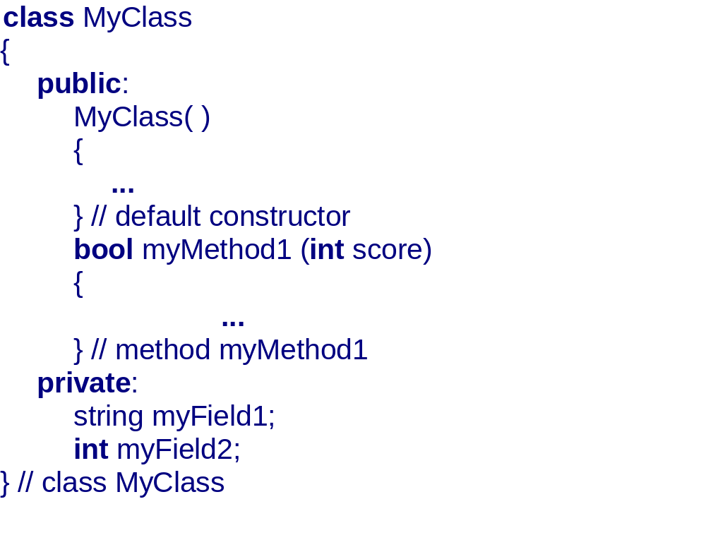

Slide 8
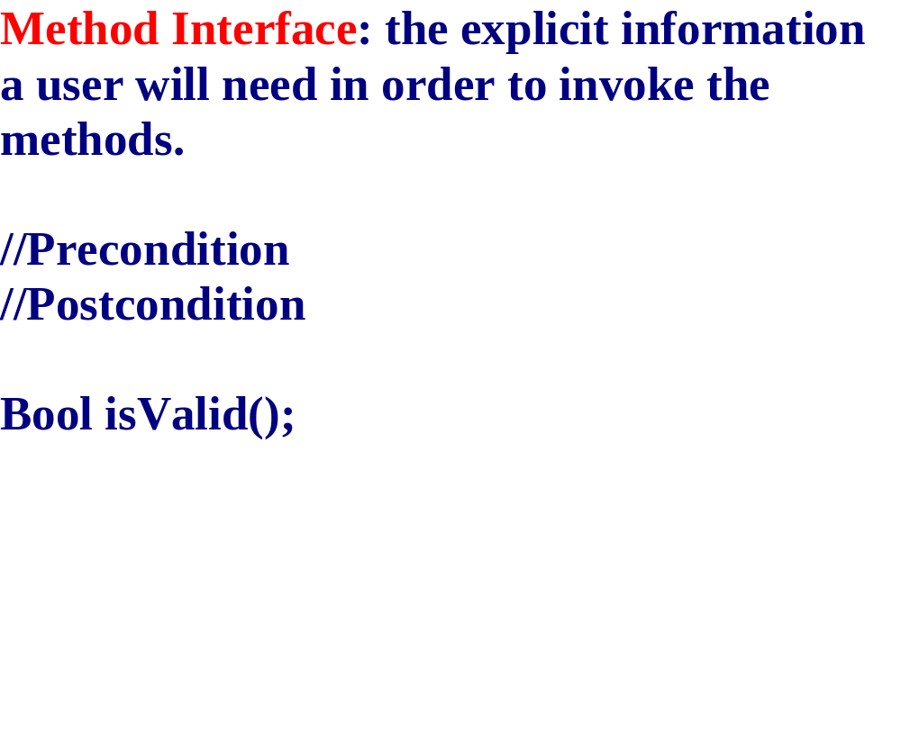

Slide 9
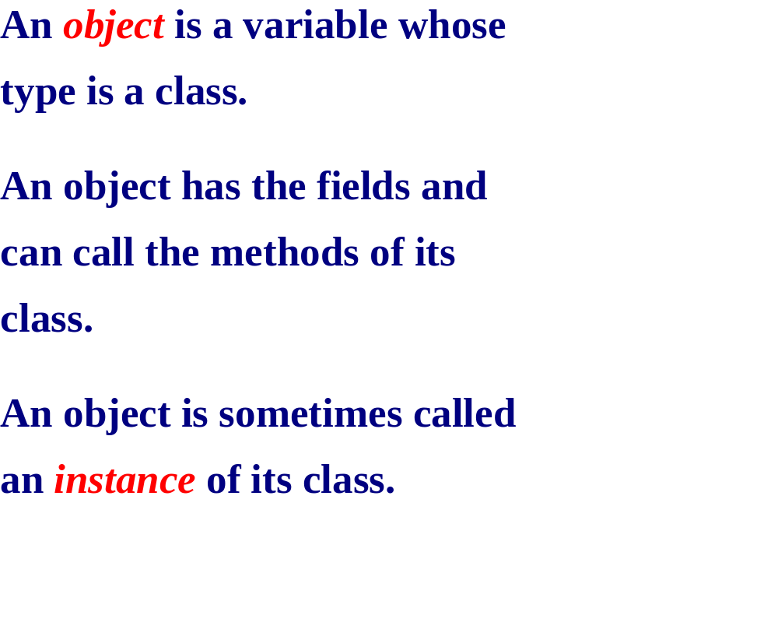

Slide 10
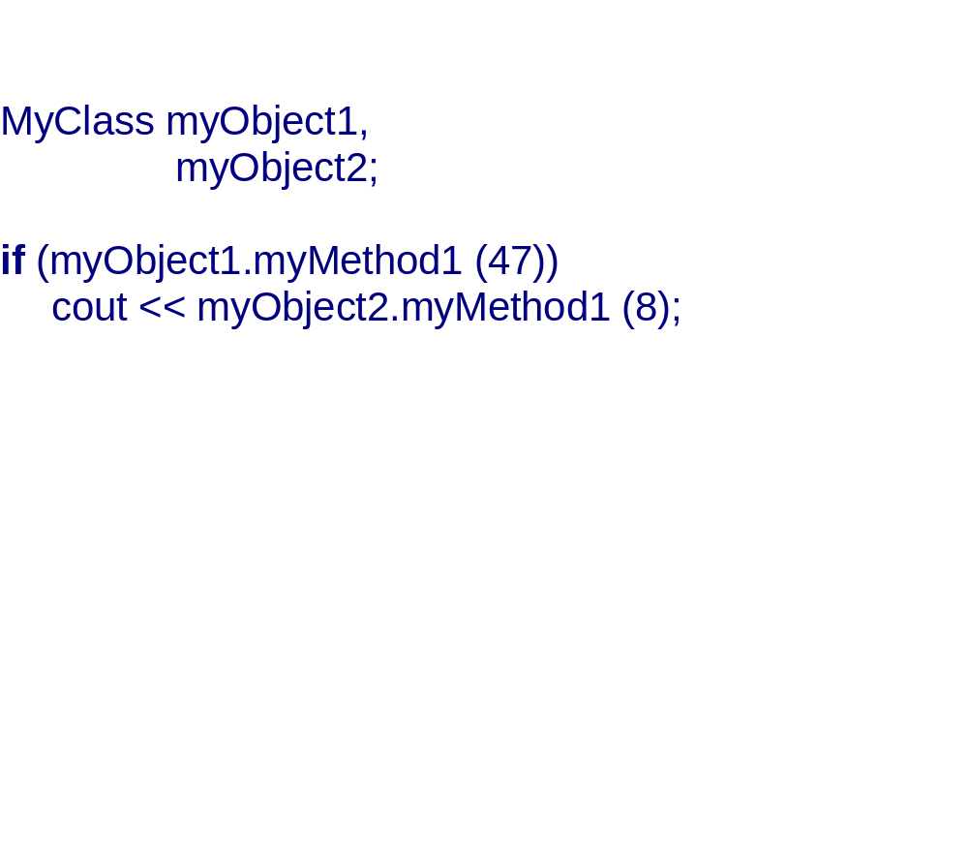

Slide 11

USER’S VIEW OF A CLASS:
METHOD INTERFACES
(= PRECONDITION + POSTCONDITION
+ METHOD HEADING)
DEVELOPER’S VIEW OF A CLASS:
FIELDS AND METHOD DEFINITIONS

Slide 12
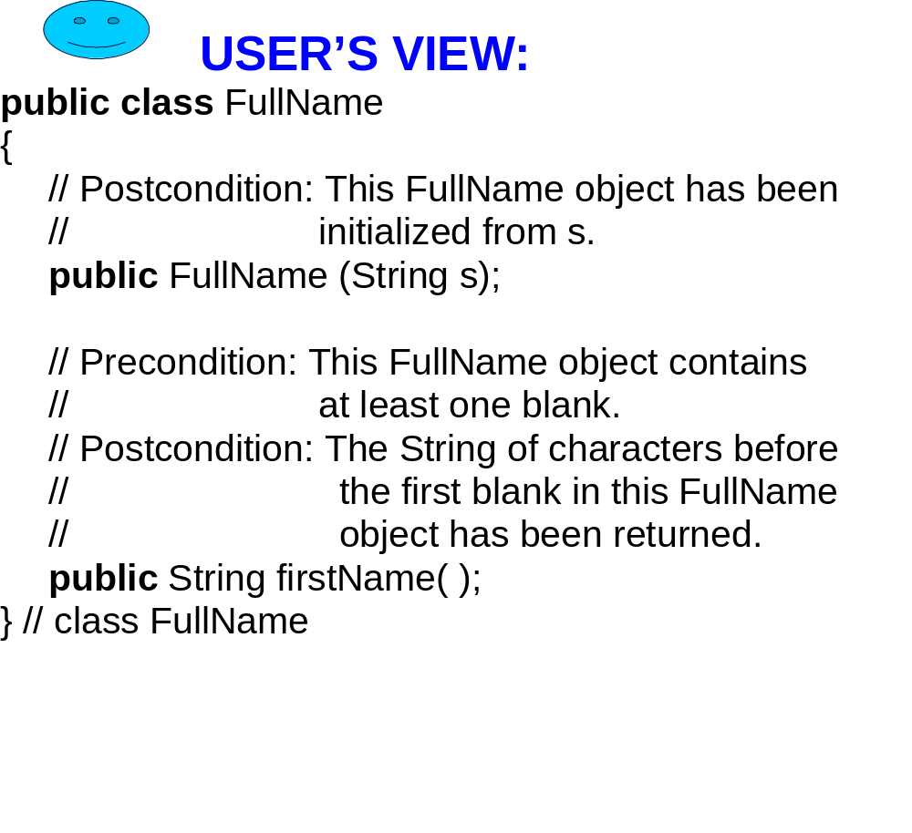

Slide 13
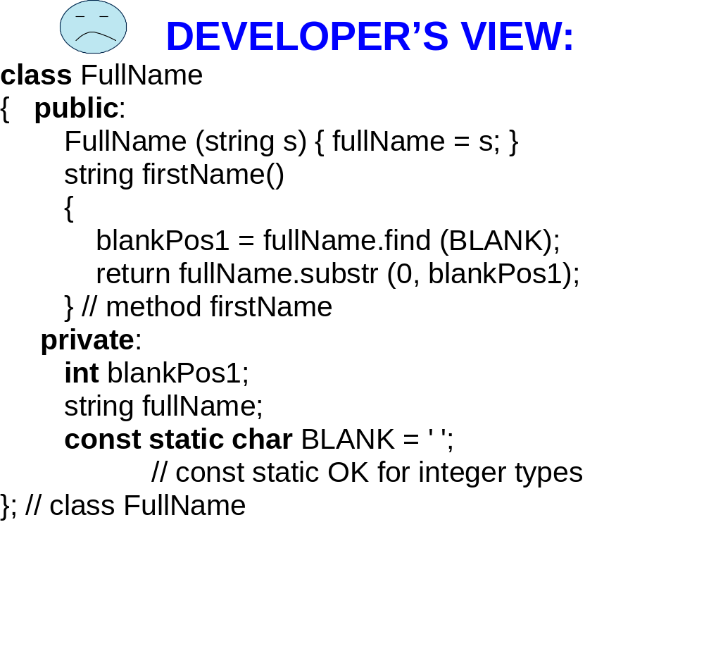

Slide 14
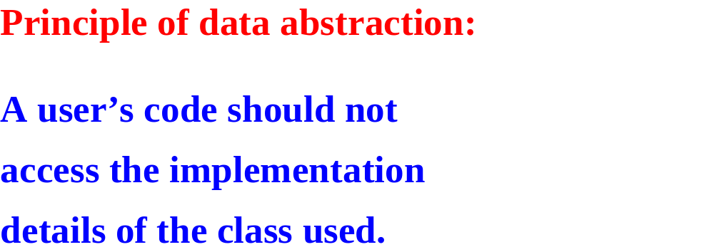

Slide 15
BEST-PAID EMPLOYEE IN A COMPANY?
CREATE A CLASS CALLED Employee.
THE INFORMATION AVAILABLE ON EACH EMPLOYEE CONSISTS OF THE EMPLOYEE’S NAME AND GROSS PAY.

Slide 16
THE Employee CLASS
USER’S VIEW

Slide 17
THE Employee CLASS: USER’S VIEW
// Postcondition: this Employee's name has been set to
// “” and gross pay to 0.00.
Employee( );

Slide 18
THE Employee CLASS: USER’S VIEW
// Postcondition: This Employee's name has been set to
// “” and gross pay to 0.00.
Employee( );
NOTE: In the above postcondition, and in
The postconditions that follow, “this
Employee” refers to the calling object: the
Object that called the method.

Slide 19
THE Employee CLASS: USER’S VIEW
// Postcondition: The name and gross pay of this
// Employee been read in.
void readInto( );

Slide 20
THE Employee CLASS: USER’S VIEW
// Postcondition: true has been returned if this
// Employee is the sentinel. Otherwise, // false has been returned.
bool isSentinel( ) const;
NOTE: the reserved word const at the end
of the method heading means that the
definition of the method is not allowed
to modify the calling object.

Slide 21
THE Employee CLASS: USER’S VIEW
// Postcondition: true has been returned if this
// Employee's gross pay is greater than
// that of otherEmployee. Otherwise, false
// has been returned.
bool makesMoreThan (const Employee&
otherEmployee) const;

Slide 22
THE Employee CLASS: USER’S VIEW
// Postcondition: true has been returned if this
// Employee's gross pay is greater than
// that of otherEmployee. Otherwise, false
// has been returned.
bool makesMoreThan (const Employee&
otherEmployee) const;
DEFINITION NOT ADDRESS OF ARGUMENT ALLOWED TO MODIFY SENT, NOT A COPY
ARGUMENT OF ARGUMENT
(PROVIDES SECURITY) (SAVES TIME AND SPACE)

Slide 23
THE Employee CLASS: USER’S VIEW
// Postcondition: this Employee contains a copy of
// otherEmployee.
void getCopyOf (const Employee& otherEmployee);
// Postcondition: this Employee's name and gross pay
// have been written out.
void printOut( ) const;

Slide 24
Employee OBJECTS
Employee employee1,
employee2;
employee1.readInto( );
employee2.readInto( );
if (employee1.makesMoreThan (employee2))
employee1.printOut( );
else
employee2.printOut( );

Slide 25
THE Employee CLASS:
DEVELOPER’S VIEW employee1.h (THE HEADER FILE)
#ifndef EMPLOYEE
#define EMPLOYEE
#include <string> // declares string class using namespace std; class Employee
{

Slide 26
THE Employee CLASS:
DEVELOPER’S VIEW employee1.h (continued) public:
// Postcondition: this employee's name has
// been set to "" and gross pay
// to 0.00.
Employee( );
// method interfaces for other methods

Slide 27
THE Employee CLASS:
DEVELOPER’S VIEW employee1.h (continued) private: string name; double grossPay; const static double GROSS_PAY_SENTINEL; const static string EMPTY_STRING; const static string NAME_SENTINEL;
}; // Employee
#endif

Slide 28
THE Employee CLASS:
DEVELOPER’S VIEW employee1.cpp (THE SOURCE FILE )
#include <iostream>
#include <iomanip> // declares output formatting objects
#include "employee1.h" // declares Employee class

Slide 29
THE Employee CLASS:
DEVELOPER’S VIEW employee1.cpp (continued )
Employee::Employee( )
{ name = EMPTY_STRING; grossPay = 0.00;
} // default constructor

Slide 30
scope-resolution employee1.cpp (continued ) operator (the readInto method in void Employee::readInto( ) the Employee class)
{ const string NAME_AND_PAY_PROMPT =
"Please enter a name and gross pay, to quit, enter "; cout << NAME_AND_PAY_PROMPT
<< NAME_SENTINEL << " "
<< GROSS_PAY_SENTINEL; cin >> name >> grossPay;
} // readInto

Slide 31
employee1.cpp (continued )
// definitions of other employee methods
... const string Employee::EMPTY_STRING = ""; const string Employee::NAME_SENTINEL = "*"; const double Employee::GROSS_PAY_SENTINEL =
-1.0;

Slide 32
APPLICATION:
FIND THE BEST PAID EMPLOYEE
IN A COMPANY.

Slide 33
The Company Class: User’s View
// Postcondition: this Company has been initialized.
Company( );
// Postcondition: this Company’s best‑paid employee
// has been determined.
void findBestPaid( );
// Postcondition: this Company’s best‑paid employee
// has been printed out.
void printBestPaid( ) const;

Slide 34
THE Company CLASS: DEVELOPER’S VIEW
SEE LAB 1

Slide 35
EXERCISE: To get things started,
The main function must define a
Company object. Provide that
Definition. WHAT FILE (employee1.H,
Employee1.Cpp, company1.H, company1.Cpp)
Must be included in the class that has the main function?

Slide 36
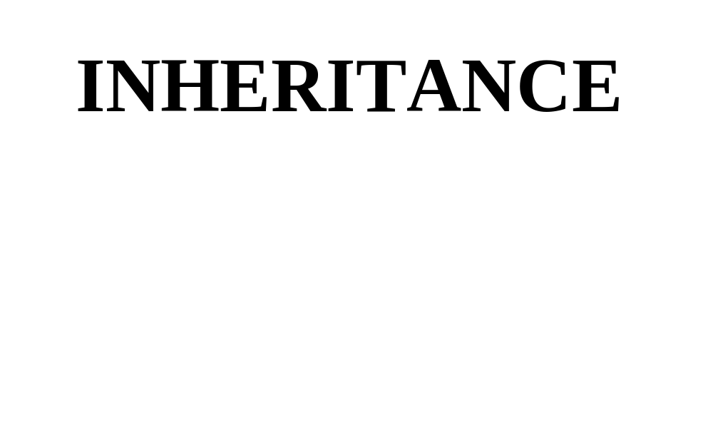

Slide 37
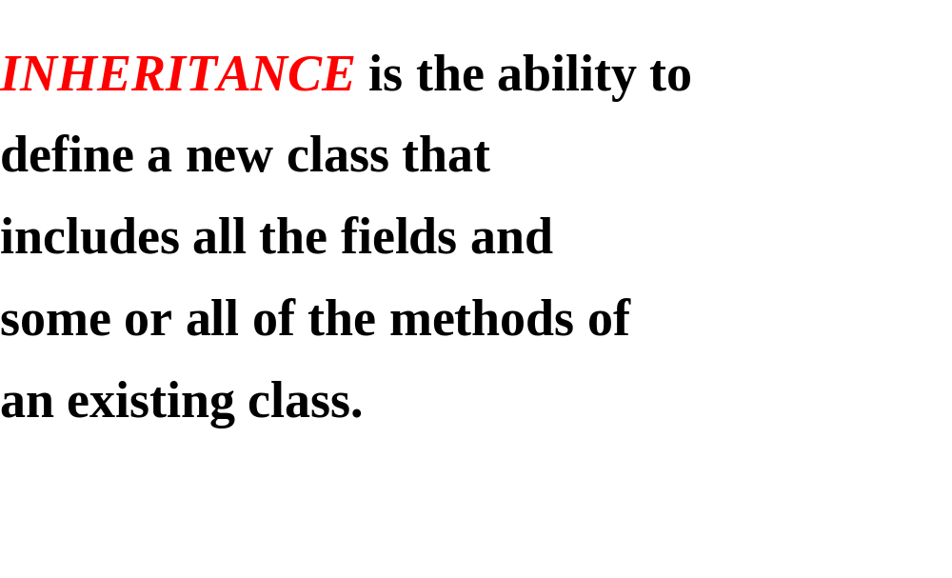

Slide 38
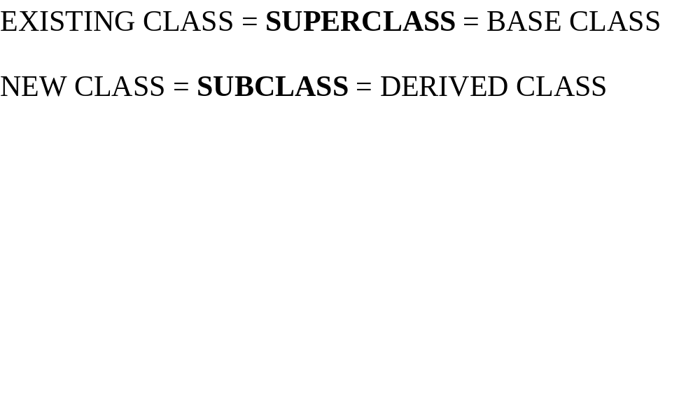
SUPERCLASS
SUBCLASS

Slide 39
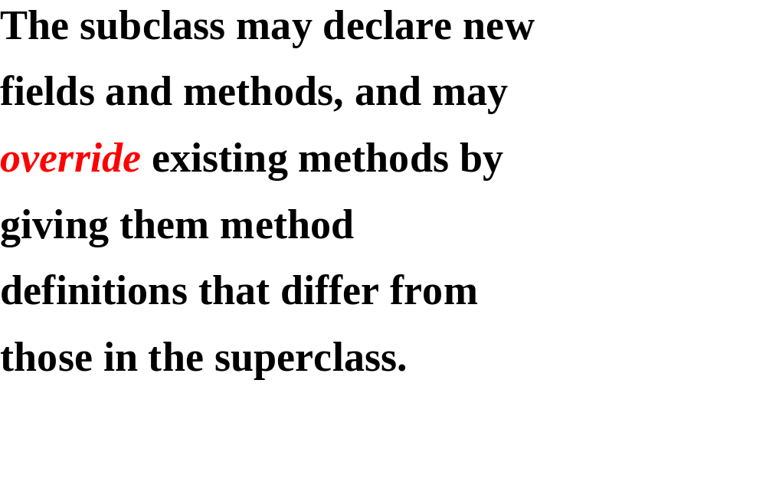

Slide 40
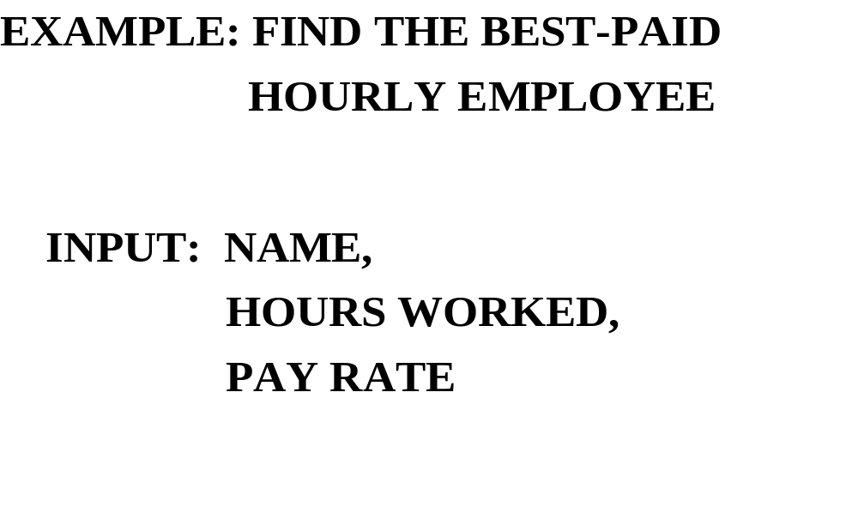

Slide 41
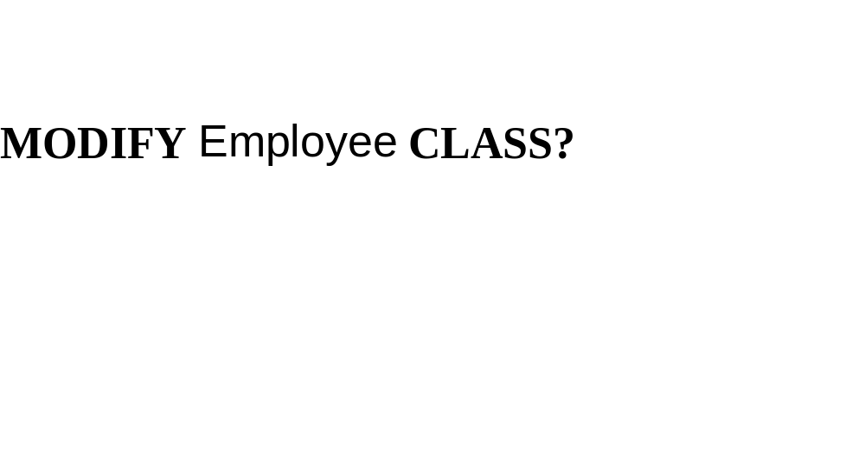

Slide 42
THE OPEN-CLOSED PRINCIPLE
EVERY CLASS SHOULD BE
OPEN: Extendible through inheritance
CLOSED: Stable for existing applications

Slide 43
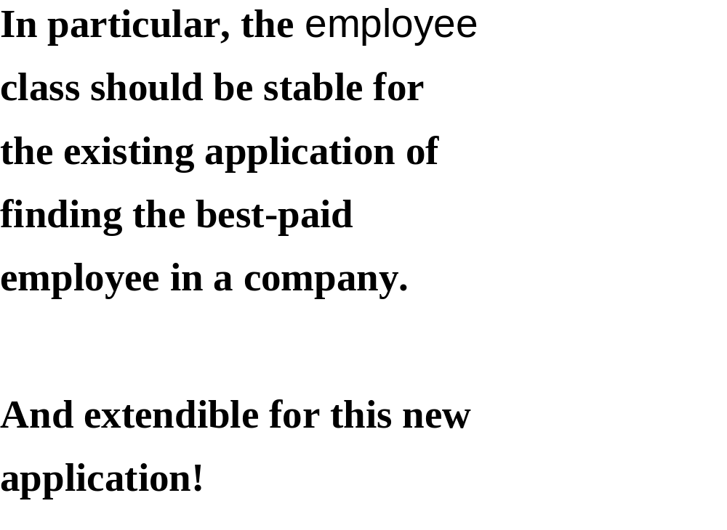

Slide 44
THE NEW CLASS WILL BE
HourlyEmployee
A SUBCLASS OF Employee. WHICH
Employee METHODS WILL BE
OVERRIDDEN?

Slide 45
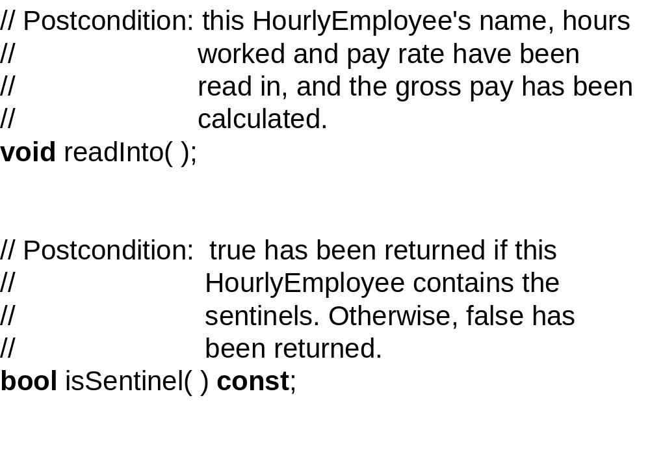

Slide 46
THE makesMoreThan, getCopyOf and
printOut methods are untouched,
and may be called as is by any
HourlyEmployee object
After all, an HourlyEmployee IS AN
Employee!

Slide 47
WHAT FIELDS?
for the new information:
hoursWorked, payRate

Slide 48
WHAT ABOUT name AND grossPay?
According to the definition
of inheritance, the HourlyEmployee
class automatically “inherits”
these two fields.
BUT HOW?

Slide 49
To allow subclass objects to
access superclass fields, those
fields should be given the
protected level of protection.
private IS TOO RESTRICTIVE (SUPERCLASS ONLY)
public IS TOO LAX (ANY CLASS’S CODE CAN ACCESS THE FIELD)

Slide 50
So, in the Employee class, we
change the protection level
for those two fields:
protected:
string name,
double grossPay;

Slide 51
Then those two fields can be
accessed in any Employee class
method, and in any method in any
subclass of Employee.
Here is the declaration of the
HourlyEmployee class (the post-
conditions were given above):

Slide 52
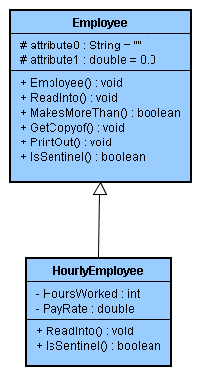

Slide 53
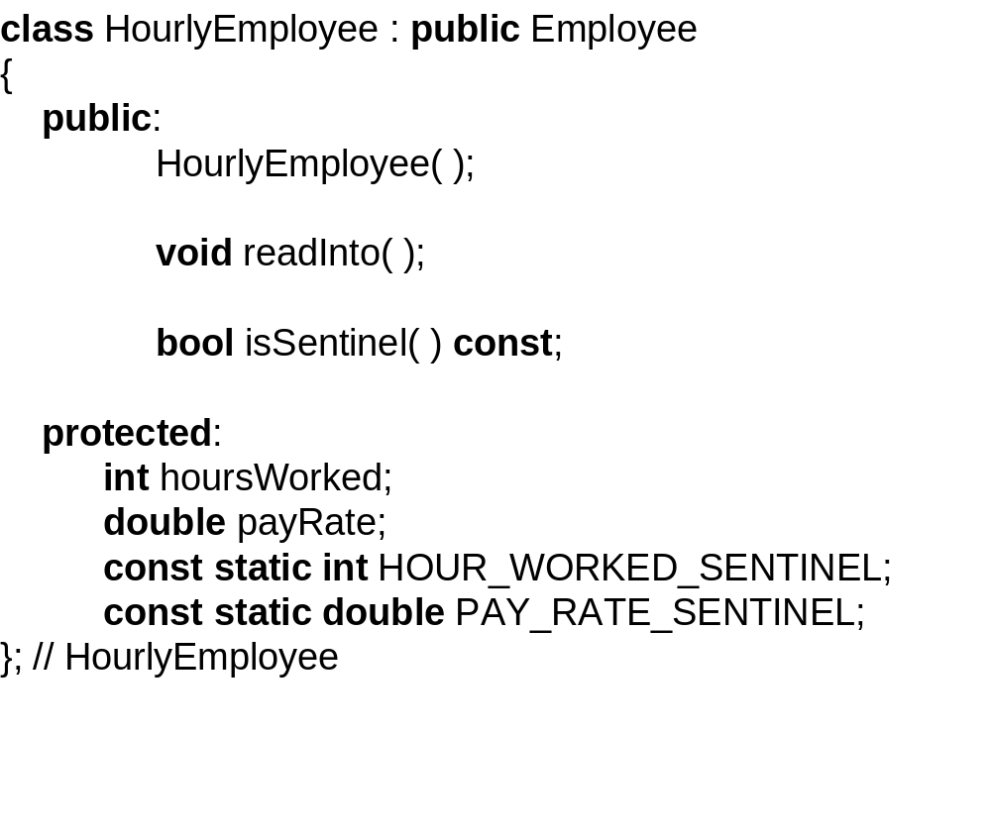

Slide 54
The method definitions are just
what you would expect. for
example, here is the definition
of isSentinel:

Slide 55
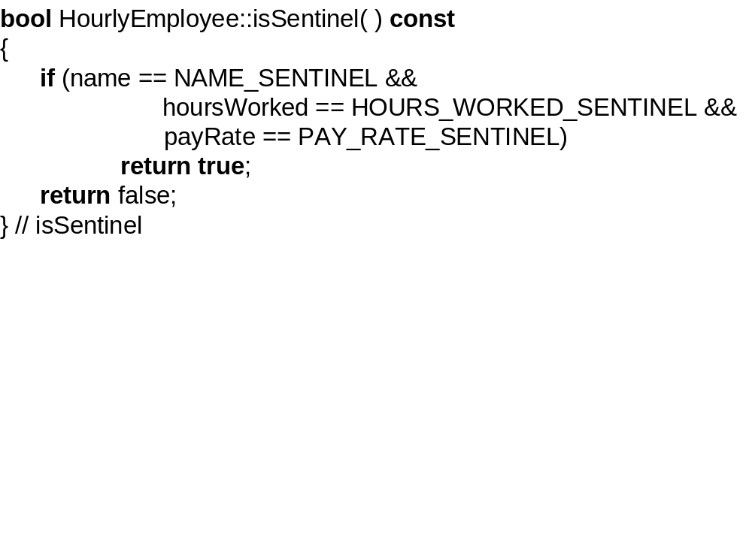

Slide 56
We created this HourlyEmployee
class for the application of
finding the best-paid hourly
employee in a company. can the
original company class use the
HourlyEmployee class for this
new application?

Slide 57
No, because the Company class
makes no mention of an
HourlyEmployee object. so we will
define Company2, a subclass of
Company.
Here is the declaration of the
Company2 class:

Slide 58
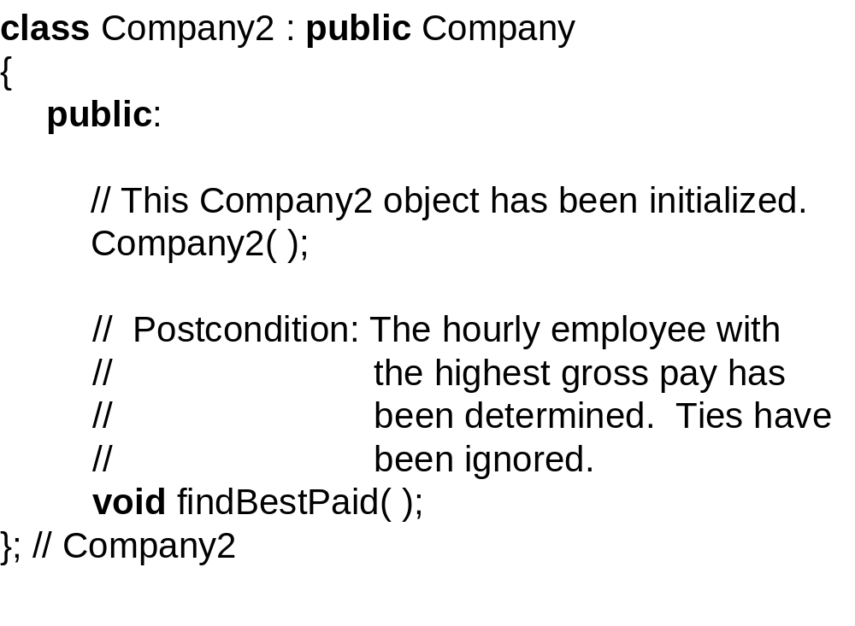

Slide 59
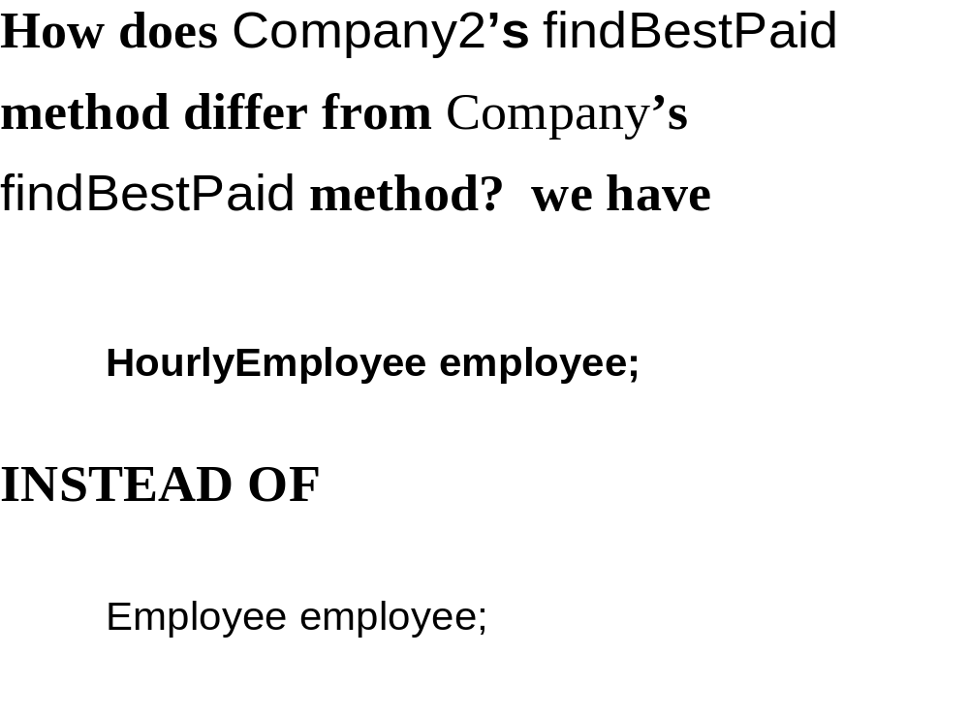

Slide 60
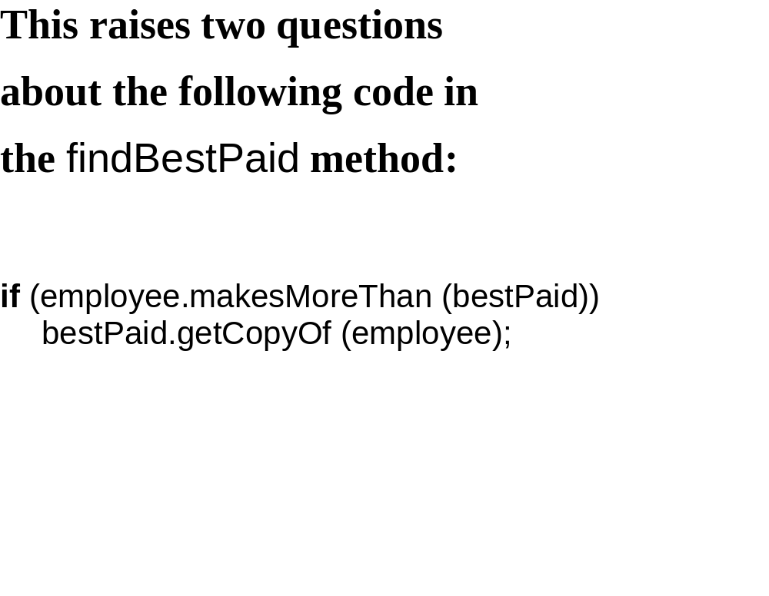

Slide 61
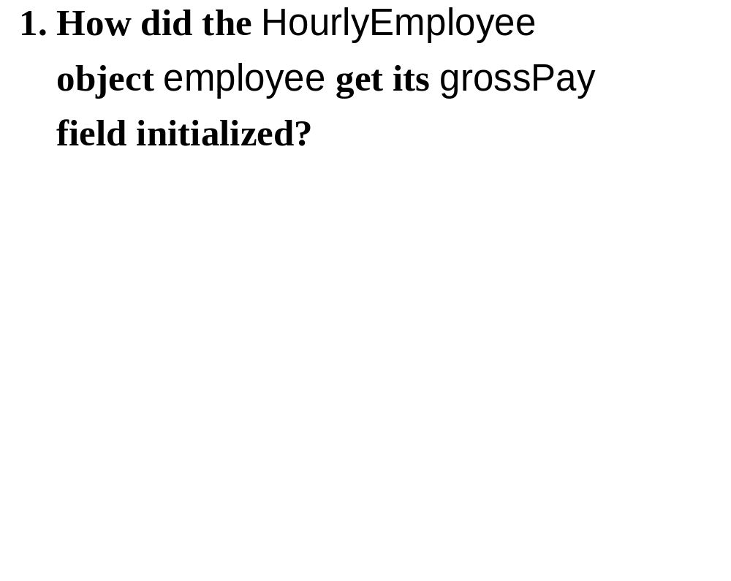

Slide 62
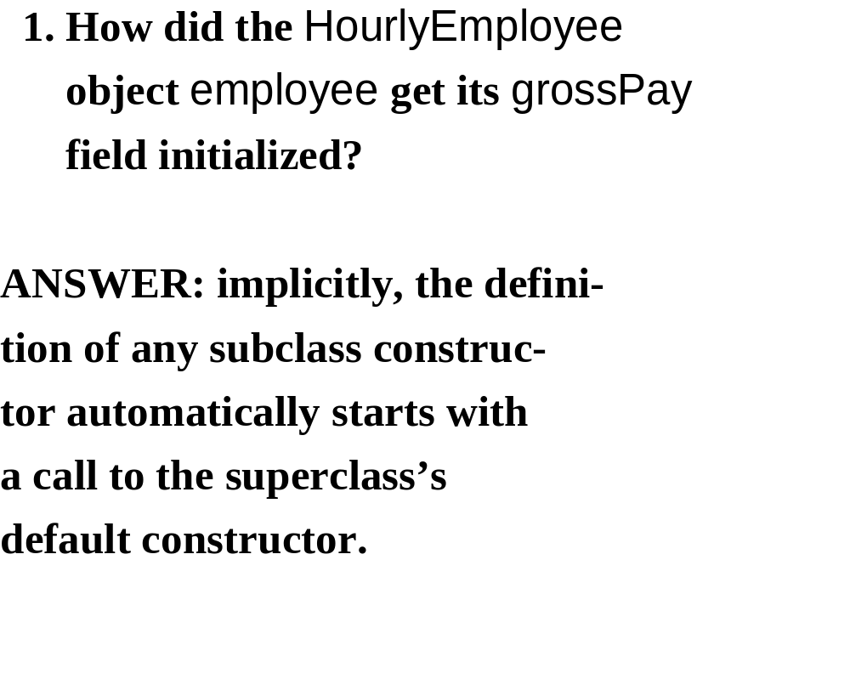

Slide 63
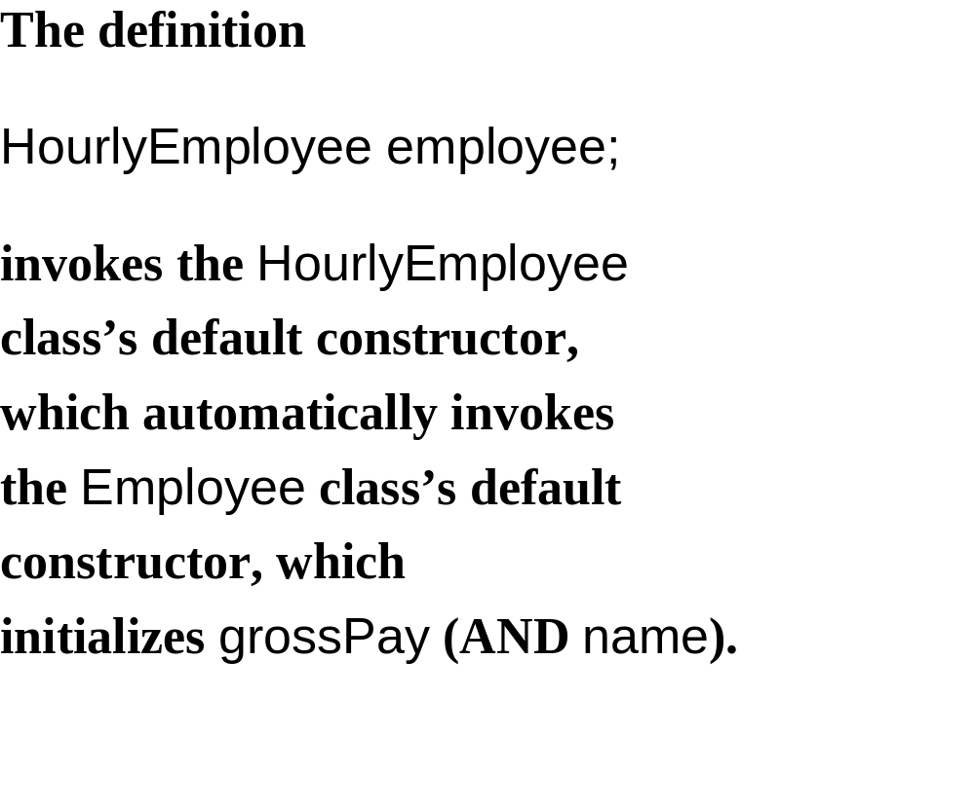

Slide 64
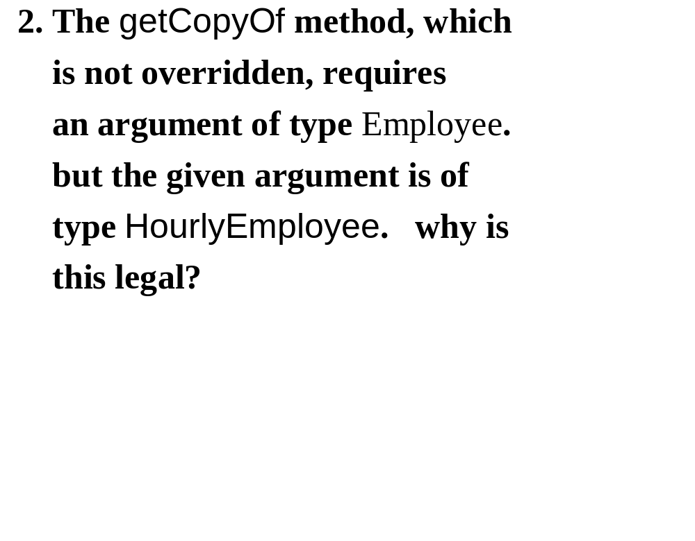

Slide 65
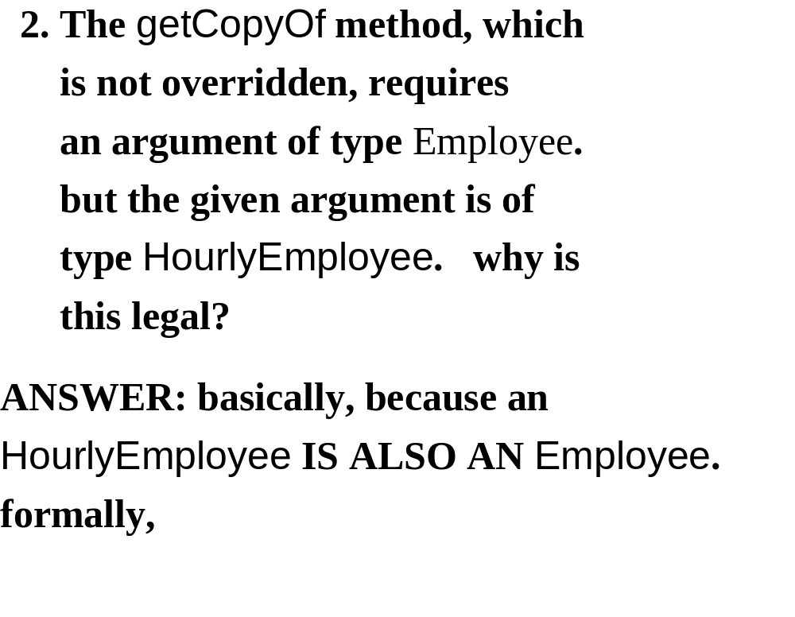

Slide 66
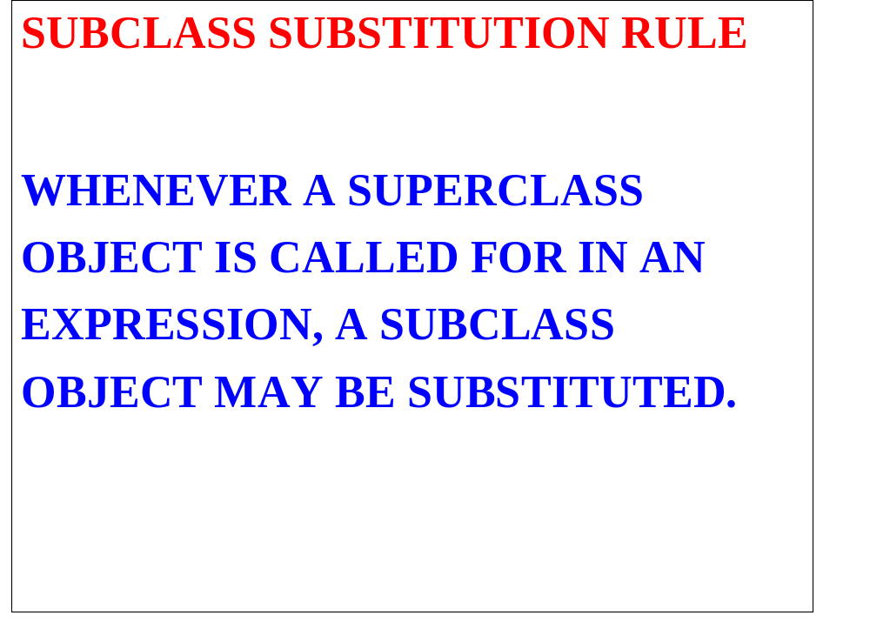

Slide 67
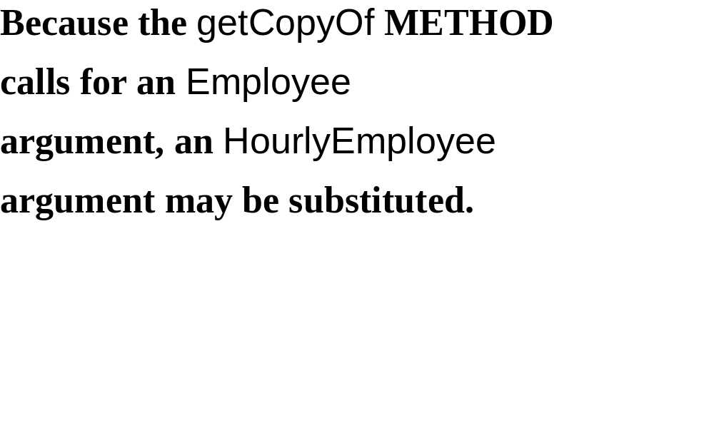

Slide 68


Slide 69
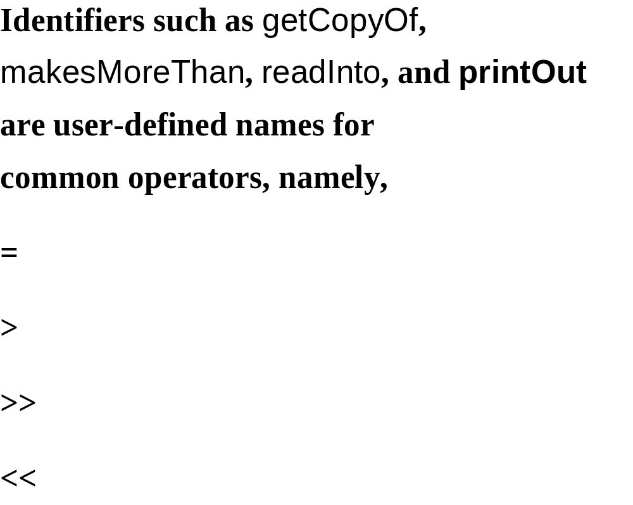

Slide 70
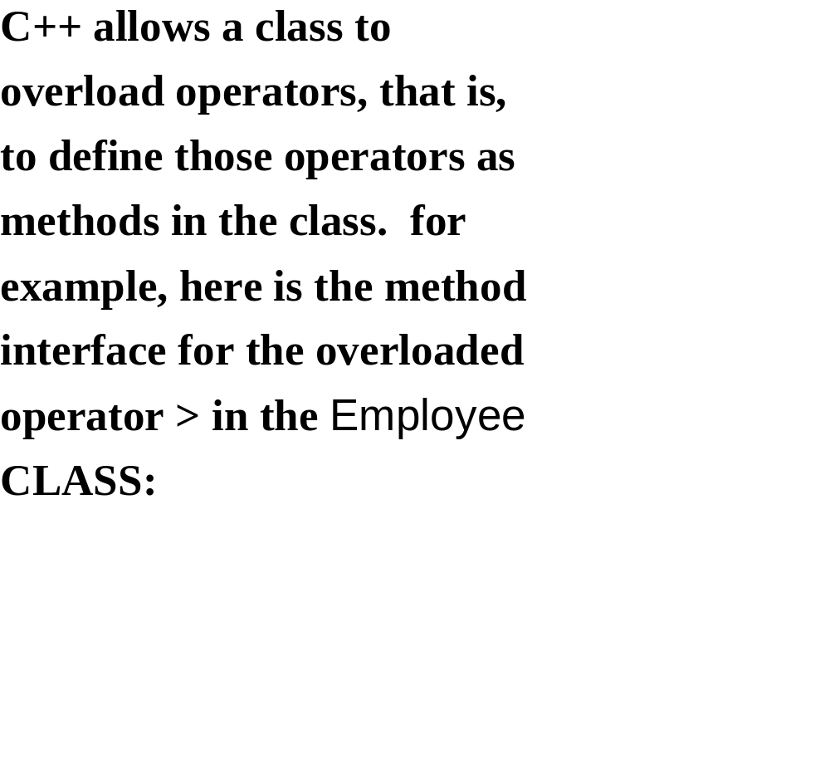

Slide 71
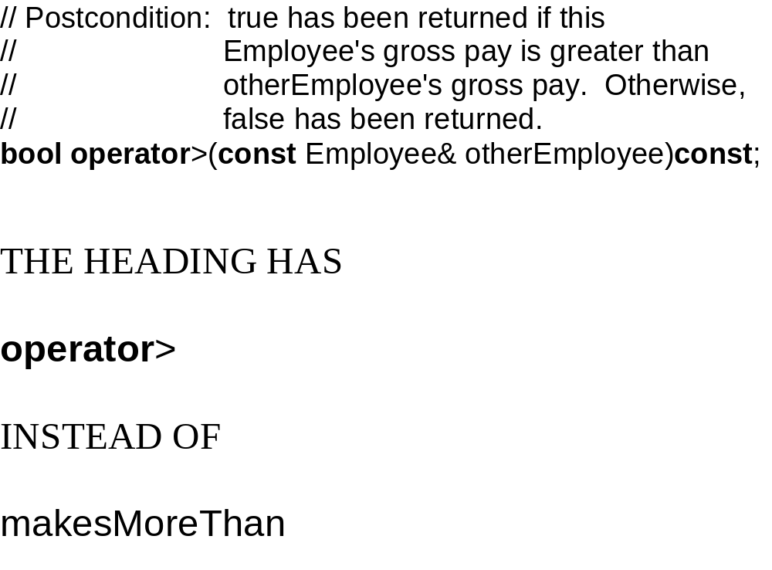

Slide 72
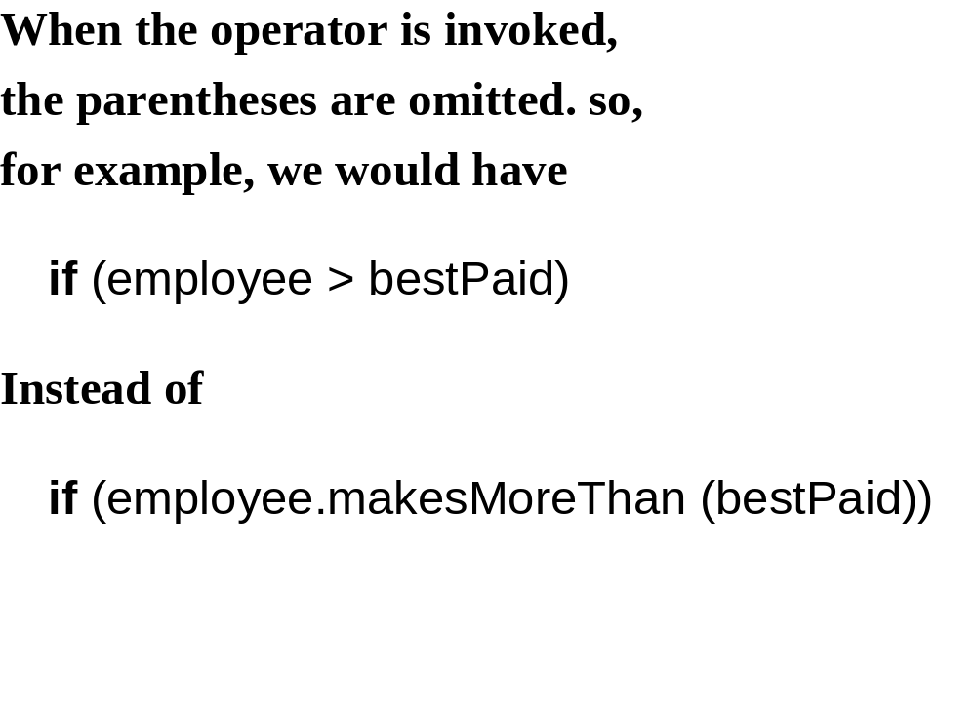

Slide 73
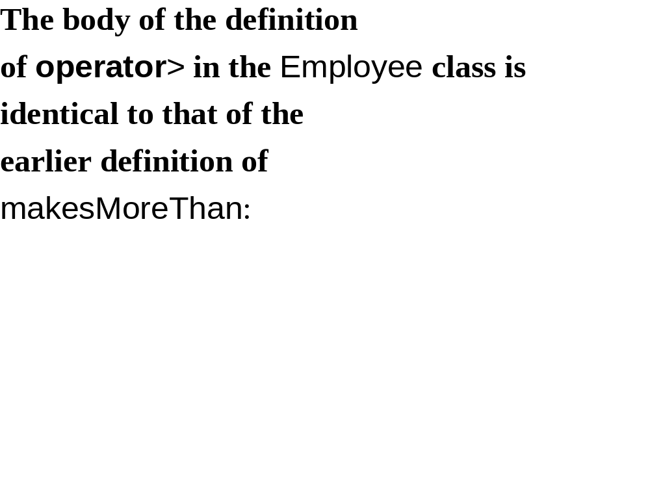
bool Employee:: (const Employee &otherEmployee) const
{
return grossPay > otherEmployee.grossPay;
}
makesMoreThan
operator >

Slide 74
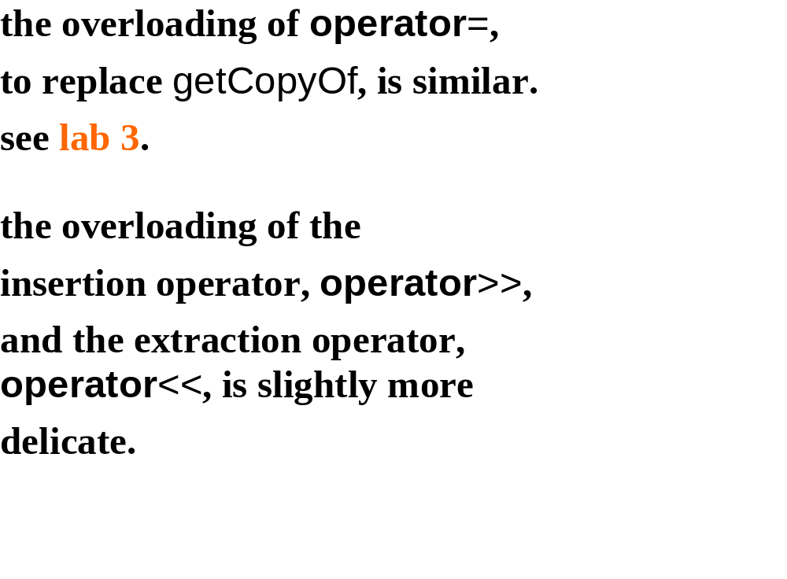

Slide 75
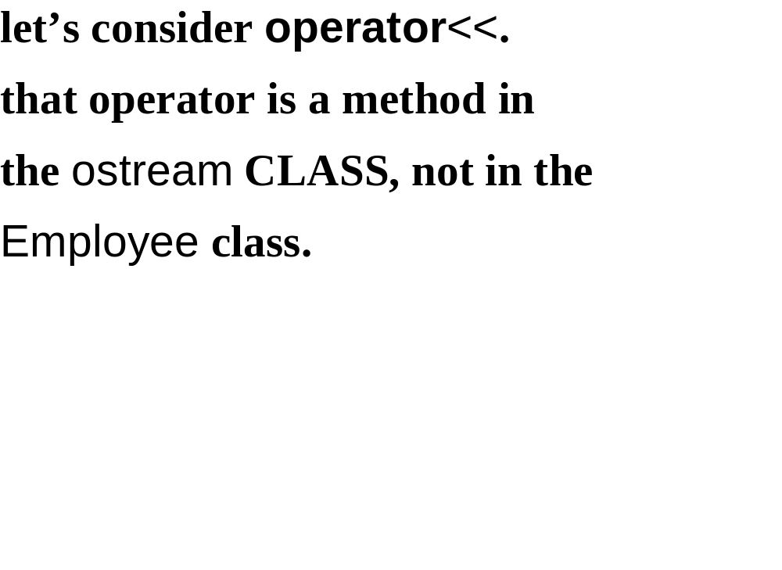

Slide 76
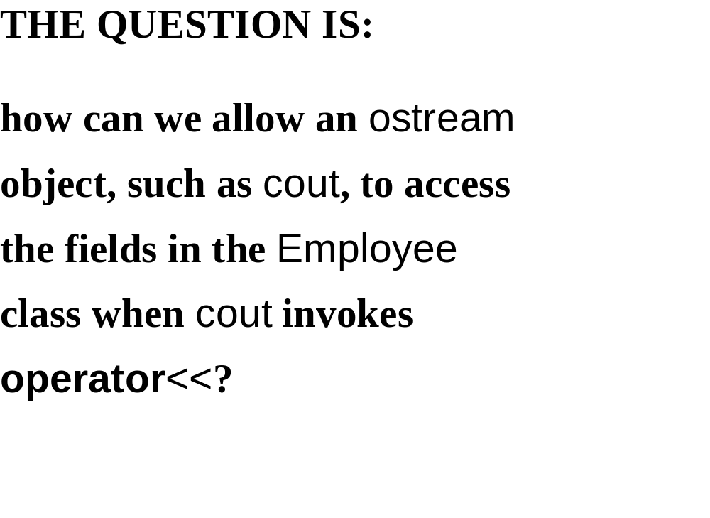

Slide 77
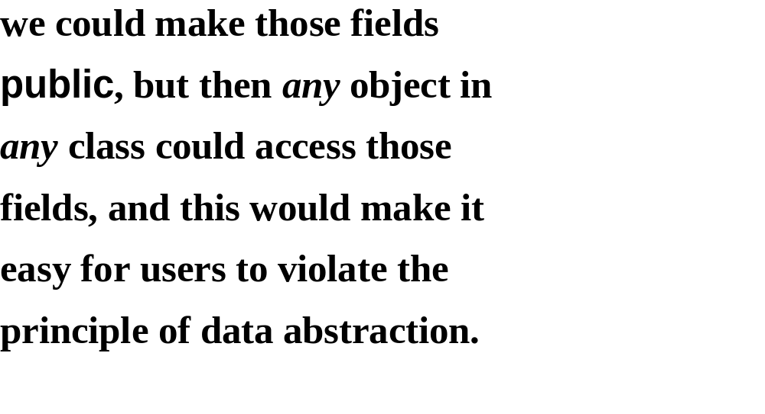

Slide 78
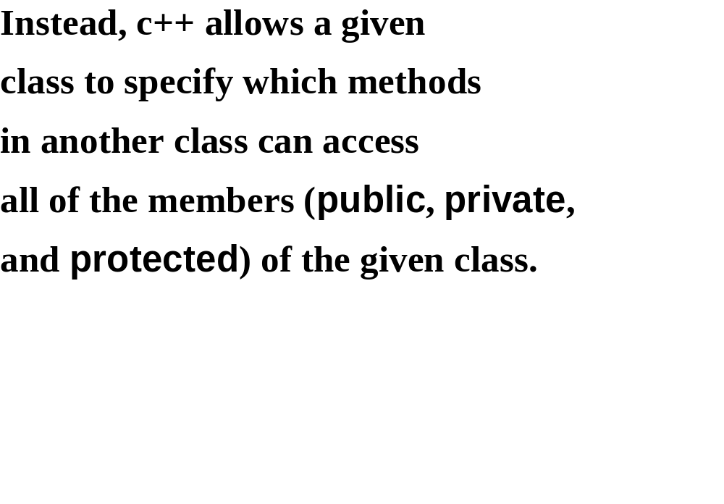

Slide 79
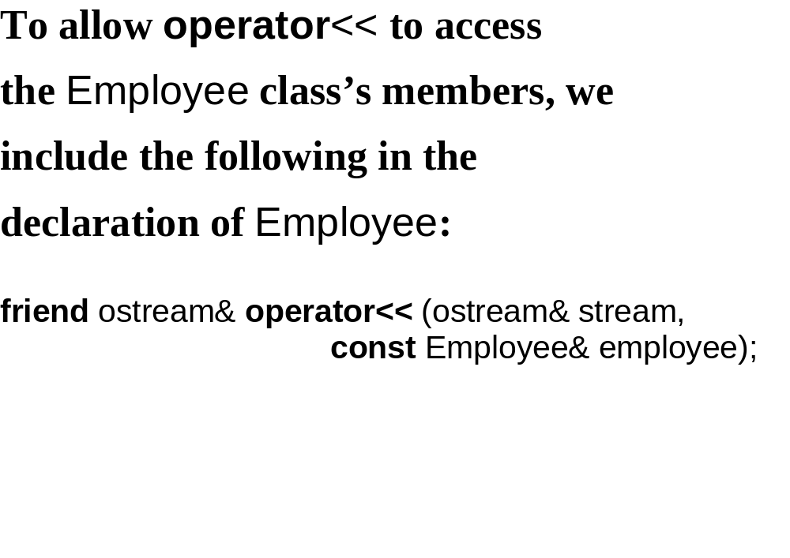

Slide 80
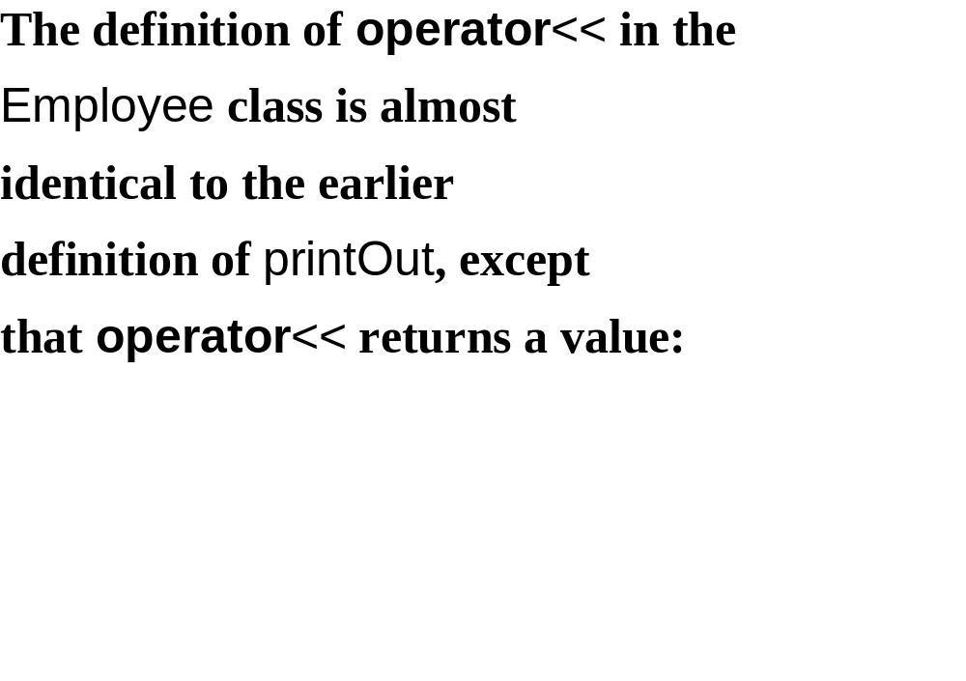

Slide 81
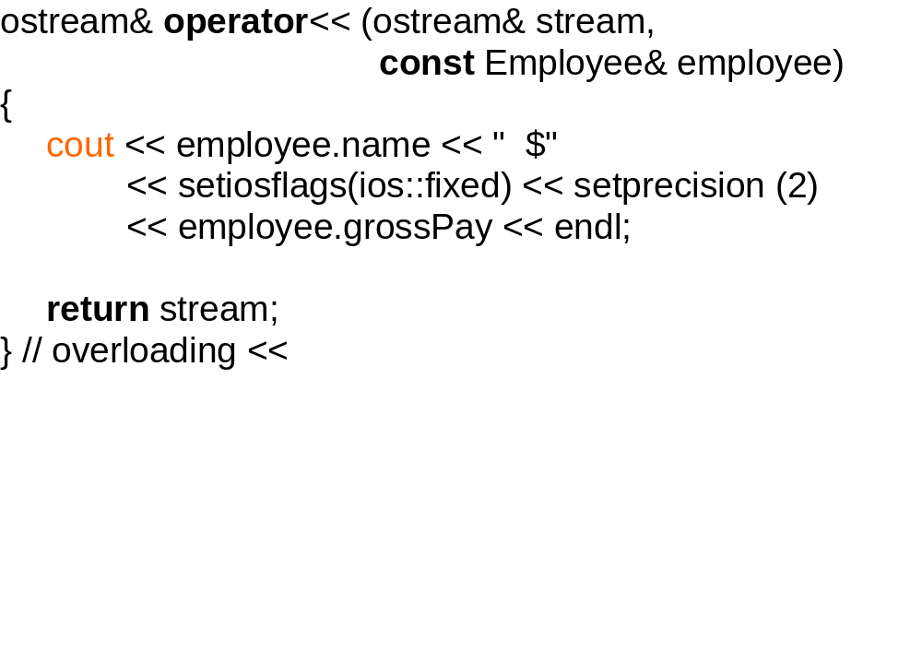

Slide 82
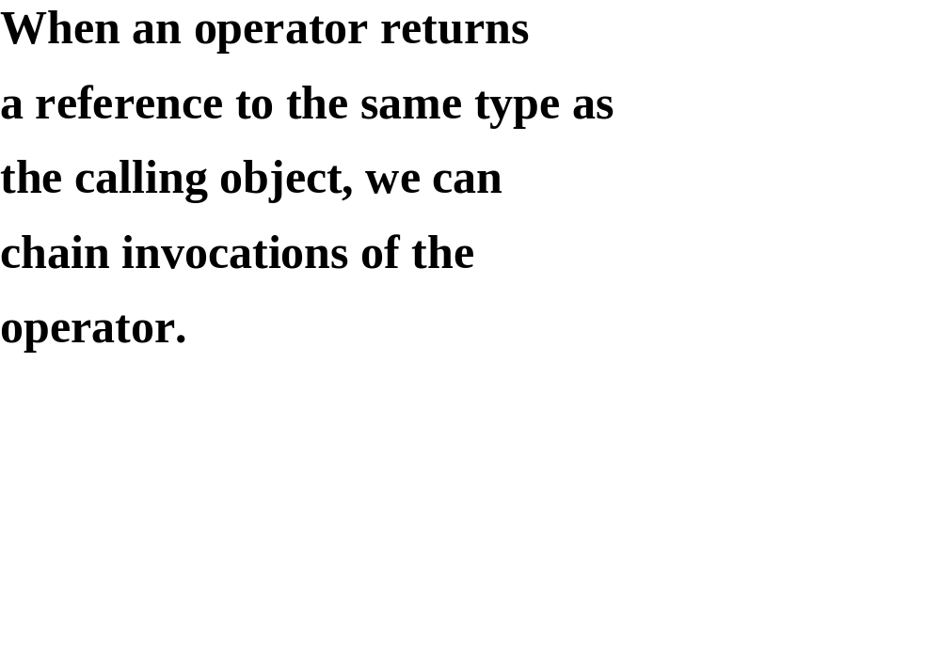

Slide 83
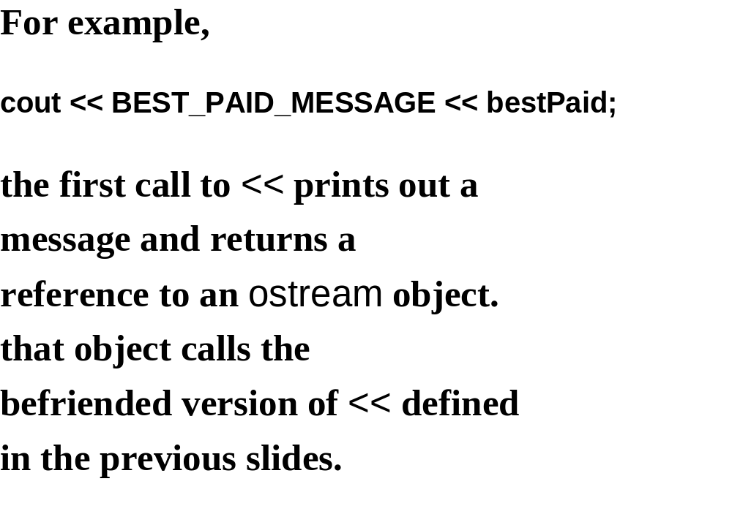

Slide 84
