Slide 1


Slide 2
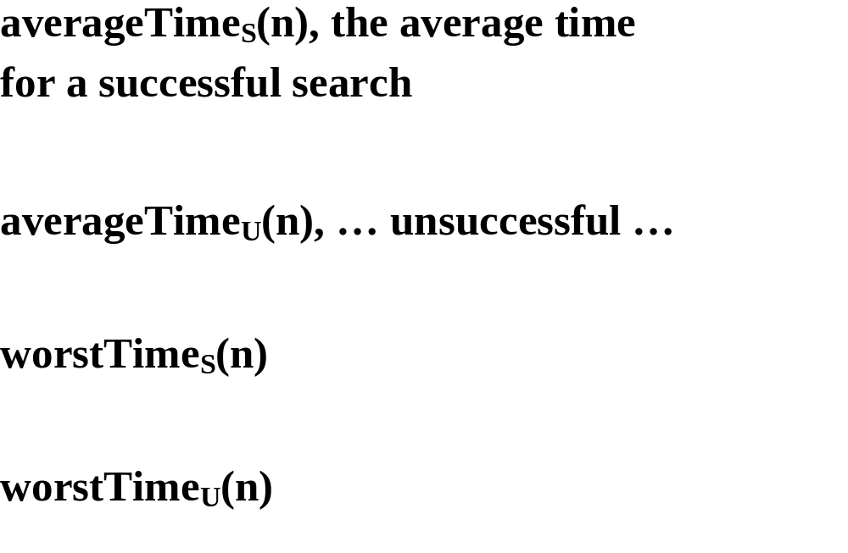

Slide 3


Slide 4
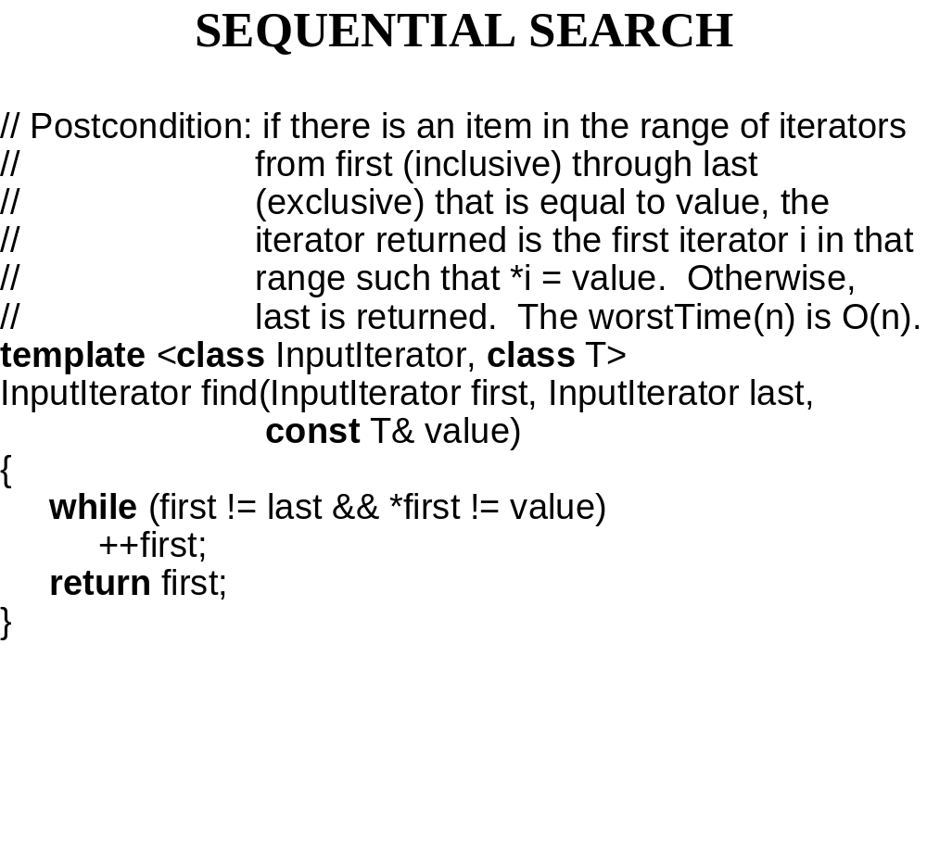

Slide 5
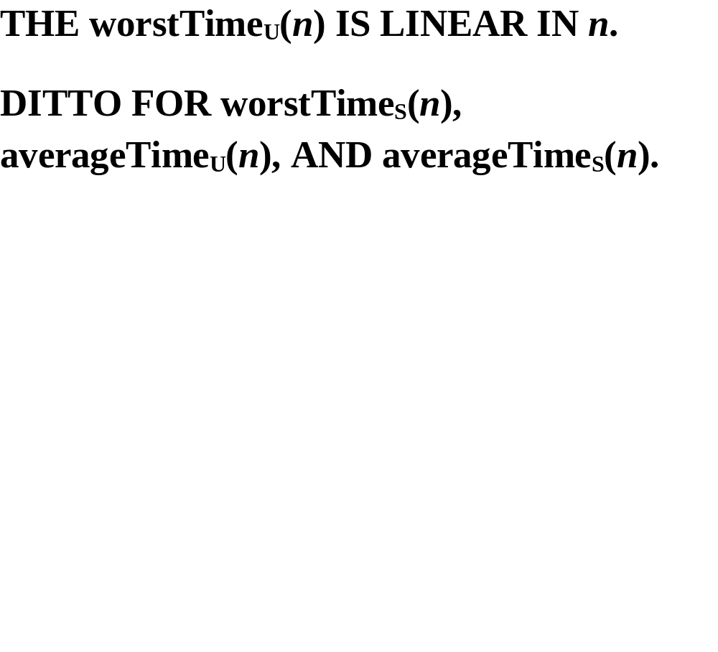

Slide 6
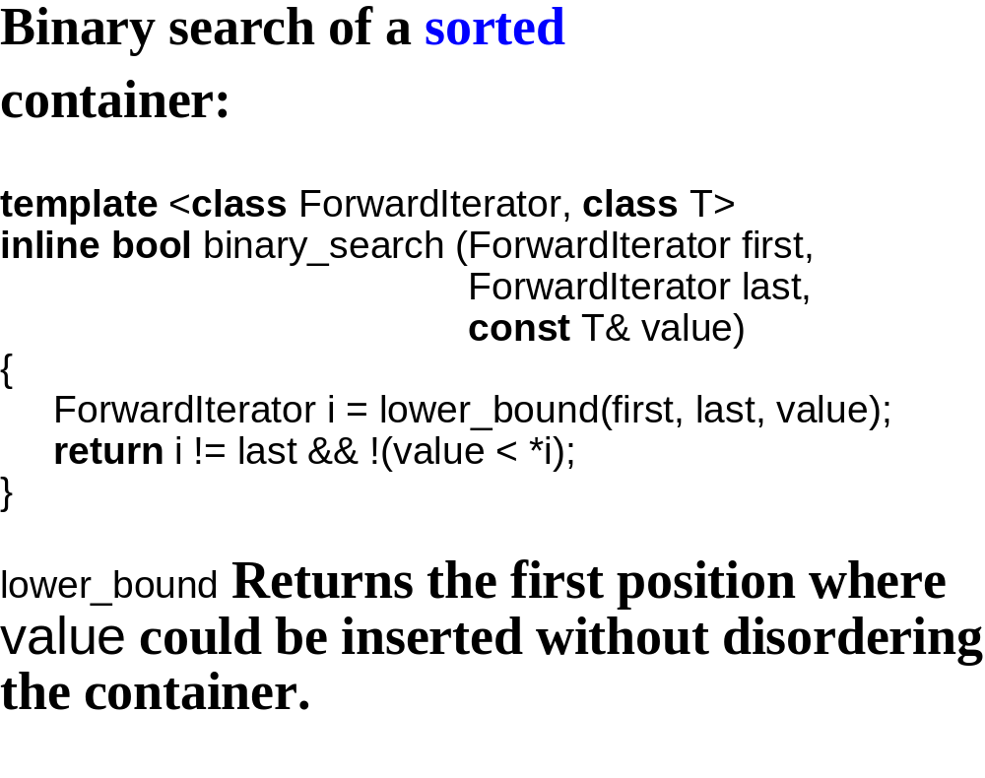

Slide 7
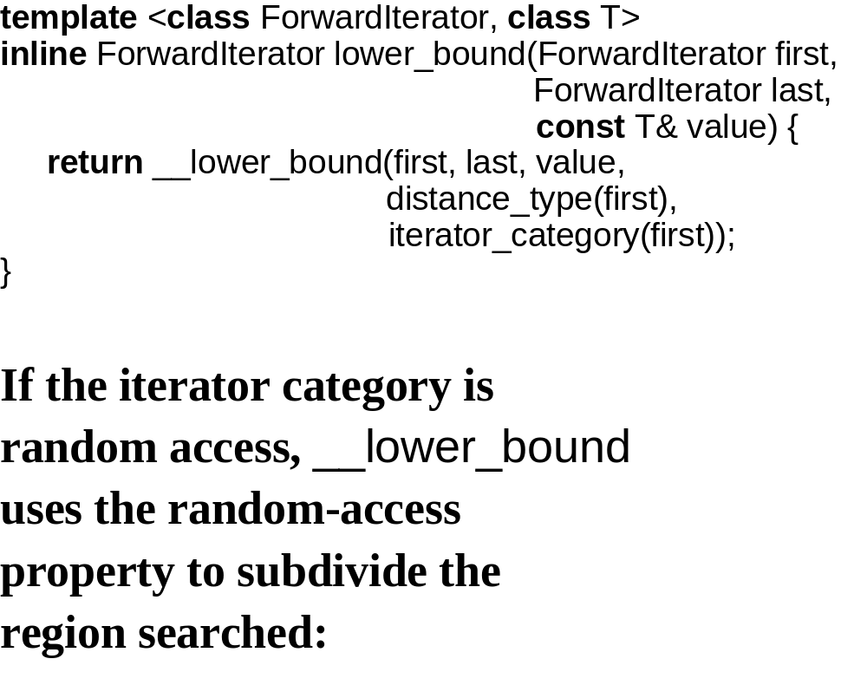

Slide 8
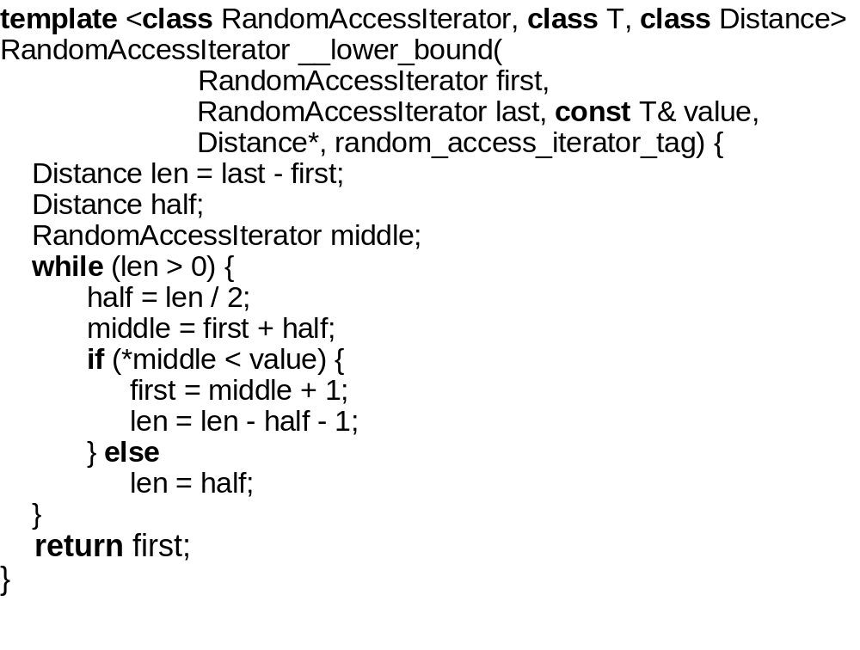

Slide 9
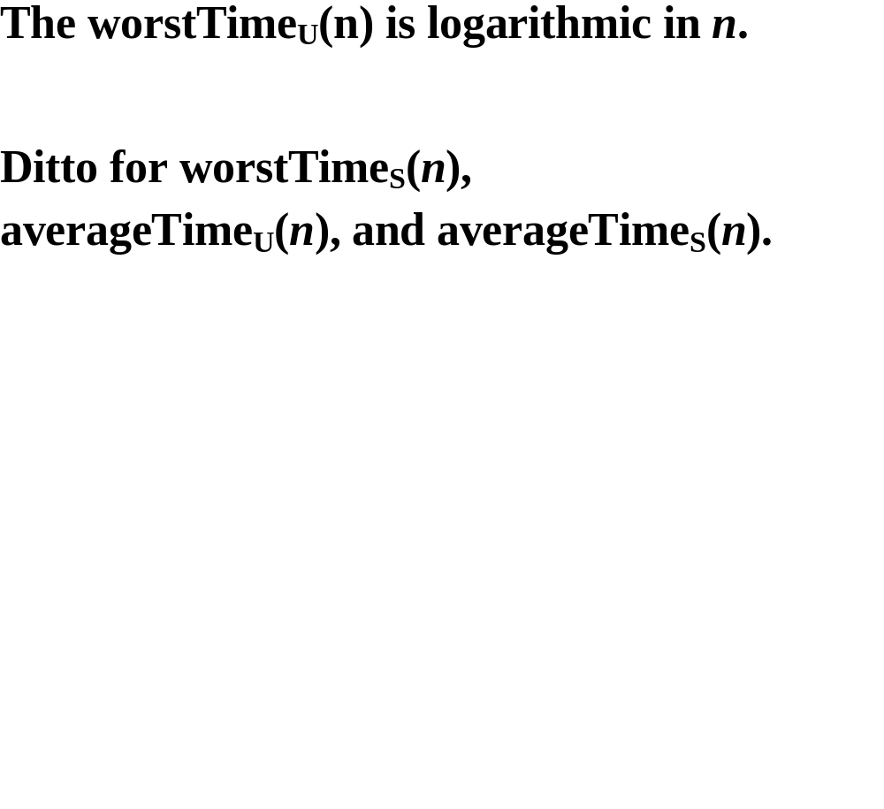

Slide 10
Red-black tree search
the following method is in
tree.h of the hewlett-packard
implementation:

Slide 11
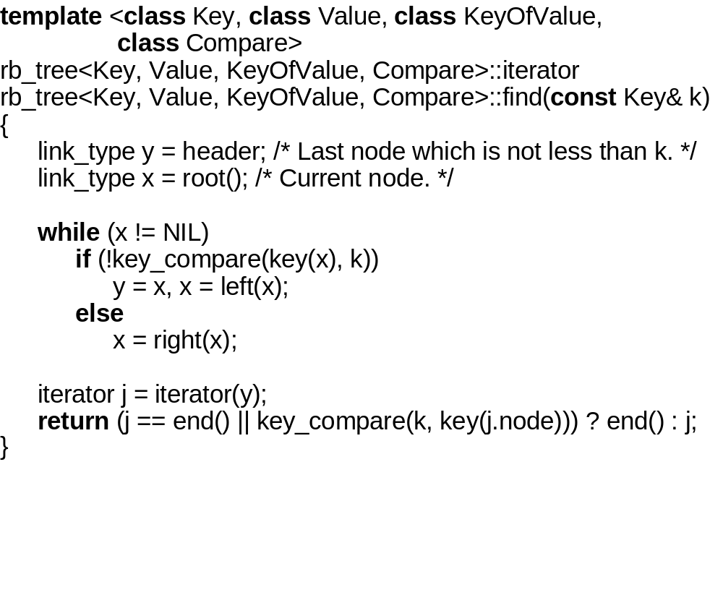

Slide 12
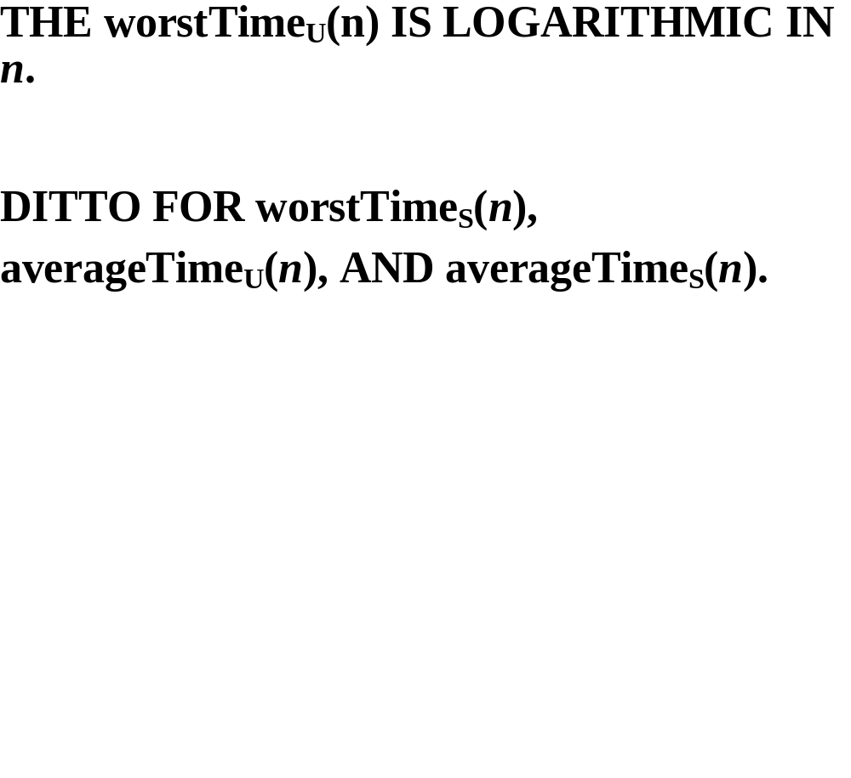

Slide 13
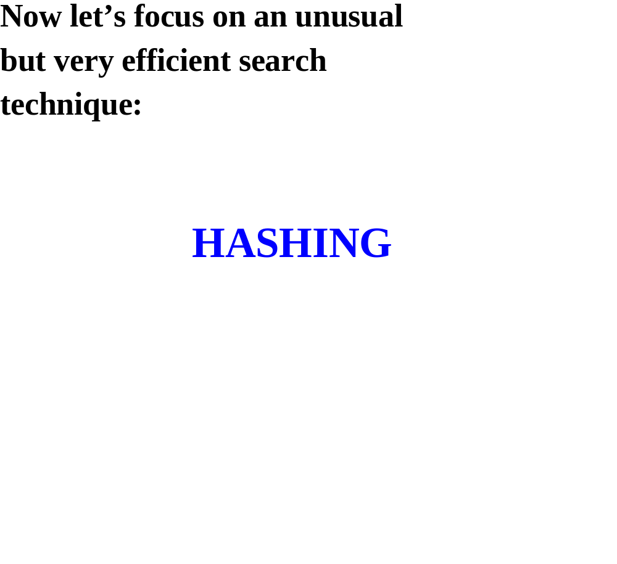

Slide 14
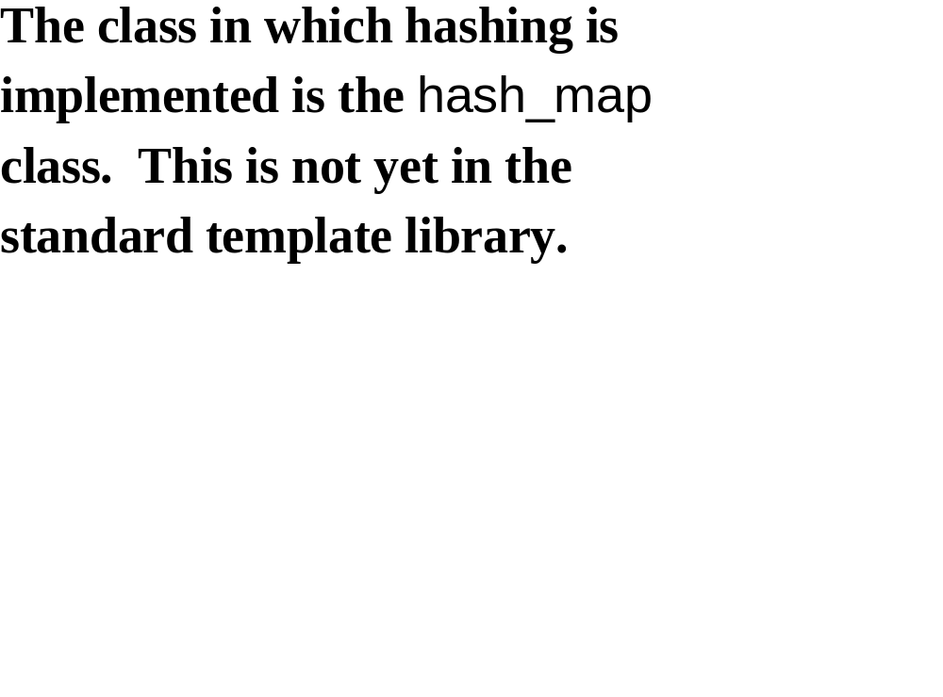

Slide 15
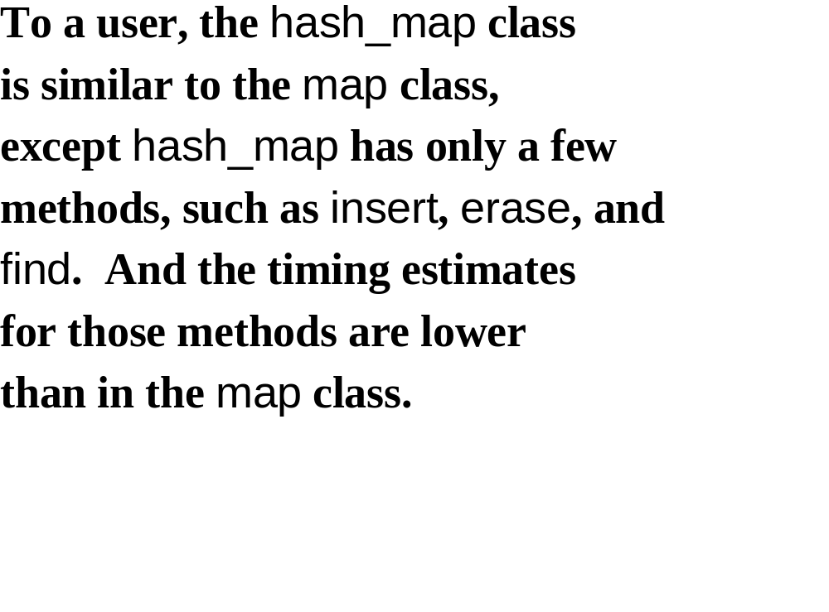

Slide 16
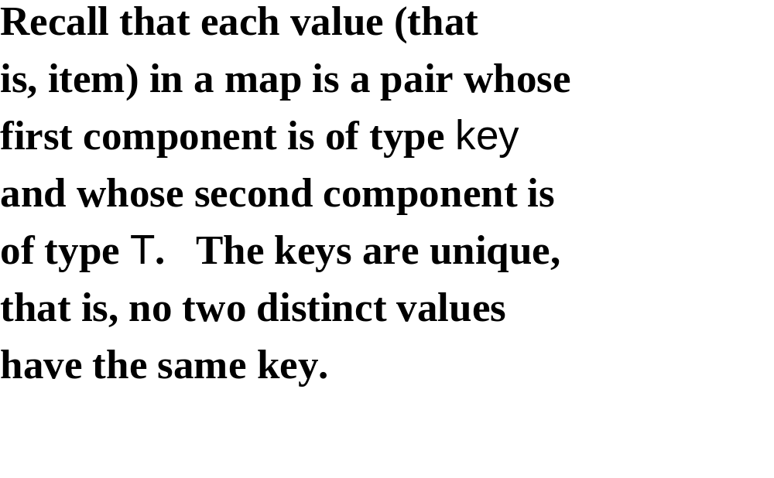

Slide 17
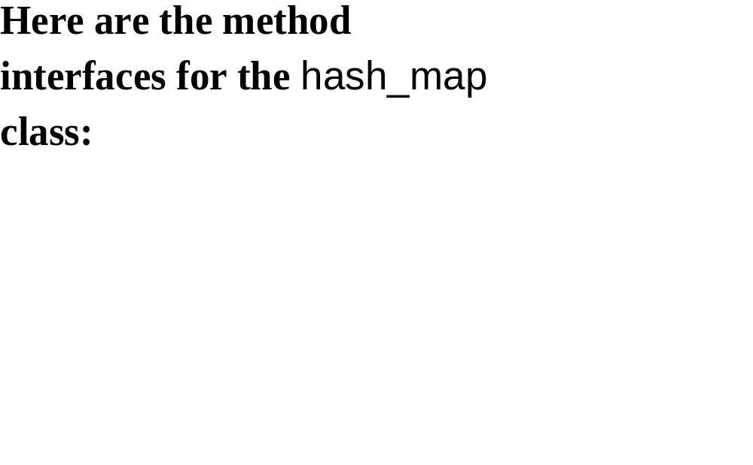

Slide 18
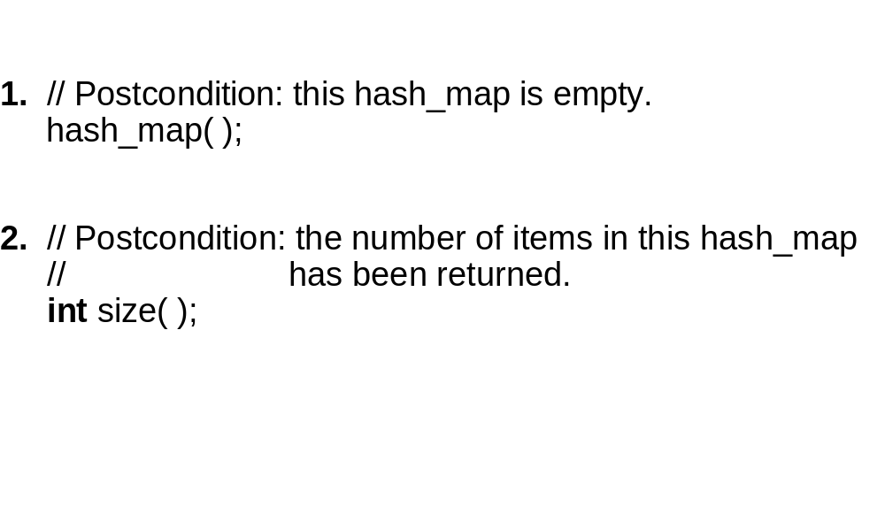

Slide 19
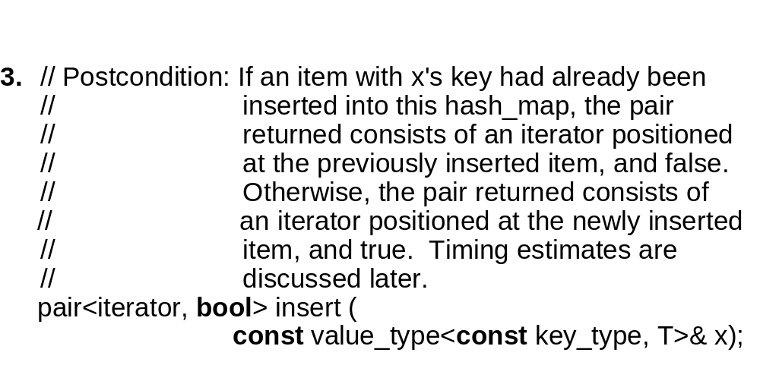

Slide 20
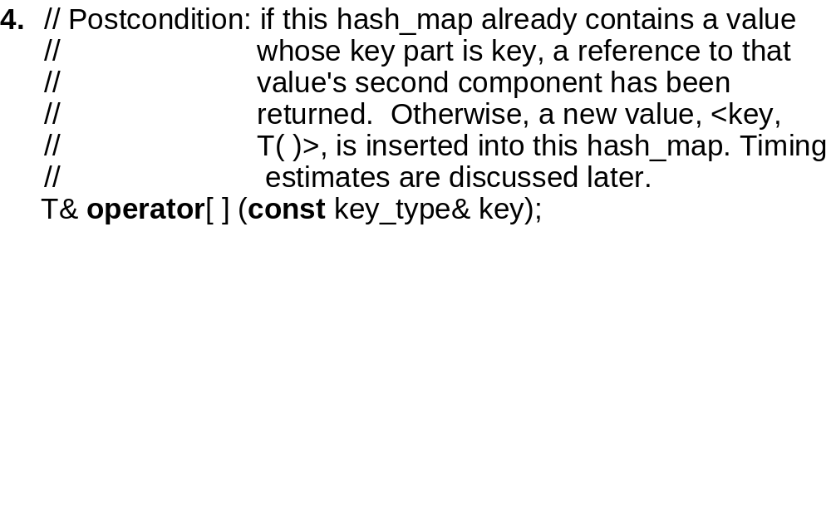

Slide 21
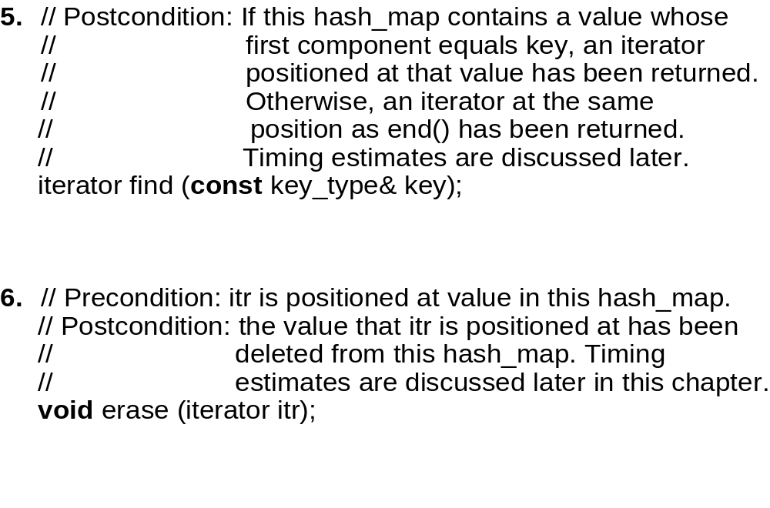

Slide 22
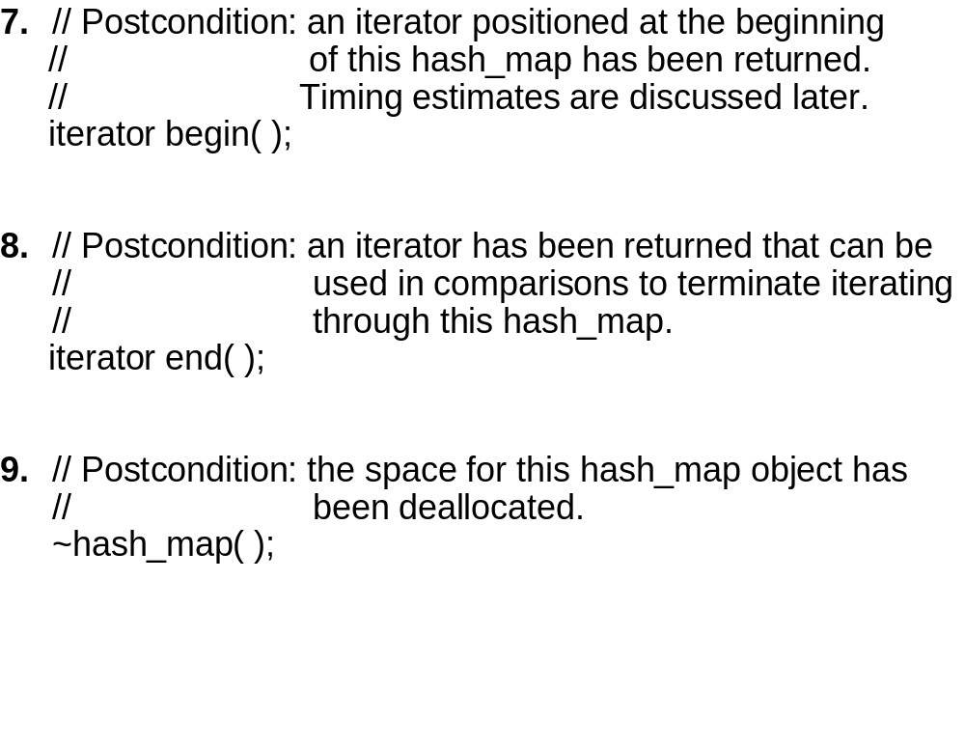

Slide 23
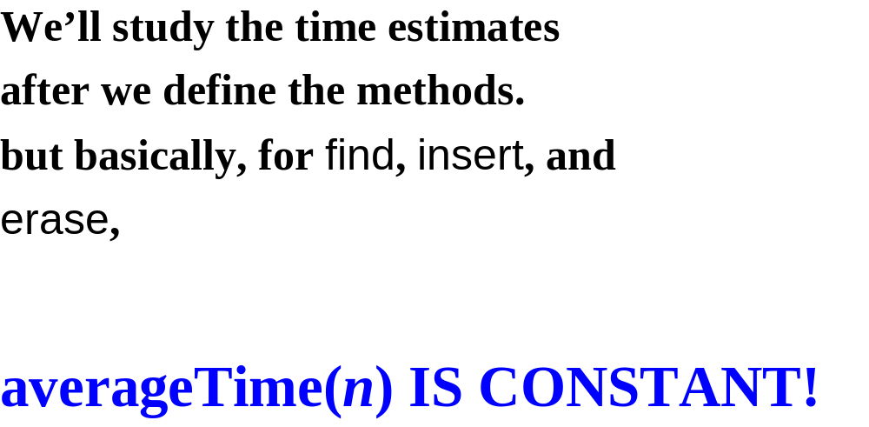

Slide 24
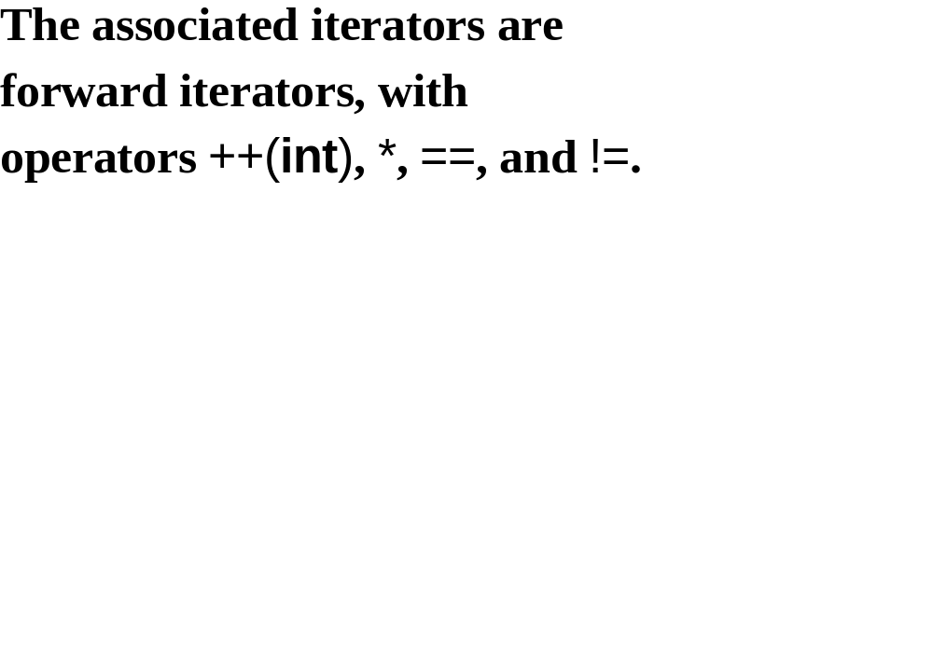

Slide 25


Slide 26
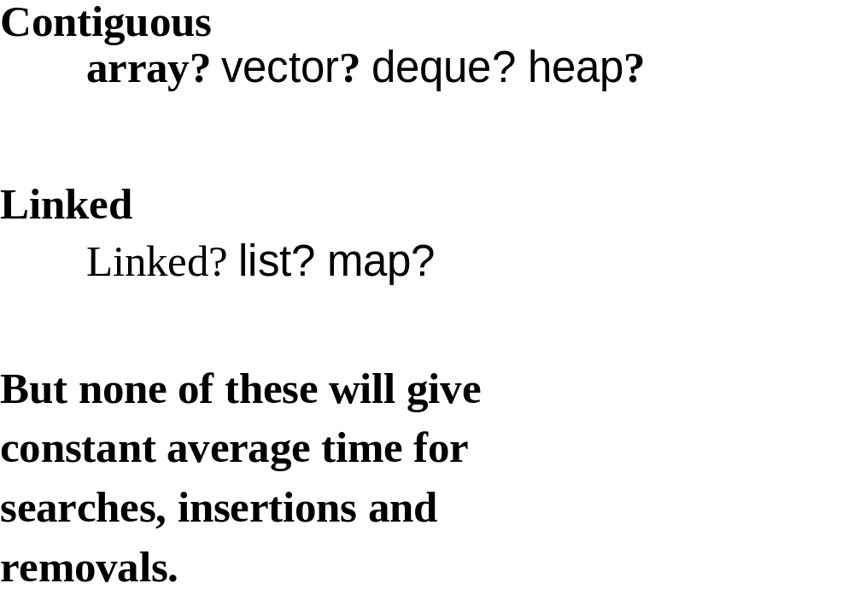

Slide 27
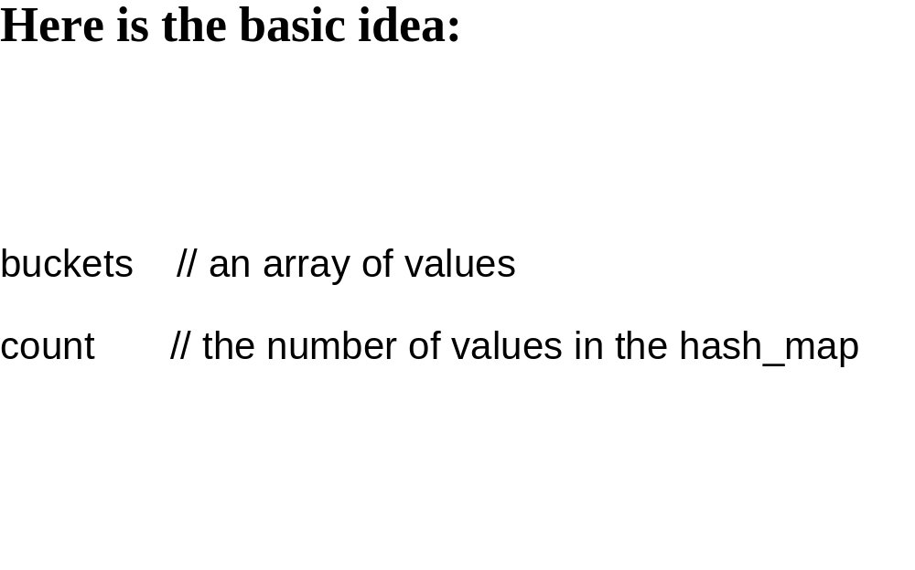

Slide 28
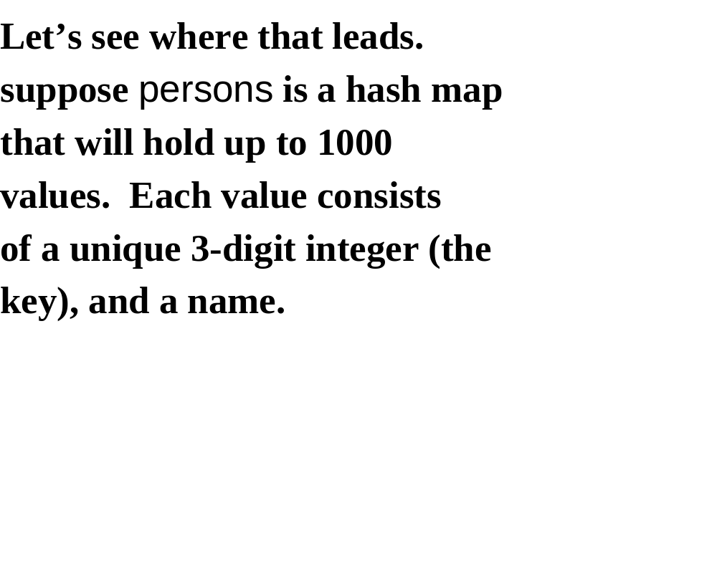

Slide 29
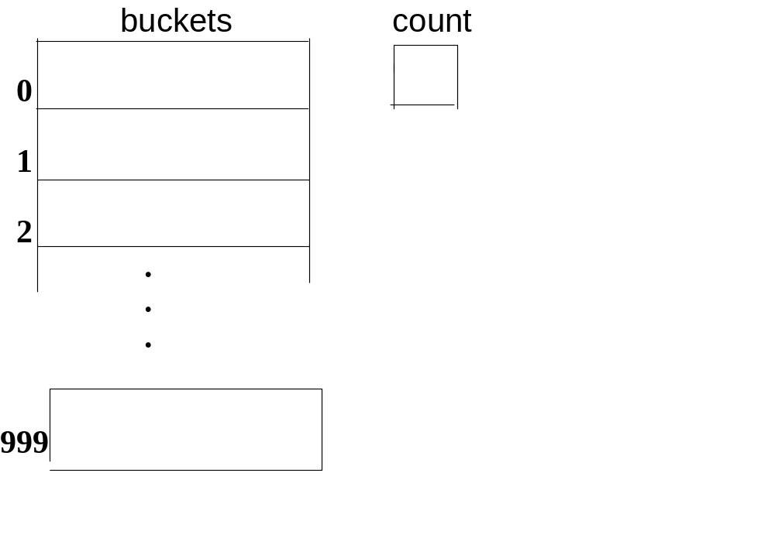

Slide 30
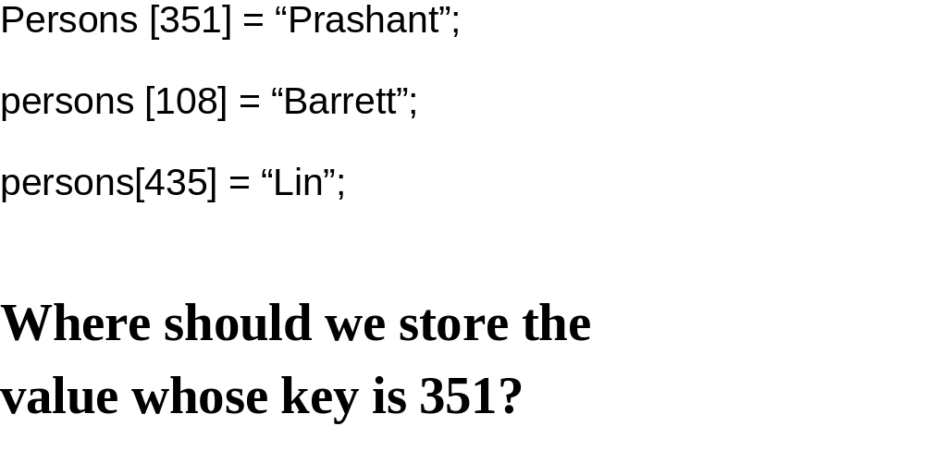

Slide 31
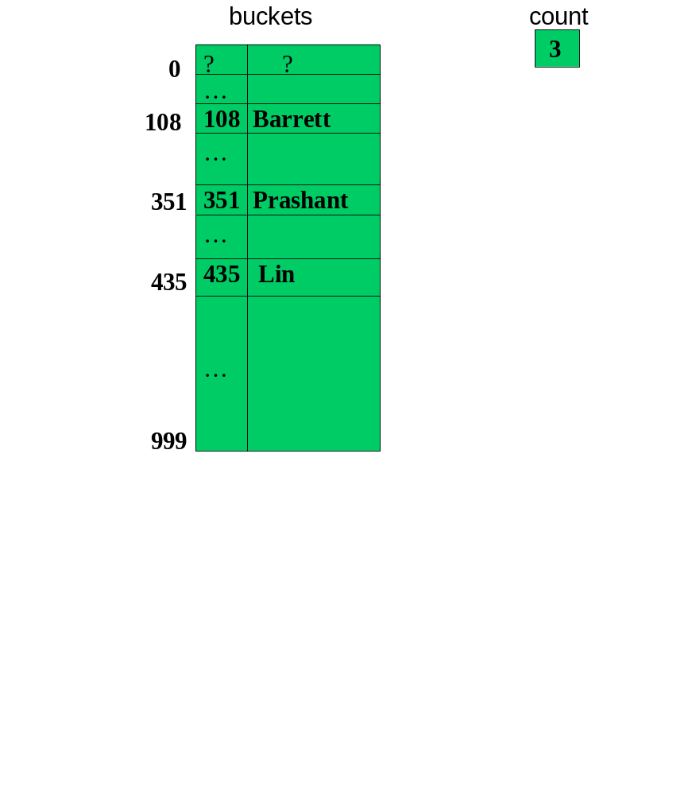

Slide 32
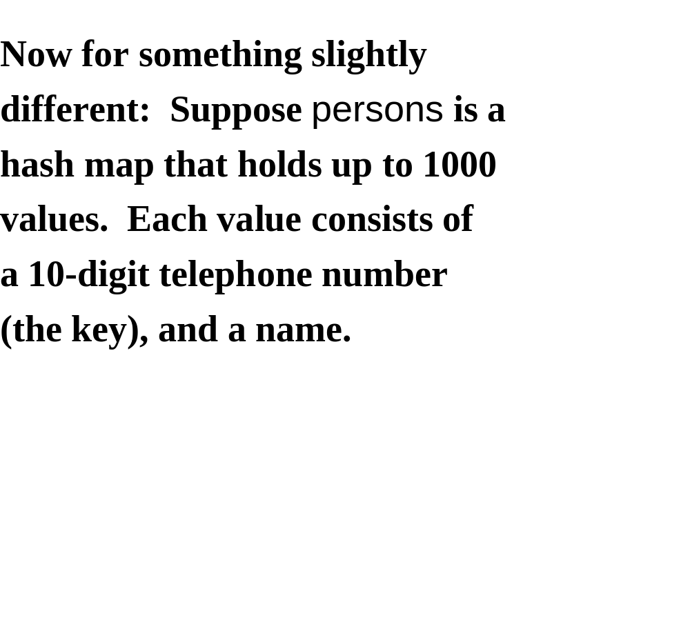

Slide 33
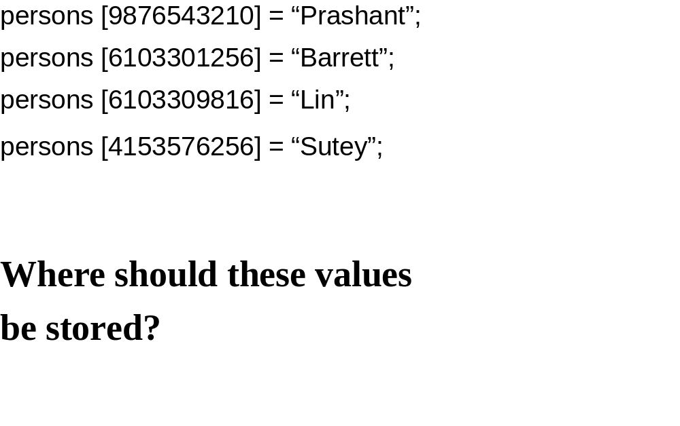

Slide 34
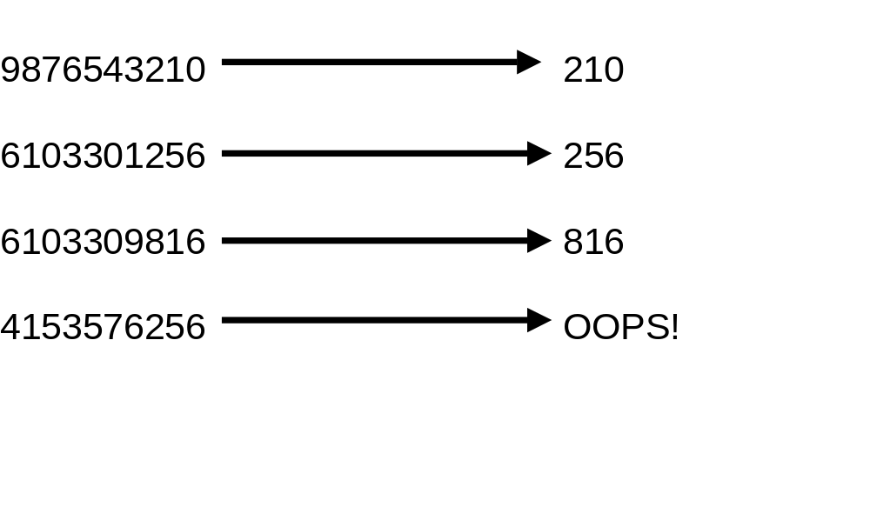

Slide 35
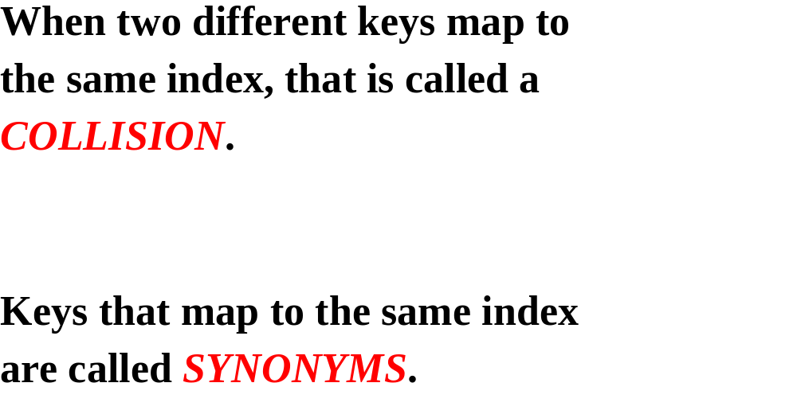

Slide 36
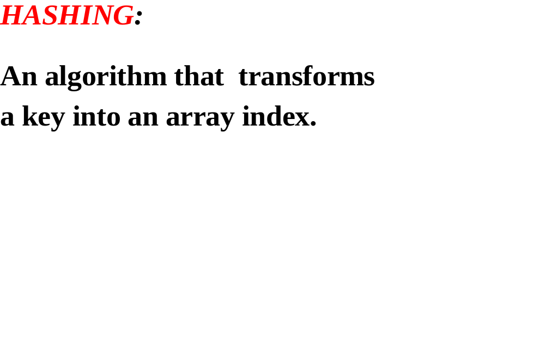

Slide 37
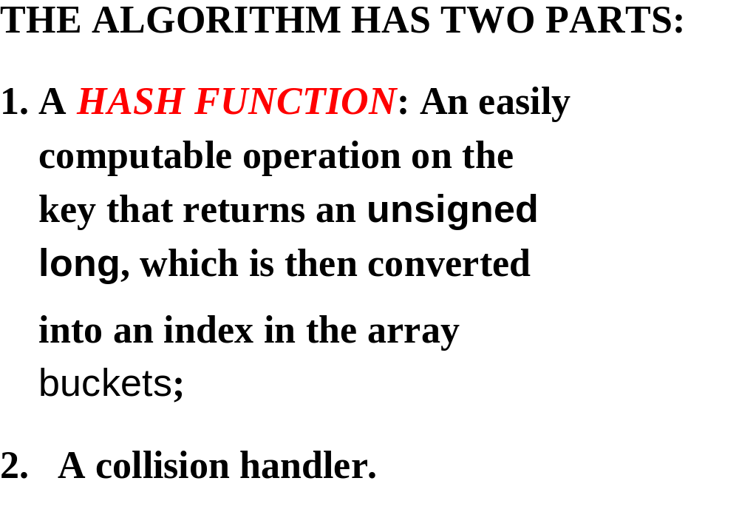

Slide 38
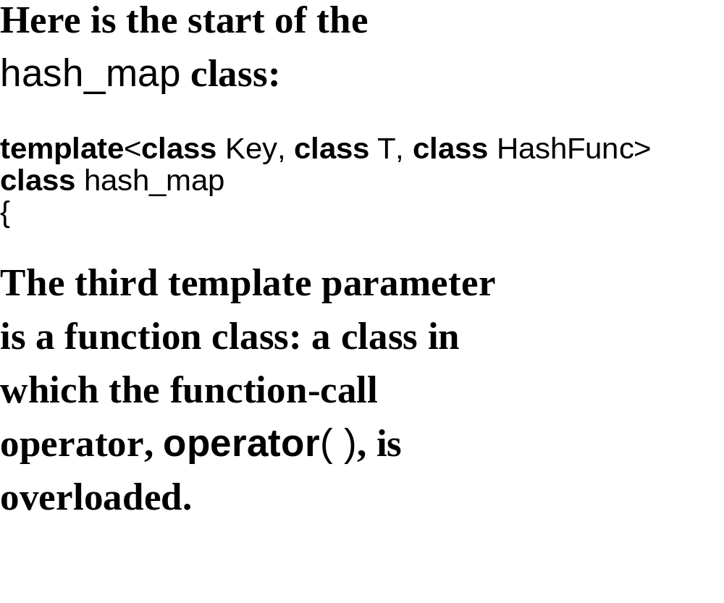

Slide 39
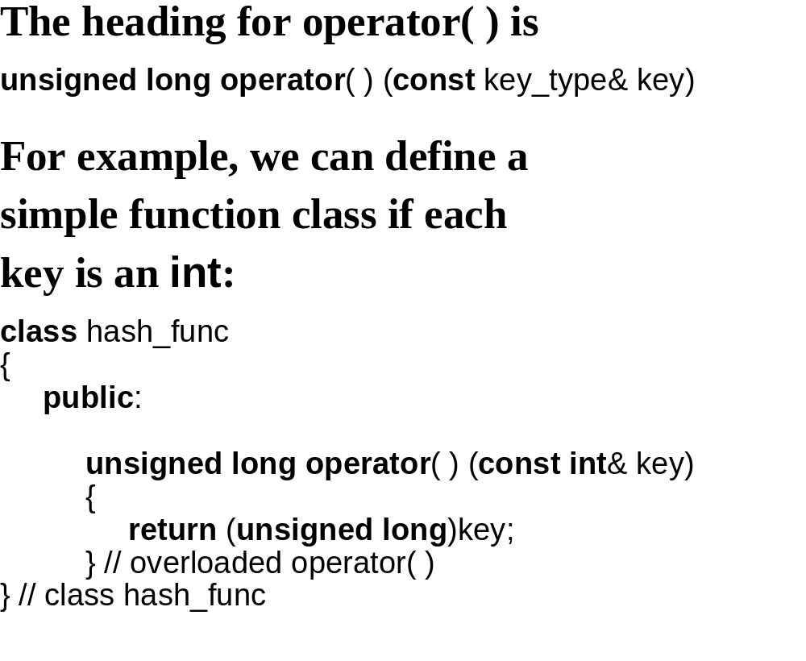

Slide 40
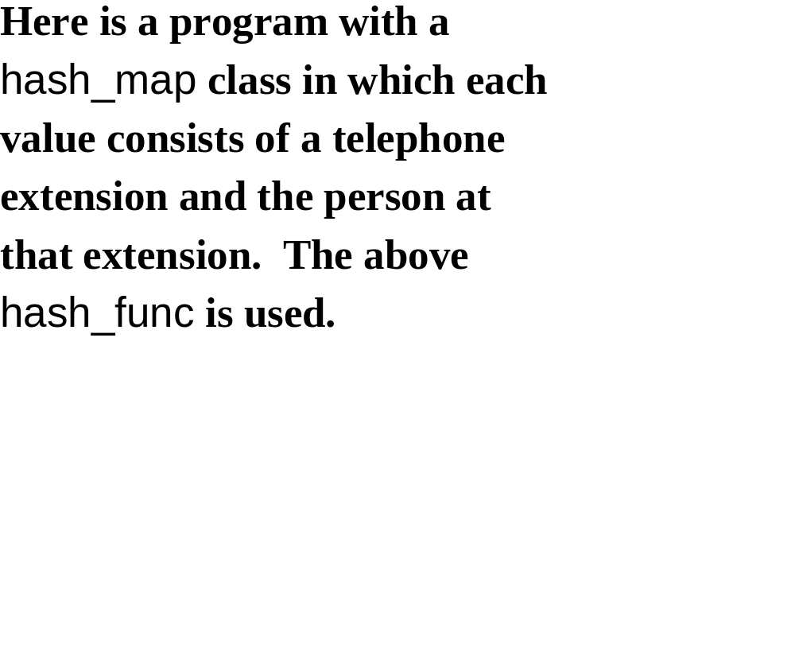

Slide 41
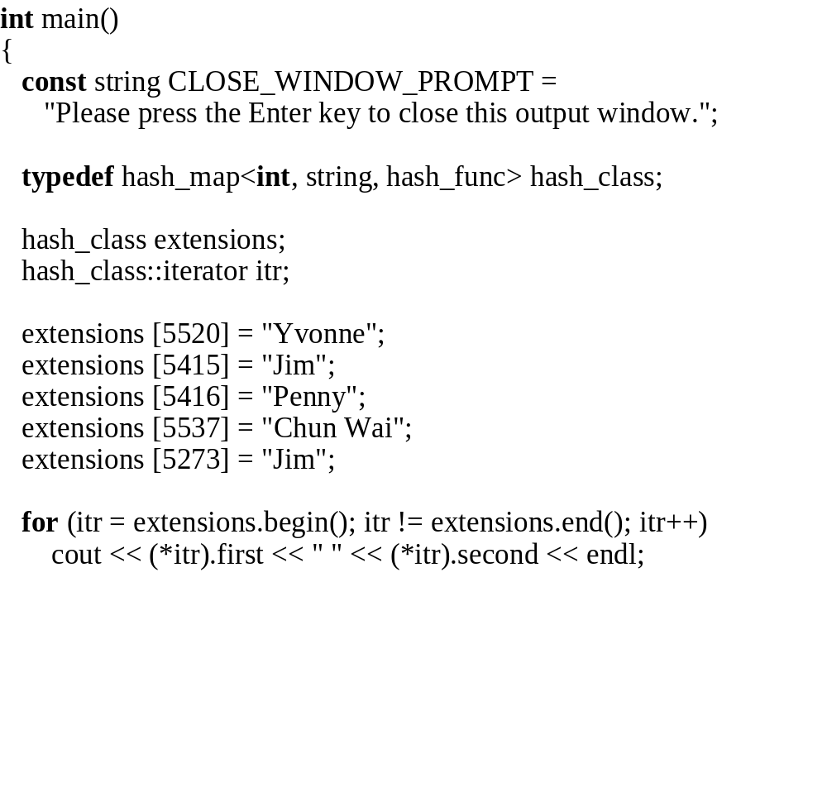

Slide 42
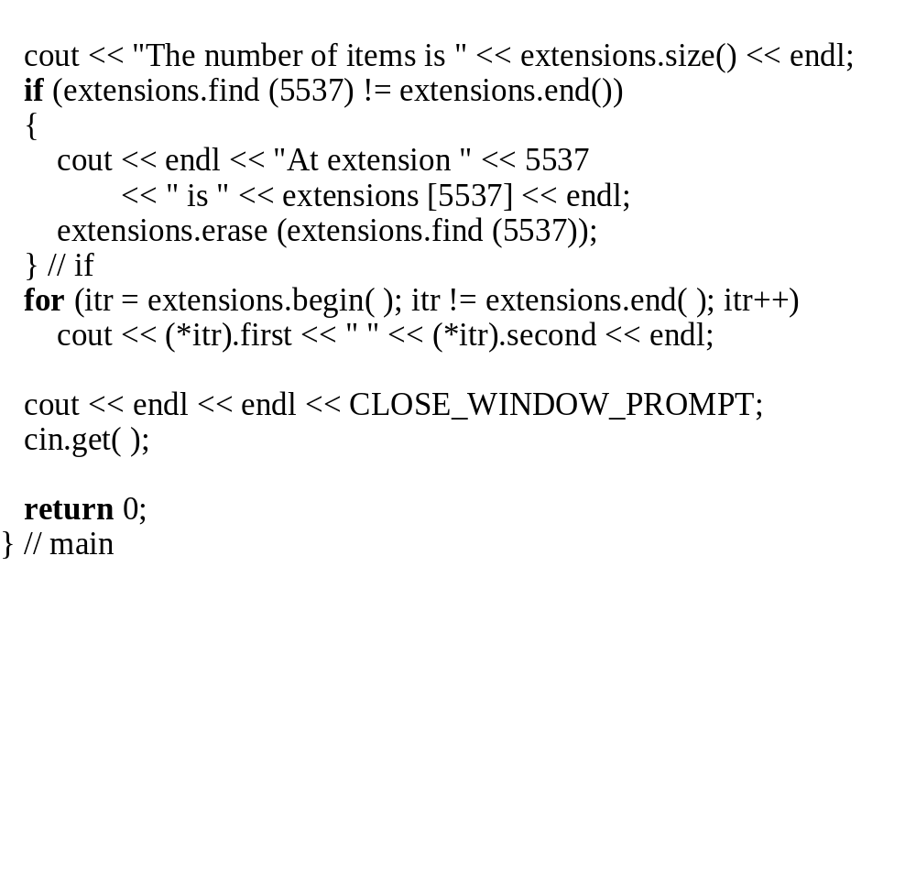

Slide 43
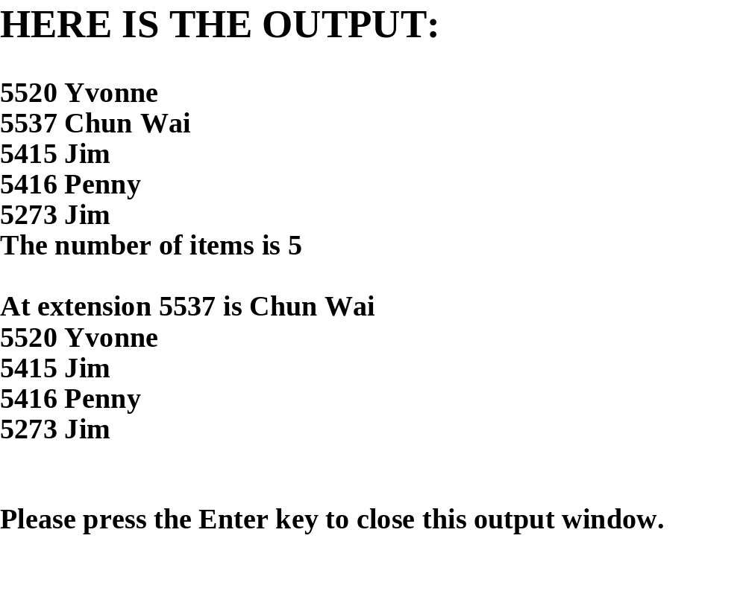

Slide 44
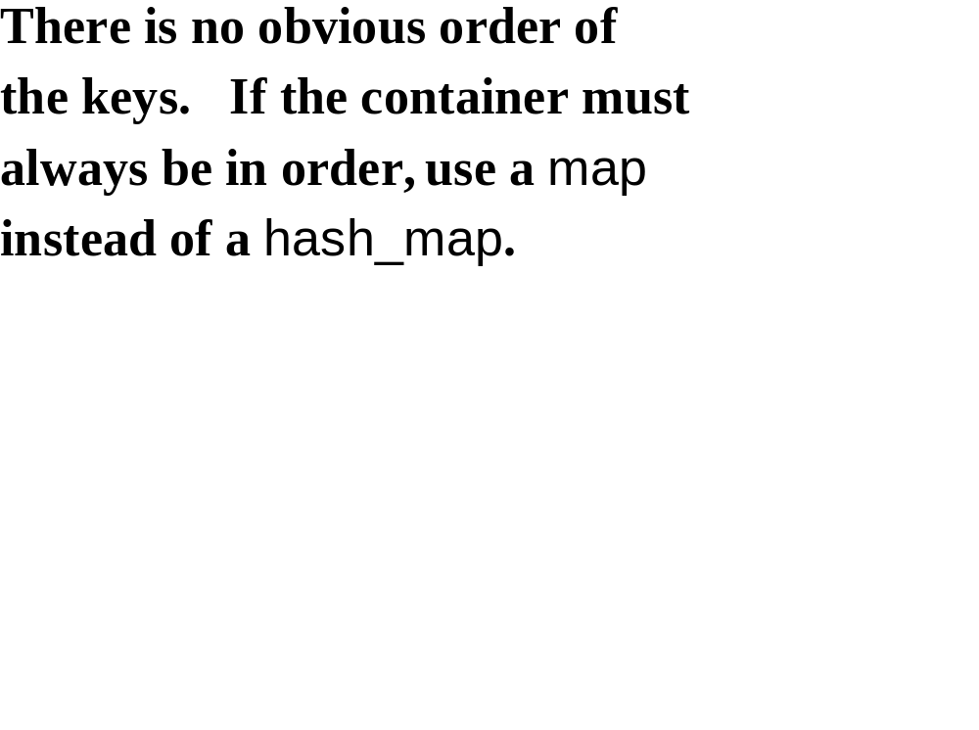

Slide 45
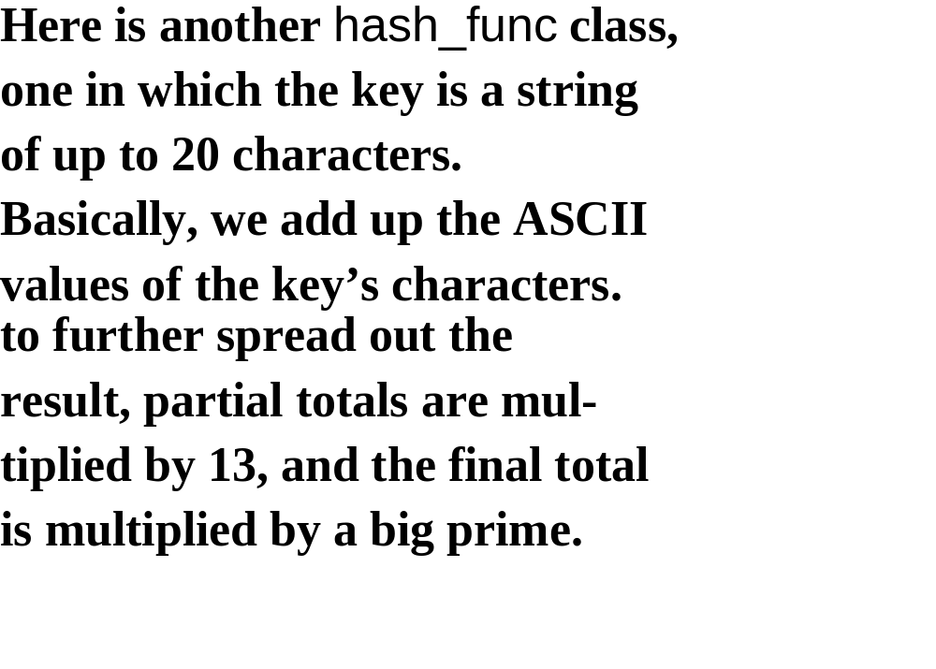

Slide 46
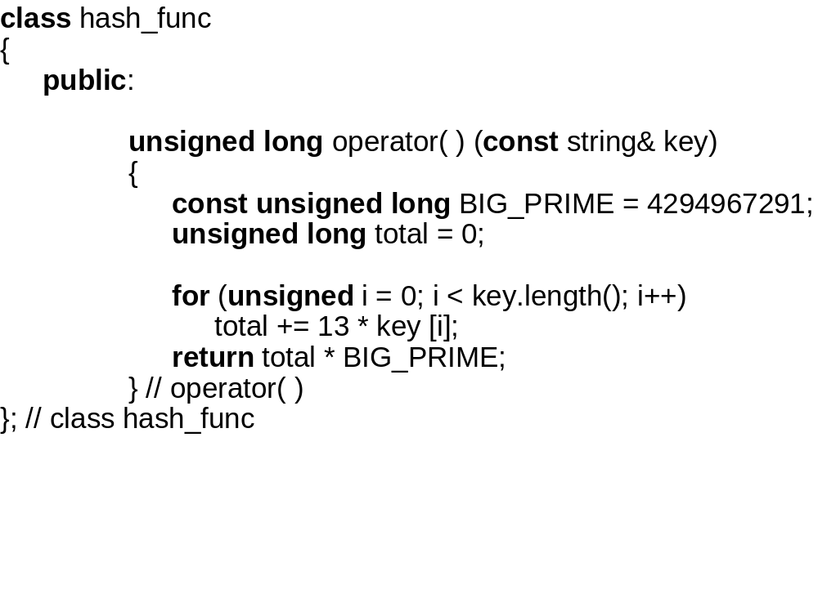

Slide 47
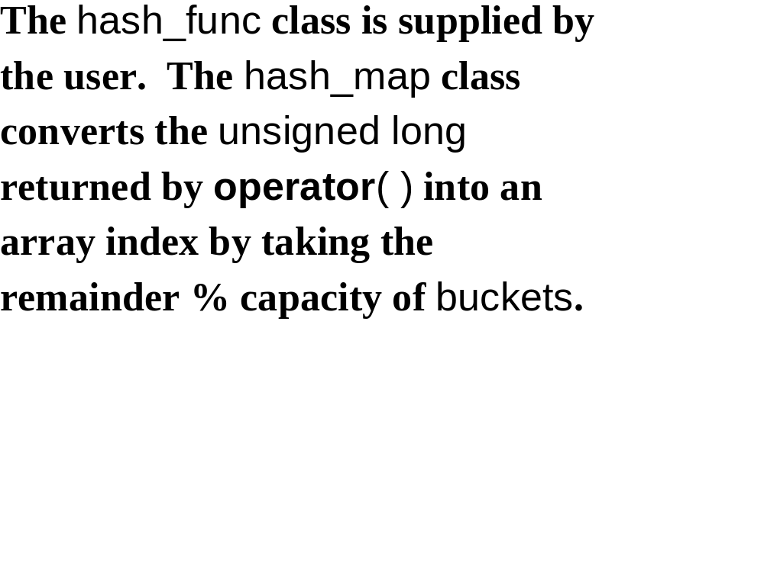

Slide 48
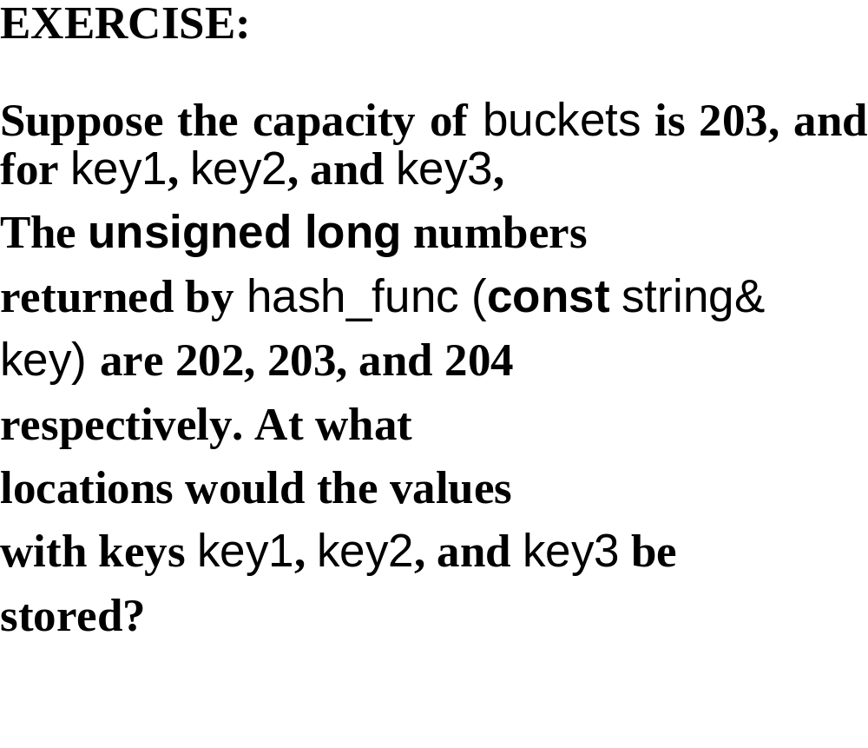

Slide 49
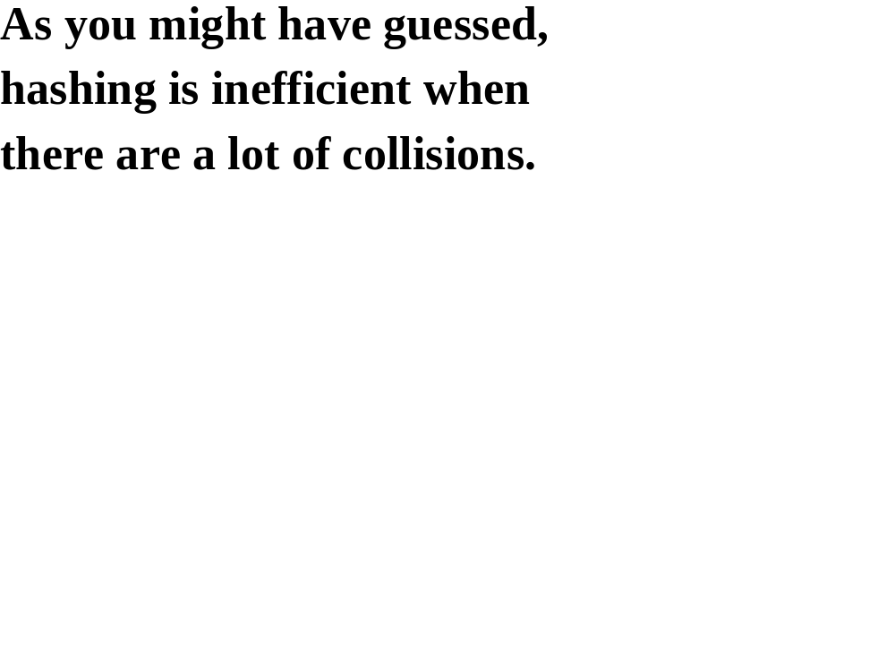

Slide 50
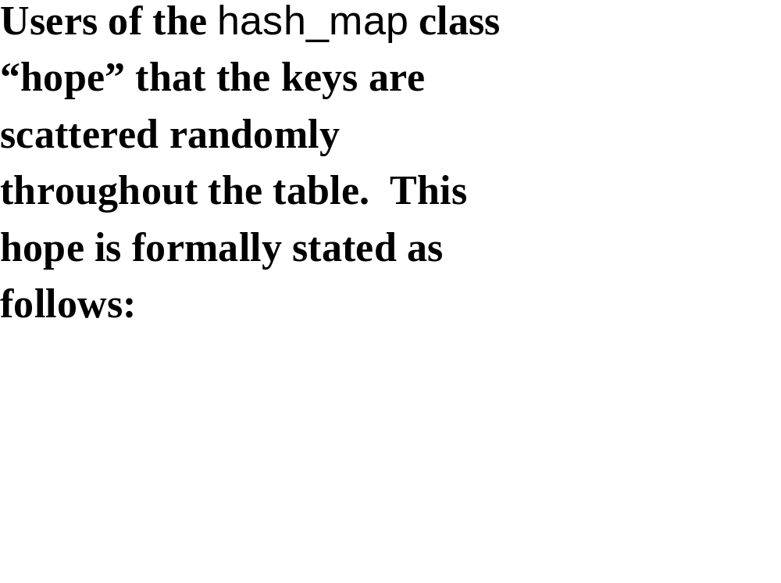

Slide 51
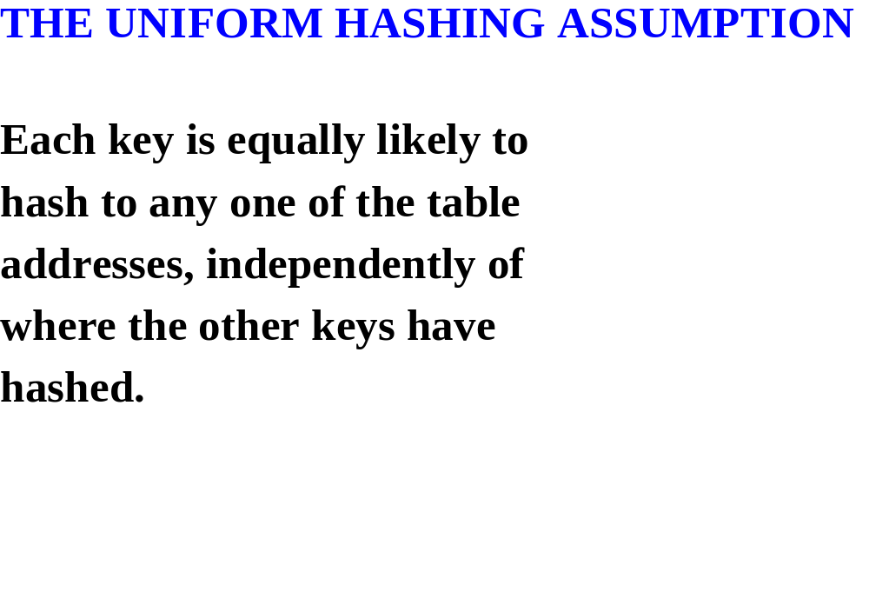

Slide 52
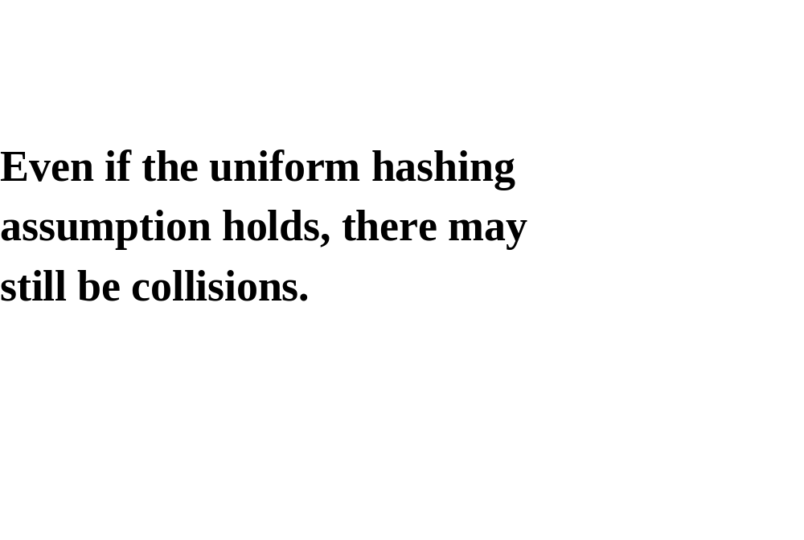

Slide 53
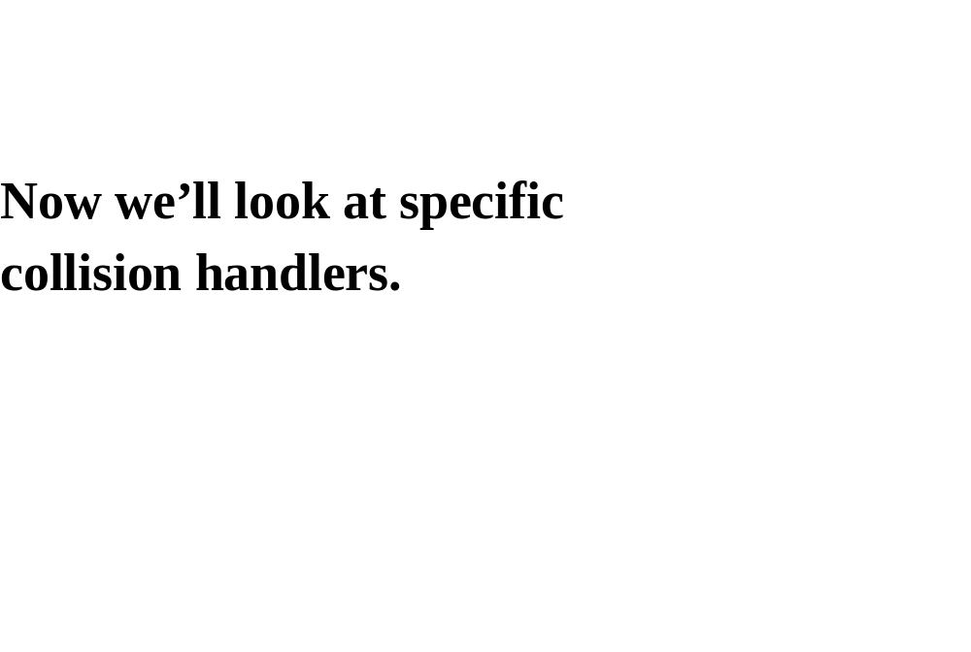

Slide 54
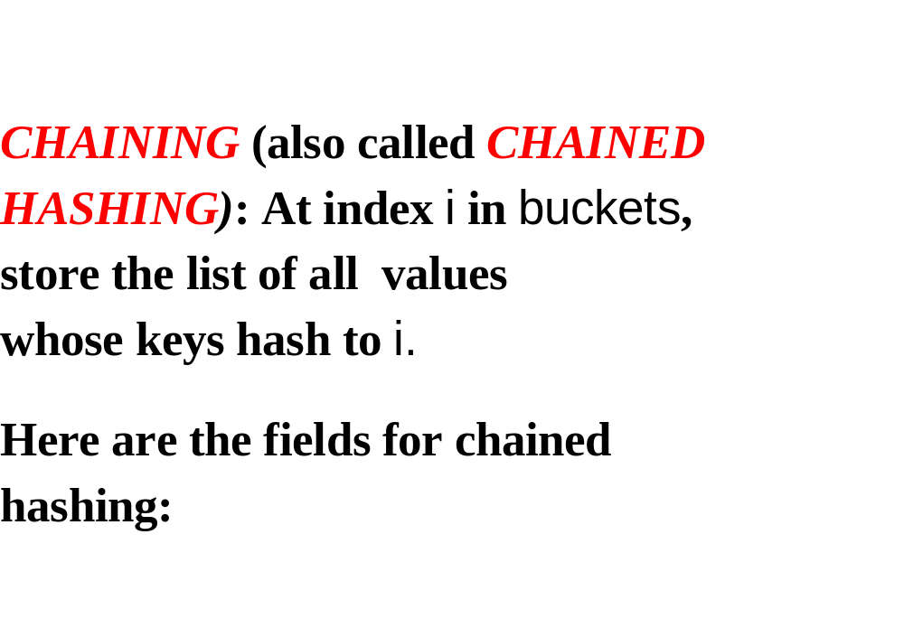

Slide 55


Slide 56


Slide 57


Slide 58


Slide 59
IMPLEMENTATION OF THE hash_map
CLASS

Slide 60


Slide 61


Slide 62


Slide 63


Slide 64


Slide 65


Slide 66


Slide 67


Slide 68


Slide 69


Slide 70


Slide 71


Slide 72


Slide 73


Slide 74


Slide 75


Slide 76


Slide 77


Slide 78


Slide 79


Slide 80


Slide 81


Slide 82


Slide 83


Slide 84


Slide 85
TIME ESTIMATES:
LET n = count, LET m = length.
MAKE THE UNIFORM HASHING
ASSUMPTION AND ASSUME THAT
count <= length * 0.75.

Slide 86
THE AVERAGE SIZE OF EACH LIST IS
n / m

Slide 87
FOR THE find METHOD,
averageTime_{S}(n, m) ≈ n / 2m iterations.
<= 0.75 / 2
SO averageTime_{S}(n, m) <= A CONSTANT.
averageTime_{S}(n, m) IS CONSTANT.

Slide 88


Slide 89


Slide 90


Slide 91


Slide 92


Slide 93


Slide 94


Slide 95


Slide 96


Slide 97


Slide 98


Slide 99
Solution:
bool marked_for_removal;
the constructor sets each
bucket’s marked_for_removal field to false.
insert SETS marked_for_removal TO false;
erase SETS marked_for_removal TO true.
SO AFTER THE INSERTIONS:

Slide 100


Slide 101


Slide 102


Slide 103
This solution leads to another
problem: suppose length = 203.
insert
erase // what was just inserted
(insert AND erase A TOTAL OF 202 TIMES)
insert
count = 1, so there is no need to
expand and re=hash. but there
are 202 marked-for-removals!

Slide 104


Slide 105
max = 202,
min = 0,
average = 101

Slide 106
SOLUTION: keep track of removals:
int count_plus // count + number of removals since last rehashing
void check_for_expansion()
{
if (count_plus >= int (MAX_RATIO * length))
{
// Do not copy the marked_for_removals.
delete[ ] temp_buckets;
count_plus = count;
} // doubling buckets size
} // method check_for_expansion

Slide 107


Slide 108
CLUSTER: A SEQUENCE OF NON-EMPTY LOCATIONS

Slide 110


Slide 111


Slide 112
Solution: double hashing, that
is, obtain both indices and
Offsets by hashing:
unsigned long hash_int = hash (key);
int index = hash_int % length,
offset = hash_int / length;
Now the offset depends on the
key, so different keys will usu-
ally have different offsets, so
no more primary clustering!

Slide 113
TO GET A NEW INDEX IF THERE IS
COLLISION:
index = (index + offset) % length;

Slide 114
EXAMPLE: length = 11
key index offset
15 4 1
19 8 1
16 5 1
58 3 5
27 5 2
35 2 3
30 8 2
47 3 4
WHERE WOULD THESE KEYS GO IN buckets?

Slide 115
index key
0 47
1
2 35
3 58
4 15
5 16
6
7 27
8 19
9
10 30

Slide 116
PROBLEM: WHAT IF OFFSET IS MULTIPLE OF length?
EXAMPLE: length = 11
key index offset
15 4 1
19 8 1
16 5 1
58 3 5
27 5 2
35 2 3
47 3 4
246 4 22 // BUT 15 IS AT INDEX 4
FOR KEY 246, NEW INDEX = (4 + 22) % 11 = 4. OOPS!

Slide 117
SOLUTION:
if (offset % length == 0)
offset = 1;
on average, offset % length will
equal 0 only once in every
length times.

Slide 118
Final problem: what if length has several factors?
EXAMPLE: length = 20
key index offset
20 0 1
25 5 1
30 10 1
35 15 1
110 10 5 // BUT 30 IS AT INDEX 10
FOR KEY 110, NEW INDEX = (10 + 5) % 20 = 15,
WHICH IS OCCUPIED, SO NEW INDEX = (15 + 5) % 20, WHICH IS OCCUPIED, SO NEW INDEX = ...

Slide 119
SOLUTION: MAKE length A PRIME.

Slide 120


Slide 121


Slide 122


