Slide 1
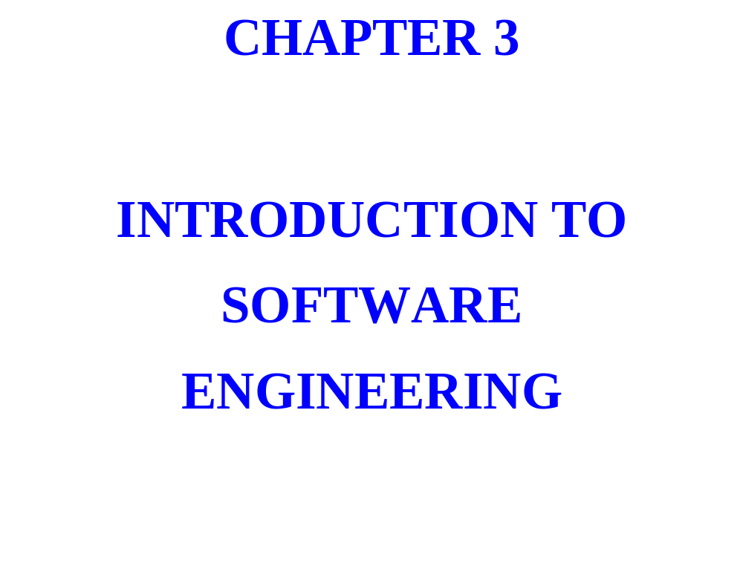

Slide 2
HARDWARE ADVANCES
MOORE’S LAW: COMPUTER POWER
(CIRCUITS PER CHIP) DOUBLES ABOUT
EVERY 18 MONTHS.

Slide 3


Slide 4
SOFTWARE ENGINEERING: A SYSTEMATIC
APPROACH TO THE DEVELOPMENT OF
MEDIUM-TO-LARGE PROGRAMS

Slide 5
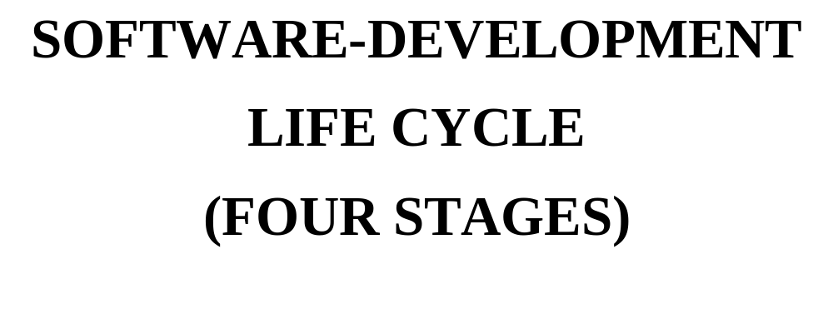

Slide 6
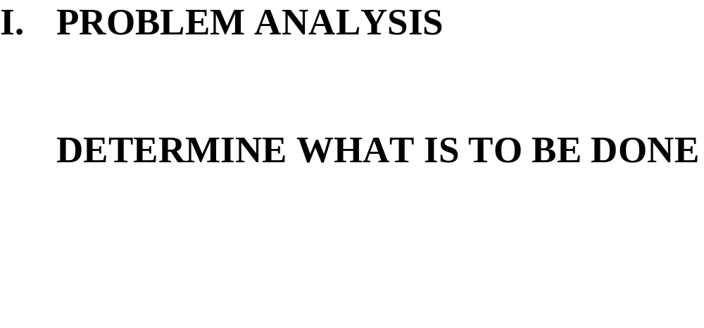

Slide 7
PRINCIPLE OF ABSTRACTION
WHEN TRYING TO SOLVE A PROBLEM,
SEPARATE WHAT IS TO BE DONE
FROM HOW IT WILL BE DONE.

Slide 8
THIS GENERALIZES THE PRINCIPLE OF DATA
ABSTRACTION: SEPARATE WHAT A CLASS DOES
FROM HOW THE CLASS IS DEFINED.

Slide 9
THERE ARE TWO DELIVERABLES
FOR THIS STAGE:

Slide 10
1. FUNCTIONAL SPECIFICATIONS
EXPLICITLY DESCRIBE THE
BEHAVIOR (THAT IS, INPUT
AND OUTPUT) OF THE PROGRAM.

Slide 11
FOR EXAMPLE:
“EACH WORD IN THE TEXT CONSISTS
OF LETTERS ONLY; SOME OR ALL
MAY BE IN UPPER-CASE.”

Slide 12
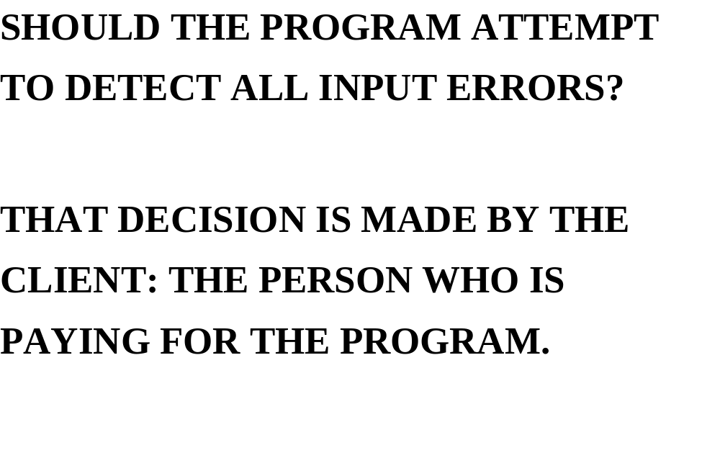

Slide 13
2. SYSTEM TESTS ARE CREATED TO
REINFORCE AN UNDERSTANDING
OF THE PROBLEM AND TO PROVIDE
DATA FOR TESTING THE
COMPLETED PROGRAM.

Slide 14
System Test 2: (input in boldface)
Please enter the mean arrival time: 5
Please enter the mean service time: 4
Please enter the maximum arrival time: 20
    Time Event Waiting Time
    6 Arrival
    7 Departure 0
    12 Arrival
    17 Arrival
    18 Departure 0
    19 Departure 1
The average waiting time was 0.3 minutes.
The average queue length was 0.1 cars.
The number of overflows was 0.

Slide 15
SOFTWARE DEVELOPMENT LIFE CYCLE
I. STAGE II. PROGRAM DESIGN
WHAT CLASSES WILL I NEED?
WHAT METHODS WILL I NEED?
WHAT FIELDS WILL I NEED?

Slide 16
SUPPOSE AN EXISTING CLASS HAS
EVERYTHING NEEDED.

Slide 17
GREAT! USE THAT CLASS.

Slide 18
SUPPOSE AN EXISTING CLASS HAS
ALMOST EVERYTHING NEEDED.

Slide 19
VERY GOOD! CREATE A SUBCLASS OF
THAT CLASS.

Slide 20
SUPPOSE YOU HAVE TO START FROM
SCRATCH.

Slide 21
1. DETERMINE RESPONSIBILITIES OF
THE CLASS: WHAT THE CLASS WILL
WILL PROVIDE TO USERS.

Slide 22
2. REFINE RESPONSIBILITIES INTO
METHOD INTERFACES.

Slide 23
3. DECIDE WHAT FIELDS TO HAVE.

Slide 24
AFTER INDIVIDUAL CLASSES HAVE
BEEN DESIGNED, DETERMINE
CLASS-TO-CLASS RELATIONSHIP
AND
OBJECT-FIELD TO CLASS RELATIONSHIP

Slide 25
DEPENDENCY DIAGRAMS

Slide 26
CLASS-TO-CLASS RELATIONSHIP
Employee Company
HourlyEmployee Company2

Slide 27
OBJECT-FIELD TO CLASS RELATIONSHIP:
WHEN THE CALLING OBJECT IS
DESTROYED, SHOULD THE OBJECT
FIELDS ALSO BE DESTROYED?

Slide 28
class Employee
{
protected:
string name;

Slide 29
COMPOSITION: WHEN THE SPACE
FOR THE CALLING OBJECT IS
DEALLOCATED, THE SPACE FOR
THE OBJECT FIELDS IS ALSO
DEALLOCATED.
name DEPENDS ON Employee OBJECT

Slide 30
name
♦
Employee

Slide 31
HERE IS AN EXAMPLE IN WHICH THE
SPACE FOR THE FIELD OBJECT IS
NOT DEALLOCATED EVEN AFTER
THE SPACE FOR THE CALLING
OBJECT IS DEALLOCATED:

Slide 32
class X
{
Y y;
Y* sendIt( )
{
…
return &y;
} // method sendIt
…
}; // class X

Slide 33
AGGREGATION: THE SPACE
ALLOCATED FOR y SHOULD NOT BE
DEALLOCATED WHEN THE SPACE FOR
THE CALLING X OBJECT IS DEALLOCA-
TED. WHY? BECAUSE THE ADDRESS OF
y WAS RETURNED FROM sendIt.

Slide 34
AGGREGATION: THE SPACE FOR THE
y DOES NOT DEPEND ON THE X OBJECT.

Slide 35
y
◊
X

Slide 36
SOFTWARE DEVELOPMENT LIFE CYCLE
STAGE III:PROGRAM IMPLEMENTATION

Slide 37
DEFINE THE METHODS; THEN
A. CHECK FOR CORRECTNESS
B. CHECK FOR EFFICIENCY

Slide 38
A. METHOD VALIDATION
USE TESTING TO INCREASE
CONFIDENCE IN THE
CORRECTNESS OF A METHOD.

Slide 39
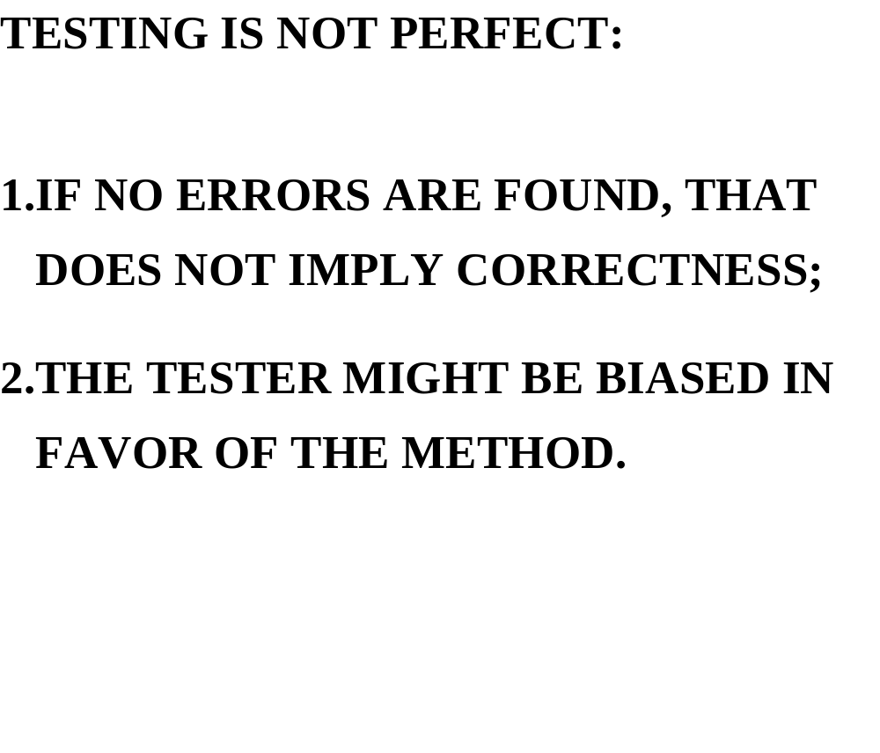

Slide 40
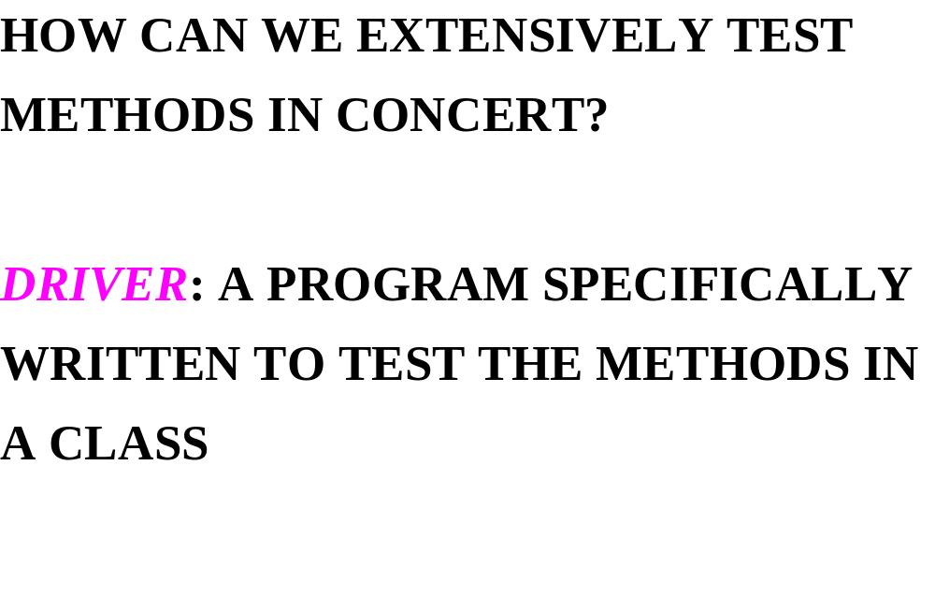

Slide 41
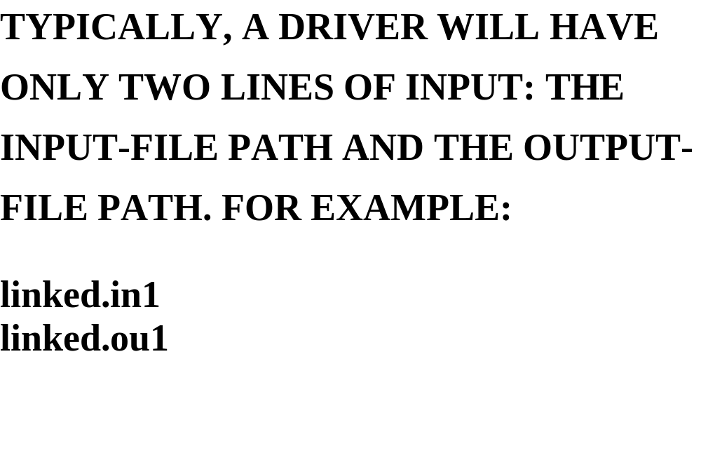

Slide 42
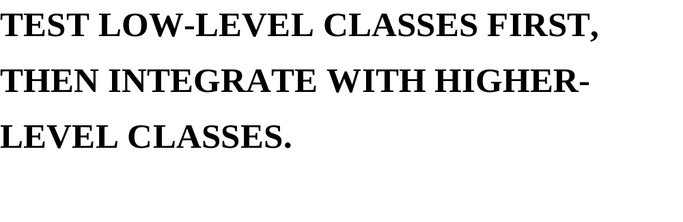

Slide 43


Slide 44
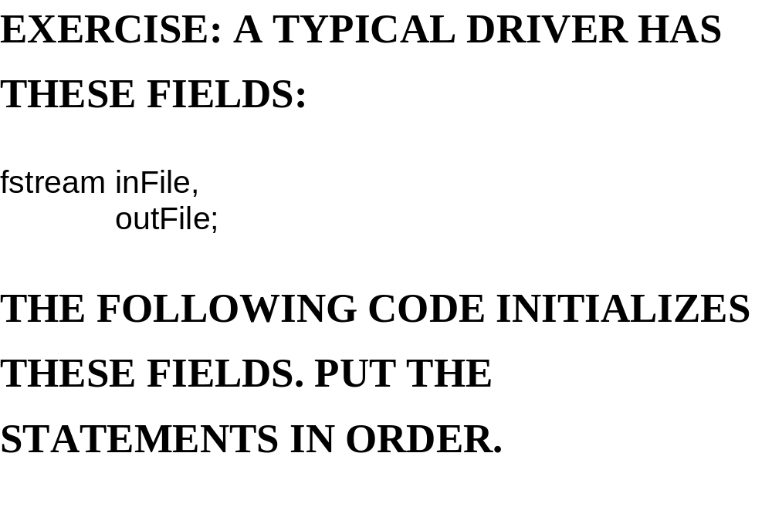

Slide 45
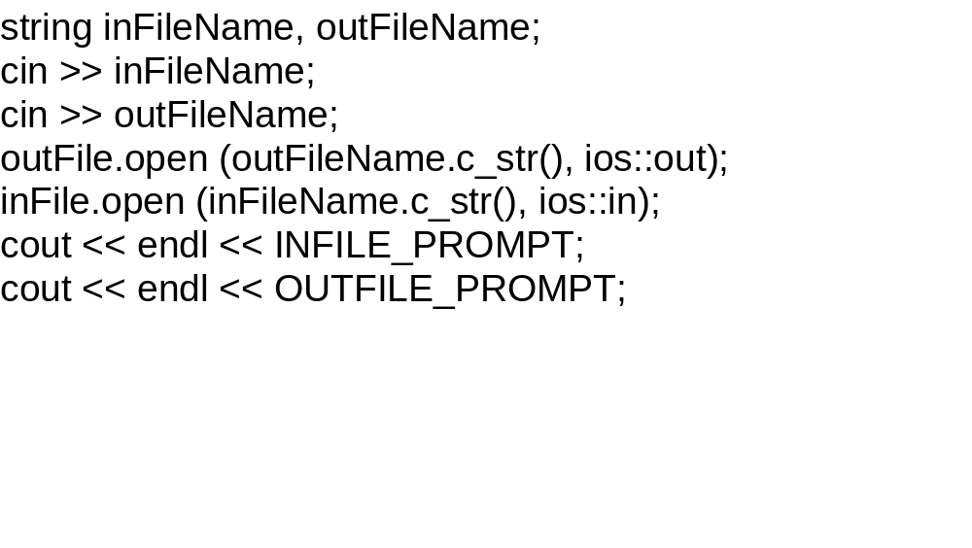

Slide 46
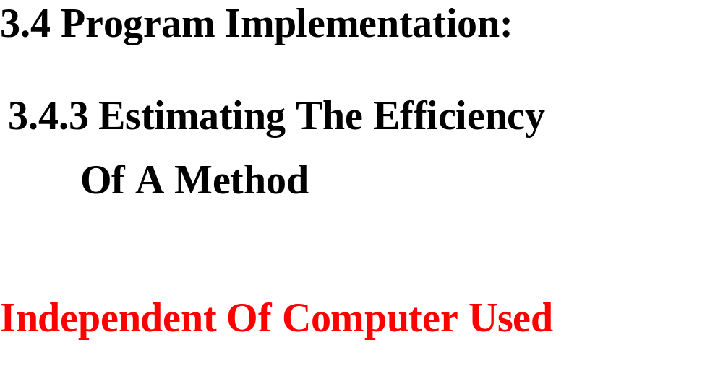

Slide 47
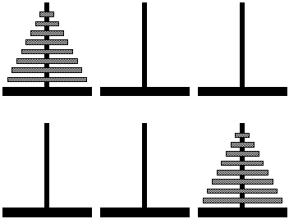
Towers of Hanoi
Move 2⁶⁴-1 times
One year=31536000 sec.
Monks move 1 plate per sec. =584.9 billion years
Computers move 10 million plates per sec. =58490 years

Slide 48
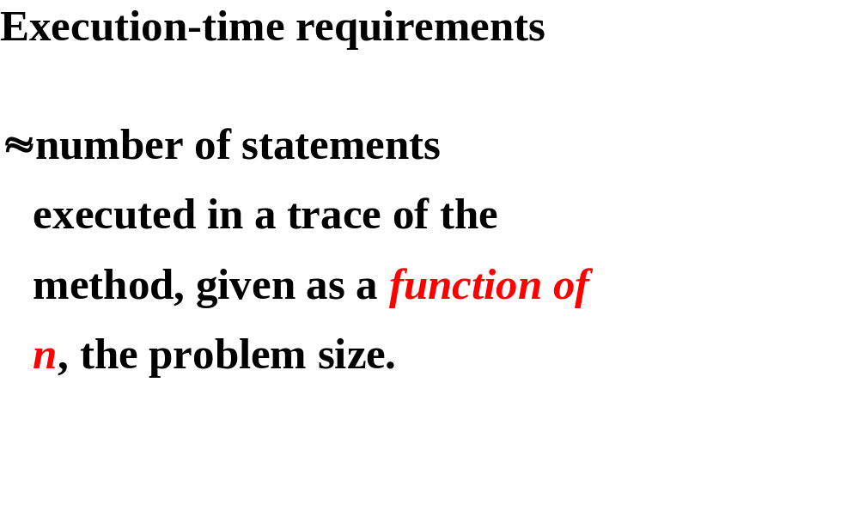

Slide 49
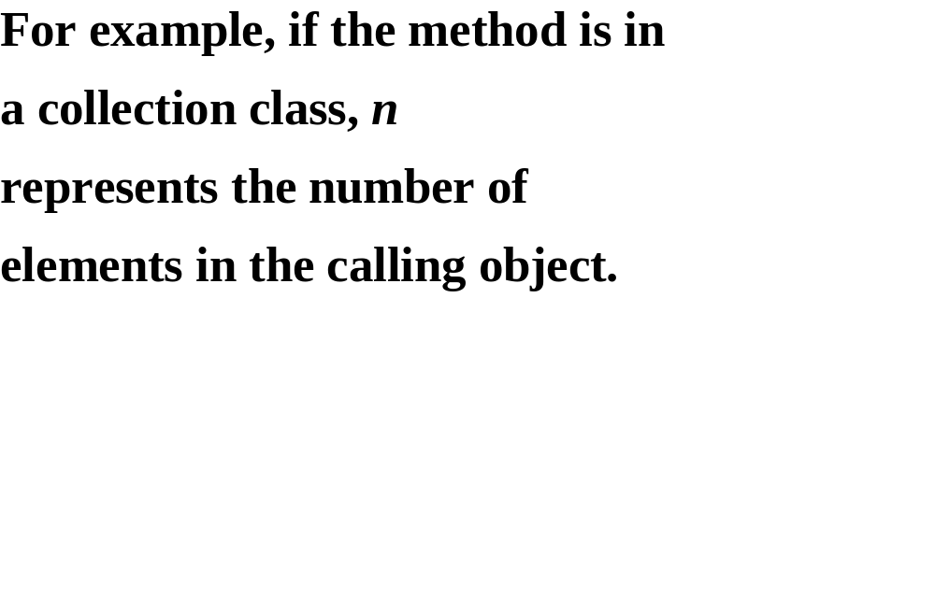

Slide 50
Let worstTime(n) be the maximum number of statements executed in a trace.
Let averageTime(n) be the average number of statements executed in a trace.

Slide 51
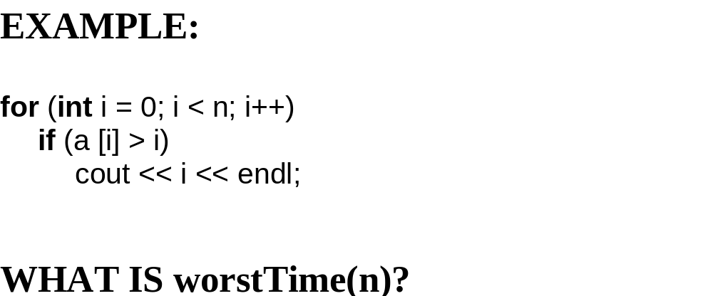

Slide 52
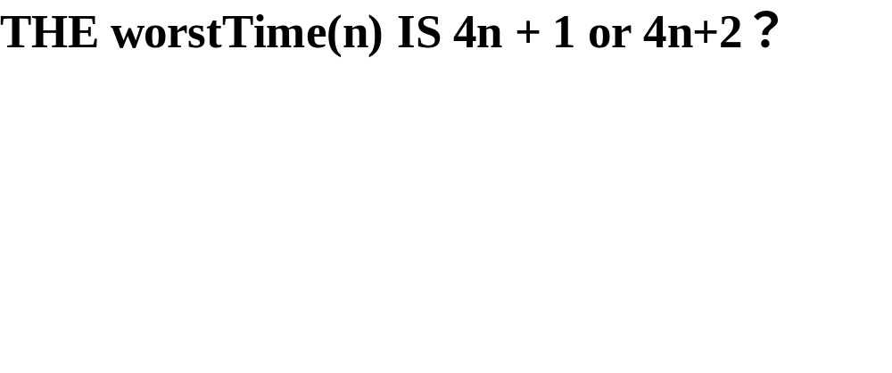

Slide 53
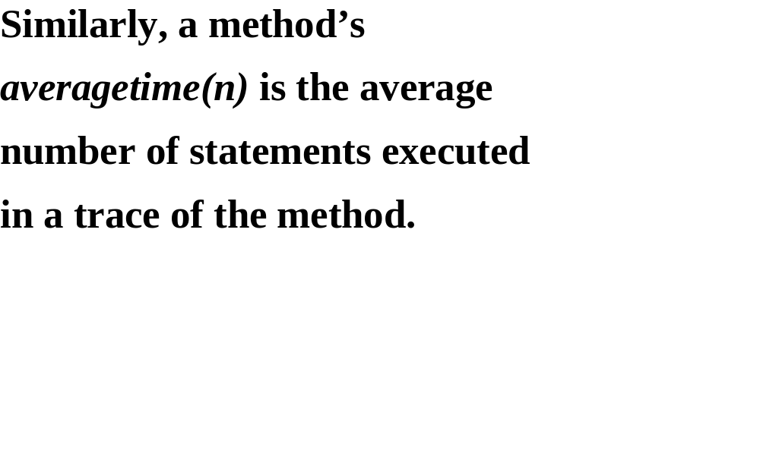

Slide 54
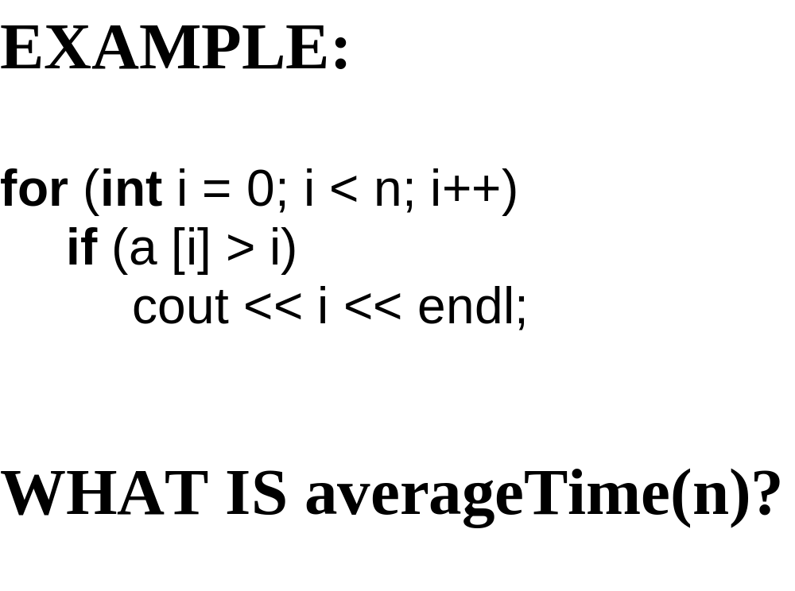

Slide 55
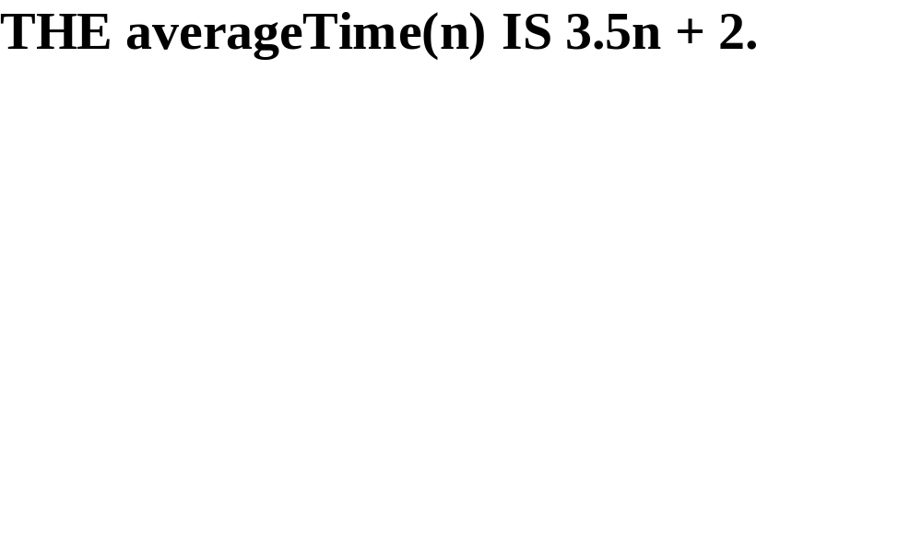

Slide 56
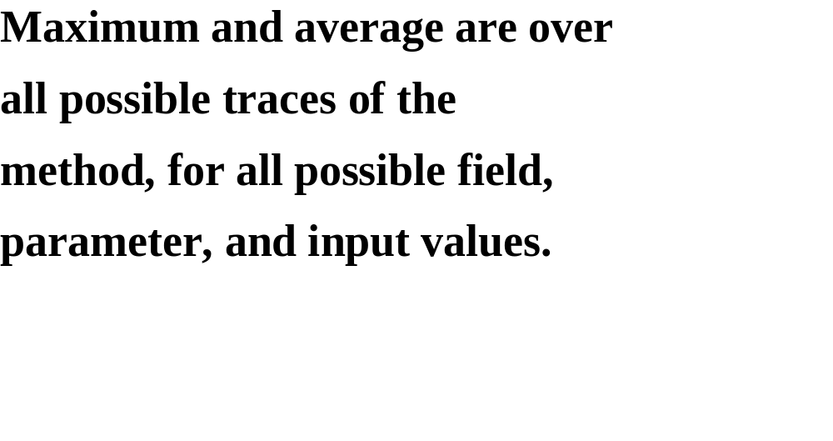

Slide 57
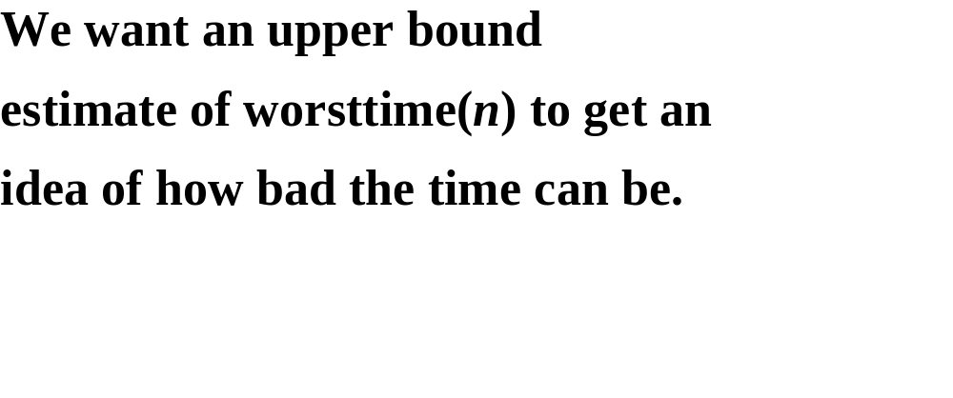

Slide 58
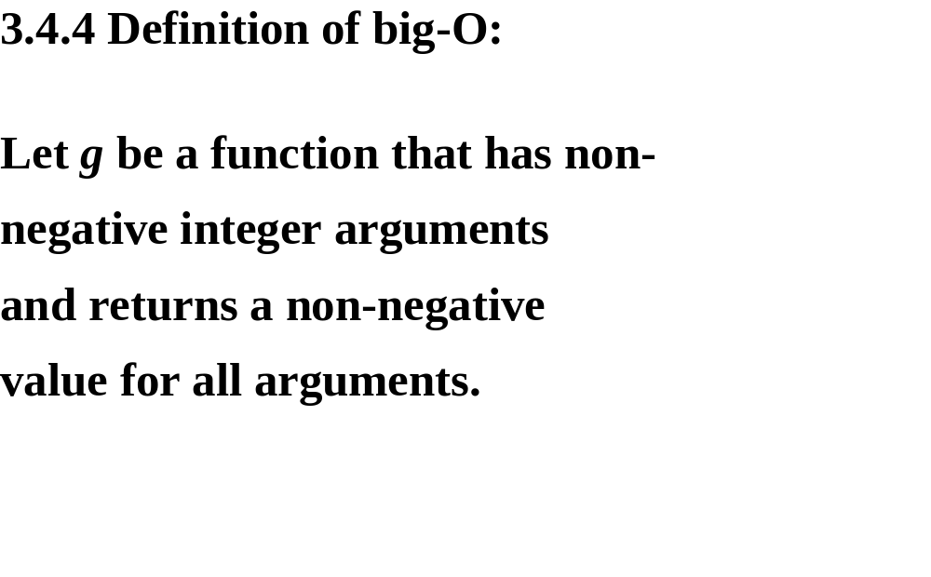

Slide 59
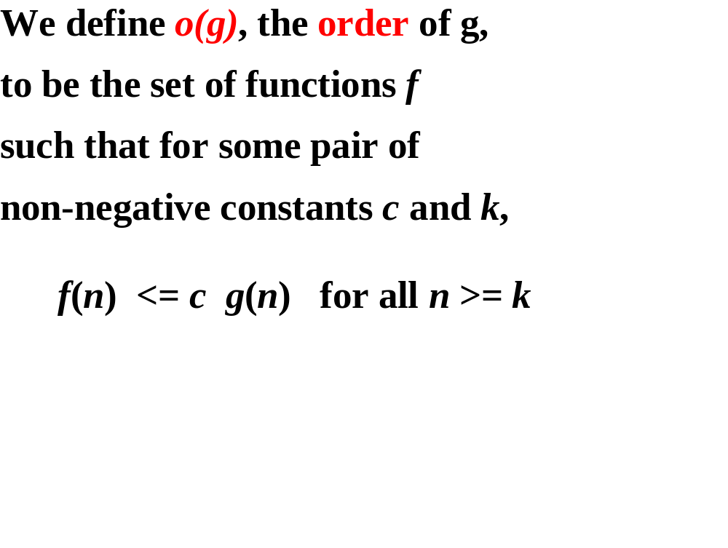
Notes:
Order 等级、数量级、量级， f is o(g) f是g数量级

Slide 60
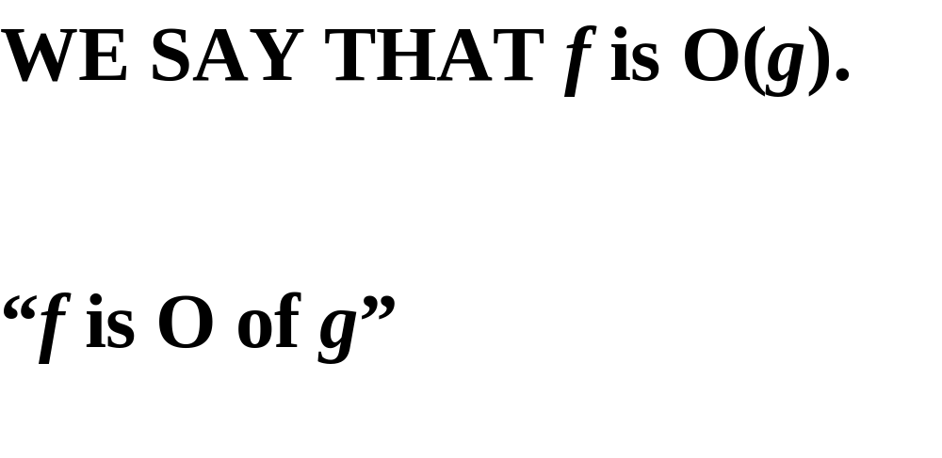

Slide 61
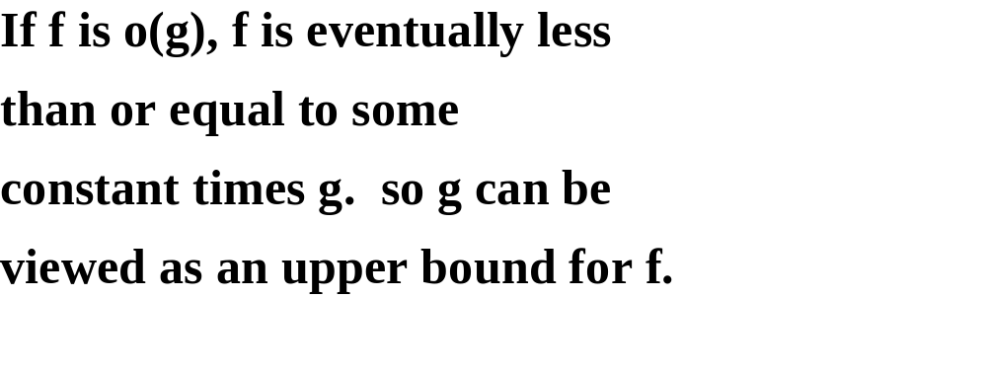

Slide 62
一般情况下，算法中基本操作重复执行的次数是问题规模n的某个函数，用f(n)表示，若有某个辅助函数g(n),使得当n趋近于无穷大时，g（n)/f(n)的极限值为不等于零的常数，则称g(n)是f(n)的同数量级函数。
记作f(n)=Ｏ(g(n)),称Ｏ(g(n)) 为算法的渐进时间复杂度，简称时间复杂度。

Slide 63
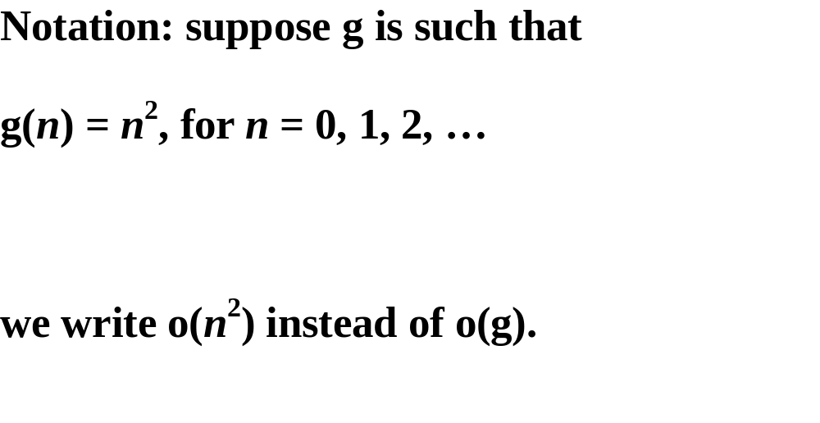

Slide 64
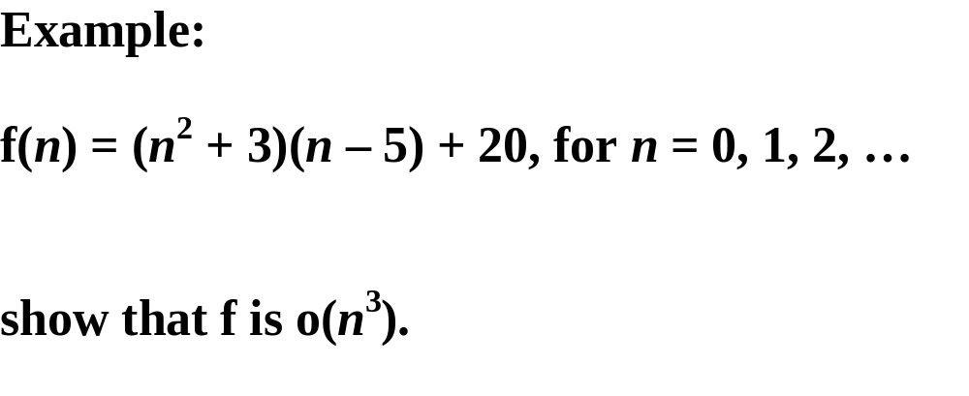

Slide 65
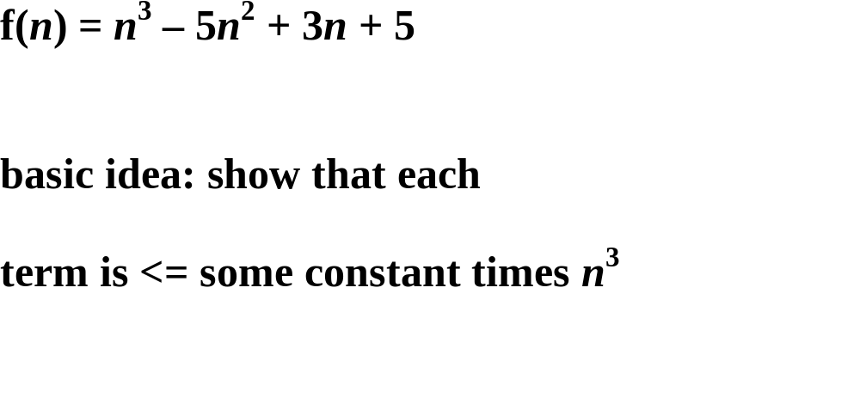

Slide 66
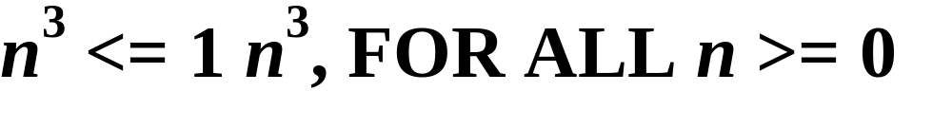

Slide 67
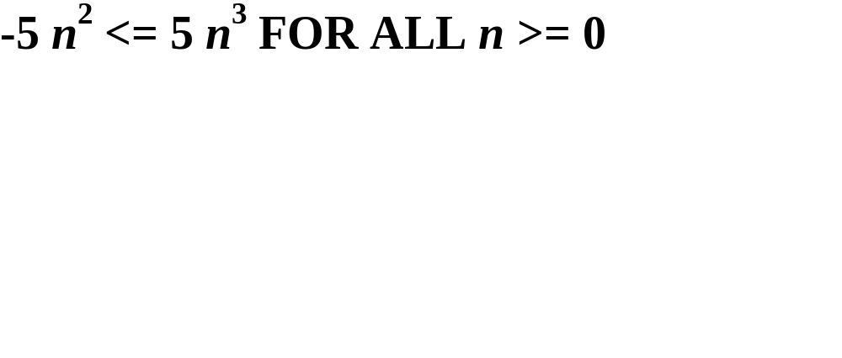

Slide 68
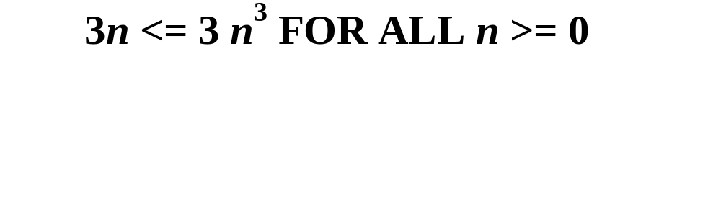

Slide 69
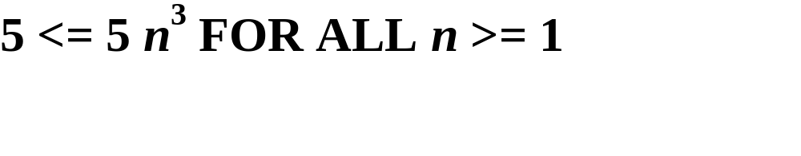

Slide 70
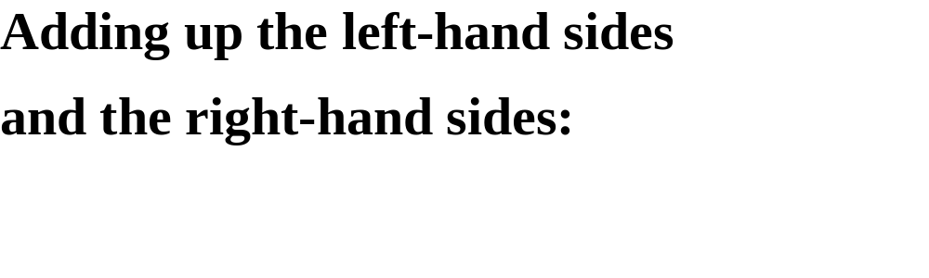

Slide 71
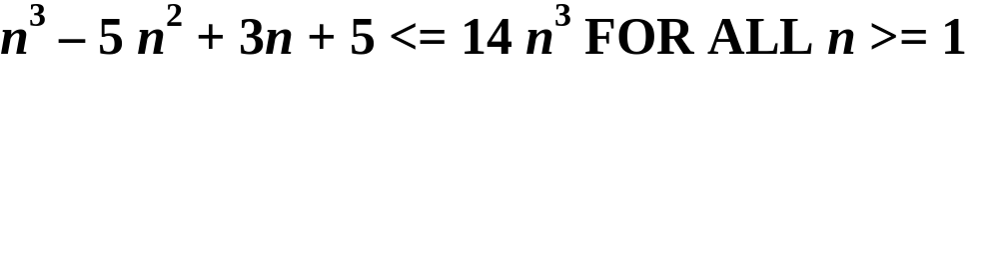

Slide 72
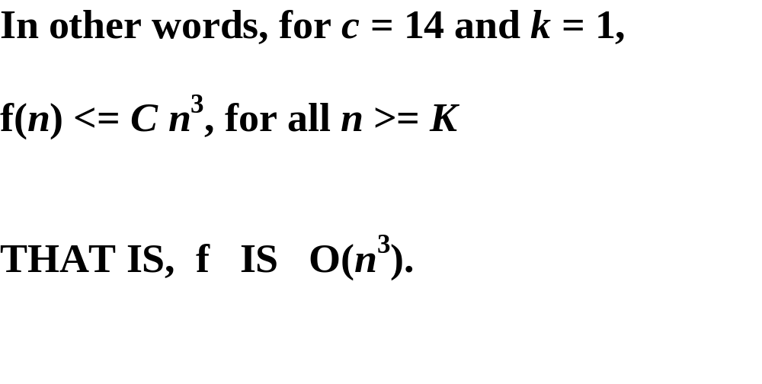

Slide 73
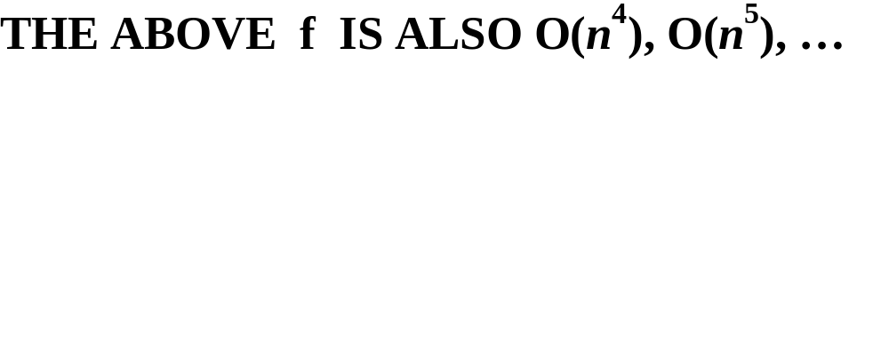

Slide 74
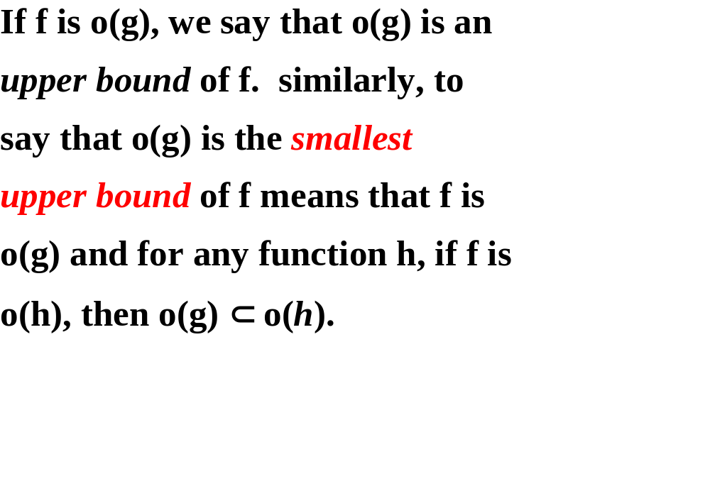

Slide 75
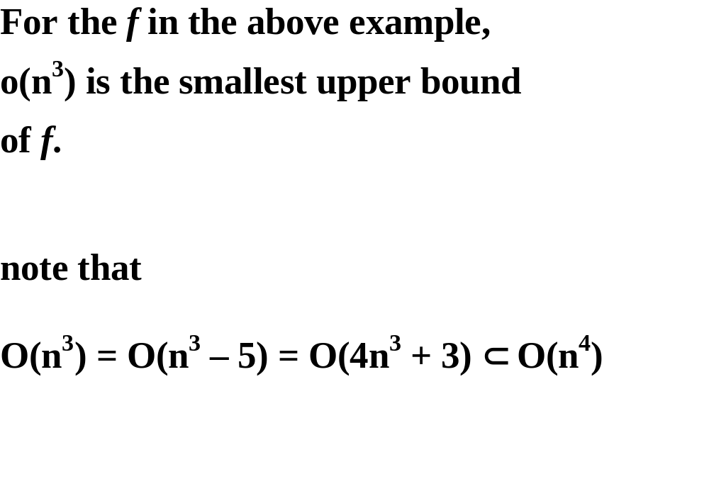

Slide 76
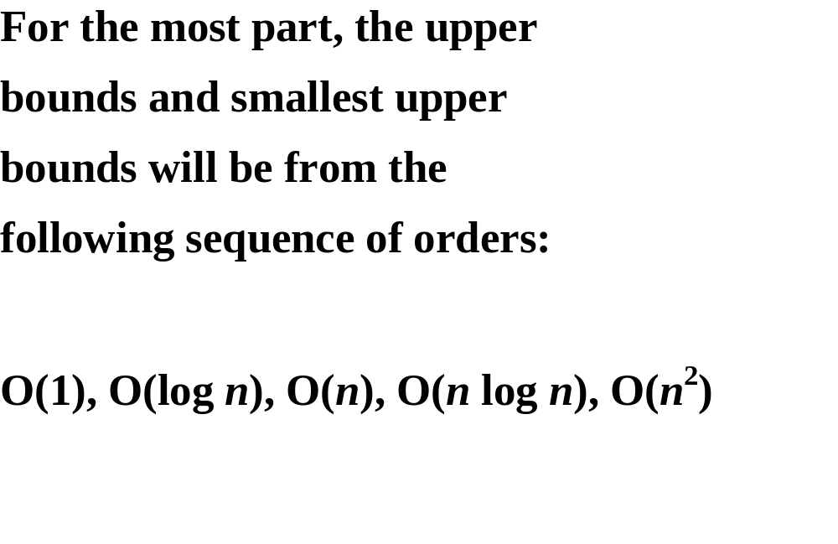

Slide 77
GROWTH RATES
worstTime(n)
O(2^{n})
O(n²)
O(n log n)
O(n)
O(log n)
O(1)
n

Slide 78
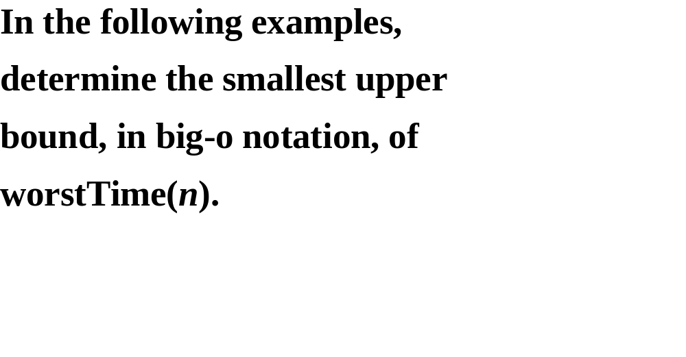

Slide 79
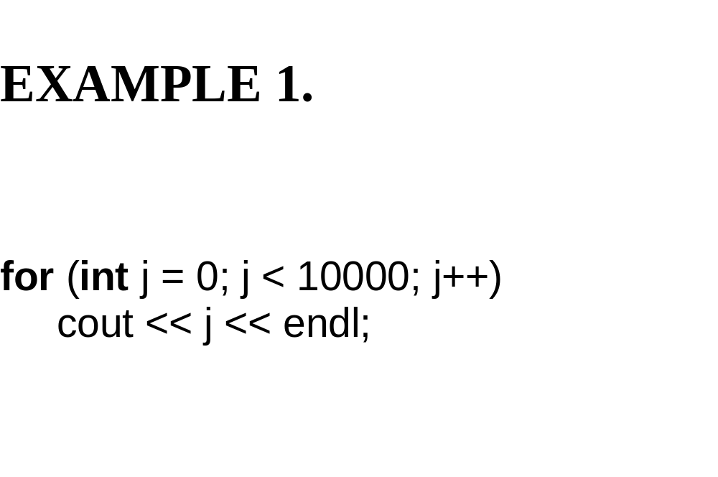

Slide 80
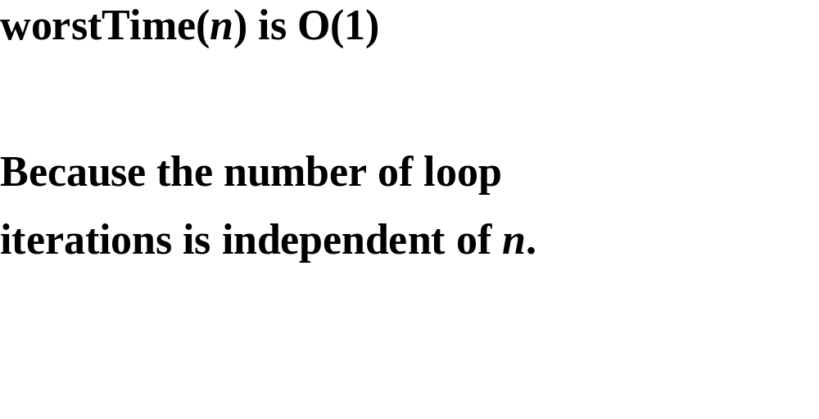

Slide 81
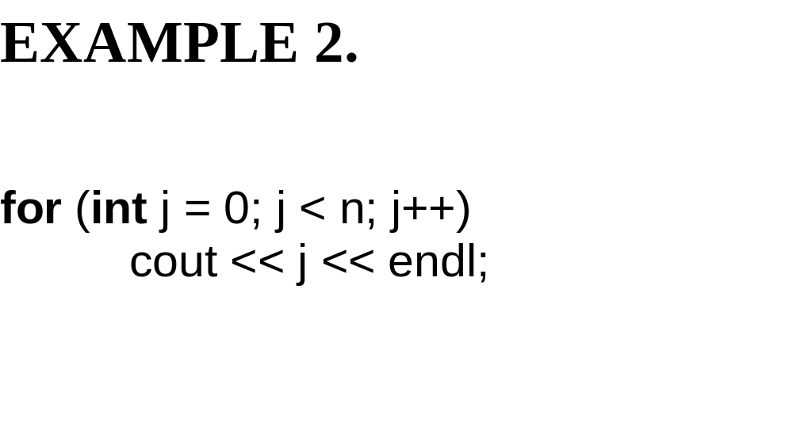

Slide 82
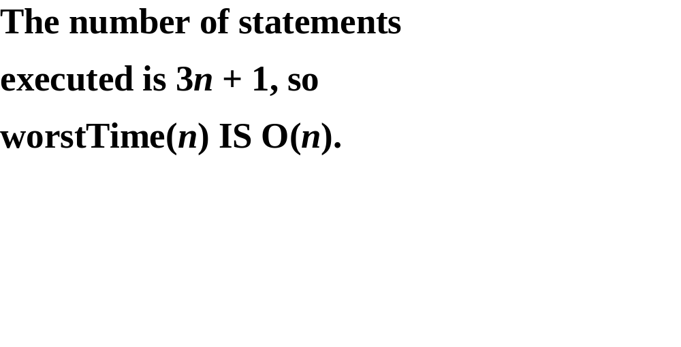

Slide 83
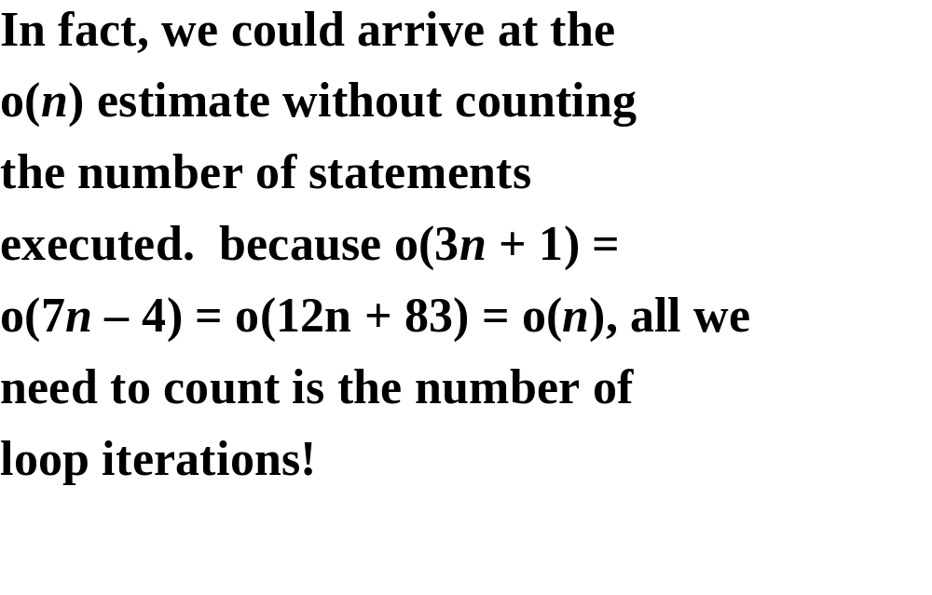

Slide 84
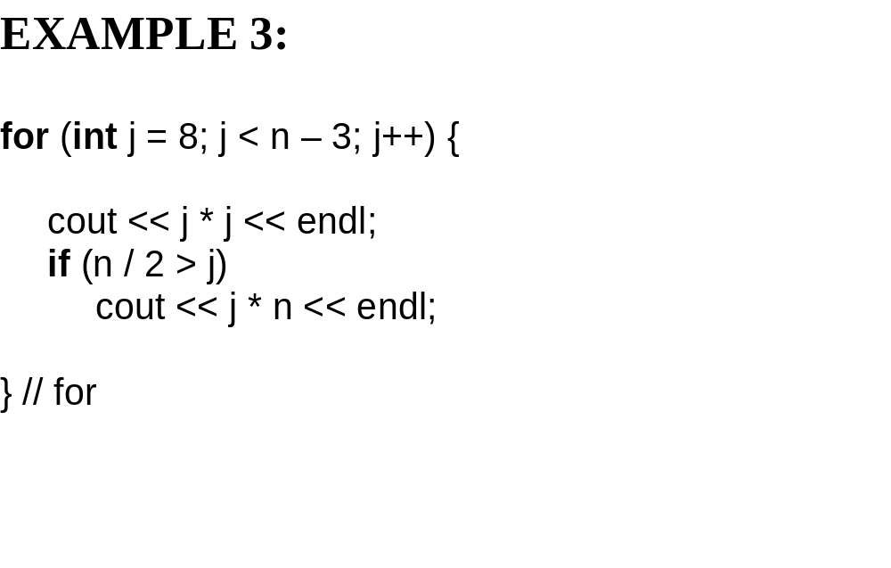

Slide 85
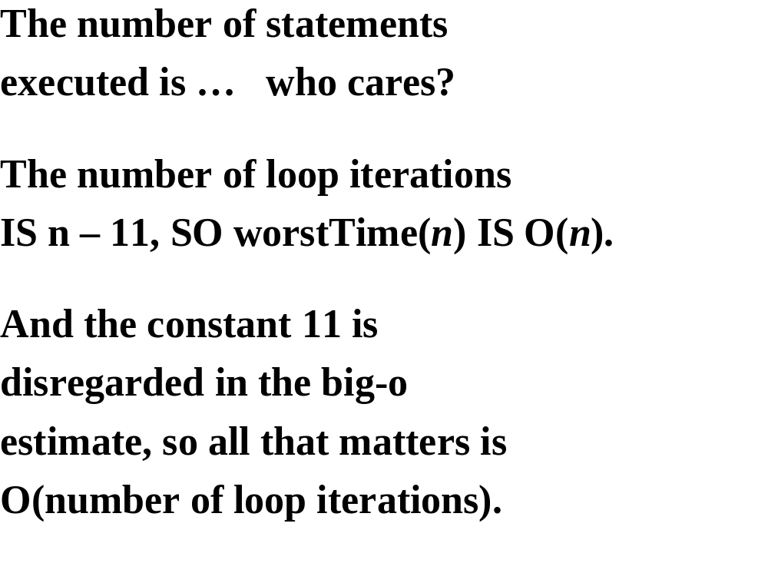

Slide 86
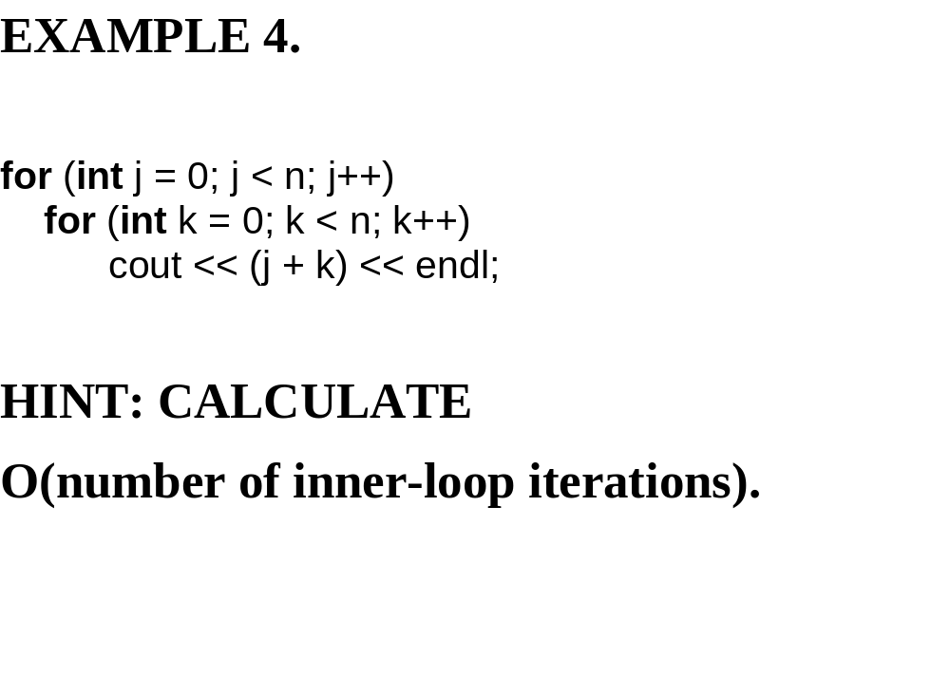

Slide 87
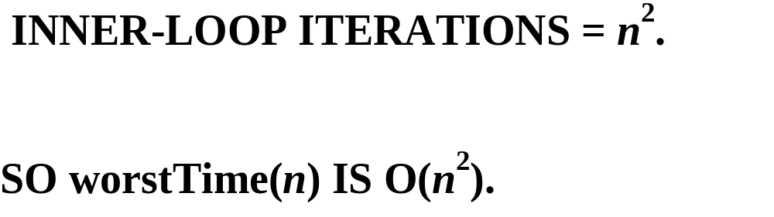

Slide 88
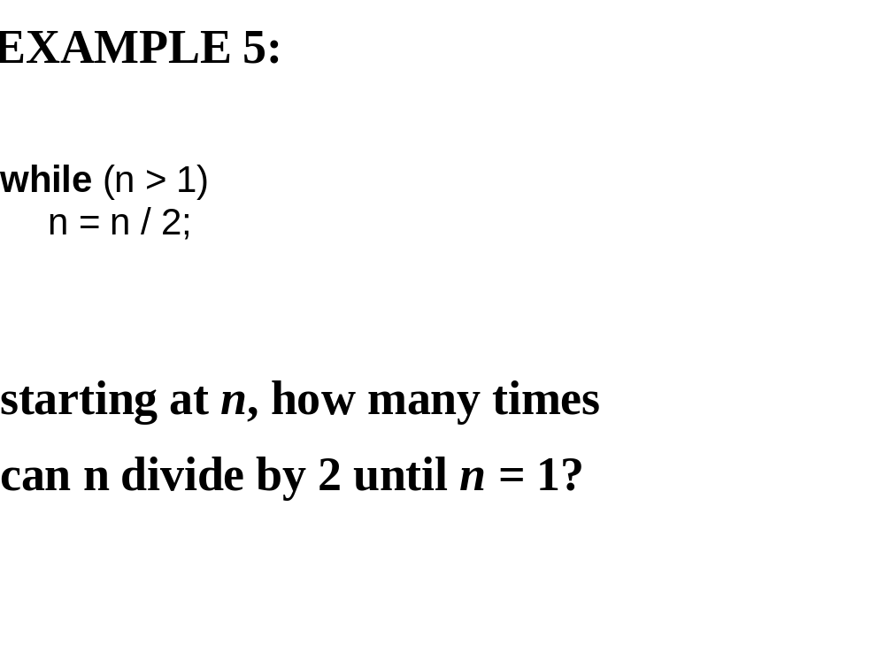

Slide 89


Slide 90


Slide 91


Slide 92


Slide 93


Slide 94


Slide 95
1000
500
250
125
62
31
15
7
3
1
there are 9 divisions required; floor(log₂1000) = 9

Slide 96


Slide 97


Slide 98


Slide 99


Slide 100


Slide 101


Slide 102


Slide 103


Slide 104


Slide 105


Slide 106


Slide 107


Slide 108


Slide 109


Slide 110


Slide 111


Slide 112


Slide 113


Slide 114


Slide 115


Slide 116


Slide 117


Slide 118


Slide 119


Slide 120


Slide 121


Slide 122


Slide 123


Slide 124


Slide 125


Slide 126


Slide 127


Slide 128


Slide 129


Slide 130


Slide 131


