Slide 1
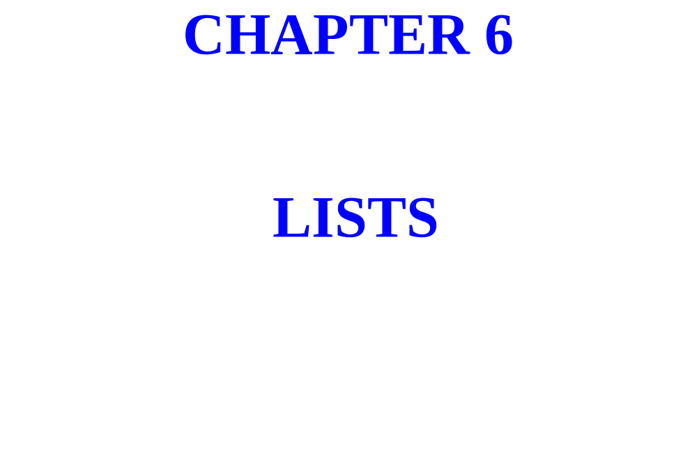

Slide 2
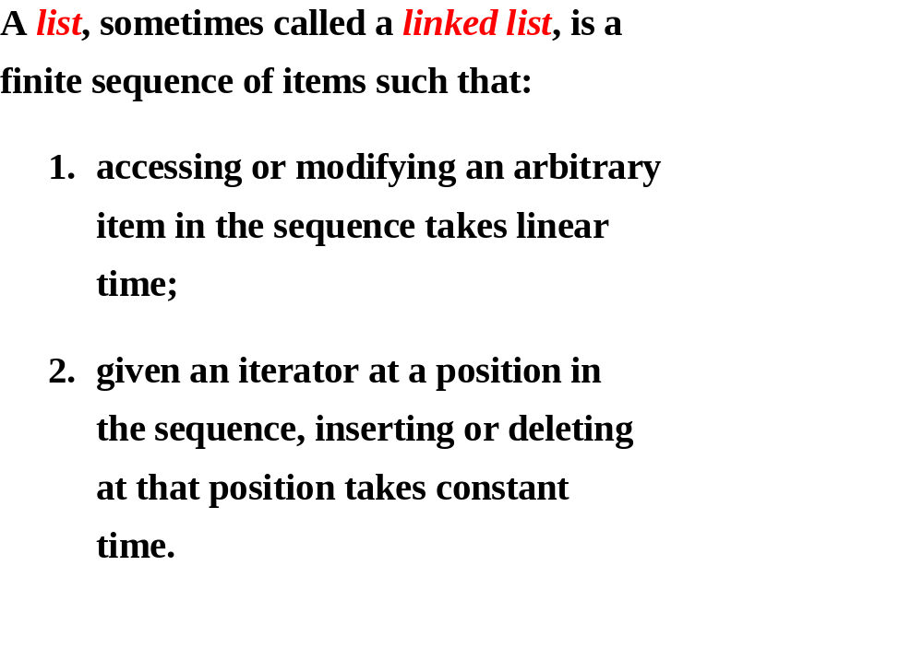

Slide 3
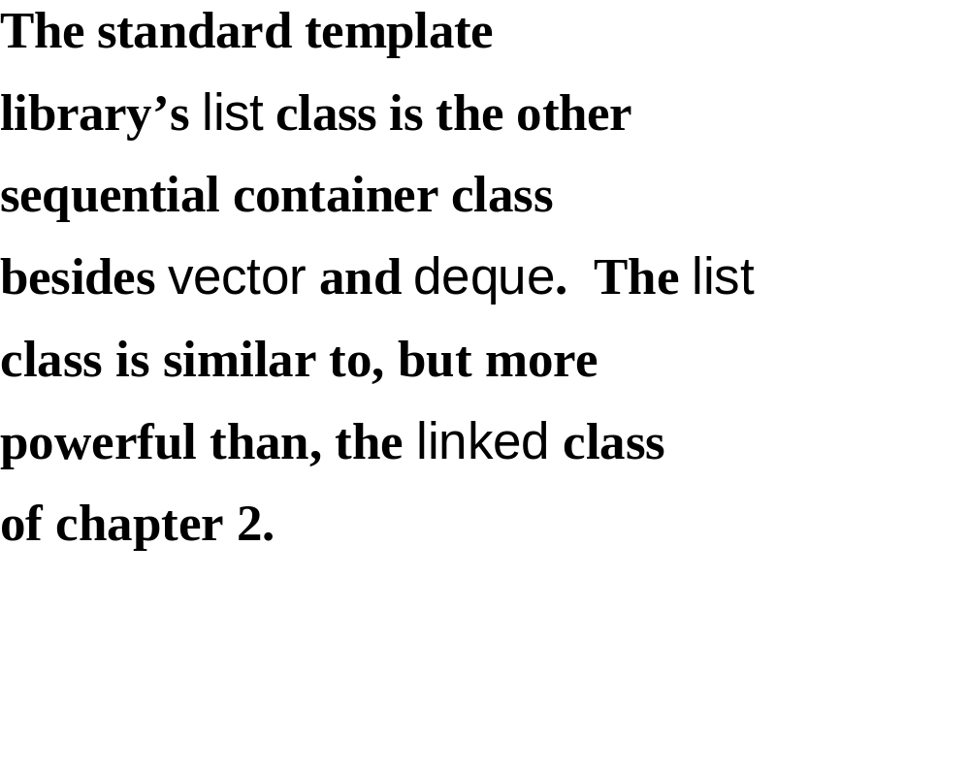

Slide 4
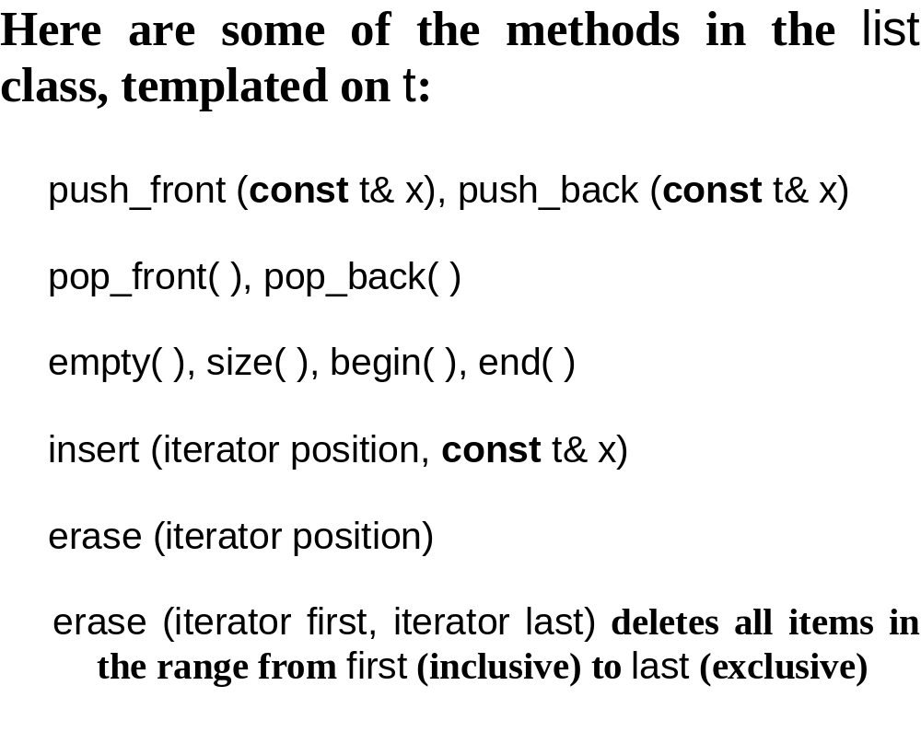

Slide 5
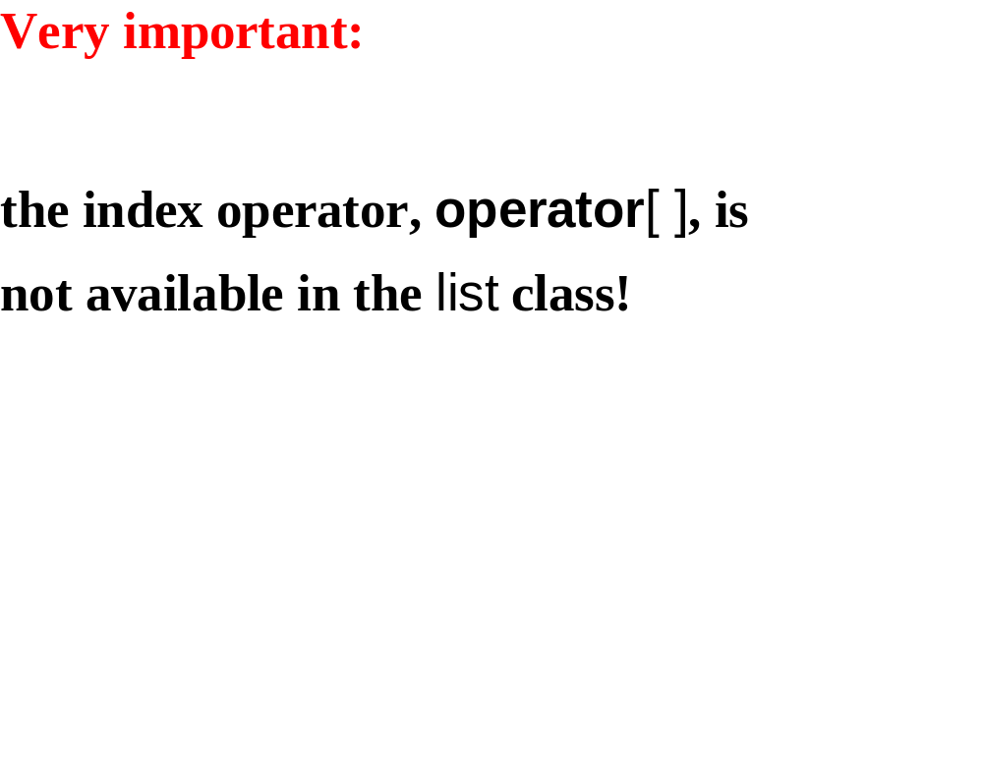

Slide 6
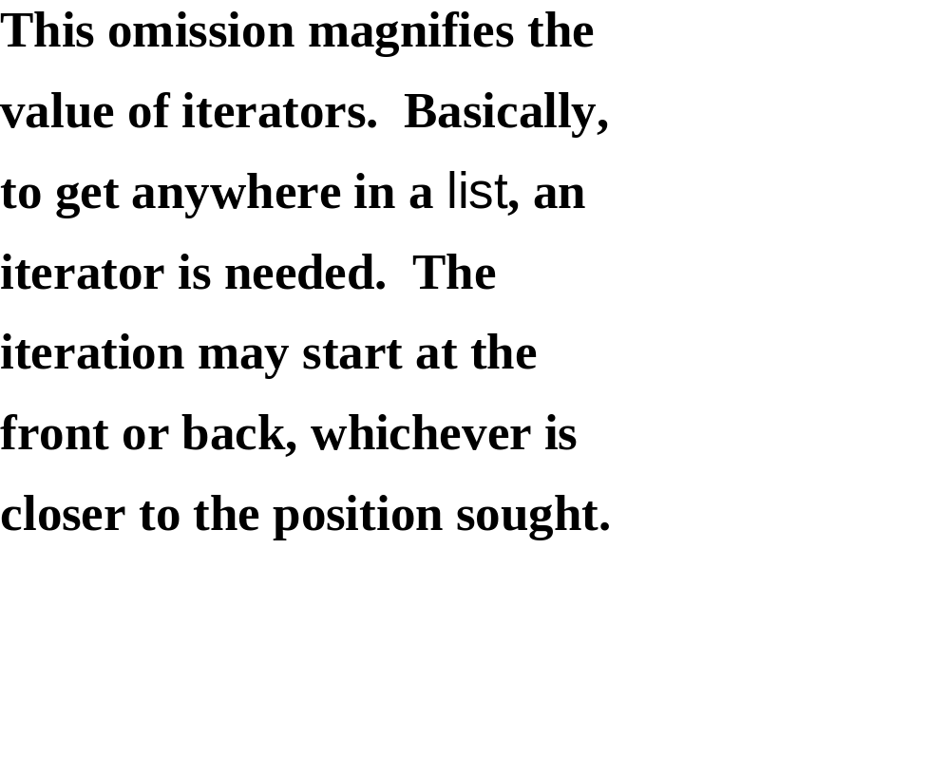

Slide 7
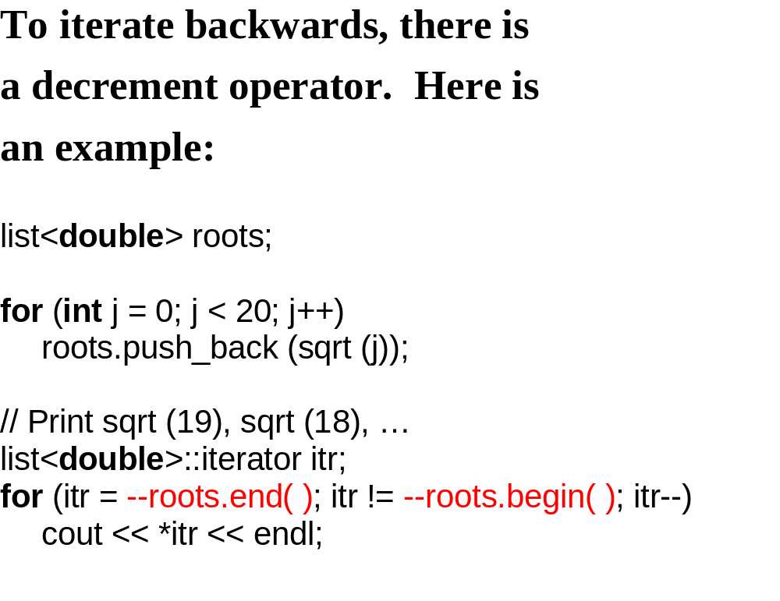

Slide 8
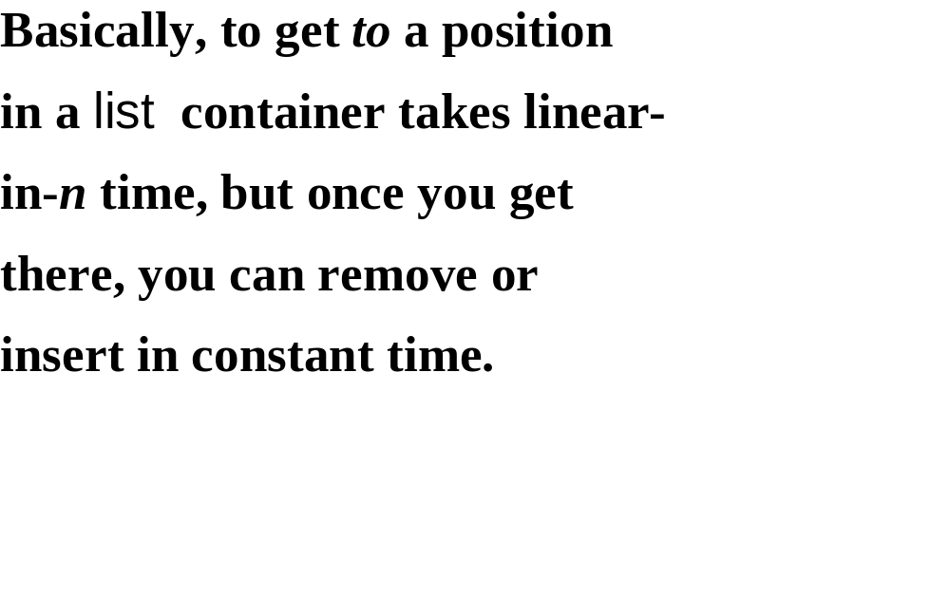

Slide 9
User’s guide for choosing a list or vector:
If the application entails a lot of
accessing and/or modifying items at
widely varying positions, a vector
will be much faster than a list.
If a large part of the application
consists of iterating through a container
and making insertions and/or deletions
during the iterations, a list will be much
faster than a vector.

Slide 10
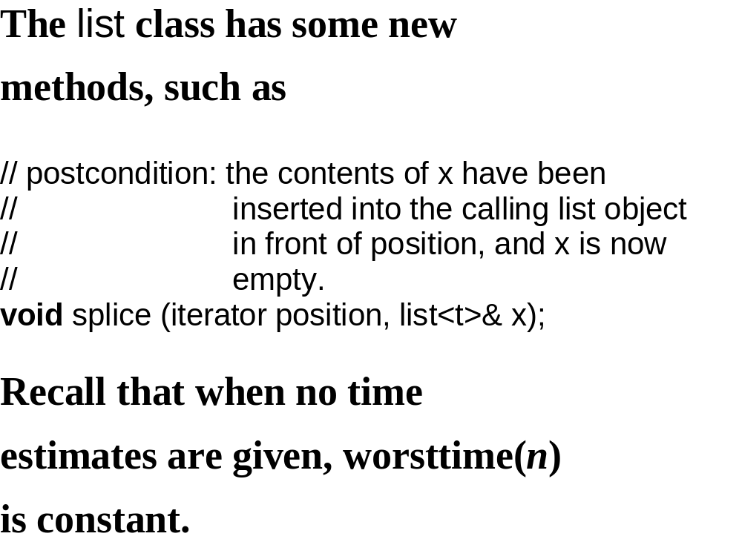

Slide 11
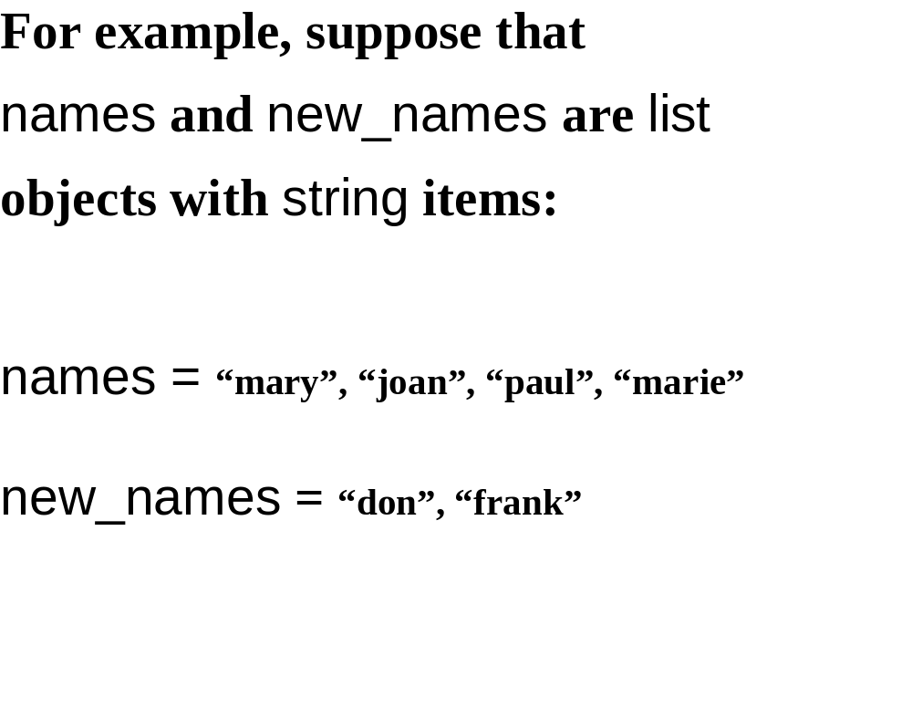

Slide 12
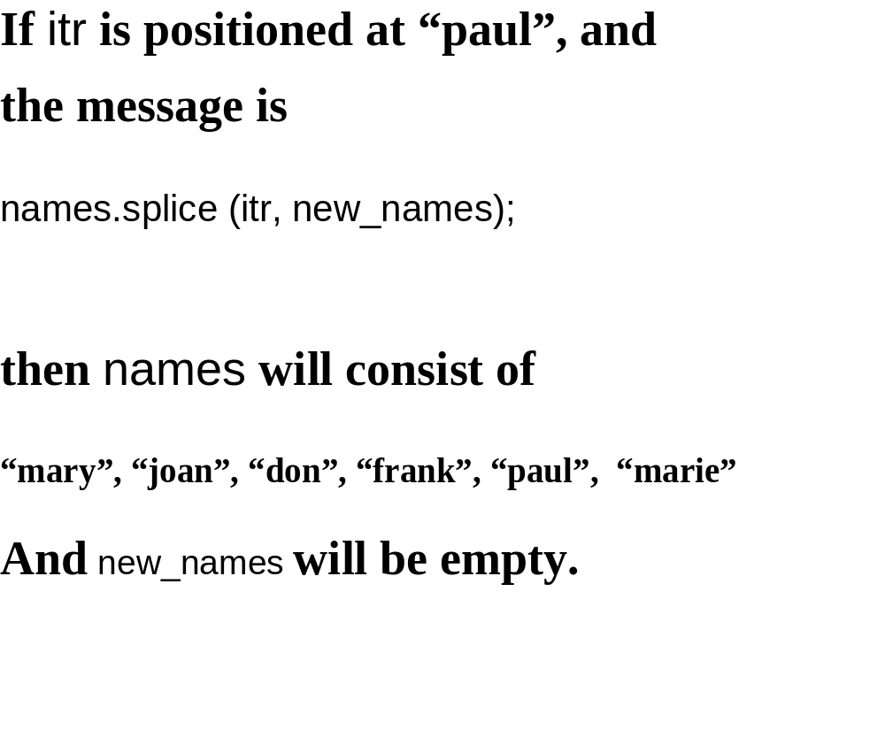

Slide 13
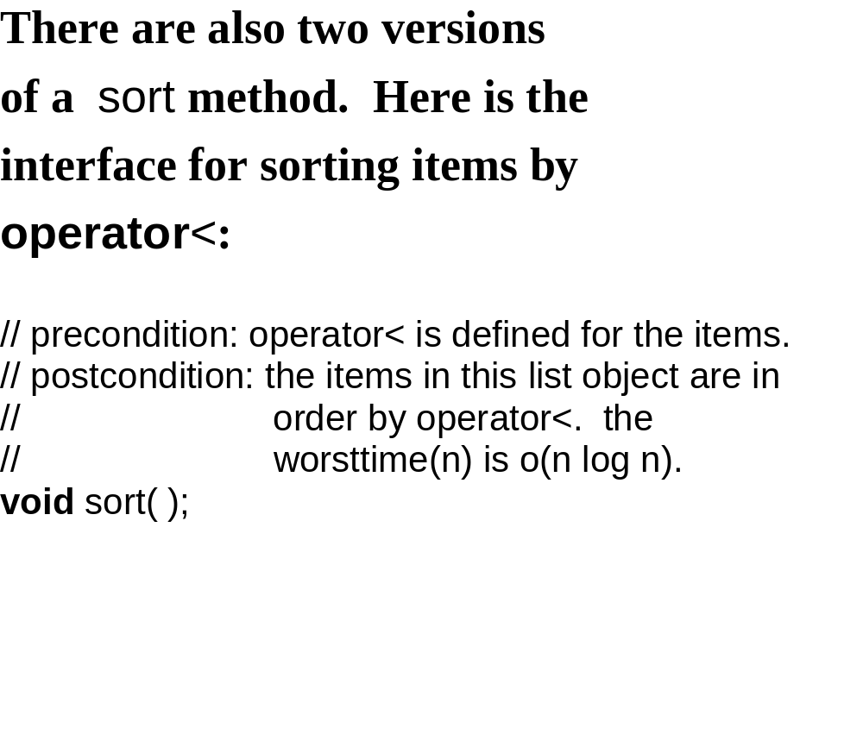

Slide 14
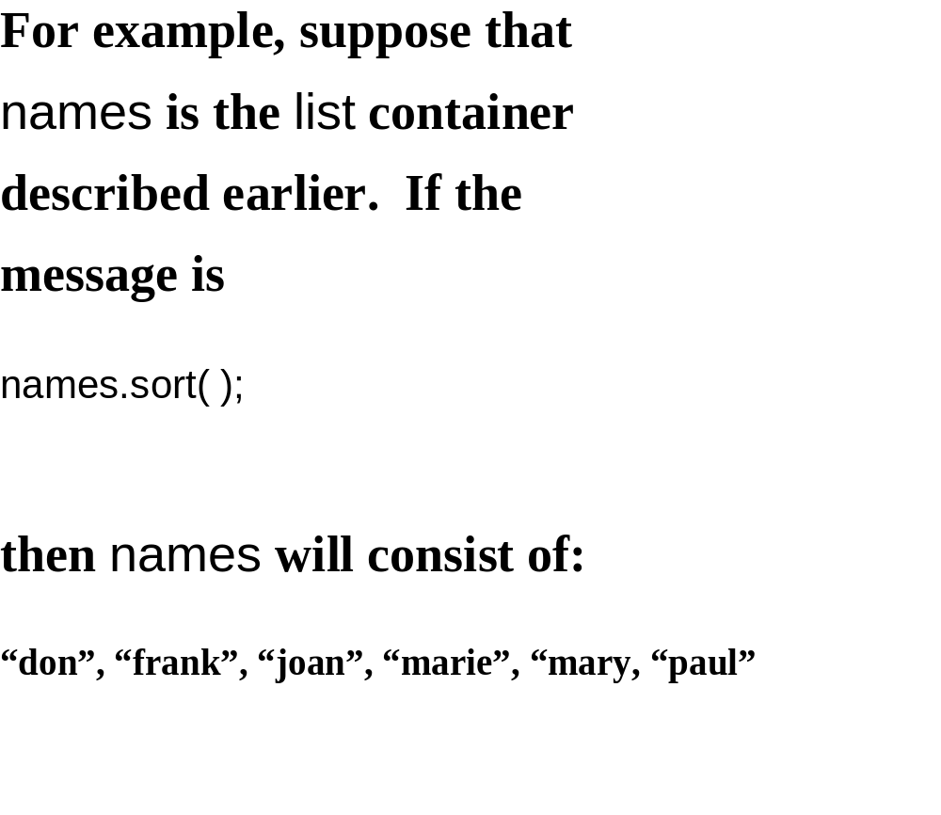

Slide 15
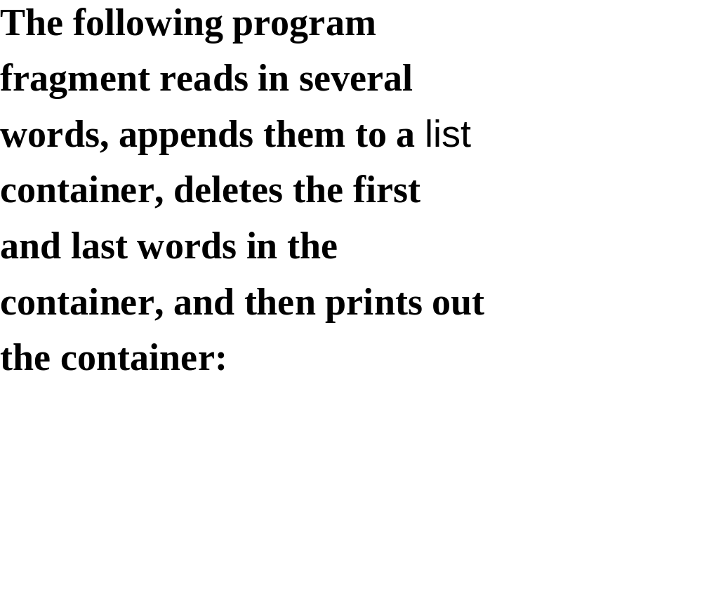

Slide 16
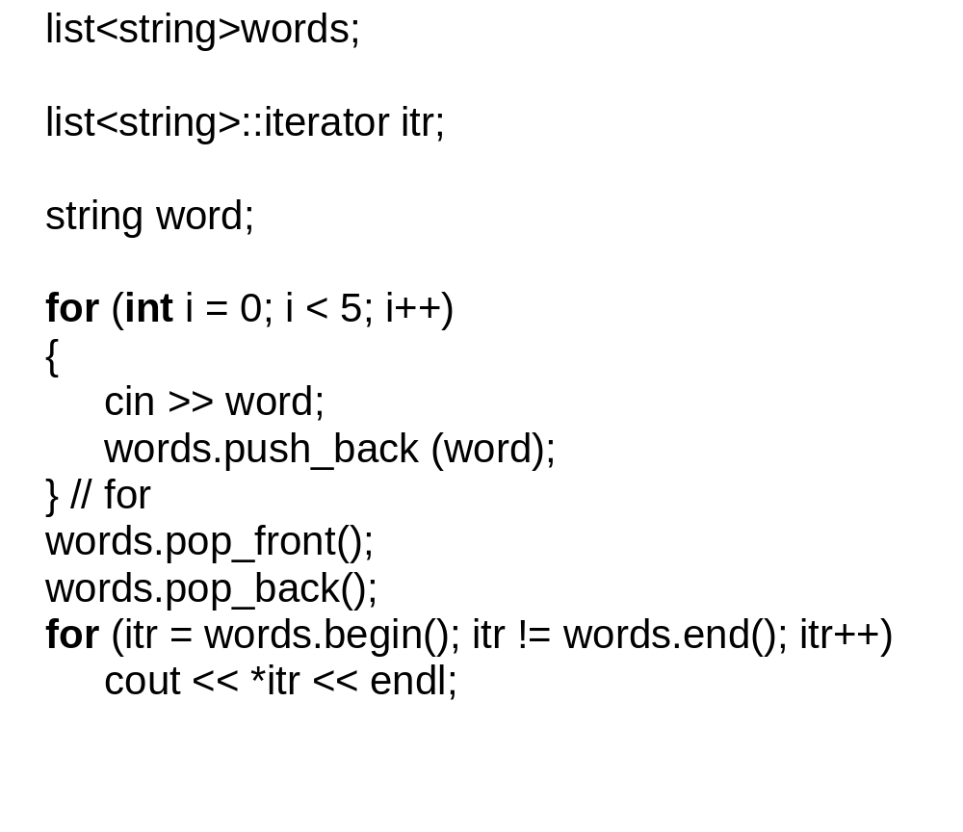

Slide 17
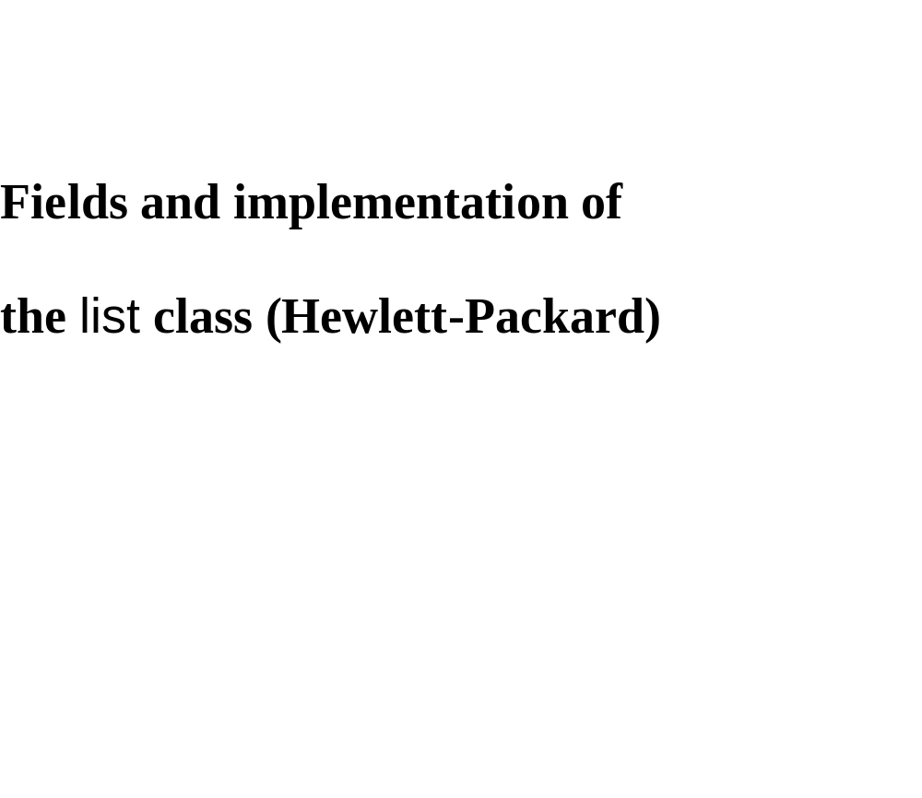

Slide 18
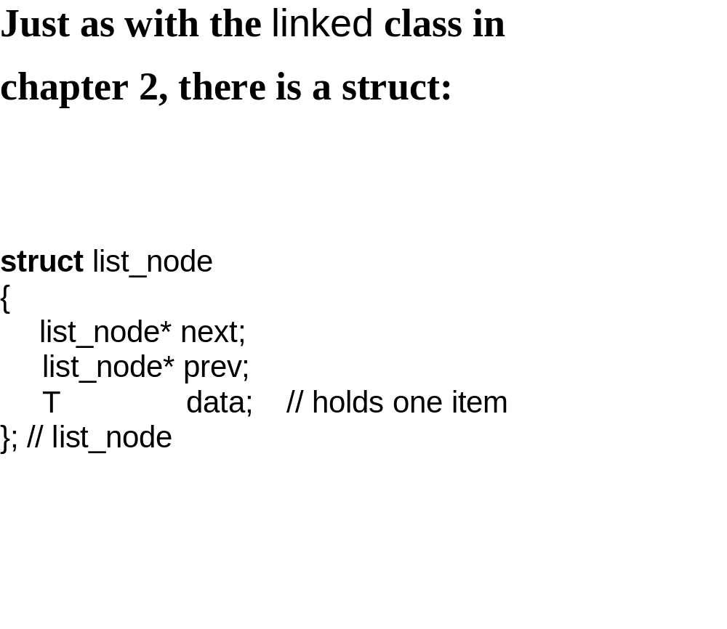

Slide 19
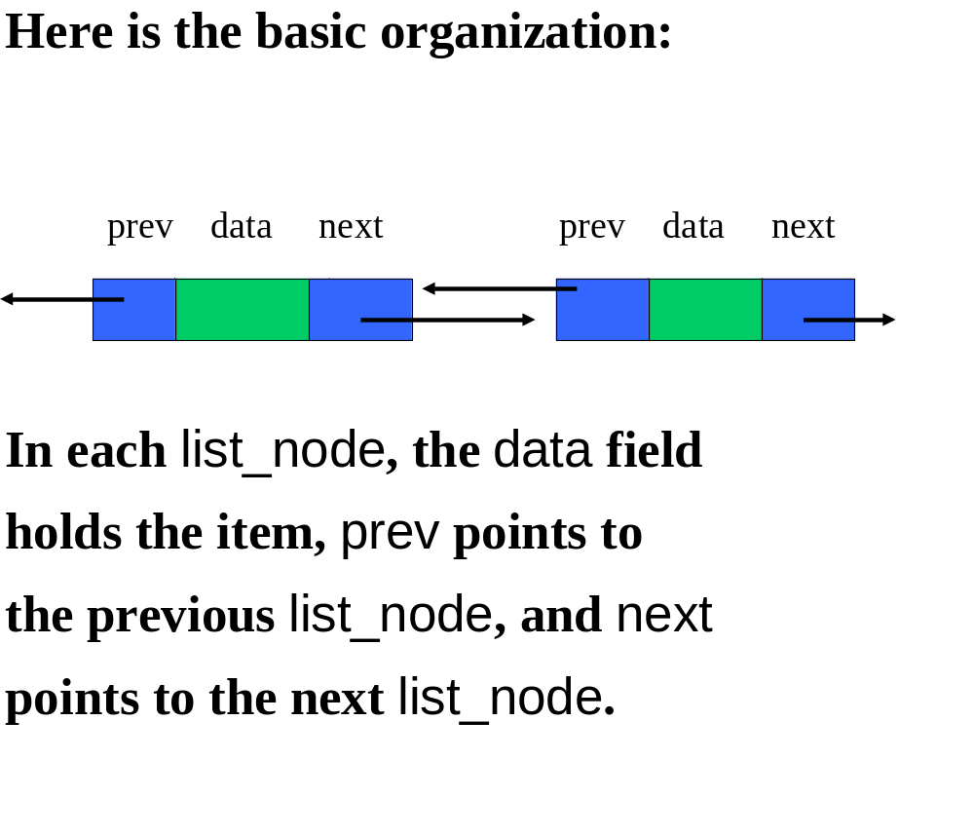

Slide 20
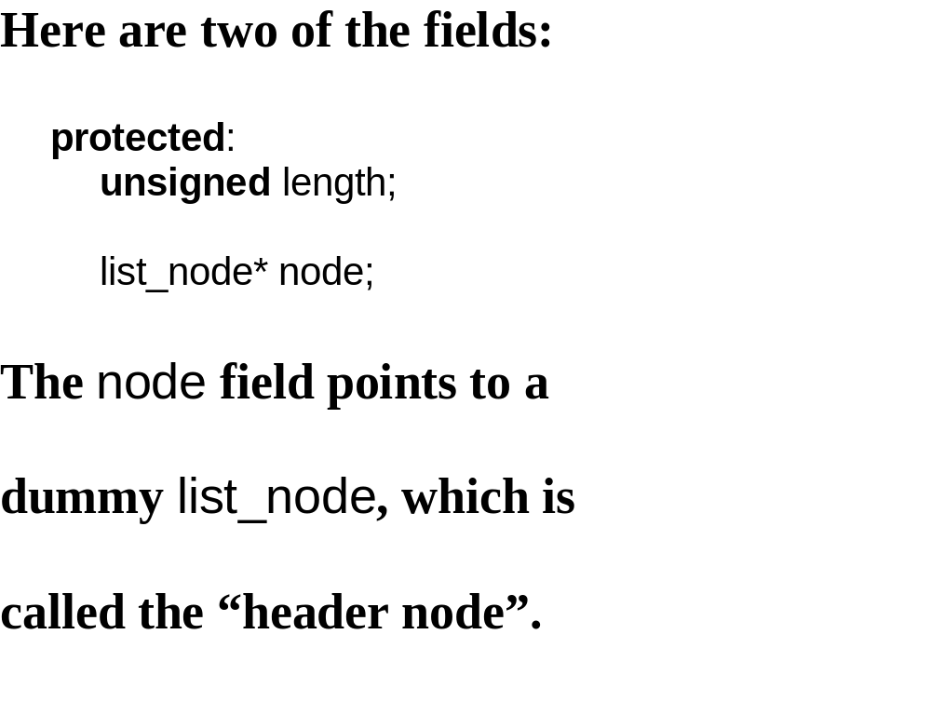

Slide 21
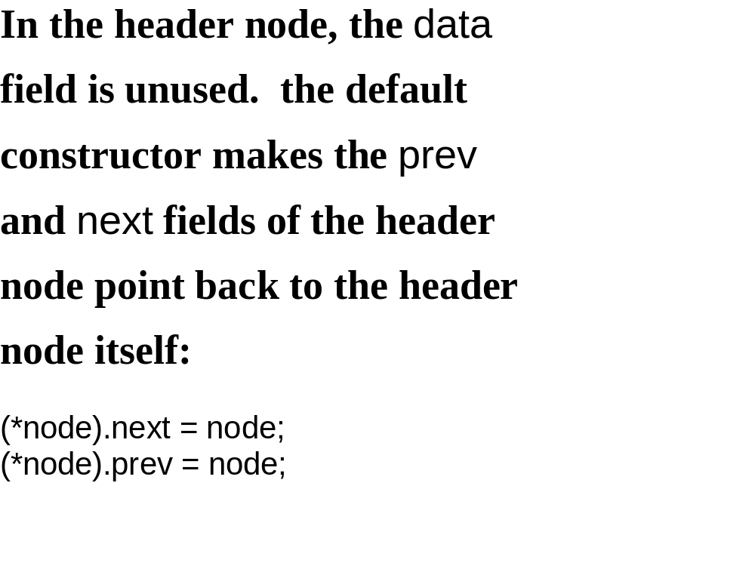

Slide 22
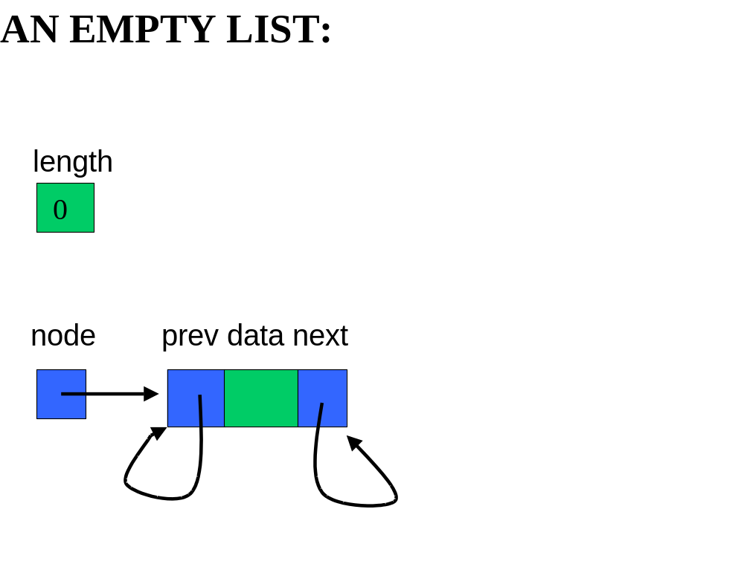

Slide 23
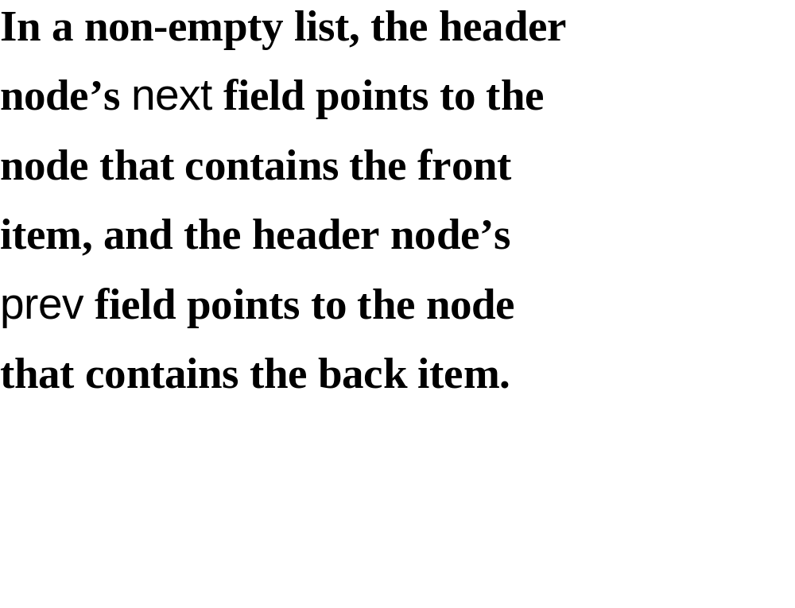

Slide 24
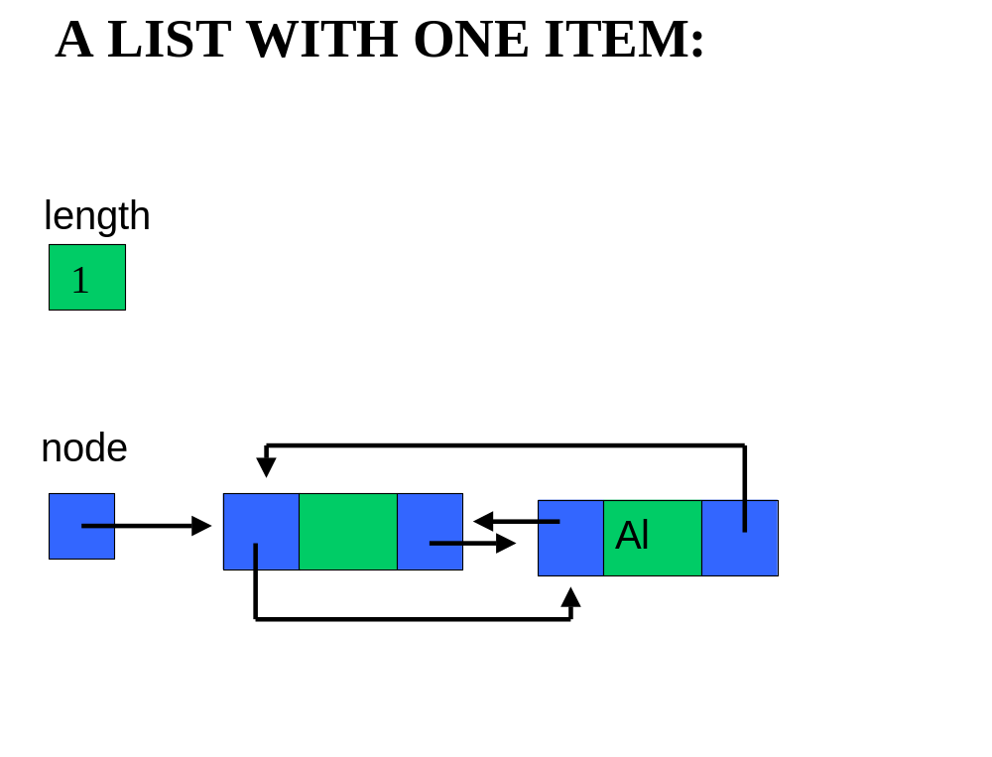

Slide 25
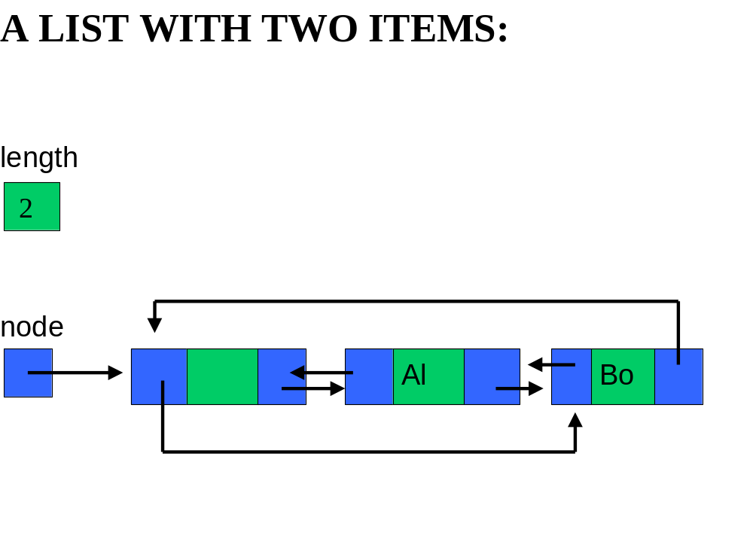

Slide 26
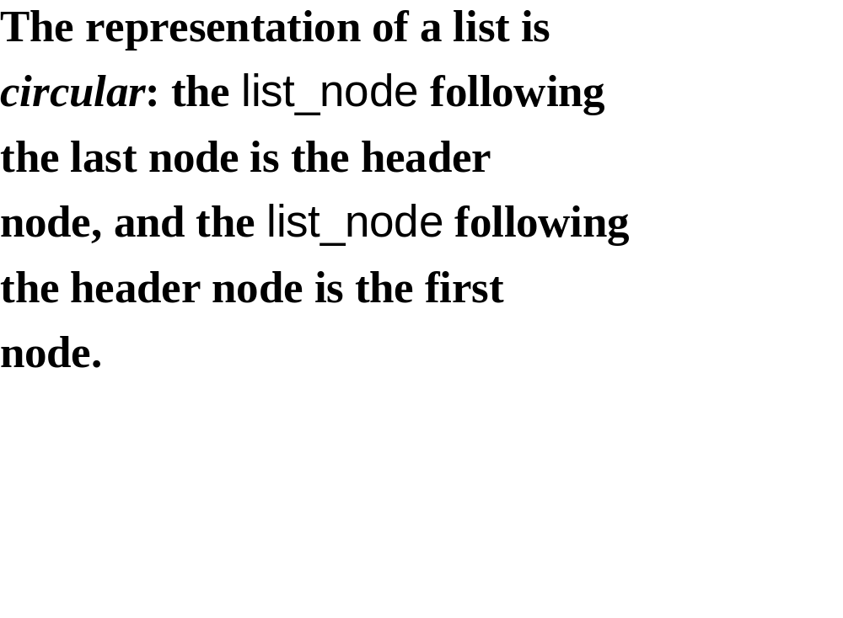

Slide 27
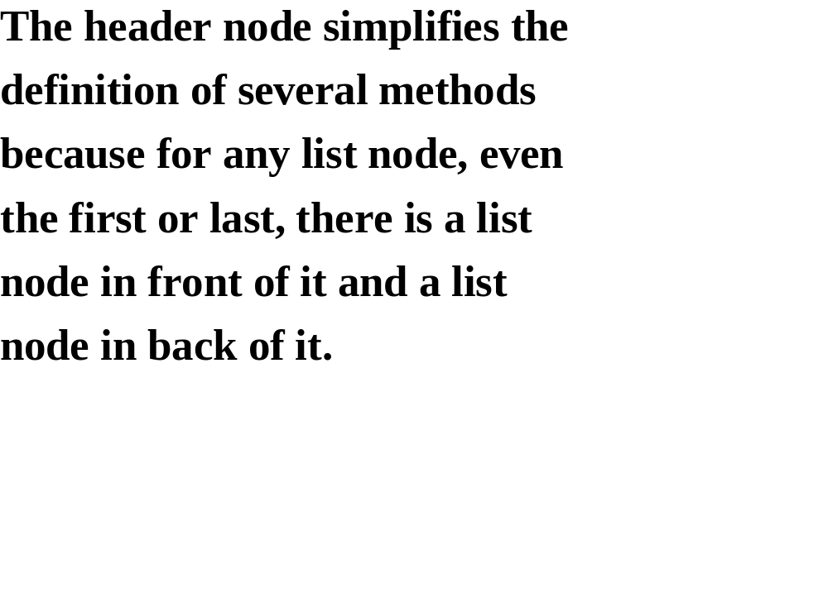

Slide 28
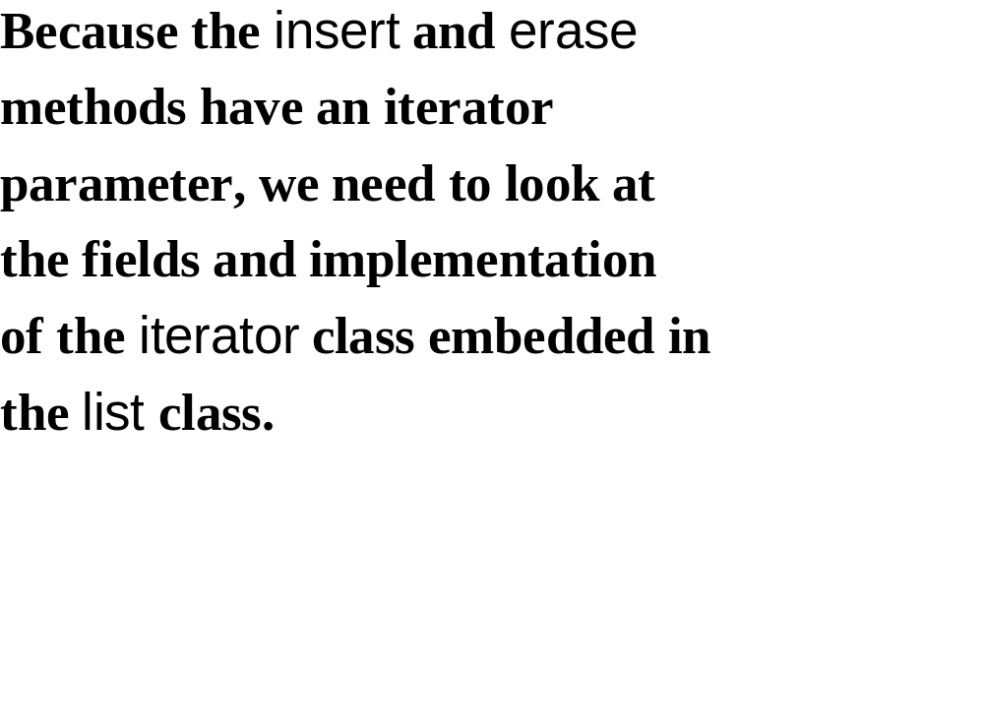

Slide 29
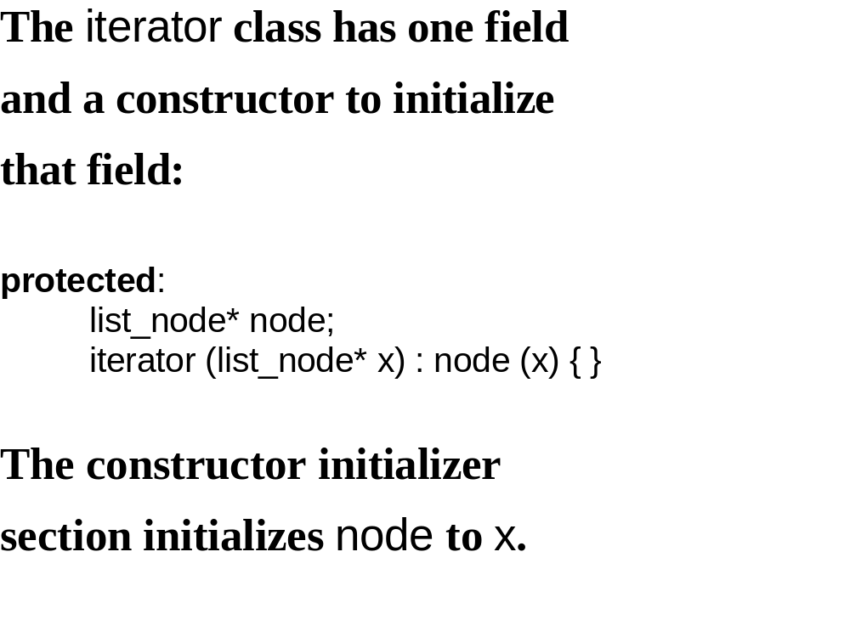

Slide 30
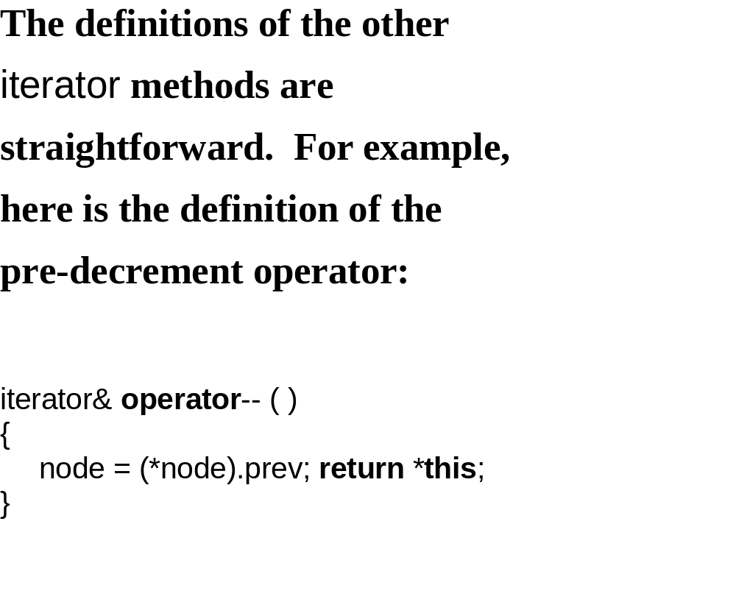

Slide 31
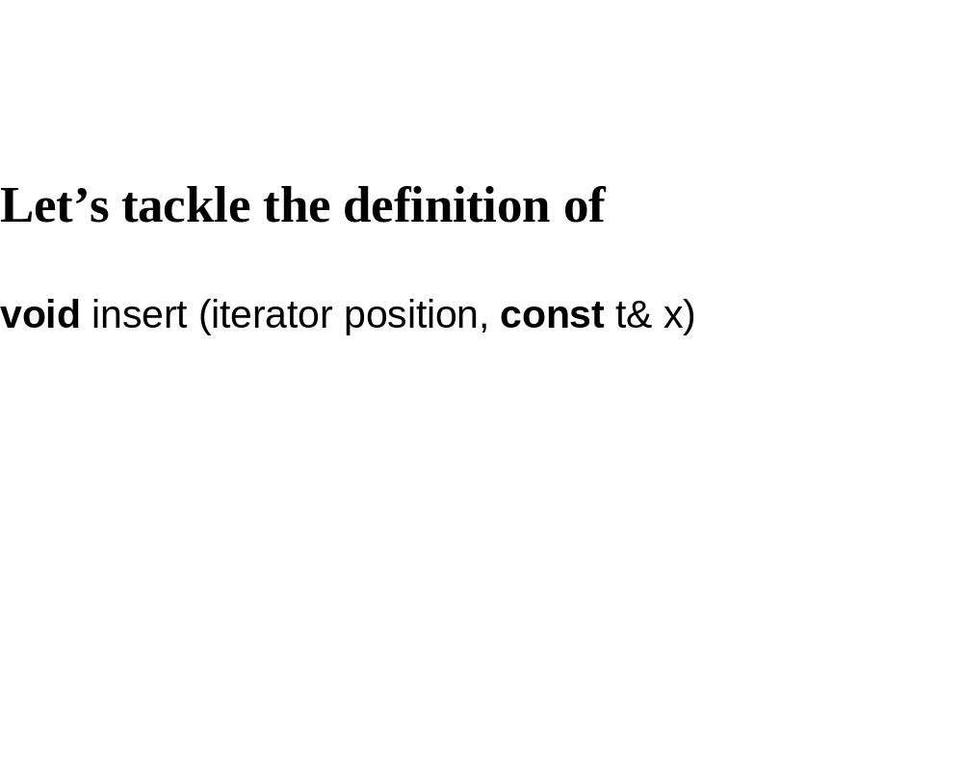

Slide 32
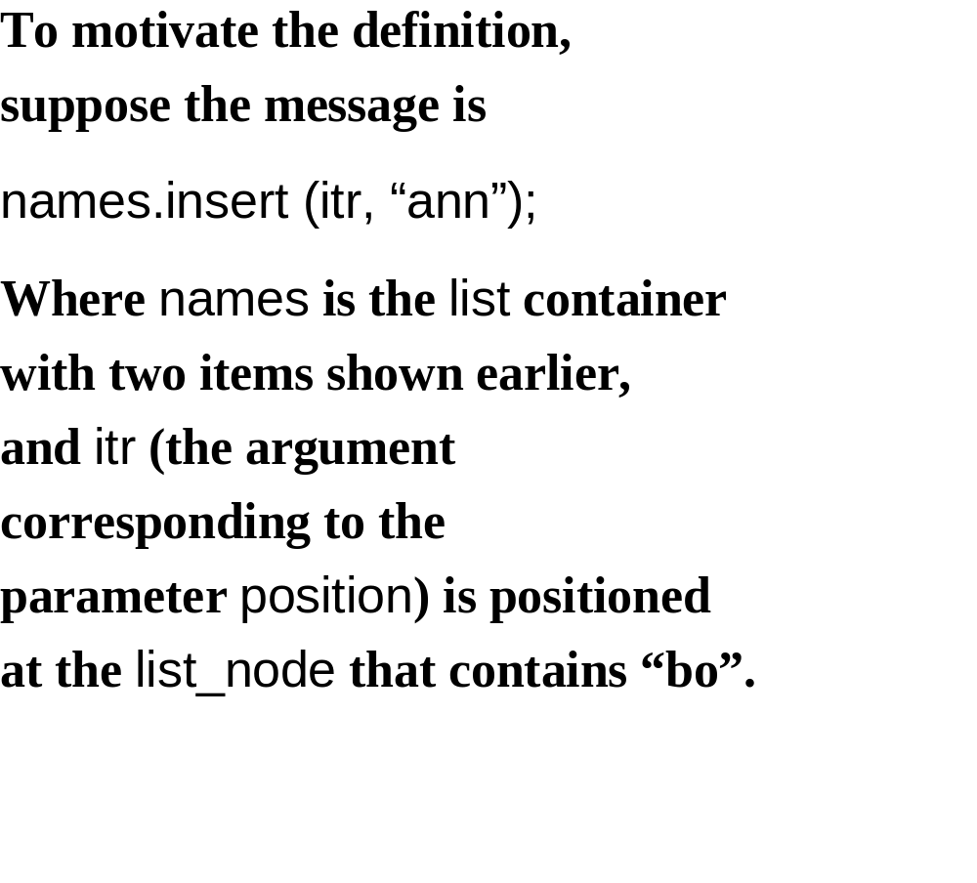

Slide 33
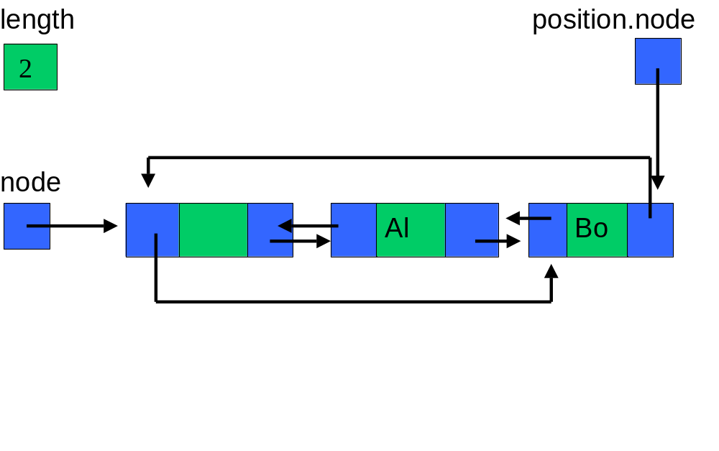

Slide 34
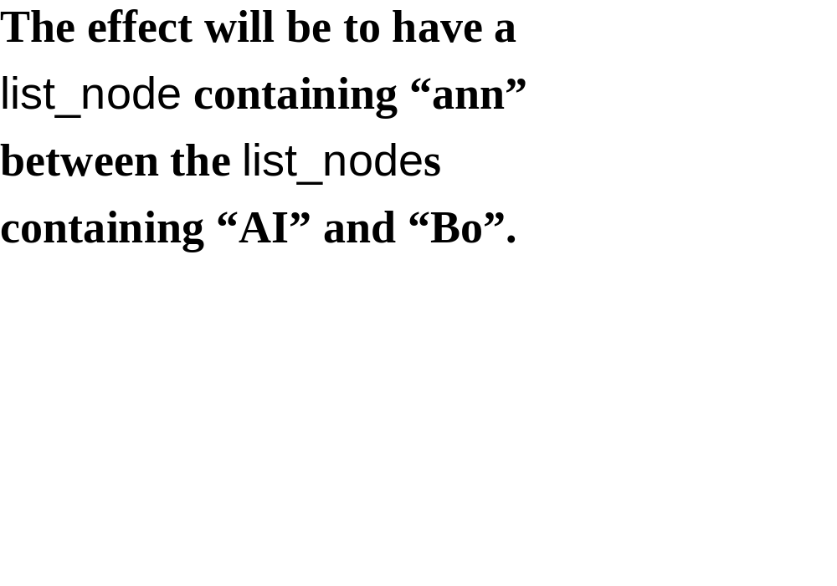

Slide 35
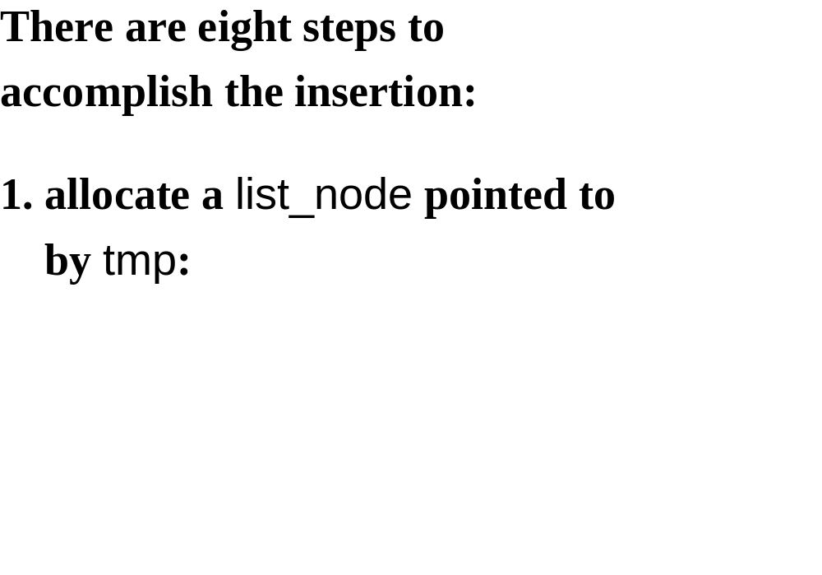

Slide 36
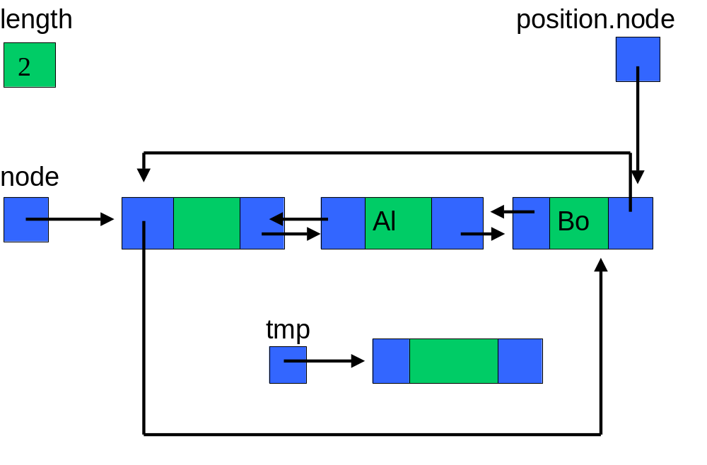

Slide 37
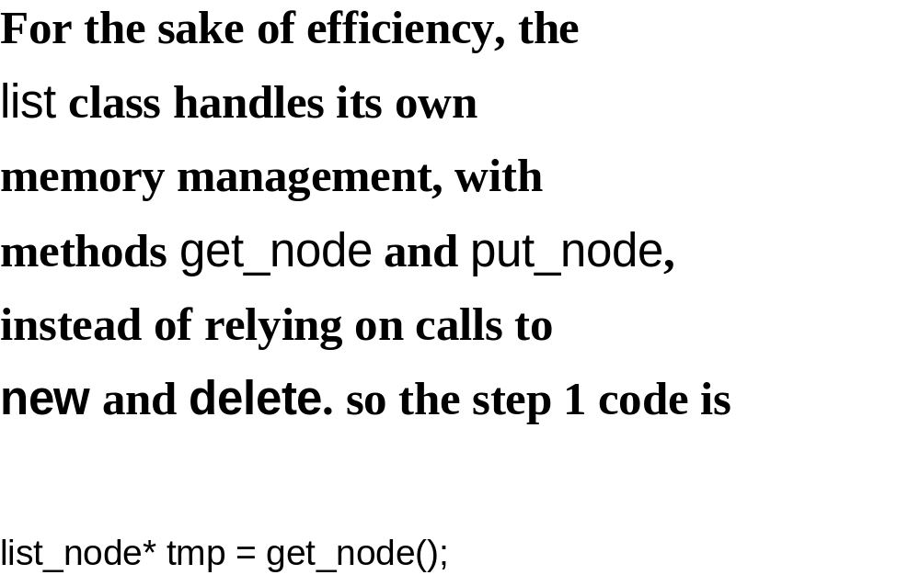

Slide 38
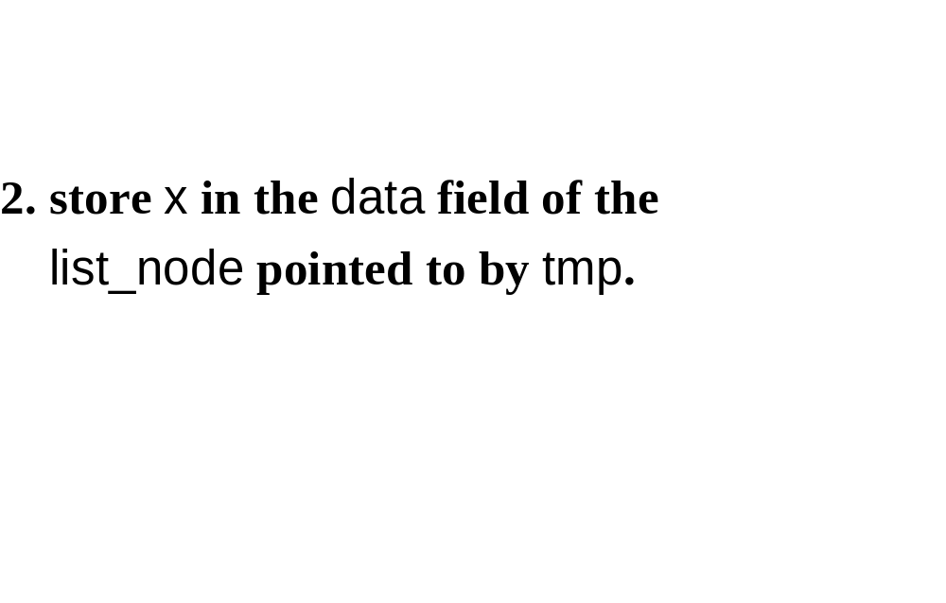

Slide 39


Slide 40
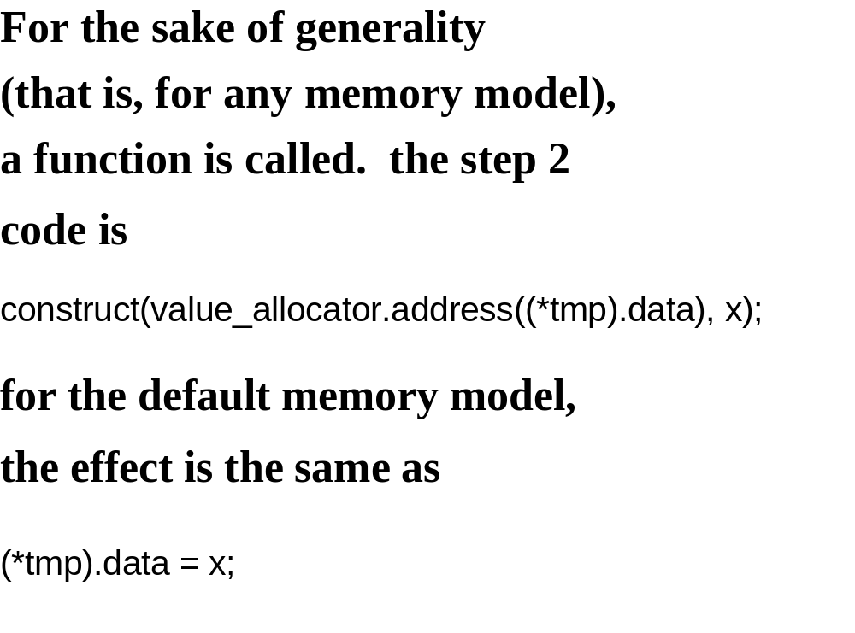

Slide 41
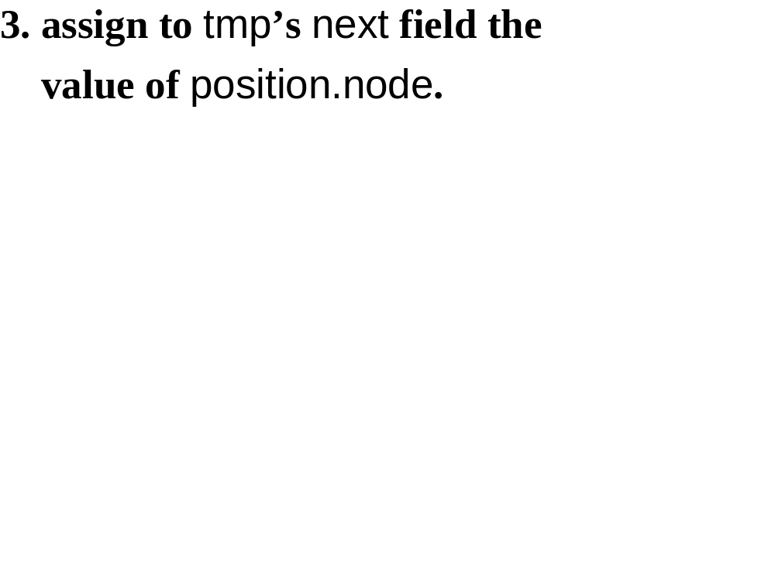

Slide 42
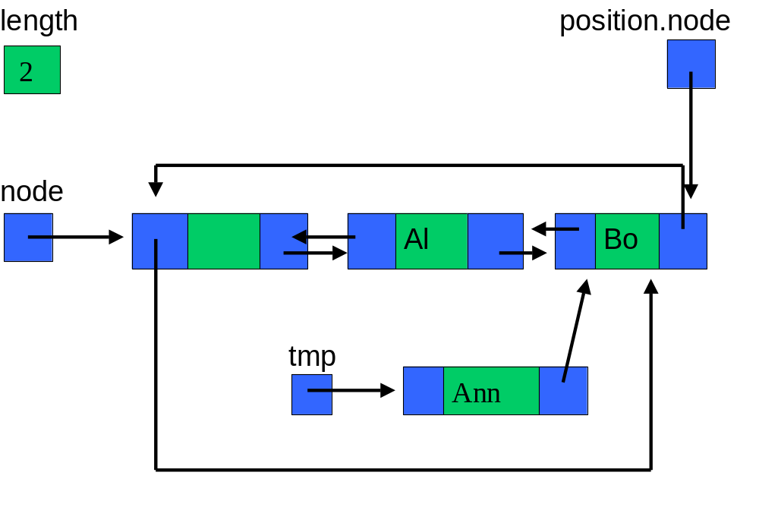

Slide 43
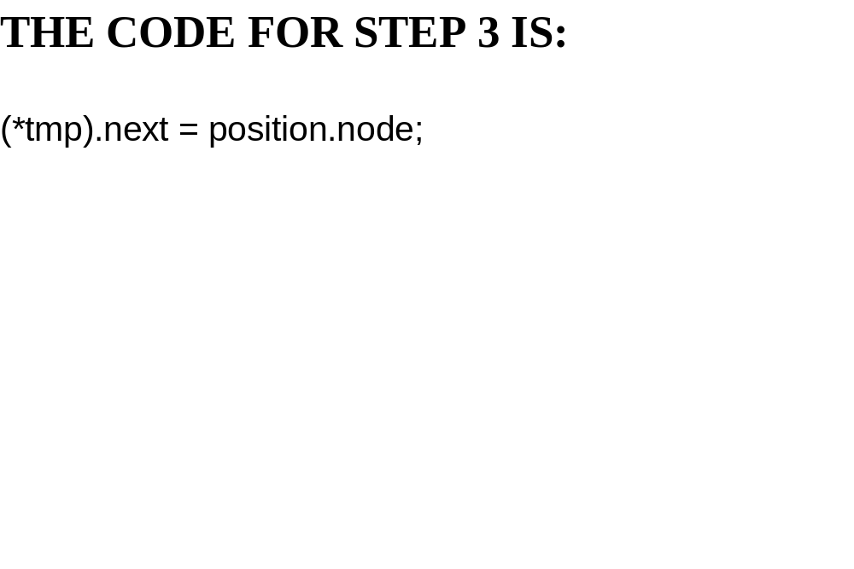

Slide 44
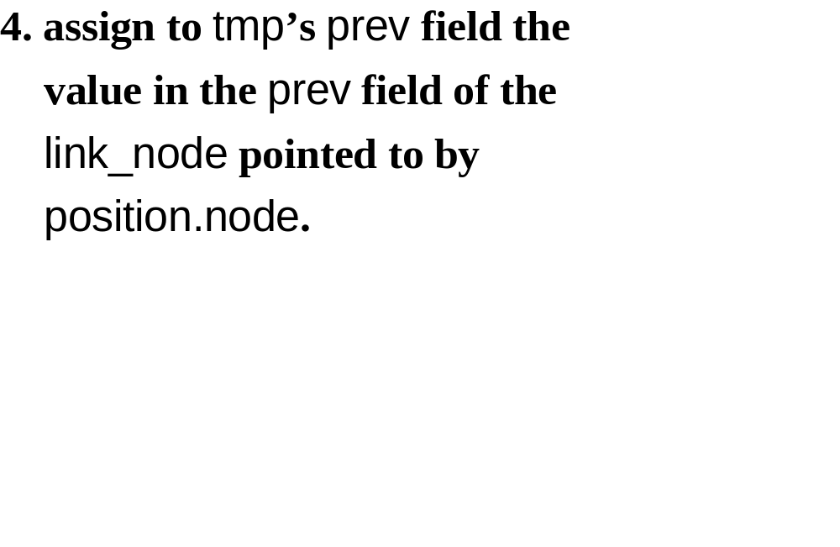

Slide 45


Slide 46
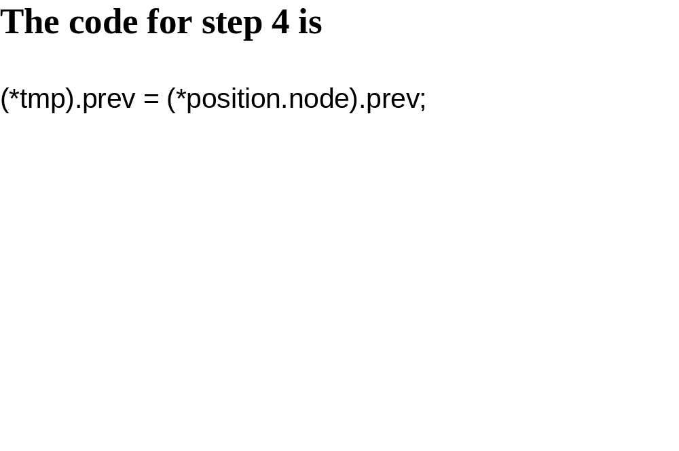

Slide 47
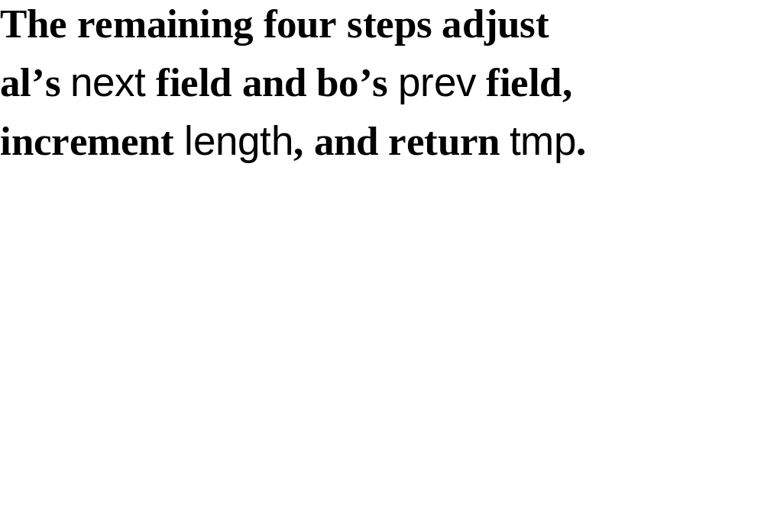

Slide 48
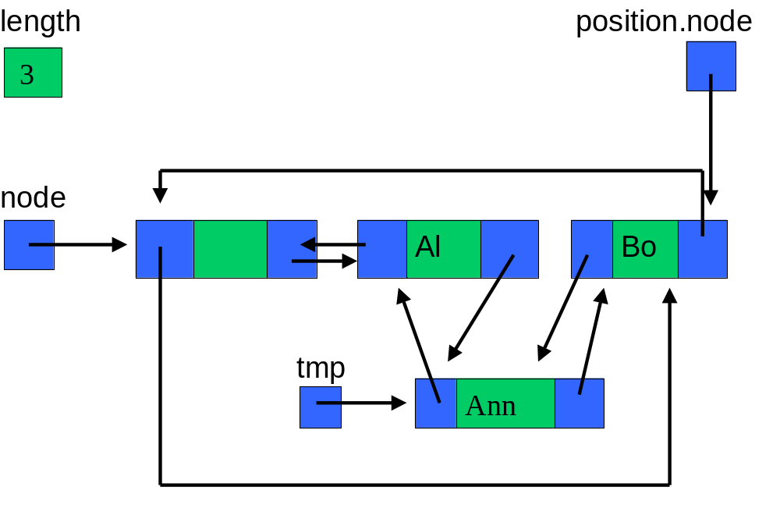

Slide 49
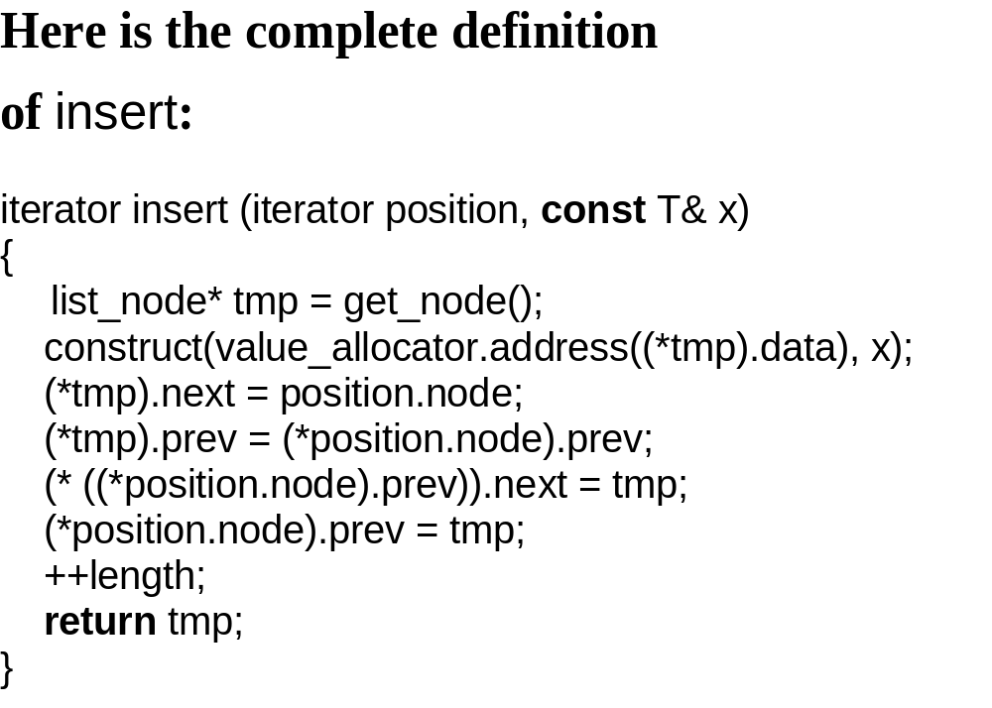

Slide 50
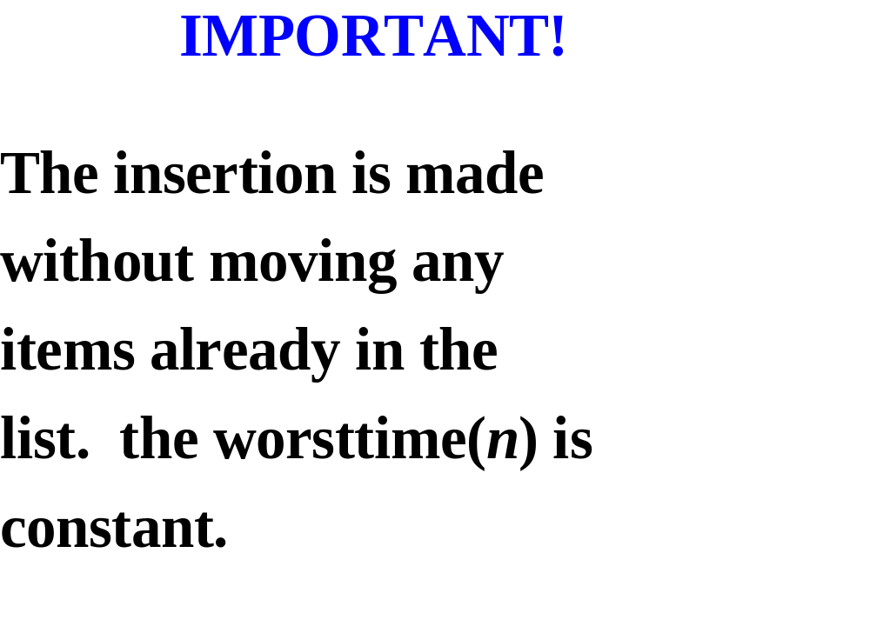

Slide 51
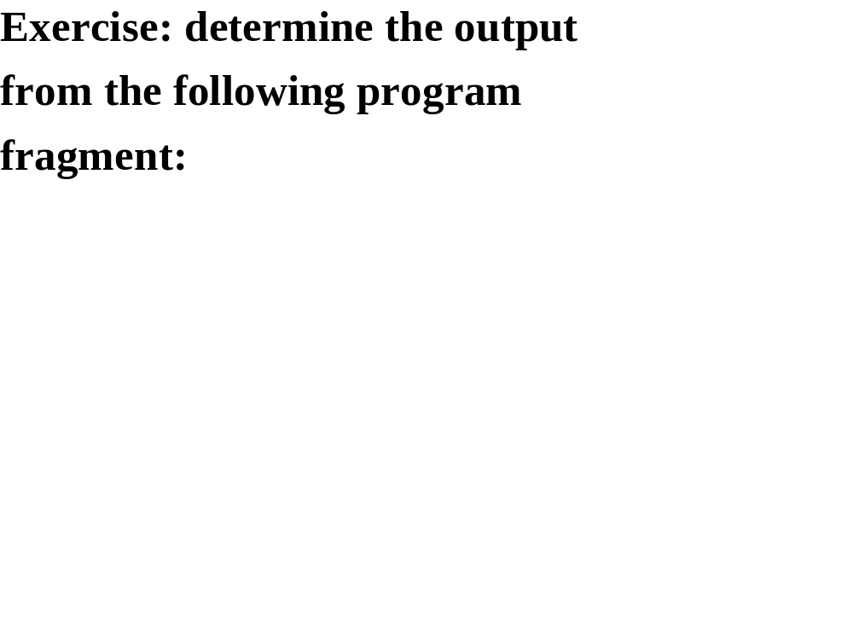

Slide 52
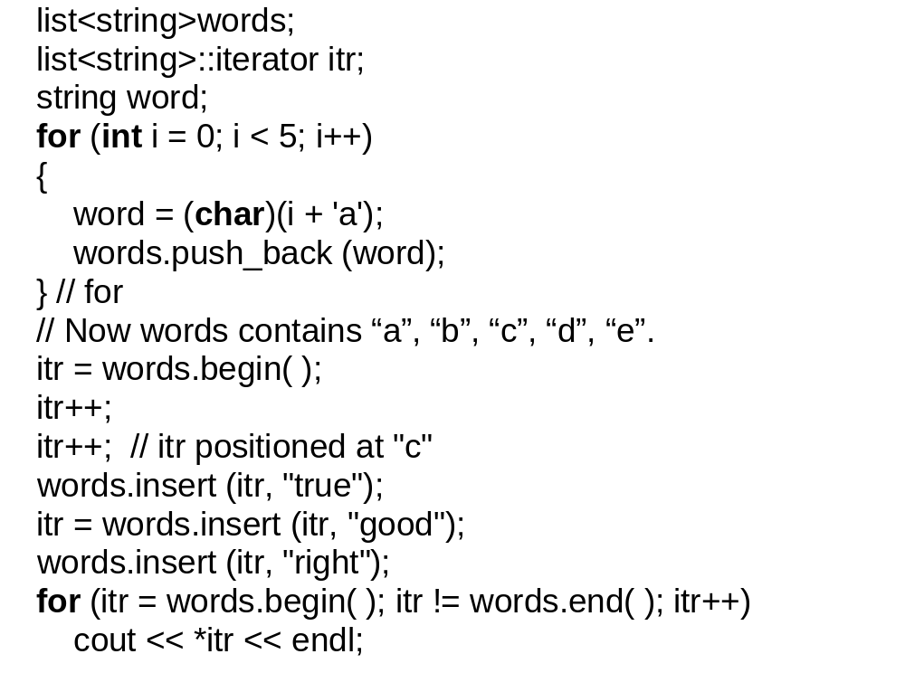

Slide 53
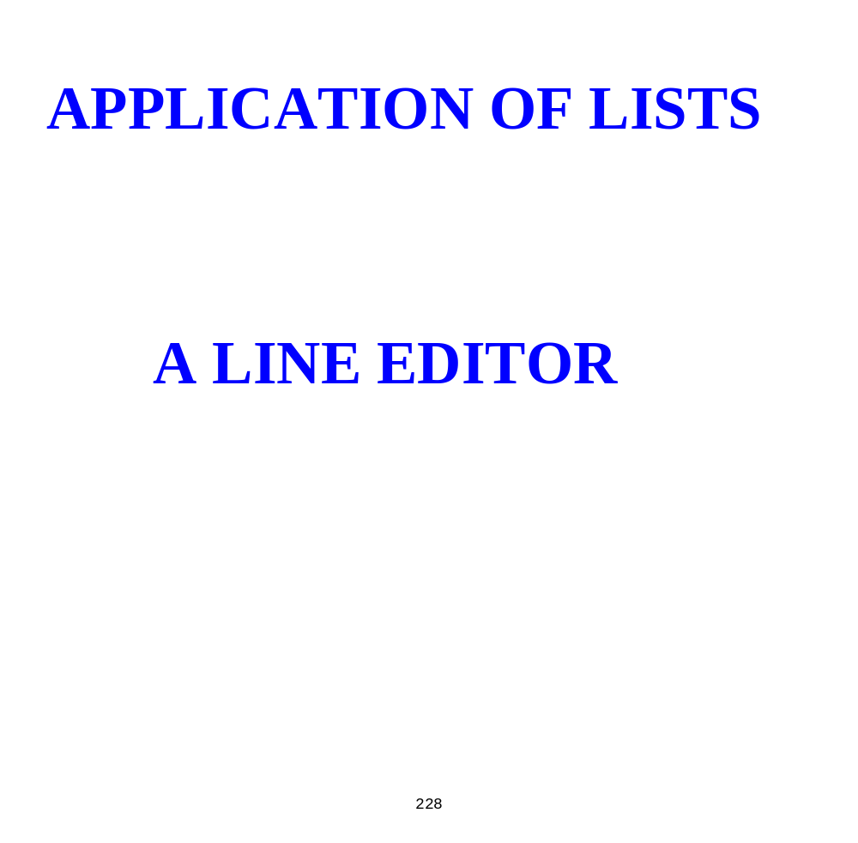

Slide 54


Slide 55


Slide 56


Slide 57


Slide 58


Slide 59


Slide 60


Slide 61


Slide 62


Slide 63


Slide 64


Slide 65


Slide 66


Slide 67


Slide 68


Slide 69


Slide 70


Slide 71


Slide 72


Slide 73


Slide 74


Slide 75


Slide 76


Slide 77


Slide 78


Slide 79


Slide 80


Slide 81


Slide 82


Slide 83


Slide 84
const int MAX_LINE_LENGTH = 75;
const string BLANK = " ";
const string EMPTY_STRING = "";
const string COMMAND_START = "$";
const string INSERT_COMMAND = "$Insert";
const string DELETE_COMMAND = "$Delete";
const string LINE_COMMAND = "$Line";
const string DONE_COMMAND = "$Done";
const string MISSING_COMMAND_ERROR =
"Error: a command must start with ";
const string MISSING_NUMBER_ERROR =
"Error: the line entered is missing a line number.";
const string TWO_NUMBERS_ERROR =
"Error: the line entered is missing both line numbers.";
const string ILLEGAL_COMMAND_ERROR =
"Error: not one of the given commands";
const string LINE_TOO_LONG_ERROR =
"Error: the number of characters in the line is more than the max allowed";
const string FIRST_TOO_SMALL_ERROR =
"Error: the first line number given is less than -1.";
const string SECOND_TOO_LARGE_ERROR =
"Error: the second line number > the last line number in the text.";
const string FIRST_GREATER_THAN_SECOND_ERROR =
"Error: the first line number > the second line number.";
const string FIRST_TOO_LARGE_ERROR =
"Error: the first line number > the last line number in the text.";

Slide 85


Slide 86


Slide 87


Slide 88


Slide 89


Slide 90


Slide 91


Slide 92


Slide 93


Slide 94


Slide 95


Slide 96


Slide 97


Slide 98


Slide 99


Slide 100


Slide 101


Slide 102


Slide 103


