Slide 1
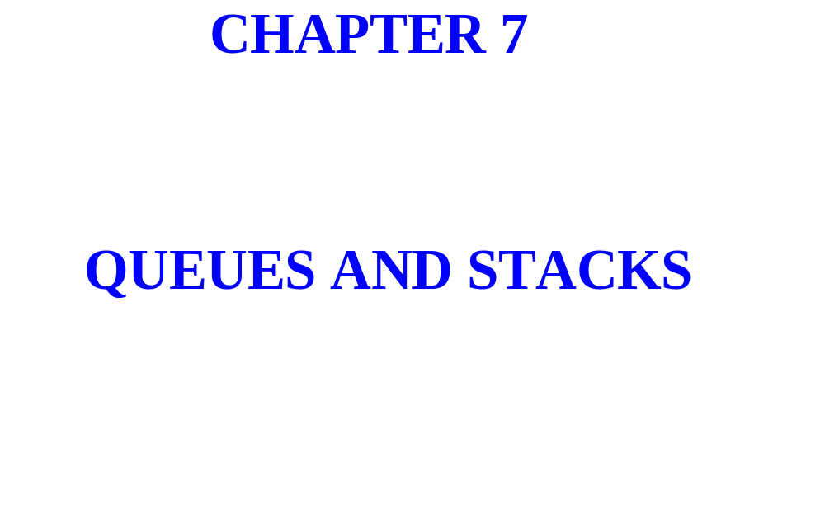

Slide 2
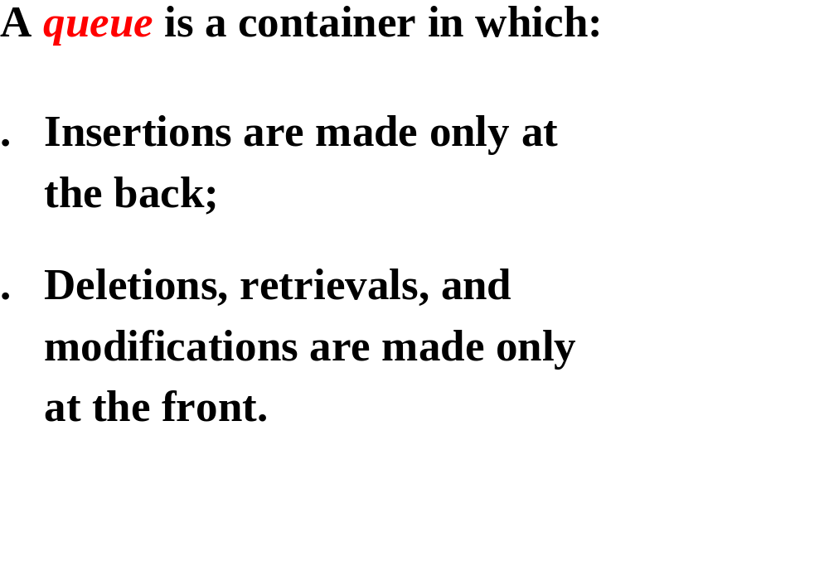

Slide 3
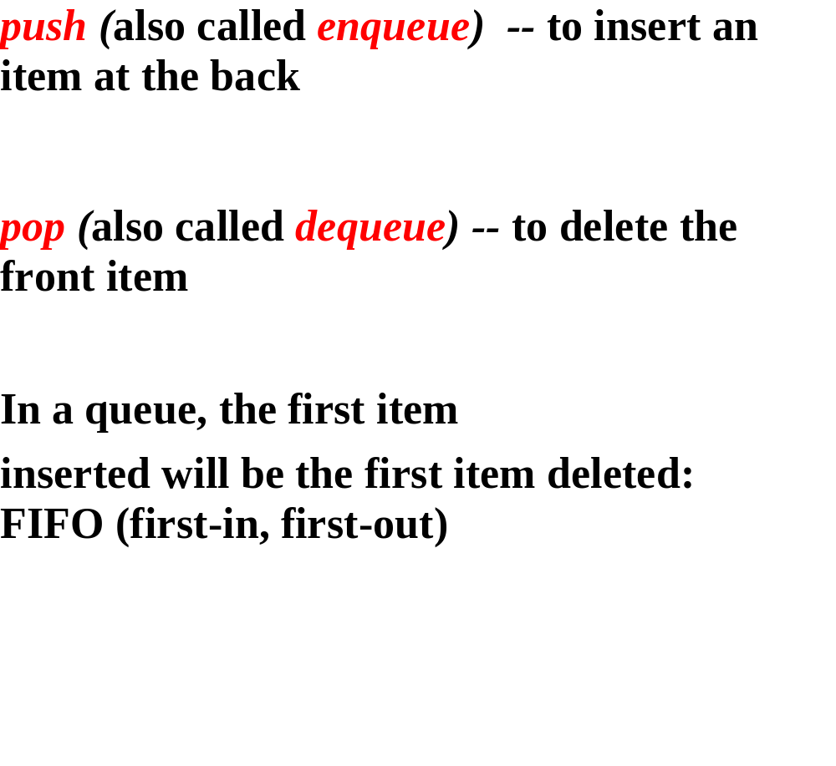

Slide 4
PUSH “MATT”

Slide 5
MATT
FRONT
BACK

Slide 6
PUSH “ANDREW”

Slide 7
MATT
ANDREW
FRONT
BACK

Slide 8
PUSH “SAMIRA”

Slide 9
MATT
ANDREW
SAM IRA
FRONT
BACK

Slide 10
POP

Slide 11
ANDREW
SAM IRA
FRONT
BACK

Slide 12
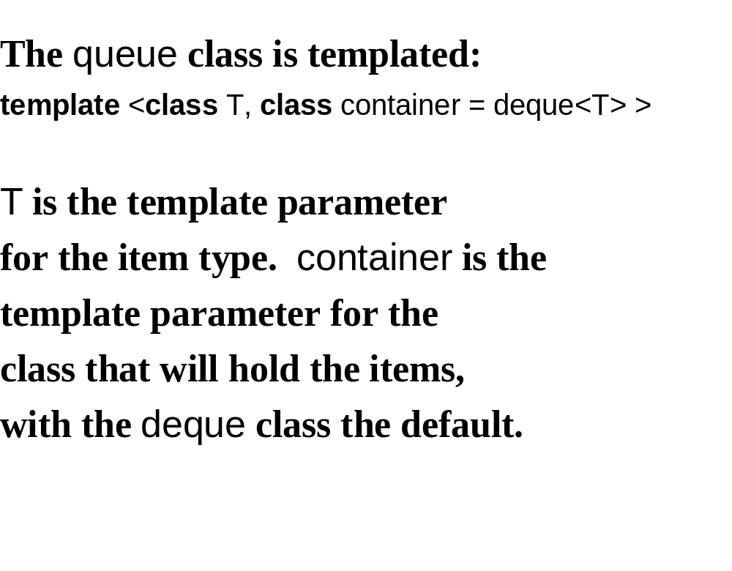

Slide 13
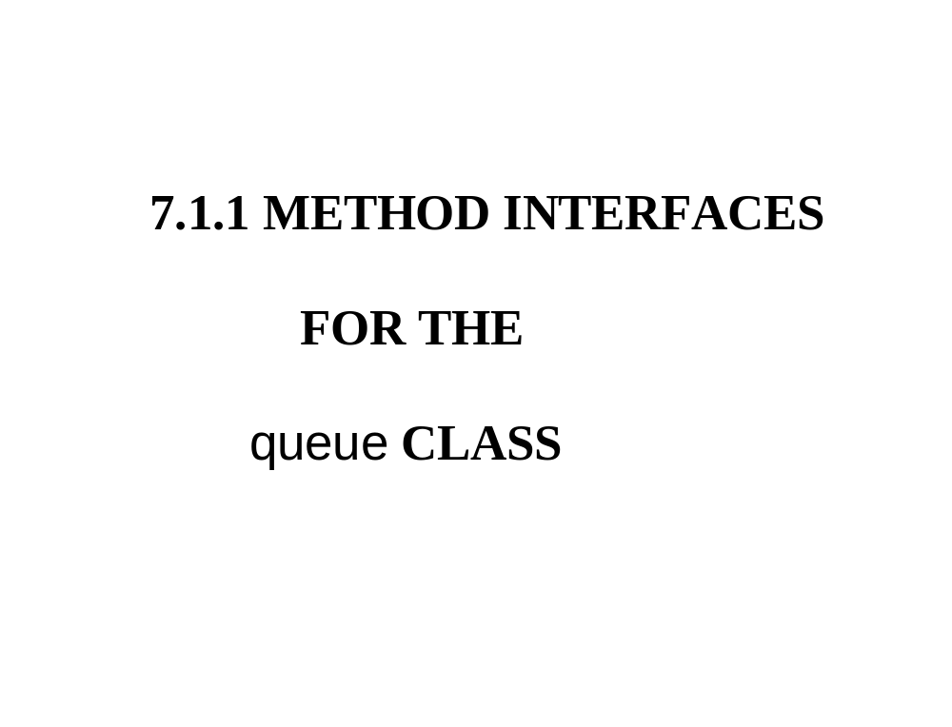

Slide 14
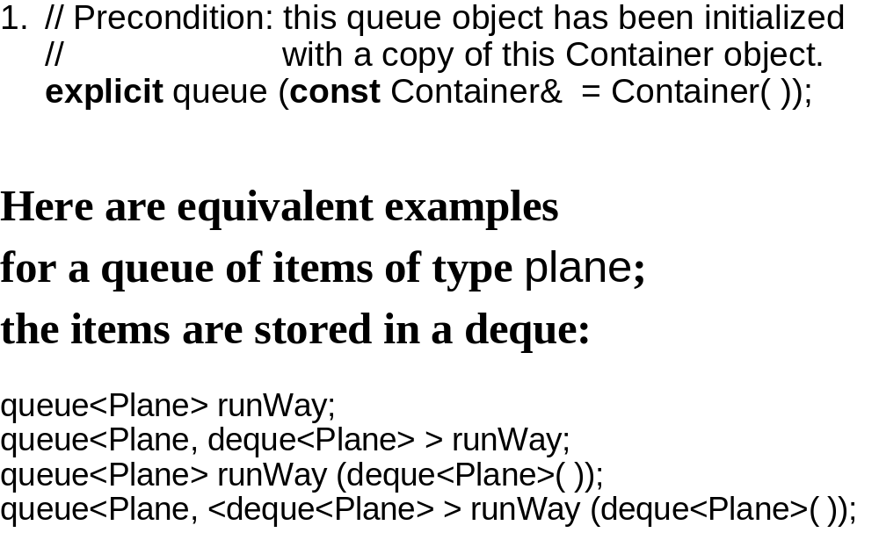
Notes:
c++中的explicit关键字用来修饰类的构造函数，表明该构造函数是显式的，既然有"显式"那么必然就有"隐式"，那么什么是显示而什么又是隐式的呢？
如果c++类的构造函数有一个参数，那么在编译的时候就会有一个缺省的转换操作：将该构造函数对应数据类型的数据转换为该类对象，如下面所示：
class MyClass
{
public:
MyClass( int num );
}
....
MyClass obj = 10; //ok,convert int to MyClass
在上面的代码中编译器自动将整型转换为MyClass类对象，实际上等同于下面的操作：
MyClass temp(10);
MyClass obj = temp;
上面的所有的操作即是所谓的"隐式转换"。
如 果要避免这种自动转换的功能，我们该怎么做呢？嘿嘿这就是关键字explicit的作用了，将类的构造函数声明为"显示"，也就是在声明构造函数的时候前 面添加上explicit即可，这样就可以防止这种自动的转换操作，如果我们修改上面的MyClass类的构造函数为显示的，那么下面的代码就不能够编译 通过了，如下所示：
class MyClass
{
public:
explicit MyClass( int num );
}
....
MyClass obj = 10; //err,can't non-explict convert

Slide 15
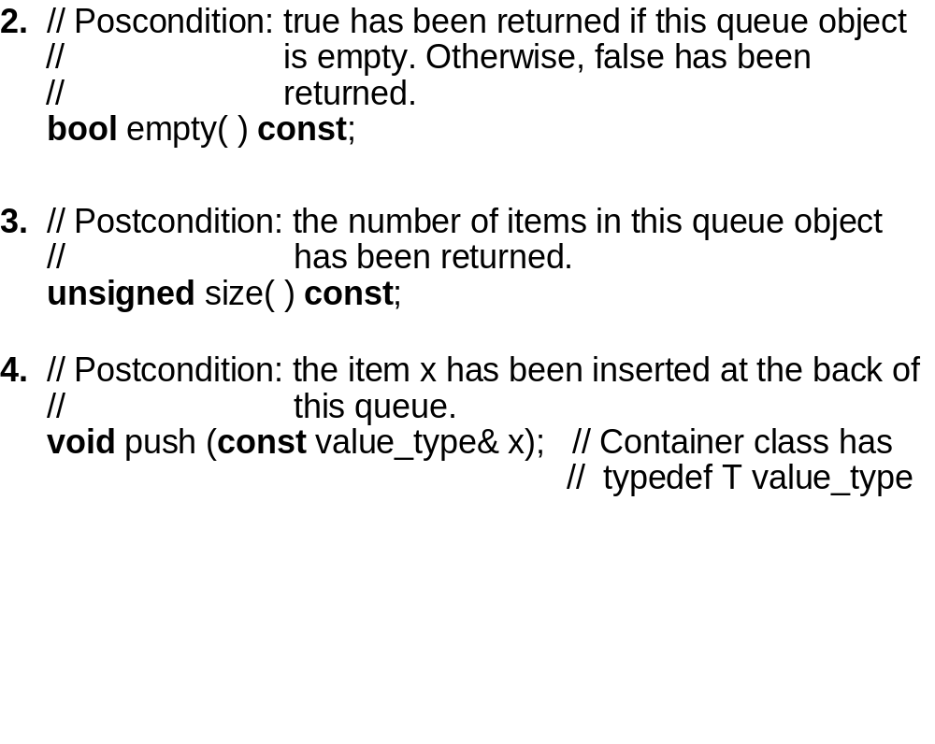

Slide 16
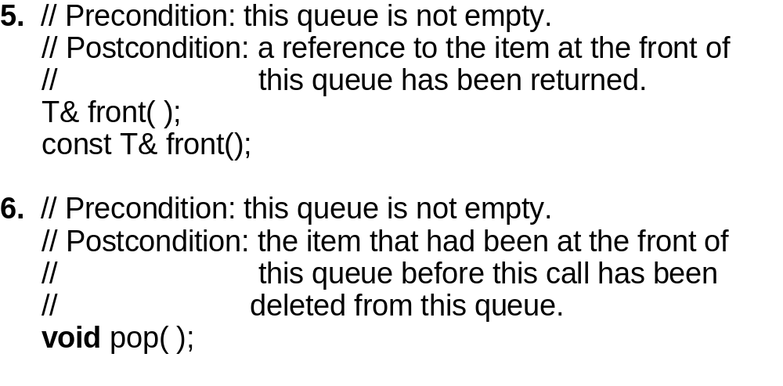

Slide 17
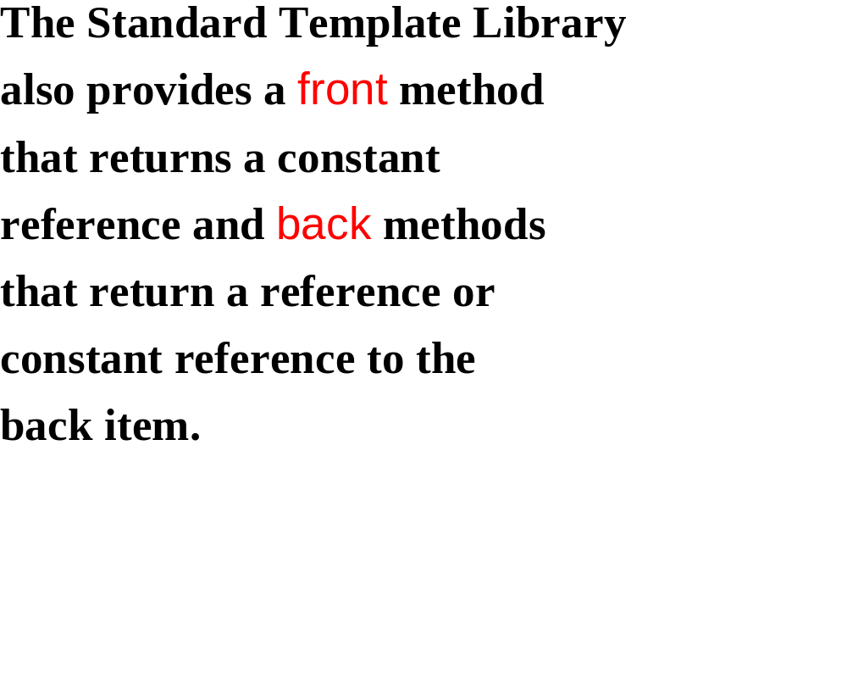

Slide 18
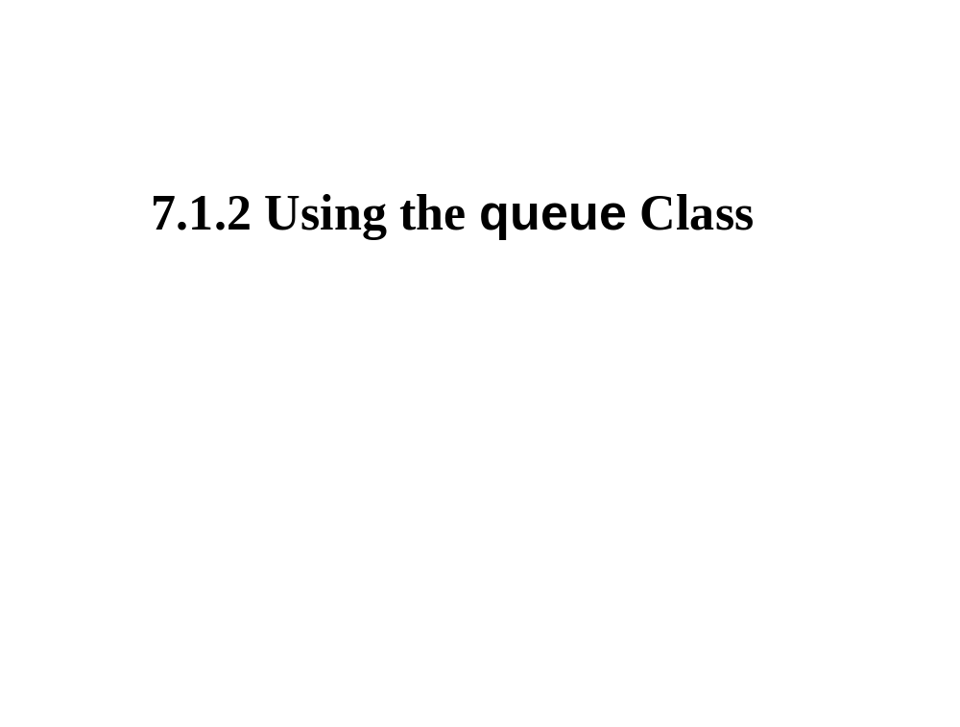

Slide 19
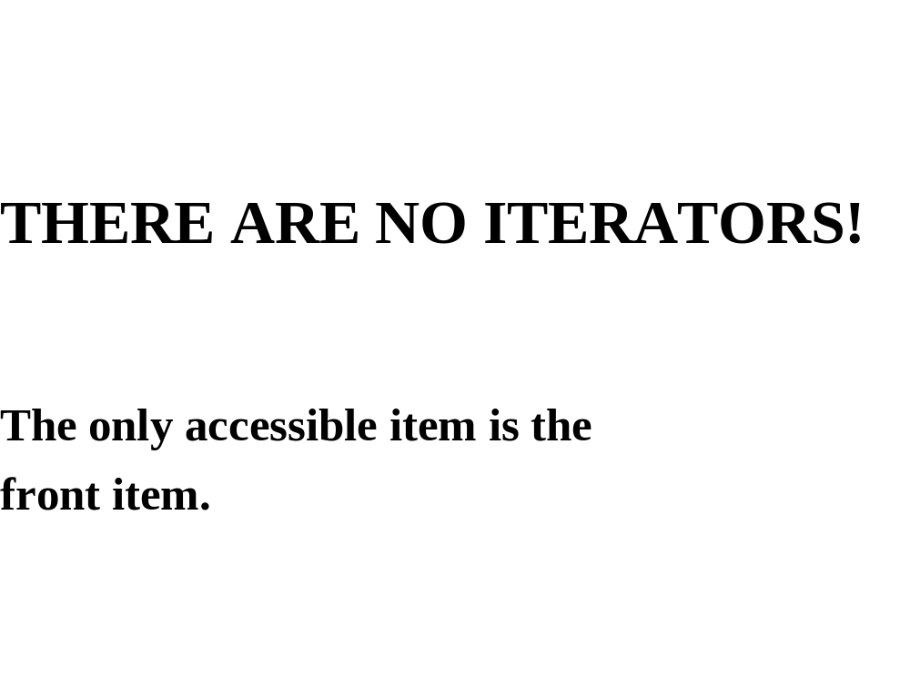

Slide 20
Determine the output from the
following:
queue<int> my_queue;
for (int i = 0; i < 10; i++)
my_queue.push (i * i);
while (!my_queue.empty())
{
cout << my_queue.front() << endl;
my_queue.pop();
} // while

Slide 21
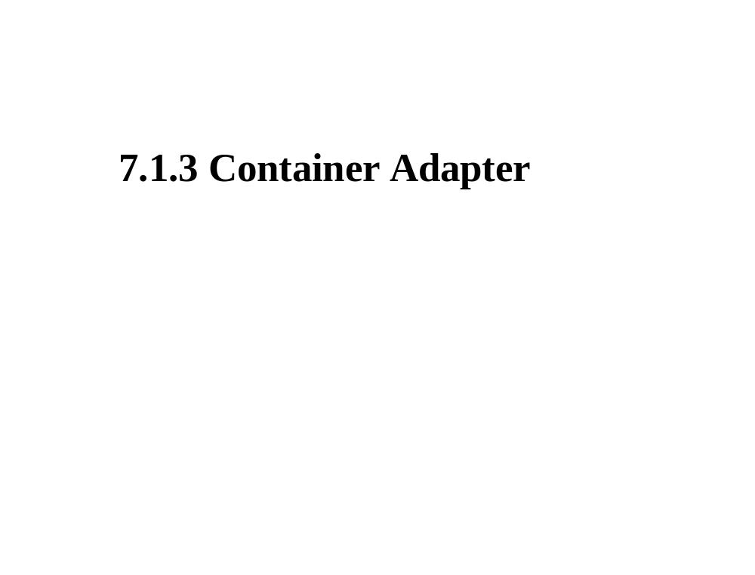

Slide 22
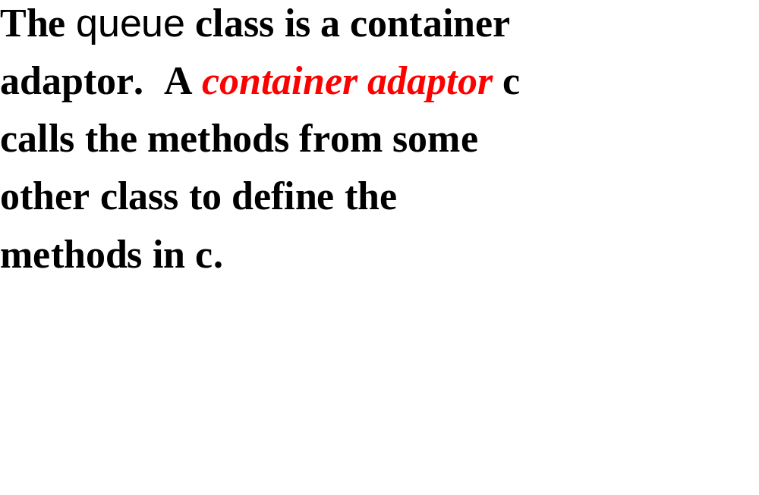
Items
Adapter
Container

Slide 23
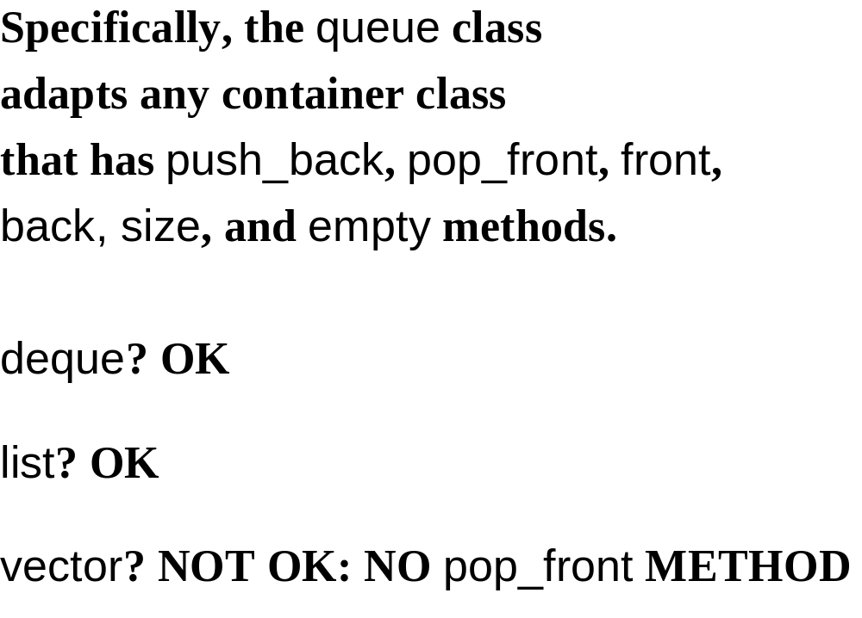

Slide 24
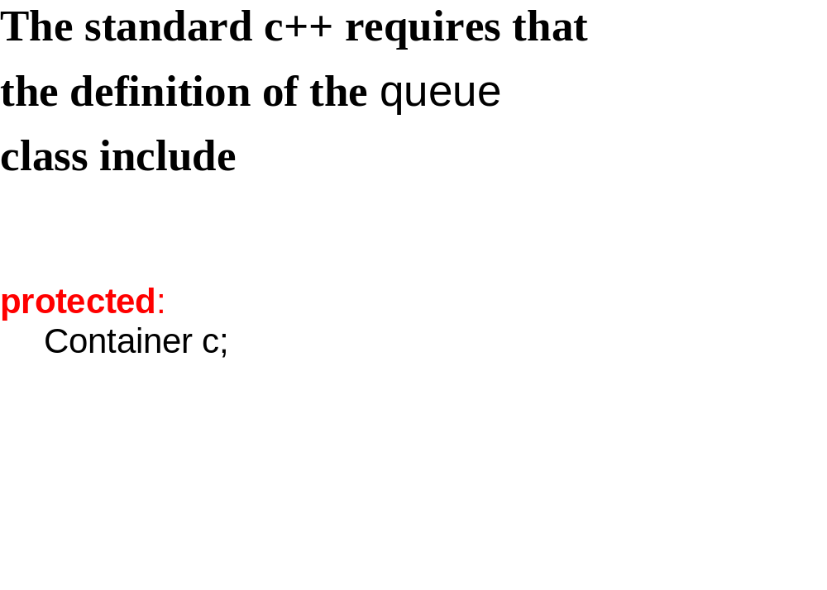

Slide 25
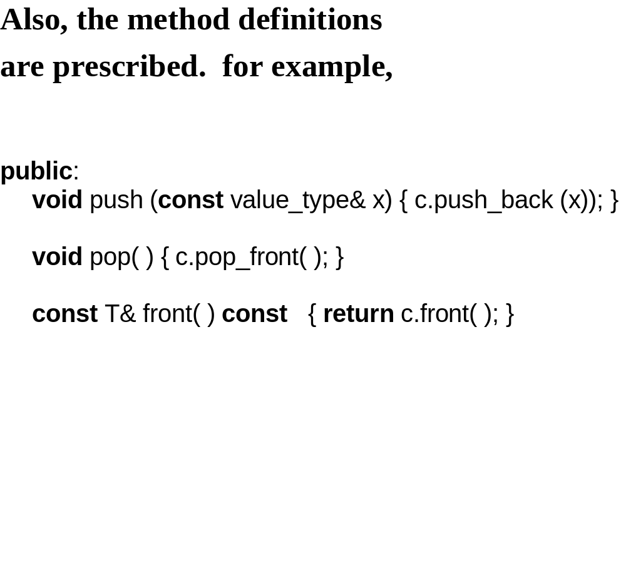

Slide 26
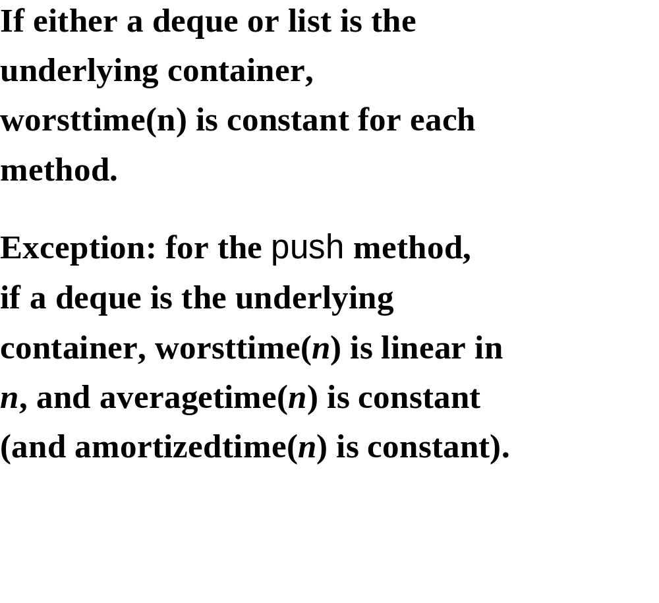

Slide 27
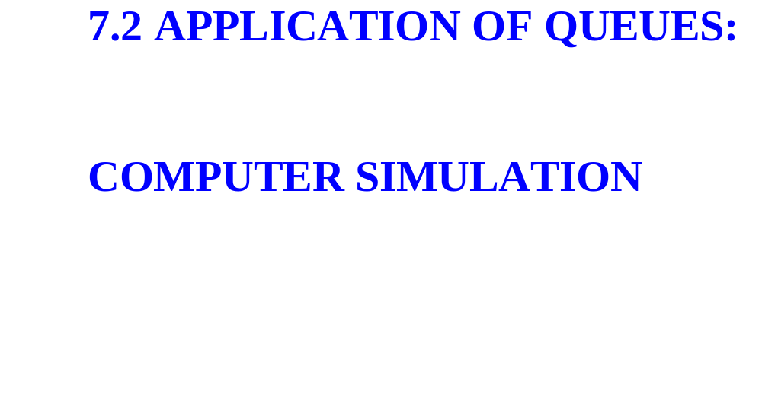

Slide 28
A system is a collection of
interacting parts.

Slide 29
A model is a simplification of
a system.
The purpose of building a model
is to study the underlying system.

Slide 30
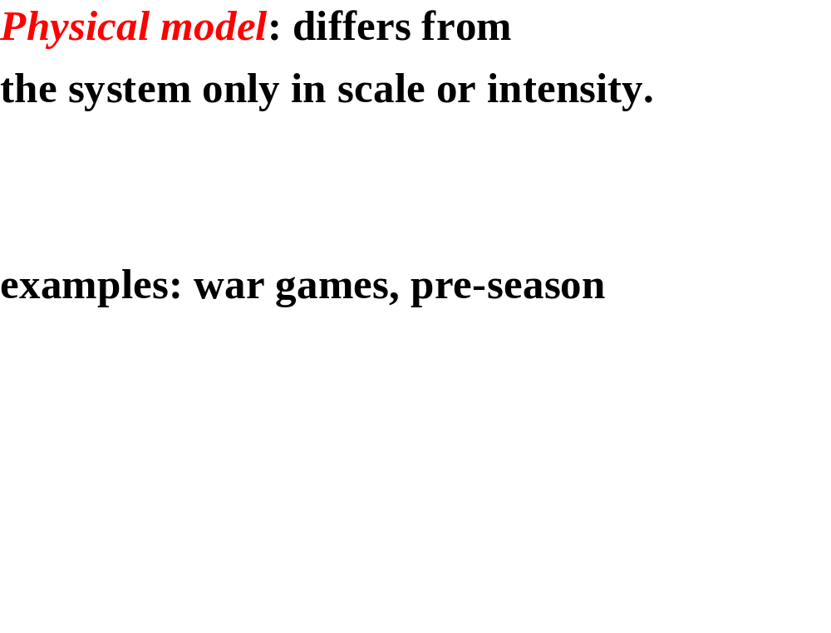

Slide 31
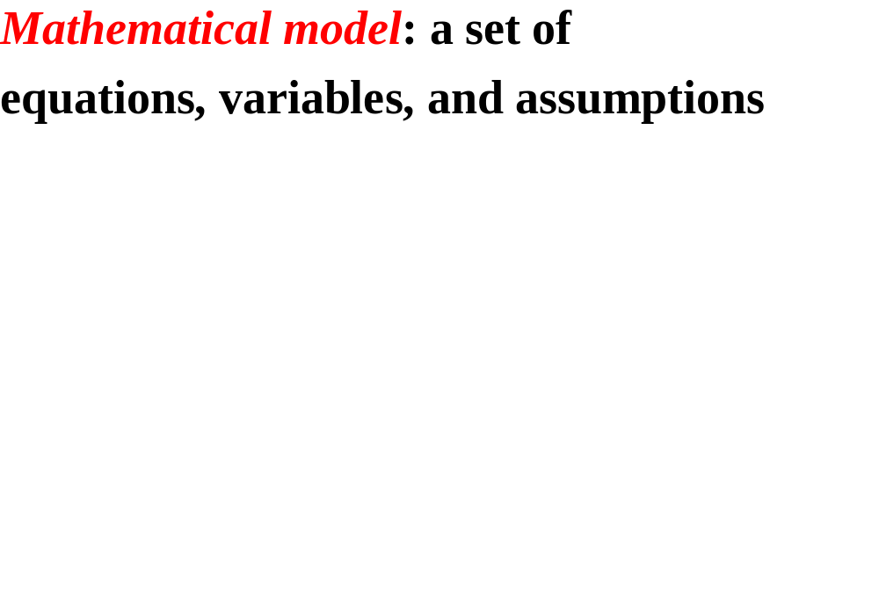

Slide 32
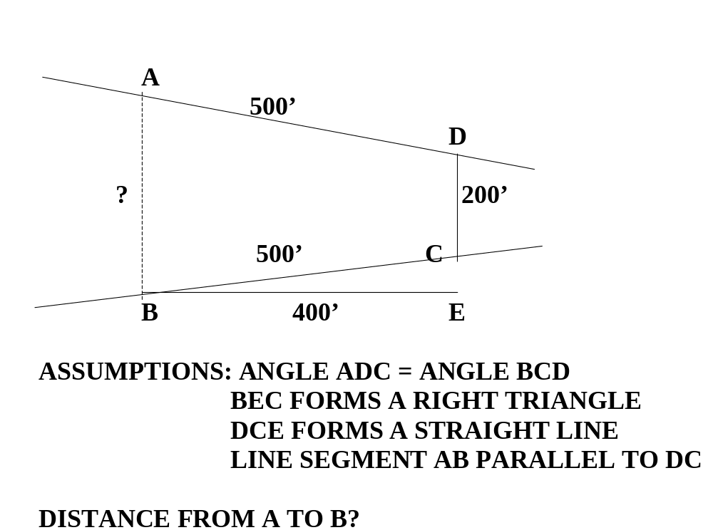

Slide 33
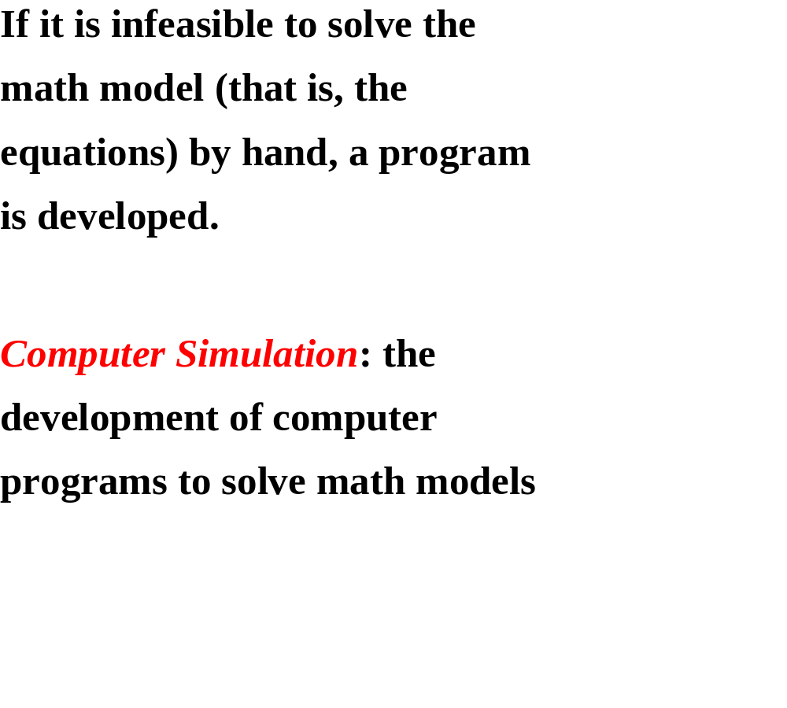

Slide 34
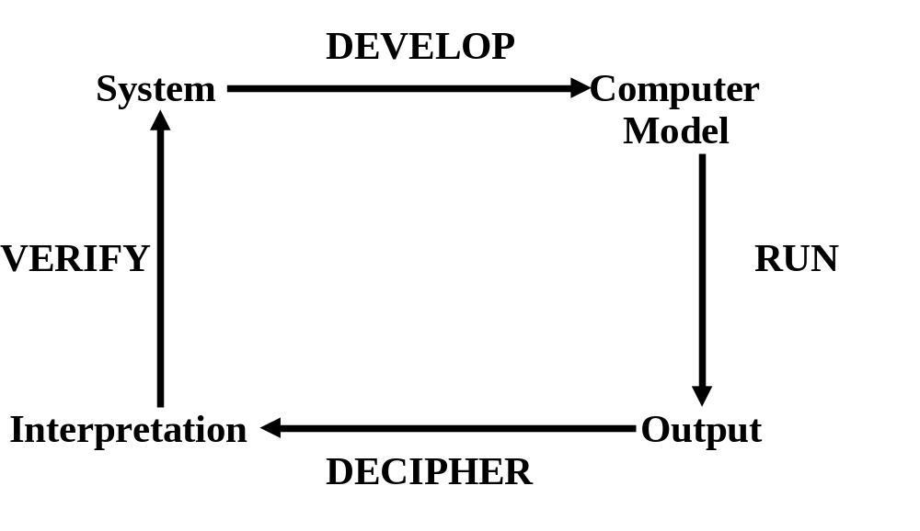

Slide 35
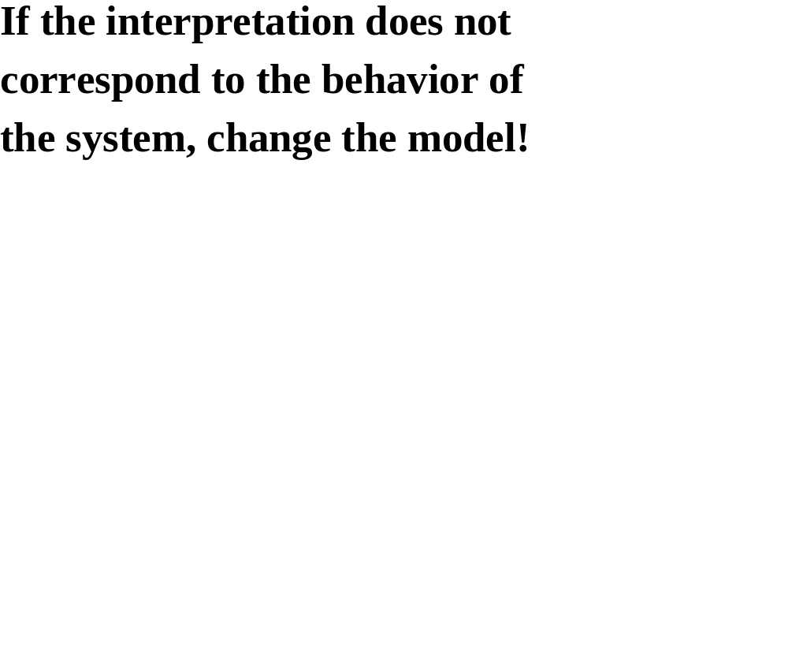

Slide 36
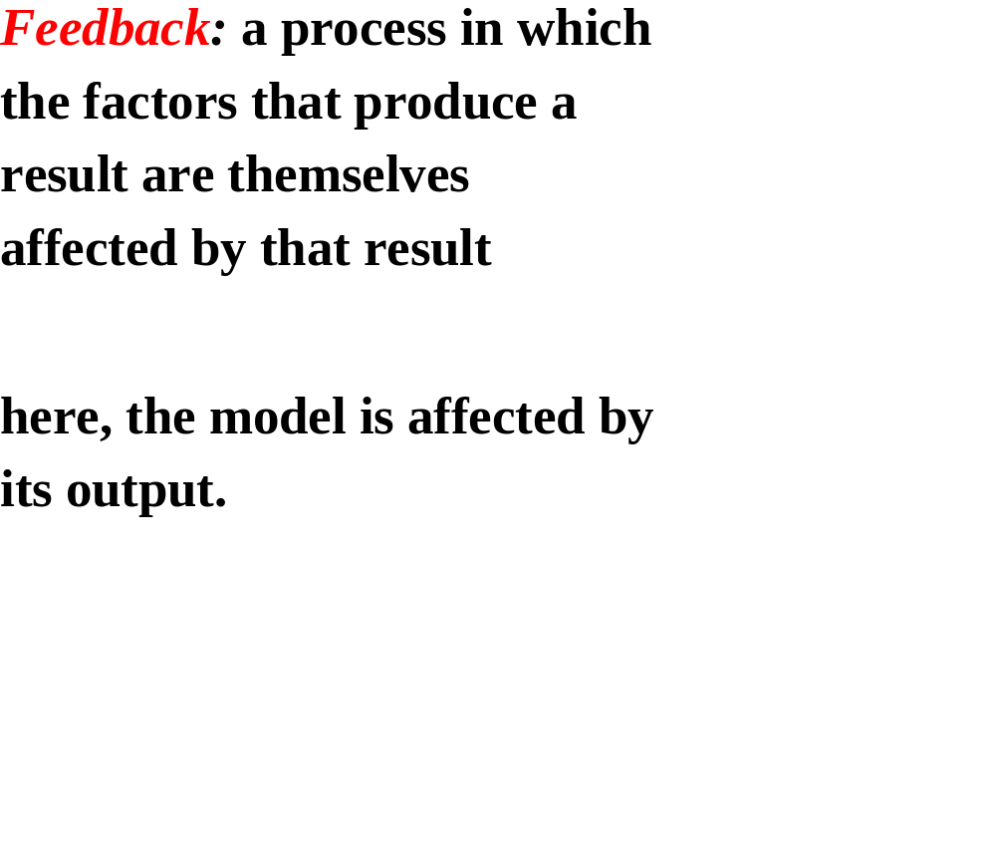

Slide 37
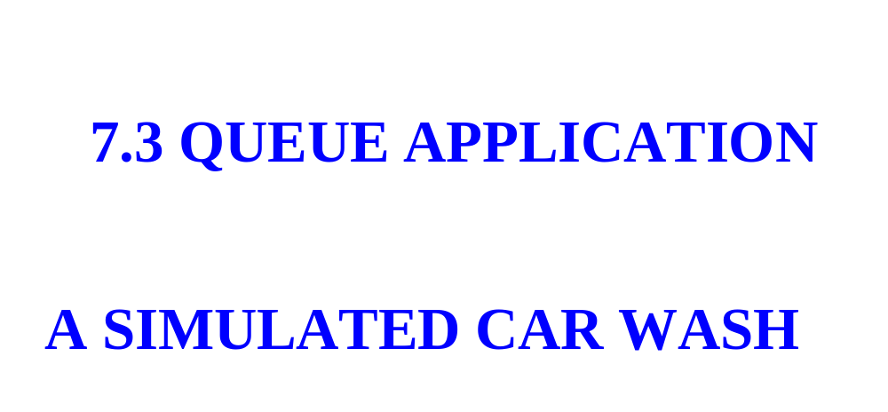

Slide 38
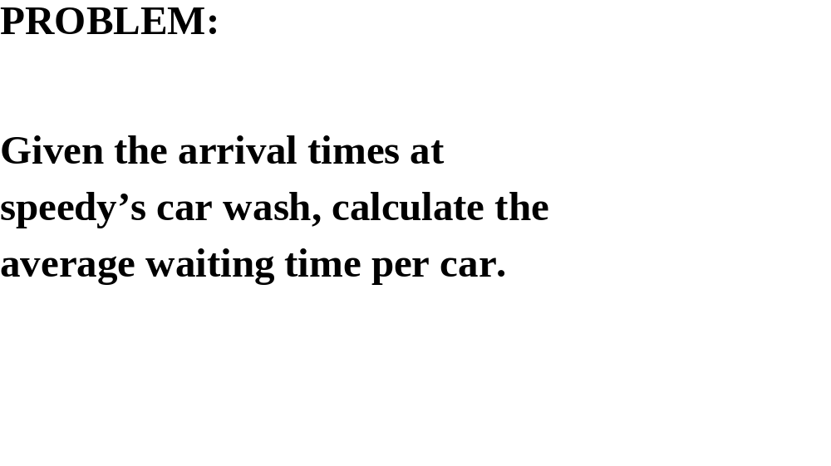

Slide 39
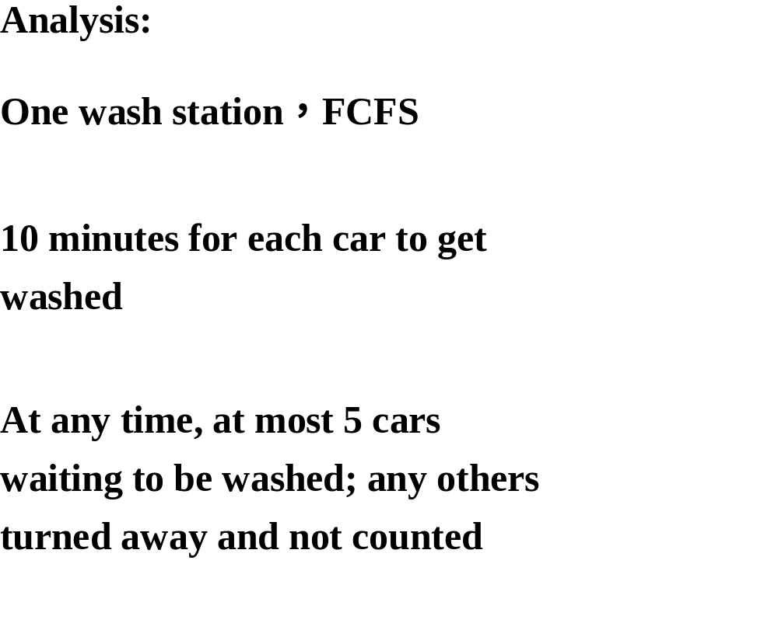


Slide 40
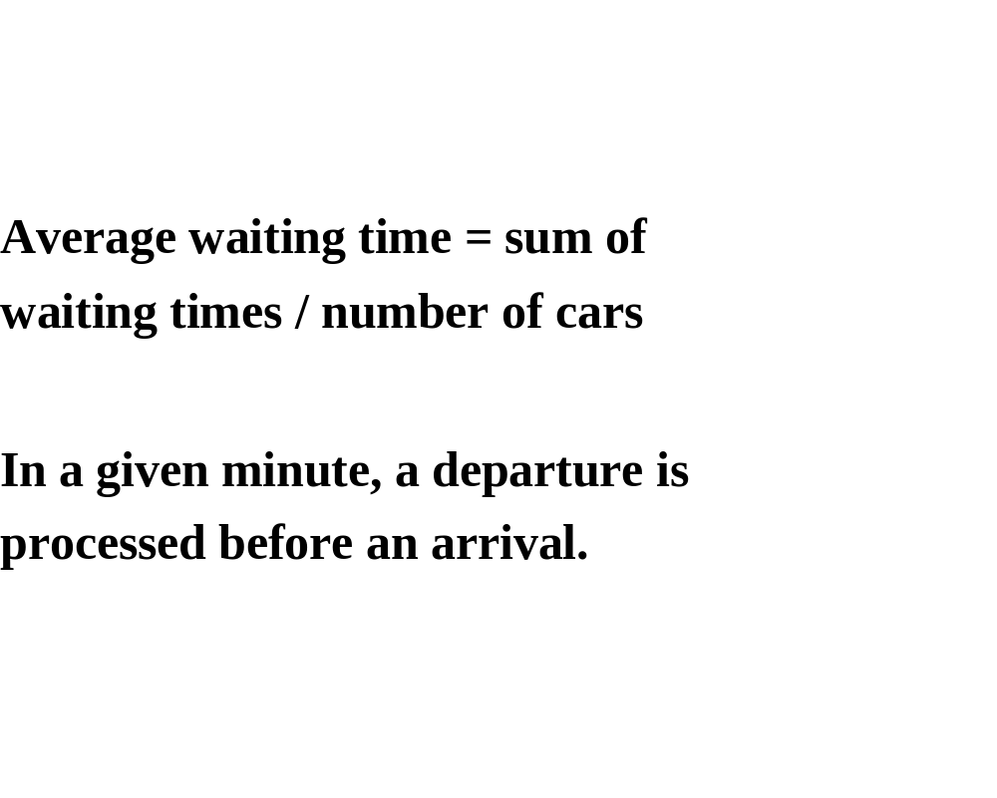

Slide 41
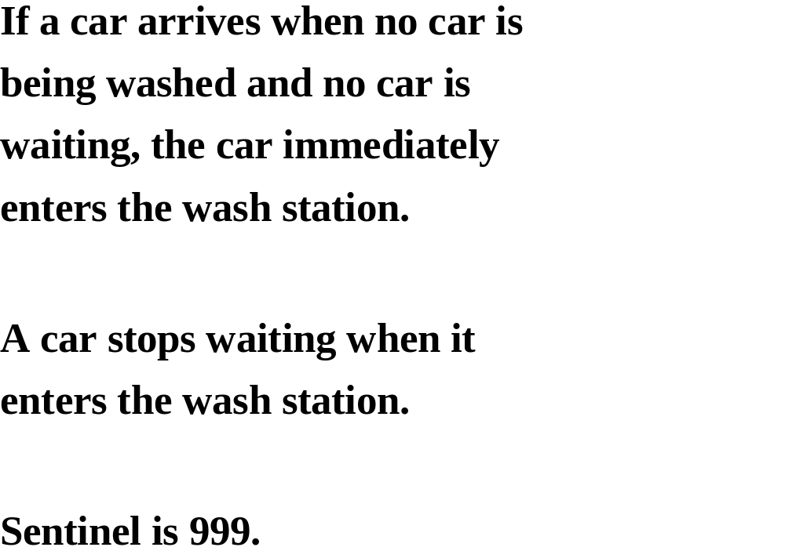

Slide 42
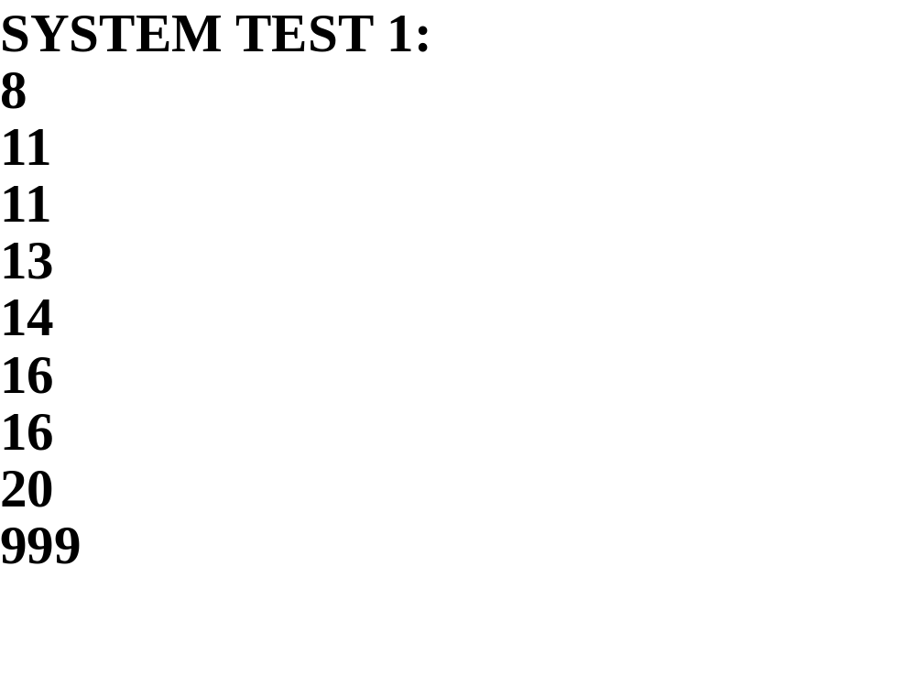

Slide 43
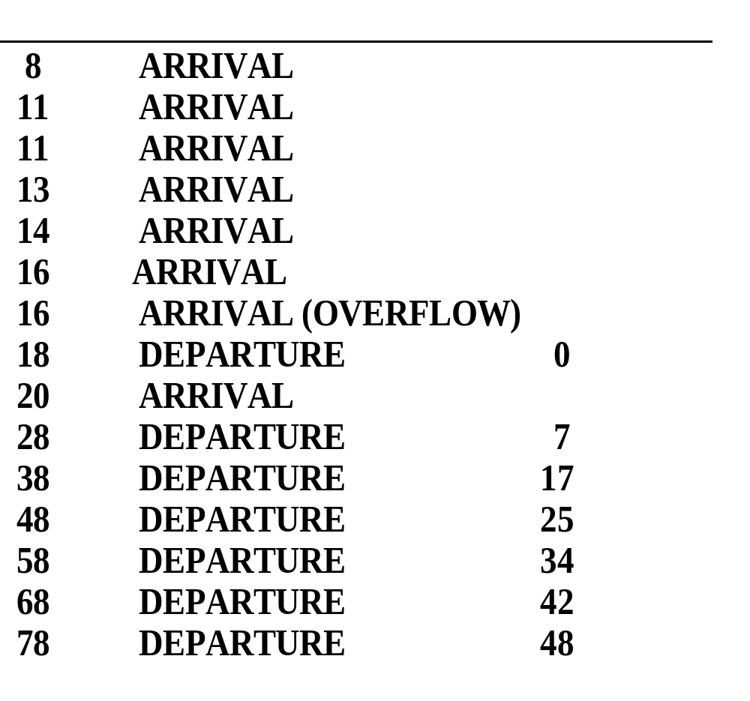

Slide 44
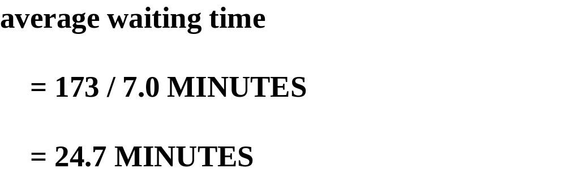

Slide 45
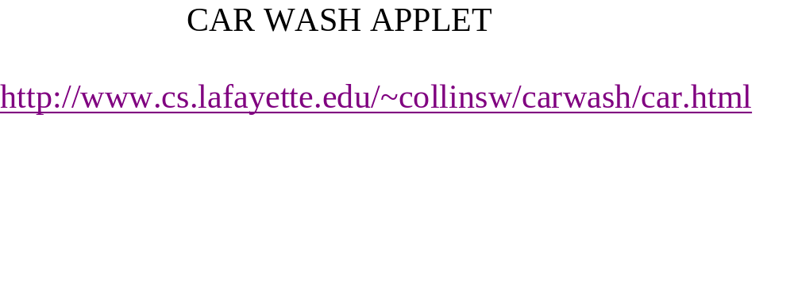

Slide 46
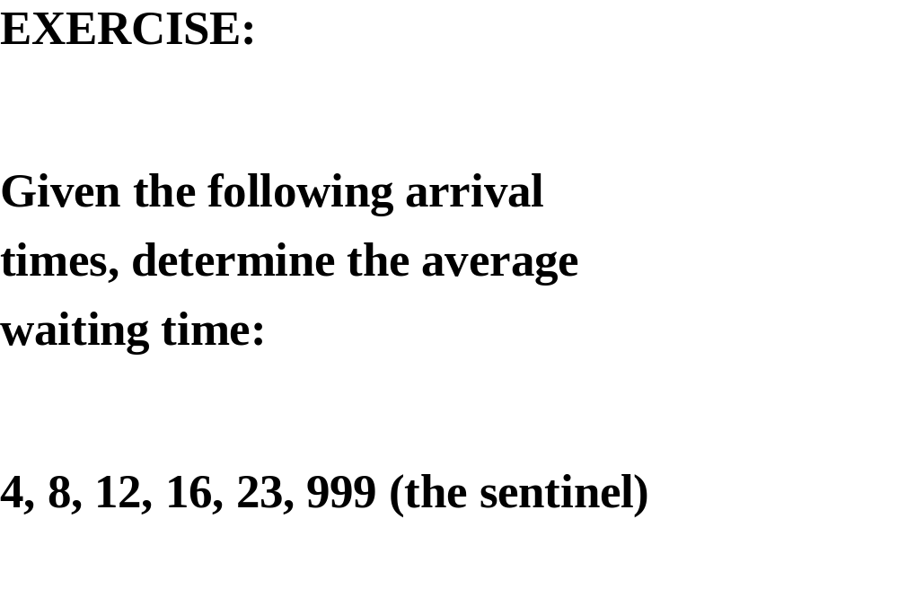

Slide 47
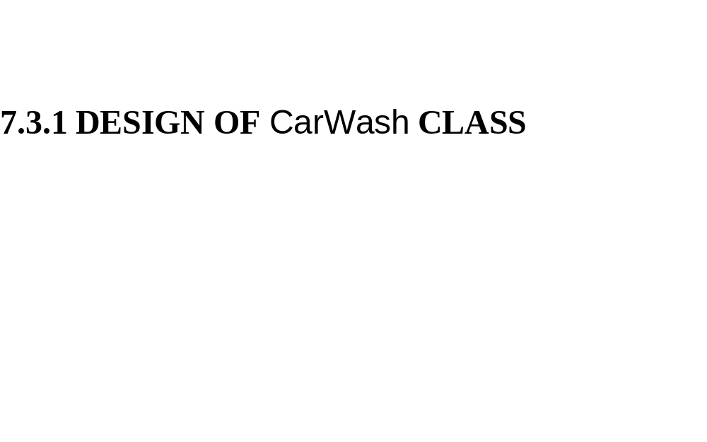

Slide 48
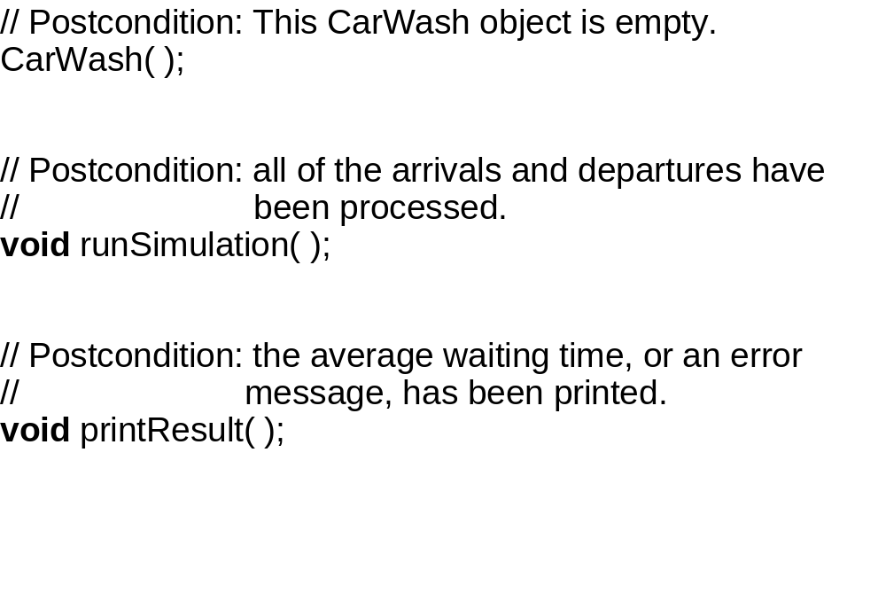

Slide 49
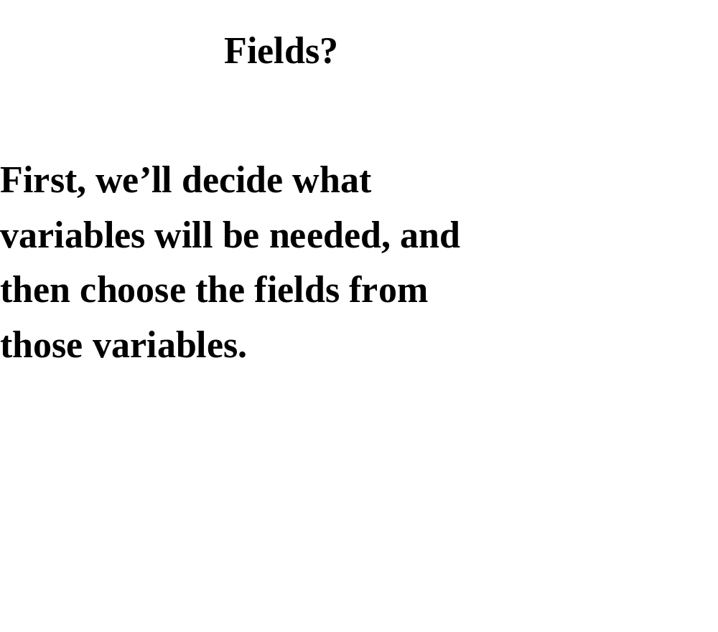

Slide 50
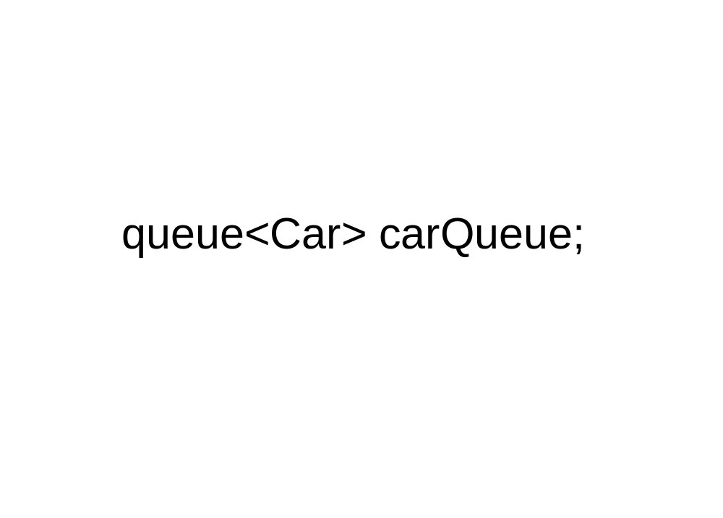

Slide 51
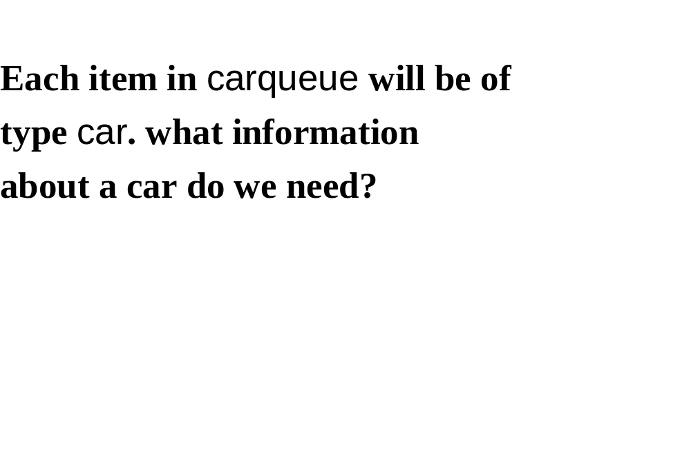

Slide 52
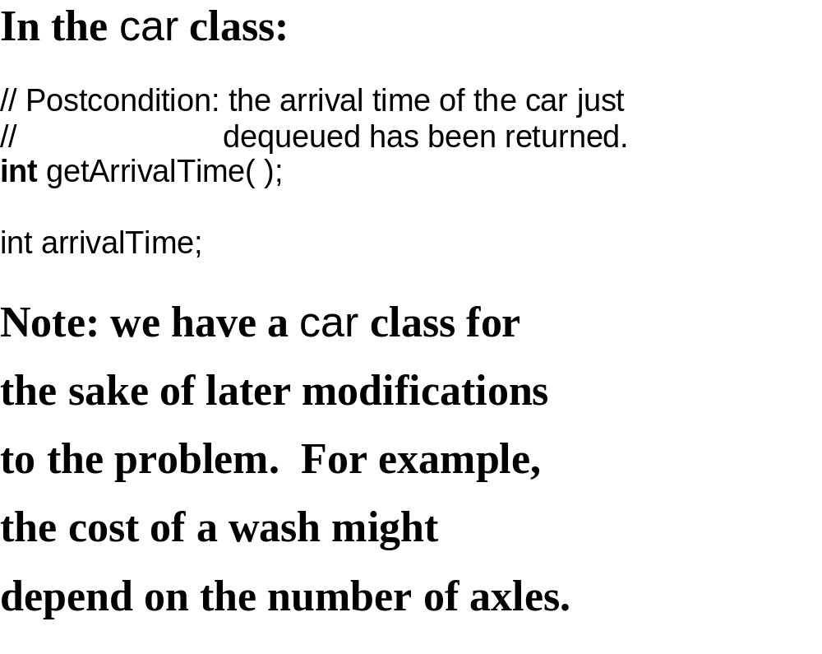

Slide 53
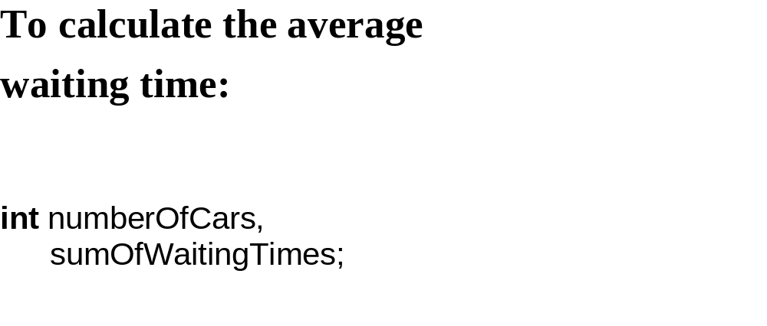

Slide 54
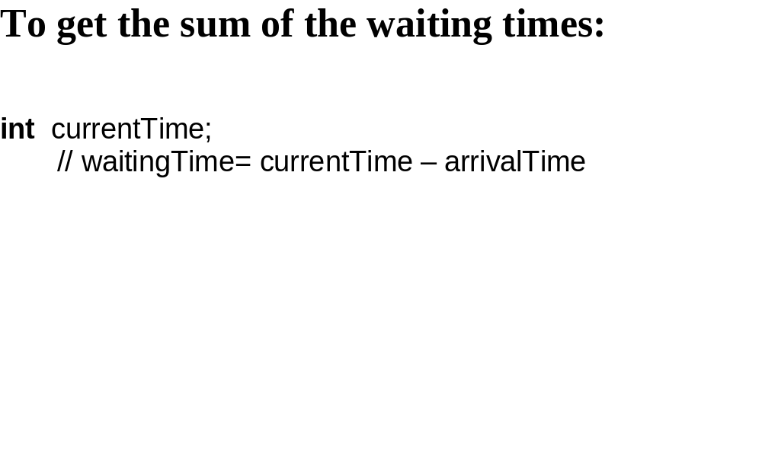

Slide 55
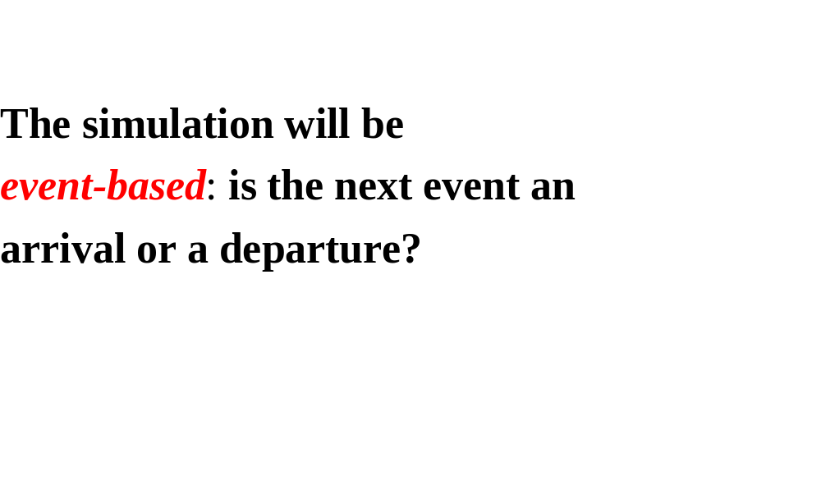

Slide 56
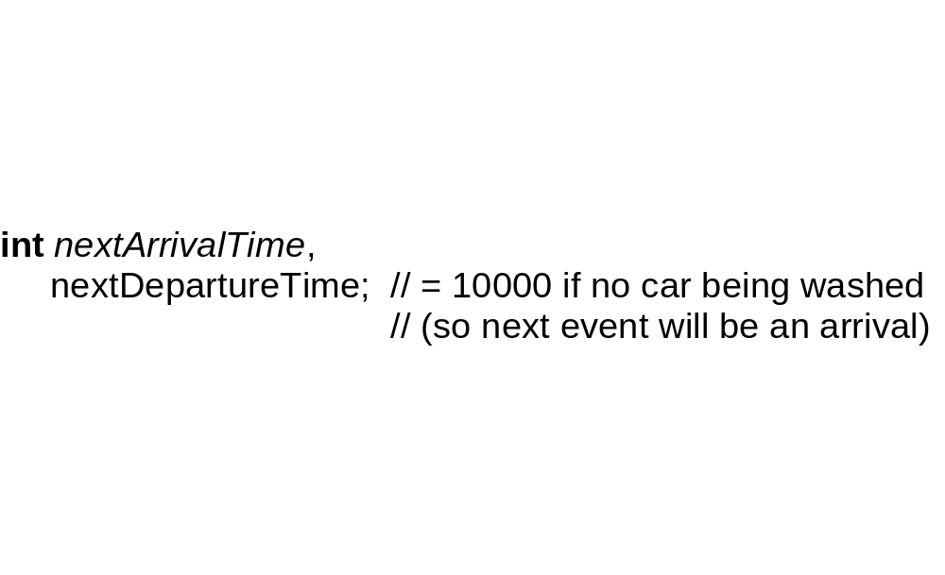

Slide 57
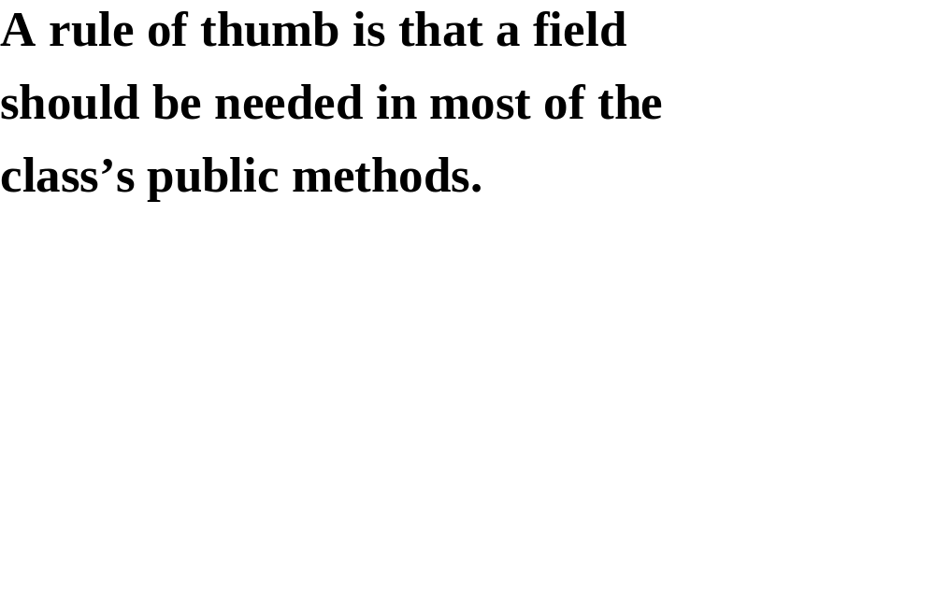

Slide 58
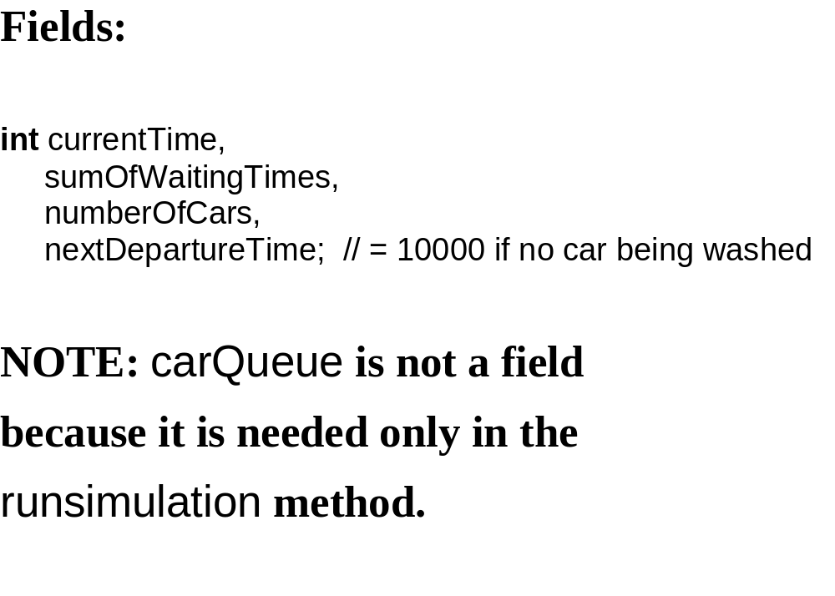

Slide 59
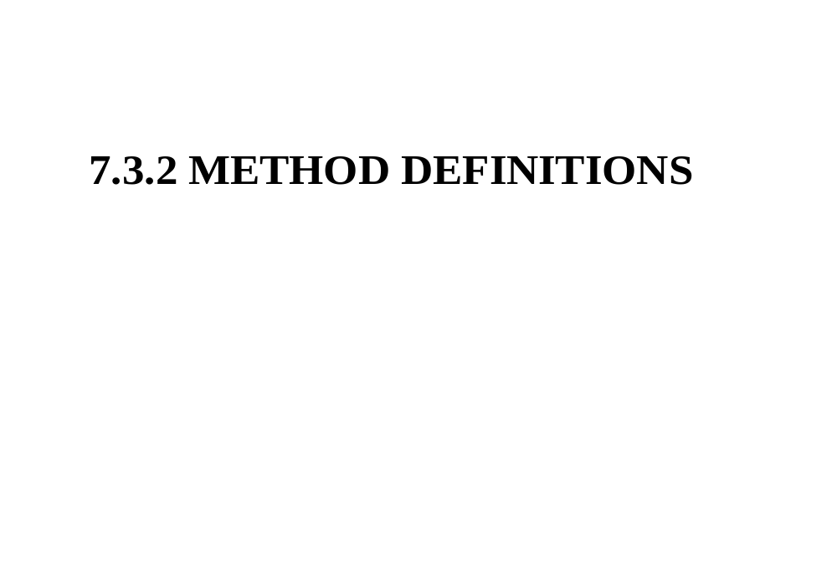

Slide 60
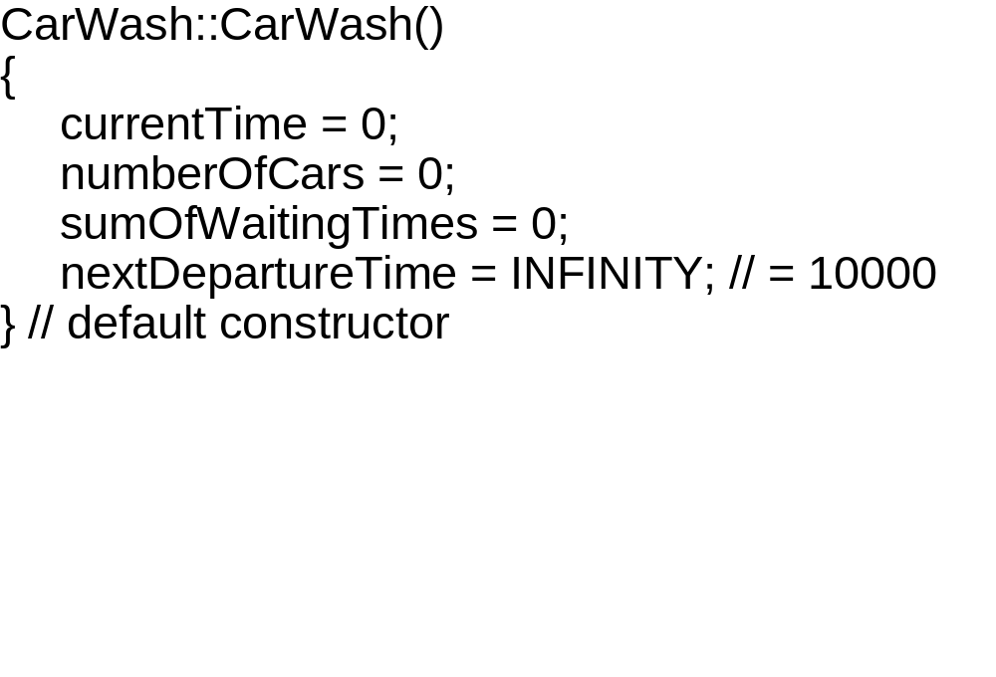

Slide 61
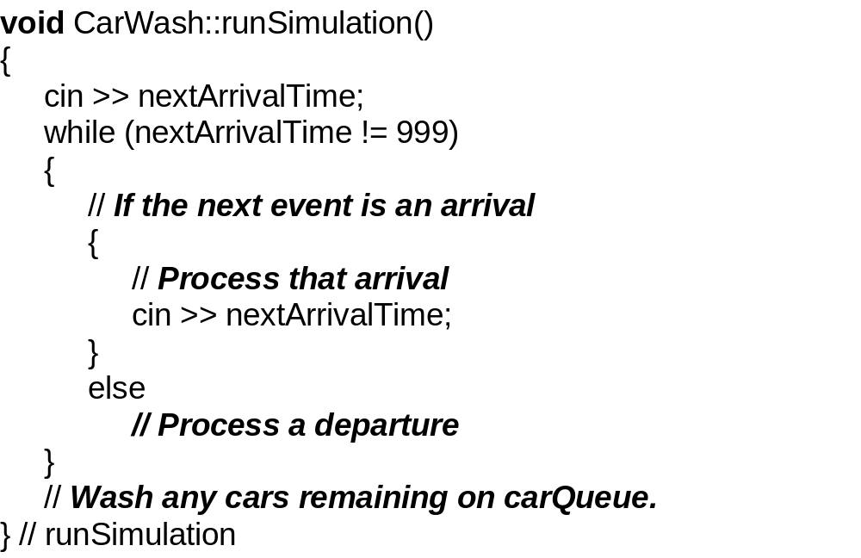

Slide 62


Slide 63


Slide 64


Slide 65


Slide 66


Slide 67


Slide 68


Slide 69

Notes:
The constant RAND_MAX is the maximum value that can be returned by the rand function. RAND_MAX is defined as the value 0x7fff.
The rand function returns a pseudorandom integer in the range 0 to RAND_MAX. Use the srand() function to seed the pseudorandom-number generator before calling rand.

Slide 70


Slide 71


Slide 72
7.4 STACKS

Slide 73


Slide 74


Slide 75


Slide 76


Slide 77


Slide 78


Slide 79


Slide 81


Slide 82


Slide 83


Slide 84


Slide 85


Slide 86


Slide 87


Slide 88
determine the output from the
following:
stack<int> my_stack;
for (int i = 0; i < 10; i++)
my_stack.push (i * i);
while (!my_stack.empty())
{
cout << my_stack.top() << endl;
my_stack.pop();
} // while

Slide 89


Slide 90


Slide 91


Slide 92
7.5 STACK APPLICATION 1
HOW COMPILERS IMPLEMENT
RECURSION

Slide 93


Slide 94
Each activation record contains:
1. a variable that contains the return address
in the calling method;
2. for each value formal parameter, a variable that contains a copy of the argument;
3. for each reference formal parameter, a variable that contains the address of the argument;
4. for each variable defined in the method’s block, a variable that contains a copy of that defined variable.

Slide 95
There is a run-time stack to
handle these activation
records.
push: when function is called
pop: when execution of function
is completed

Slide 96
An activation record is similar
to an execution frame, except
that an activation record has
variables only, no code.
You can replace recursion with
iteration by creating your own
stack.

Slide 97


Slide 98


Slide 99


Slide 100
7.6 STACK APPLICATION 2
CONVERTING FROM
INFIX TO POSTFIX

Slide 101
In infix notation, an operator is
placed between its operands.
a + b
c – d + (e * f – g * h) / i

Slide 102
Old compilers:
infix machine language
this gets messy because of parentheses.
newer compilers:
infix postfix machine language

Slide 103
In postfix notation, an operator is placed immediately after its operands.
INFIX POSTFIX
a + b ab+
a + b * c abc*+
a * b + c ab*c+
(a + b) * c ab+c*

Slide 104
Parentheses are not needed,
and not used, in postfix.

Slide 105
Let’s convert an infix string to
a postfix string.
x – y * z

Slide 106
Postfix preserves the order of
operands, so an operand can be
appended to postfix as soon as
that operand is encountered in
infix.

Slide 107
INFIX POSTFIX
x – y * z x

Slide 108
INFIX POSTFIX
x – y * z x
The operands for ‘-’ are not yet
in postfix, so ‘-’ must be
temporarily saved somewhere.

Slide 109
INFIX POSTFIX
x – y * z xy

Slide 110
INFIX POSTFIX
x – y * z xy
The operands for ‘*’ are not yet
in postfix, so ‘*’ must be
temporarily saved somewhere,
and restored before ‘-’.

Slide 111
INFIX POSTFIX
x – y * z xyz

Slide 112
INFIX POSTFIX
x – y * z xyz* –

Slide 113
Suppose, instead, we started with
x*y-z. after moving ‘x’ to postfix,
‘*’ is temporarily saved, and then
‘y’ is appended to postfix. what
happens when ‘-’ is accessed?
INFIX POSTFIX
x * y – z xy

Slide 114


Slide 115
The temporary storage facility
is a stack.
Here is the strategy for
maintaining the stack:

Slide 116


Slide 117
INFIX GREATER, PUSH

Slide 118
CONVERT FROM INFIX TO POSTFIX:
INFIX POSTFIX
a + b * c / d - e

Slide 119
INFIX POSTFIX
a + b * c / d – e abc*d/+e –
-
/
*
+
OPERATOR STACK

Slide 120


Slide 121
CONVERT TO POSTFIX:
x * (y + z)

Slide 122


Slide 123


Slide 124


Slide 125


Slide 126


Slide 127
TOKENS

Slide 128


Slide 129


Slide 130


Slide 131


Slide 132


Slide 133


Slide 134


Slide 135


Slide 136


Slide 137


