Slide 1
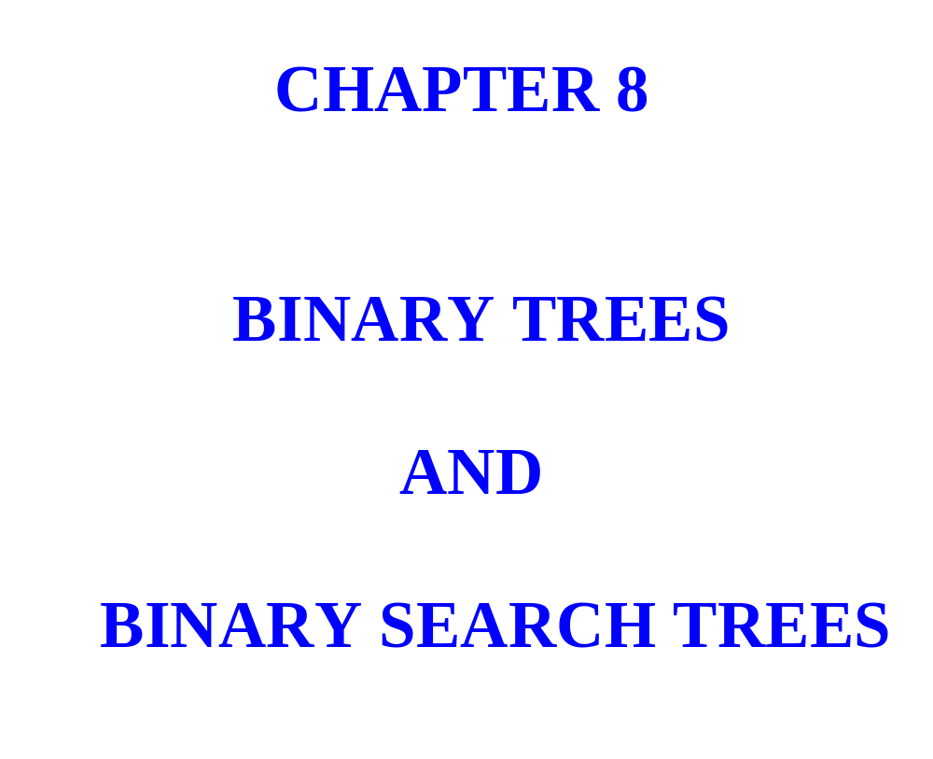

Slide 2
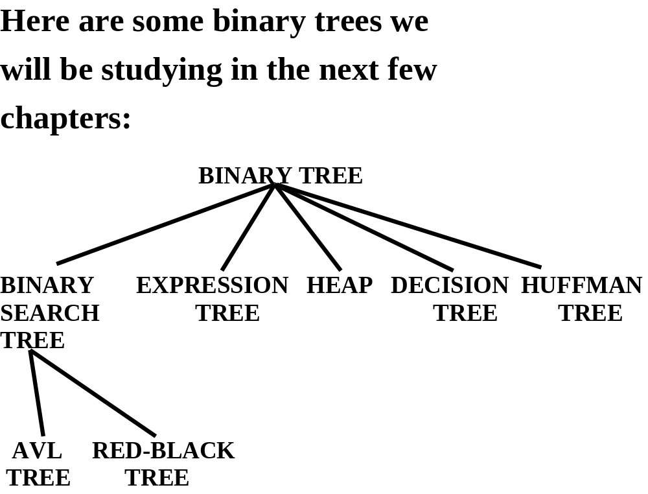

Slide 3
BINARY TREES

Slide 4
A binary tree t is either empty or consists of an item, called the root item, and two distinct binary trees, called the left subtree and right subtree of t.

Slide 5
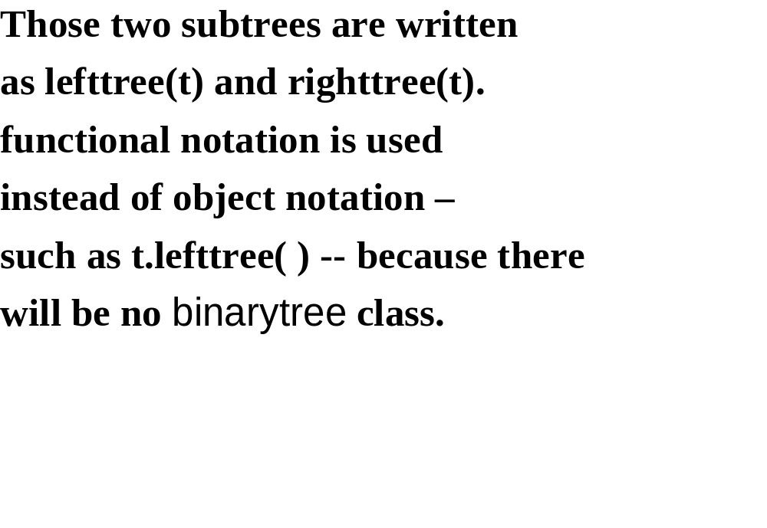

Slide 6
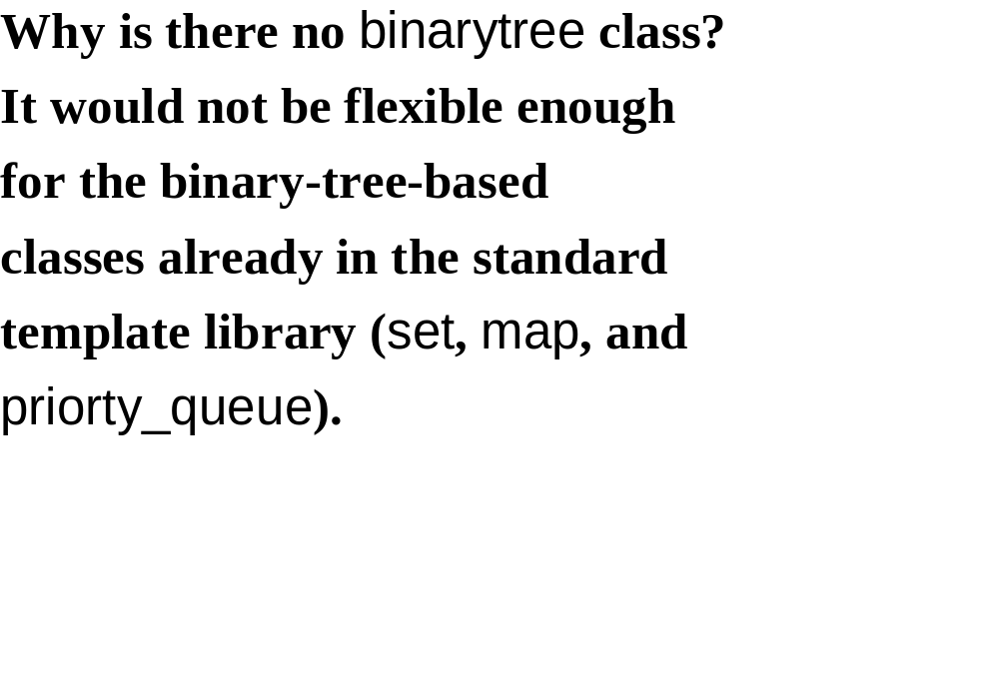

Slide 7
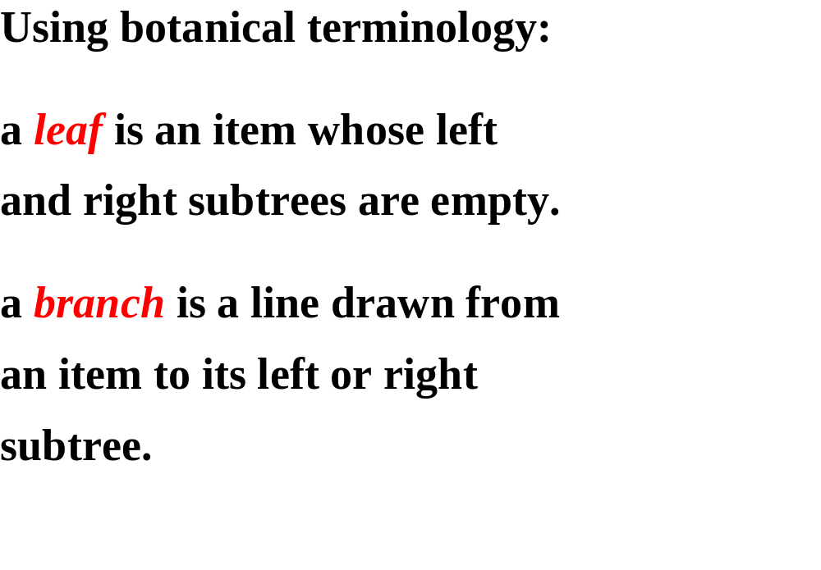

Slide 8
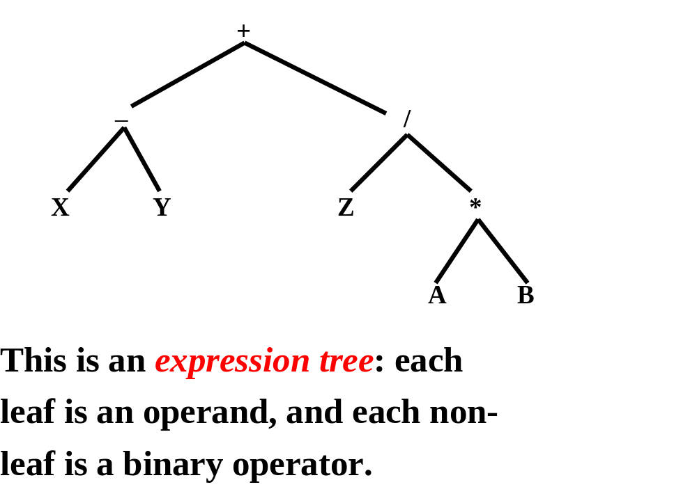

Slide 9
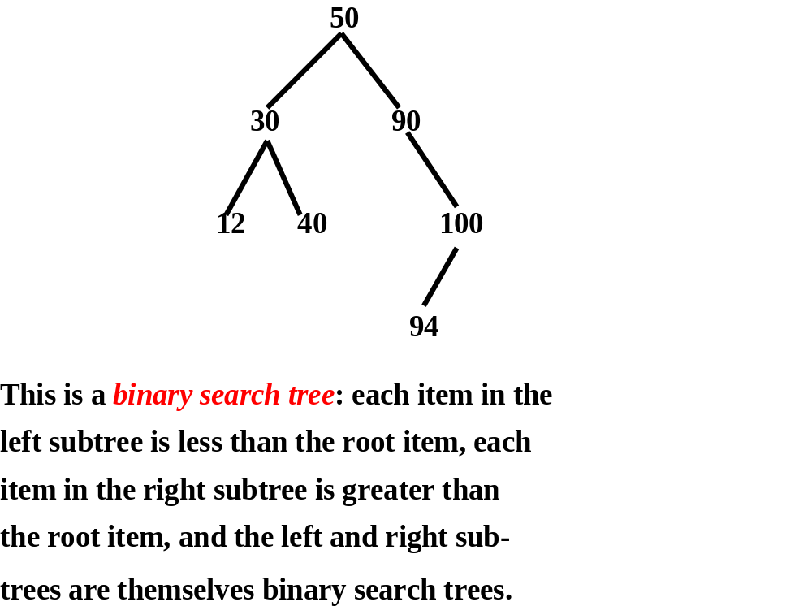

Slide 10
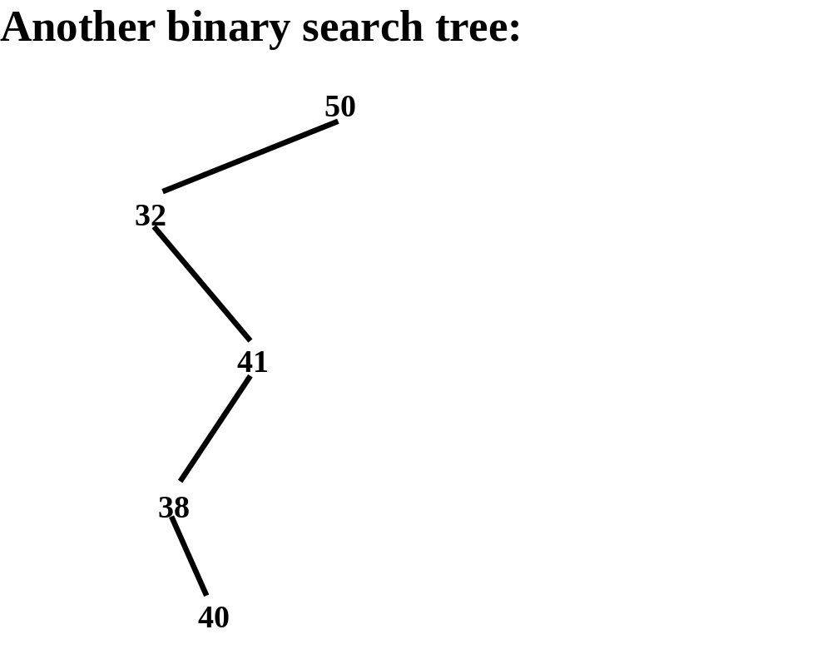

Slide 11
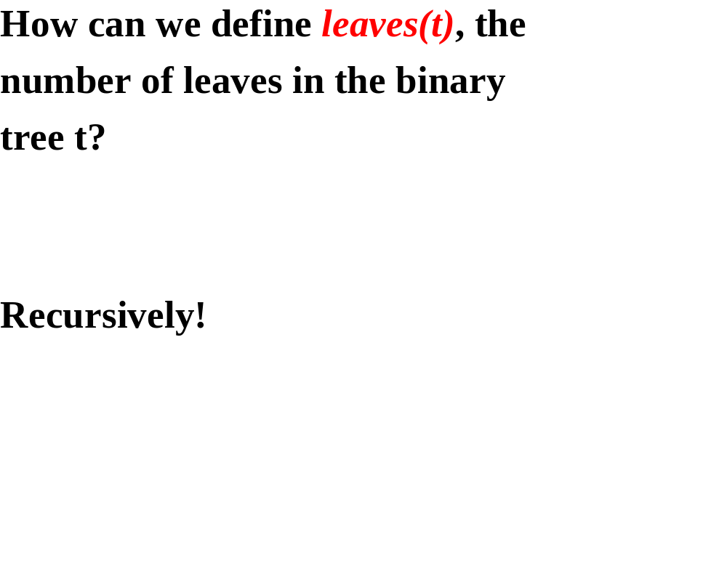

Slide 12
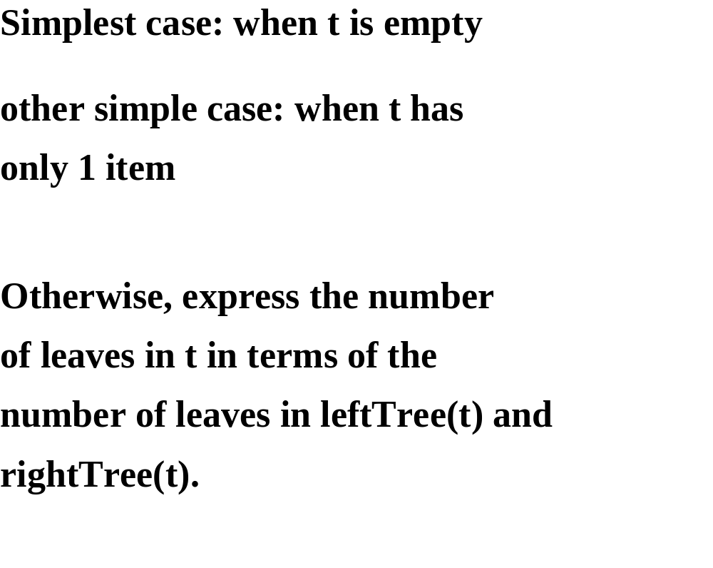

Slide 13
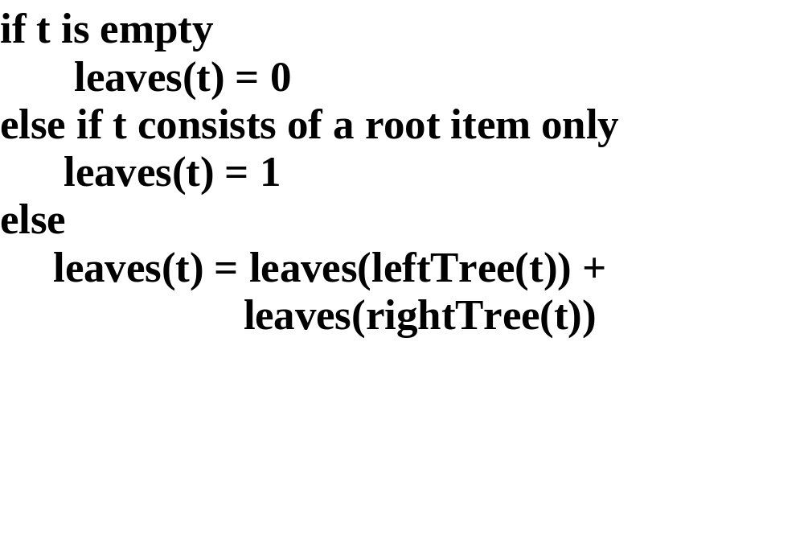

Slide 14
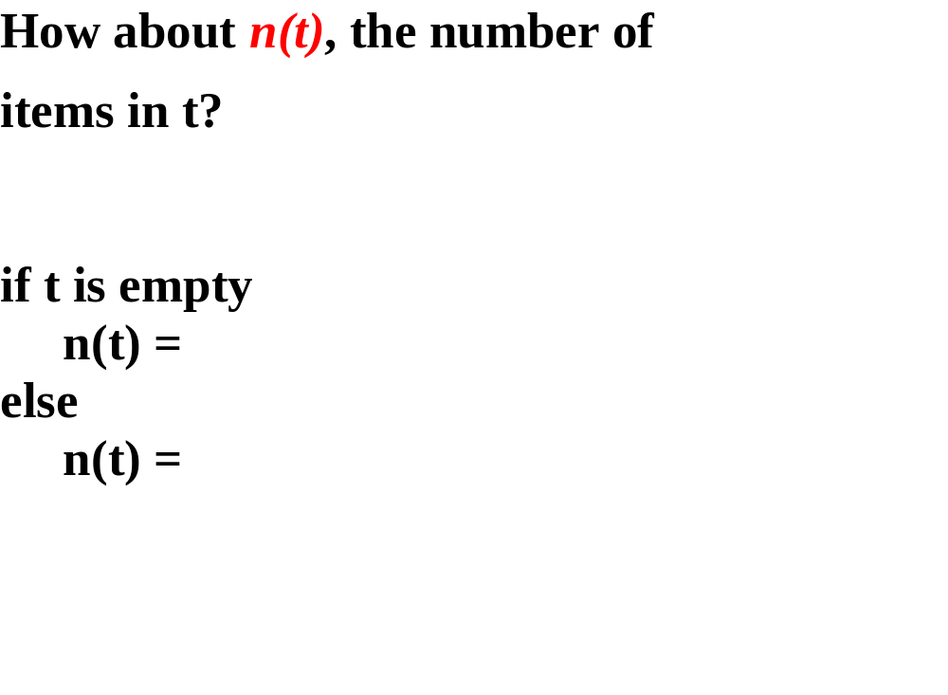

Slide 15
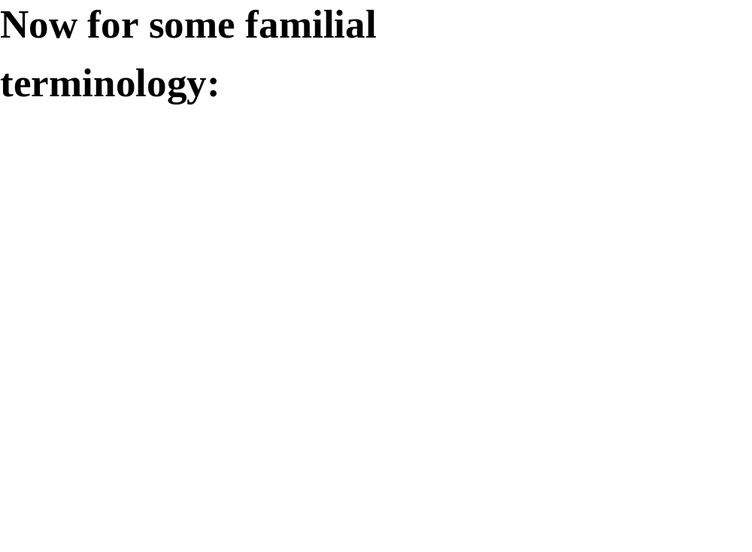

Slide 16
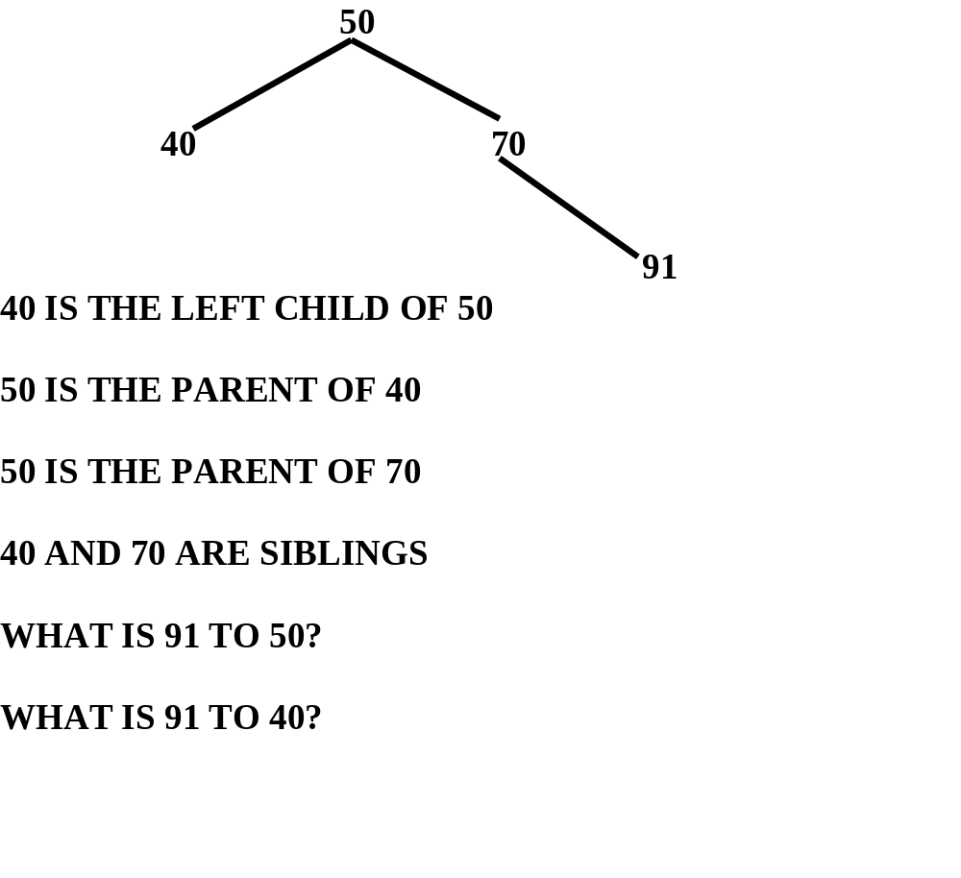

Slide 17
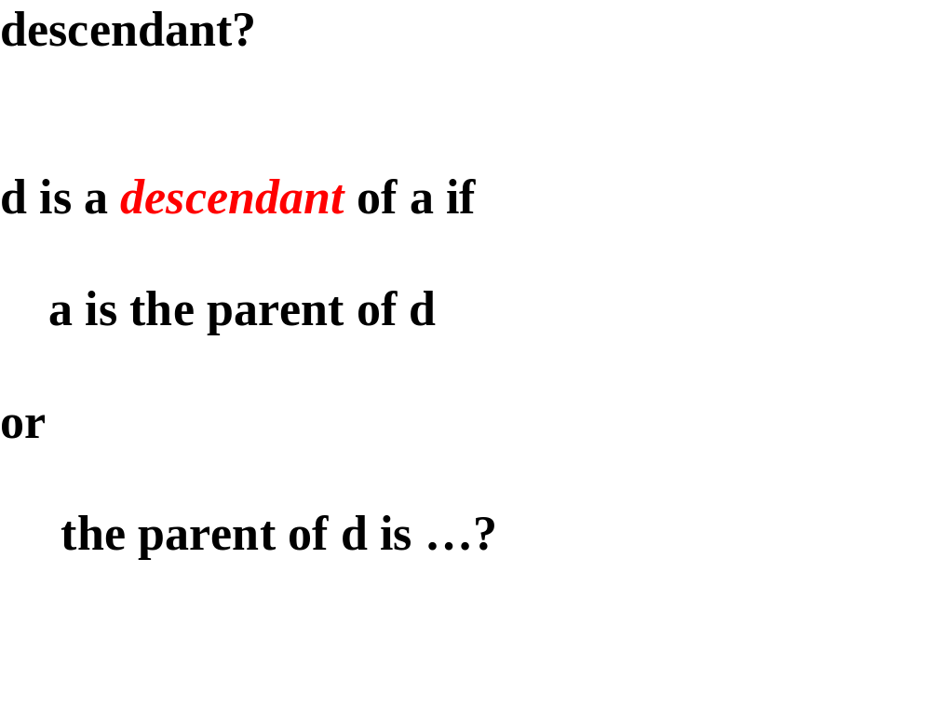

Slide 18
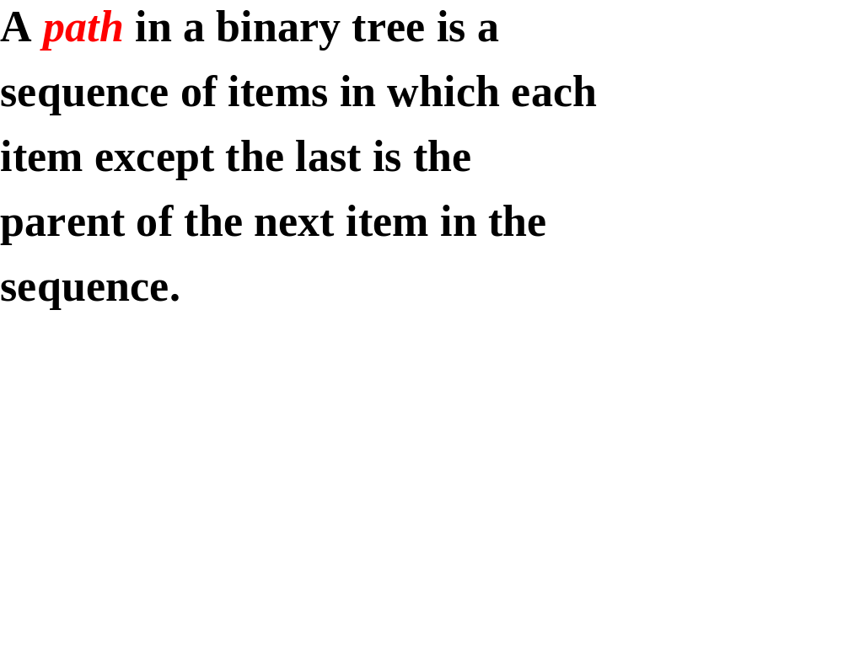

Slide 19
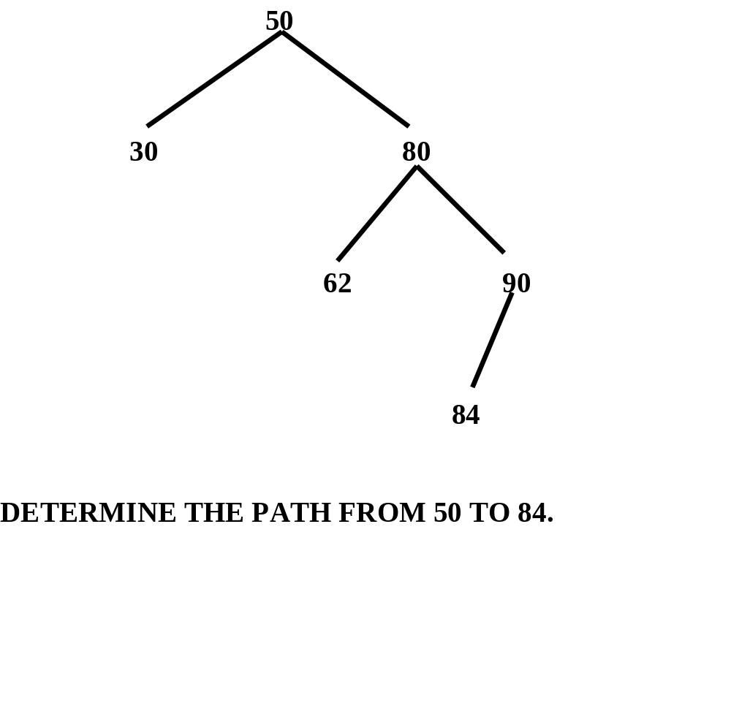

Slide 20
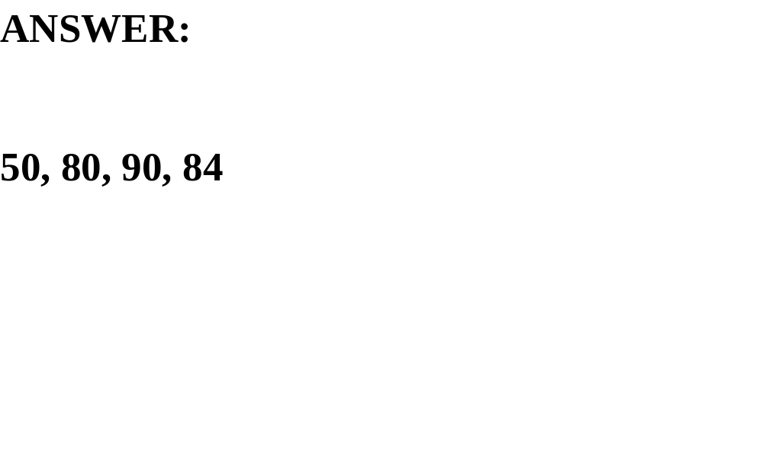

Slide 21
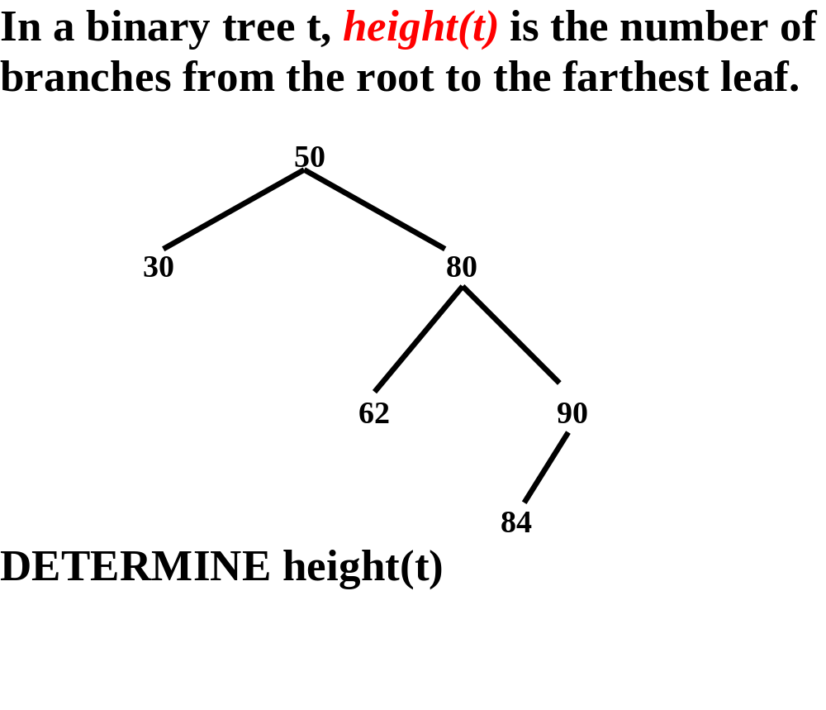

Slide 22
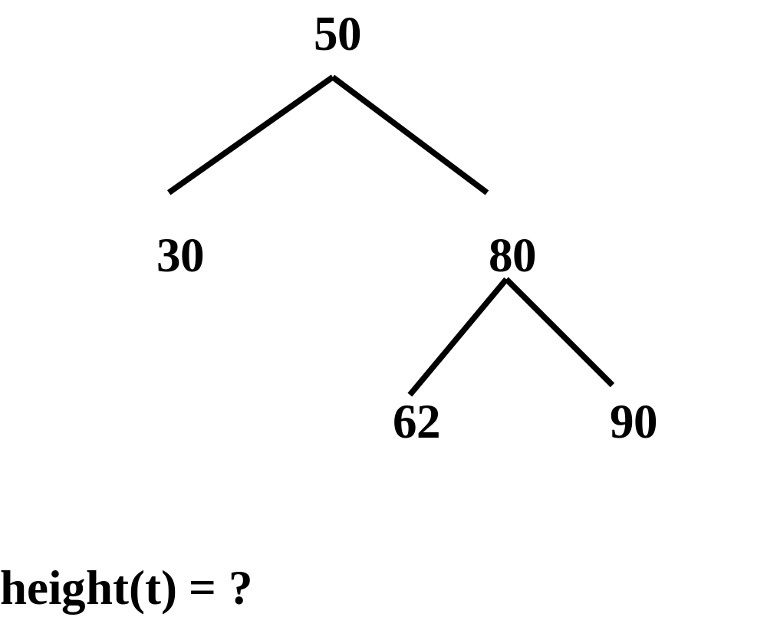

Slide 23
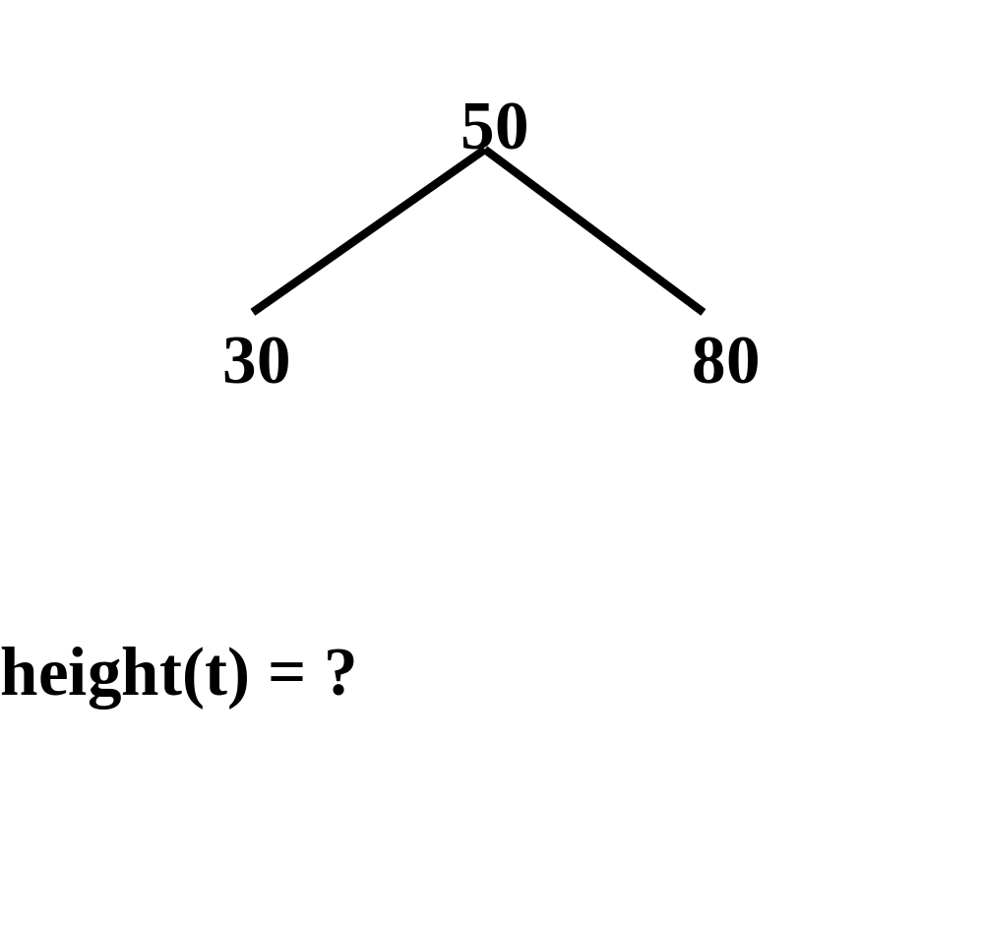

Slide 24
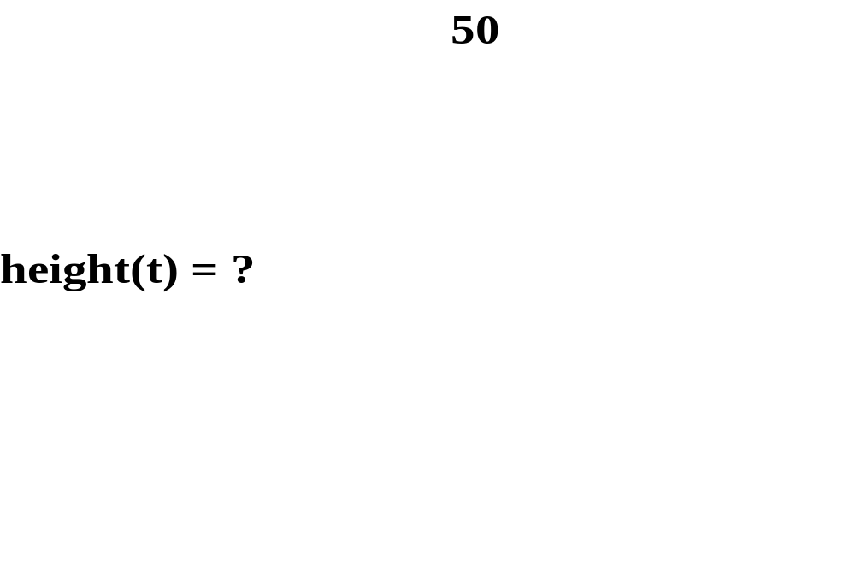

Slide 25
height(t) = ?
to distinguish the height of an
empty tree from the height of a
single-item tree, what should the
height of an empty tree be?

Slide 26
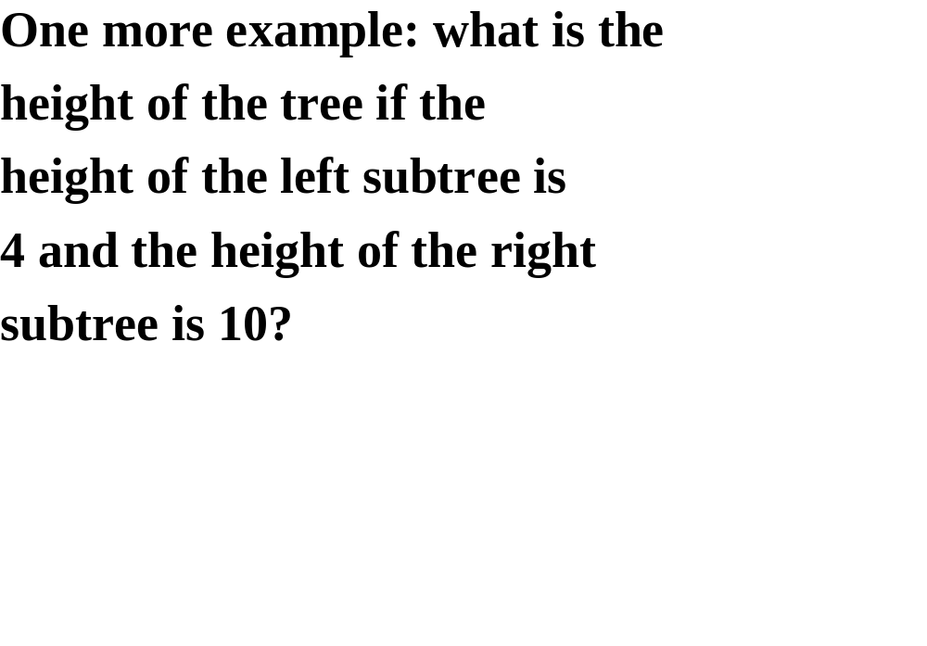

Slide 27
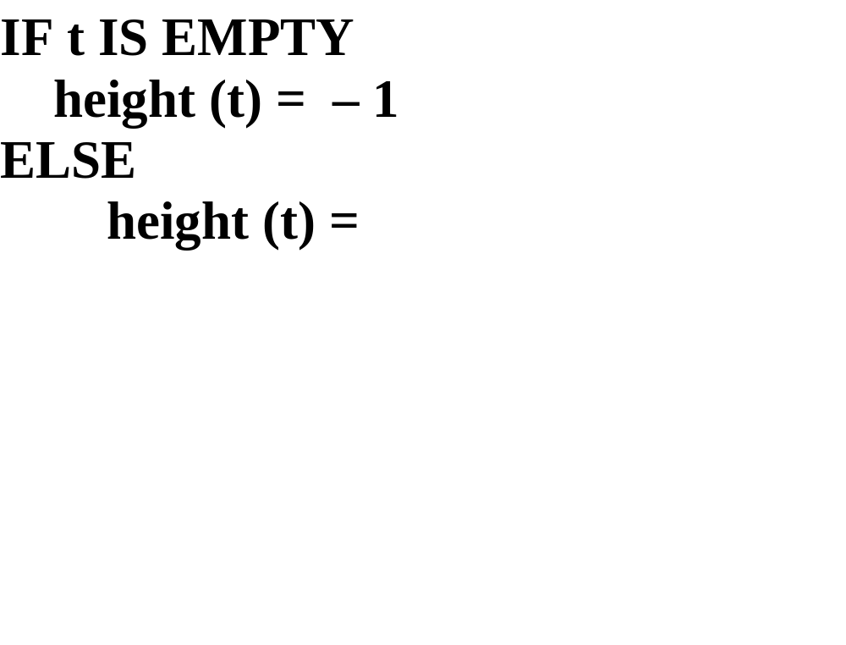

Slide 28
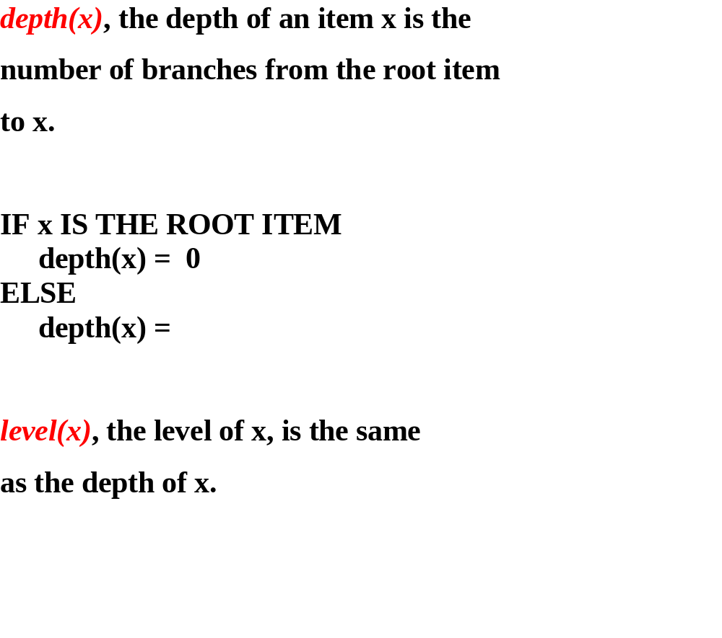

Slide 29
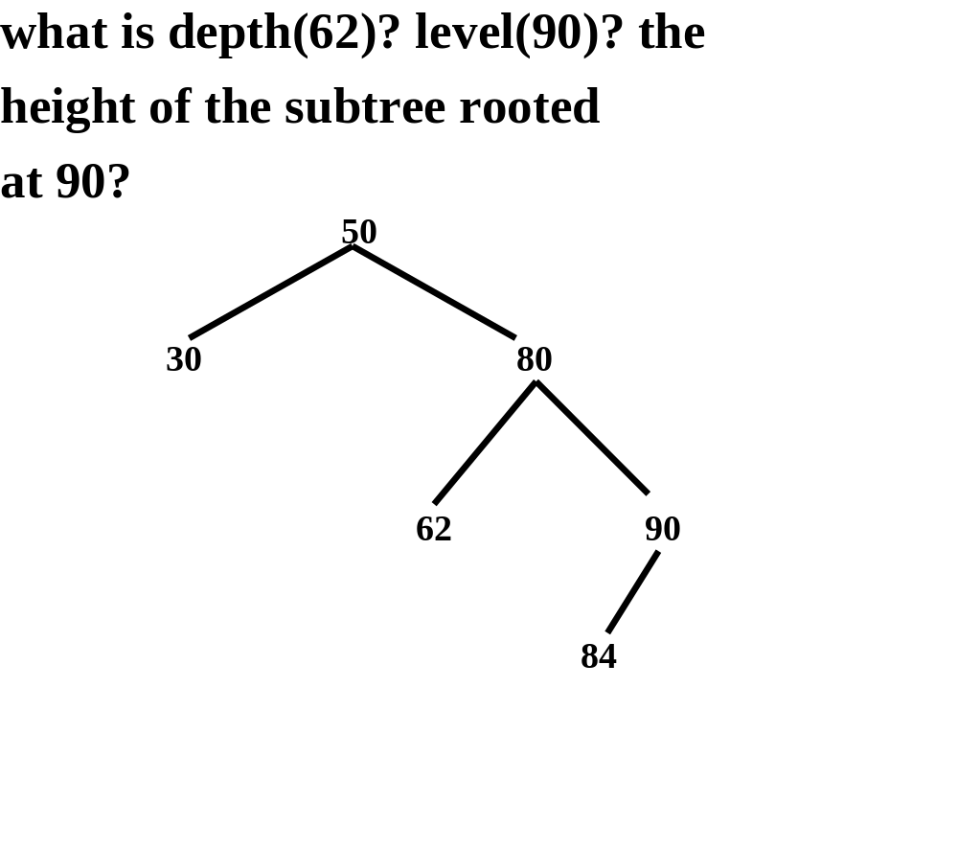

Slide 30
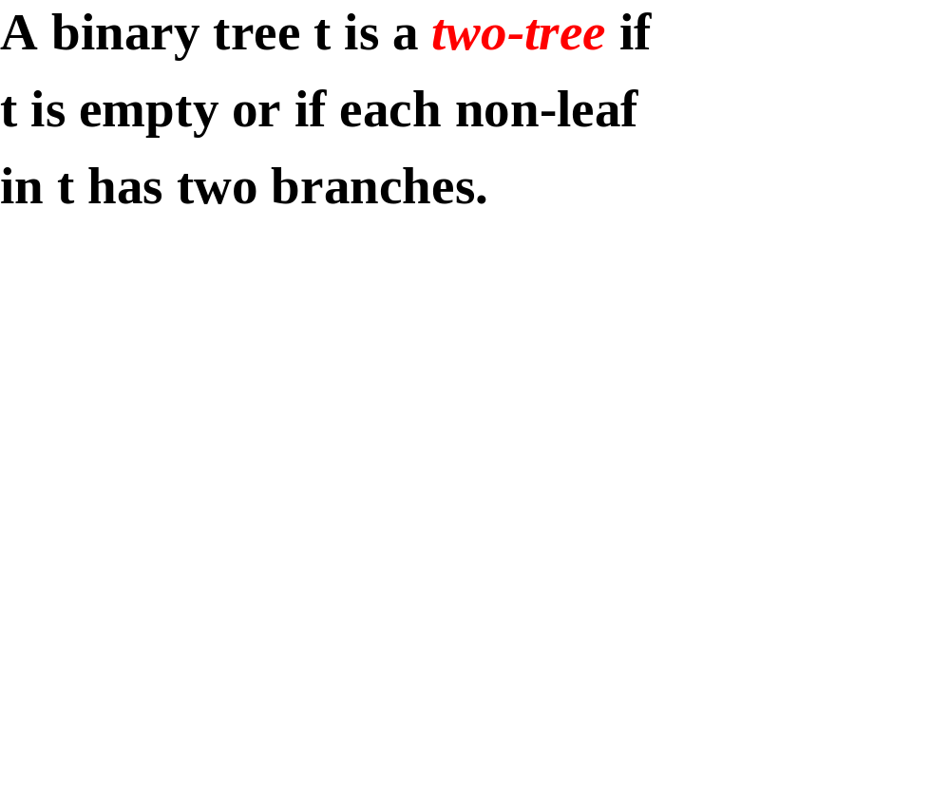

Slide 31
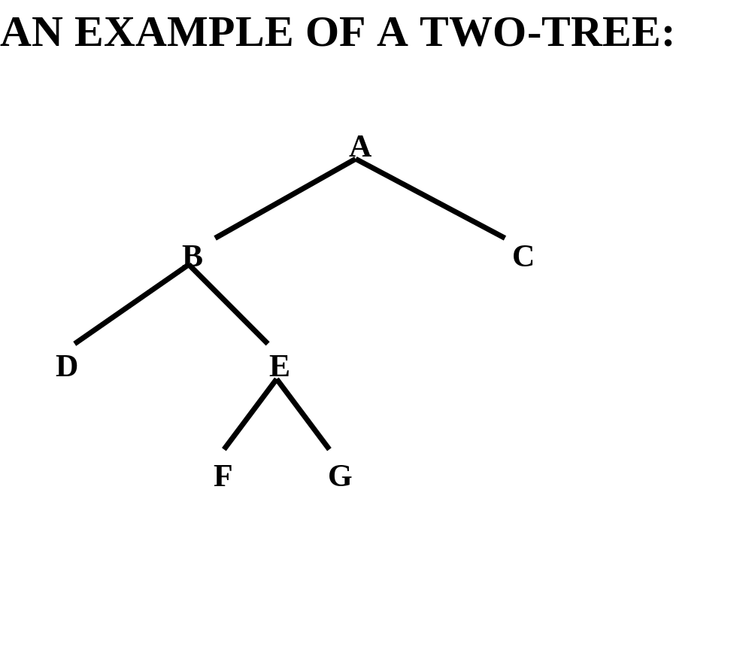

Slide 32
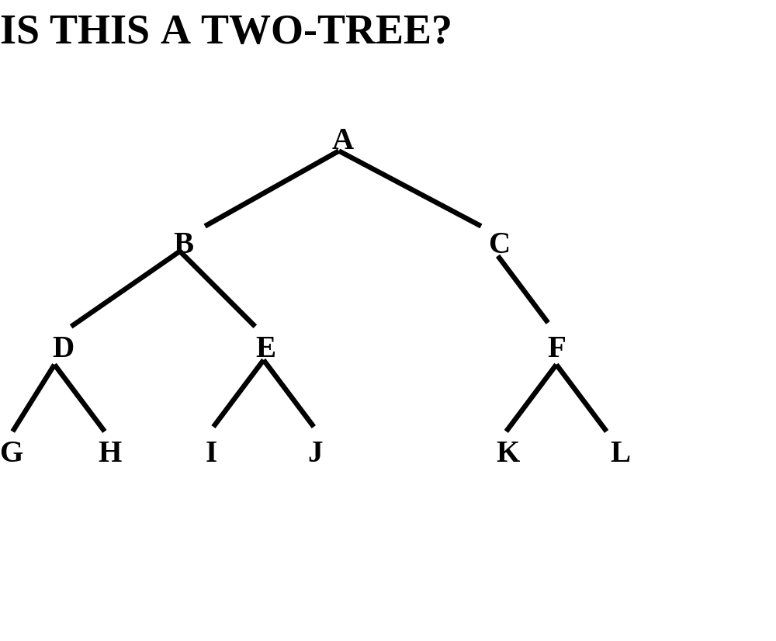

Slide 33
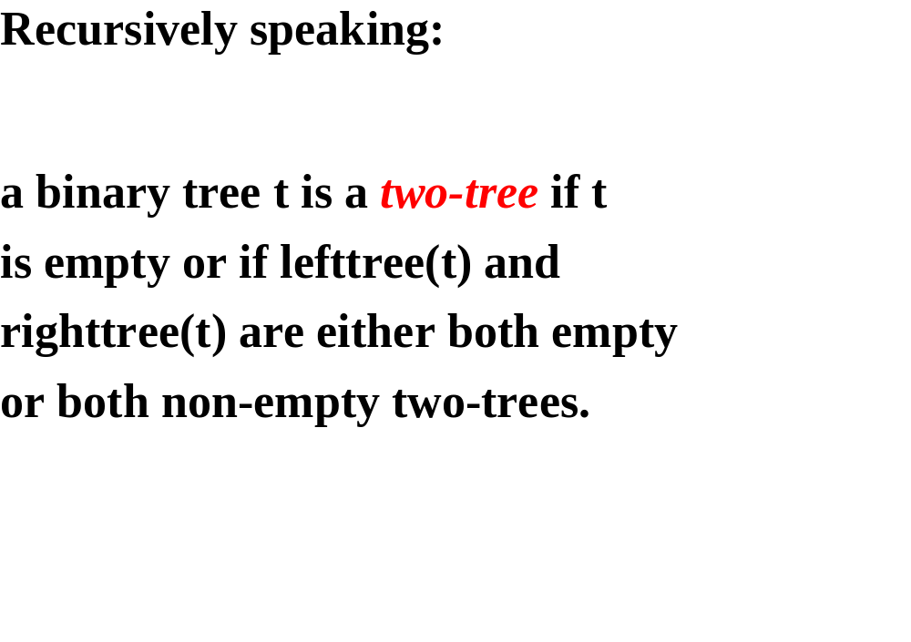

Slide 34
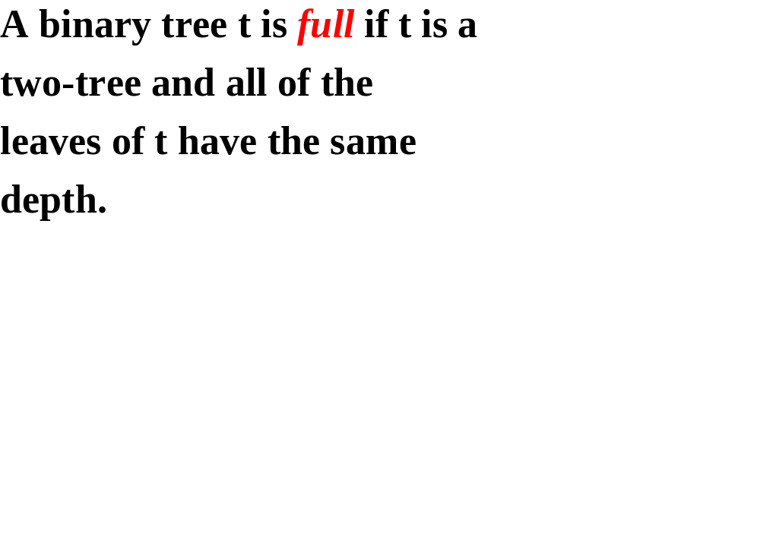

Slide 35
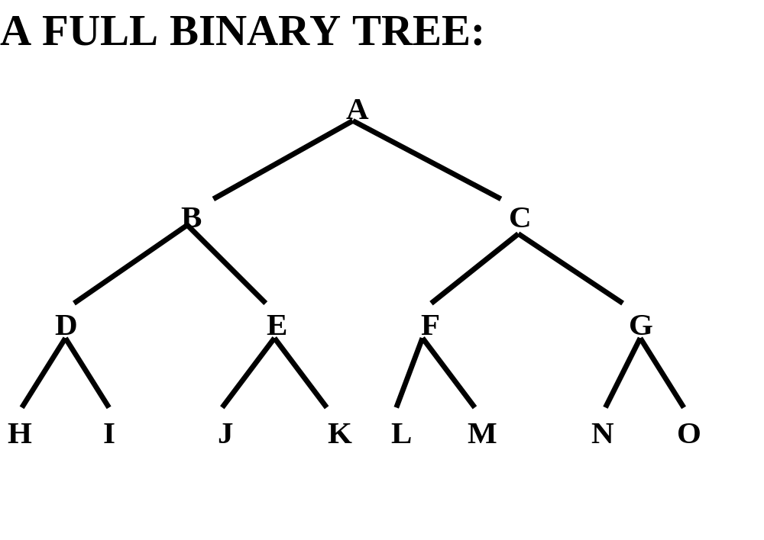

Slide 36
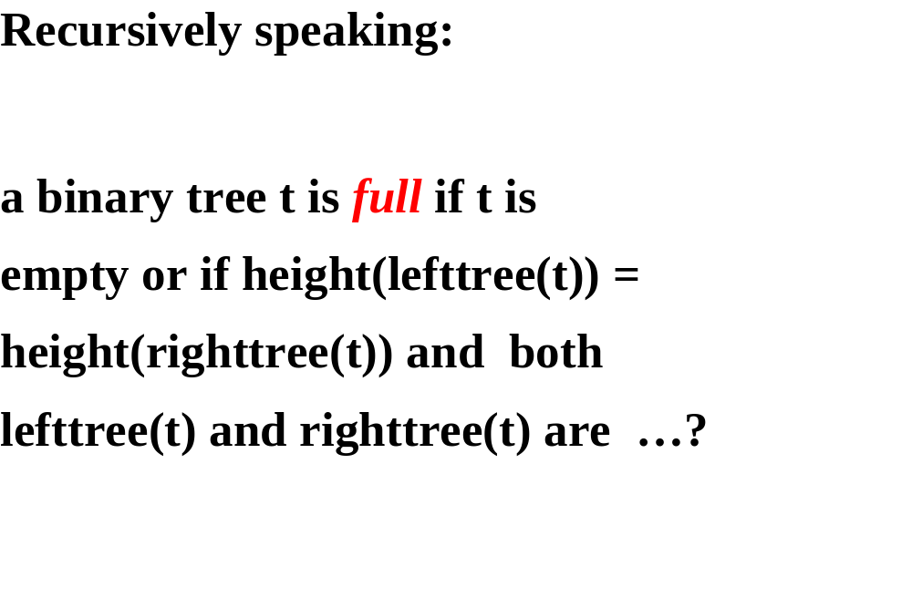

Slide 37
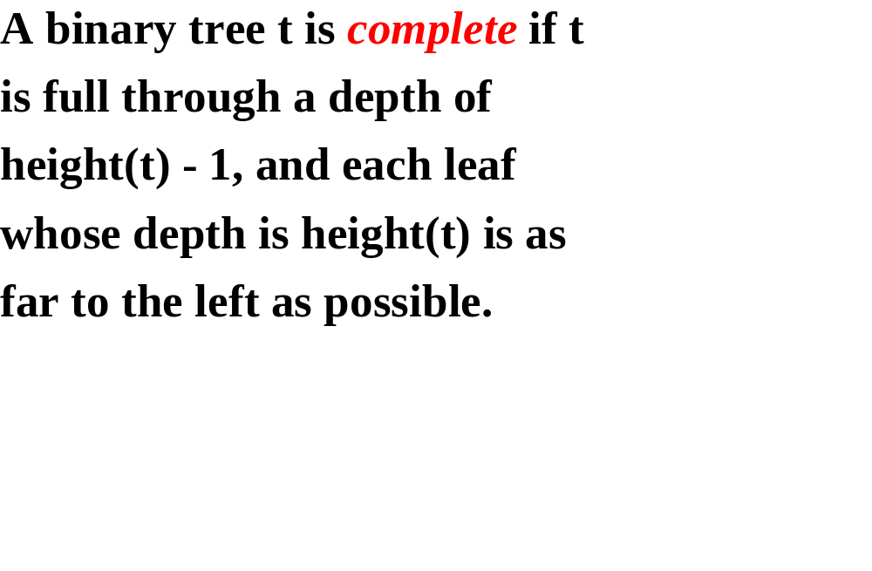

Slide 38
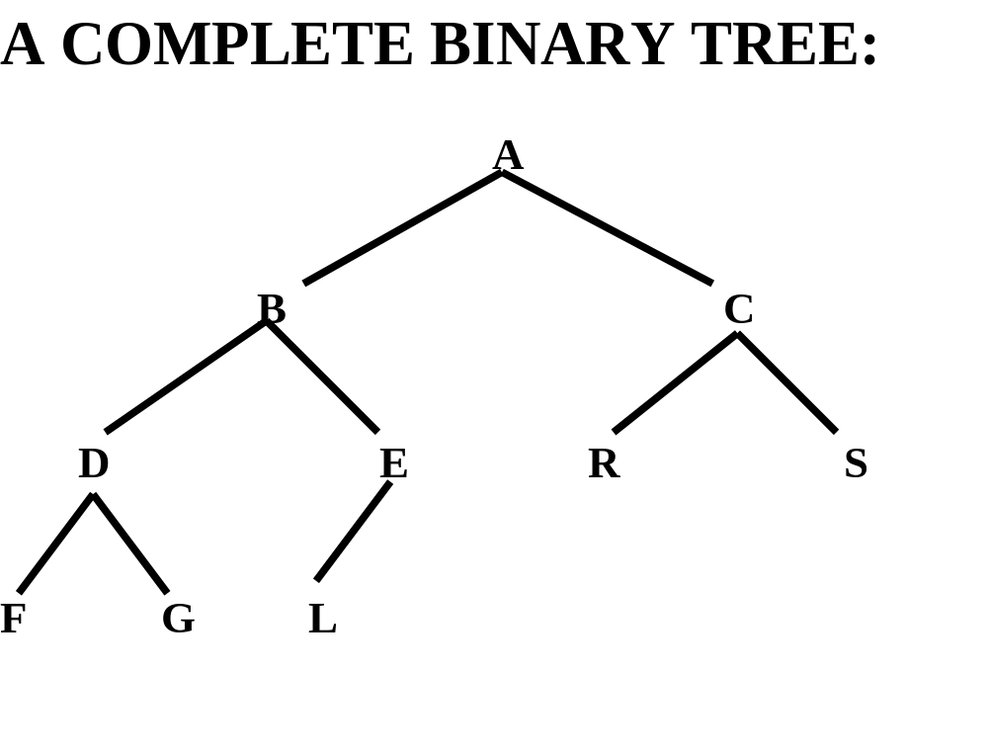

Slide 39
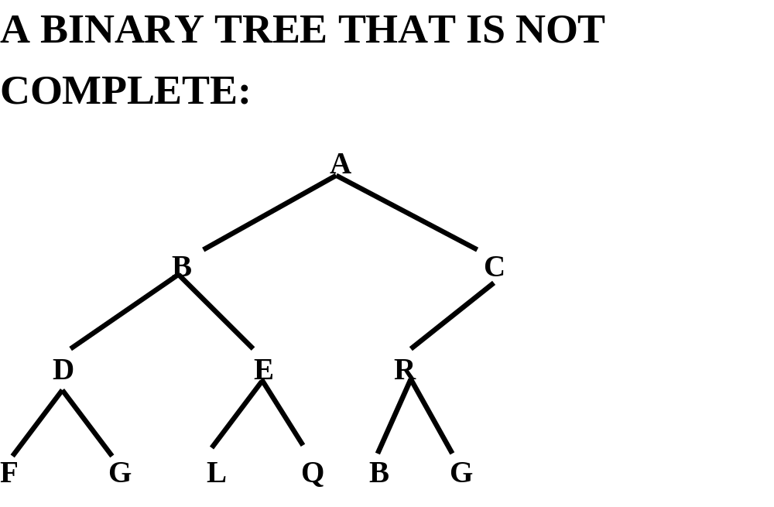

Slide 40
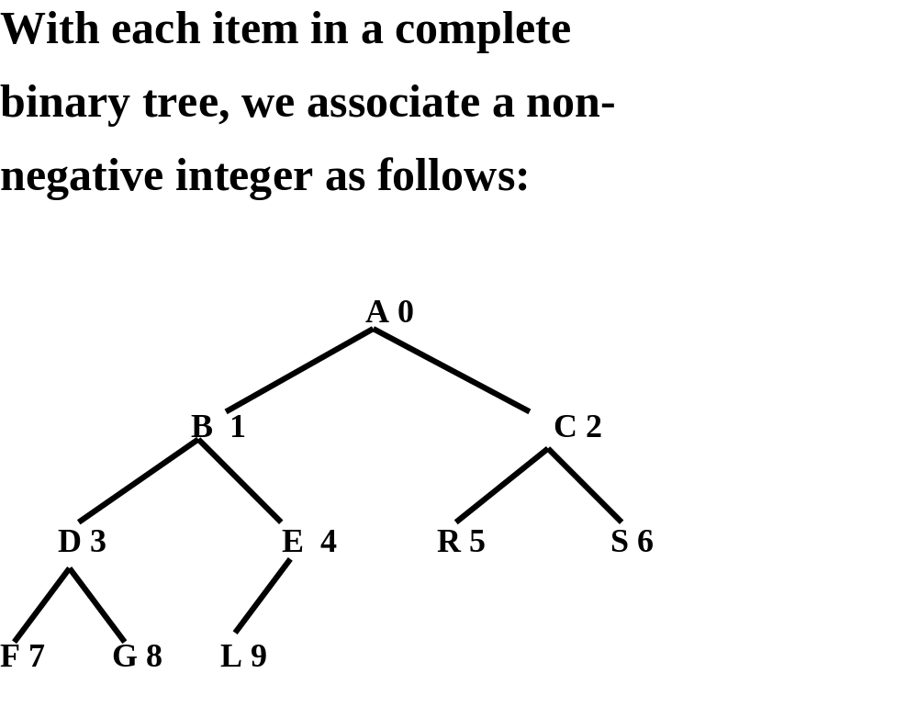

Slide 41
this association suggests that a complete binary tree can be stored in an array:
A
B
C
D
E
R
S
F
G
L

Slide 42
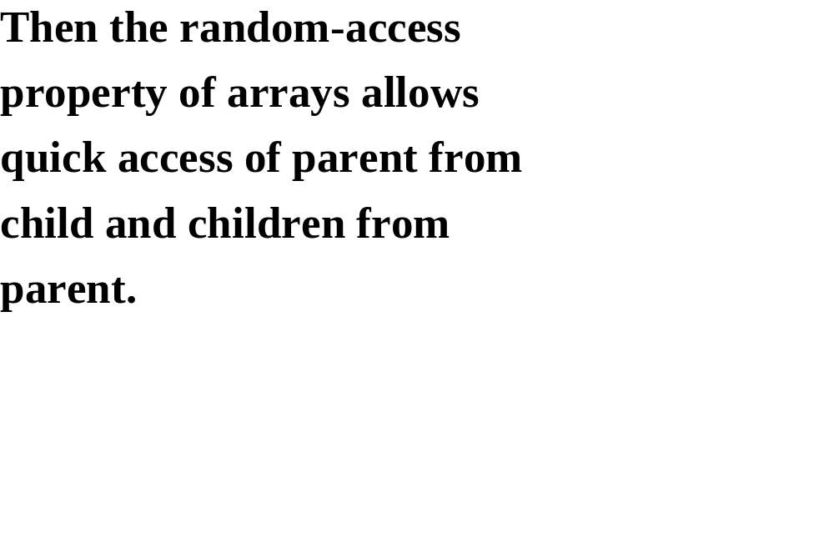

Slide 43
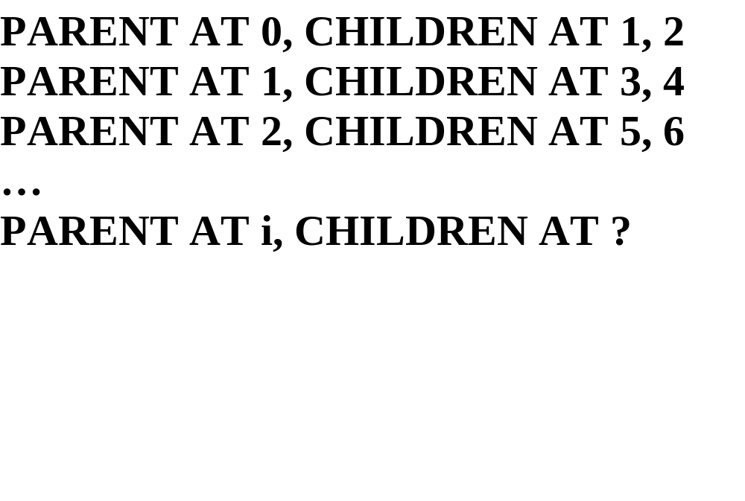

Slide 44
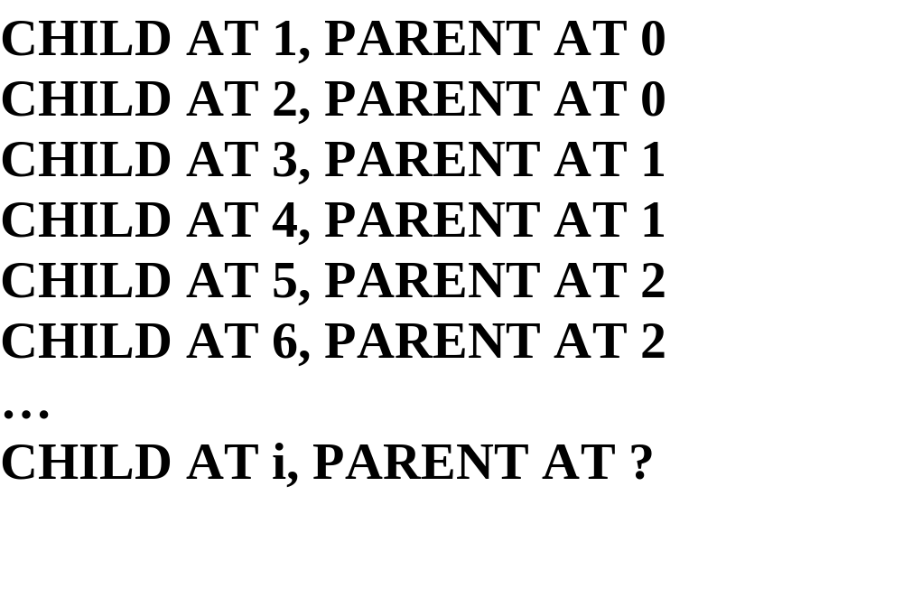

Slide 45
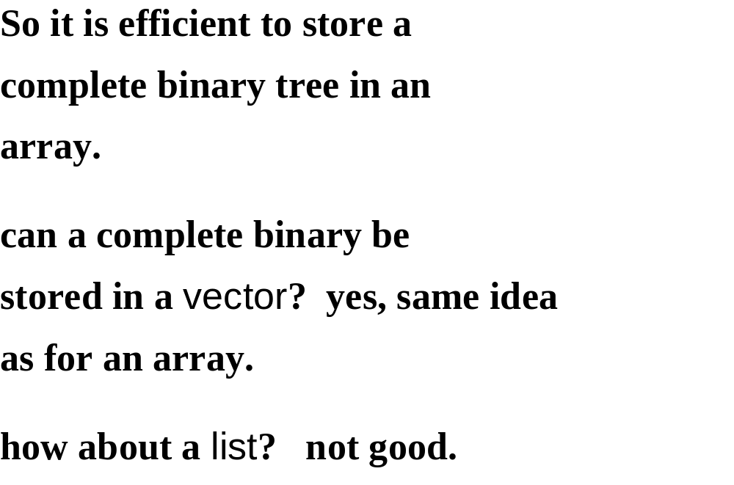

Slide 46
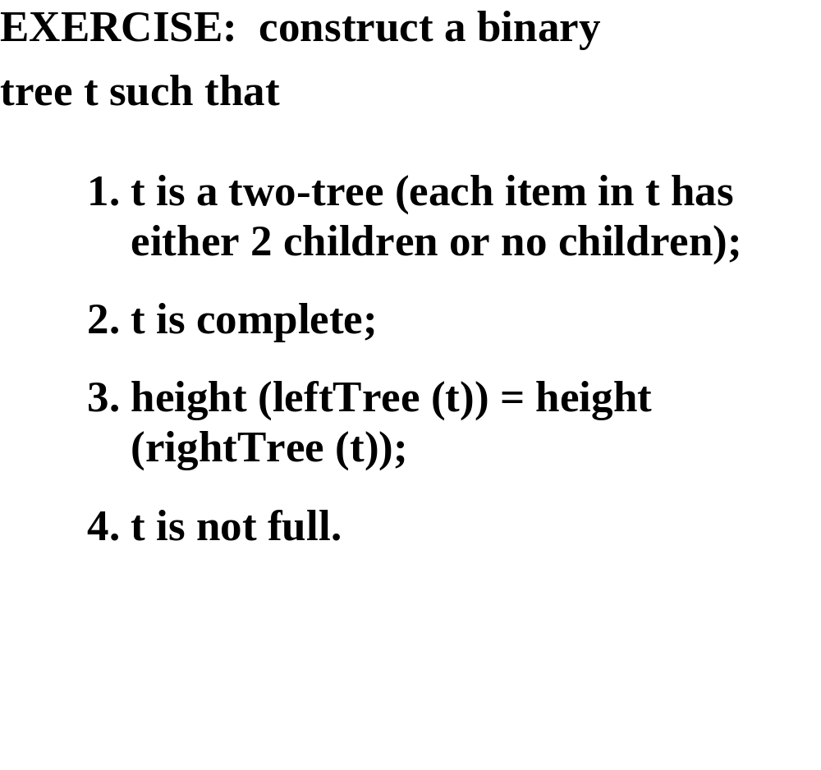

Slide 47
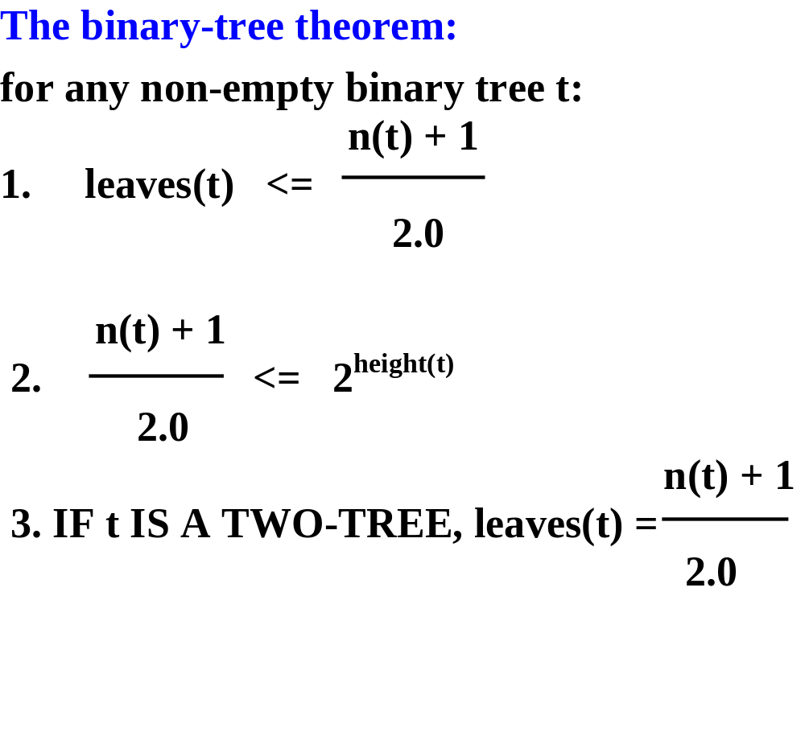

Slide 48
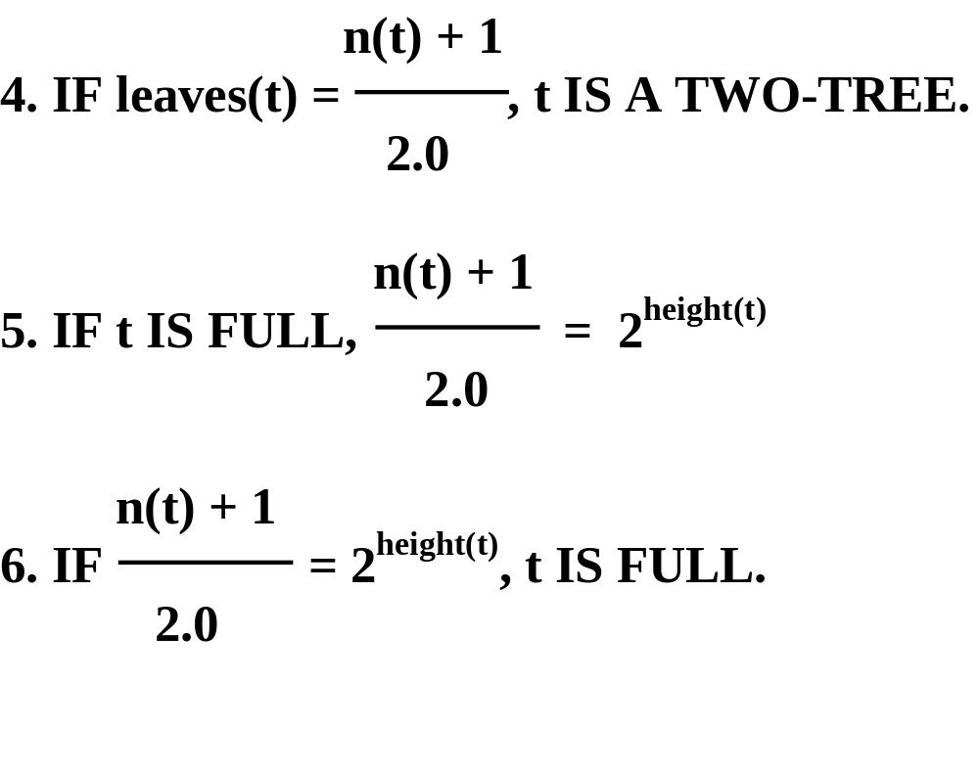

Slide 49
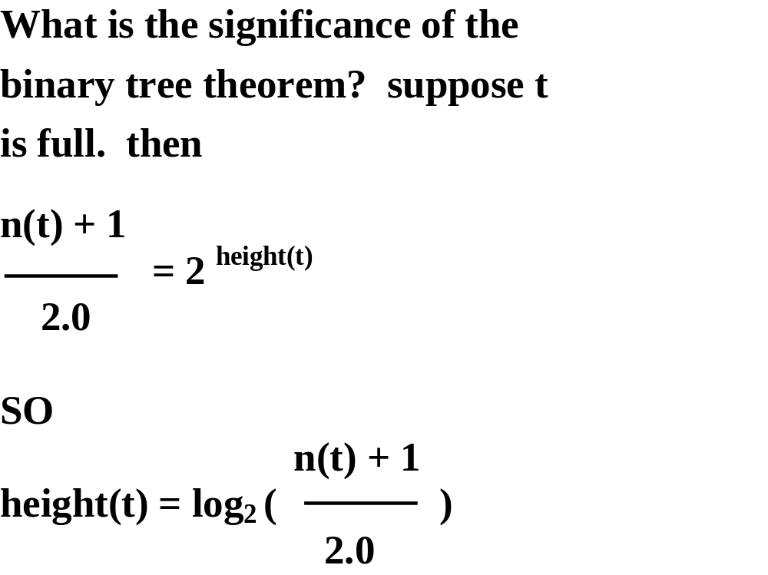

Slide 50
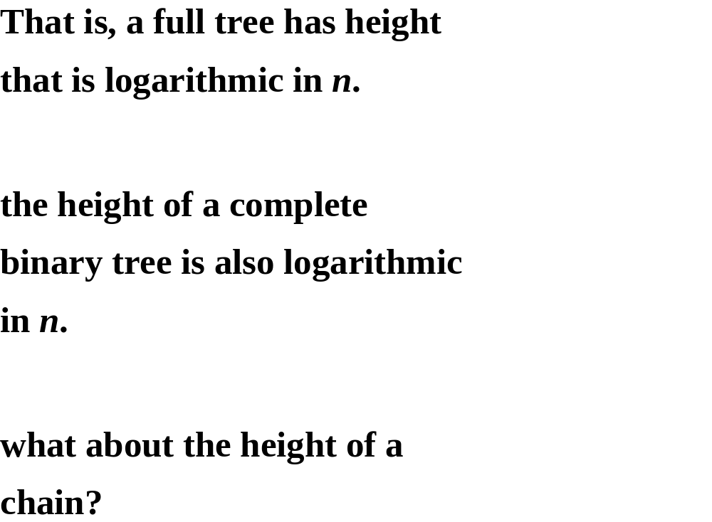

Slide 51
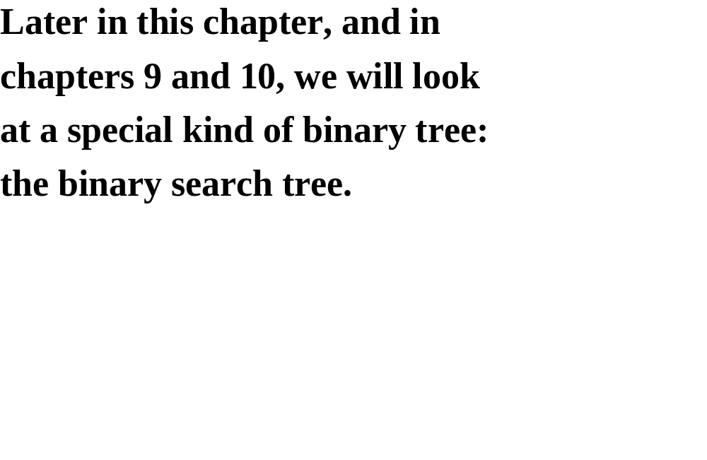

Slide 52
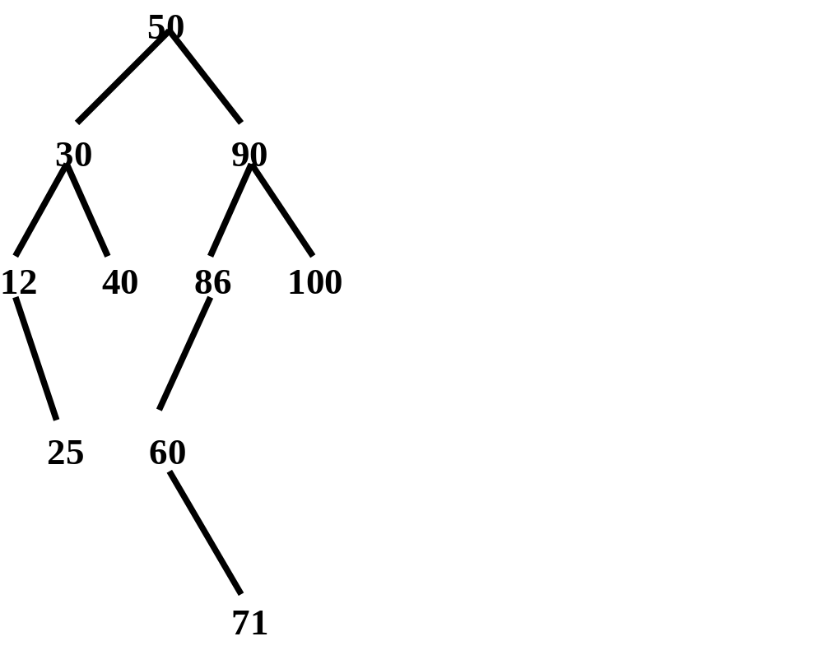

Slide 53
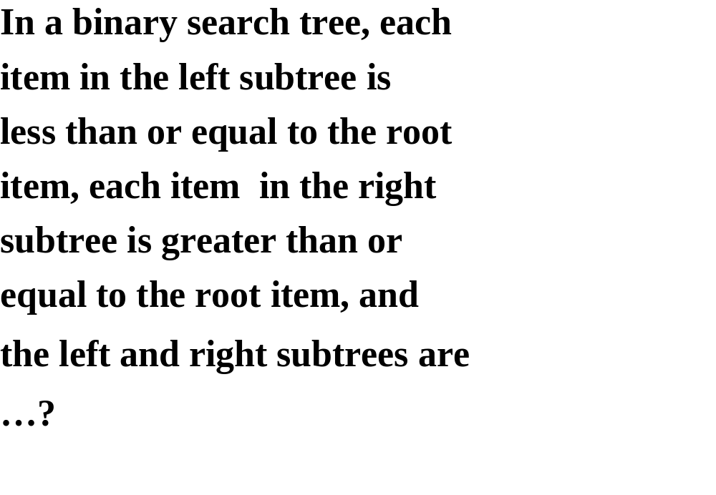

Slide 54
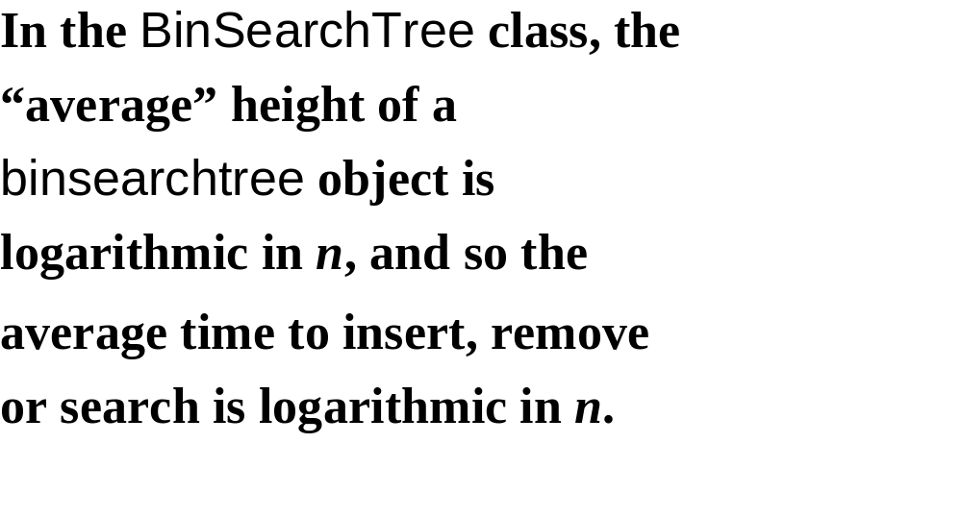

Slide 55


Slide 56


Slide 57
EXTERNAL PATH LENGTH

Slide 58


Slide 59


Slide 60


Slide 61


Slide 62


Slide 63
TRAVERSALS OF A BINARY TREE

Slide 64


Slide 65


Slide 66


Slide 67


Slide 68


Slide 69


Slide 70


Slide 71


Slide 72


Slide 73


Slide 74


Slide 75


Slide 76


Slide 77


Slide 78


Slide 79


Slide 80


Slide 81


Slide 82


Slide 83


Slide 84


Slide 85


Slide 86


Slide 87


Slide 88


Slide 89


Slide 90


Slide 91


Slide 92


Slide 93


Slide 94


Slide 95


Slide 96


Slide 97


Slide 98


Slide 99


Slide 100


Slide 101


Slide 102


Slide 103


Slide 104


Slide 105


Slide 106
80
40 90
60
50 75
Considering find (60)
parent
child

Slide 107


Slide 108
80
40 90
60
50 75
HERE ARE THE STEPS IF THE CALL IS find (60):

Slide 109


Slide 110
80
40 90
60
50 75
HERE ARE THE STEPS IF THE CALL IS find (70):

Slide 111


Slide 112


Slide 113


Slide 114


Slide 115


Slide 116


Slide 117


Slide 118


Slide 119
insert (73)
80
40 90
60
50 75

Slide 120
80
40 90
60
50 75
73
WILL THE INSERTED ITEM ALWAYS BE A LEAF?

Slide 121


Slide 122


Slide 123


Slide 124


Slide 125


Slide 126


Slide 127
SUPPOSE link IS POINTING TO THE NODE WITH 50.
80
40 90
60
50 75
73

Slide 128
80
40 90
60
75
73

Slide 129
WHAT IF link IS POINTING TO THE NODE WITH 40?
80
40 90
60
75
73

Slide 130
80
60 90
75
73

Slide 131


Slide 132
SUPPOSE link IS POINTING TO 80’S NODE:
80
60 110
75 100 150
73 85 105
95

Slide 133
The item 80 has two children, so we
cannot simply unlink 80 from the tree:
that would create a hole.
Of the items already in the tree, which
two could replace 80 without destroying
the structure of the tree?

Slide 134
we can replace 80 with either its
predecessor, 75, or its successor, 85. we’ll
choose its successor. the successor of an
item is the leftmost item in the right
subtree.
replace 80 with 85, and then remove 85.

Slide 135
HERE IS THE RESULTING TREE:
85
60 110
75 100 150
73 95 105

Slide 136
Can removing the successor get
complicated? can the successor
have two children?

Slide 137


Slide 138


Slide 139


Slide 140


Slide 141
Recall that link is the only field in the iterator
class.
if (link has a right child)
// make link point to the leftmost node in link’s right subtree
else
// go up the tree to the left as far as possible, then go up
// to the right. Make link point to that ancestor.

Slide 142


Slide 143


Slide 144


Slide 145


