Slide 1

Dataset Exploration Project Part-4 BDAT 1005-23F-Mathematics for Data Analytics
Sambad Rupakheti
GC ID: 200421504
200421504@student.georgian.on.ca

Slide 2
Impact of Remote Work on Mental Well-Being
Theme:
The dataset focuses on employee experiences across various industries, exploring factors like job roles, work locations, stress levels, mental health conditions, and productivity. It aims to analyze the impact of work conditions on employee well-being, work-life balance, and overall performance.
To check for any missing values in the dataset, COUNTBLANK() function was used.
Source of the Data:
https://www.kaggle.com/datasets/waqi786/remote-work-and-mental-health
Motivation for Study:
The COVID-19 pandemic has significantly increased remote work, raising concerns about its effects on employees' mental health.
This study aims to analyze the relationship between remote work conditions and mental well-being, providing insights to help organizations support their workforce effectively.

Slide 3
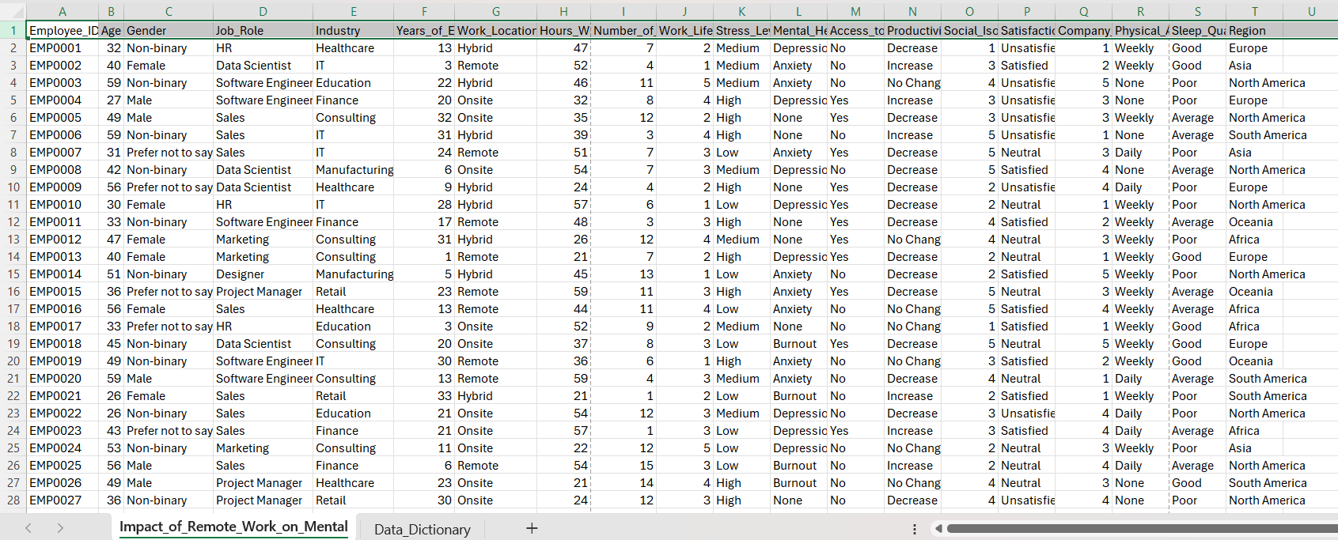
Data file: Impact_of_Remote_Work_on_Mental_Health.csv

Slide 4
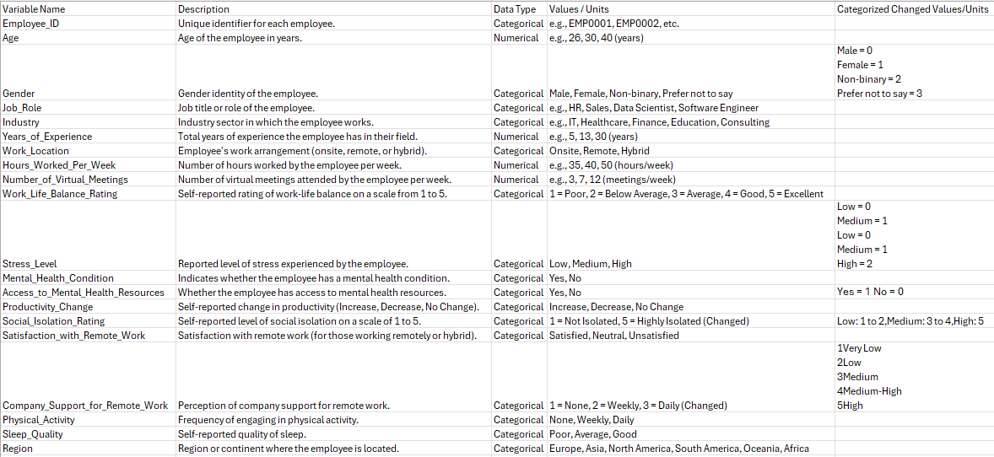
Data Dictionary

Slide 5
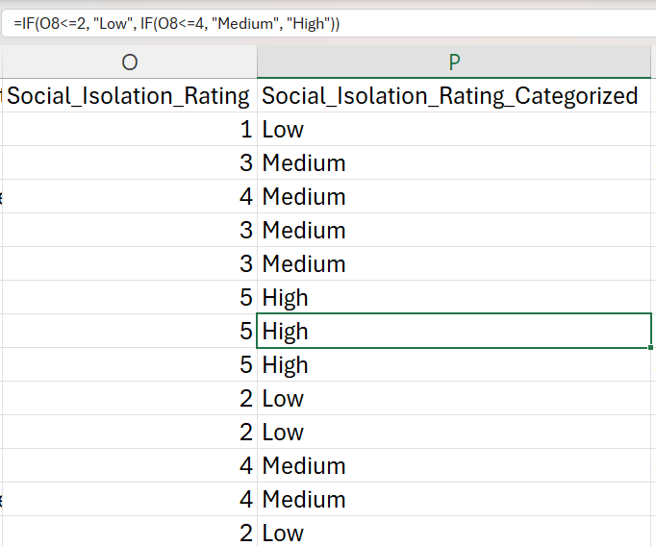
Social Isolation Rating Categories: Categorized into 'Low', 'Medium', and 'High'.
Coding & Categorization

Slide 6
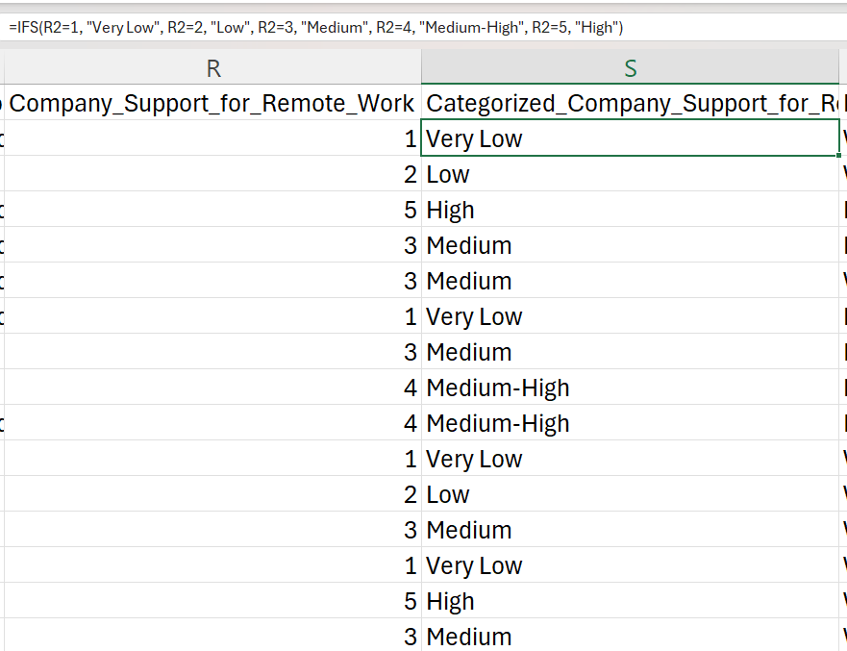
Coding & Categorization
Company Support for Remote Work Categories: Grouped by supportive levels from 1 (low) to 5 (high).

Slide 7
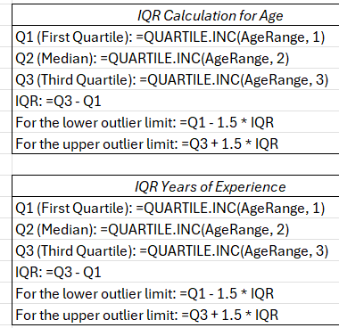
Outlier Analysis
Age:
No outliers found
Limits were set between 1 and 81
Years of Experience:
No outliers found
Limits were set between -16.5 and 51.5
=IF(F3>51.5,"Outlier","") formula was used to check the outlier

Slide 8
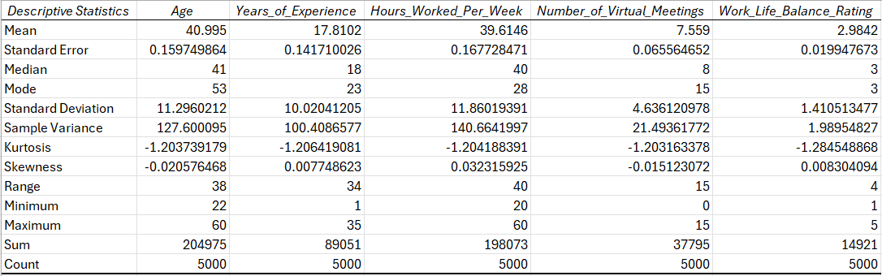
Univariate Descriptive Statistics

Slide 9
Univariate statistics Visualizations

Slide 10
Histogram Showing Employee Distribution by Job Role

Slide 11
Clustered Bar Indicating Work Location Distribution

Slide 12
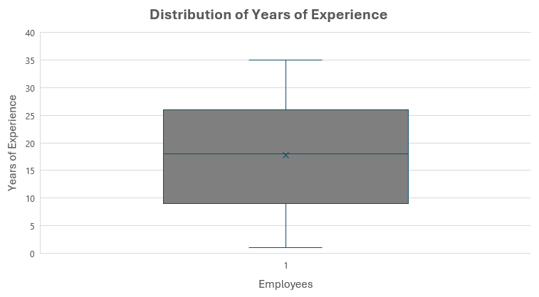
Box & Whisker Plot Showing Distribution of Years of Experience of Employees

Slide 13
Pie Chart Showing Employee Gender Breakdown
Gender | Count of Gender
Female | 1274
Male | 1270
Non-binary | 1214
Prefer not to say | 1242

Slide 14
Bar Graph Indicating Social Isolation Rating Distribution

Slide 15
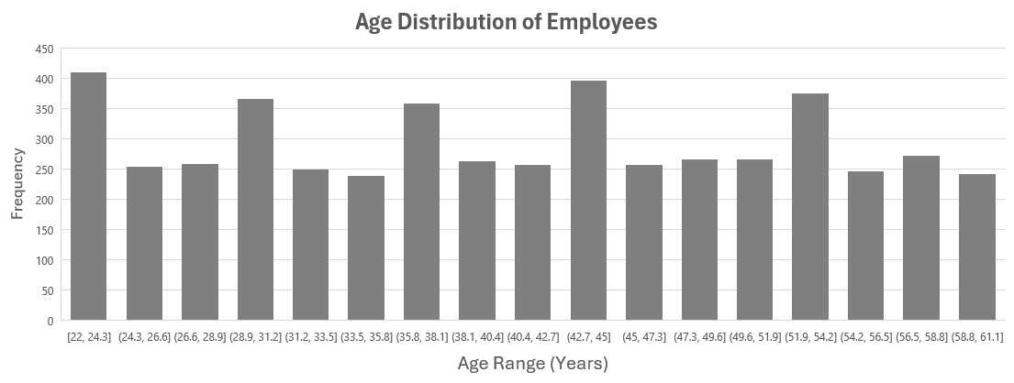
Histogram Showing Age Distribution of Employees

Slide 16
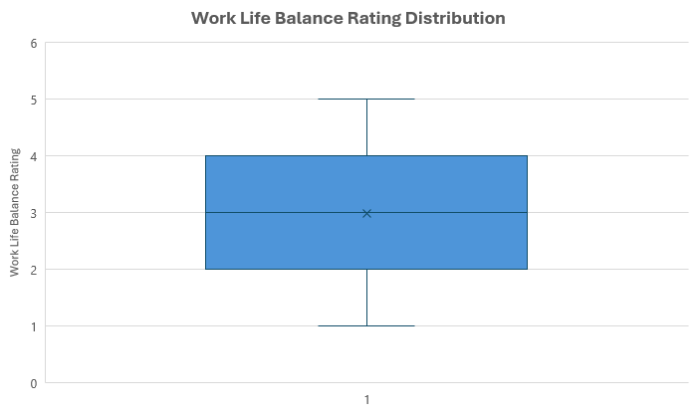
Box & Whisker Plot Showing Work Life Balance Rating Distribution

Slide 17
Clustered Bar Indicating Company Support for Remote Work Ratings

Slide 18
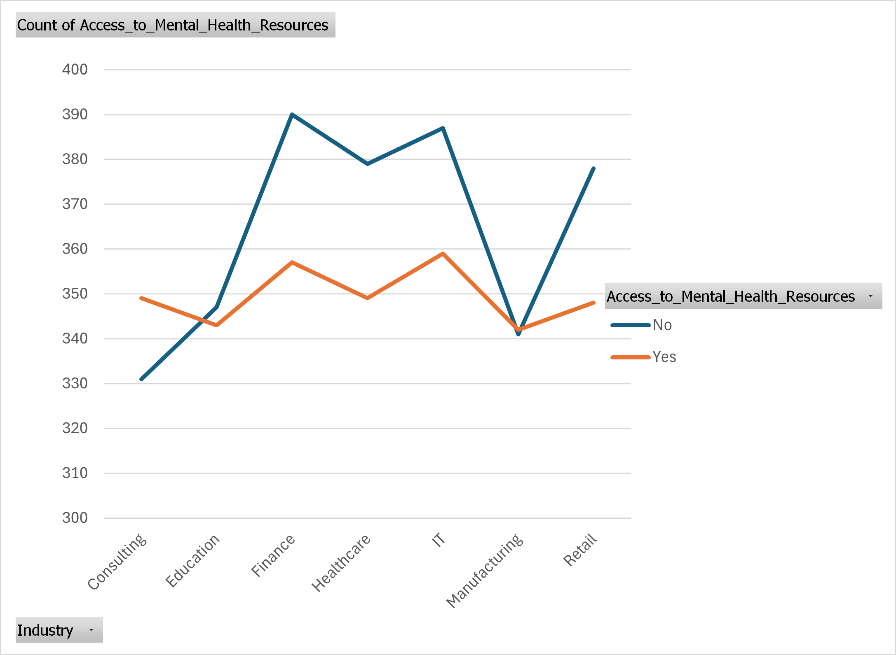
Line Graph Indicating Mental Health Access Across Various Industries

Slide 19
Hypothesis Testing

Slide 20
Chi-Square Test For Gender and Stress Level
Hypothesis Statement
Null Hypothesis (H0): There is no significant relationship between Gender and Stress Level. In other words, the distribution of stress levels is independent of gender.
Alternative Hypothesis (H1): There is a significant relationship between Gender and Stress Level. In other words, the distribution of stress levels depends on gender.

Slide 21
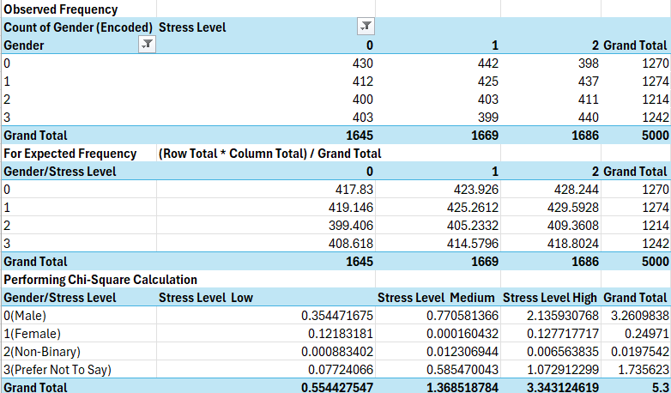
Contingency Table
Here,
Degree of freedom(df) is df=(r−1)(c−1)
Where: r is the number of rows (i.e. 4) and c is the number of columns (i.e. 3).
So, df = (4 - 1)(3 - 1) = 3 × 2 = 6.
Chi-Square statistic = 5.3
P-value calculated using CHISQ.DIST.RT = 0.505951

Slide 22
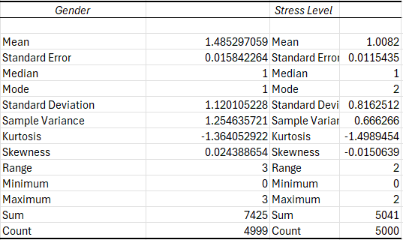
Conclusion
Univariate Analysis
Since the p-value is greater than 0.05, we fail to reject the null hypothesis, indicating no significant relationship between Gender and Stress Level.

Slide 23
Clustered Column Showing Chi-Square Contributions by Gender and Stress Level

Slide 24
OR and RR for Stress Level and Access To Mental Health Resources
Hypothesis Statements:
Null Hypothesis (H0) for each stress level:
Stress Level 0: Access to mental health resources does not significantly impact the likelihood of reporting low stress.
Stress Level 1: Access to mental health resources does not significantly impact the likelihood of reporting medium stress.
Stress Level 2: Access to mental health resources does not significantly impact the likelihood of reporting high stress.
Alternative Hypothesis (H1) for each stress level:
Stress Level 0: Access to mental health resources significantly impacts the likelihood of reporting low stress.
Stress Level 1: Access to mental health resources significantly impacts the likelihood of reporting medium stress.
Stress Level 2: Access to mental health resources significantly impacts the likelihood of reporting high stress.

Slide 25
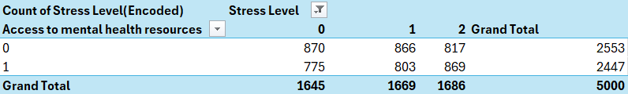
Odds Ratio (OR) Interpretation: Stress Level 0: An OR of 0.7935 means that people with access to mental health resources are less likely to report no stress compared to those without access. Stress Level 1: An OR of 0.8598 means that people with access to resources are less likely to report medium stress compared to those without access. Stress Level 2: An OR of 1.1313 means that people with access to resources are more likely to report high stress compared to those without access. Risk Ratio (RR) Interpretation: Stress Level 0: An RR of 0.9294 indicates that the risk of reporting no stress is slightly lower for people with access to resources. Stress Level 1: An RR of 0.9674 indicates that the risk of reporting medium stress is similar for both groups. Stress Level 2: An RR of 1.1097 indicates that the risk of reporting high stress is higher for those with access to resources.

Slide 26
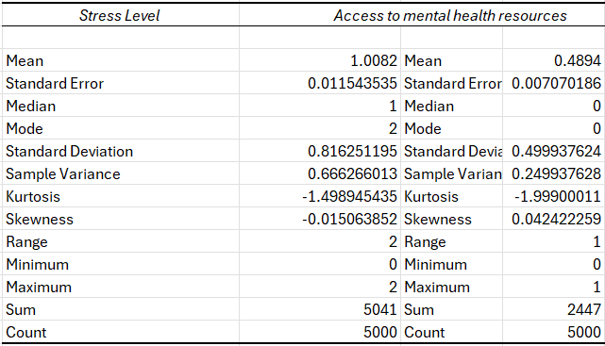
Univariate Analysis

Slide 27
Clustered Column Showing Odds Ratio and Risk Ratio for Stress Levels

Slide 28
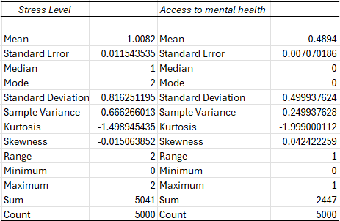
ANOVA of Stress Level and Access to Mental Health Resources
Univariate Analysis

Slide 29
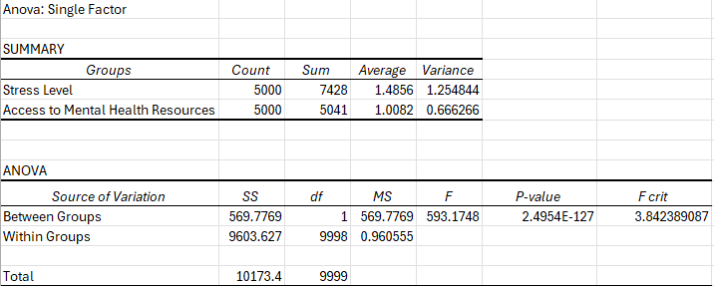
Groups: Column 1: Stress Level (Encoded), which has a sum of 7428, an average of 1.4856, and a variance of 1.2548. Column 2: Access to Mental Health Resources (Encoded), which has a sum of 5041, an average of 1.0082, and a variance of 0.6663. Interpretation: Null Hypothesis (H₀): There is no significant difference between the groups (i.e., there is no relationship between Stress Level and Access to Mental Health Resources). Alternative Hypothesis (H₁): There is a significant difference between the groups (i.e., Stress Level and Access to Mental Health Resources are related). Since the p-value is extremely small (2.4954E-127), we reject the null hypothesis. Since the p-value is very small, we can confidently say that Access to Mental Health Resources affects the Stress Level.

Slide 30
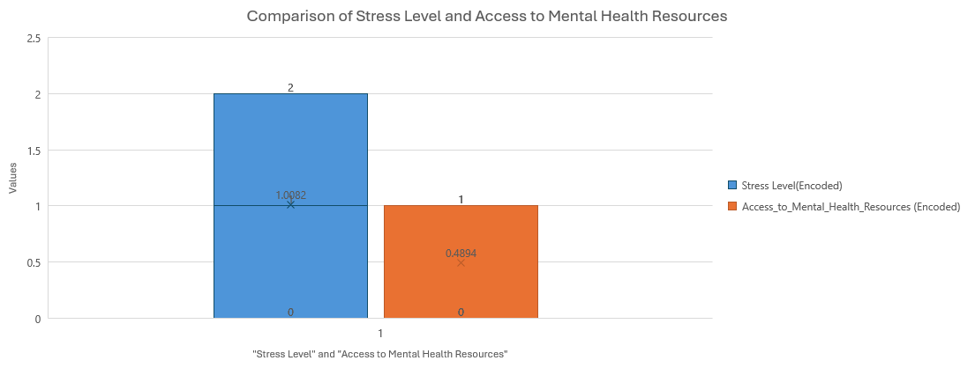
Box Plot Comparison of Stress Level and Access to Mental Health Resources

Slide 31
Two Sample t-test for Gender and Stress Level
Hypothesis Statements:
Null Hypothesis :
There is no significant difference in the stress levels between Gender
Alternative Hypothesis :
There is a significant difference in the stress levels between Gender

Slide 32
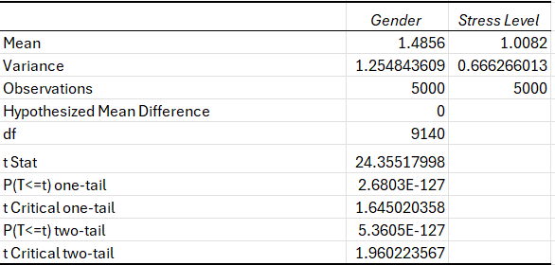
t- Test Results
Interpretation:
The calculated t-statistic is 24.3552, which is significantly greater than the critical value of 1.9602.
The p-value is 5.3605E-127, which is extremely small and less than the significance level of 0.05.
Since the p-value is less than 0.05 and the t-statistic is greater than the critical value, we reject the null hypothesis.
Conclusion:
There is a statistically significant difference in the stress levels between Gender.
Therefore, we conclude that Gender has an impact on stress levels in the dataset.

Slide 33
Clustered Bar Showing Comparison of Mean and Standard Deviation for Gender and Stress Level

Slide 34
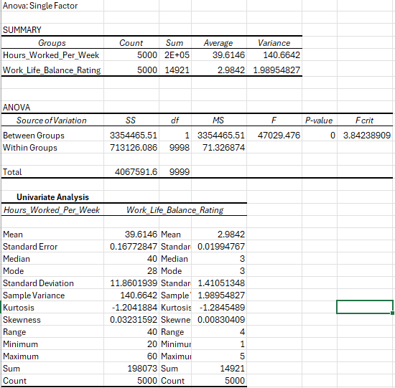
ANOVA of Hours Worked Per Week and Work Life Balance Rating

Slide 35
Hypothesis for ANOVA Analysis:
Null Hypothesis (H0): There is no significant difference between Hours Worked Per Week and Work Life Balance Rating. In other words, Hours Worked Per Week does not impact Work Life Balance Rating.
Alternative Hypothesis (H1): There is a significant difference between Hours Worked Per Week and Work Life Balance Rating. In other words, Hours Worked Per Week impacts Work Life Balance Rating.
Interpretation of ANOVA Results:
F-statistic: The calculated F-value is 47029.47604, which is much higher than the critical F-value of 3.842. This indicates that the variability between groups is significantly higher than the variability within groups.
P-value: The P-value is 0, which is much less than the significance level of 0.05. This indicates strong evidence against the null hypothesis.
Conclusion:
Since the P-value is significantly less than 0.05 and the F-statistic is greater than the critical F-value, we reject the null hypothesis. This means there is a statistically significant difference between Hours Worked Per Week and Work Life Balance Rating. Thus, we can conclude that Hours Worked Per Week has a significant impact on Work Life Balance Rating. These findings suggest that differences in Hours Worked Per Week do influence the perceived Work Life Balance Rating, supporting the significant relationship between these variables.

Slide 36
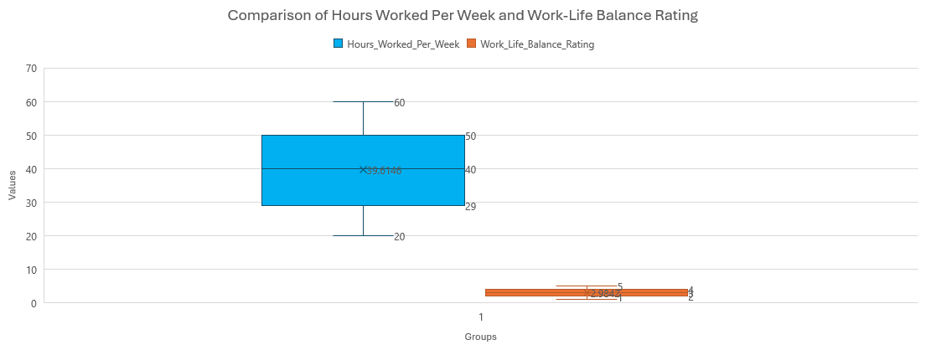
Box Plot Showing Comparison of Hours Worked Per Week and Work-Life Balance Rating

Slide 37
Inferential Techniques

Slide 38
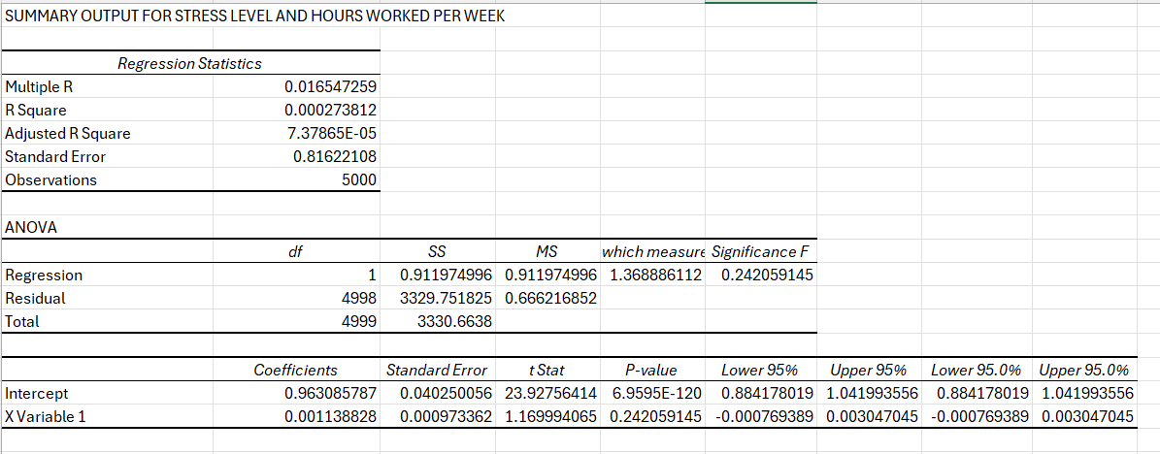
Regression Analysis (Predictive Technique)

Slide 39
Regression Statistics
R-Square (0.000273812):
This indicates that the model explains only 0.027% of the variance in Stress Level.
This is extremely low, meaning Hours Worked Per Week is not a strong predictor of Stress Level.
Adjusted R-Square (7.37865E-05):
Adjusted for the number of predictors, it’s close to zero, reaffirming that the independent variable (Hours Worked Per Week) has little explanatory power.
Standard Error (0.8162): This is the standard deviation of the residuals, which measures the average error in predicting Stress Level.
ANOVA Table
F-statistic (1.3689) and Significance F (0.242):
The F-statistic tests whether the regression model provides a better fit than a model with no predictors.
Since the Significance F (p-value) is 0.242 (greater than 0.05), the regression model is not statistically significant, meaning Hours Worked Per Week does not significantly predict Stress Level.
Coefficients
Intercept (0.9631):
When Hours Worked Per Week is zero, the predicted Stress Level is approximately 0.963.
X Variable 1 (Hours Worked Per Week - 0.0011):
The coefficient indicates that for every additional hour worked, Stress Level increases by 0.0011 units.
However, the p-value (0.242) indicates this relationship is not statistically significant (p > 0.05).

Slide 40
Conclusion & Insights
The independent variable (Hours Worked Per Week) does not significantly predict Stress Level.
The relationship is weak, as shown by the low R² and non-significant p-value.
Insights:
This result suggests that other factors (e.g., access to mental health resources, work location) might be stronger predictors of Stress Level.

Slide 41
Visualization

Slide 42
Insights from the Scatter Plot
Trend Line Equation:
The equation y = 0.0233x
y = 0.0233x suggests that for every additional hour worked per week, the average stress level increases by 0.0233 units.
This indicates a positive correlation, meaning higher hours worked may lead to slightly higher stress levels.
R² Value (0.9213):
A value of 0.9213 implies that 92.13% of the variability in the average stress levels can be explained by hours worked per week in this averaged dataset.
Important Note: This high R² might not be representative of the true relationship due to the averaging process used to generate the scatter plot (grouped data smoothens variability).
Comparison with Regression Analysis Results:
The scatter plot gives a stronger impression of correlation (R² = 0.9213) compared to the regression analysis on the raw data (R² = 0.0003)
This discrepancy arises because the scatter plot is based on averaged stress levels, which reduces variability and inflates
Conclusion:
There is a positive relationship between hours worked per week and average stress levels, but the effect size is small (y = 0.0233 x)
Limitations:
The high R² value from the scatter plot may overstate the strength of the relationship due to the grouped nature of the data.

Slide 43
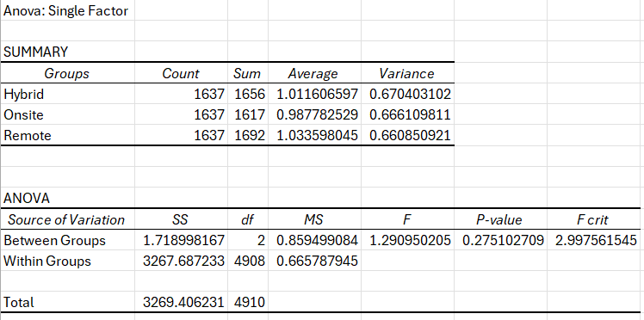
ANOVA – Single Factor for Work Location and Stress Level

Slide 44
Evaluation
F-value = 1.29095:
This is the ratio of the variance between the groups to the variance within the groups.
It compares whether the variability in stress levels across work arrangements is larger than random variability.
P-value = 0.2751:
Since the p-value is greater than 0.05, the result is not statistically significant.
This means there is no strong evidence to suggest that the work arrangement (Hybrid, Onsite, Remote) has a significant effect on stress levels.
F-critical = 2.9976:
The calculated F-value (1.29095) is smaller than the F-critical value, reaffirming that the differences in group means are not statistically significant.
Conclusion:
The type of work arrangement (Hybrid, Onsite, Remote) does not appear to significantly affect stress levels.
The differences observed between the group averages are likely due to random chance rather than a true effect.

Slide 45
Visualization
Average Stress Levels
Hybrid: Average stress level is approximately 1.01.
Onsite: Average stress level is slightly lower, around 0.99.
Remote: Average stress level is the highest, approximately 1.03.
Observations
The differences in average stress levels are minimal across the three work arrangements.
Remote work shows a slightly higher average stress level compared to Hybrid and Onsite, though the difference is not substantial.

Slide 46
FINER Research Questions
What is the distribution of employee ages within the organization?
(To understand the age demographics of the workforce, which can influence various factors like productivity, work-life balance, and engagement)
How do employees distribute across different work locations (onsite, remote, hybrid)?
(To evaluate the prevalence of different work arrangements and their potential impact on organizational culture and employee well-being)
What are the self-reported work-life balance ratings among employees?
(To assess employees' perceptions of their work-life balance, which can inform initiatives aimed at improving employee satisfaction and retention)
What is the relationship between access to mental health resources and job satisfaction among employees in different industries?
(To investigate how industry-specific factors influence mental health resources' effectiveness)
Is there a correlation between age and self-reported feelings of social isolation among remote employees?
(To explore demographic factors affecting mental health in a remote work context)

Slide 47
What is the distribution of employee ages within the organization?
Results:
The age distribution analysis shows that most employees fall between the ages of 30 to 50. There is a smaller representation of employees under 30 and over 50.
Interpretation:
This indicates a mid-career workforce predominantly, which suggests stability and experience in the workforce but might also imply a need for succession planning as employees near retirement.
Recommendation:
Consider leadership development programs for mid-career employees and initiatives to attract younger talent to ensure workforce sustainability.

Slide 48
How do employees distribute across different work locations (onsite, remote, hybrid)?
Results:
The work arrangement distribution shows approximately equal representation across hybrid, onsite, and remote setups, with slight differences in numbers.
Interpretation:
This balance indicates organizational flexibility in work arrangements, likely catering to diverse employee needs.
Recommendation:
Maintain and optimize support systems for all work arrangements. For remote employees, ensure access to mental health resources and collaborative tools to reduce isolation.

Slide 49
Is there a correlation between age and self-reported feelings of social isolation among remote employees?
Results:
A weak but statistically insignificant correlation was found between age and social isolation among remote employees. Older employees tend to report slightly higher feelings of social isolation.
Interpretation:
While the correlation is not strong, older remote employees may feel more isolated due to lesser familiarity with technology or fewer opportunities for social engagement.
Recommendation:
Provide targeted social and technological support for older remote employees, such as virtual networking events or technology training sessions.

Slide 50
Data Transformation Tracking Log
Label Encoding for Ordinal Data
Variable: Gender
Transformation: Assigned numerical labels to categorical gender data to maintain an ordinal relationship, where different values indicate different responses without suggesting a specific hierarchy in this context.
Male = 0
Female = 1
Non-binary = 2
Prefer not to say = 3
Reasoning: This encoding simplifies categorical data, allowing it to be used in various statistical models while preserving original response information.
Impact on Analysis: Allows us to treat Gender as an ordinal variable in tests requiring numerical input.

Slide 51
Label Encoding for Ordinal Data
Variable: Stress_Level
Transformation: Converted categorical stress levels into ordinal numerical labels to reflect increasing levels of stress.
Low = 0
Medium = 1
High = 2
Reasoning: This encoding preserves the order in Stress_Level, allowing the variable to be analyzed as ordinal data, suitable for statistical tests that account for a ranking structure.
Impact on Analysis: Encoding this variable supports direct comparisons between levels of stress and enables use in analyses that consider ordinal relationships, such as ordinal logistic regression or ordered hypothesis testing.
Binary Encoding for Yes/No Questions
Variable: Access_to_Mental_Health_Resources
Transformation: Replaced binary responses with numerical values to indicate the presence or absence of access.
Yes = 1
No = 0
Reasoning: Binary encoding transforms Access_to_Mental_Health_Resources into a format easily usable in quantitative analyses, such as logistic regression or chi-square tests, while keeping the true/false nature of the responses.
Impact on Analysis: Simplifies analysis of resource access by converting it to a binary numerical variable, making it suitable for statistical tests and visualizations that require numeric input.

Slide 52
Tracking
Data Exploration: The dataset has been initially explored to understand its structure and variables. It consists of 5000 rows (employees) and 20 columns, covering demographic information, job roles, work environments, and mental health-related indicators.
Research Questions: Three research questions have been developed to guide the analysis, focusing on the relationship between work arrangements (remote, hybrid, onsite), self-reported stress levels, and the presence of mental health conditions. These questions aim to provide insights into how different work environments impact employees’ mental well-being.
Data Pre-processing: If necessary, the data will be pre-processed by handling missing values, converting categorical variables such as Gender and Work Location into numerical representations, and normalizing continuous variables such as Hours Worked Per Week if required.
Statistical Analysis: I will employ statistical techniques, including data visualization (e.g., histograms, box plots) and potential hypothesis testing, to analyze relationships and answer the research questions.
Documentation: I’ll be documenting each step throughout the analysis process, detailing the methodologies employed and how I arrived at my conclusions to ensure transparency and replicability.
Interpretation: After the completion of the analysis, I will provide meaningful insights from the findings and address my research questions, discussing implications for organizations aiming to support employee mental health effectively.

Slide 53
Assumptions
The dataset contains binary responses ("Yes" or "No") for the Mental Health Condition variable. This includes any diagnosed or self-reported condition related to mental health, such as anxiety or depression, without distinguishing the severity or type of mental health issue.
Changes in productivity are categorized as "Increase," "Decrease," or "No Change." These changes are self-reported and subjective, without specific numeric values tied to the level of productivity.
The Access to Mental Health Resources variable has binary responses ("Yes" or "No"). "No" is interpreted as having no reliable access to mental health resources, while "Yes" indicates sufficient access.
The Social Isolation Rating has been categorized into three levels based on self-reported scores: Low (1 to 2), Medium (3 to 4), and High (5). This categorization assumes that a lower rating indicates less social isolation, while a higher rating indicates greater isolation.
The variable has been recategorized to reflect levels of perceived support: Very Low (1), Low (2), Medium (3), Medium-High (4),High (5). This assumes a scale where higher values correspond to greater levels of perceived support from the company regarding remote work arrangements.

Slide 54
Thankyou!

