Slide 1

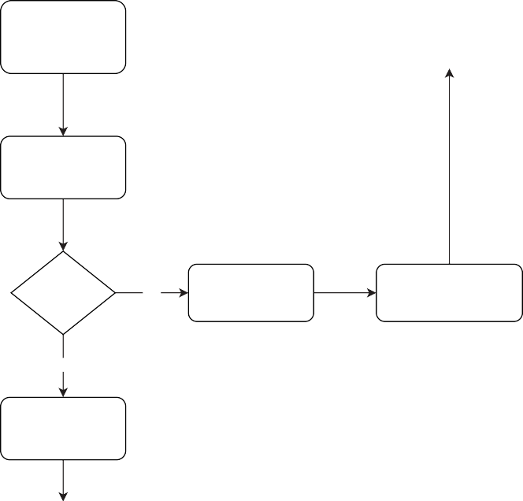
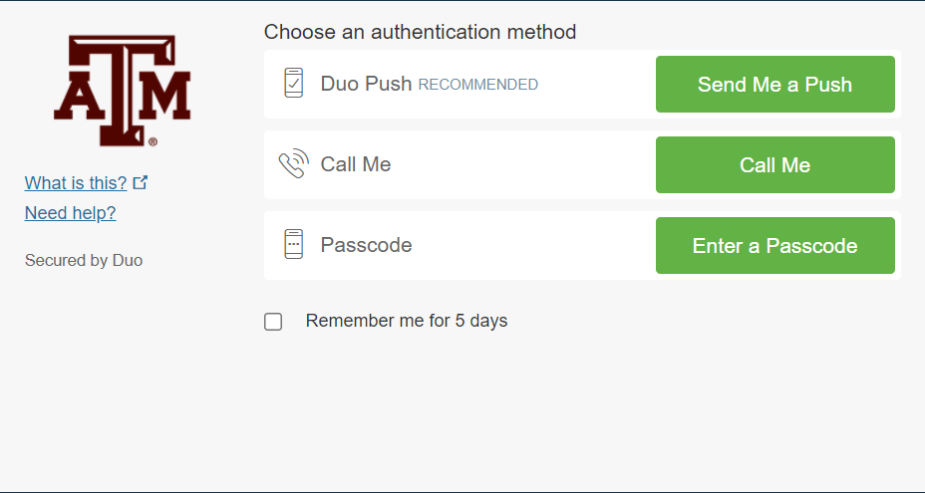
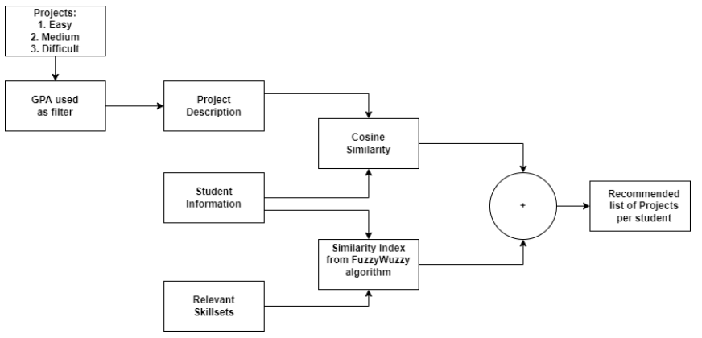
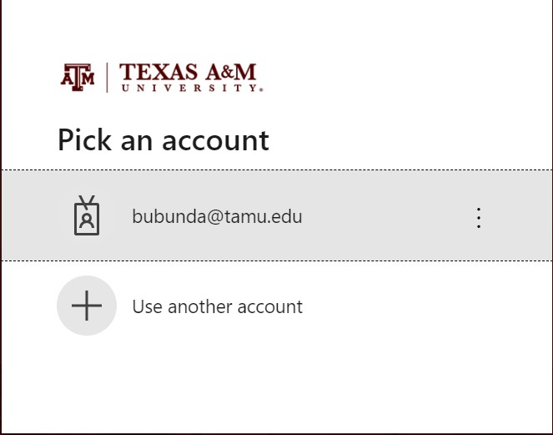
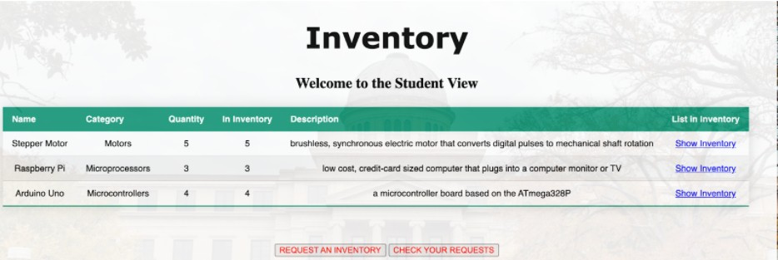
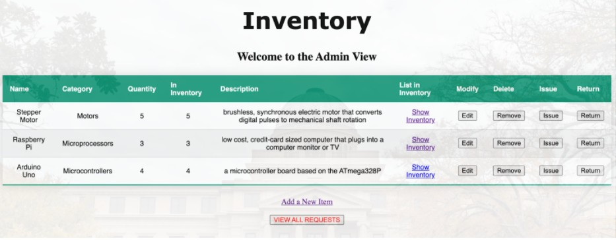
TAMU ECEN CAPSTONE MANAGER
Souryendu Das Vaidhyesh Padma Sundar Swarnabha Roy Sambandh Dhal
Satya Sreenadh Meesala Aditya Tathagarthi Arun
CSCE 606 Software Engineering
Introduction
The website is exclusively designed for ECEN students and serves as a management site for ECEN Senior Capstone design. It has sections for students to upload their resumes and personal information. It also has section for Sponsors to upload projects. The idea is to implement machine learning model to get a recommendation of project that can be allocated to teams based on their resume, GPA and proﬁle. The website also has a separate inventory management component which enlists parts that can be issued to students for their projects and supports a student and admin view for different functionalities of the inventory. The novel part is the TAMU two factor authentication which allows only authenticated users to use all the features of the website mentioned above based on their roles
Machine Learning Description
The ML model takes into account the resume of a student and returns a list of 5 projects based on skills and GPA It returns a list of projects that is common to all the members of the team
Itﬁlters the projects based on student’s GPA and allocates challenging projects to the best teams with highest average GPA The algorithm uses cosine similarity to check similarity between student resume and projects.
Website Flow
Two Factor Authentication
WELCOME & SPONSOR PROJECT SUBMISSION
Sign Out
Sign In TAMU NetID
is Admin?
Yes
INVENTORY
Full Inventory Access CRUD
Get Project Recommendations from ML
No
Duo two factor authentication
INVENTORY
Request for inventory Check Requests
ML Backend Model
Form a team
Overall Flow and Website Functioning
Login and Authentication
Project list recommendation to admins based on GPA, internships, and projects
Inventory Management
Student View
The Student view gives access to a
Admin View
student to view the inventory, make ^{The Admin view gives access to} requests for parts issue and check the admin to view the inventory
whatever requests they have made ^{and make changes to it.}
The
throughout history.
_{The students} changes include CRUD operations
are not allowed to do changes to in- on database. The admin can also
ventory for security reasons.
view the requests made by stu- dents and mark them as complete
Team TechNoobs

