Slide 1
Secure data hiding in images using stenography
CAPSTONE PROJECT
Presented By: Lonka Samba raju
Student Name : Lonka Samba raju
College Name & Department : Vignana Bharathi Institute Of Technology(ECE)

Slide 2
OUTLINE
Problem Statement
Technology used
Wow factor
End users
Result
Conclusion
Git-hub Link
Future scope

Slide 3
Problem Statement
The project focuses on developing a secure steganographic technique for embedding sensitive data within digital images.
The aim is to ensure that the hidden data remains undetectable, robust against common image processing techniques (such as compression and noise), and preserves the visual quality of the image.
By enhancing security and data integrity, this project seeks to provide a covert and reliable method for secure communication without revealing the presence of hidden information.
The proposed solution will integrate advanced encryption methods with steganography to protect data during transmission, making it resilient to detection and unauthorized access.

Slide 4
Technology used
To run the code you provided, you will need the following libraries and platforms: 1. Libraries: Open CV2, OS, String. 2. Platform/software: Python 3. Operating System: Windows, Macos/linux. 4. For execution: Python IDE/Text Editor, VS Code, PyCharm, Jupyter Notebook:

Slide 5
Wow factors
Here are some unique features that distinguish this project:
1. Image-Based Steganography with Passcode Protection:
Secret Message Hiding in Image: The project hides a secret message within the pixel values of an image, which is the core principle of steganography. This technique ensures the hidden message is not immediately visible to someone who looks at the image.
Passcode for Access Control: The code introduces an extra layer of security by requiring a passcode for decryption. This means that even if someone finds the image, they cannot extract the hidden message without the correct passcode, adding a password-protected layer to the steganography.
2. Encryption and Decryption Mechanism Using Pixels: The secret message characters are directly encoded into the image by modifying pixel values. This is a unique approach to encoding information in an image, as each character's ASCII value is hidden in the pixel’s RGB color channels.

Slide 6
End users
Here are some key categories of users who might benefit from or be interested:
Private Individuals: People who want to securely send sensitive information (e.g., passwords, personal messages, confidential data) via images.
Cybersecurity Professionals: Professionals who are looking for quick and simple ways to hide data within media files.
Digital Forensics Experts: Digital forensics experts who might use similar techniques to uncover hidden data or to understand how steganography can be used to protect data during investigations.
Confidential Document Sharing: Businesses dealing with confidential documents could use this type of steganography to hide important details or instructions within images sent over email or through other digital means.

Slide 7
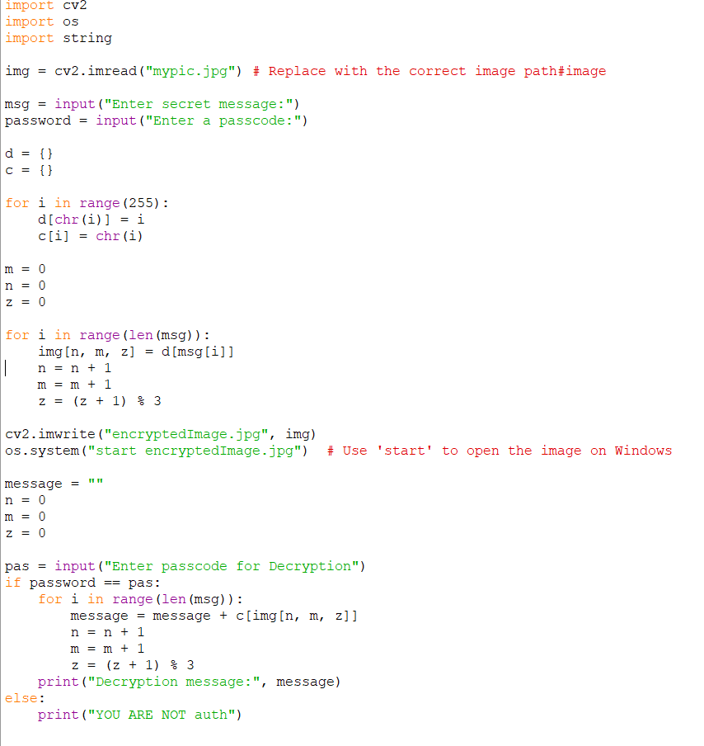

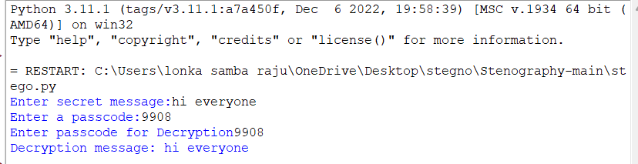
Results
Encrypted image:
OUTPUT:

Slide 8
Conclusion
The Secure Data Hiding in images using Steganography successfully demonstrates a practical and effective method for concealing sensitive data within image files. After the successful execution of the code, the project proves that it's possible to hide a secret message within the pixels of an image, making it imperceptible to the human eye, while still being retrievable by those with the correct passcode for decryption. Steganography as a tool for secure data transmission, where the hidden message remains undetectable in a casual glance at the image. The combination of image manipulation (using OpenCV) and basic encryption techniques demonstrates an accessible yet secure method for data hiding, which can be applied in real-world scenarios for confidential communication, privacy protection, or secure file sharing.

Slide 9
GitHub Link
https://github.com/Sambaraju-hub/stegnography.git

Slide 10
THANK YOU

