Slide 1
NutriFix
Project status, verification, cleanup, and next steps · 28 October 2026
AI-powered blood-report analysis
with human review first
Private GitHub repository
Versioned baseline and iterative fixes
Research prototype · not a medical device

Slide 2
What works today
The complete local workflow is implemented
FastAPI extraction and reviewed-analysis endpoints
Selectable PDF text + local Tesseract OCR
Canonical biomarker matching with provenance
React/Vite upload → review → analysis flow
Dark mode and responsive desktop/mobile UI
Optional Gemini nutrition education

Slide 3
Testing summary
Verification completed before this checkpoint
44 Python tests passed in 12.977 seconds
Frontend build passed
Frontend lint passed
git diff --check passed
Responsive browser checks: 1440, 1024, 768, and 390 widths
All tested widths reported zero horizontal overflow

Slide 4
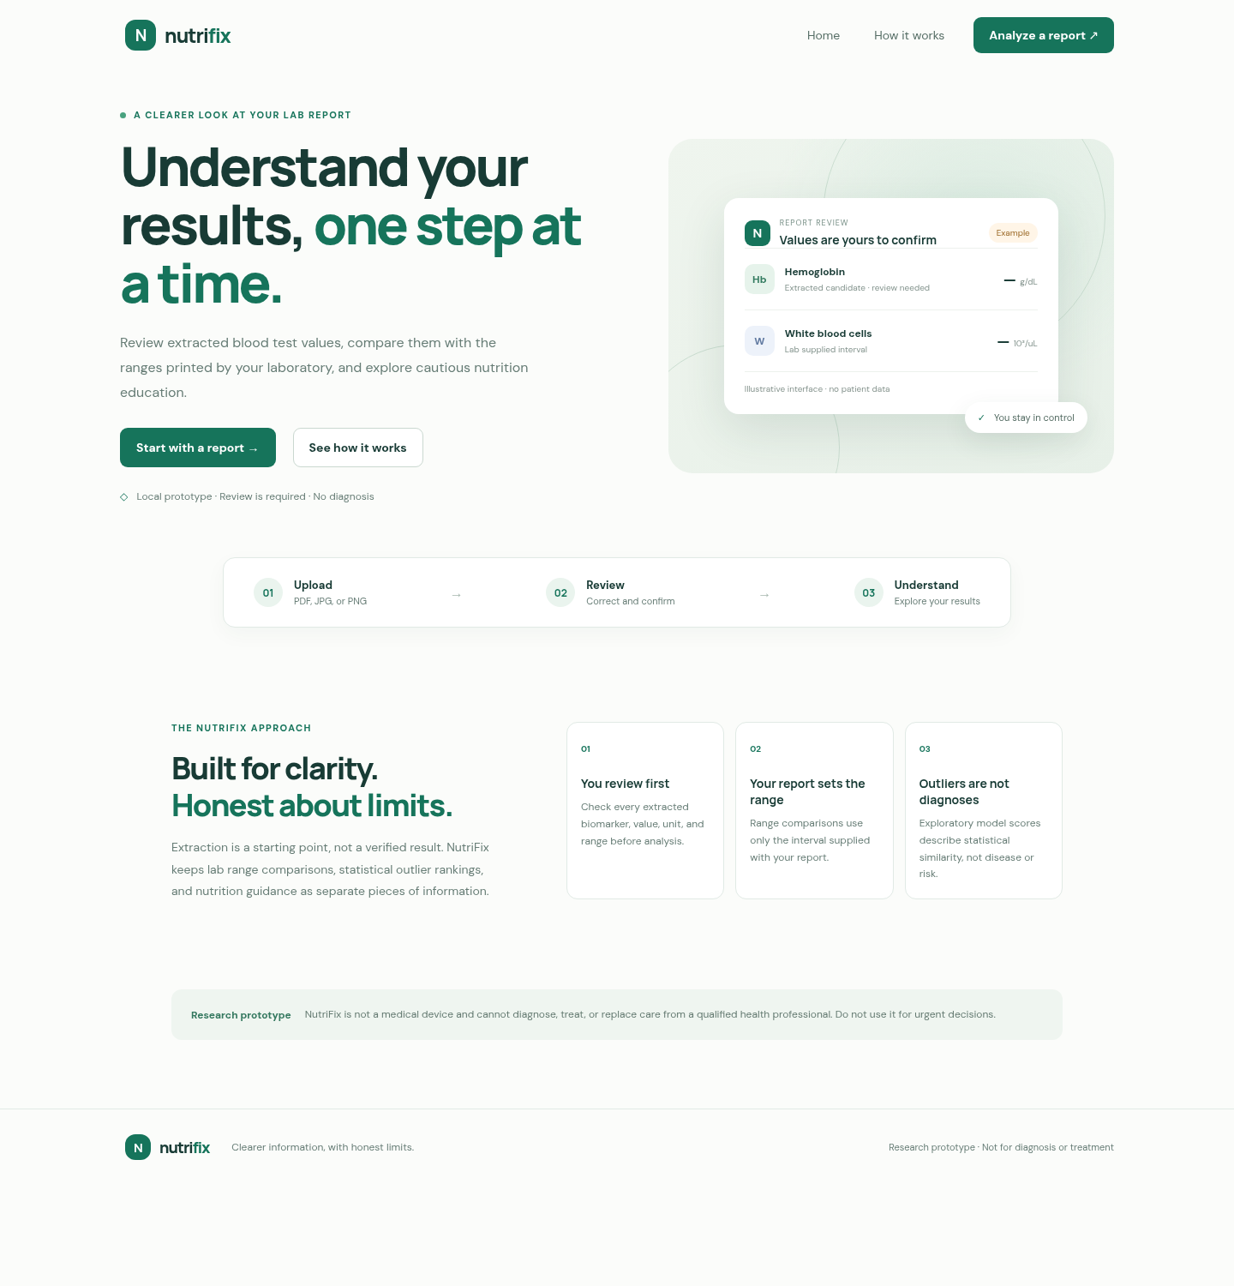
Interface evidence
Synthetic/demo interface capture from the project documentation

Slide 5
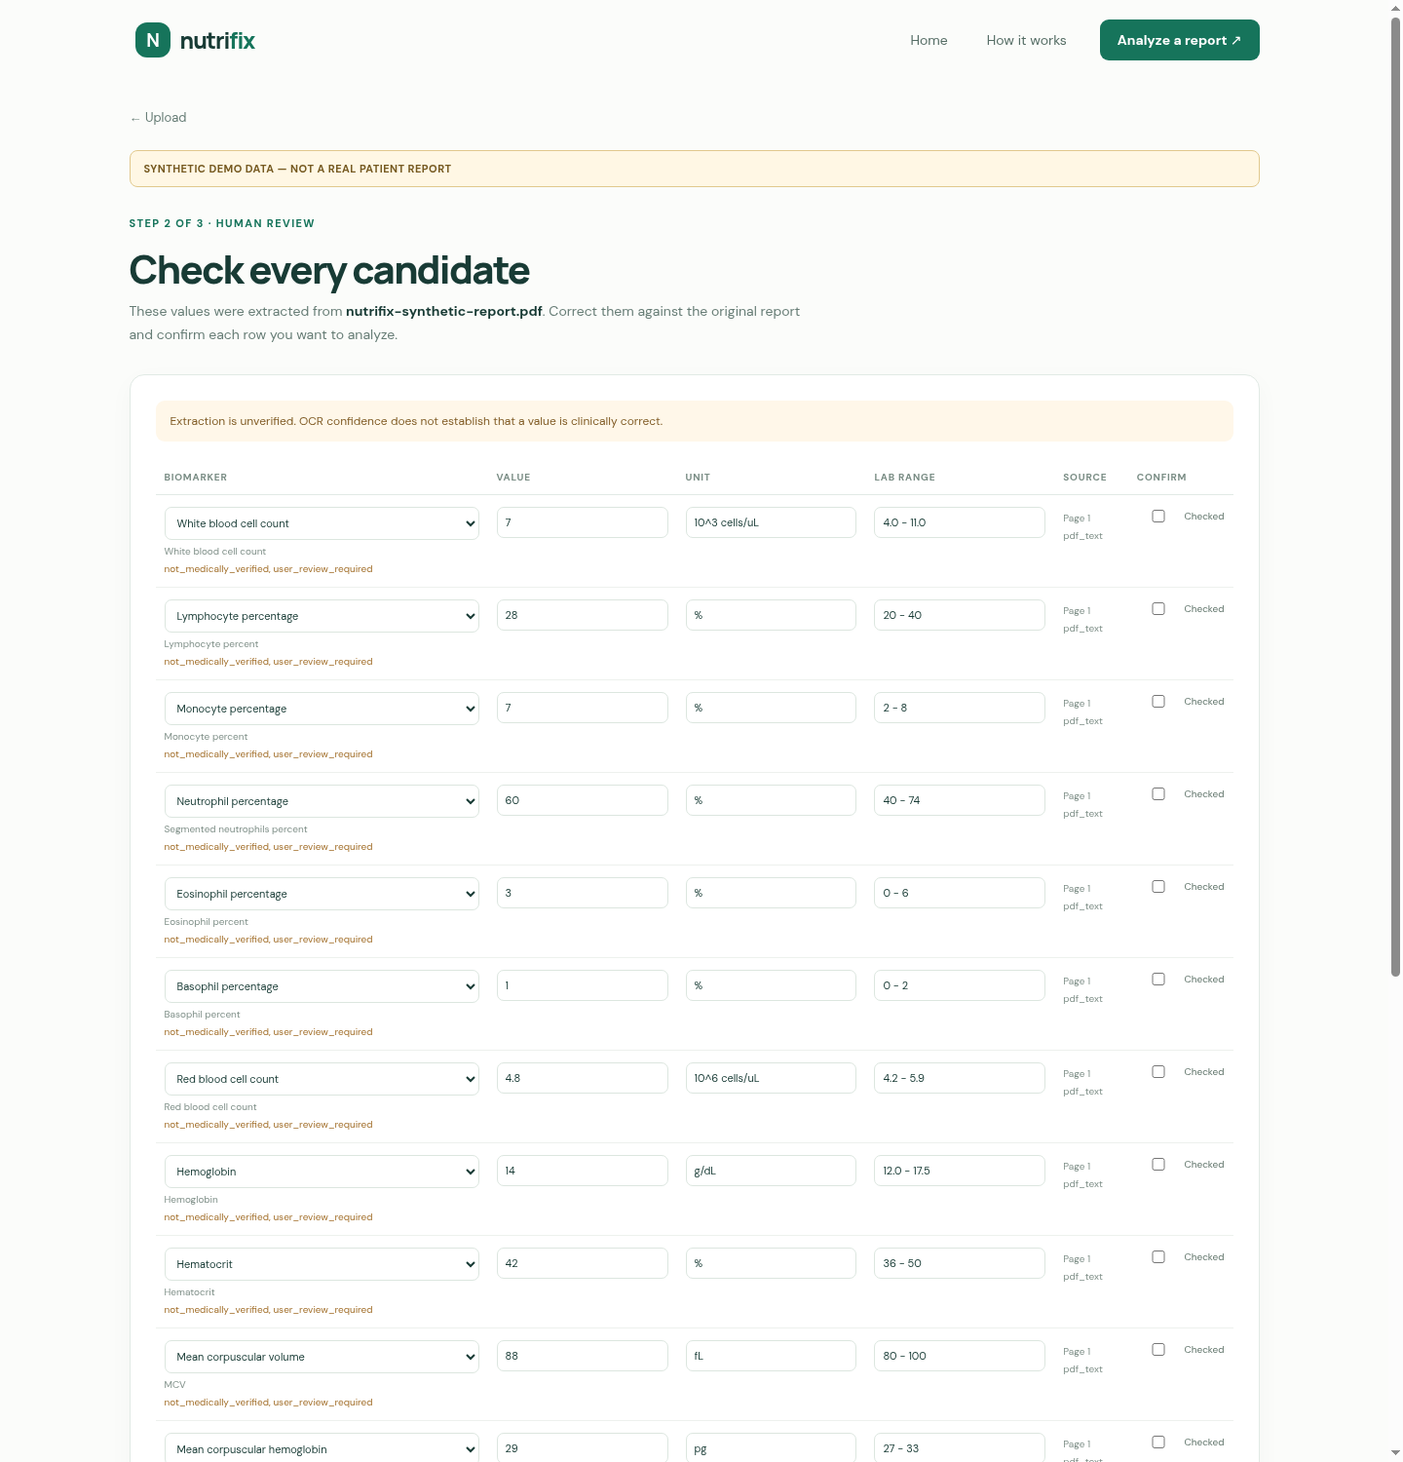
Human review flow
Values remain unverified until the user checks and confirms them

Slide 6
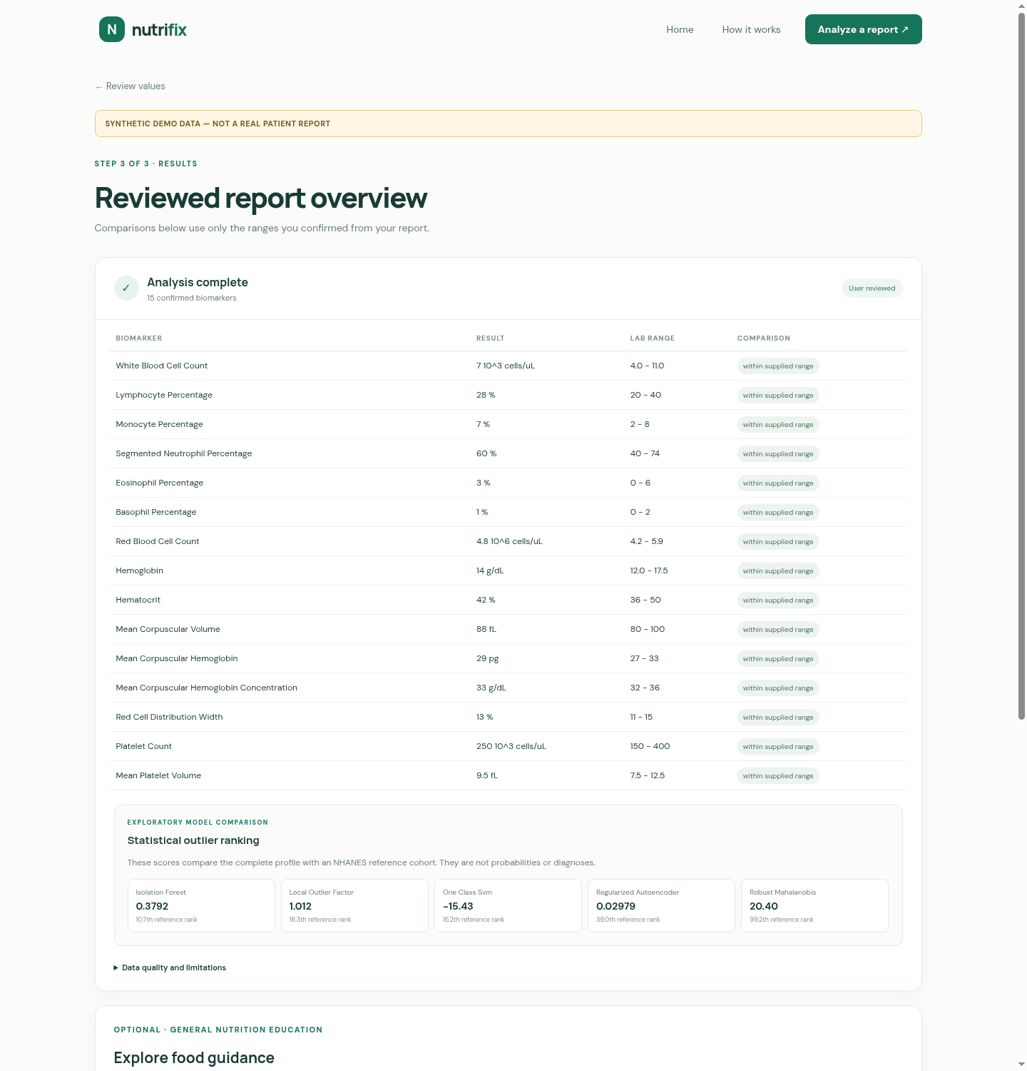
Results and limitations
Report-supplied range comparisons and exploratory output

Slide 7
Cleanup completed
Only confirmed-unused or generated clutter was removed
Removed unused React and Vite starter SVGs
Removed unused public icon bundle
Removed local api.py.save backup
Removed frontend/dist and Python cache directories
Preserved source code, tests, schemas, screenshots, and research workflows
Secrets, datasets, and generated outputs remain ignored

Slide 8
AI provider status
Configuration was checked without exposing credentials
A Gemini key is configured locally in .env
A synthetic request reached Gemini
Gemini returned temporary 503 model-demand availability
This was not a missing-key response
Groq is not currently wired into the application
No API key was committed or included in this presentation

Slide 9
Known limitations and next steps
The project is ready for continued controlled development
OCR and extracted values require human confirmation
Anomaly scores are exploratory, not diagnoses
Nutrition output is general education, not treatment
No clinical validation has been completed
Next: improve report coverage, evaluate OCR on a representative corpus, and review provider strategy

