Slide 1
Innovation Fest 2016 Sambhav Patni

Slide 2
IEExtension

Slide 3
About IEExtension
It is an extension to Internet Explorer® which creates additional functionalities for WorkCenter, CSTT, TFS, SalesForce, by formulating Search queries on Context menu of any selected text.
Similar to what we see in “Search with Google”
It uses IE’s menu Extension feature to insert Scripts into IE frame.
Hence adds new features to it.
It works on all IE Versions

Slide 4
Why IEExtension
What's is most important part in the IT world
Any Guesses??

Slide 5
Why IEExtension
It ‘s
INFORMATION
Or rather Information flow, now if there are obstructions in the flow then it might make process stale or even useless.

Slide 6
Why IEExtension
TFS
CSTT
SharePoint
SalesForce

Slide 7
How I got the Idea..
In Our Team we work closely with multiple layer of developers as well management now that’s a rare combination as we need to critically analyse the problem and also provide a quick solution to it.
Obviously for that we would need complete and concrete knowledge of entire product ranges of Mitchell.
Considering Every 3 months we might have entire set of new features added.

Slide 8
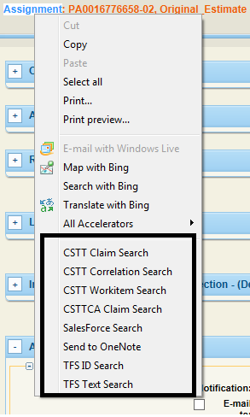
How I got the Idea..
Earlier searching in information sources was done manually.
But it is pretty hectic and human error is inevitable.
Then it occurred.

Slide 9
Demo
Its Demo Time

Slide 10
Benefits
Easy to Use
No third party tool or integration is required
Easy correlation of data.
Can easily be extended to be used with other apps.
To Business
Smaller turn around time with issues.
For developers as well as customers.

Slide 11
Thanks.

Slide 12
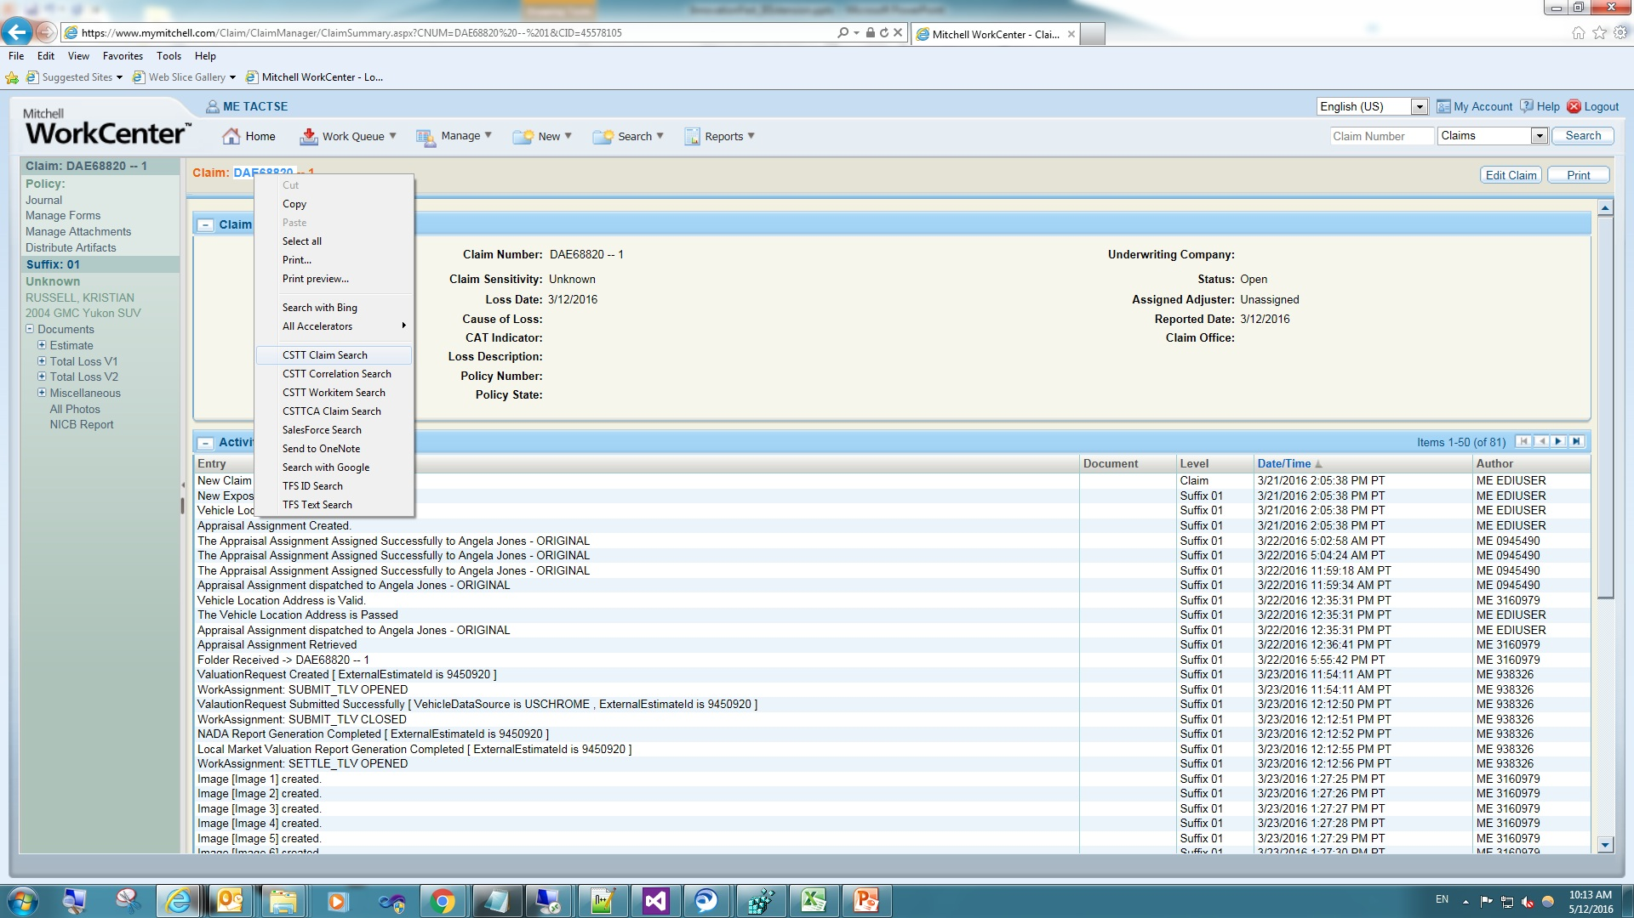
Usage

Slide 13
Innovation Fest
Each Scrum team will be given 20 minutes to present their idea and demo their working POC.
Scrum teams should not club unless it is a small team of only 2/3 members.
Presentation coverage
About the idea
Benefits of the idea
Demo
Judging Parameters
Domain Innovativeness (improvement in existing process or suggesting a new process etc.)
Technology Innovativeness (niche factor etc.)
Immediate Applicability to Infogain Business/Customer Business
Working POC

