Slide 1
PRIVACYGATE AI
Blockchain-Based Privacy-Preserving
IoT Intelligence Exchange
B.Tech Project Presentation
Presented by
Sambhav Surana
Enrollment: 23100BTCSAII14318
Group 24
Under the guidance of
Prof. Rohit Choubey
Artificial Intelligence & Data Science
PrivacyGate AI
01 / 10
Notes:
Good morning. I am Sambhav Surana from Group 24. My project is PrivacyGate AI, a blockchain-based privacy-preserving IoT intelligence exchange. It demonstrates how an equipment owner can share a useful anomaly insight with an authorized reader while retaining detailed sensor readings locally. The current implementation is a Windows-native academic MVP with a local custom permission blockchain.
Sources: docs/SPEC.md (project identity); docs/V2.md
Implementation: approved native v2. Results cited from 26 October 2026. Synthetic local demonstration.

Slide 2
Introduction and problem statement
Industrial IoT data can reveal sensitive operating conditions
IoT measurements
Temperature, vibration and RPM describe the machine in detail.
Privacy concern
An external maintenance reader may need an alert without continuous access to raw measurements.
Problem: How can an owner share useful insights with controlled access?
PrivacyGate AI
02 / 10
Notes:
Industrial IoT systems generate detailed measurements such as temperature, vibration and rotational speed. A maintenance service may only need to know whether an anomaly occurred. Sharing continuous raw data gives the service more information than it needs and can reveal operational patterns. Our problem is to provide a useful machine insight while allowing the equipment owner to control the recipient and duration of access. The demonstration uses a simulated machine and synthetic readings.
Sources: docs/SPEC.md; docs/V2.md
Implementation: approved native v2. Results cited from 26 October 2026. Synthetic local demonstration.

Slide 3
Project objectives
01 Protect input
Verify signed sensor packets and reject tampering, stale data and replay.
02 Detect anomalies
Run a local Isolation Forest model on synthetic machine readings.
03 Control access
Record expiring owner grants and revocations in a permission blockchain.
04 Limit disclosure
Encrypt only the five approved insight fields for the intended reader.
PrivacyGate AI
03 / 10
Notes:
The main objective is owner-controlled selective disclosure. The system verifies signed readings, encrypts raw payloads before storage, and runs local anomaly detection. It then applies deterministic rules before sharing an insight. The owner can grant expiring READ_INSIGHT access and revoke it later. A reader receives an encrypted event for that account and decrypts it locally. We evaluate both the privacy controls and the anomaly model using synthetic data.
Sources: docs/V2.md; docs/ARCHITECTURE_V2.md
Implementation: approved native v2. Results cited from 26 October 2026. Synthetic local demonstration.

Slide 4
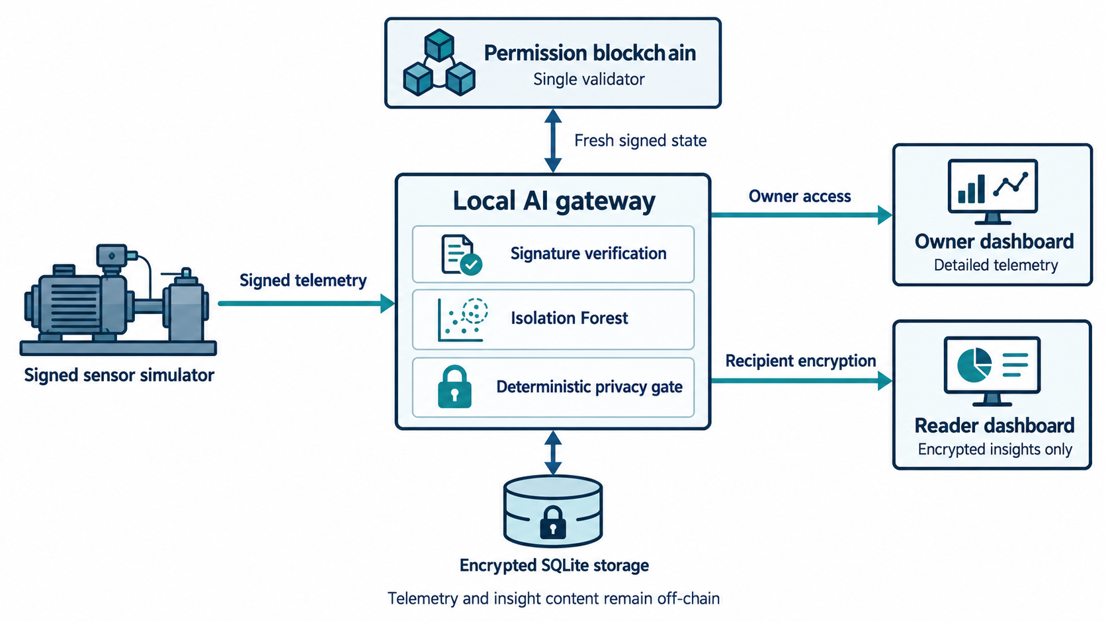
System architecture
Current MVP: one simulated sensor, one trusted gateway, one local validator
PrivacyGate AI
04 / 10
Notes:
This diagram shows the implemented v2 components. A signed sensor simulator submits readings to the trusted local gateway. The gateway verifies them, encrypts raw payloads into SQLite and runs the anomaly model. The owner dashboard provides detailed readings and permission controls. A separate local validator records signed permission changes. Before creating and retrieving an encrypted reader insight, the gateway checks fresh signed ledger state. The chain stores permission metadata only. One validator is centralized authority, not distributed consensus.
Sources: docs/ARCHITECTURE_V2.md; docs/V2.md; architecture illustration generated for this presentation
Implementation: approved native v2. Results cited from 26 October 2026. Synthetic local demonstration.

Slide 5
Working methodology
1. Register and verify
Owner registers equipment. Gateway checks each packet’s signature, schema, timestamp and sequence.
2. Store and classify
Gateway encrypts the raw reading, then applies local anomaly detection.
3. Authorize and encrypt
Current ledger permission and fixed output schema control recipient encryption.
4. Retrieve and revoke
Reader decrypts locally. A confirmed revocation blocks later release.
PrivacyGate AI
05 / 10
Notes:
The workflow begins with equipment registration and a pinned simulator signing key. The simulator sends a signed packet with a timestamp and sequence number. The gateway validates it and atomically stores the encrypted reading with its sequence state. Isolation Forest produces an anomaly candidate. The privacy gate builds a fixed five-field insight and verifies the current permission and reader key versions. It encrypts the event for that reader. Retrieval repeats the permission check, so an old queued event cannot bypass a confirmed revocation.
Sources: docs/V2.md; apps/gateway/src/privacygate_v2/service.py
Implementation: approved native v2. Results cited from 26 October 2026. Synthetic local demonstration.

Slide 6
Privacy and access control
Security boundary | Implemented control
Sensor input | Ed25519 signature and durable replay defense
Raw data storage | AES-256-GCM payload encryption before SQLite write
Owner permission | Signed grant/revoke history with expiry and versions
Reader delivery | X25519 + HKDF-SHA256 + AES-GCM envelope
Validator unavailable | Third-party disclosure fails closed
AI proposes an anomaly. Deterministic code enforces permission.
Revocation prevents future release. It cannot erase previously received copies.
PrivacyGate AI
06 / 10
Notes:
The owner and reader have deliberately different views. The owner sees numeric readings for owned equipment and manages access. The reader receives exactly event ID, event type, severity, observation time and model version. These fields still reveal some metadata, such as event timing. Raw payloads use AES-256-GCM before persistence. Reader envelopes use ephemeral X25519, HKDF-SHA256 and AES-GCM. The browser holds the private viewing key. The gateway checks fresh ledger state on dispatch and retrieval, and denies disclosure if state cannot be verified.
Sources: docs/V2.md; docs/ARCHITECTURE_V2.md
Implementation: approved native v2. Results cited from 26 October 2026. Synthetic local demonstration.

Slide 7
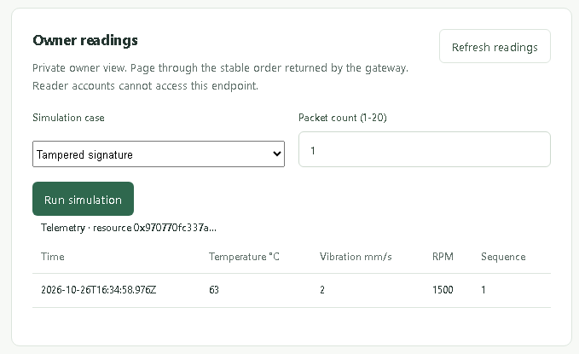
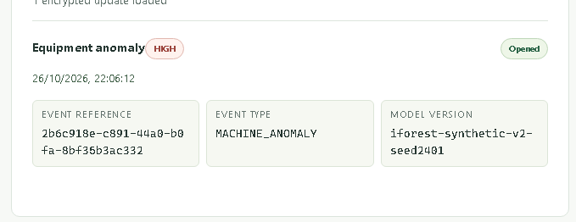
Implementation and demonstration
Owner dashboard
Reader dashboard
Detailed readings and permission management
Only the permitted anomaly insight
Python / FastAPI / SQLite / scikit-learn / Next.js / TypeScript
PrivacyGate AI
07 / 10
Notes:
The backend uses Python, FastAPI and SQLite. The frontend uses Next.js, React and TypeScript. The model uses scikit-learn on CPU. These are screenshots from the actual local v2 demo. On the left, the owner can see numerical measurements and run bounded simulations. On the right, the reader opens a restricted anomaly event in the browser. The demo sequence is registration, reader key setup, grant, anomaly generation, decryption and revocation. Reader accounts cannot retrieve the owner telemetry endpoint.
Sources: docs/V2.md; docs/results/playwright/v2-demo-owner.png; docs/results/playwright/v2-demo-reader.png
Implementation: approved native v2. Results cited from 26 October 2026. Synthetic local demonstration.

Slide 8
Anomaly detection results
Training: 512 normal samples Holdout: 256 normal + 128 anomalous samples
Model | TP | FP | TN | FN
Isolation Forest | 128 | 5 | 251 | 0
Rule baseline | 128 | 0 | 256 | 0
Isolation Forest
Precision 0.9624 Recall 1.0000 F1 0.9808
The rule baseline performs better on this synthetic holdout.
Real machine data is required to assess field performance.
PrivacyGate AI
08 / 10
Notes:
We trained Isolation Forest on 512 synthetic normal samples using a fixed seed. The disjoint holdout contains 256 normal and 128 anomalous samples. Isolation Forest detected all 128 anomalies but also flagged five normal samples. This gives precision 0.9624, recall 1.0000 and F1 0.9808. The rule baseline made no errors on the same holdout, so it performed better here. The distributions are intentionally easy to separate. These results demonstrate reproducible evaluation and do not establish real equipment accuracy.
Sources: docs/results/v2-model-evaluation.json
Implementation: approved native v2. Results cited from 26 October 2026. Synthetic local demonstration.

Slide 9
Validation and performance
28 Python tests passed
11 browser cases passed
Security cases: tampering, replay, wrong key, expiry, revocation and chain outage
Local benchmark stage | Samples | p95 latency
Grant request to durable commit | 10 | 22.89 ms
Signed simulation to encrypted dispatch | 40 | 49.96 ms
Authorized envelope retrieval | 40 | 14.28 ms
Recorded 26 October 2026. One optional browser case skipped.
Single host, sequential bursts. Stage percentiles cannot be added.
PrivacyGate AI
09 / 10
Notes:
The retained execution report dated 26 October 2026 records 28 passing Python tests and a final browser run with 11 passing cases and one optional case skipped. The checks include tampered and replayed sensor data, wrong recipient keys, expiry, revocation and chain outage. The latency table reports separate stages measured with sequential bursts on one Windows host. These measurements are not a complete end-to-end percentile and do not prove sustained throughput. The slide reports retained evidence, rather than claiming a fresh test run today.
Sources: docs/results/2026-10-26-v2-completion.md; docs/results/v2-benchmarks.json
Implementation: approved native v2. Results cited from 26 October 2026. Synthetic local demonstration.

Slide 10
Conclusion and future scope
Conclusion
The MVP demonstrates owner-controlled disclosure
of encrypted IoT anomaly insights.
Current limitations
Future scope
Trusted gateway and single validator
Synthetic evaluation data
Recipient copies remain after revocation
Evaluation with real equipment data
Multiple independent validators
Stronger key custody and recovery
Thank you
PrivacyGate AI
10 / 10
Notes:
The project demonstrates owner-controlled sharing of a restricted, recipient-encrypted machine insight. Signed input, local encrypted storage, a deterministic privacy gate and fresh permission checks connect into one reproducible demonstration. The main limits are a trusted gateway, one centralized validator and synthetic model evaluation. Future work should validate the model on realistic equipment data, evaluate multiple independently operated validators and strengthen key custody and recovery. These are proposed extensions, not implemented features. Thank you. I am ready for questions.
Sources: docs/V2.md; docs/ARCHITECTURE_V2.md; docs/results/2026-10-26-v2-completion.md
Implementation: approved native v2. Results cited from 26 October 2026. Synthetic local demonstration.

