Slide 1
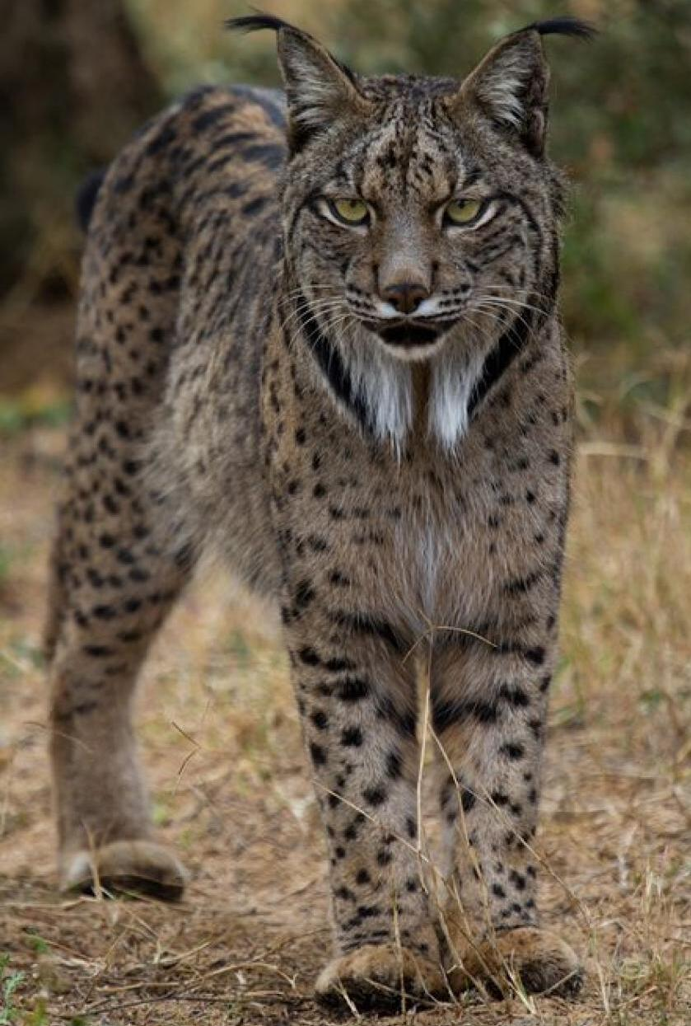
ADSDB P1 · UPC
EcoSentinel
Wildlife data connected
to its sources
Mario Rodrigo
Sambhav · Wassim
Photo: lynxexsitu.es · CC BY 3.0 es
01
Notes:
Mario · 30 seconds
A photograph, a field recording and a species description may all refer to the same animal, yet they usually live in separate catalogues. EcoSentinel connects those materials and keeps their sources accessible. We are Mario Rodrigo, Sambhav and Wassim. Today we will explain how we built the system, why we made these choices, and what our validation actually demonstrates.
Project sources: docs/final_report.md, docs/user_guide.md.
Photograph: https://commons.wikimedia.org/wiki/File:Iberian_Lynx_front_(cropped).jpg
Author: http://www.lynxexsitu.es. Licence: CC BY 3.0 es (https://creativecommons.org/licenses/by/3.0/es/deed.en). Content unchanged.

Slide 2
One wildlife question, several sources
“I have a photograph.
What can help me
understand it?”
Find related images
Listen to recordings
Explore descriptions
Proposed use: education and biodiversity exploration
02
Notes:
Mario · 60 seconds
Imagine someone preparing an educational activity about Iberian wildlife. They have a photograph and want to find related material, listen to recordings and understand the animal's habitat. Usually, that means moving between catalogues, repeating searches and checking where each piece of information came from. Our proposal brings that journey into one tool. It could support education or help someone explore a biodiversity collection before specialist review. The intended value is easier discovery, with a traceable path back to the original evidence. These are potential benefits of the prototype. We have not measured time savings or tested adoption in an organisation. That distinction runs through the project: we show what the system does, and we keep the remaining evaluation visible.
Project sources: docs/data_sources.md.

Slide 3
The reference corpus
198
Modality | Assets | Source
Images | 100 | Wikimedia
Audio | 34 | Xeno-canto
Text | 64 | Wikipedia / GBIF
accepted assets
10 Iberian wildlife species
Uneven availability: no audio for the ocellated lizard
03
Notes:
Mario · 55 seconds
We chose ten species of Iberian wildlife to give the project a clear scope. Our reference corpus contains one hundred images from Wikimedia Commons, thirty-four recordings from Xeno-canto, and sixty-four texts from Wikipedia and GBIF. Together, these are one hundred and ninety-eight accepted assets. Images are balanced across species, but the other modalities depend on source availability. For example, we have no audio for the ocellated lizard. That matters because availability affects what a search can retrieve. We retain source identifiers, attribution and available licence information alongside the files. These numbers describe the collection we audited. A new download may produce different material, so its counts and quality need a separate evaluation.
Project sources: docs/evidence/quality_images.json, docs/evidence/quality_audio.json, docs/evidence/quality_text.json.

Slide 4
Four zones, four contracts
Zone | Responsibility | Storage
Landing | Preserve originals | S3 · Docker
Formatted | Standardise representation | S3 · Docker
Trusted | Assess quality and provenance | S3 · Docker
Exploitation | Prepare vector retrieval | Persistent Chroma
Queries use an independent snapshot of the index
04
Notes:
Mario · 80 seconds
The architecture separates four responsibilities. Landing receives and preserves originals. Formatted converts each modality into a common representation. Trusted checks quality and provenance against explicit policies. Exploitation prepares the representations used by retrieval. This separation gives us a practical recovery path. If we change an encoder, we can start again from Trusted. If a quality rule changes, we can revisit Formatted without downloading the source again. Landing, Formatted and Trusted use S3-compatible object storage deployed in Docker. Object storage fits photographs, recordings and documents with different formats and sizes. Chroma then stores vectors and references to those assets. The Python packages follow the same boundaries, so each stage can run and be tested independently. Internet acquisition is optional. Once the files and model weights are prepared, the pipeline can operate locally. Model-specific choices stay downstream, while the original evidence remains available for inspection.
Project sources: docs/pipeline_orchestration.md.

Slide 5
Preserving originals, standardising formats
Preserved original
Common representation
Temporal and Persistent Landing
Copy verified with SHA-256
Content identity
Image: RGB JPEG
Audio: FLAC PCM16
Text: UTF-8, NFC and LF
Model-specific segmentation and resampling happen later
05
Notes:
Mario · 75 seconds
Before ingestion, a Security Gate checks allowed formats, file signatures and input limits. Landing then separates temporary reception from persistent original storage. Promotion uses content identities and verifies the copy before recording completion. In Formatted, each modality has its own converter. Images become RGB JPEG, audio becomes FLAC PCM16, and text becomes UTF-8 with consistent character normalisation and line endings. These choices have trade-offs. JPEG is lossy, and PCM16 can reduce the precision of a higher-depth source. We therefore retain the original file upstream. At this stage, we also preserve audio sample rates and channels. Resampling and segmentation belong in Exploitation, where the model requirements are known. Each transformation retains source keys and hashes, so a result can be traced back to its original bytes. With that foundation in place, Sambhav will explain how we assess quality and build retrieval.
Project sources: docs/landing_zone_documentation.md, docs/formatted_zone_documentation.md.

Slide 6
Trusted retains potentially useful signals
198 / 198
32
possible watermark flags
accepted under the corpus
technical policies
9
low-energy audio warnings
Weak signals remain available for review
06
Notes:
Sambhav · 60 seconds
In Trusted, we distinguish a technically invalid file from a signal that deserves review. A quiet recording might contain a useful call. A dark photograph might be the observation someone needs. We therefore avoid aggressive cleaning, automatic denoising and visual correction. We use YAML policies, independent validators and duplicate checks. Reports record accepted assets and quality warnings. In the reference corpus, thirty-two images have possible watermark flags, and nine recordings have low-energy warnings. These are heuristic signals, not confirmed defects. All one hundred and ninety-eight assets pass the technical rules for this collection. Passing those rules does not establish correct biological labels. Semantic review remains a separate responsibility, and the reports preserve enough detail to support it.
Project sources: docs/trusted_zone_documentation.md.

Slide 7
198 assets, 6,021 embeddings
6,021
Collection | Vectors
Image · CLIP | 100
Audio · CLAP | 357
Text · E5 | 547
Image + text · CLIP | 1,763
Audio + text · CLAP | 3,254
persisted vectors
Segments with identity,
hash and contract
07
Notes:
Sambhav · 70 seconds
In Exploitation, one asset can produce several vectors. A photograph has a visual representation, while a long recording is divided into windows and a long document into passages. That is how one hundred and ninety-eight assets produce six thousand and twenty-one embeddings. We maintain five collections: three for individual modalities and two shared spaces. The image-and-text collection places aligned representations together. The audio-and-text collection does the same for sounds and language. Each record includes its asset identity, segment position, content hash and model-policy contract. This tells us what a vector represents and helps detect incomplete publication. Before computing embeddings again, we check both compatibility and exact segment coverage. A matching record count alone is insufficient: two duplicated parts could hide a missing part. Compatible reruns reuse the existing index instead of repeating inference.
Project sources: docs/exploitation_zone_documentation.md.

Slide 8
The encoder follows the relationship
Encoder | Represented relationship | Practical choice
CLIP | Aligned image and text | Visual concepts
CLAP | Aligned audio and text | Sound descriptions
E5 small | Multilingual text | Compact representation
CPU · pretrained models · separate contracts
No comparative model benchmark for this domain
08
Notes:
Sambhav · 60 seconds
We do not use one encoder for every relationship. CLIP connects visual concepts with images and aligned text. CLAP connects audio with language, which lets a description retrieve relevant recordings. For text, we use multilingual E5 small, which gives us a compact representation for queries in several languages. These are practical choices for CPU execution and reuse of pretrained models. We have not established that they are the best wildlife models through a labelled comparison. Their limitations matter. English sound descriptions may work better with CLAP, and CLIP is not a specialist species classifier. Equal vector dimensions do not make two embedding spaces compatible. We keep separate contracts and compare similarity within the appropriate space, rather than mixing unrelated distances.
Project sources: docs/data_sources.md, config/model_manifest.json.

Slide 9
Task 1: similarity within a modality
Query | Results
Image | Other images
Audio | Other recordings
Text | Other texts
One result per asset
Entire reference asset excluded
External files serve as queries and are not indexed
09
Notes:
Sambhav · 60 seconds
Task one answers a focused question: given an asset, which other assets of the same type resemble it? An image retrieves images, a recording retrieves recordings, and text retrieves text. The query can start from an indexed record or an external file. When we use a stored asset, we exclude all of its segments, so the system cannot return the reference as its own best match. We also group retrieved segments by asset. Otherwise, several windows from one recording could occupy the result list. The interface exposes results and provenance. The order reflects model similarity, rather than a species probability. An external file acts only as a query. Uploading it does not automatically add it to the dataset or the vector index.
Project sources: docs/multimodal_tasks_documentation.md.

Slide 10
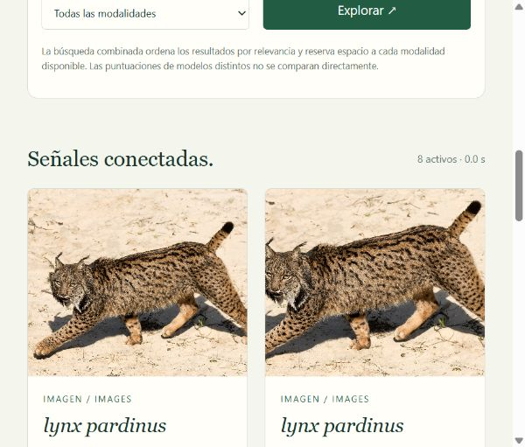
Task 2: retrieval across modalities
“Iberian lynx
in a forest”
CLIP: image and text
CLAP: audio and text
All modalities:
rank fusion with RRF
Actual combined search interface (Spanish)
10
Notes:
Sambhav · 50 seconds
Task two extends that journey across modalities. A description can retrieve images and text in the shared CLIP space, or recordings and text through CLAP. The screenshot shows the actual interface for a combined search. We also offer a view across all modalities. Here we combine ranking positions using Reciprocal Rank Fusion, rather than comparing raw scores from different encoders. An explicit diversity policy gives available modalities a place in the results. The combined order therefore follows a documented policy, rather than a single global distance. With retrieval available, Wassim will explain how we use its evidence to generate an answer.
Project sources: docs/multimodal_tasks_documentation.md, reports/validation/ui_task1.png.

Slide 11
Task 3: evidence before generation
Question + optional image
01 Retrieval with E5 / CLIP
02 Text context and BLIP observation
03 Qwen 2.5 · 3B · GGUF · CPU
04 Checked quotations and explicit status
Qwen receives text. BLIP interprets the image.
11
Notes:
Wassim · 75 seconds
Task three uses retrieval-augmented generation. We first retrieve evidence from the corpus, then ask Qwen to answer using that context. If a query includes an image, CLIP provides visual matches and BLIP produces an automatic description. Qwen receives that text and retrieved passages. It does not inspect the image pixels directly. We use Qwen two point five, with three billion parameters, in a quantised GGUF format, to make CPU generation practical on our machine. The model revision and file hash are fixed. We limit the context and control model loading. The generator selects permitted evidence identifiers, and the server resolves their quotations. We then check that references and extracts belong to the retrieved sources. Missing support produces abstention or a partial answer. A generation failure produces a technical error. These states remain distinct, and the user can inspect how the response was built.
Project sources: docs/generative_tasks_documentation.md, config/rag.yaml.

Slide 12
An answer with sources you can inspect
Corpus candidate: Pelophylax perezi
Habitat [S1]
“areas with little current”
Diet [S2]
“They feed on terrestrial
and aquatic prey”
Translated extracts from a real run · the candidate does not confirm the photo’s species
12
Notes:
Wassim · 60 seconds
This example comes from a real test using a frog image already in Trusted. We asked about habitat and diet for the retrieved candidates, without confirming the species in the photograph. The interface presented a corpus candidate and two claims with source extracts. Opening a reference lets us compare the answer with the retrieved document. The case also exposed an earlier technical failure: generation reached its time limit and left incomplete JSON. We reduced context and retrieved by aspect, keeping separate evidence for habitat and diet. Regression tests now cover those failure boundaries. This test used the real models, but it remains one example. An existing quotation does not guarantee every interpretation is correct, and visual similarity does not establish a taxonomic identification.
Sources: reports/validation/ui_frog_rag.png, docs/evidence/native_models.json. Slide excerpts translated from Spanish for presentation. Original fragments: “zonas con escasa corriente”; “Se alimentan tanto de presas terrestres como acuáticas”.

Slide 13
The second run matters too
16 steps
7
vectors in the first run
Execution lock
Per-step report and log
Explicit failure and retry
0
new in the second run
Isolated run with three synthetic assets and CPU models
13
Notes:
Wassim · 55 seconds
The system has a sequential orchestrator with sixteen steps. It runs the zones, writes a log for each step and finishes with reconciliation. A resource lock prevents concurrent pipeline runs. When a step fails, execution stops and preserves its report, so we can fix the cause and retry. We do not assume one transaction across all stores. Recovery checks the state at each boundary. We tested this with two complete runs using isolated storage and real CPU models. The first produced three synthetic assets and seven vectors. The second completed with zero new vectors across all five collections. This demonstrates integration and idempotent reuse. The synthetic noise image and audio tone do not evaluate wildlife retrieval quality.
Project sources: docs/evidence/final_validation.json.

Slide 14
What we validated
344
71.25%
offline tests
combined coverage
+ 1 real integration test
6,021 original vectors
with identical files and hashes
Windows / Linux CI configured · verify the published commit
14
Notes:
Wassim · 60 seconds
Our validation has several layers because they reveal different problems. Three hundred and forty-four offline tests cover contracts, edge cases and controlled failures. One additional integration test runs all zones with real S3 storage and Chroma, using deterministic encoders. Separately, we ran the full CLI and generative examples with real CPU models. Combined statement coverage is seventy-one point two five percent. That measures executed code, not retrieval accuracy. We also verified that the original six thousand and twenty-one embeddings retain identical files and hashes, and that the MinIO inventory remains unchanged. GitHub Actions configures checks on Windows and Linux. Its remote result must be checked for the submitted commit. A labelled evaluation set is still needed to measure retrieval relevance and semantic answer quality systematically.
Project sources: docs/evidence/final_validation.json.

Slide 15
A query with a traceable path
Preserved originals
Retrieval across three modalities
Answers linked to sources
Next evaluation: relevance and semantic quality
with labelled examples and specialist review
15
Notes:
Wassim · 50 seconds
Let us return to the person who started with a photograph. They can now explore related assets, move across modalities and ask a question linked to its sources. That experience rests on preserved originals, explicit transformations, quality policies and model contracts. This is EcoSentinel's contribution: connecting a useful query workflow with a data backbone we can explain and check. The repository includes a user guide, design decisions and selected validation evidence. The next evaluation would use labelled examples and specialist review before considering operational deployment. That is the scope of our prototype and the evidence behind it. Thank you. We are ready to discuss the system or show the workflow in the interface.
Project sources: docs/final_report.md.

