Slide 1
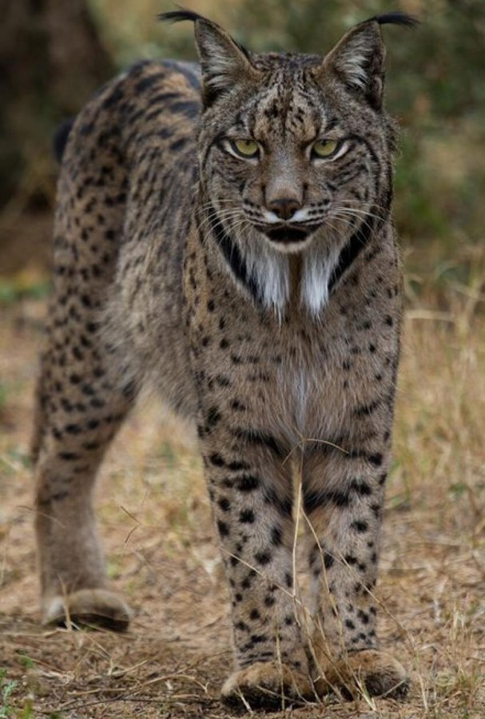
ADSDB P1 / UPC
EcoSentinel
Where does the
answer come from?
Mario Rodrigo · Sambhav · Wassim
Photo: lynxexsitu.es / CC BY 3.0 es
01
Notes:
Mario / 25 seconds
Suppose we upload this photograph and ask what the animal eats. Where should the answer come from? EcoSentinel connects the image to stored wildlife evidence and lets us inspect the sources behind the response. We will show the engineering that makes this possible.
Project evidence: docs/final_report.md, docs/evidence/final_validation.json, docs/evidence/native_models.json; zone and Task guides in docs/. The diagrams describe implemented stages and contracts.
Photo: https://commons.wikimedia.org/wiki/File:Iberian_Lynx_front_(cropped).jpg; http://www.lynxexsitu.es; CC BY 3.0 es; https://creativecommons.org/licenses/by/3.0/es/deed.en. Display crop only.

Slide 2
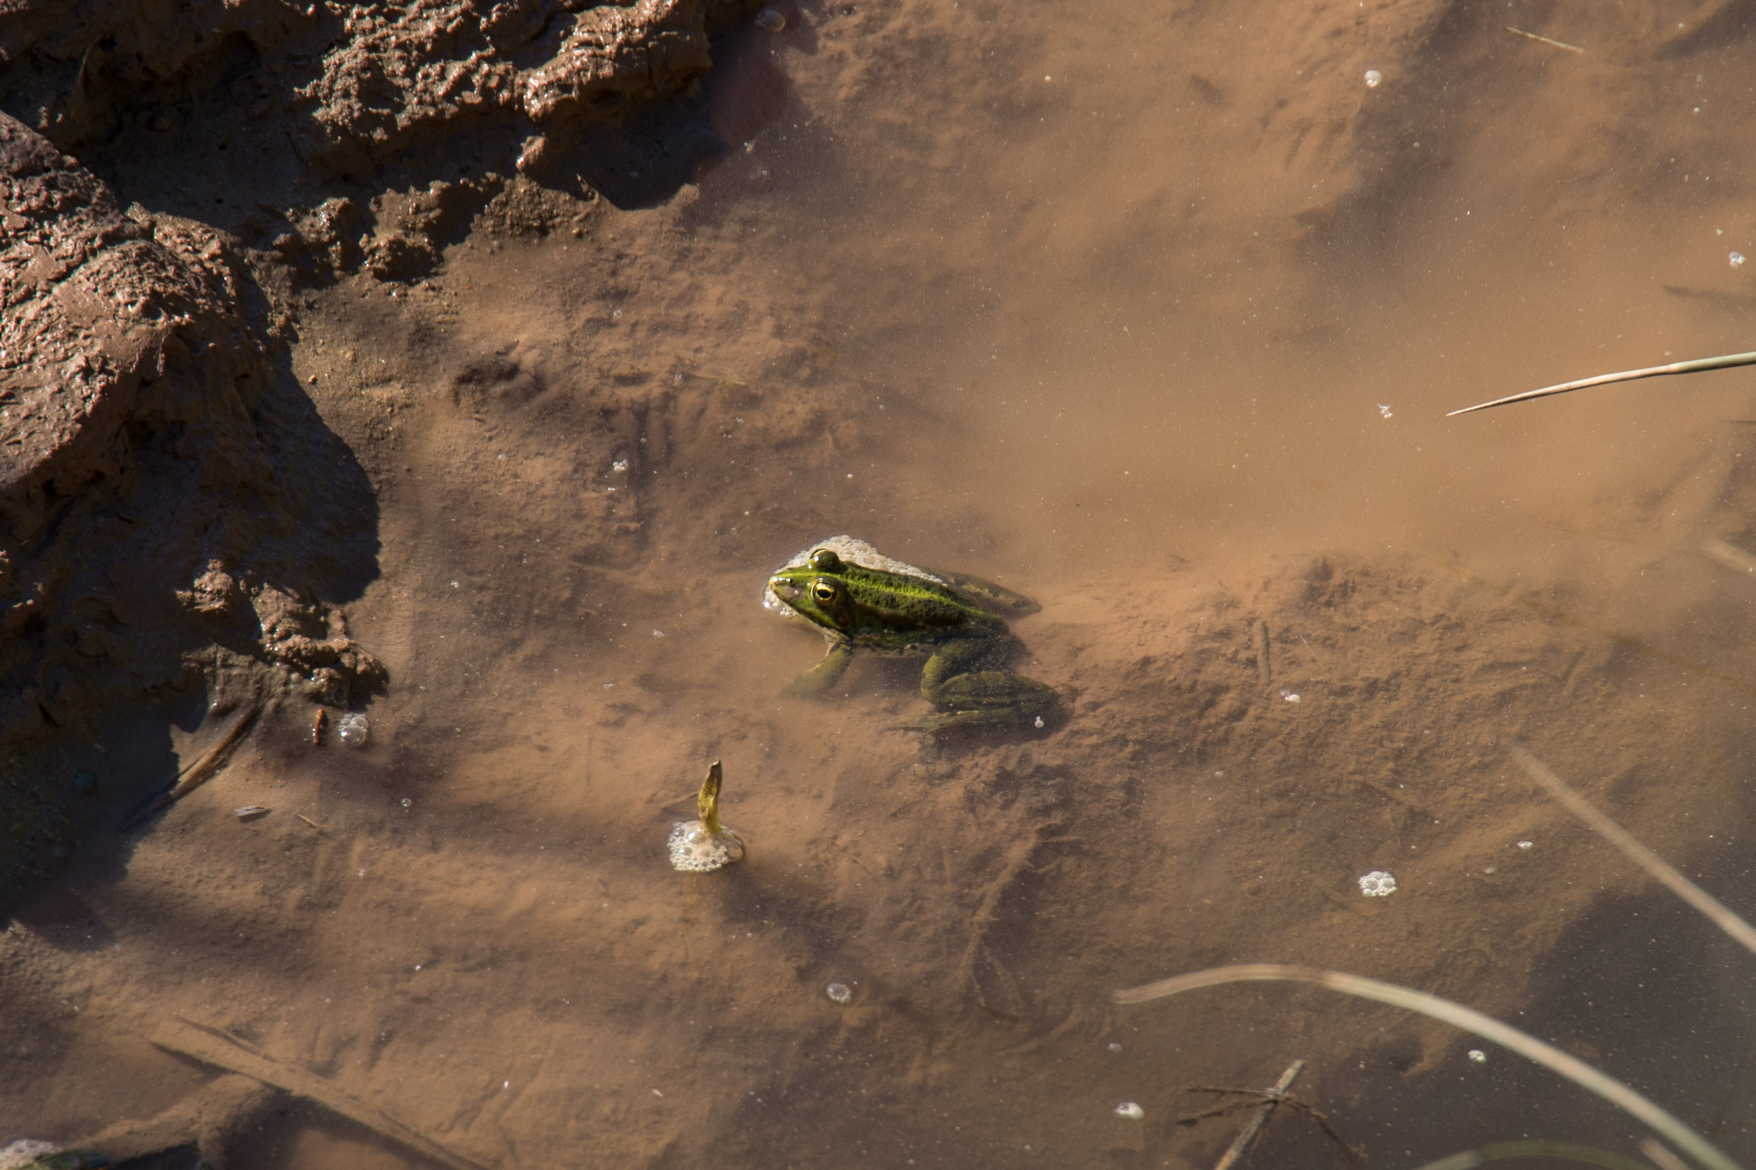
A photograph starts the investigation
“What can help me
understand this
photograph?”
Related images
Recordings
Source descriptions
Education and biodiversity exploration
Photo: Alexkom000 / CC BY 4.0
02
Notes:
Mario / 20 seconds
Our use case is a shared wildlife collection for education and biodiversity exploration. Someone can start with a photograph, find related recordings and descriptions, and ask a question grounded in those documents. We chose Iberian fauna to keep that investigation concrete.
Project evidence: docs/final_report.md, docs/evidence/final_validation.json, docs/evidence/native_models.json; zone and Task guides in docs/. The diagrams describe implemented stages and contracts.
Illustrative corpus photo: https://commons.wikimedia.org/wiki/File:2026-05-17_Iberian_green_frog_on_the_cliffs_of_S%C3%A3o_Pedro_da_Cadeira.jpg; Alexkom000; CC BY 4.0; https://creativecommons.org/licenses/by/4.0. This is not claimed to be the image used in the recorded RAG acceptance case.

Slide 3
Three modalities, one reference dataset
198
100
Images / Wikimedia
34
Audio / Xeno-canto
accepted assets
10 Iberian wildlife species
64
Text / Wikipedia + GBIF
Uneven availability remains visible: no audio for the ocellated lizard
03
Notes:
Mario / 25 seconds
Our reference dataset contains one hundred images, thirty-four recordings and sixty-four texts across ten Iberian species. Wikimedia, Xeno-canto, Wikipedia and GBIF provide the source material. Availability is uneven: the lizard has no audio. We retain that gap and preserve attribution rather than inventing missing observations.
Project evidence: docs/final_report.md, docs/evidence/final_validation.json, docs/evidence/native_models.json; zone and Task guides in docs/. The diagrams describe implemented stages and contracts.

Slide 4
The EcoSentinel pipeline
Optional acquisition or local files / Security Gate
16-step orchestrator
Lock, timeouts and step reports
Landing
Formatted
Trusted
Exploitation
Preserve
originals
Standardise
representation
Check quality
and provenance
Create model
representations
S3-compatible object storage in Docker
Chroma
Source keys, hashes and policies
travel with each asset
Tasks 1 / 2 / 3
Query snapshot
04
Notes:
Mario / 35 seconds
The orchestrator runs sixteen steps across four zones and finishes with reconciliation. Landing preserves originals. Formatted establishes file representations. Trusted makes quality decisions. Exploitation creates searchable vectors. The first three zones use S3-compatible storage in Docker; Chroma stores the vectors. Queries open a verified copy of that persistent index to protect the audited original from internal database writes. After data updates, we explicitly refresh the copy.
Project evidence: docs/final_report.md, docs/evidence/final_validation.json, docs/evidence/native_models.json; zone and Task guides in docs/. The diagrams describe implemented stages and contracts.

Slide 5
Hashes and embeddings
 | SHA-256 hash | Embedding
Question | Did the bytes change? | Which assets are similar?
Output | 64 hexadecimal digits | 384 or 512 numbers
EcoSentinel use | Identity and integrity | Similarity and retrieval
Re-encode a photo: a different hash, potentially similar embeddings
05
Notes:
Mario / 40 seconds
We use two representations for different jobs. SHA-two-fifty-six fingerprints the file bytes. It helps verify integrity and build deterministic identities. An embedding represents features learned by a particular model, so nearby vectors can retrieve related content. Recompressing a photograph changes its bytes and therefore its hash, while its embedding may remain similar. That is a conceptual example, not a new measurement. Landing uses a hash prefix and filename for ingestion identity. Similarity search uses embeddings. A high similarity score does not establish an exact copy or confirm a species.
Project evidence: docs/testing_and_validation.md, docs/evidence/final_validation.json and maintained zone guides.
Sources: landing_zone/temporal_landing/ingest_local_data.py build_object_key/build_control_key; exploitation_zone/encoders.py; contracts and configured dimensions. The recompression example is explanatory, not a new inference result.

Slide 6
Landing identity and completion records
temporal_landing/<SHA-256[:16]>__<filename>
Temporal object exists
Check source identity, then reuse
Temporal is absent
Check completion
Persistent exists
Matching identity + recorded Persistent target: skip
No completion record: ingest as new
Promotion verifies the copy before completion. Missing targets or conflicts fail.
06
Notes:
Mario / 60 seconds
Landing gives each ingestion a deterministic key: the first sixteen hexadecimal characters of SHA-two-fifty-six, followed by the original filename. Same bytes and filename produce the same key. Before uploading, we check whether that object already exists in Temporal. If Temporal is absent, a separate completion record points to its Persistent copy. We check that target and the source identity before skipping the upload. Promotion writes completion only after verifying the copied bytes. A missing target or conflicting identity produces an error. A renamed copy gets a different ingestion key, so Trusted handles content duplicates separately. The marker confirms Persistent promotion; later reconciliation checks the downstream state.
Project evidence: docs/final_report.md, docs/evidence/final_validation.json, docs/evidence/native_models.json; zone and Task guides in docs/. The diagrams describe implemented stages and contracts.
Landing identity is hash prefix + local filename. A different filename is not globally deduplicated here. Rerun evidence: reports/validation/delivery_smoke_repeat.log, Uploaded=0, Already completed=3.
Exact scope: Temporal key uses SHA-256(raw bytes)[:16] plus filename. Completion key uses full SHA-256(Temporal key). Ingestion validates marker identity fields and target existence; promotion verifies copied bytes. The marker does not attest Trusted acceptance. Sources: ingest_local_data.py and process_to_persistent.py; copy/marker safety regressions.

Slide 7
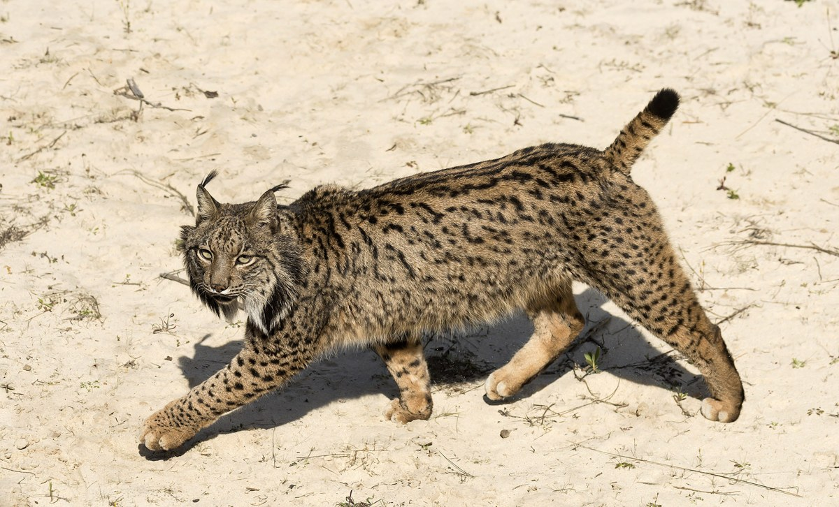
Landing: four identity cases
Same source metadata; the first file is already recorded
Already seen | Incoming file | Key change | Action
lynx.jpg hash de7879... | lynx.jpg hash de7879... | None | SKIP
lynx.jpg hash de7879... | renamed.jpg hash de7879... | Name | INGEST
lynx.jpg hash de7879... | lynx.jpg hash 3e983a... | Hash | INGEST
lynx.jpg hash de7879... | renamed.jpg hash 3e983a... | Both | INGEST
Technical ingestion reuse; Trusted still checks image content
07
Notes:
Mario / 45 seconds
These four cases show what technical deduplication means. Assume the source metadata matches and the first file is already recorded. Same bytes and same filename reuse the existing key, so there is no new upload. Identical bytes under another name create a new key and enter Landing. Different bytes under the same name also enter: their hash changes, so the original is not overwritten. If both change, the file enters too. Landing prevents repeated technical ingestion. Trusted still checks content duplicates and perceptual similarity. A recompressed photograph can pass Landing even when it looks unchanged.
Project evidence: docs/testing_and_validation.md, docs/evidence/final_validation.json and maintained zone guides.
Sources: landing_zone/temporal_landing/ingest_local_data.py build_object_key and ingestion identity checks. Scenarios assume compatible species_id/modality/source_name and a previously recorded key (existing Temporal or valid completion + Persistent target). No record means new ingestion; conflicting metadata or broken targets produce errors. Different bytes here produce different 16-hex prefixes; the 64-bit prefix has no mathematical collision-free guarantee. Photos are existing embedded presentation assets, reused explicitly to show byte/name combinations; filenames are illustrative and displayed hash prefixes refer to those embedded bytes, not original raw-dataset filenames. A: lynxexsitu.es / CC BY 3.0 es, source photo from task_examples.json Task 1 reference. B: Task 1 rank 1 photo; complete provenance retained below.
{"A":{"path":"photo-A.jpeg","source_part":"ppt/media/image4.jpeg","sha256":"de7879dccfd8e4abfa0236aa0c0c7377a77585387e00dfbb500358e1bdd3a5d9"},"B":{"path":"photo-B.jpeg","source_part":"ppt/media/image5.jpeg","sha256":"3e983a74713d0049c4e04364eafbfe701a5dd326c325ad0e8622a0c7dbb45700"}}
Sambhav / 60 seconds
Here is an actual image-to-image query on our corpus. The photograph on the left is the reference. We show selected matches at ranks one and three with recorded cosine scores. The complete response contains five distinct assets and excludes the reference. Four have lynx catalogue labels; the fifth has a wolf label. These are similarity candidates, not species probabilities. All segments of a stored reference are excluded before grouping by asset. Audio-to-audio and text-to-text use the same workflow. The full response remains available so the selected examples can be checked against the actual ranking.
Project evidence: docs/final_report.md, docs/evidence/final_validation.json, docs/evidence/native_models.json; zone and Task guides in docs/. The diagrams describe implemented stages and contracts.
Retrieval evidence: docs/presentation/task_examples.json. Queried a disposable snapshot with cached CPU models, without re-indexing. Slide 13 shows ranks 1 and 3 of five, not the full list. Slide 14 shows overall image rank 5 and text rank 4 of eight. The text excerpt is verbatim.
Photo: https://commons.wikimedia.org/wiki/File:Iberian_Lynx_front_(cropped).jpg; http://www.lynxexsitu.es; CC BY 3.0 es; https://creativecommons.org/licenses/by/3.0/es/deed.en. Display resizing only.
Photo: https://commons.wikimedia.org/wiki/File:F_18.04.02_Observatorio_Lince_PTA-GC.190-1_(27314142758).jpg; Junta de Andalucía; CC BY-SA 2.0; https://creativecommons.org/licenses/by-sa/2.0. Display resizing only.
Photo: https://commons.wikimedia.org/wiki/File:Female_Iberian_Lynx_(Lynx_pardinus),_La_Lancha,_Parque_natural_de_la_Sierra_de_And%C3%BAjar,_Espa%C3%B1a_(33022496950).jpg; Frank Vassen from Brussels, Belgium; CC BY 2.0; https://creativecommons.org/licenses/by/2.0. Display resizing only.

Slide 8
Formatted choices for wildlife data
Asset | Canonical format | Why it fits this pipeline
Image | RGB JPEG, quality 95 | Compact photographic representation Keep original width and height
Audio | FLAC PCM16 | Compressed PCM for wildlife audio Keep rate, channels and duration
Text | UTF-8, LF, NFC | Consistent multilingual decoding Readable input for quality and retrieval
Real exception: 6 multiframe sources contribute their primary frame
Trade-offs: JPEG loss, PCM16 quantisation, extracted layout. Originals stay in Persistent.
08
Notes:
Mario / 60 seconds
For wildlife photographs, RGB JPEG gives us a compact, widely supported representation. Quality ninety-five prioritises visual fidelity. It remains lossy; PNG would preserve pixels and transparency instead. We keep dimensions and leave model cropping to Exploitation. Six real multiframe image sources required an explicit primary-frame policy. Audio becomes FLAC PCM sixteen: compressed PCM avoids another lossy audio encode, while preserving rate, channels and duration when possible. Higher-precision input can lose precision through quantisation. UTF-eight, consistent line endings and Unicode normalisation keep Spanish and English text readable across platforms. Text extraction loses layout. Persistent Landing keeps every complete original. Sambhav will explain the quality decisions.
Project evidence: docs/final_report.md, docs/evidence/final_validation.json, docs/evidence/native_models.json; zone and Task guides in docs/. The diagrams describe implemented stages and contracts.
Sources: formatted_zone/format_images.py canonical_jpeg/to_rgb; format_audio.py canonical FLAC PCM16; format_text.py normalisation; trusted_zone/quality/text_quality.py. JPEG is lossy; PCM16 may quantise; extraction discards layout. Images retain EXIF without materialising rotation. MPO uses frame 0. Trusted does not denoise/trim/normalise audio, and text casefolding is used for similarity features rather than rewriting stored text.

Slide 9
Trusted: rejection or warning?
Observation | Policy
Invalid decoding | Reject with a reason
Confirmed image duplicate | Exclude the later matching image
Watermark / low-energy audio | Retain with a warning
Image budget: 20 MB / 40 MP / minimum 128 × 128
Audio: 200 MB / text: 4 MB / preserve previously accepted bytes after later failures
09
Notes:
Sambhav / 50 seconds
Our Trusted policy separates rejection from warnings. Images must decode and respect a twenty-megabyte, forty-megapixel budget, with at least one hundred and twenty-eight pixels per side. Pixel count matters because compressed size alone does not bound decoding cost. Audio has a two-hundred-megabyte ceiling and text has four. These are operational budgets. Exact hashes detect identical image bytes; perceptual candidates need structural and colour confirmation. Watermark signals and quiet recordings remain visible warnings. Quiet intervals can carry ecological meaning. A later rejection or storage error preserves an earlier accepted object and records the reason for review.
Project evidence: docs/final_report.md, docs/evidence/final_validation.json, docs/evidence/native_models.json; zone and Task guides in docs/. The diagrams describe implemented stages and contracts.
Image duplicate confirmation uses SHA-256 or pHash candidates plus SSIM and RGB confirmation. Audio and text have modality-specific scope. The policy does not guarantee removal of all near duplicates.

Slide 10
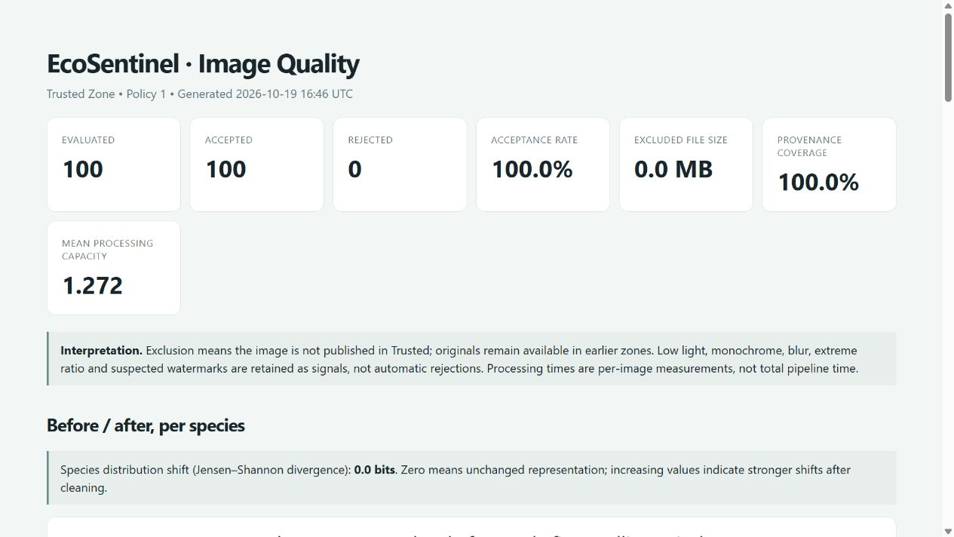
Quality decisions leave an audit trail
Per-asset manifests / HTML + CSV + JSON + plots
100%
Provenance fields complete
0.0 bits
Species distribution shift
Real image report / 100 retained / 32 possible watermark flags / 19 Oct 2026
10
Notes:
Sambhav / 20 seconds
Each asset receives a quality manifest. We aggregate those records into HTML, CSV, JSON and plots. This is our recorded image report: all one hundred images remain, including thirty-two possible watermark warnings. Complete provenance fields establish traceability, not biological correctness.
Project evidence: docs/final_report.md, docs/evidence/final_validation.json, docs/evidence/native_models.json; zone and Task guides in docs/. The diagrams describe implemented stages and contracts.
Actual report: reports/trusted_quality/images/20261019T164636Z/quality_report.html and summary.json. HTML captured without regenerating metrics. Provenance 100 percent means metadata completeness; JSD 0 bits means unchanged observed distribution. Neither proves biological correctness. Portable source: docs/evidence/quality_images.json.

Slide 11
Did filtering change species representation?
100 images before / 100 after / Jensen–Shannon divergence: 0.0 bits
11
Notes:
Sambhav / 20 seconds
We compare species distributions before and after Trusted because filtering could alter what users retrieve. Here, both series remain at ten images per species and the measured distribution shift is zero. This describes our small curated sample, not the distribution of wildlife populations.
Project evidence: docs/final_report.md, docs/evidence/final_validation.json, docs/evidence/native_models.json; zone and Task guides in docs/. The diagrams describe implemented stages and contracts.
Editable chart data: docs/presentation/quality_charts.json. Image categories use English common-name labels in the same order as source species identifiers. Audio counts derive from existing report CSV, with fixed 0/20/40/60/80/100 bins for legibility; original report uses six data-dependent bins. Measurements were not recomputed; original media and indexes were not opened by the chart build. All 34 audio records are accepted; 9 warnings use >=80 percent low-energy windows. Observed unchanged distributions do not prove representativeness or biological correctness.

Slide 12
Quiet intervals remain in the evidence
Recordings grouped by low-energy window percentage
9 warnings
34 retained
Complete recordings
remain available
50-ms windows below −50 dBFS / flag at ≥80% / same observed distributions
12
Notes:
Sambhav / 20 seconds
Nine recordings have a high proportion of low-energy windows. We retain all thirty-four recordings, so the distributions before and after match. Removing quiet sections could erase distant calls or environmental context. The warning tells a reviewer what to inspect without rewriting the recording.
Project evidence: docs/final_report.md, docs/evidence/final_validation.json, docs/evidence/native_models.json; zone and Task guides in docs/. The diagrams describe implemented stages and contracts.
Editable chart data: docs/presentation/quality_charts.json. Image categories use English common-name labels in the same order as source species identifiers. Audio counts derive from existing report CSV, with fixed 0/20/40/60/80/100 bins for legibility; original report uses six data-dependent bins. Measurements were not recomputed; original media and indexes were not opened by the chart build. All 34 audio records are accepted; 9 warnings use >=80 percent low-energy windows. Observed unchanged distributions do not prove representativeness or biological correctness.

Slide 13
Five collections, 6,021 embeddings
6,021
Image / CLIP
100
Audio / CLAP
357
embeddings
from 198 assets
Text / E5
547
Image + text / CLIP
1,763
Audio + text / CLAP
3,254
Reuse requires source/model compatibility and exact segment coverage
13
Notes:
Sambhav / 35 seconds
Long recordings and documents produce several segments, which explains how one hundred and ninety-eight assets generate six thousand and twenty-one vectors. Each vector retains its source, asset identity, segment position and model-policy contract. Compatible reruns check exact segment coverage before reusing results. Counts alone are insufficient: a duplicated segment could hide a missing one. This contract lets us detect and recover incomplete publication without recomputing every embedding.
Project evidence: docs/final_report.md, docs/evidence/final_validation.json, docs/evidence/native_models.json; zone and Task guides in docs/. The diagrams describe implemented stages and contracts.

Slide 14
Three encoders, three relationships
Image + text
CLIP
Visual concepts
Audio + text
CLAP
Sound descriptions
Multilingual text
E5 small
Compact retrieval
Aligned space: cosine / across models: combine ranks (RRF)
14
Notes:
Sambhav / 50 seconds
For an image and a sentence, CLIP uses separate encoders trained to place related content in one shared space. CLAP does the same for sounds and descriptions, without treating animal calls as speech. Multilingual E-five small retrieves passages in Spanish and English. These pretrained models support our CPU deployment. Within each compatible space, we can compare vectors. Across different models, we combine their result positions using reciprocal rank fusion, rather than compare raw scores. Equal vector dimensions do not make spaces interchangeable. English descriptions generally suit CLAP better. We have not established which model is best on a labelled wildlife benchmark.
Project evidence: docs/final_report.md, docs/evidence/final_validation.json, docs/evidence/native_models.json; zone and Task guides in docs/. The diagrams describe implemented stages and contracts.

Slide 15
Similarity is an angle, not a probability
cos(q, x) = (q · x) / (||q|| ||x||)
Illustrative 2D unit vectors: q = (1, 0) / cosine = dot product
Candidate vector x | Cosine | Relative alignment
(0.96, 0.28) | 0.96 | Closest of these three
(0.60, 0.80) | 0.60 | Less aligned
(0.00, 1.00) | 0.00 | Perpendicular to q
Higher = closer in this space. No universal relevance threshold.
Production: 384 / 512 dimensions. A score of 0.96 is not 96% confidence.
15
Notes:
Sambhav / 45 seconds
Cosine similarity measures the angle between two vectors. We divide their dot product by their lengths. Our vectors are normalised, so the calculation becomes a dot product. In this two-dimensional example, the query is one, zero. The first candidate scores zero point nine six, the second zero point six, and the third zero. The first is most aligned; zero means perpendicular. Our actual vectors have hundreds of dimensions. Higher scores mean closer representations within that space. There is no universal cut-off for relevant wildlife, and zero point nine six is not ninety-six percent confidence.
Project evidence: docs/testing_and_validation.md, docs/evidence/final_validation.json and maintained zone guides.
Sources: multimodal_tasks/search.py cosine scoring and fuse_rankings; exploitation_zone/encoders.py normalize_vector. Toy 2D candidates are illustrative unit vectors, not measured wildlife embeddings. No relevance threshold is claimed. Production search uses exact dot products for small candidate sets and cosine HNSW for larger searches. Raw scores across different models are not compared; RRF uses rank constant 60.

Slide 16
Finding neighbours: HNSW in Chroma
Hierarchical Navigable Small World / approximate nearest neighbours
Sparse
Longer hops
Refine locally
Cosine ranks candidates
Denser
Our exact path: scan all eligible vectors when N <= 64
Schematic graph / ANN may miss a true neighbour / no measured recall claim
16
Notes:
Sambhav / 50 seconds
The lecture distinguishes a similarity measure from a search algorithm. Cosine scores two vectors. To find neighbours among many vectors, our Chroma collections configure H-N-S-W: Hierarchical Navigable Small World. Its sparse upper layers make longer hops; denser lower layers refine the candidate neighbourhood. This is approximate search, so it can miss a true nearest neighbour. We use the database implementation and have not measured its recall on labelled wildlife queries. Our code also has an exact path for at most sixty-four eligible vectors. It compares all of them directly, avoiding a dependency on a persisted graph for tiny or newly created collections.
Project evidence: docs/testing_and_validation.md, docs/evidence/final_validation.json and maintained zone guides.
Project sources: exploitation_zone/vector_store.py configures {hnsw: {space: cosine}}; multimodal_tasks/search.py uses exact normalised dot products when eligible count <= 64 and delegates larger candidate search to Chroma. Course source: supplied 5 - Vector Databases.pdf, pages 31–34 (exact scan / ANN) and 87–105 (Hierarchical Navigable Small World). Diagram is a conceptual graph, not exported Chroma topology or a measured execution trace. Chroma implements the algorithm; EcoSentinel configures and queries it. ANN has a recall/latency trade-off; no measured recall or speedup claim. SHA-256 identity hashing is not the lecture LSH algorithm.
Lecture file: C:/Users/Mario/Downloads/5 - Vector Databases.pdf

Slide 17
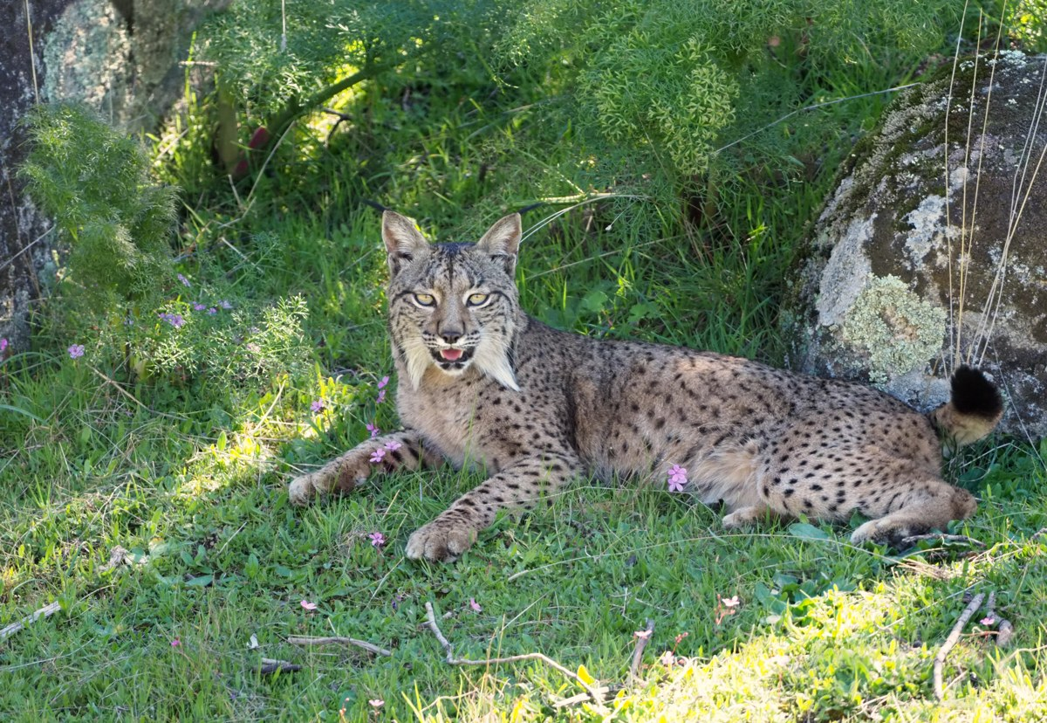
Task 1: a real image query
REFERENCE IMAGE
SELECTED MATCHES / RANKS 1 AND 3
Query / CLIP
#1 / cosine 0.912
#3 / cosine 0.871
5 distinct assets / reference excluded / 4 lynx labels and 1 wolf label
17
Notes:
Sambhav / 40 seconds
This is a recorded image query using real CLIP embeddings. We exclude the entire reference asset and group segments by file. The slide shows matches at ranks one and three from five returned assets. Four catalogue labels are lynx and one is wolf; a cropped variant also survives. These results demonstrate retrieval and expose the limits of visual similarity. A high score does not verify species identity or prove that every near duplicate has been removed.
Project evidence: docs/final_report.md, docs/evidence/final_validation.json, docs/evidence/native_models.json; zone and Task guides in docs/. The diagrams describe implemented stages and contracts.
Retrieval evidence: docs/presentation/task_examples.json. Queried a disposable snapshot with cached CPU models, without re-indexing. Slide 17 shows ranks 1 and 3 of five, not the full list. Slide 18 shows overall image rank 5 and text rank 4 of eight. The text excerpt is verbatim.
Photo: https://commons.wikimedia.org/wiki/File:Iberian_Lynx_front_(cropped).jpg; http://www.lynxexsitu.es; CC BY 3.0 es; https://creativecommons.org/licenses/by/3.0/es/deed.en. Display resizing only.
Photo: https://commons.wikimedia.org/wiki/File:F_18.04.02_Observatorio_Lince_PTA-GC.190-1_(27314142758).jpg; Junta de Andalucía; CC BY-SA 2.0; https://creativecommons.org/licenses/by-sa/2.0. Display resizing only.
Photo: https://commons.wikimedia.org/wiki/File:Female_Iberian_Lynx_(Lynx_pardinus),_La_Lancha,_Parque_natural_de_la_Sierra_de_And%C3%BAjar,_Espa%C3%B1a_(33022496950).jpg; Frank Vassen from Brussels, Belgium; CC BY 2.0; https://creativecommons.org/licenses/by/2.0. Display resizing only.

Slide 18
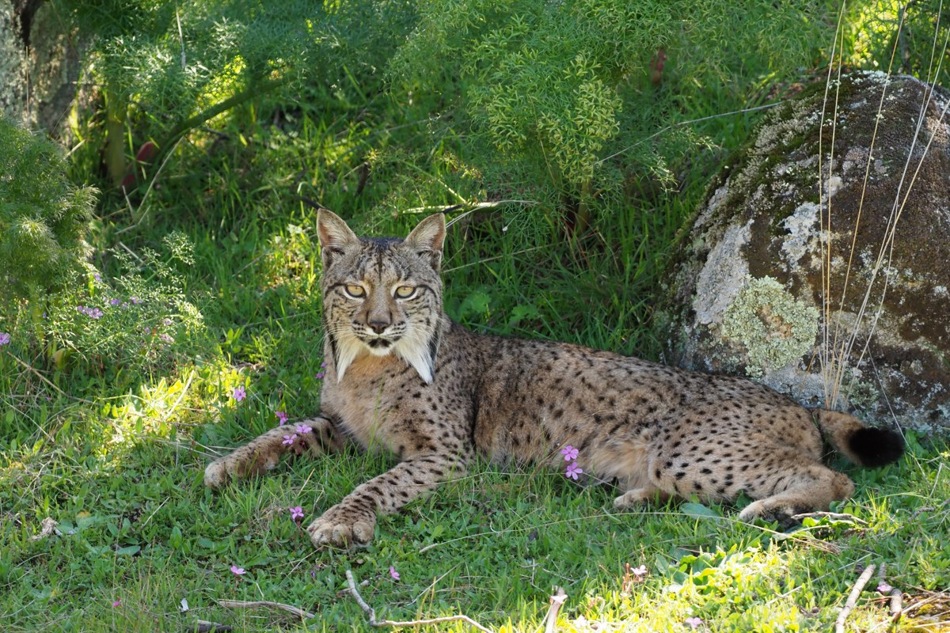
Task 2: one query, images and text
“Iberian lynx in its natural habitat”
IMAGE #5 / cosine 0.332
TEXT #4 / cosine 0.778
“About half the size
of Eurasian Lynx”
Catalogue label: Lynx pardinus
8 results / 4 images + 4 texts / explicit diversity policy
Interface: top-k 1-50 / default 8 / distinct assets with explicit diversity
18
Notes:
Sambhav / 35 seconds
This text query returned four images and four texts. The illustrated image scores zero point three three two. It is a useful candidate despite scoring much lower than our image-to-image example. Query type changes the score distribution; one threshold would mislead. A diversity policy prevents text passages dominating the display. Users choose top-k from one to fifty; eight is the default, counting distinct assets. Wassim will show how retrieved evidence supports generation.
Project evidence: docs/final_report.md, docs/evidence/final_validation.json, docs/evidence/native_models.json; zone and Task guides in docs/. The diagrams describe implemented stages and contracts.
Retrieval evidence: docs/presentation/task_examples.json. Queried a disposable snapshot with cached CPU models, without re-indexing. Slide 17 shows ranks 1 and 3 of five, not the full list. Slide 18 shows overall image rank 5 and text rank 4 of eight. The text excerpt is verbatim.
Photo: https://commons.wikimedia.org/wiki/File:Female_Iberian_Lynx_(Lynx_pardinus),_La_Lancha,_Parque_natural_de_la_Sierra_de_And%C3%BAjar,_Andaluc%C3%ADa,_Espa%C3%B1a_-_Flickr_-_Frank.Vassen.jpg; Frank Vassen from Brussels, Belgium; CC BY 2.0; https://creativecommons.org/licenses/by/2.0. Display resizing only.

Slide 19
Task 3: answer from retrieved evidence
Text question
Retrieve
E5 / CLIP
Evidence
ID + text
Generate
Qwen 3B
Optional image
CLIP + BLIP
Answer / partial / abstention
Check source IDs and quotations
Technical errors stay separate
Qwen receives text. Source matches do not prove semantic correctness.
19
Notes:
Wassim / 50 seconds
Task three retrieves evidence before asking Qwen to generate an answer. For image questions, CLIP retrieves visual candidates and BLIP supplies an unverified caption. E-five retrieves relevant text; we pass bounded evidence units with explicit identifiers to Qwen. The three-billion-parameter quantised model runs locally on CPU. It receives text rather than image pixels, which controls memory but loses visual detail. After generation, we validate allowed source identifiers and literal quotations. This does not prove every interpretation is correct. We distinguish supported answers, partial answers and abstention from technical failures such as timeouts.
Project evidence: docs/final_report.md, docs/evidence/final_validation.json, docs/evidence/native_models.json; zone and Task guides in docs/. The diagrams describe implemented stages and contracts.

Slide 20
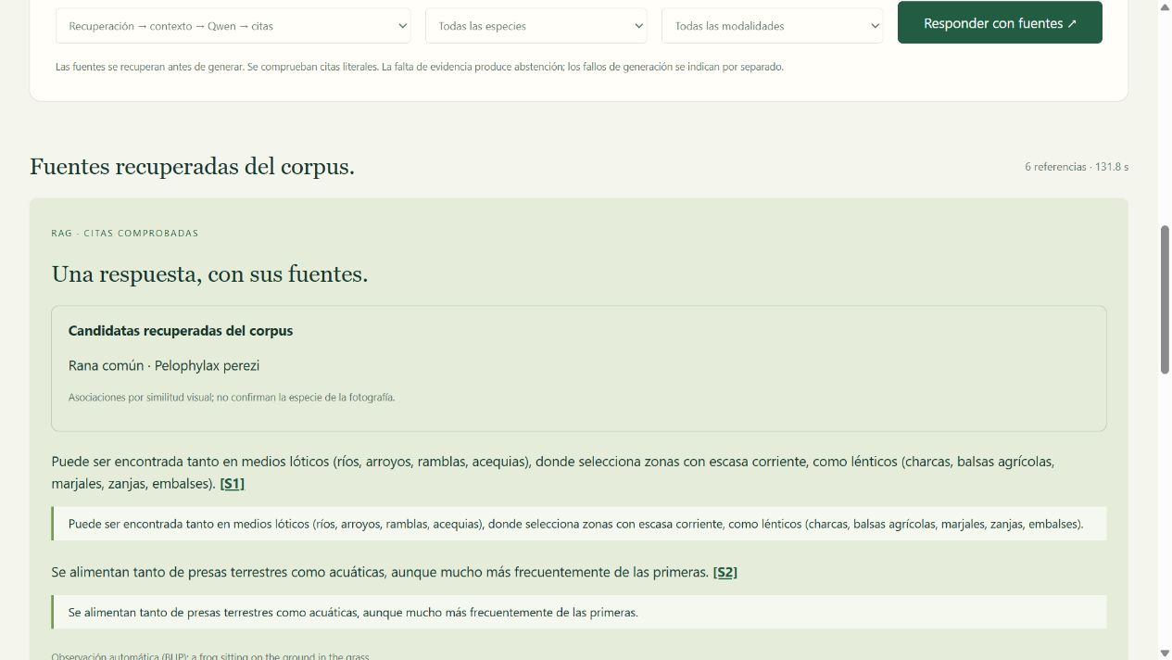
The frog case: evidence and uncertainty
Retrieved candidate
Actual interface / Spanish
Pelophylax perezi
Habitat [S1]
“areas with little current”
Diet [S2]
“terrestrial and aquatic prey”
Separate test: complete-genome request / abstained
Real model runs / translated extracts / species identity remains unconfirmed
20
Notes:
Wassim / 35 seconds
The recorded frog case answered habitat and diet using source excerpts. The interface exposes both the candidate species and the quotations. We keep the photographic identification uncertain. A separate complete-genome request produced an abstention because the required evidence was absent. These examples test the behaviour of the full model pipeline. They are qualitative cases, not a biological accuracy benchmark. We use the recording here because CPU generation can take minutes.
Project evidence: docs/final_report.md, docs/evidence/final_validation.json, docs/evidence/native_models.json; zone and Task guides in docs/. The diagrams describe implemented stages and contracts.
English translations of recorded Spanish extracts: “zonas con escasa corriente”; “Se alimentan tanto de presas terrestres como acuáticas”. Source: reports/validation/ui_frog_rag.png. No new inference is claimed.

Slide 21
The second run adds zero new vectors
RUN 1
3 synthetic assets
7 vectors
RUN 2
Verify and reuse
0 new vectors
16 steps / isolated storage / real CPU models
Reconciliation checks outcomes. This synthetic run is not a relevance benchmark.
21
Notes:
Wassim / 35 seconds
We also tested the complete command-line pipeline with isolated storage and real CPU models. Three synthetic assets produced seven vectors on the first run. The second completed all sixteen steps with zero new vectors. Reconciliation checked the resulting state. This demonstrates compatible reuse across the zones. The image is noise and the audio is a tone, so this execution test does not measure wildlife relevance.
Project evidence: docs/final_report.md, docs/evidence/final_validation.json, docs/evidence/native_models.json; zone and Task guides in docs/. The diagrams describe implemented stages and contracts.

Slide 22
How we tested the pipeline
Layer | Concrete check | Recorded result
Offline | Generated faults and contract assertions | 364 tests passed
Integration | All zones twice, deterministic encoders | 1 test passed
CPU CLI | Real decoders and cached models | 7 vectors, then 0 new
Browser | Selected top-k reaches HTTP handlers | 8 checks passed
Failure assertions inspect stored state and recovery
Copy mismatch, failed completion record, missing vector parts, accepted bytes retained
22
Notes:
Wassim / 50 seconds
Our validation has several layers. Three hundred and sixty-four offline tests use generated inputs to check contracts and failure paths. The isolated integration test runs real zone code with S3 and Chroma twice, using deterministic encoders. Separate native CPU runs check the actual model path. We inject copy mismatches, failed completion records and incomplete vector publication, then verify that retries preserve accepted data and recover missing work. Search tests check grouping, filters and exclusion of the reference. The new browser check follows top-k through real HTTP requests. The tests assert resulting state, not simply that a command returned successfully.
Project evidence: docs/testing_and_validation.md, docs/evidence/final_validation.json and maintained zone guides.
Scope: 364 offline tests and one isolated integration from docs/evidence/final_validation.json. Native CLI has two recorded synthetic runs. Eight Edge-browser checks use synthetic service/RAG doubles with real HTTP handlers; they do not run encoders or production storage. Source: reports/validation/top_k_ui.json. Test modules: test_pipeline_integration.py, test_safety_regressions.py, test_input_boundaries.py, test_search_and_web.py.

Slide 23
An input can fail before it reaches storage
lynx.jpg
Corrupt files / empty inputs
Archive expansion / resource limits
Harmless MZ header / synthetic fixture
BLOCKED
Watermark warning
retains the image
Before hashing or upload
71.82% combined statement coverage / input screening does not replace antivirus
23
Notes:
Wassim / 35 seconds
Here, a file called lynx dot jpg contains a harmless Windows executable header. Our Security Gate blocks it before hashing or upload; we never execute it. Other generated cases cover corrupt files, empty inputs, archive expansion and resource limits. A controlled watermark signal verifies the opposite outcome: retain the image and record a warning. Combined statement coverage is seventy-one point eight two percent. It measures code exercised, not retrieval accuracy. This screening does not replace antivirus.
Project evidence: docs/final_report.md, docs/evidence/final_validation.json, docs/evidence/native_models.json; zone and Task guides in docs/. The diagrams describe implemented stages and contracts.
Reproduce with python tests/demo_security_gate.py and python -m pytest tests/test_input_boundaries.py tests/test_trusted_images.py -q. This is bounded screening, not antivirus. Current test results: docs/testing_and_validation.md.

Slide 24
A query with a traceable answer
A result we can trace
back to its source
Preserve
Standardise
Validate
Retrieve
Next: labelled retrieval and answer evaluation with specialist review
24
Notes:
Wassim / 20 seconds
We began by asking where an answer should come from. EcoSentinel makes that route inspectable: source material, explicit transformations, quality decisions and retrieved evidence. Our next evaluation needs expert-labelled relevance and answers, including cases where the system abstains unnecessarily.
Project evidence: docs/final_report.md, docs/evidence/final_validation.json, docs/evidence/native_models.json; zone and Task guides in docs/. The diagrams describe implemented stages and contracts.

